Slide 1

DSS Visualizer
Quick Start User Guide
Robert McCain

Slide 2
Installation and Setup

Slide 3
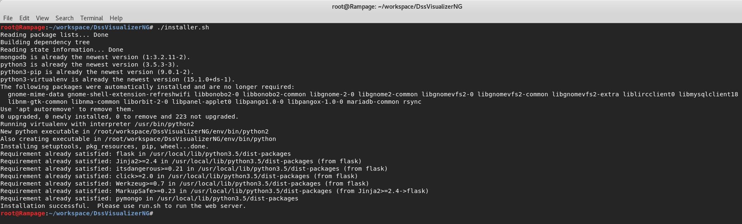
Installation
Extract the archive to where you would like within the file system. Change directory to the root of the extracted archive.
Run installer.sh in the root directory of extracted archive and follow any on screen prompts. An internet connection is required for this step.

Slide 4
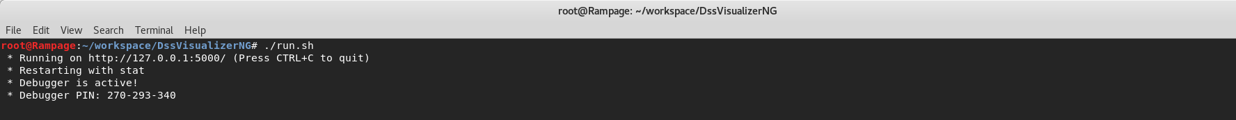
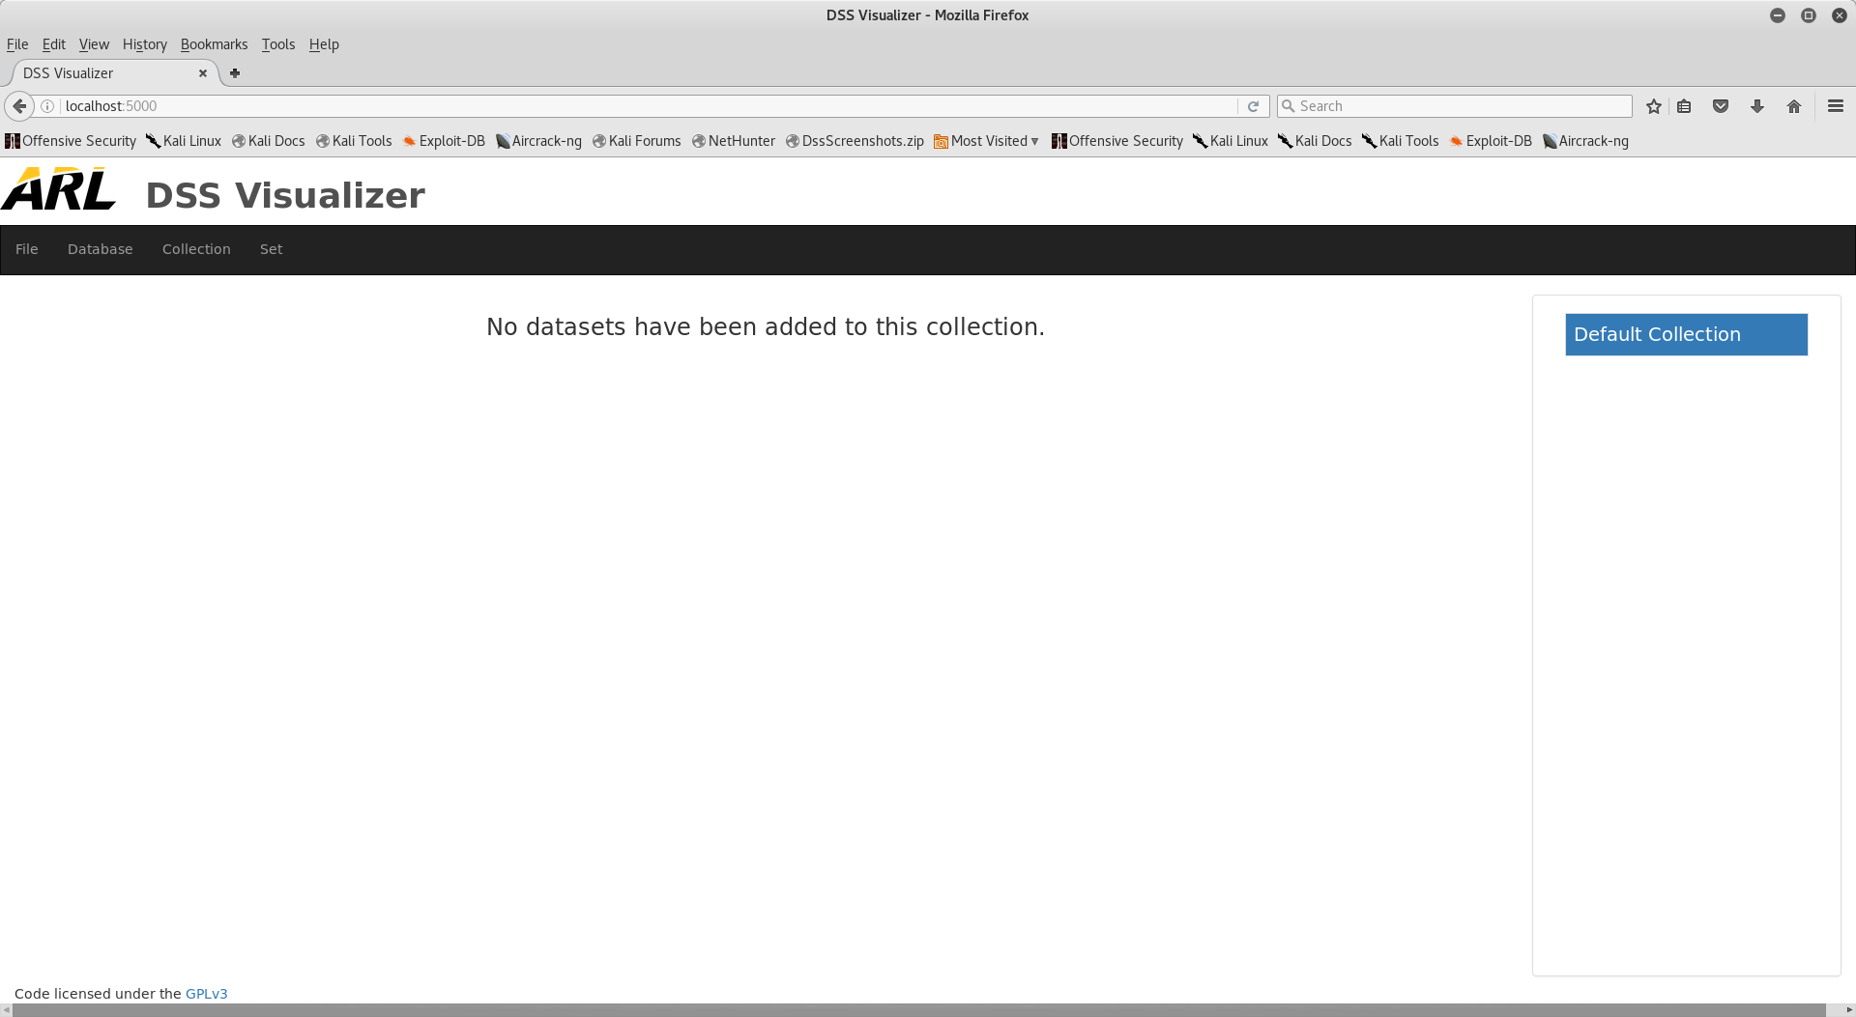
Running Server
Execute run.sh in the root directory of the project. This will start the web server and database. Make sure you do not close the terminal while using the system. Once the user is done with the system, use CTRL+C to properly shut down the service.
Use a web browser in order to connect to the server. The following URL will allow you to connect to the web server: http://localhost:5000. Please note that the web server can only be accessed from the host machine and not over the network.

Slide 5
Key System Terms

Slide 6
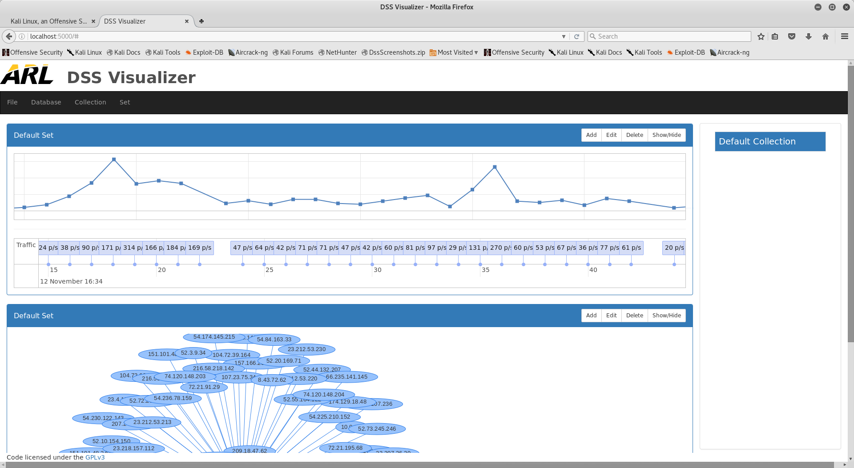
Terms
Visualization – A graphical method of representing ECEL data stored in the database. Highlighted above is an example of a frequency graph.

Slide 7
Terms
Visualization Set – A cohesive group of visualizations. Visualizations within a set share database query information.

Slide 8
Terms
Collection – A cohesive group of visualization sets.

Slide 9
Terms
Workspace – The workspace encompasses all collections, sets, and visualizations that are in the system. Workspaces can be zeroized (reset), saved to disk, and loaded from disk.

Slide 10
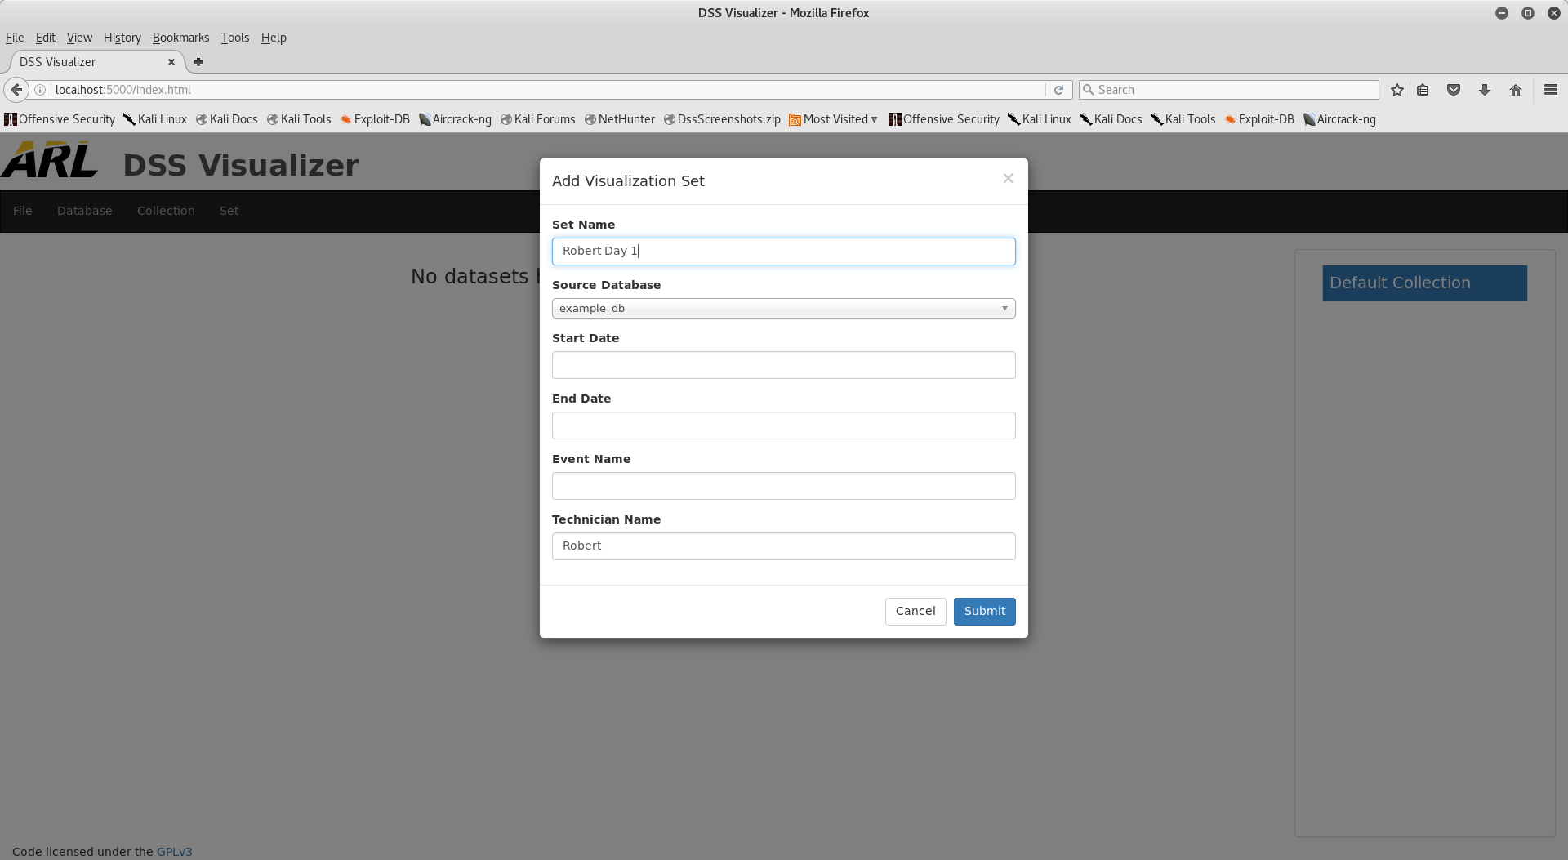
Terms
Database – Stores ECEL data for use by visualizations. Multiple databases can be instantiated within the system, allowing for the operator to logically separate data however he or she chooses. Databases do not belong to a particular collection or visualization and can be reused as many times as needed.

Slide 11
Primary Views

Slide 12
Primary Views
The primary presentation of the system has four main views:
  Toolbar
  Collection Selector
  Collection Manager
  Settings

Slide 13
Toolbar
The Toolbar provides useful options for modifying the workspace and currently selected collection. The toolbar has four dropdowns:
  File – Allows user to change system settings as well as save, load, and reset the workspace.
  Database – Allows user to create and delete databases as well as upload ECEL data to a particular database.
  Collection – Allows for adding, deleting, and editing collections in the workspace.
  Set – Permits user to add a visualization set to the currently selected collection as well as expand/collapse sets.

Slide 14
Collection Selector
Allows the operator to choose a particular collection for the purposes of editing or viewing the collection within the Collection Manager.

Slide 15
Collection Manager
The Collection Manager is the main view of the system. This view is used for previewing and editing a collection. Visualization sets can be added to a collection using (Set > Add) from within the toolbar. A visualization set has the following options:
  Add – Adds a new visualization to the set.
  Edit – Changes global information (title, date ranges, operator, event name) for the set.
  Delete – Deletes the visualization set.
  Show/Hide – Expands / Collapses the visualization set.

Slide 16
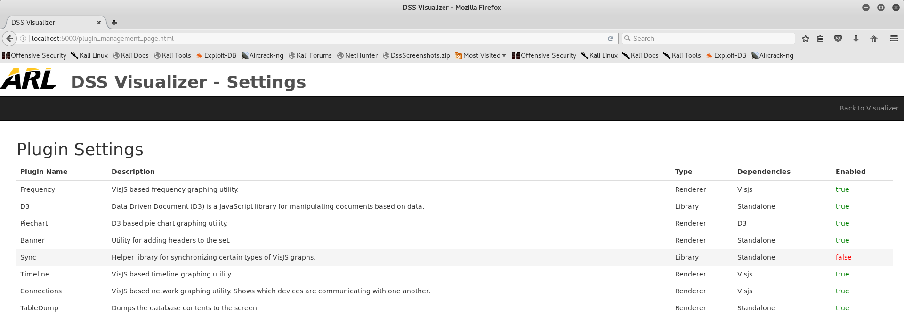
Settings
The settings view can be accessed by going to (File > Settings) within the toolbar. The settings view is primarily used for controlling the state (enabled/disabled) of plugins. Plugin state can be toggled by clicking on an individual plugin. Please refer to the “DSSVisualizer_SystemMaintenanceGuide.docx” artifact for creating and installing new plugins.

Slide 17
General System Usage

Slide 18
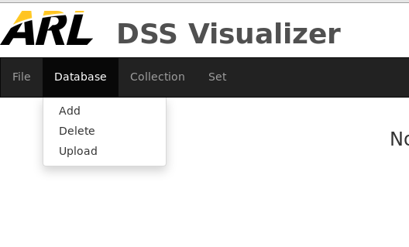
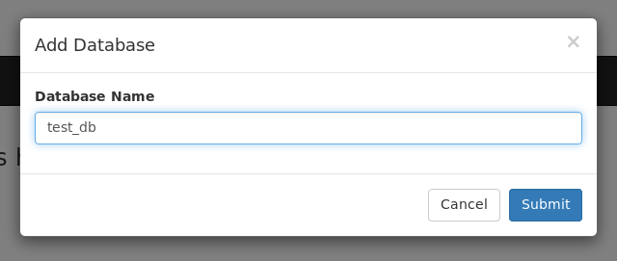
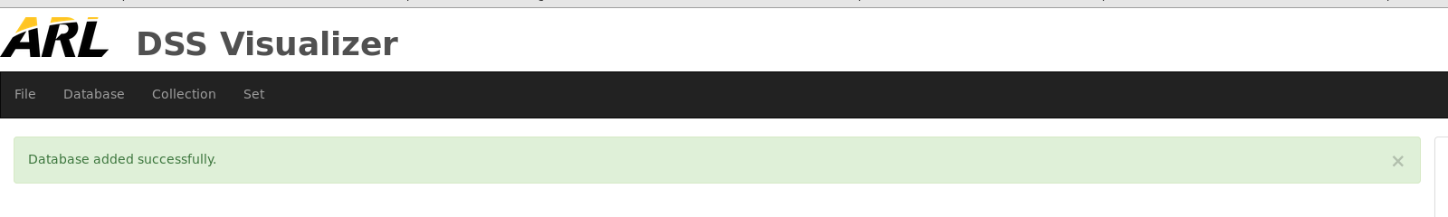
Creating a Database
Databases are needed in order to store ECEL data. Steps for database creation:
From the toolbar, go to (Database > Add).
A modal will be displayed. Enter the name you would like the database to have and click “Submit”.
A success or failure message will be displayed. If an error message is displayed, details will be provided as to why the request failed.

Slide 19
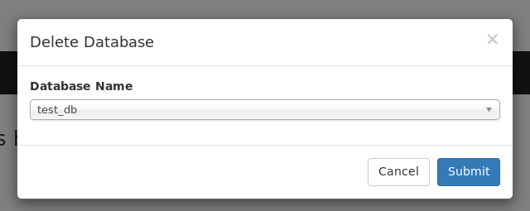

Deleting a Database
Users can delete databases if they choose to do so. Procedure for database deletion:
From the toolbar, go to (Database > Delete).
A modal will be displayed. Select the database you wish to delete from the dropdown and click “Submit”.
A success message should be displayed, indicating successful database deletion.

Slide 20
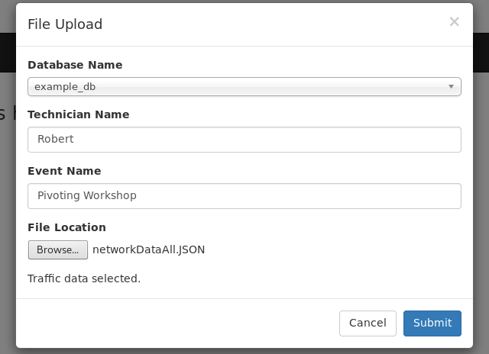

Uploading ECEL Data
The system needs ECEL data in order to visualize that information. In order to upload data:
From the toolbar, go to (Database > Upload).
In the modal, provide the following information & click submit:
  Database you wish to store the information in.
  Name of the technician / analyst whom generated the data (optional).
  Name of the event where the data was collected (optional).
  A location to a valid, parsed ECEL file on the file system.
If the information is formatted correctly, a success prompt should be displayed by the system.

Slide 21
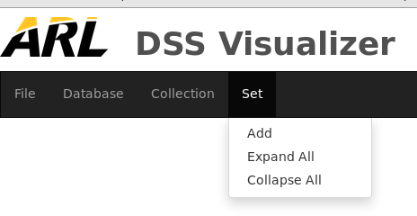
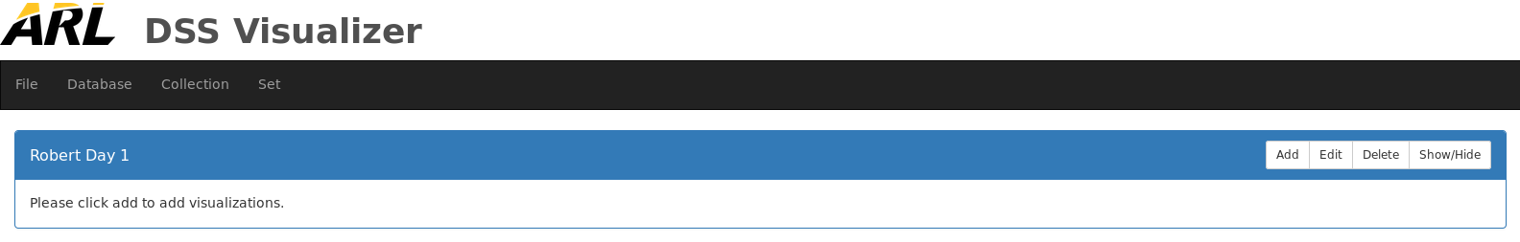
Creating a Visualization Set
Visualization sets are used in order to store visualizations. In order to add a new set:
From the toolbar, go to (Set > Add).
Fill out the following information & click submit:
  The name of the set.
  The database which you would like to collection data from.
  Start date for the set (optional).
  End date for the set (optional).
  The name of the event (optional).
  The name of the technician (optional).
If the information is formatted correctly, a new set will appear within the Collection Manager.

Slide 22
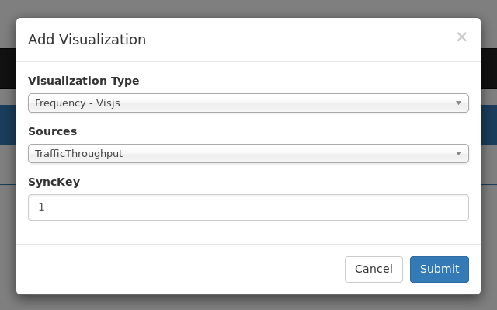
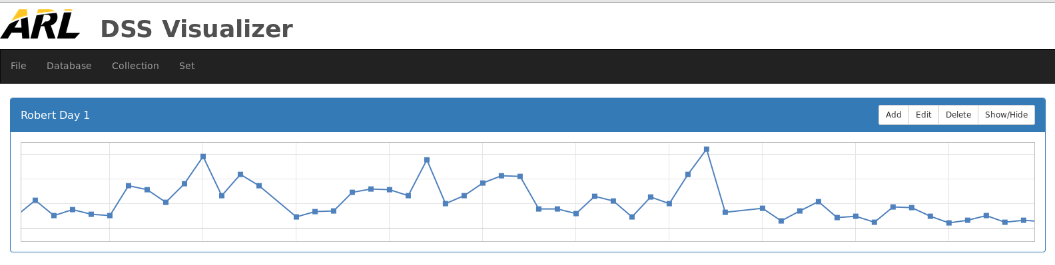
Adding a Visualization
  Visualizations are used to display ECEL data in meaningful ways. In order to add a visualization to a set:
  Click the add button of the set you wish to add the visualization to.
  Select the visualization you wish to add from the pulldown. Add information as needed and click submit. Please note that visualizations have different options.
  The visualization should be visible within the set.

Slide 23
Questions?

