Slide 1
Automatic Query Reformulations for Text Retrieval in Software Engineering Sonia Haiduc¹, Gabriele Bavota², Andrian Marcus¹, Rocco Oliveto³, Andrea De Lucia², Tim Menzies⁴ ¹Wayne State University, Detroit MI, USA ²University of Salerno, Fisciano (SA), Italy ³University of Molise, Pesche (IS), Italy ⁴University of West Virginia, Morgantown VA, USA
35th International Conference on Software Engineering (ICSE)
18-26 May 2013
Ronaldo Goncalves Junior – rxp152830@utdallas.edu

Slide 2
Text Retrieval (TR) in SE
Concept location
Traceability link recovery
Bug triage
Requirements analysis
etc.

Slide 3

TR applications in SE
Activities related to “search”
Text query
Software artifact X Query
Vocabulary
DPA: http://www.itv.com/news/update/2014-06-03/cyber-gang-stole-millions-worldwide/

Slide 4
Query Reformulation
Queries needs to be reformulated frequently
Improve its performance
Relevance (top results)
Main proposed approaches
User Relevance Feedback
Automatic addition of similar terms

Slide 5
Query Reformulation
User Relevance Feedback
User defines whether a document is relevant or not
Interactive and rely on the developer
Automatic addition of similar terms
E.g. synonyms
Strategy is the same for every query
What about queries with different properties?

Slide 6
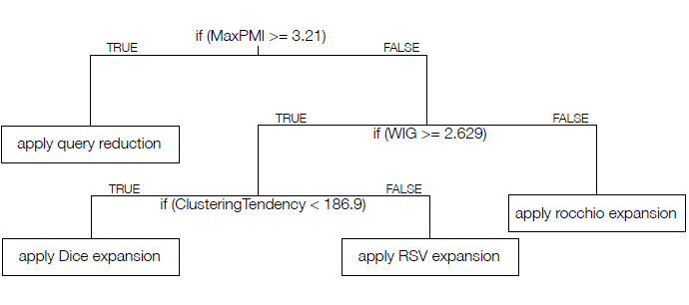
Refoqus – Reformulation of queries
Recommender
Properties of a query
Reformulation techniques
Machine learning
Data set (training)
Haiduc et al, 2013

Slide 7
Query Reformulation Techniques
Query Expansion
Query Reduction

Slide 8
Query Expansion
Terms in the query do NOT match relevant documents
A.k.a “the vocabulary problem”
Three best strategies
Dice similarity
Rocchio’s method
Robertson Selection Value (RSV)

Slide 9

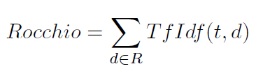
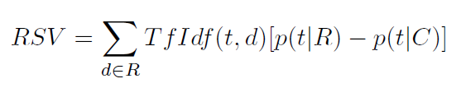
Query Expansion
Dice similarity
Rocchio’s method
Robertson Selection Value (RSV)

Slide 10
Query Reduction
Noise
Noise + information = query
Words that do not contribute to the main intent of the query
May actually harm the results (Lu and Keefer, 1995)
Absence of user feedback
Absence of information about semantics of the query
Conservative query reduction strategy
Eliminate terms that appear in more than 25% of the documents

Slide 11
Query Properties
Used to evaluate the “performance”
Relevance
Top results
Two main categories
Pre-retrieval
Post-retrieval

Slide 12
Pre-Retrieval Properties
Computed BEFORE the query is executed
Do not require the list of results
Relationship between query and the entire document collection
Linguistic and statistical properties

Slide 13
Pre-Retrieval Properties
Evaluation of properties
Specificity: differentiate relevant documents from non-relevant
Similarity: ease to retrieve relevant documents
Coherency: similarity between documents containing the query terms
Term Relatedness: query terms are expected to occur together frequently
Refoqus uses 21 measures

Slide 14
Post-Retrieval Properties
Considers the results
Relies on the analysis of the highest ranked documents
Three main paradigms
Robustness
Score distribution
Clarity
Not used in the approach
Extended execution times
Unpractical in realistic settings

Slide 15
Post-Retrieval Properties
Robustness-based
Query perturbations
Small changes to query should NOT change results much
Inject noise for re-ranking and measure the difference
Score distribution
Score assignment based on similarity between query and results
Top-ranked with low scores indicates difficulty in retrieval
Refoqus uses 7 post-retrieval measures (28 total)

Slide 16
Refoqus – Training the Classifier
Training data set
Data should come from the system being used
TR Engine – Lucene
For each query:
Rank all documents
Compute the 28 property measures
Apply Reformulation techniques
Compare results
Remove unfit queries
Compute the final 29 attributes
TR Engine
21 pre-retrieval
7 post-retrieval
Dice
Rocchio’s
RSV
Reduction
Best reformulation defined
Unable to make recommendations
28 properties and
Best reformulation

Slide 17
Refoqus – Classification tree
Easy to understand
Automatic definition of relevant properties
Haiduc et al, 2013

Slide 18
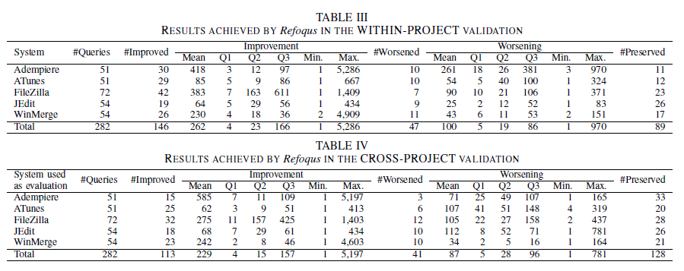
Evaluation

Slide 19
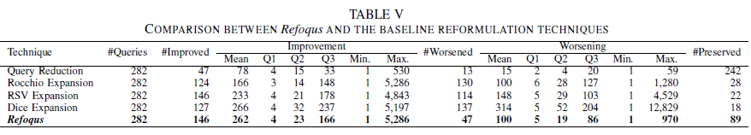
Evaluation

Slide 20
Quiz
What makes a search result “good”?
When should we use Refoqus?
What is the relationship between Refoqus, TR and SE?

Slide 21
Thank you!
Questions?
Ronaldo Goncalves Junior – rxp152830@utdallas.edu

