Slide 1
Automatically Discovering, Reporting and Reproducing Android Application Crashes Moran, K.¹, Linares-Vásquez, M. ¹, Bernal-Cárdenas, C. ¹, Vendome, C. ¹, and Poshyvanyk, D.¹ ¹College of William & Mary, Williamsburg, Virginia, USA
Proceedings of 9th IEEE International Conference on Software Testing, Verification and Validation (ICST’16)
Chicago, IL, April 10-15, 2016
Ronaldo Goncalves Junior – rxp152830@utdallas.edu

Slide 2
What is it?
Gesture-driven nature of mobile apps
New challenges
Crashes represent a fault that is directly user facing
Impacts an app’s utility and success
Nearly half of users are likely to abandon the app for a competitor
Heavily rely on user reviews and crash reports from the field in the form of stack traces

Slide 3
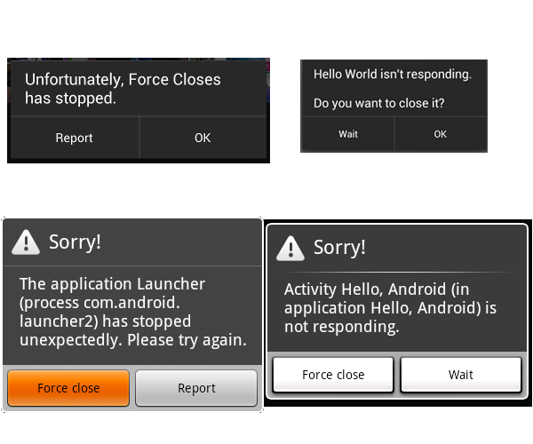
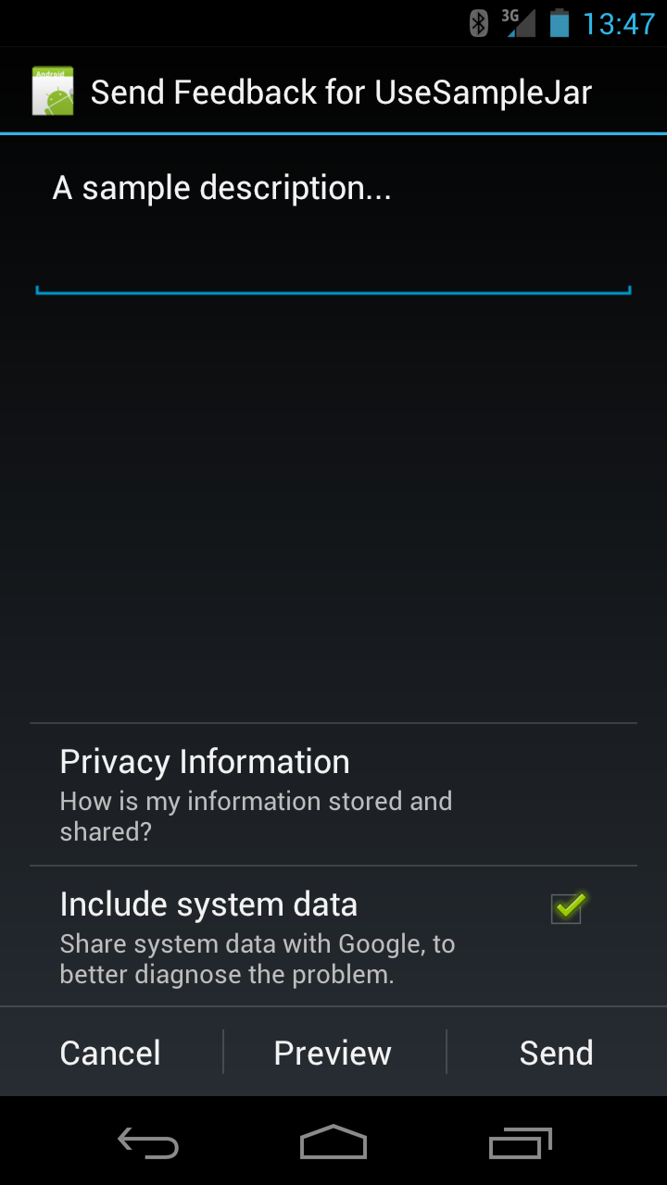
What is it?

Slide 4
What is it?
lacking in information
Contains stack trace, overly detailed logs or loosely structured natural language (NL) information regarding the crash
some other factors
specific to Android apps such as hardware and software
fragmentation [3], API instability and fault-proneness [21],
[48], the event-driven nature of Android apps, gesture-based
interaction, sensor interfaces, and the possibility of multiple
contextual states (e.g., wifi/GPS on/off) make the process of
detecting, reporting, and reproducing crashes challenging

Slide 5
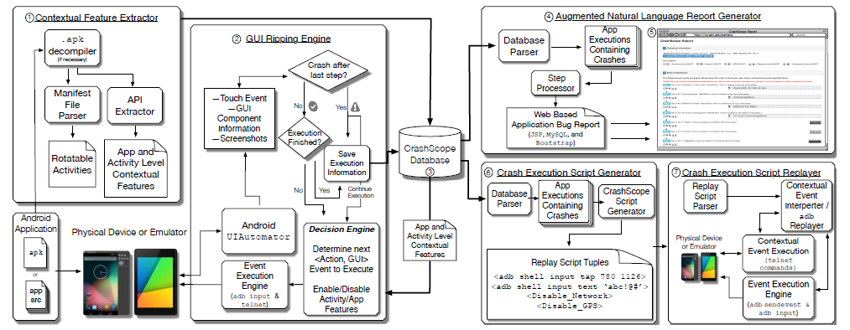
CrashScope
A practical system that automatically discovers, reports, and reproduces crashes for Android applications

Slide 6
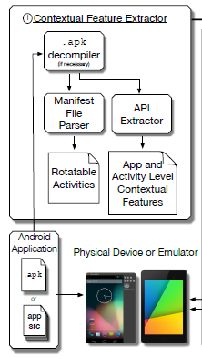
CrashScope
Obtain the source code of the app (either directly or through decompilation)
Detect Activities (by means of static analysis) related to contextual features
Uses Abstract Syntax Tree (AST) based analysis to extract the API-call
Employs two granularities for testing contextual features:
activity (screen-) level
and app-level

Slide 7
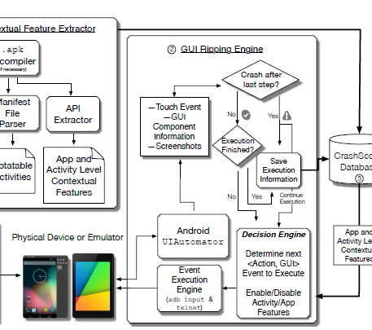
CrashScope
First checks for app-level contextual features that should be tested
detects the type of text expected (e.g., numbers)
adb shell dumpsys input_method
employs two strategies to generate text inputs:
expected
and unexpected

Slide 8
CrashScope
Traverses the GUI hierarchy:
bottom of the hierarchy up
or from the top of the hierarchy down
Rationale: mimic user behavior
Constructs a graph containing all of the possible transition states

Slide 9
CrashScope
Multiple Execution Strategies:
1) the direction in which to traverse the GUI Hierarchy (topdown or bottom-up)
2) the method by which inputs are generated for user text entry fields (no text, expected text, unexpected text)
3) enabling or disabling the testing of adverse contextual states (e.g., if an activity is found to have utilize wifi, should it be turned on or off?)
<no_text, top_down, enable_all_context_states>
change of contextual state triggers a crash
<unexpected_text, top_down, disable_context_states>
crashes related to user input being handled improperly

Slide 10
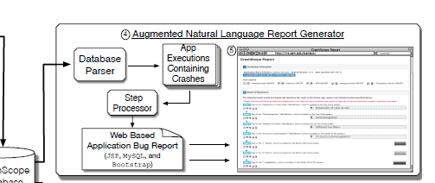
CrashScope
Four major types of
information:
1) general information
2) natural language
sentences
3) app’s screen flow
4) a pruned stack trace
Template: <action> on <component text> <component type>, which is located on the <relative location> of the screen

Slide 11
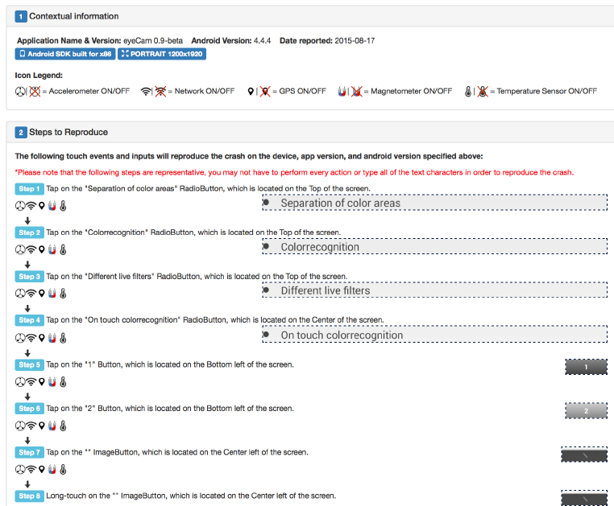

Slide 12
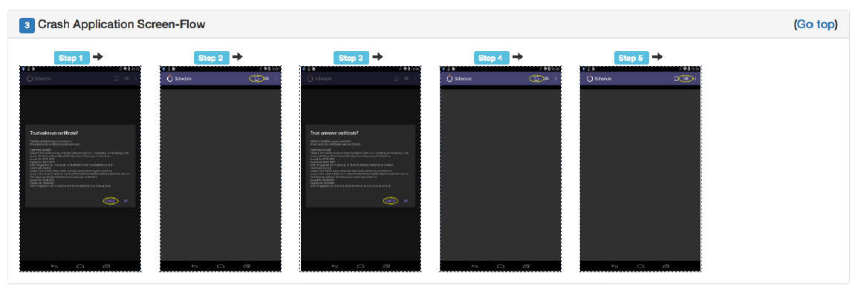

Slide 13
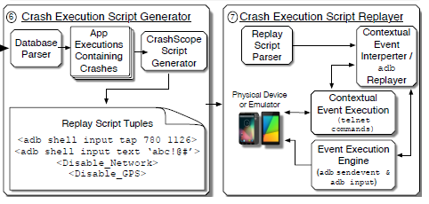
CrashScope

Slide 14
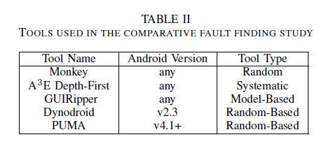
Comparative study

Slide 15
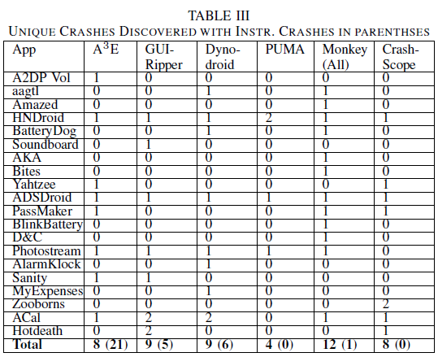
Comparative study (cont)

Slide 16
Thank you!
Questions?
Ronaldo Goncalves Junior – rxp152830@utdallas.edu

Slide 17
Quiz
Do you prefer manual testing over automated testing? If so, why?
How would you enhance/improve the multiple execution strategy?
Do you believe an emulator is sufficient to assess an app? If not, why?

