Slide 1
Towards Automatically Generating Summary Comments for Java Methods
Giriprasad Sridhara, Emily Hill, Divya Muppaneni, Lori Pollock and K. Vijay-Shanker
Department of Computer and Information Sciences, University of Delaware
25th IEEE/ACM Int’l Conference on
Automated Software Engineering,
September 2010, Antwerp, Belgium
Presented by Sung Soo Ahn
March 1st, 2016

Slide 2
Table of Contents
Introduction
Problem & Challenge
Automatic Summary Generation
Evaluation
Conclusion
Questions

Slide 3
1. Introduction (1/2)
Few software projects adequately document the source code
Solutions ?
Extremely descriptive identifier names
Developers write comments
Automatic comments generation (this paper)
Input: A method signature, body
Output: Natural Language (NL) summary for a method

Slide 4
1. Introduction (2/2)
Focus on descriptive comments
Summarize the major algorithmic actions of a method
Content selection
Choose the important code statements
Text generation
Express the content in natural language phrases

Slide 5
2. Problem & Challenge
Given a method signature and body statements for a method M, generate natural language text that summarizes the overall actions of M accurately, adequately, and concisely
Challenges to Comments Generation
Method names are inadequate summaries
compareTo(Object object)
reactiveMethods: mousedPressed()
Not all method body statements belong in a summary
Exceptions, resource cleanup, object creation
Using names in the summary loses contextual information
print(current) ; context?

Slide 6
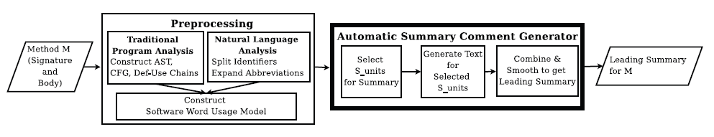
3. Automatic Summary Generation
The Summary Comment Generation Process

Slide 7
3.1 Preprocessing
3. Automatic Summary Generation
Split Identifiers
XYLine3DRenderer → XY, Line, 3, D, Renderer
Expand Abbreviations
Button butSelectAll
MouseEvent evt

Slide 8
3.2 Software Word Usage Model
3. Automatic Summary Generation
Identify the action, theme, and any secondary arguments for a given method
E.g. list.add(Item i)
Action: “add”
Theme: “item”
Secondary argument: “(to) list”

Slide 9
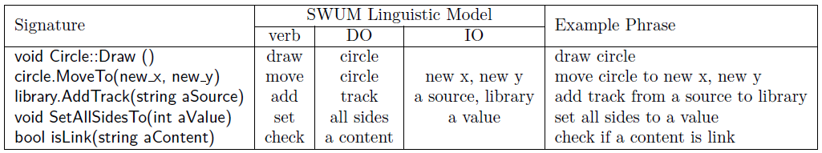
SWUM Examples
3. Automatic Summary Generation
SWUM captures program word relationships and links them with program structure

Slide 10
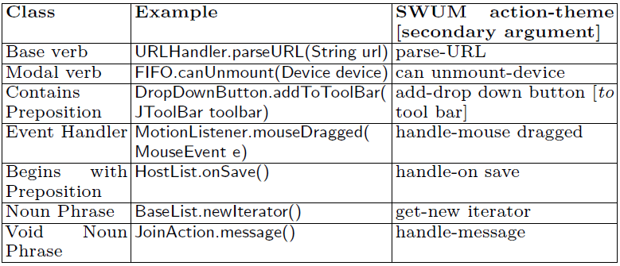
More SWUM Examples
3. Automatic Summary Generation

Slide 11
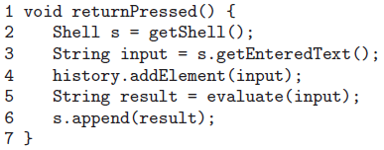
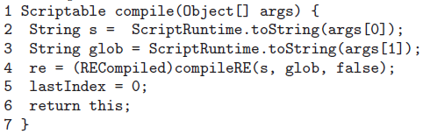
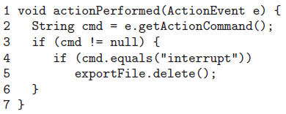
3.3 S_unit Selection Identifying Major S_unit Candidates
3. Automatic Summary Generation
Ending S_units
Void-Return S_units
Same-Action S_units
Data-Facilitating S_units
Controlling S_units

Slide 12
3.3 S_unit Selection Filtering out Ubiquitous Operations
3. Automatic Summary Generation
Less specific operations to a method’s computational intent
Exception handling
Resource cleanup
Logging
If (X == null)
Ending s_units returning a boolean value
Get/set/object creation operation

Slide 13
3.3 S_unit Selection S_unit Selection Process
3. Automatic Summary Generation
Identify and add same-action, ending and void-return s_units to summary_set
Add data-facilitating s_units to the set
Add controlling s_units to the set
returnPressed()
1. lines 4 and 6
2. lines 5
3. Nothing

Slide 14
3.4 Text Generation
3. Automatic Summary Generation
Lexicalization of Variables
Place the variable name to the left of the type name
Document current → current document
CallFrame parentFrame → parent call frame
Selectable item → selectable item
Single Method Call
action theme secondary-args
and get return-type [if M returns a value]
os.print(msg) → print message to output stream

Slide 15
3.4 Text Generation
3. Automatic Summary Generation
Nested and Composed Method Calls
print(sendRequest()) → Send request and get response, print response
Assignment
action theme secondary-args and get return-type
assign to lhs
fileName = showFileDialog(…); → Show file dialog and get file name

Slide 16
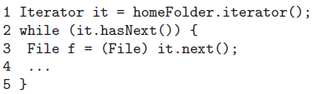
3.4 Text Generation
3. Automatic Summary Generation
Conditional Expression
if (visible) → If windows is visible
if (saveAuctions()) → if save auctions succeeds
Loop Expressions
→For each file in home folder

Slide 17
4. Evaluation
Accuracy: How accurately does the generated text represent the code’s actions?
Content Adequacy and Conciseness: How effectively can we automatically identify the s_units for the summary?
Methods from four open source projects
Megamek, SweetHome3D, JHotDraw, and Jajuk

Slide 18
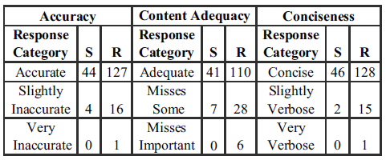
4.1 Evaluating S_unit Text Generation
A total of 48 s_units were selected
Each of 12 human evaluator examined a total of 12 s_units

Slide 19
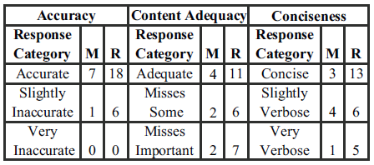
4.2 Evaluating Whole Summary Comments
A total of 8 summary were judged independently by 3 human evaluators
Each method contains 10 to 40 s_units

Slide 20
5. Conclusion
The summary comment generation for Java methods has met its goals of accurate and reasonably concise text, while tolerating some extra and missing relatively unimportant information
The first technique to automatically generate leading comments
An algorithm to automatically extract important code statements
A text generation technique that takes a Java code and outputs a NL phrases

Slide 21
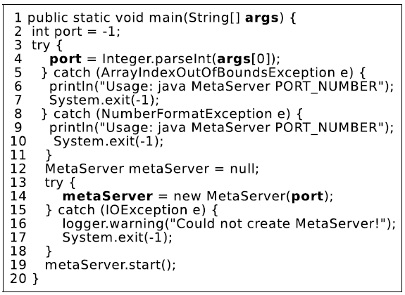
Question 1
Q: Summarize this method.

Slide 22
Summary for Q1
@summary: Start meta server
@param args: create meta server, using args

Slide 23
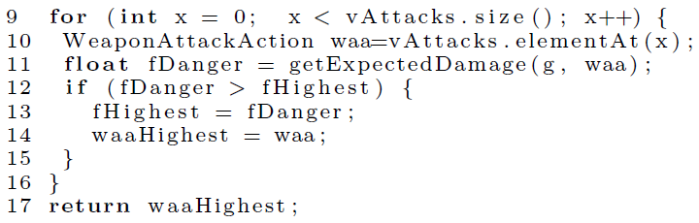
Question 2
Q: Summarize this fragment

Slide 24
Summary for Q2
@summary: Get weapon attack action object (in vectorAttacks) with highest expected damage

Slide 25
Question 3
This paper combined, smoothed and generated NL summary for the selected s_units. When abstracting the summary, can we apply different weights for the s_units calculating its importance?
Something like tf, idf

Slide 26
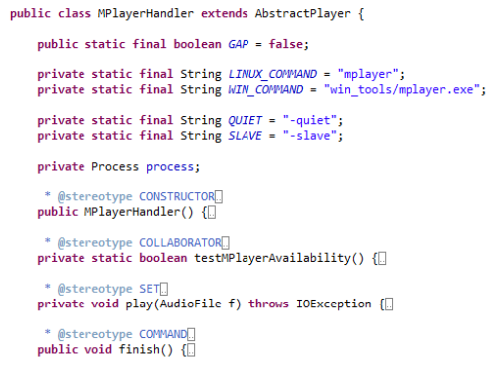
Question 4
Automatic summary generation of Java Classes ?

Slide 27
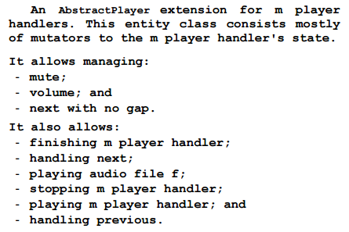
Summary for Q4

Slide 28


