Slide 1
Selection and Presentation Practices for Code Example Summarization
Annie T. T. Ying and Martin P. Robillard
McGill Univ., Montreal, Canada
Foundation of Software Engineering Conference,
2014, November, Hong Kong, China
Presented by Sungsoo Ahn
02-25-2016

Slide 2
Table of Contents
Introduction
Related Work
Study Set-Up
Conceptual Framework
Selection Practices
Presentation Practices
Questions

Slide 3
1. Introduction
Code examples are important in modern software development
A third of programmers search for them every day in a survey
API docs contain
On Stack Overflow, 65% of accepted answers contain code examples
concise or longer code examples. Which one is effective?
Great potential for technology
automatically shorten a source code fragment
adapt it appropriately in context
natural language summarization is not suitable for this work

Slide 4
1. Introduction
Goal : Automatic source-to-source summarization
Study:
How humans summarize examples?
which content to select and how to present the content
156 summaries generated by 16 programmers on 52 code examples
Q: How do you think the participants summarized codes?

Slide 5
2. Related Work
Studies on Code Examples: what is important in code example ?
Concise (< 4 lines), shorter, reduced complexity, and unnecessary details on Stack Overflow (Nasehi et el)
Ellipses (indicating input variable’s context-specific value) and exception handling were employed in JDK examples (Buse et el)
Source Code Explanations:
code-to-text summarization
Textual summary of a class or a method (Moreno et el, Sridhara et el)
Snippet Generation in Search Engines:

Slide 6
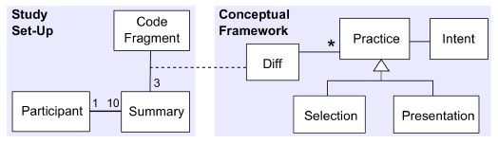
3. Study Set-Up
Goal: To learn code summarization practices & justification
can be used in source code summarization and presentation development
Research Questions:
Selection: Which part of the code be selected and why ?
Presentation: How should the code be presented and why ?
16 participants
Shorten code fragments
Verbalize thought process
which was recorded

Slide 7
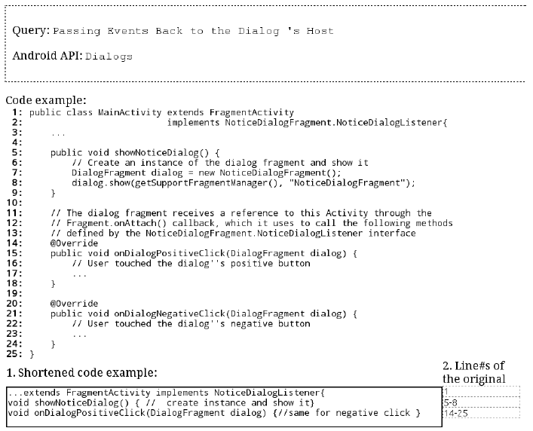
3.1 Summarization Task
3. Study Set-Up
To present main ideas in less space
Constraints:
Less than 3 lines

Slide 8
3.2 Code Fragments
3. Study Set-Up
Challenge:
the general idea of summarization is context-sensitive
code summarization requires a non-trivial level of programming expertise
Solution:
The Official Android API Guides (a mix of natural language text and code)
Participants who have experience in Android programming
52 code fragments were used among 166 candidates in Android Guides
Explain and demonstrate the usage of Android API

Slide 9
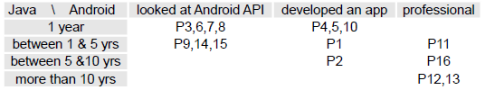
3.3 Participants
3. Study Set-Up
16 participants, 52 fragments
12 participant * 10 fragments = 120
4 person * 9 fragments = 36
156 / 52 = 3 fragments

Slide 10
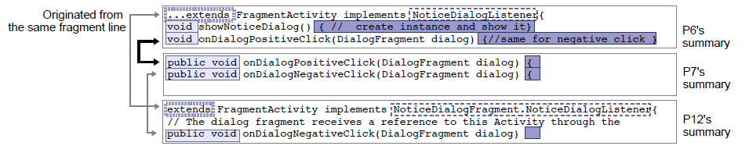
4. Conceptual Framework

Slide 11
5. Selection Practices
How participants decided on which content to include in a summary
Language constructs from the code example itself
Query terms
Human considerations
For what ?
Helps determin what type of content should automatically be selected when presenting code examples in contexts where summarization is appropriate
E.g., in search results

Slide 12
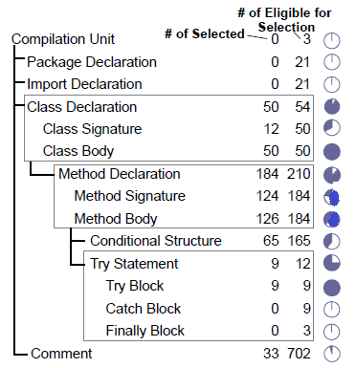
5.1 Using Language Constructs
5. Selection Practices
Including (or Excluding) the Method Signature
Including Overriding Methods
Excluding Exception Handling Blocks
Keeping Only One Case in a Parallel Structure
E.g., if or switch statement

Slide 13
5.2 Using Query Terms
5. Selection Practices
All participants used the query in content selection
verbalizations and summarization
“startForeground [a method declaration] actually starts the foreground service. Since the query [“Running as a foreground service”] doesn’t have anything to do with the media player, even though it’s part of the API being used, […] I left it out.” P15

Slide 14
5.3 Considering Human Reader
5. Selection Practices
Including Easy-to-Miss Code
E.g., the method declaration onResume “is something people tend to forget.”
B. Accounting for Programming Expertise
Previous languages (C language) used
Assumption on the knowledge of Java or Android API
C. Using the Query to Infer Expertise
“If someone is doing NFC, [...] someone already knows what onPause [or] onResume is, so I don’t need to stress it.” P11

Slide 15
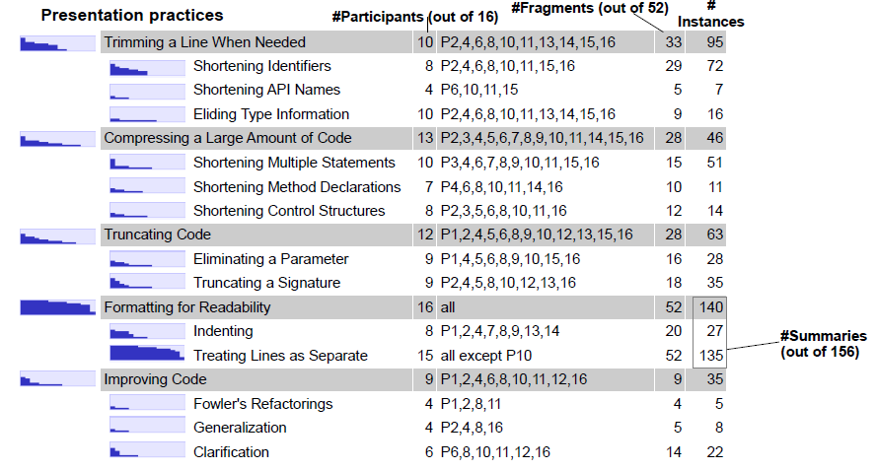
6. Presentation Practices
Decision about how the selected content appeared in a summary

Slide 16
6.1 Trimming a Line When Needed
6. Presentation Practices
Shortening Identifiers
Using acronyms (sharedPreferences → sp)
Shortening words in an identifier (defaultValue → defaultVal)
B. Shortening API Names
Abnormally long, “unregisterOnSharedPreferenceChangeListener” → “unregister…”
C. Eliding Type Information
removing name-space (import), Object→ obj

Slide 17
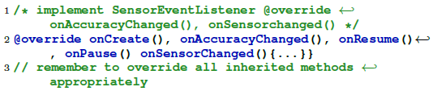

6.2 Compressing a Large Amount of Code
A. Shortening Multiple Statements
Ellipses and comments were evenly used
B. Shortening Method Declarations
Comments were mostly used to abstract method declaration
C. Shortening Control Structures

Slide 18
6.3 Truncating Code
6. Presentation Practices
Shortening a line while violating syntax vs compilability
Eliminating a Parameter
“When we search for something, we don’t want too much stuff that is irrelevant, [for example] the parameters.” P9
B. Truncating a Signature
Java keywords (public or static), identifier names or whole signature replaced by a comment

Slide 19
6.4 Formatting Code for Readability
Indenting Code
“It’s easier to see the layers, the level of importance, You look at [the code] from top to bottom.” P9
Keeping Lines as Separate
All participants treated at least one summary with all separate lines
Participant’s view on readability
Readability is important - half of the participants
Packing more information is important - half of the participants

Slide 20

6.5 Improving Code
6. Presentation Practices
Fowler’s Refactoring
Consolidate Conditional Fragments
Generalization
Intent.CATEGORY_ALTERNATIVE → myCategory
R.id.menu_search → <NAME>
Clarification
cur → queryResult

Slide 21
7. Question
Q1. Can you propose a summarization algorithm of codes based on this paper ?
Q2. In twiter, hashtag# are used to index common topics. In programmming, Do you think the use of hashtag# in source codes will be useful for summarization or indexing?

