Slide 1
Spoof...and other n-coins games
Some smart subtitle

Slide 2
Spoof
N players
Each player clenches between 0 and M coins
One at a time, each player guesses the total number.
All hands are revealed
Win if you have guessed exactly
Next round is played with N-1 players
Last player to stand loses and buys everyone else a round of drinks

Slide 3
2-Player Game
Zero-sum game
Each player (A and B) chooses an integer (coins) between 0 and 3
Player A attempts to guess the total number of coins in play and announces his guess (integer between 0 and 6)
Player B attempts a guess taking into account player A’s guess in the previous step
Player to guess right total wins the round; otherwise players draw
Play is repeated (customary for A and B to exchange roles)

Slide 4
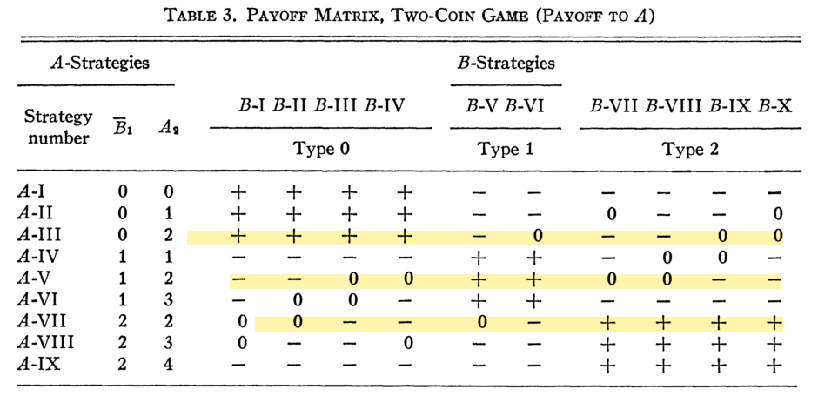
2-Player Game
Benjamin (1959)
Fair Game
Optimal strategy for A
  Pick coin uniformly at random
  Always guess 2

Slide 5
Experience Weighted Attraction
At each time step , player among N possible moves
Player picks move from with probability
is taken from probability vector
If A plays and B plays , player A and B receive payoffs and respectively

Slide 6
Experience Weighted Attraction
At each time step , each player calculates their probability vector (strategy) as follows:
Where

Slide 7
Implementation
Python
Simple learning algoritmh above
Can it play better then a human?
References
Schwartz, Benjamin L. ; Solution of a Set of Games, The American Mathematical Monthly, Vol. 66, No. 8 (Oct., 1959), pp. 693-701
T. H. Ho, C. F. Camerer, J.-K. Chong, Self-tuning experience weighed attraction learning in games, J. Econ. Theor. 133, 177-198 (2007)
T Galla, JD Farmer; Complex dynamics in learning complicated games, Proceedings of the National Academy of Sciences 110 (4), 1232-1236

