Slide 1


Imitative Text Generation using Presidential Speeches
Rajeev Parvathaneni

Slide 2
Goal of the Project
Project focused on generating text related to political speeches. Ultimately, we wanted the output to sound like the original speakers.
Wanted to build an extractive and abstractive summarization machine, which would rank existing sentences and create new sentences from the given input text.
Used several NLP and Machine Learning techniques to achieve results.

Slide 3

Dataset Information
Inaugural speeches of Presidents from The American Presidency Project website.
Used speeches of past presidents from Jimmy Carter(1977) to Donald Trump(2017).

Slide 4
Methods and Models Used
Extractive Summarization (ranking and choosing existing sentences in the source documents) using Text Rank Algorithm and Frequencies of words
Abstractive Summarization (generating new sentences that ‘sound similar’ to original source documents) using NLP, Machine Learning techniques.

Slide 5
Using Frequency of Words
Convert Paragraphs to Sentences
Text Preprocessing
Tokenizing the Sentences
Find Weighted Frequency of Occurrence
Replace Words by Weighted Frequency in Original Sentences
Sort Sentences in Descending Order of Sum
Notes:
First tokenize and remove stop words.
The algorithm goes through every word in each sentence and adds it to a word frequencies dictionary - if it's not already there the word gets assigned a value of 1, and if it is already there that value is incremented up by 1, and then finally all of these values are divided by the quantity of the most frequently occurring word in the documents, to get normalized weights for all the words.
With these frequency values for all the words in the document, each sentence (if it has less than 30 words total, to avoid having very long sentences in the summary output) gets a score from the sum of all the weighted frequency values of the words in it, not including stop words.
The top sentences from this ranking are chosen for the extractive summarization output.

Slide 6
Results Achieved
“We the citizens of America are now joined in a great national effort to rebuild our country and restore its promise for all of our people. We will get our people off of welfare and back to work rebuilding our country with American hands and American labor. When America is united America is totally unstoppable. Together we will determine the course of America and the world for many many years to come We share one heart one home and one glorious destiny.”

Slide 7
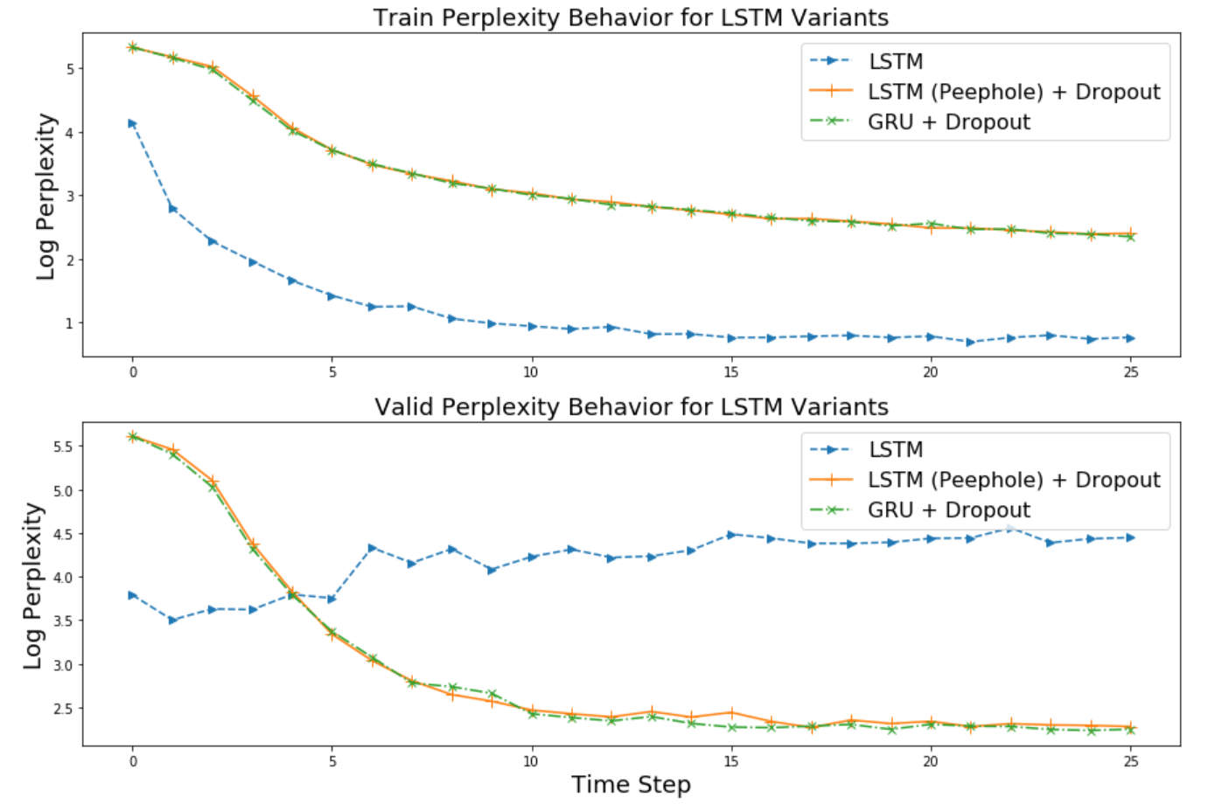
Abstractive summarization continued: Long Short-Term Memory (LSTM) ,Gated Recurrent Units (GRU)

Slide 8
Results Achieved from 25 epochs – GRU
we have the problems which the same glotes of the basis of our nothing but no promise of the promise.
we have the same and whose who will make our congress the world with the world and will make america spirit of their own government of our strong.
and we will be never know that we will be precise of our continue to the will be we are not be must be not been this storms of america. we had ensured the pride will make america wealthy again.
i would betrom the world with the same globed, we are will make america strength and our belief in the world of america, we will be a nation, together of our souls, live in the world to those who we will always beloved that it we had enabled our people.
we will not be make the people of our country to all our pland in the fair of our country to that we will make america safe of our most in one will be we will be read to believe for this we are problems will be not on the sacrifice and we will make america will be not be done.

Slide 9
Using AWS SageMaker- and tuning hyperparameters -Results Achieved from 100 epochs – GRU
and to be proud fort god blessedou, fo today great all no war. america. we must be never your along birth right, of must beyo the day of prosper again.
its neartion and every. we cannot not turn by the same fard the problems, we cannot our counity, letter, and our not only the issue to their areat's tho dream.
that if on mericanswer. nower to he hastolera as a common the capities has firsn live or the size of our own most with the willengery what is our nation with caill.
we are the unity, the same doneed. we will make america great again. thour faces to be citizens of the unders today, haven we cannot the democracy of life that when the end of old
american people more continuing moral strength and our belief in an undiminis the king coment, a cessure the sameet it human flag.
it is the father, as hat we relng back in its citizens and does, and our country will be generant sto serving the source of our nations that we will not be my accomplishment but the affirmatio

Slide 10
Observations Using ROGUE
ROUGE-Type | System Name | Avg_Recall | Avg_Precision | Avg_F-Score | Num Reference Summaries
ROUGE-L | Text Rank Output.txt | 0.07076 | 0.59375 | 0.12646 | 3
ROUGE-L | Presidents-speech-summarization.txt | 0.07076 | 0.48101 | 0.12338 | 3
ROUGE-L | lstm_extensions.txt | 0.04097 | 0.28205 | 0.07154 | 3
ROUGE-1 | Text Rank Output.txt | 0.07081 | 0.99065 | 0.13217 | 3
ROUGE-1 | Presidents-speech-summarization.txt | 0.08484 | 1 | 0.1564 | 3
ROUGE-1 | lstm_extensions.txt | 0.1149 | 0.84729 | 0.20235 | 3
ROUGE-2 | Text Rank Output.txt | 0.06695 | 0.96 | 0.12516 | 3
ROUGE-2 | Presidents-speech-summarization.txt | 0.08438 | 0.96032 | 0.15513 | 3
ROUGE-2 | lstm_extensions.txt | 0.05509 | 0.39109 | 0.09658 | 3
ROUGE-SU4 | Text Rank Output.txt | 0.05851 | 0.86373 | 0.1096 | 3
ROUGE-SU4 | Presidents-speech-summarization.txt | 0.08237 | 0.928 | 0.15132 | 3
ROUGE-SU4 | lstm_extensions.txt | 0.06604 | 0.46269 | 0.11559 | 3

Slide 11
Conclusion
Summarization is still a research subject and is done using different techniques .There are lot of external dependencies for the expected results. Modern techniques are improving but they are not there yet.

Slide 12
References
https://stanfordnlp.github.io/CoreNLP/tutorials.html https://towardsdatascience.com/automatically-summarize-trumps-state-of-the-union-address-6757c6af6534
https://medium.com/jatana/unsupervised-text-summarization-using-sentence-embeddings-adb15ce83db1
https://www.aclweb.org/anthology/J05-3002
https://arxiv.org/pdf/1807.08000.pdf Natural Language Processing with TensorFlow –Thushan Ganegedara

Slide 13
Questions ?

Slide 14
Thank you

Slide 15
First Abstractive Summarization Tool: Sequence to Sequence Model
Seq2Seq Model is an encoder-decoder model in TensorFlow which can be used in abstractive summarization.
It consists of two sub-models, the first called an Encoder, and the second a Decoder. The Encoder takes input text up into a Recurrent Neural Network (RNN) architecture, outputting a neural representation for the decoder. We use a dictionary of words generated from our input documents, each of which has an embedding from a wikipedia-trained model, and the decoder taking our trained sentence embeddings accordingly uses words from this dictionary to generate new sentences.
As you will see, our results were disappointing.

Slide 16
Results Achieved
Example Seq2Seq outputs to go here
Actual Summary: a new breeze is blowing and the old bipartisanship must be made new again
Created Summary: a new breeze breeze blowing blowing the the bipartisanship must must made made be
The summaries we created using this method were not satisfactory, as they often had many identical consecutive words in the output sentences, and thus were rarely grammatical.

