Slide 1
Web Applications
Week 8 – Pt. 1
Ryan Haley
Adapted from Material by Deron Grzetich and Li-Wey Lu

Slide 2
Web Application Fundamentals

Slide 3
Web App Hacking
Web Application Hacking
To define web application hacking for our purposes we will focus on the web application and its associated logic
This is different from vulnerabilities in the operating system layer (OS) or the web server layer (IIS, Apache, WebSphere, etc.)

Slide 4
Web Application Architecture
Web Server
First line for web traffic
Receives communications via Hypertext Transfer Protocol (HTTP)
Determines how to route web traffic
Handles static content (html, pictures, css, etc)
Examples of Web Servers: IIS, Nginx, Apache, lighttpd
Application Server
Serves dynamic content for websites
Examples of Application Servers: Tomcat, PHP, WebLogic, ASP.NET
File System
Hosts files for websites
Hosts static or dynamic (application server code) files

Slide 5
Web Application Architecture
Databases
Used to host patternable data
Only accessed with application server
Example databases: mysql, mongodb, mssql, Oracle
External Systems
Systems used to provide information or functionality to the application server
Examples: External API (Twitter feed), internal authentication (LDAP)

Slide 6

Web Application Architecture
Web Server
Application Server
Database
File System
External Systems

Slide 7
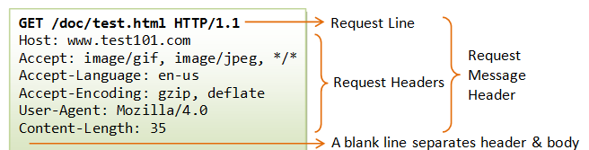
HTTP – Request
Request line
Consist of one or more headers
Mandatory blank line
Optional message body

Slide 8
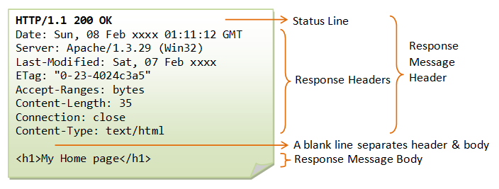
HTTP – Response
Status line
HTTP version
Status code
Reason phrase (describes status code)
Response headers
Response body

Slide 9
HTTP – Methods
GET
Server returns requested resource to user
POST
Attempts to send data to the server
HEAD
Server returns only headers
TRACE
Server returns the exact contents of the request received
OPTIONS
Server returns what methods are allowed
PUT
Attempts to upload a specified resource to the server

Slide 10
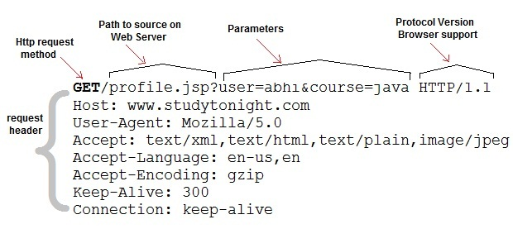
HTTP – GET Method
Retrieve resources
Send parameters through URL query string
https://www.example.com/index.php?search=myParameter
Enables users to bookmark a URL for a dynamic resource for reuse
URLs are logged in various places and are also transmitted in the Referer header
GET should not be used to transmit sensitive data

Slide 11
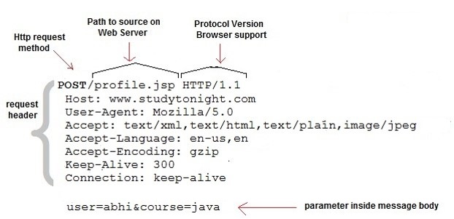
HTTP – POST Method
Perform actions
Parameters can be sent in either the URL query string or request body
Parameters are excluded from bookmarks, logs, and the referer header

Slide 12
HTTP – Uniform Resource Locators (URLs)
Unique identifier for a web resource
Typical Format:
protocol://hostname[:port]/[path/]file[?param=value][&param2=value2]
Example: http://www.example.com:8080/images/index.php?id=432&x=100&y100
RESTful format:
Protocol://hostname[:port]/[path/][query_string/]
Example: http://www.example.com/store/department/item
REST is similar to SOAP (Simple Object Access Protocol), as it facilitates the communication between web services

Slide 13
HTTP – General Headers
Connection
Content-Encoding
Content-Length
Content-Type
Transfer-Encoding

Slide 14
HTTP – Common Request Headers
Accept
Accept-Encoding
Authorization
Cookie
Host
If-Modified-Since
If-None-Match
Origin
Referer
User-Agent

Slide 15
HTTP – Common Response Headers
Access-Control-Allow-Origin
Cache-Control
Etag
Expires
Location
Pragma
Server
Set-Cookie
WWW-Authenticate
X-Frame-Options

Slide 16
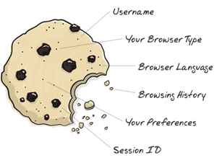
HTTP – Cookies
Cookies help manage sessions
Set by the server in HTTP responses
Cookies also have attributes:
Expires
Set date until which the cookie is valid
Domain
Specifies the domain for which the cookie is valid
Path
Specifies URL path for which the cookie is valid
Secure
Cookie is only submitted in HTTPS requests
HTTPOnly
Cookie cannot be accessed via client-side JavaScript
Server Response:
Set-Cookie: cookieName = cookieValue
Client Request:
Cookie: cookieName = cookieValue

Slide 17
HTTP – Status Codes
1xx – Informational
2xx – The request was successful
3xx – The client is redirected to a different resource
4xx – The request contains an error of some kind
5xx – The server encountered an error fulfilling the request

Slide 18
HTTP – Common Status Codes
100 Continue
200 OK
201 Created
301 Moved Permanently
302 Found
304 Not Modified
400 Bad Request
401 Unauthorized
403 Forbidden
404 Not Found
405 Method Not Allowed
413 Request Entity Too Large
414 Request URI Too Long
500 Internal Server Error
503 Service Unavailable

Slide 19
HTTP – User Agent String
Common Strings
Mozilla – Mozilla Usually a historical artifact from Netscape days
Firefox – Gecko (rendering engine)
AppleWebKit – fork of KHTML
Web servers just look for keywords, not exact strings
Mozilla/5.0 (Windows NT 6.1; Win64; x64) AppleWebKit/537.36 (KHTML, like Gecko) Chrome/60.0.3112.113 Safari/537.36
Mozilla – Mozilla based or in most cases compatible. Usually a historical artifact
Windows NT 6.1 - Windows OS version 6.1 (Windows 7)
AppleWebKit – rendering engine used or compatible with
Chrome – Web Browser Type and version
Safari – Web browser compatibility, ties with AppleWebKit version

Slide 20
HTTP – User Agent String Examples
Chrome
Mozilla/5.0 (X11; Linux x86_64) AppleWebKit/537.36 (KHTML, like Gecko) Chrome/51.0.2704.103 Safari/537.36
Firefox
Mozilla/5.0 (Windows NT 6.1; Win64; x64; rv:47.0) Gecko/20100101 Firefox/47.0
Internet Explorer
Mozilla/5.0 (compatible; MSIE 9.0; Windows Phone OS 7.5; Trident/5.0; IEMobile/9.0)
Edge
Mozilla/5.0 (Windows NT 10.0; Win64; x64) AppleWebKit/537.36 (KHTML, like Gecko) Chrome/51.0.2704.79 Safari/537.36 Edge/14.14393
Resources:
https://www.nczonline.net/blog/2010/01/12/history-of-the-user-agent-string/
https://en.wikipedia.org/wiki/Windows_NT
https://developer.mozilla.org/en-US/docs/Web/HTTP/Headers/User-Agent

Slide 21
Minilab
Visit depaul.edu and secdaemons.org. Do either of these sites have cookies?
Capture your user agent. Decipher each part of it. Is it what you expect?

