Slide 1
Evaluating Decision Tree models for credit
Data Analysis FGV – Winter School
Raphael Ferreira

Slide 2
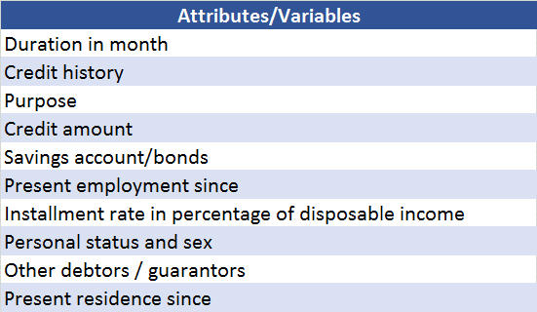
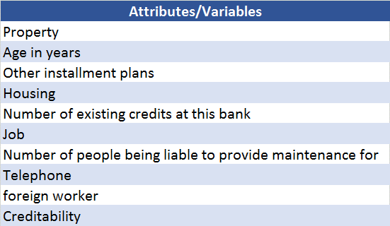
Problem Evaluating possible decision tree models for credit
Target: Creditability (“bad” or “good”)
Database
German Credit Data (Statlog)
1000 instances
20 attributes (13 categorical, others integer)
Year: 1994
Source: UCI Machine Learning Repository (http://archive.ics.uci.edu/ml/datasets.html)
300 Bad 700 Good

Slide 3
Data Preparation
Changing categorical to numerical
Database split in 60% training and 40% testing, randomly sorted
Watson Suggestion
- Predictive strength was around 70% for almost all variables, when it was in categorical format (Age was the first variable suggested)
- But predictive strength drop to 18% and variables chosen changed, when was formatted as numerical
- However, using numerical format, accuracy improved in this model
- And data quality improved as well: from 69% to 74%

Slide 4
Models
Model 1: “All”
“Supervised”
Use all variables
Model 2: “Chosen”
Supervised
Use some variables
Duration in month
Credit Amount
Credit History
Present Employment Since
Job
Model 5: “Watson Analytics”
“Supervised”
Use some variables
Duration In month
Installment Rate
Credit Amount
Credit History
Provide Maintenance For
Model 4: “Random Forest”
“Supervised”
Use all variables

Slide 5
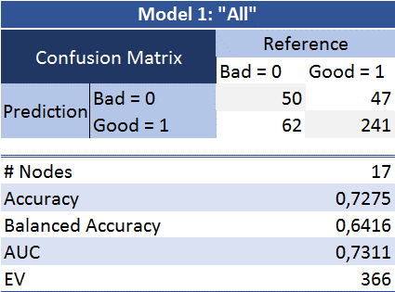


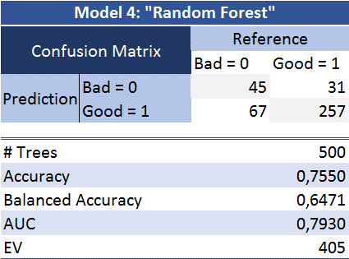
Results Considering this Cost/Ben. Matrix

Slide 6
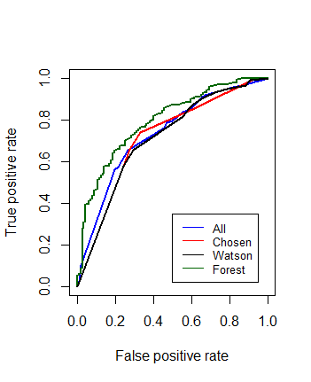
Performance
Random Forest presents the best performance in all indicators
“Watson” is the second, and not so far from Random Forest (Accuracy, Balance Acc. and EV), and less complex
“Chose” is the worst
Important: EV depends on Cost/Benefit Matrix
Conclusions
Although Random Forest is the best model, it uses all variables, and some of them could lead to accountability problems (expected legal costs)
Board should take in account these potential legal costs and expected profit from this model, and if potential costs are too high then..
Watson Model is recommended!

