Slide 1
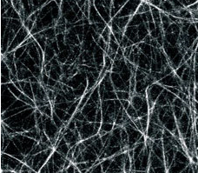
Mechanical Properties
of Simulated Temporary Cross-linked
F-actin Polymer Networks
Rita Philavanh
San Diego State University
Undergraduate in Physics and Chemistry
Advisor:
Dr. Arlette R. C. Baljon
Department of Physics
San Diego State University
A network of actin filaments in solution formed by addition of the crosslinking protein.
* Douglas Durian and Haim Diamant. 'Condensed-matter physics: In search of soft solutions.' Nature 412, 391 (2001)‏

Slide 2
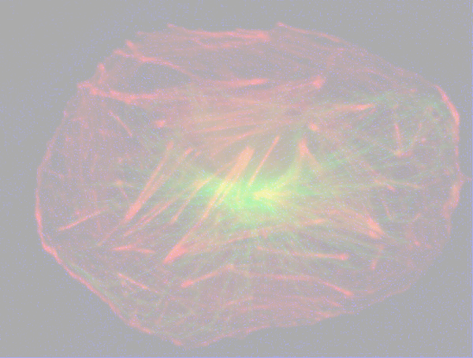
Motivation

Slide 3
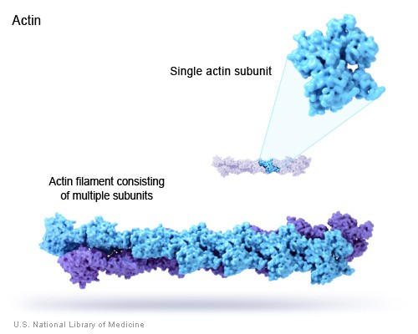
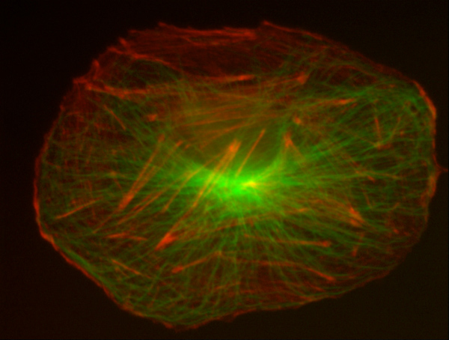
Motivation
- Polymeric F-actin
- Mechanical Properties
- Objective
Polymeric F-actin network
Actin filaments are an important structural
component in the cell and essential for its
survival
Actin binding proteins (ABP) temporary
cross-link the F-actin polymer together into
a dynamic network
This network is a dominant part of the
cytoskeleton found in the cytoplasm of cells
Many mechanical properties of the cell
are predominantly determined by the
properties of the F-actin network
Cytoskeleton of a cultured epithelial cell.
F-actin network shown in red.
(Fluorescence Microscope) Image by Steve Rogers.
http://www.itg.uiuc.edu/exhibits/gallery/pages/image-13.htm

Slide 4
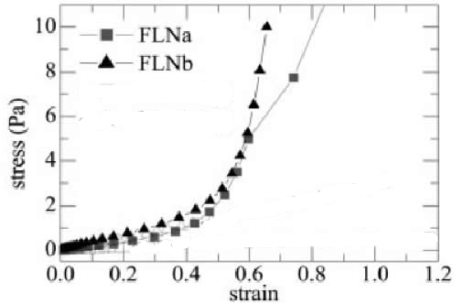

Motivation
- Polymeric F-actin
- Mechanical Properties
- Objective
Mechanical Properties
Weitz* lab: In vitro experiments of FLNa cross-linking F-actin polymers into networks to replicate conditions in living cells
Measured strain(deformation) (γ) of network in response to applied stress (σ)
    elastic modulus=σ/γ
For low stress and strain, the relationship increases in direct proportion until a critical stress
At large stresses or strain, mechanical response can be highly non linear, until the network breaks
* Gardel, M. L., et al. 'Prestressed F-actin networks cross-linked by hinged filamins replicate mechanical properties of cells.' PNAS (Proceedings National Academy of the Sciences). February 7, 2006. Vol 103. p. 1762

Slide 5
Motivation
- Polymeric F-actin
- Mechanical Properties
- Objective
Objective
The F-actin network making up the cytoskeleton of cells is responsible for:
        Many important physiological roles (motion, transport, etc.)‏
        Resisting tension
        Maintaining cellular shape
        Giving the cell its viscoelastic properties
An explanation for this non-linear response is still lacking
Little is known about how stress propagates through the cell
        Objective: Analyze the dynamics of the network structure through simulation
        to help explain mechanical properties observed in actual cells

Slide 6
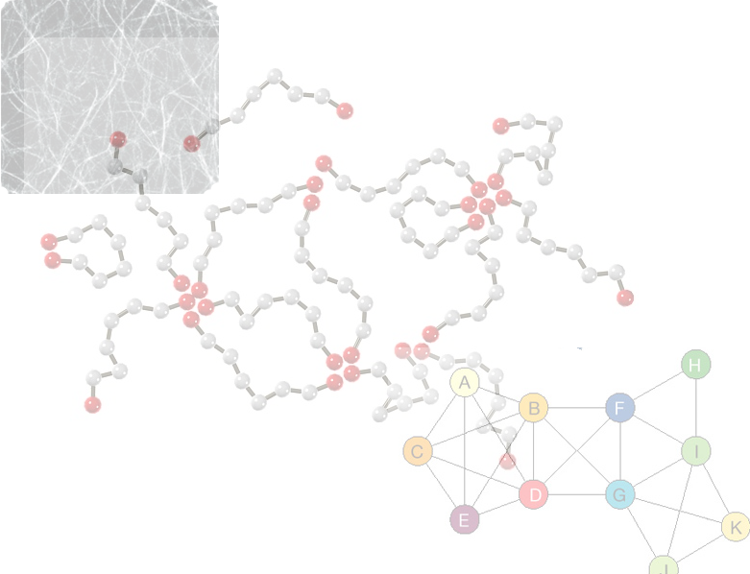
Model

Slide 7
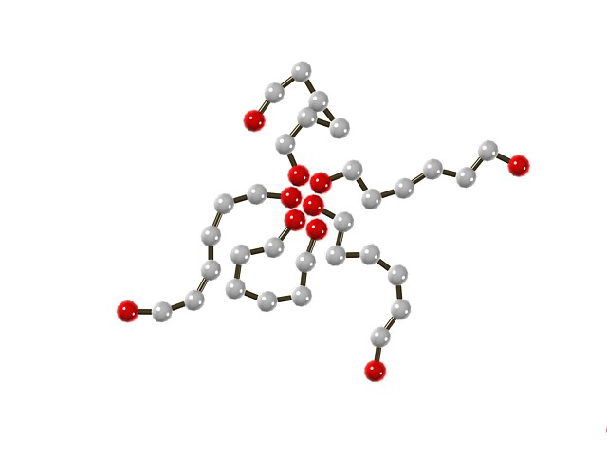
Motivation
Model
- Molecular Dynamics
- Lennard-Jones‏
-Monte Carlo
Molecular Dynamics Simulation
The Baljon lab has constructed code to model polymeric networks in which crosslinks are nonpermanent.
Molecular Dynamics: move molecules around
Kremer and Grest* bead-spring model simplifies chain of monomers (actin) as a sequence of beads connected with nonlinear springs
1000 chains, each with 8 beads connected by a strong anharmonic spring potential
All beads experience truncated Lennard-Jones potential
Monte Carlo: employed to model reaction between linkers
* K. Kremer and G. S. Grest. Dynamics of entangled linear polymer melts: A molecular-dynamics simulation. Journal of Chemical Physics , 92:5057, 1990.
* Picture from Mark Wilson's Master Thesis

Slide 8

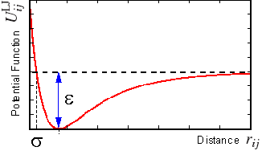
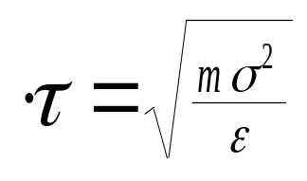
Motivation
Model
- Molecular Dynamics
- Lennard-Jones‏
-Monte Carlo
Lennard-Jones Potential
LJ potential models the interaction between molecules at
different separation distances
Reduced Units
Energy = ε
Length = σ
Temperature = kT/ε
The potential is used to obtain the forces felt by each beads
This force is used in Newton’s equation (F=ma) to move the beads around

Slide 9
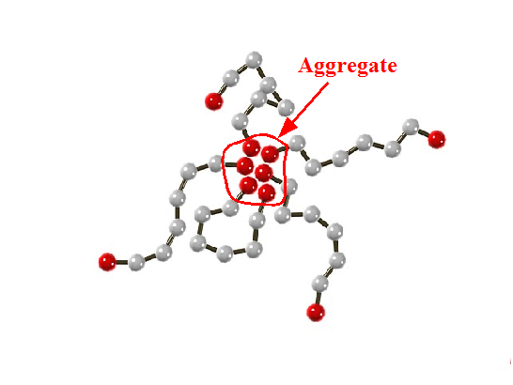
Motivation
Model
- Molecular Dynamics
- Lennard-Jones‏
- Monte Carlo
Monte Carlo Simulation
The Baljon lab has constructed code to model polymeric networks in which crosslinks are nonpermanent.
Molecular Dynamics: move molecules around
Monte Carlo: employed to model reaction between linkers
In our simulation, cross-links (ABP) are aggregates of end beads
from different chains that group together
These junctions are updated every 20 time steps
Probability of breaking or forming junctions is based on
the energy difference of new and old states
* K. Kremer and G. S. Grest. Dynamics of entangled linear polymer melts: A molecular-dynamics simulation. Journal of Chemical Physics , 92:5057, 1990.
* Picture from Mark Wilson's Master Thesis

Slide 10
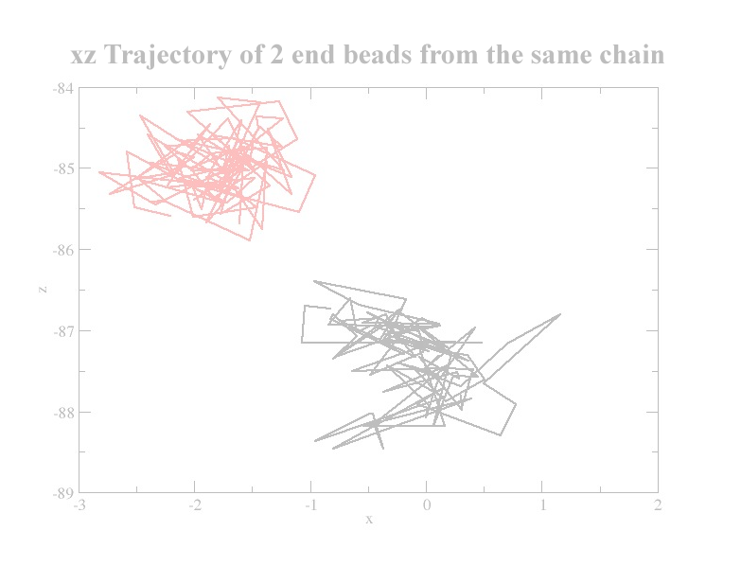
Methods/Results

Slide 11
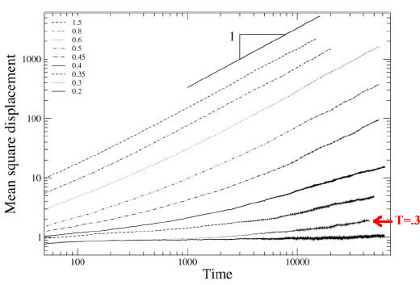
Motivation
Model
Methods/Results
- Displacement
- Changes in cross-links
- Percolation
Displacement
Investigating diffusion
* A. Baljon, D. Flynn, and D. Krawzsenek. Numerical study of the gel transition in reversible
associating polymers. The Journal of Chemical Physics, 126:044907, 2007.

Slide 12
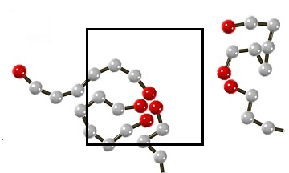
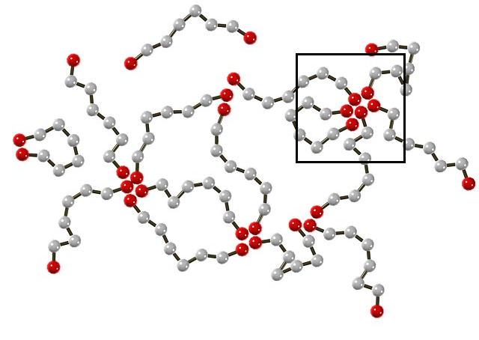
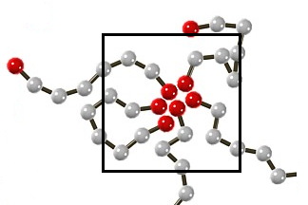
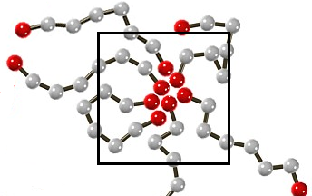
Motivation
Model
Methods/Results
- Displacement
- Changes in cross-links
- Percolation
Changes in cross-links
Investigating changes in the cross-links (aggregate size) over time :
Breaking:
Staying the Same:
Growing:
* Picture from Mark Wilson's Master Thesis

Slide 13
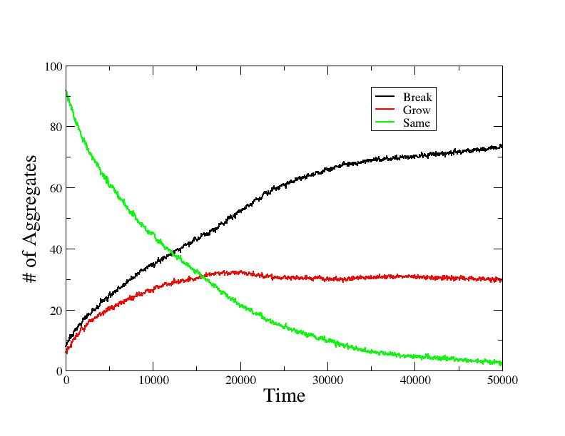

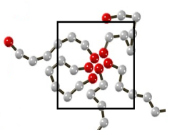
Motivation
Model
Methods/Results
- Displacement
- Changes in cross-links
- Percolation
Changes in cross-links

Slide 14
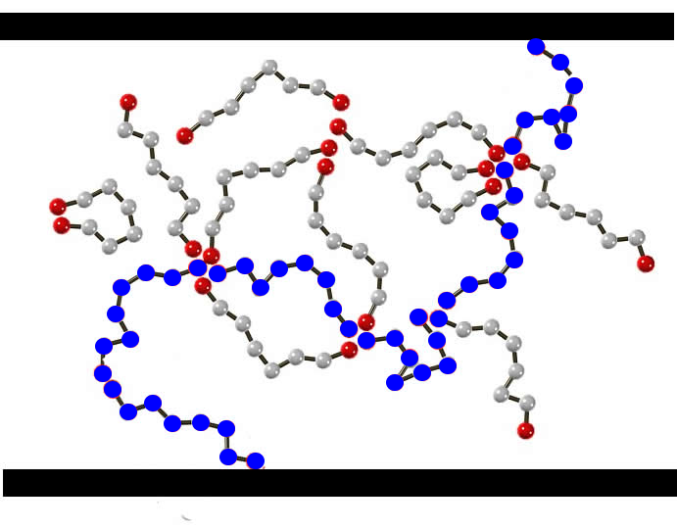
Motivation
Model
Methods/Results
- Changes in cross-links
- Percolation
- SOC
Percolation
Investigating connected path through the network

Slide 15
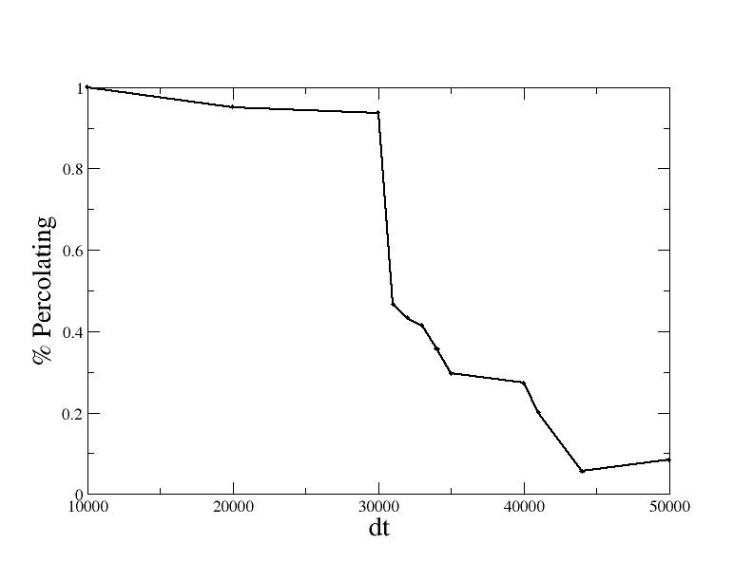
Motivation
Model
Methods/Results
- Changes in cross-links
- Percolation
- SOC
Percolation
(For aggregates staying the same or growing)‏

Slide 16
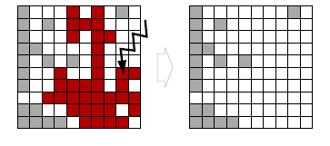
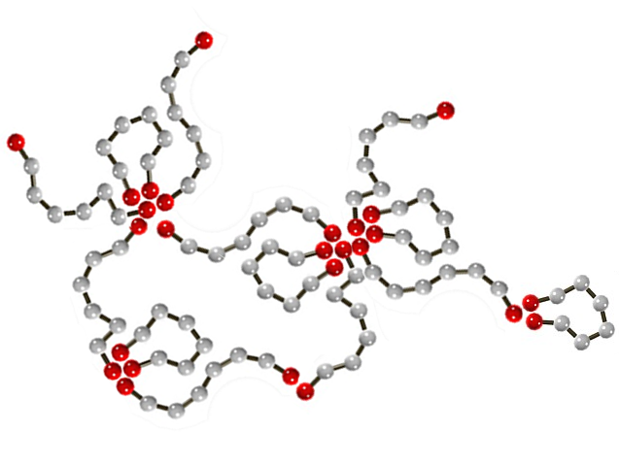
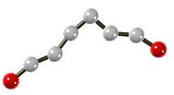
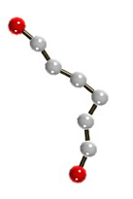
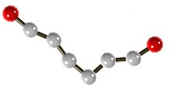
Motivation
Model
Methods/Results
- Changes in cross-links
- Percolation
- SOC
Self-organized Criticality
      Investigating the distribution size of clusters that break (with oscillatory stress)‏
SOC: Local perturbation to the system at a critical
point create transient 'avalanches' of events that can
propagate throughout a cluster due to percolation
Forest fire model from Newman*.
Cluster
  * Newman, M.E.J. 'Power laws, Pareto distribution and Zipf's law.' arXiv:cond-mat/0412004v3 [cond-mat.stat-mech]. 29 May 2006.
  * Bak, Tang, and Wiesefeld. 'Self-Organized Criticality: An Explanation of 1/f Noise.' Physical Review Letters. (1987).

Slide 17
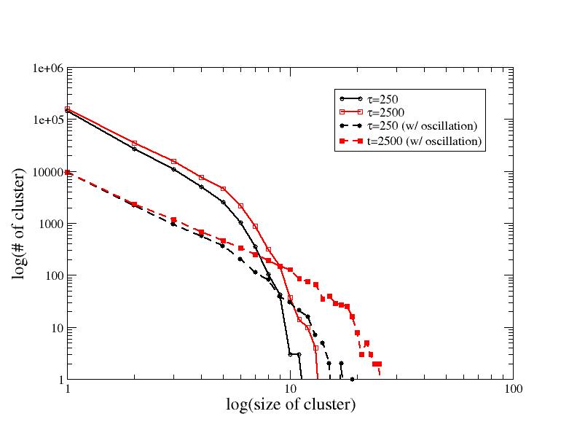
Motivation
Model
Methods/Results
- Changes in cross-links
- Percolation
- SOC
Self-organized Criticality

Slide 18
Motivation
Model
Methods/Results
Summary
- Future Work
Summary
Objective:
        To investigate the structure and dynamics of the actin cytoskeleton network
        through our simulation
        Very high stress is needed to break the F-actin network – want to understand
        more about the connectedness of the network structure
Results:
        Over time, monomers in the same aggregate gradually diffuse apart
        Some monomers that cross-link together do remain in the same aggregate
        For these aggregates, percolation is observed, but not for very long time
        intervals
        For aggregates that break – more small sized clusters, but also a few larger ones
        In the presence of an oscillation, there is an increased number of larger sized clusters
        that break
Although the structure is changing over time, the network is able to hold itself
together as long as there are aggregates that percolate at any given moment.

Slide 19
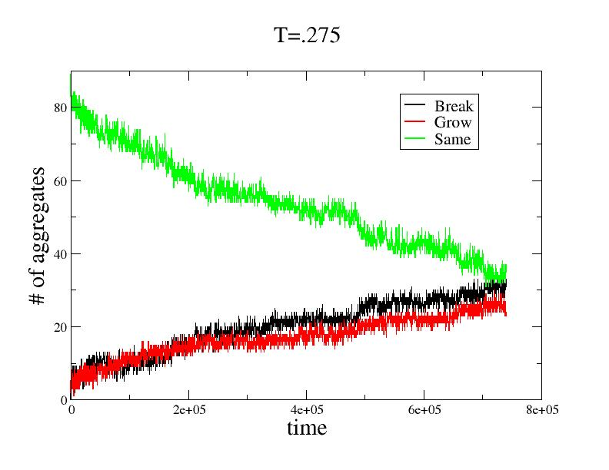

Background
Model
Methods/Results
Summary
- Future Work
Future Work
        Examine networks at lower temperature

Slide 20




Background
Model
Methods/Results
Summary
Acknowledgement
Dr. Arlette Baljon, Joris Billen and Mark Wilson
Rita Philavanh is supported as a trainee by NIH RoadMap
Initiative award T90 DK07015
CSRC NIW program
SDSU Department of Physics and Chemistry

Slide 25

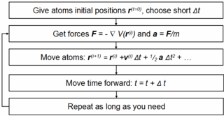



Molecular Dynamics
Monte Carlo
Calculate the change of potential energy:
, accept the new coordinates and go to step 2.
corresponding to this displacement.
· If
, select a random number R in the range [0,1] and:
A.
if
accept the new coordinates and go to step 2,
B.
if
keep the original coordinates and go to step 2.

Slide 26
Plots

Slide 27
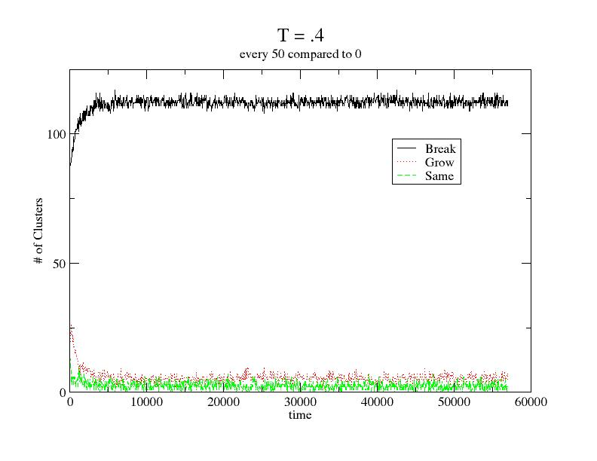
Background
Simulation
Methods
Results/Plots
- T=.4
- T=.35
- T=.3
Changes in cross-links

Slide 28
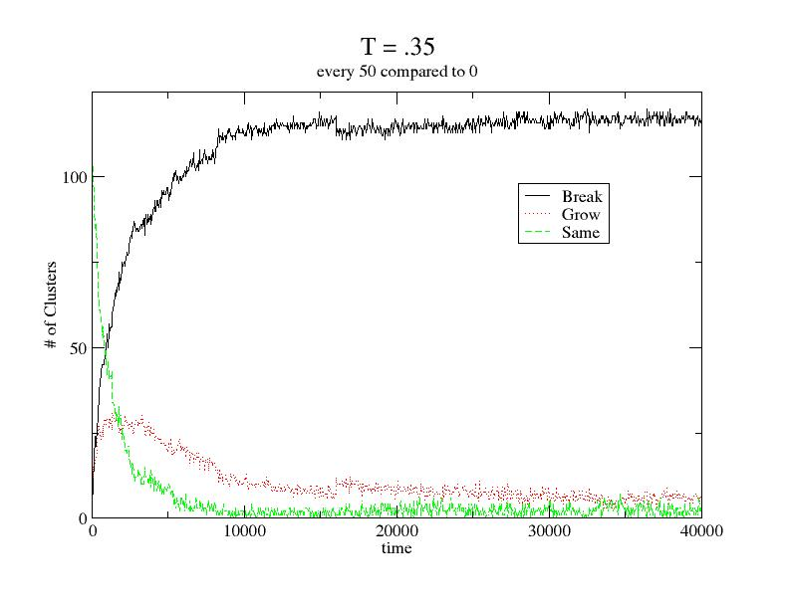
Background
Simulation
Methods
Results/Plots
- T=.4
- T=.35
- T=.3
Changes in cross-links

Slide 29
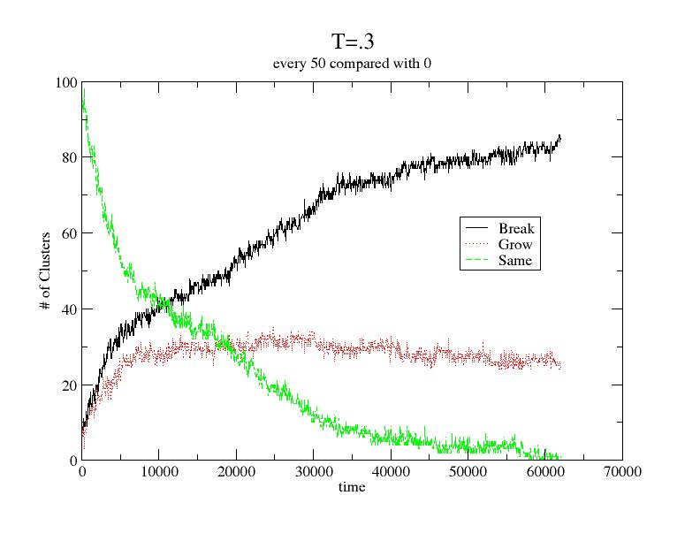
Analysis/Plots
- T=.35
- T=.3
- At Rest: T=.3
Changes in cross-links

Slide 30
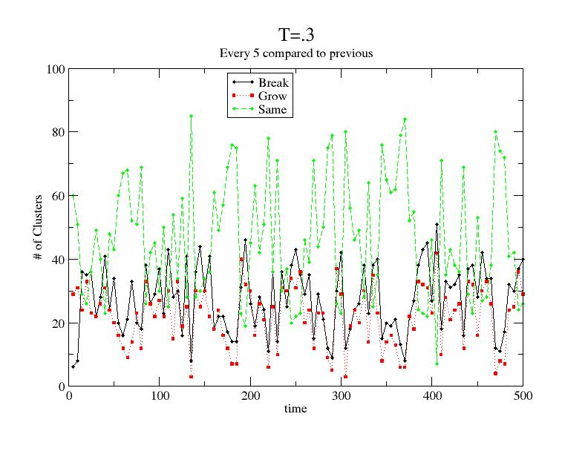
Background
Simulation
Methods
Results/Plots
- T=.3
- Oscillation
Further Investigation
Changes with Oscillation
Changes in cross-links per oscillation cycle

Slide 31
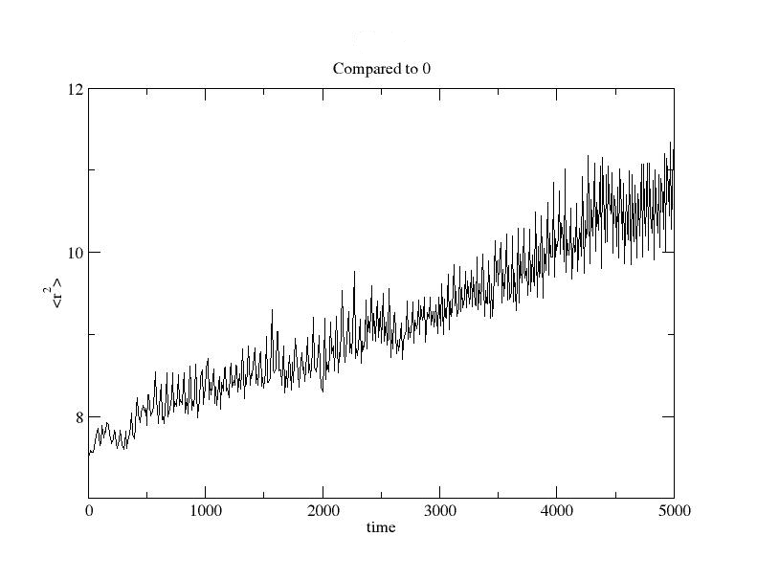
Motivation
Model
Methods/Results
- Displacement
- Changes in cross-links
- Percolation
Displacement
Average distance between end groups in an aggregate

