Slide 1
Toward Spoofing-Resilient and Communication-Integrated MmWave Radar Sensing(SCR)
Vedran BEGanovic
MCS Project

Slide 2
Spoofing Problem & SCR Concept
Spoofers can manipulate backscattered radar signals → generating “ghost targets”
GNSS spoofing (e.g., GPS L1/L5) demonstrates feasibility of signal deception
Automotive radar will need multi-frequency spoofing defenses
Spoofing-resilient and Communication-integrated Radar sensing scheme
SCR Methodology
Chirp-splitting - divides the chirp into sub-bands to detect suspicious Doppler peaks
Frame-splitting - separates uniformly vs. nonuniformly sampled chirps; spoof targets appear in uniform samples

Slide 3
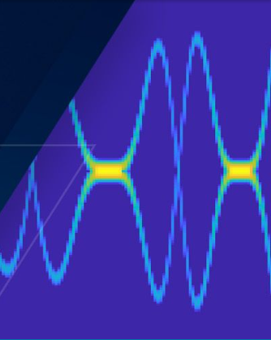


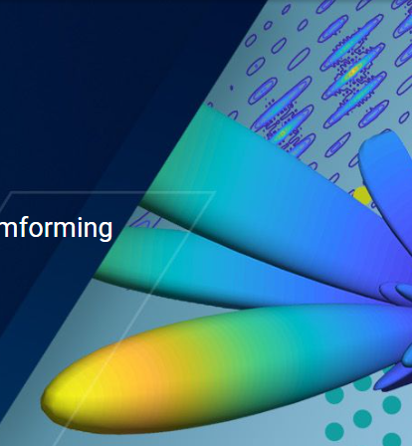
Evaluation Plan
MATLAB
  Signal Processing Toolbox
  Radar Toolbox
  Phased Array Toolbox
  No datasets or hardware experiments in this current project
  Metrics
    Peak Shift
    Peak magnitude difference

Slide 4
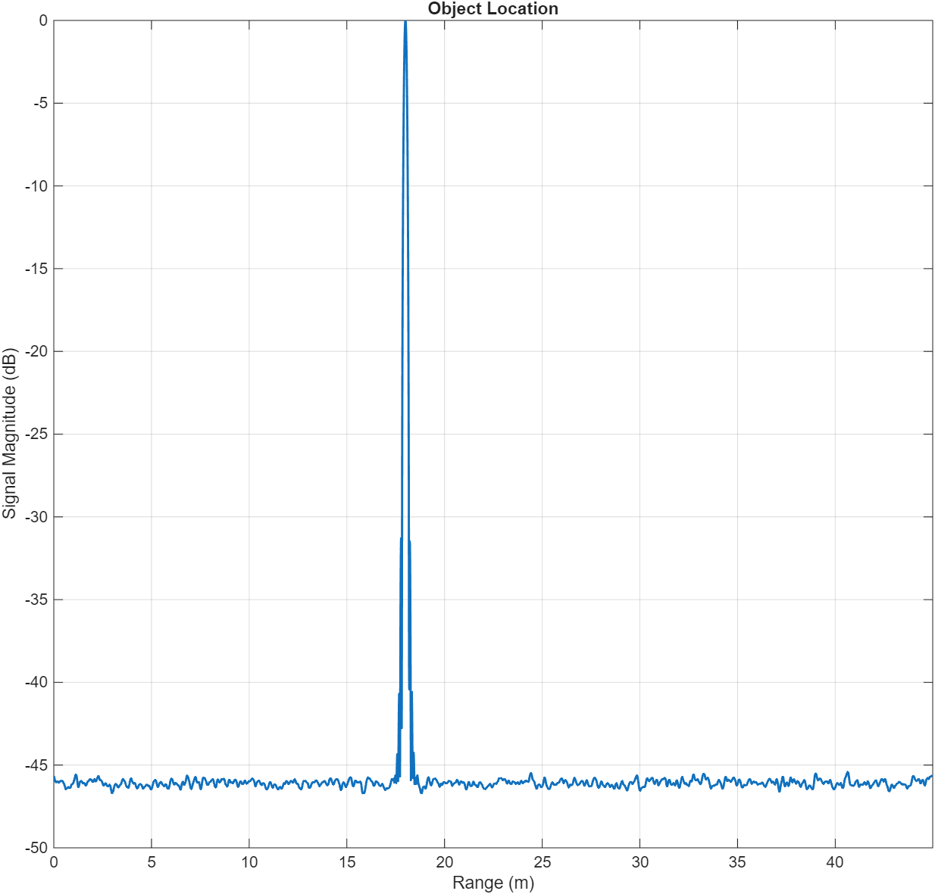

FMCW Radar
Example – Object at rest
  Radar Parameters
    Carrier Frequency: $f_{c}=77 GHz$
    Bandwidth: $B=1.6 GHz$
    Sweep Time per Chirp: $T_{s}=60 ms$
    Sample Rate: $f_{s}=8 MHz$
    # chirps per frame: $K=256$
  Location: 18m from the radar
Figure 1: Peak location displays distance from radar

Slide 5
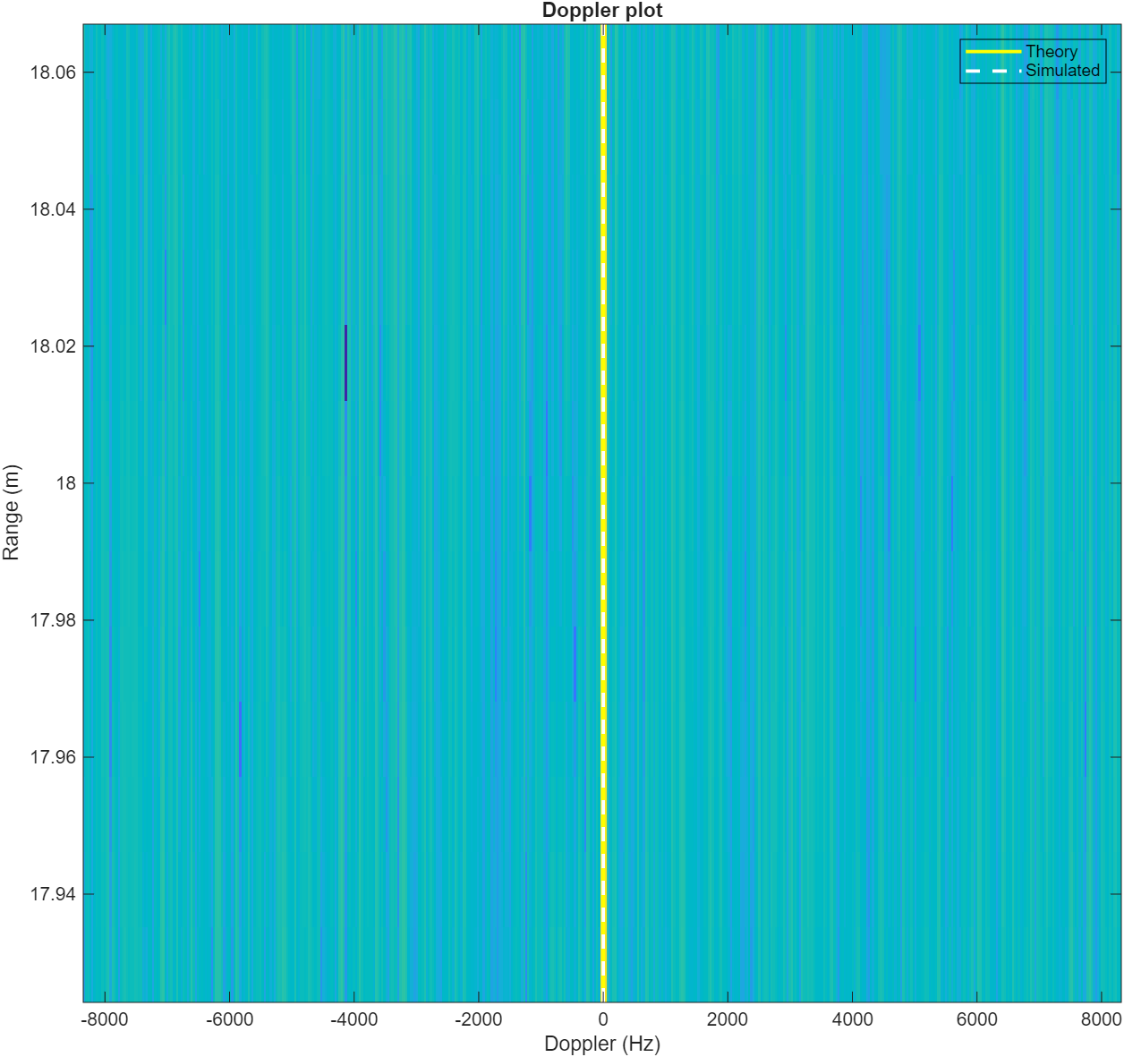
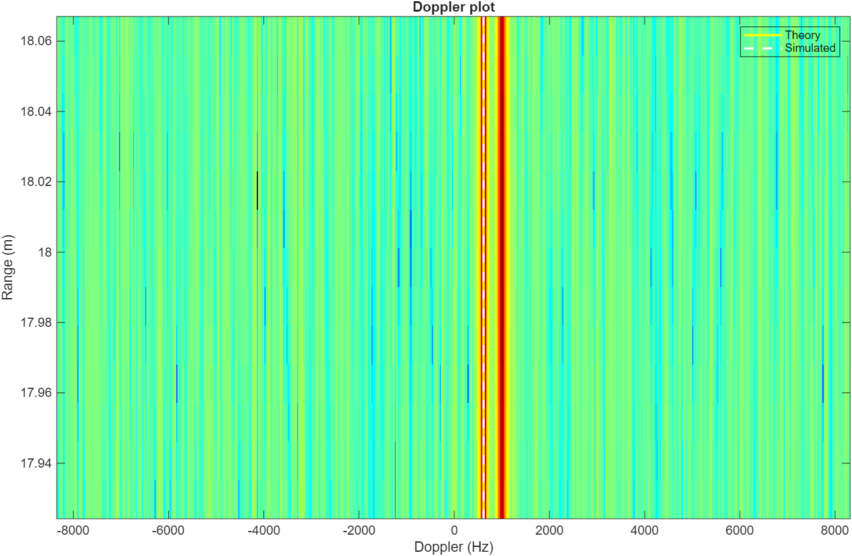
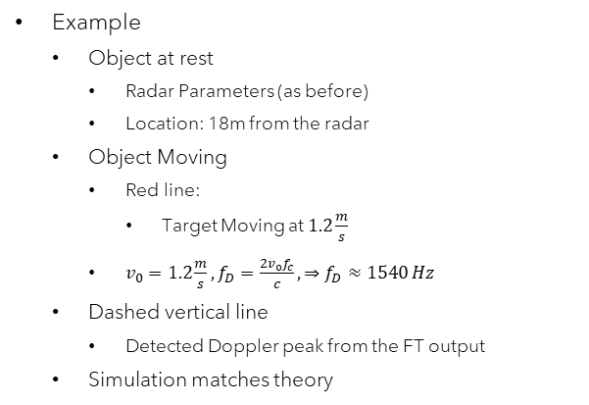
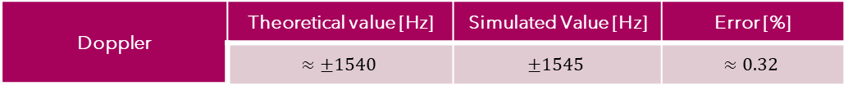
Stationary vs Nonstationary (Doppler)
Example
  Object at rest
    Radar Parameters (as before)
    Location: 18m from the radar
  Object Moving
    Red line:
      Target Moving at $1.2\frac{m}{s}$
    $v_{0}=1.2\frac{m}{s}, f_{D}=\frac{2v_{0}f_{c}}{c}, ⇒f_{D}≈1540 Hz$
  Dashed vertical line
    Detected Doppler peak from the FT output
  Simulation matches theory
Figure 2: Stationary (left) and Nonstationary (right)
Doppler | Theoretical value [Hz] | Simulated Value [Hz] | Error [%]
 | $$≈±1540$$ | $$±1545$$ | $$≈0.32$$

Slide 6
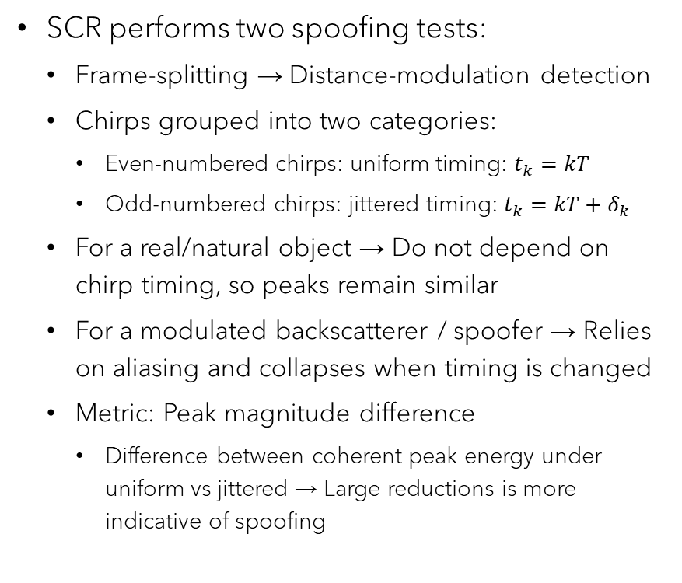
SCR Spoofing
SCR performs two spoofing tests:
  Chirp-splitting → Velocity-modulation detection
  Each chirp split into two pieces:
    Lower half of chirp: slightly lower carrier frequency
    Upper half of chirp: slightly higher carrier frequency
  For a real/natural object → Doppler scales with the carrier frequency so the peaks line up
  For a modulated backscatterer / spoofer → Doppler independent of the carrier, so the peaks will misalign.
  Metric: Peak-Shift
    Doppler peak misalignment → Large shifts are more indicative of spoofing
SCR performs two spoofing tests:
  Frame-splitting → Distance-modulation detection
  Chirps grouped into two categories:
    Even-numbered chirps: uniform timing: $t_{k}=kT$
    Odd-numbered chirps: jittered timing: $t_{k}=kT+δ_{k}$
  For a real/natural object → Do not depend on chirp timing, so peaks remain similar
  For a modulated backscatterer / spoofer → Relies on aliasing and collapses when timing is changed
  Metric: Peak magnitude difference
    Difference between coherent peak energy under uniform vs jittered → Large reductions is more indicative of spoofing

Slide 7
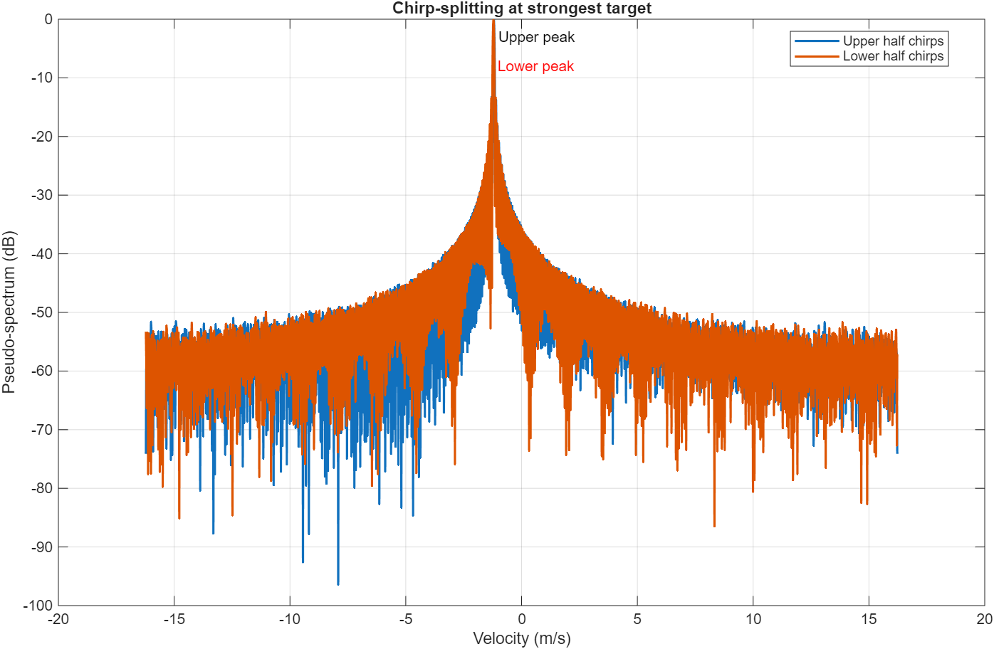
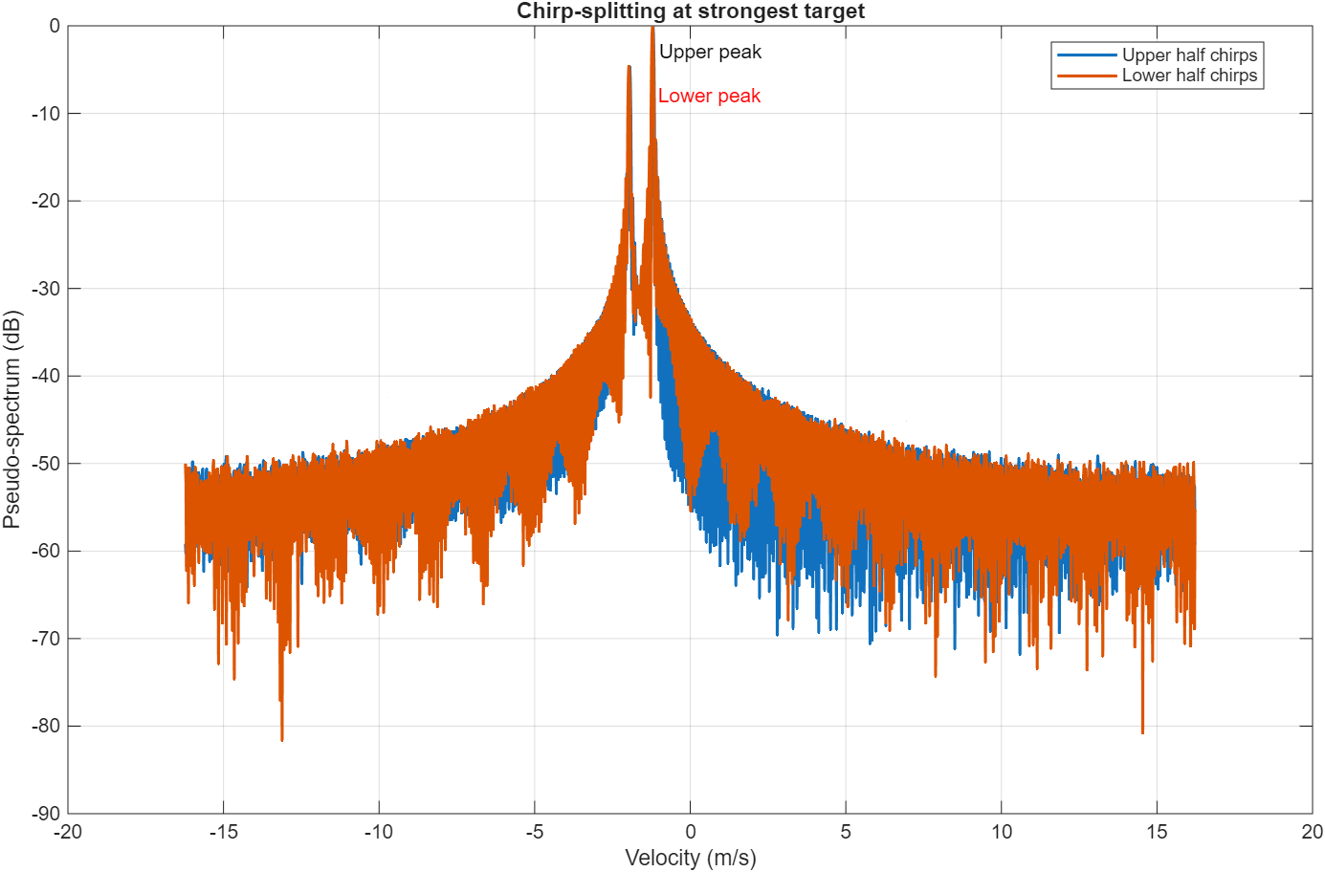
Chirp-Splitting
Figure 3: No spoofer – chirp peaks line up
Natural Target at 18m moving at 1.2 m/s
Radar – 77GHz
Spoofing
  1 kHz spoofing reflector
  60% amplitude of the natural target
Figure 4: Spoofer – chirp peaks exhibit splitting

Slide 8
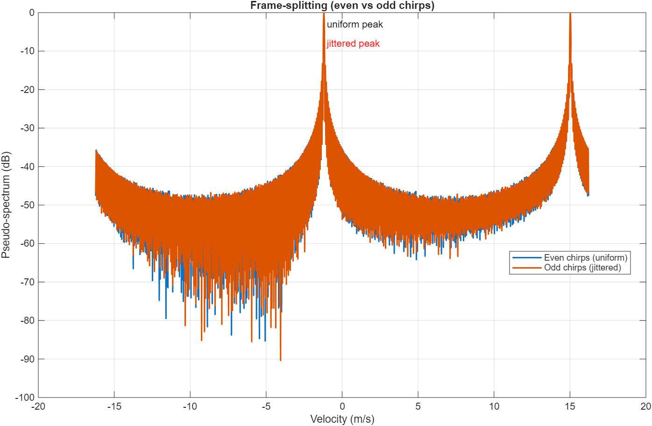
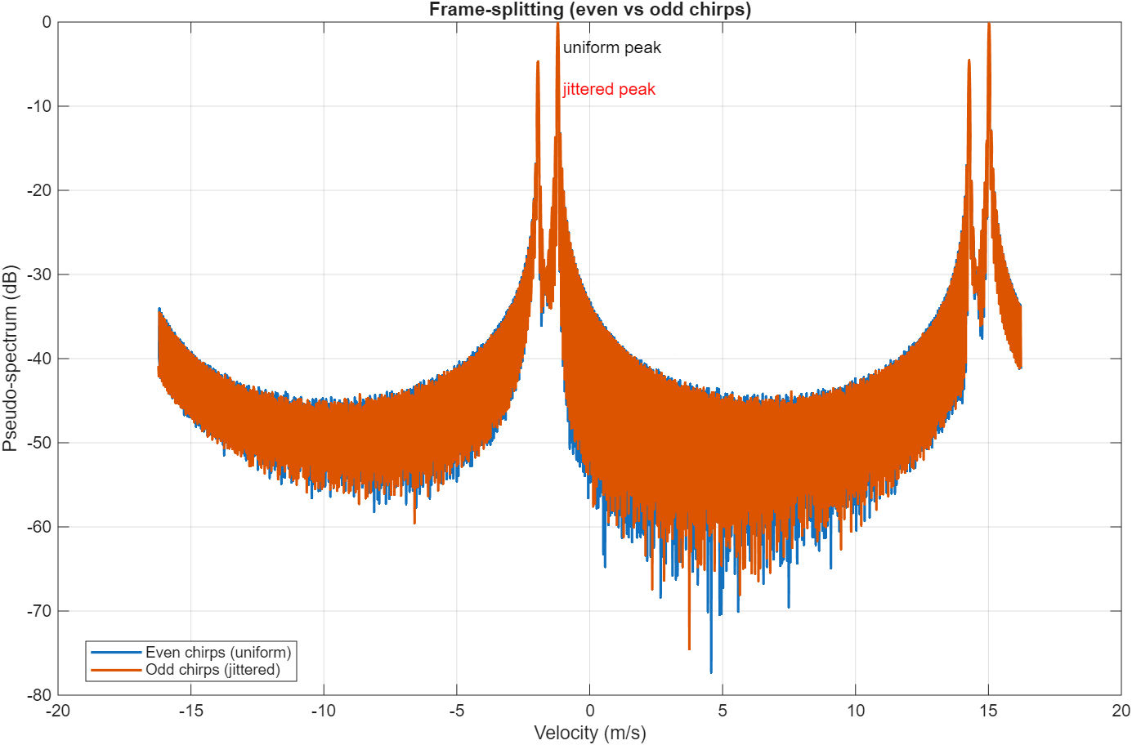
Frame-Splitting
Figure 5: No spoofer – chirp peaks line up
Natural Target at 18m moving at 1.2 m/s
Radar – 77GHz
Spoofing
  1 kHz spoofing reflector
  60% amplitude of the natural target
Figure 6: Spoofer – frame exhibits splitting

Slide 9
References
K. Qian and P. Pathak, “Toward Spoofing-Resilient and Communication-Integrated MmWave Radar Sensing,” 2025.
M. L. Psiaki and T. E. Humphreys, “GNSS spoofing and detection,” Proceedings of the IEEE, vol. 104, no. 6, pp. 1258–1270, 2016.
D. Hunt, K. Angell, Z. Qi, T. Chen, and M. Pajic, “MadRadar: A Black-Box Physical Layer Attack Framework on mmWave Automotive FMCW Radars,” in Proceedings 2024 Network and Distributed System Security Symposium, San Diego, CA, USA: Internet Society, 2024. doi: 10.14722/ndss.2024.24153.
R. Reddy Vennam et al., “mmSpoof: Resilient Spoofing of Automotive Millimeter-wave Radars using Reflect Array,” in 2023 IEEE Symposium on Security and Privacy (SP), San Francisco, CA, USA: IEEE, May 2023, pp. 1807–1821. doi: 10.1109/SP46215.2023.10179371.

Slide 10
Thank You!
Questions/Comments

