Slide 1
UTRC Meeting
ABB robot forward dynamics identification using an MNN
Shuyang Chen
08/16/2019

Slide 2

ABB Robot Forward Dynamics Identification
Goal:
find a mapping using an MNN
Data collection:
collect joint torque, joint position and joint velocity in RobotStudio every 4 ms
interpolate joint velocity to get joint acceleration
apply low-pass filter and zero-phase filter to suppress noise in the acceleration
use 80% for training, 10% for validation and 10% for testing
Network construction and training:
train an MNN using Matlab deep learning toolbox
conduct input normalization considering inputs with different scales (large torque and small angle)

Slide 3
Joint Acceleration Filter
For sinusoid joint position command to EGM, we should get sinusoid velocity and acceleration
Due to the noise in the joint velocity, the interpolated joint acceleration is noisy
The noise makes it hard for network training to converge

Slide 4
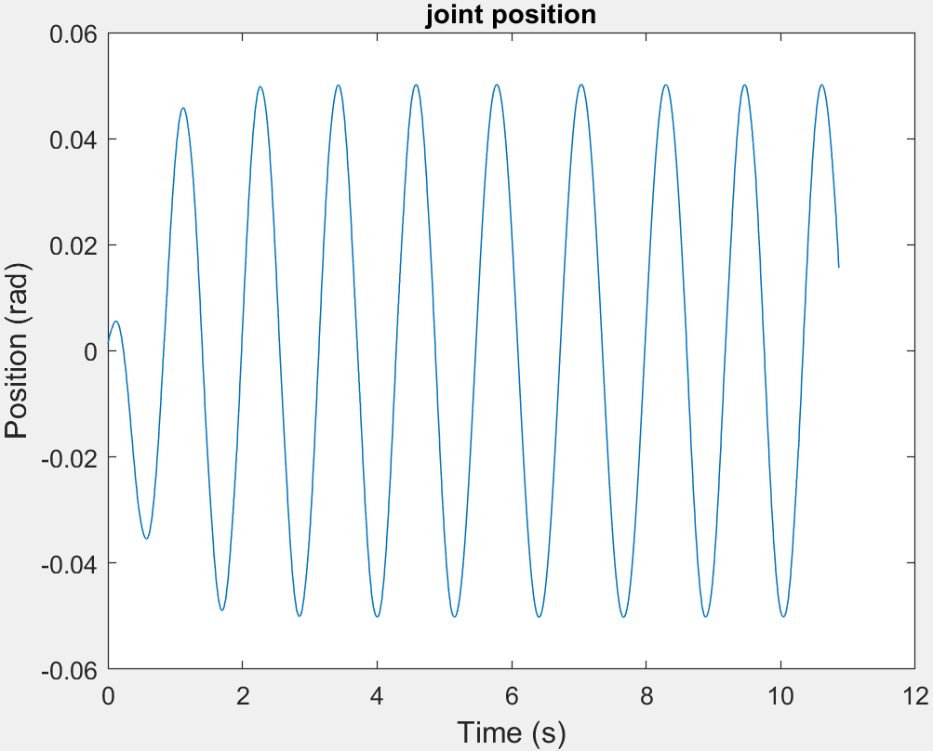
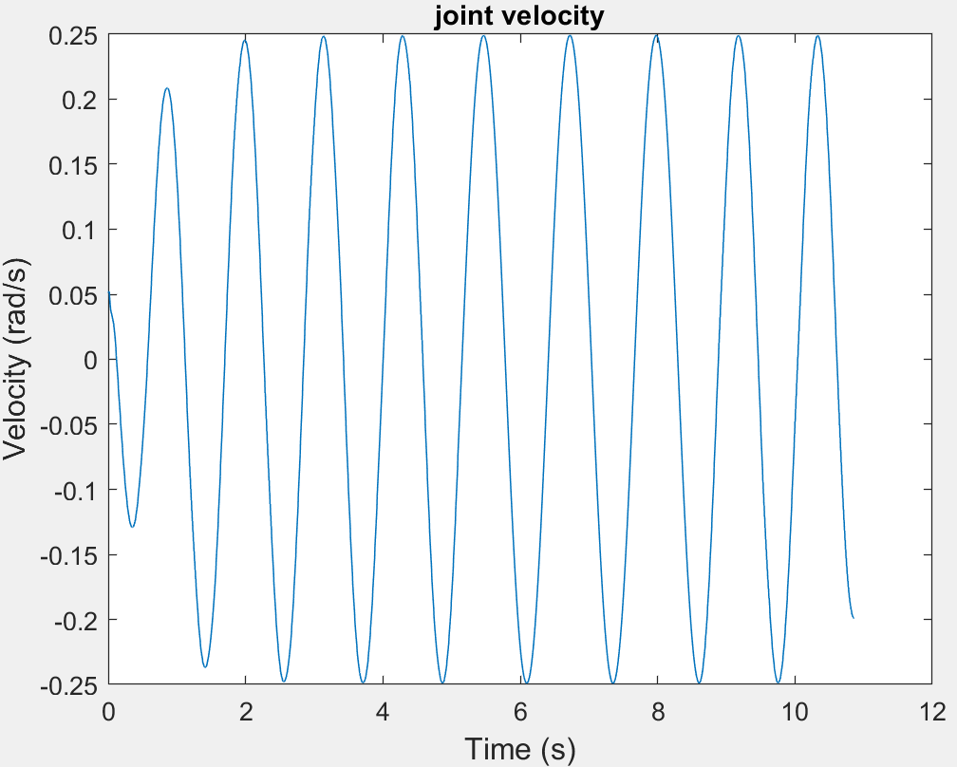
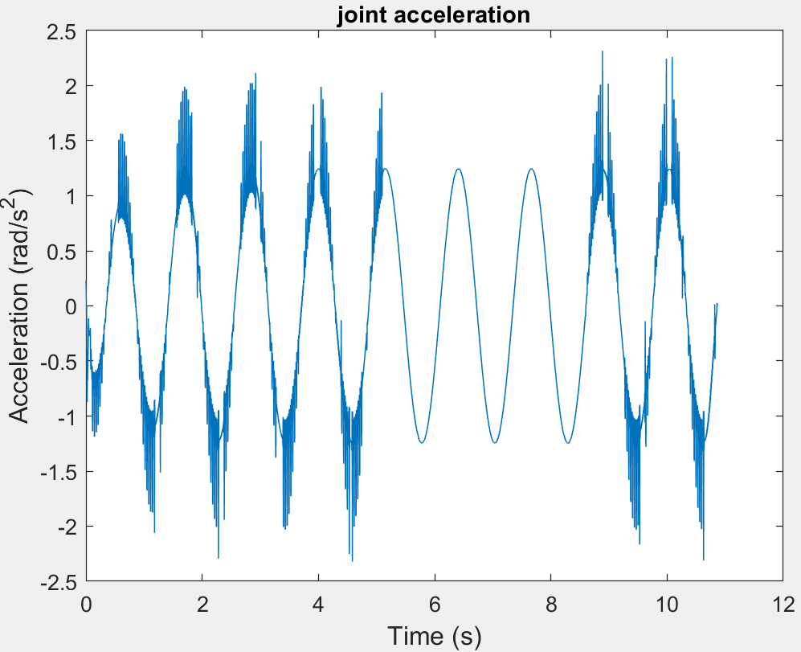
Joint Acceleration Filter

Slide 5
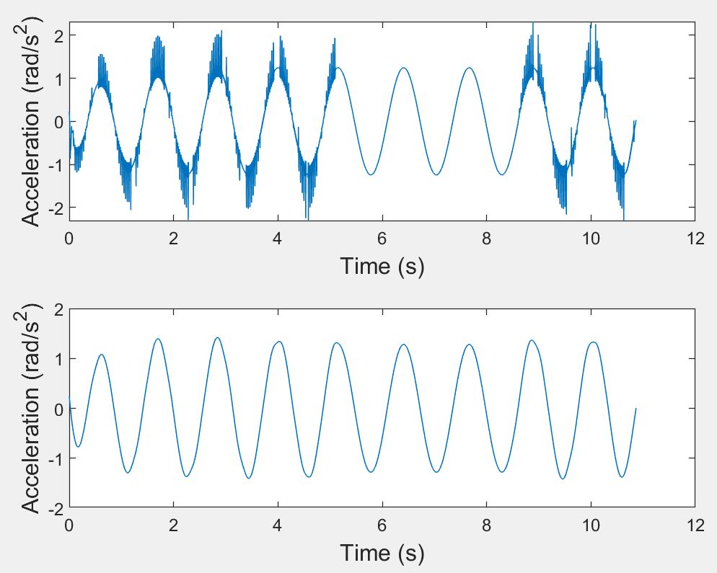
Joint Acceleration Filter
Method: low-pass filter + zero-phase filter
No phase lag

Slide 6
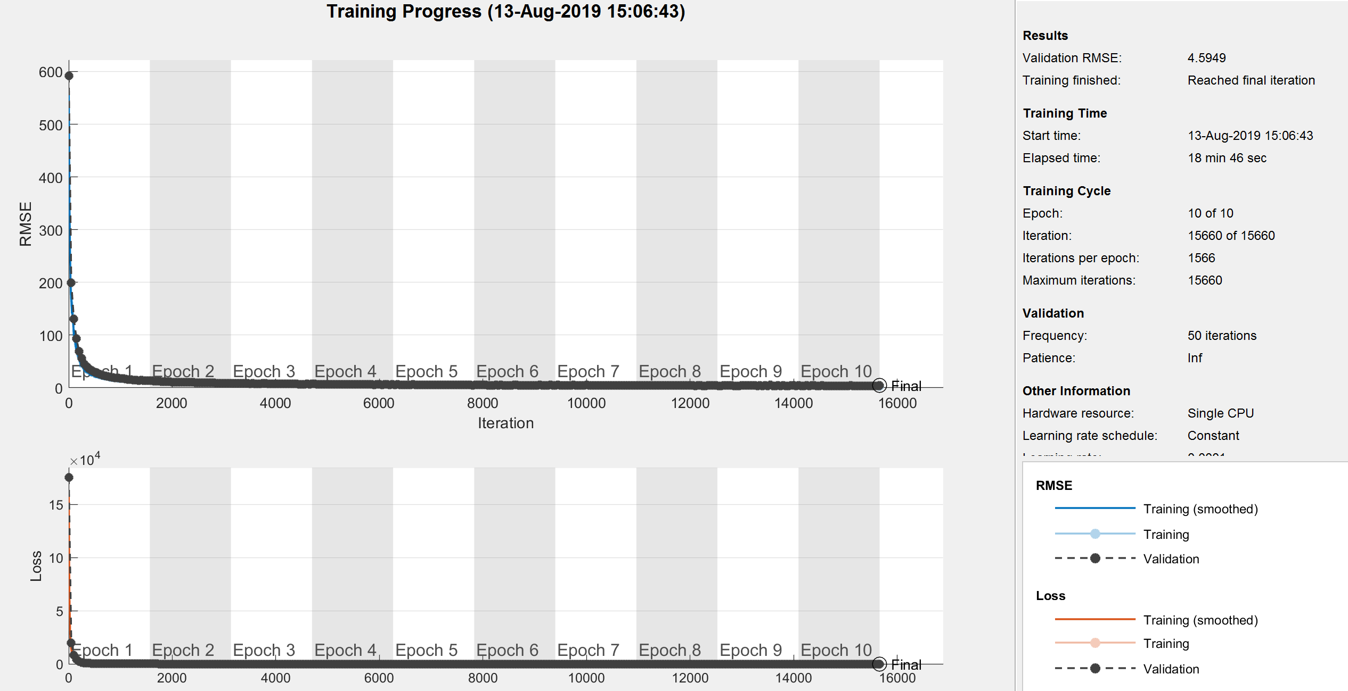
Network Training

Slide 7





Network Testing - I
Given a testing trajectory containing
Compare the predicted produced by the MNN and the ground truth acceleration

Slide 8
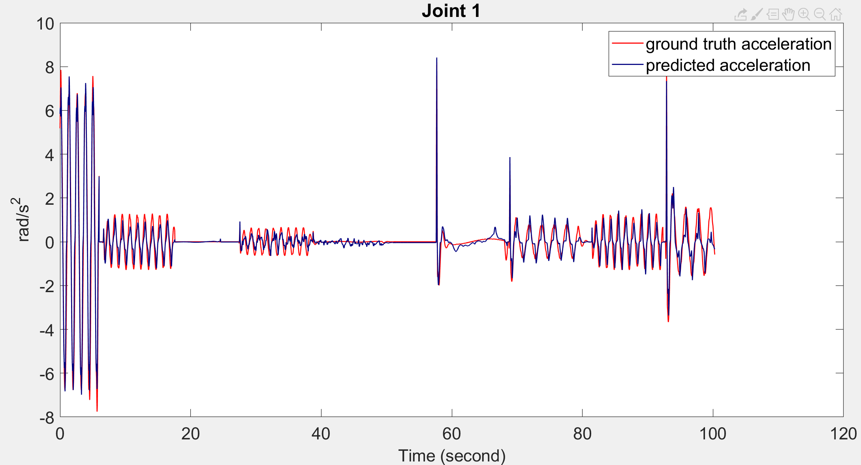
Network Testing - I

Slide 9
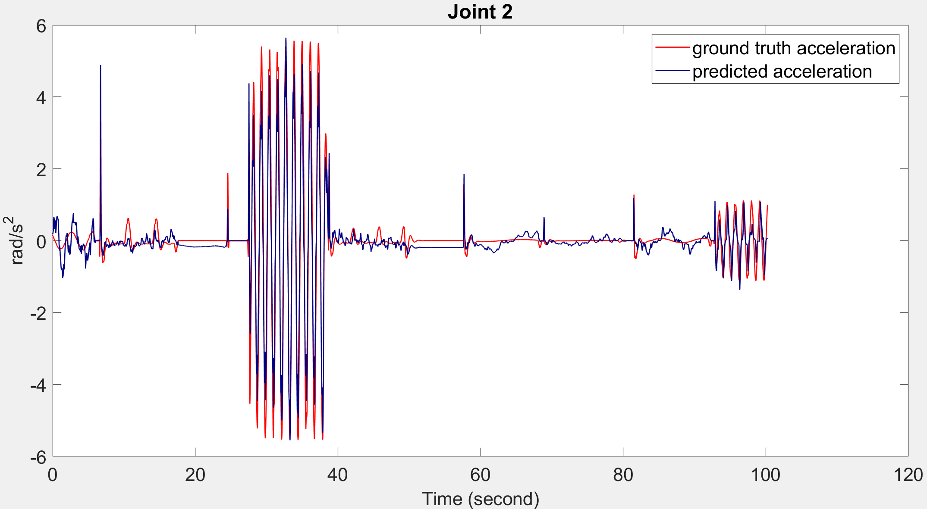
Network Testing - I

Slide 10


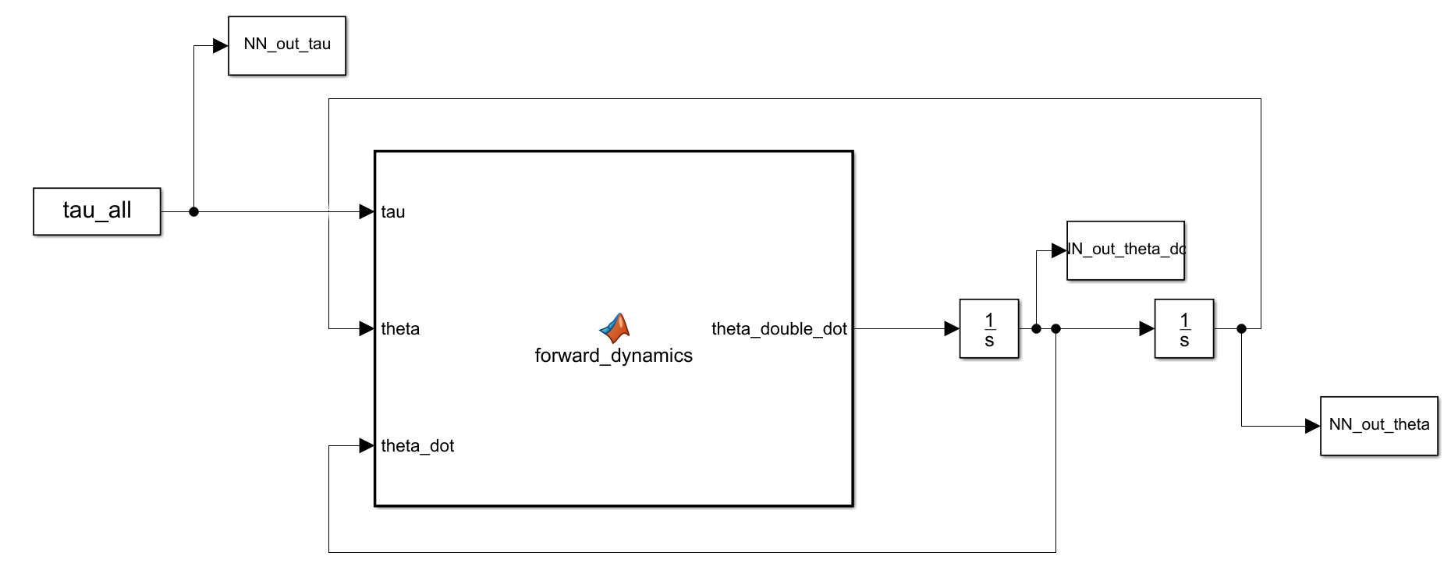
Network Testing - II
Given a testing trajectory containing
In Simulink, integrate the predicted acceleration produced by the MNN to get , which will be fed into the MNN as part of the input. The sample time of the step-sized solver is 0.004 s.

Slide 11
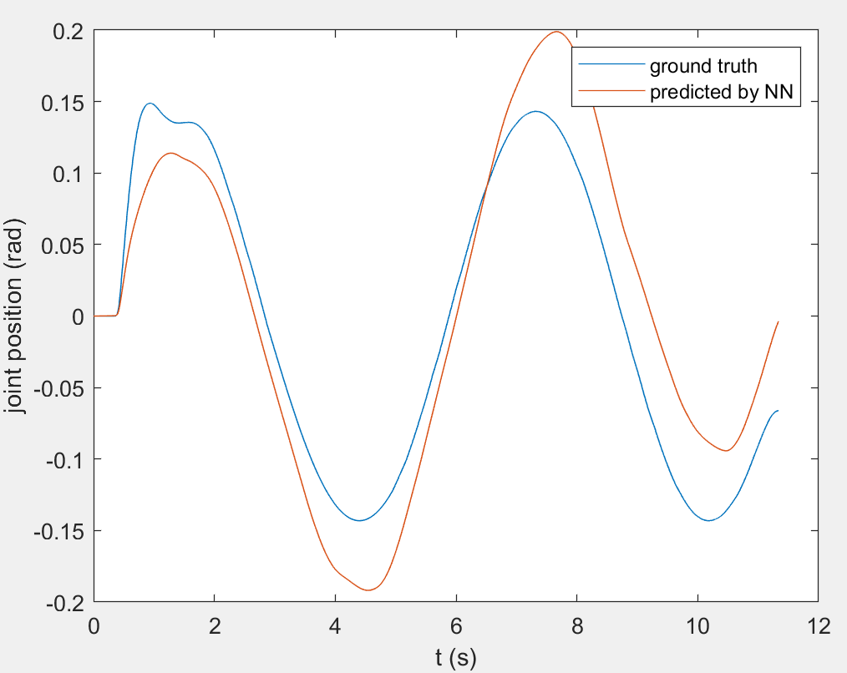
Network Testing - II

Slide 12
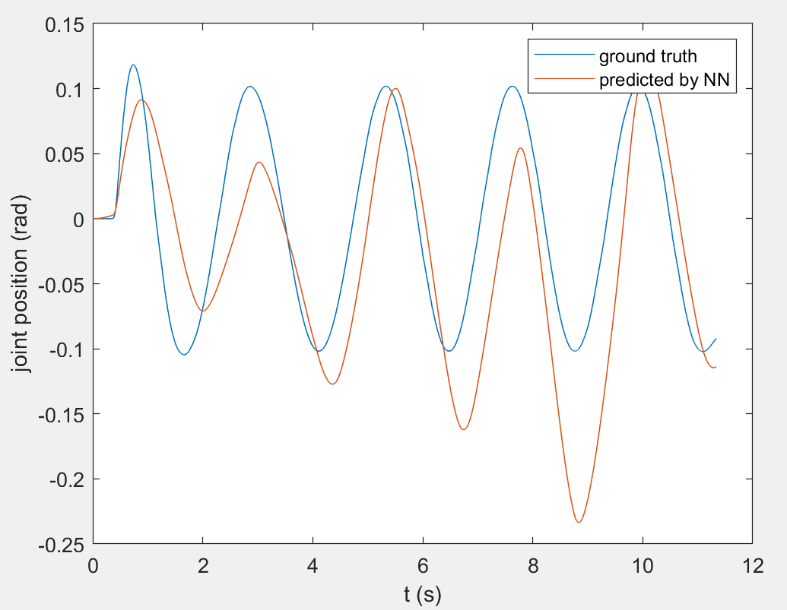
Network Testing - II

Slide 13
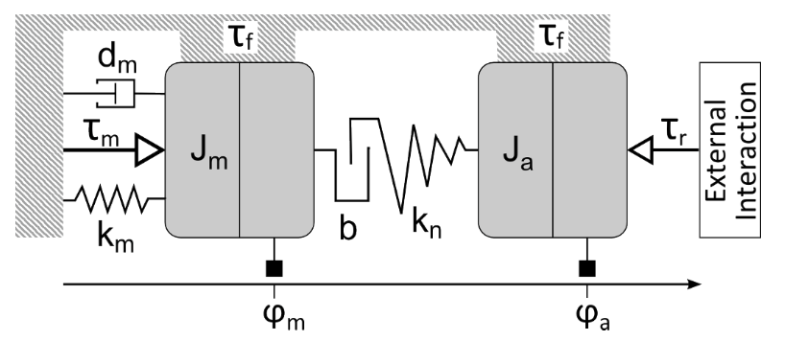
Robot Compliance Characterization Paper
“Robot Joint Modeling and Parameter Identification Using the Clamping Method” by Klas Nilsson
Develop a model of the robot joint characteristics in a machining scenario (e.g., milling)
Neglect the dynamic influence of robot inertia on the positioning and path accuracy considering the relatively low velocity of milling
Model robot joint as coupling of
Backlash angle
Static and dynamic friction (viscous plus Stribeck effect)
joint stiffness (torque-position map)

Slide 14
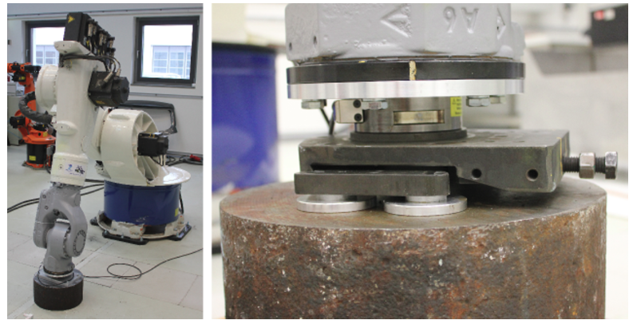
Clamping Method
Measurement of the backlash and the joint stiffness are based on rigidly clamping the robot to the environment, whereas the friction is measured by motion in free space

Slide 15
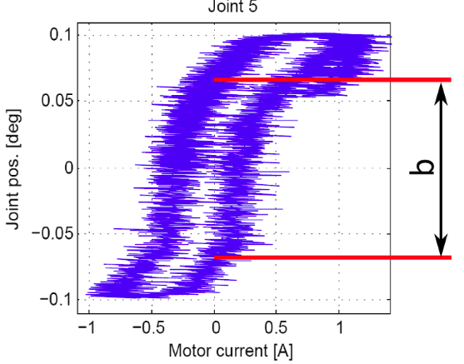
Joint Backlash
Joint backlash:
commanding each joint motion back and forth
log joint position and current/torque

Slide 16

Joint Stiffness
Joint stiffness:
log joint position and joint torque
third order polynomial to fit the nonlinear joint stiffness

Slide 17

Joint Friction
Joint friction:
Stribeck and viscous friction model
No clamping, robot moves freely
Log motor velocity and required torque

