Slide 1

Simscape Tutorial
David S. Carabis
Rensselaer Polytechnic Institute

Slide 2
Overview
Manipulator model (rigid joint):
Accounting for gearing/motor inertia:
What about friction?
Adjust motor torque
Mass-inertia
Gravitational
Motor torque
Centrifugal/Coriolis
External spatial forces
Add gear ratio squared times motor inertia to diagonal elements of mass-inertia matrix
or
Note: assumes motors are 1D rotational elements

Slide 3
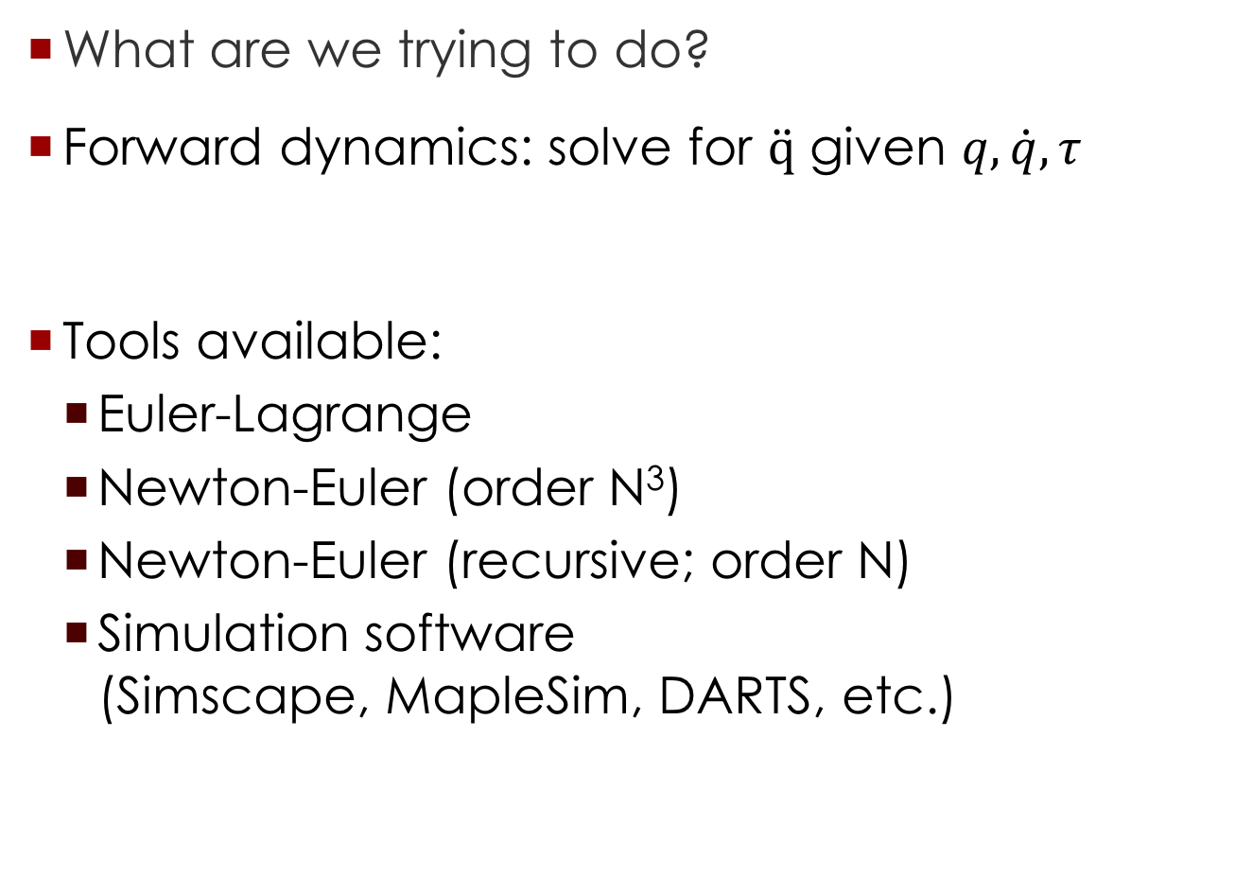
Overview
What are we trying to do?
Forward dynamics: solve for $\ddot{q}$ given $q, \dot{q},τ$
Tools available:
Euler-Lagrange
Newton-Euler (order N³)
Newton-Euler (recursive; order N)
Simulation software (Simscape, MapleSim, DARTS, etc.)

Slide 4
Method Comparison
Implementation time (my subjective opinion)
Euler-Lagrange: time consuming; requires in-depth dynamics knowledge; symbolic matrices can be difficult to work with
Newton-Euler: time consuming; requires in-depth dynamics knowledge
Simulation packages: learning curve varies (Simscape is easy to learn; DARTS is difficult to learn); implementation is fast

Slide 5
Method Comparison
Symbolic matrices available
Euler-Lagrange: yes
Newton-Euler: yes
Simscape: no
Note: for larger DOF, symbolic terms often unintelligible
Example: can’t display centrifugal/Coriolis terms for 7 DOF robot without crashing Matlab

Slide 6

Method Comparison
Run-time speed (Matlab/Simulink/Simscape)
Euler-Lagrange: 30-60 seconds in Matlab to do symbolic substitution for a single state (rigid-joint arm); then, still have to invert $M(q)$
Newton-Euler (order N): 65 s for 10 s simulation (flexible-joint robot; may be some Simulink overhead)
Simscape: 28 s for 10 s simulation (flexible-joint robot)

Slide 7
Method Comparison
Mathematical understanding (my subjective opinion)
Euler-Lagrange/Newton-Euler: Good – both can provide symbolic and numerical models
Simscape: No intuitive understanding

Slide 8
Method Comparison
Visualization
Euler-Lagrange/Newton-Euler: Need additional code
Simscape: Included in software

Slide 9
Method Comparison - Summary
Method | Euler-Lagrange | Newton-Euler | Simscape
Implementation Time | Requires good understanding of dynamics | Requires good understanding of dynamics | Learning curve; easy to implement after software is understood
Symbolic Matrices | Yes | Yes | No
Sim Time | Extremely slow | Fast | Fastest
Mathematical Understanding | Good | Good | Bad
Visualization | Need additional code | Need additional code | Included

Slide 10
Method Comparison
Why bother with different methods?
Confirm results (is code correct?)
Obtain mathematical understanding
Quick run-time
My recommendation:
Symbolic/numerical comparison of EL/NE (single states)
Simulation comparison of NE/Simscape
Use Simscape for simulations and NE for mathematical understanding of model

Slide 11
Building Model in Simscape
Consider robot:
Given: Kinematics
Link masses
Link COM
Link inertia Friction models

Slide 12
Building Model in Simscape
Local frame for 2nd link in Simscape z axis aligned with rotation

Slide 13
Building Model in Simscape
Tips:
Keep frames that data is represented in in mind – may not be what is needed in Simscape model
Keep rotation frames in mind – Simscape does NOT follow PoE convention
Consistent ODE solver/step sizes for comparison (try fixed step first)
Correct boundary conditions in NE

Slide 14
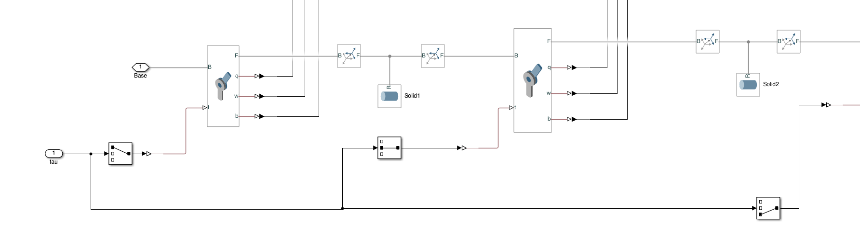
Building Model in Simscape
Base (must connect to world frame)
Motor torque vector note must be converted to Simscape signal
Transform Center of Link to next joint
Second link (keep repeating for higher DOF robot)
Joint data – note that this must be converted to Simulink signal to save data
Transform from joint coordinate frame to Center of Link (e.g., center of cylinder if using cylinder shapes)

Slide 15
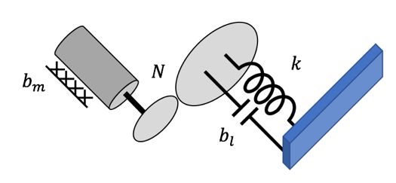
Flexible Joint Model
Assumptions
1D rotational inertia for motor
No gyroscopic effect (motors are in inertial frame)
Model [Spong 1987]
Where to add gearing? Depends on experimental setup

Slide 16
Flexible Joint Model
What about gyroscopic effects?
Usually small
For space manipulators with small floating bases, can be significant [Murphy 1993]
Dynamic model
Do NOT add motor inertias/gear ratios

Slide 17
Flexible Joint Model
What gear ratio convention is being used?
Speed reducer/torque multiplier (N>1)
Note that direction switches with every gear We assume motor direction such that positive motion of motor/link is consistent

Slide 18
Flexible Joint Model
How to implement in NE algorithm?
Use same algorithm (without motor inertia/gearing terms in mass-inertia matrix)
Set
Solve motor dynamic based on current state ; can use Simulink blocks

Slide 19
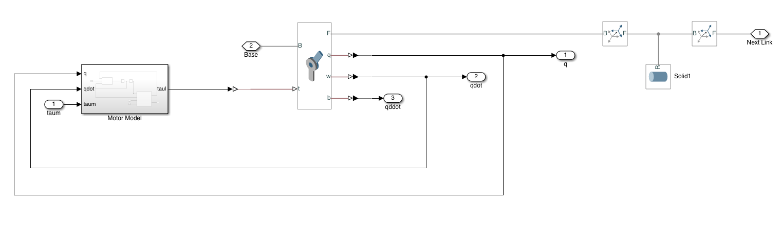
Building Flex Joint Model Simscape
Joint – do not use internal spring/ damper as they do not include gear ratio
Motor model see next slide
Transforms from joint coordinate frame to link center, link mass, and transform from link center to next joint coordinate frame (same as rigid joint example)
Motor torque
Joint data out

Slide 20
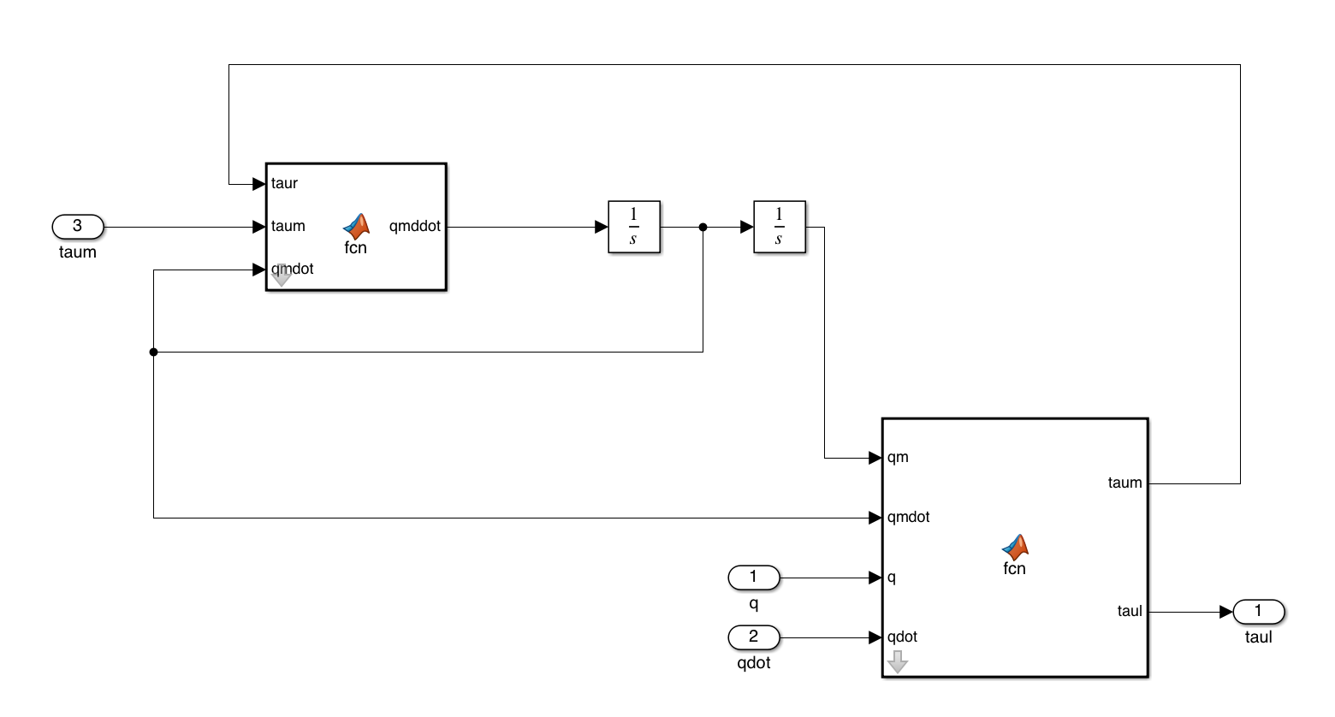
Building Flex Joint Model Simscape
Motor model
Reaction torque from flexible joint
Motor dynamics
Flexible joint model

Slide 21
Building Flex Joint Model Simscape
Motor dynamics
Flexible joint model
Motor position
Flexible joint spring coefficient
Motor inertia
Gear ratio
Motor torque
Link-side position
Reaction torque
Viscous damping
Coupled viscous damping

Slide 22
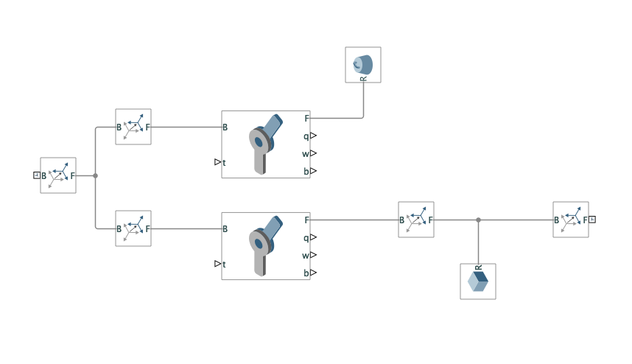
Flexible Joint Model w/ Gyro
How to include gyroscopic effect?
Use 1D rotational inertia for motor
Will generate different results than NE algorithm presented earlier in the presentation
Motor reaction torque
Reaction torque

Slide 23
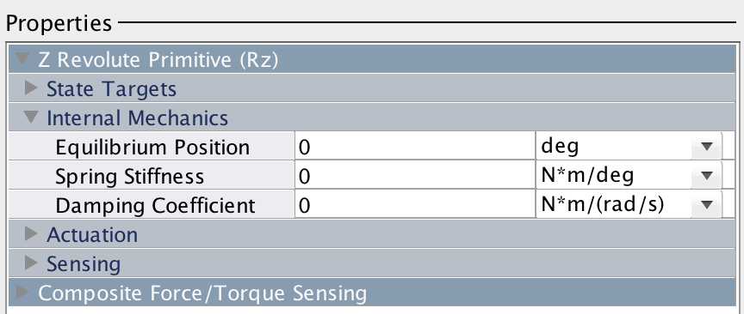
Flexible Joint Model
Simscape
What about built-in spring damper? Would get incorrect spring terms using this method

