Slide 1

RPIBuddy
Chris Brown
Rob Margolies
Pete Lanciani
Eric Cunningham

Slide 2
Goal
Creation of an AOL AIM bot that consolidates and provides information about on campus activities, locations, and events

Slide 3
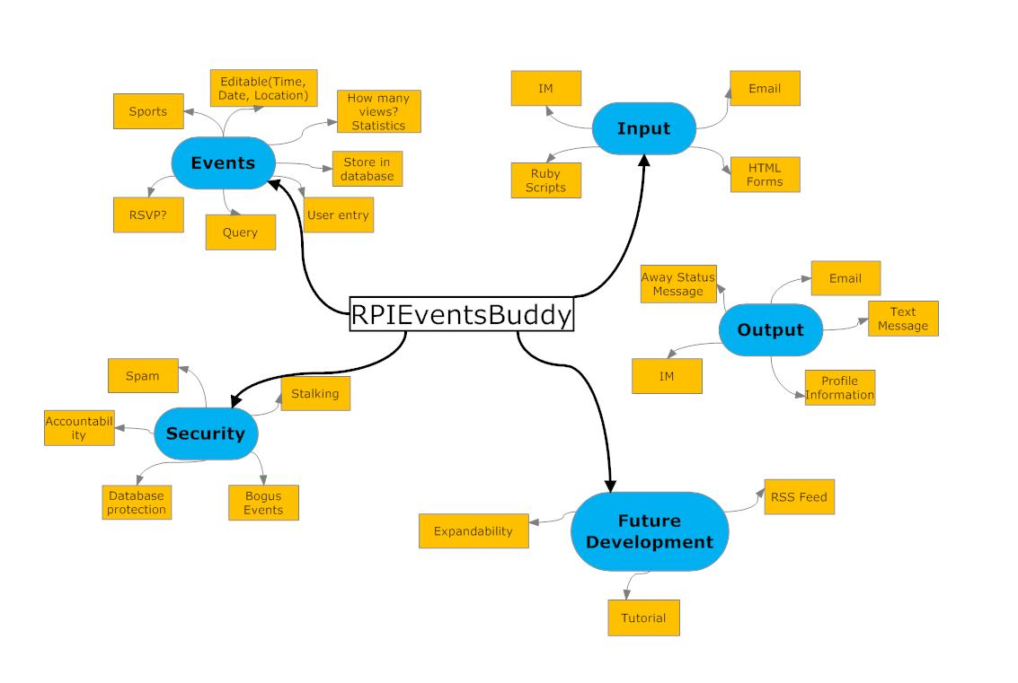
Our plan

Slide 4
Implementation
Ruby w/ rubygems
Net/toc gem
PostgreSQL database
Weighted Search
RSS parsing
Database maintenance
All code available via github at: http://github.com/rpievents/rpieventsbuddy

Slide 5
So what does that mean?
Demo…

Slide 6
Future work
Collaboration with other event cataloging groups
Other forms of access
Twitter
Google Calendar (iCalendar)
Facebook interface
Event Collision
More data sources
Fall release

Slide 7
What we’ve learned
Ruby
Git
postgreSQL
Software Development

Slide 8
Questions?
A big thank you to Sean O’Sullivan for his generous gift, Professor Moorthy for running RCOS, and Eric Allen for leading us to and through ruby and git

