Slide 1
HOME AUTOMATION
Class:- EC5B
Presented by,
Shine Ali
Rohit Sreekumar
Deepak J Puthukkaden
Govindh B
Giridhar A K

Slide 2
IDEA
¬ The proposed idea for our Mini Project for the academic year 2014-15 is home automation based on the Raspberry Pi.
¬ We intend to implement the following features in our project
* Adaptive Internal Lighting
* Temperature Controlled Air Conditioning
* Automatic External Lighting
* Automatic Water Supply system
* Keypad Enabled Door Lock system
* Interactive Music Player
* Data Logging and analysis

Slide 3
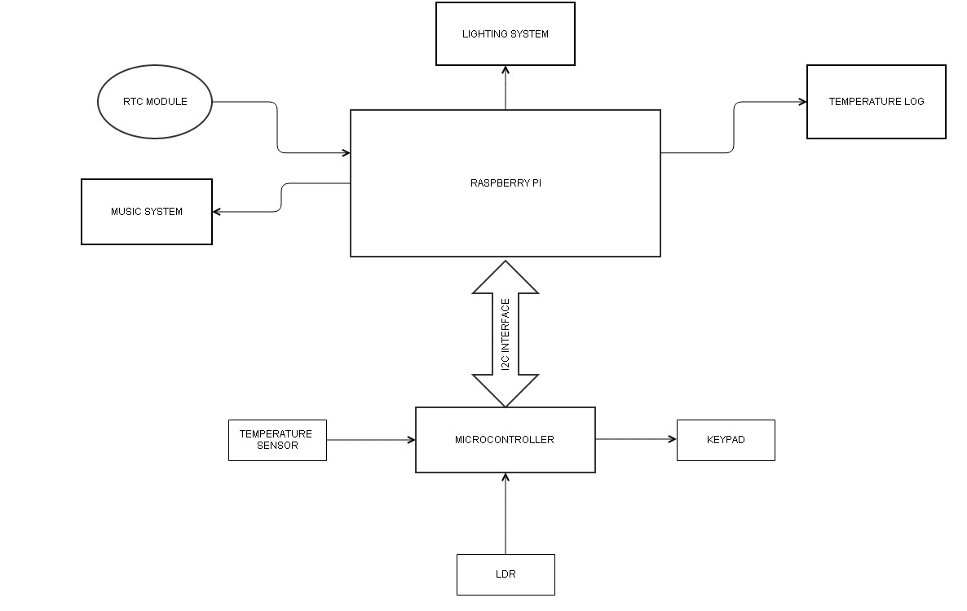
BLOCK DIAGRAM

Slide 4
HARDWARE
Raspberry Pi
DS1307-RTC
LM35-Temp sensor
ATMEGA328P-microcontroller
LDR
LCD

Slide 5
AMOUNT
Serial Number | Material | Approx. cost
1. | Raspberry Pi | 2800
2. | Atmega 328P | Sampled
3. | LM35 | Sampled
4. | LDR | 5
5. | DS1307 | Sampled
6. | LCD | Salvaged from old components
7. | Miscellaneous | 500

