Slide 1







Design rules application in manufacturing industries:
Knowledge Graph of Design Rules for a Context-Aware Cognitive Design Assistant
$$\text{Armand} \text{HUET}$$
Arts et Métiers Institute
of Technology
LCPI, HESAM Université
Paris, France
$$\text{Romain} \text{PINQUIE}$$
Grenoble INP
G-SCOPE UMR CNRS 5272
Grenoble, France
$$\text{Philippe} \text{VERON}$$
Arts et Métiers Institute
of Technology
LISPEN, HESAM Université
Aix-en-Provence, France
$$\text{Fr}\text{é}\text{d}\text{é}\text{ric} \text{SEGONDS}$$
Arts et Métiers Institute
of Technology
LCPI, HESAM Université
Paris, France
$$\text{Victor} \text{FAU}$$
Capgemini DEMS
Toulouse, France
armand.huet@ensam.eu
romain.pinquie@grenoble-inp.fr
philippe.veron@ensam.eu
frederic.segonds@ensam.eu
victor.fau@capgemini.com
Notes:
Hello everyone and welcome to this presentation for JCM 2020
I am armand huet, PHD student at Arts et Metiers school and this work is the collaboration of myself, Romain PINQUIE from Grenoble INP, Philippe Veron and FrédéricSEGONDs from Arts et Metiers as well as Victor FAU from the company Capgemnin DEMS.

Slide 2






INTRODUCTION
It is impossible to be aware of every constraints
Flawed design
Norms and legal constraints
Best practices of the company
Designer
CAD design
Product life cycle planning
Mechanical constraints and dimensioning
ElMaraghy, W. et al.: Complexity in engineering design and manufacturing. (2012).
2

Slide 3



INTRODUCTION
Flawless design
Norms and legal constraints
Best practices of the company
Design rules
CAD design
Product life cycle planning
Mechanical constraints and dimensioning
Designer
3

Slide 4
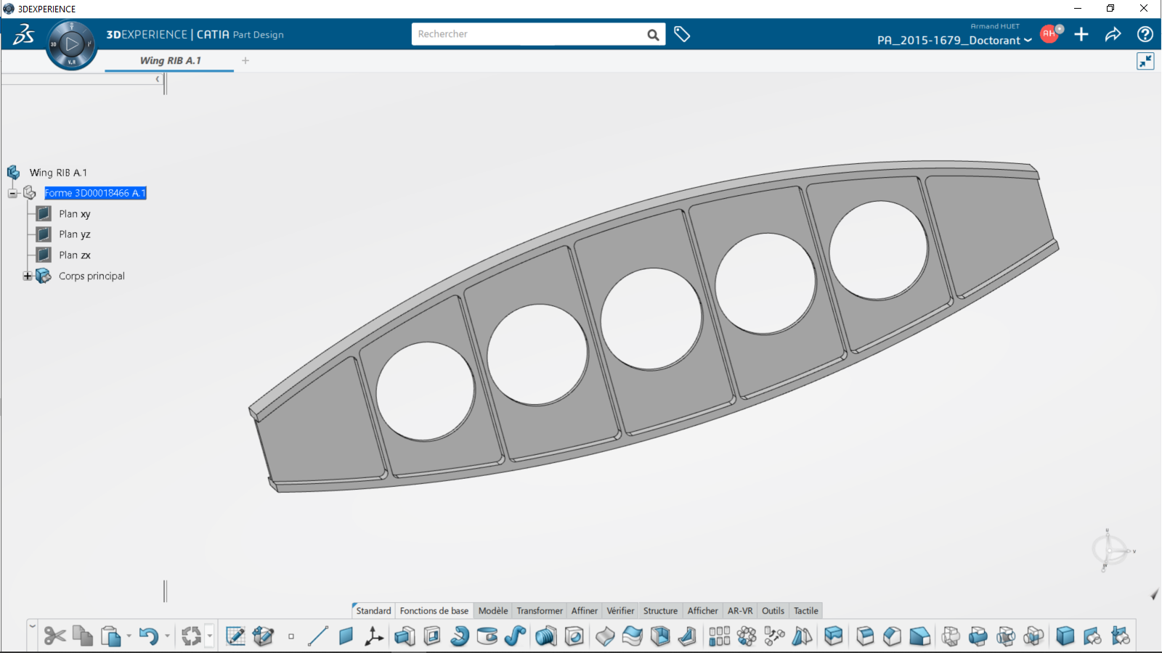
INTRODUCTION
Wing design principles
Generic design principles
212 Pages
239 Pages
Metallic design principles
Fuselage design principles
Designer
CAD design
83 Pages
853 Pages
Design rules Big Data
Design manuals:
Reference Structure Design Principles for A350
4

Slide 5
Problematic
How to simplify design rules management and application while maintaining design quality?
Context-aware for design rules application
  Design rules
  Context-awareness
  A Proactive approach
Context-Aware Cognitive Design Assistant
  Service functions
  Knowledge graph
5

Slide 6
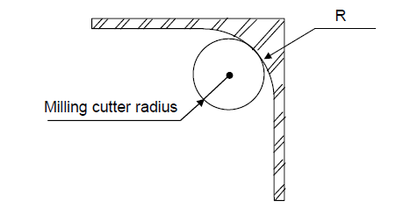
Design rules
Design rule definition (1):
It
It is stated in the grammatical imperative form
It includes a prescriptive action for a designer to take
It increases the likelihood of reaching a desirable consequence
It is situated within a particular context and point in time
Design rule example (2):
Chapter title in natural language :
Standard Values of Wall Corner
Main statement in natural language :
It is necessary to have between wall corners a radius higher than the milling cutter radius
Drawing :
Equation :
(1): Fu et al.: Design Principles: Literature Review, Analysis, and Future Directions. (2016).
(2): Design manual: General Practices of Metallic Parts: Recommended Detailed Design Practices
for Compliance to Machining Constraints. (2009).
6

Slide 7


context-awareness
A system is context-aware if it uses context to provide relevant information and/or services to the user, where relevancy depends on the user’s task
User centric approach
A cognitive assistant for the user
Presenting the right information on the right form on the right time
Dey, A. K.: Understanding and using context. Personal and ubiquitous computing. (2001).
7

Slide 8



A Proactive approach
Designer
Flaws detection
Final CAD design
Flawed design
Designer
Designer
Final CAD design
Reasoning on
design context
Design rules
recommendation
Context-Aware Cognitive Design Assistant
8

Slide 9
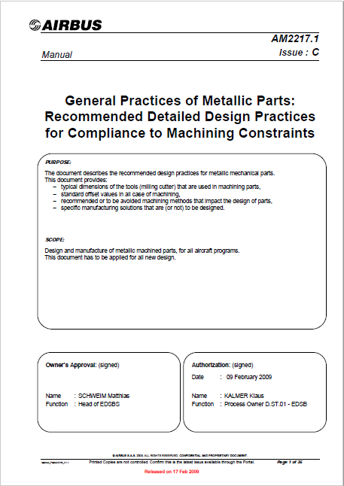
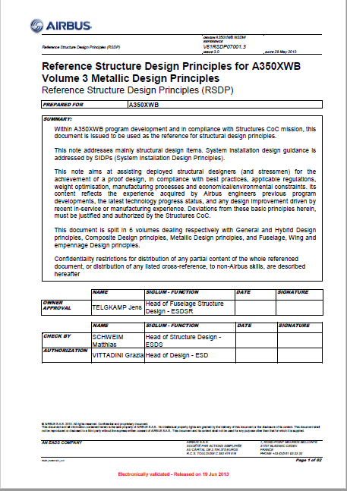
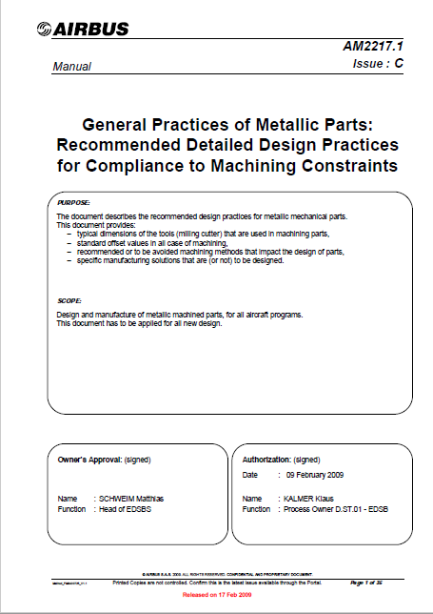
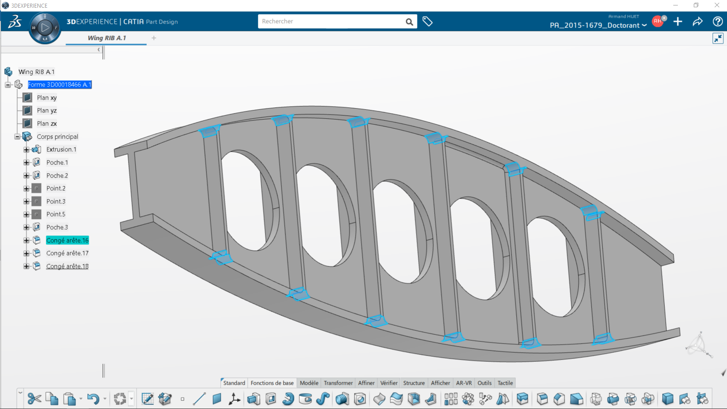


Service functions
List of design rules
FS4: Insuring rule recommendation relevance
R
Design rules application
FS1: Create engineering and semantic sub-context
FS3 : Exploit design rules in a CAD environnement
List of suggested rules
FS2: Suggest design rules adapted to the designer’s need
Knowledge graph

Slide 10





Knowledge graph modeling
Design context
Domain analysis of design
Service oriented modeling
Social
context
IT environment
Engineering context
Semantic context
Computable knowledge graph
Literature review of existing models (1 – 3)
: Dhuieb, M. A. et al.: Context-awareness: a key enabler for ubiquitous access to manufacturing knowledge. (2016).
: Ruthven, I.: Information retrieval in context. Advanced Topics in Information Retrieval. (2011).
: Moitra, A. et al.: Automated capture and execution of manufacturability rules using Inductive Logic Programming. (2016).

Slide 11
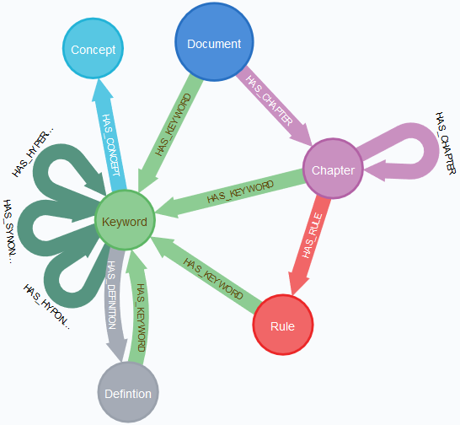
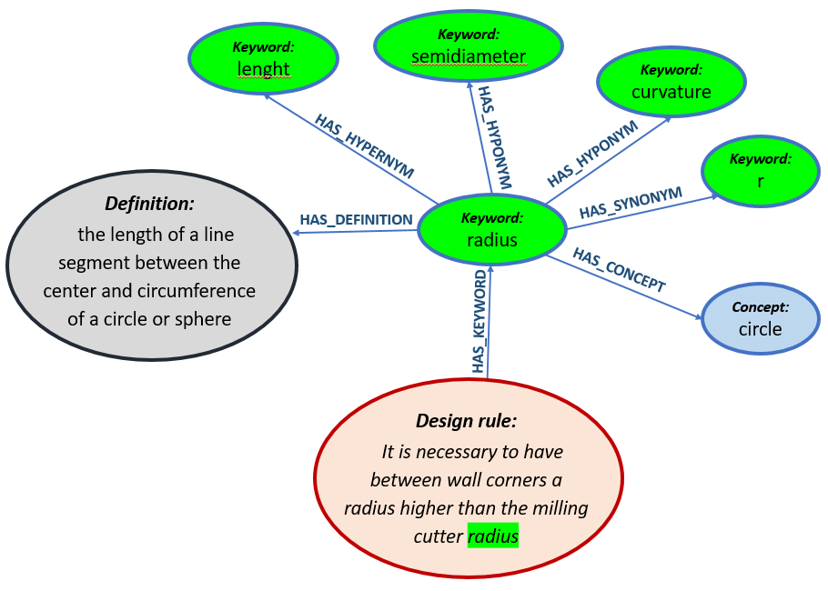
Knowledge graph: Semantic sub-context

Slide 12
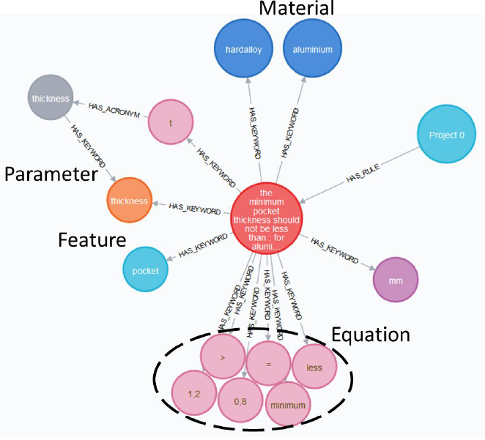
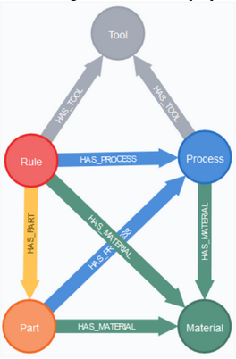
Knowledge graph: Engineering sub-context

Slide 13
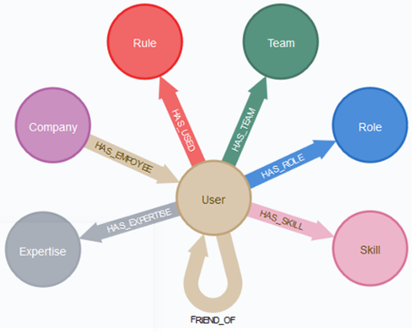
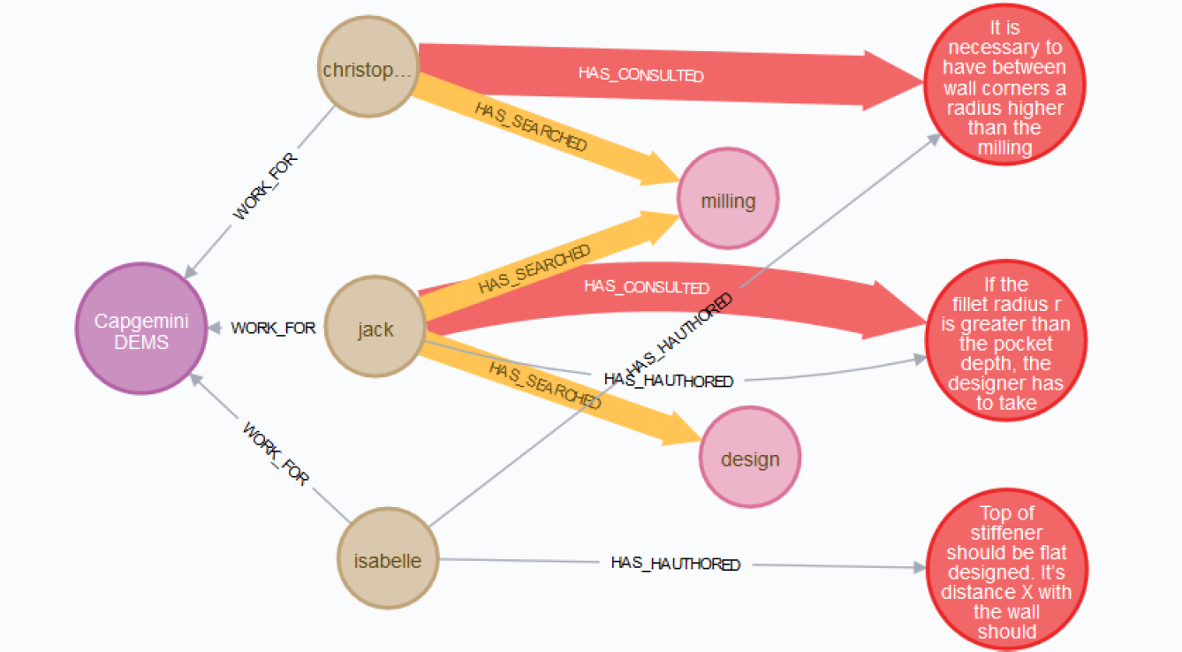
Knowledge graph: Social sub-context

Slide 14
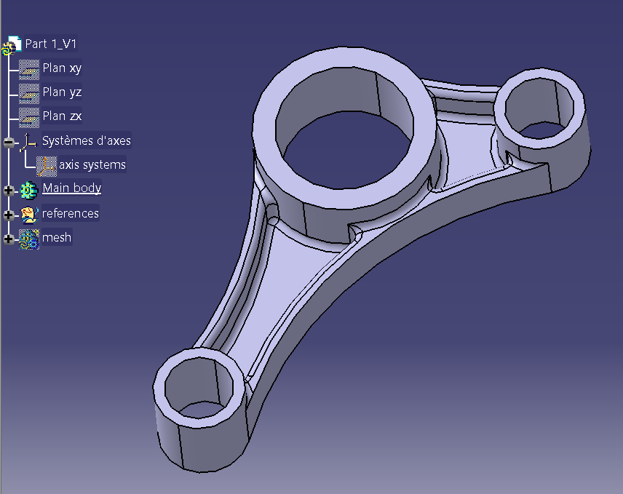
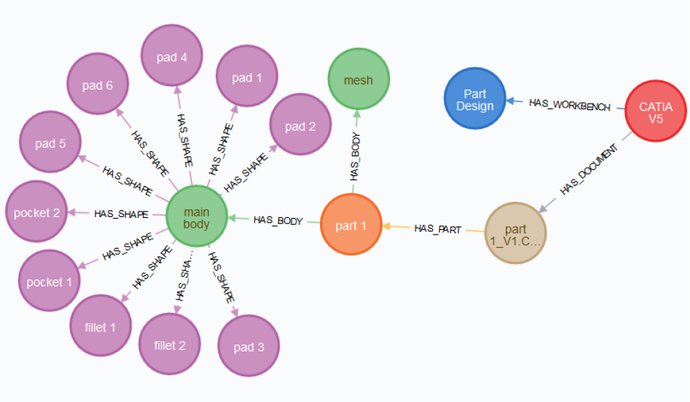
Knowledge graph: IT sub-context

Slide 15
Thank you
armand.huet@ensam.eu

