Slide 1



Property Model Methodology: a case study with Modelica
Romain PINQUIÉ, PhD Student, Arts & Métiers ParisTech, LSIS UMR CNRS 7296, France
Patrice MICOUIN, PhD, Arts & Métiers ParisTech, LSIS UMR CNRS 7296, France
Philippe VÉRON, Full Professor, Arts & Métiers ParisTech, LSIS UMR CNRS 7296, France
Frédéric SEGONDS, Assistant Professor, Arts & Métiers ParisTech, LCPI, France
Presented at: TMCE16, Tools and Methods of Competitive Engineering, 09-13 May 2016, Aix-en-Provence, France
11th May, 2016
Property Model Methodology: a case study with Modelica

Slide 2
Outline
Property Model Methodology
Modelica
PMM with Modelica
Related work
Future work

Slide 3
Outline
Property Model Methodology
Modelica
PMM with Modelica
Related work
Future work

Slide 4
1. PMM: A method that embraces systems engineering principles
Causal approach
Zigzagging (Suh, 02)
Specification domain
Design
domain
SM
DM
« What we want to achieve »
« How we want to achieve them »
SM
SM
DM
DM
SM
SM
SM
DM
DM
DM
SM
SM
DM
DM
Specification domain
Design domain

Slide 5
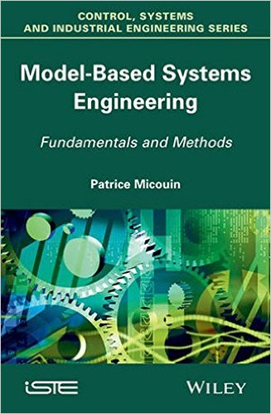

1. PMM: Follows INCOSE Model-Based Systems Engineering 2020 vision
"Model-Based Systems Engineering (MBSE) is the formalized application of modeling to support system requirements, design, analysis, verification, and validation activities beginning in the conceptual design phase and continuing throughout development and later life cycle phases.“
-- INCOSE Vision 2020
« Co-simulation » of specification model and design model
Design model
Static description
Dynamic description
Structural Design Model (SDM)
Reliability Design Model (RDM)
Equation Design Model (EDM)
Behavioural Design Model (BDM)
Typology
PMM design models
Further
details in…
BUILDING-BLOCK
Monitoring function
Compliance status wrt requirements
SPECIFICATION
Model
Execution function
DESIGN
Model
Outputs
  Micouin, P. (2014) Model-Based Systems Engineering: Fundamentals and Methods. Wiley-ISTE

Slide 6


1. PMM: Lessons learnt in industry
The number of requirements is significantly reduced (by 4 up to 10) because…
  PMM is a Goal-Oriented Requirements Engineering approach avoiding design decisions rephrasing
  Modifications of Text-Based Requirements can have an inflationary effect
The quality of requirements is highly improved because…
  PBRs are objective and uninterpretable
  Specification models are free of design biases
Various cost savings because…
  The system architecture results from a systematic top-down process avoiding interface errors
  Restricted interpretation of specifications avoids ill-informed decisions
  Requirements are validated by simulation before producing any physical (hardware and/or software) constituent
  The generation of unit, integration and installation test cases is automatic
  Poupart, E. et al. (2015) PMM: A First Application to an Operational Project in the Space Domain. CSD&M 2015.
  Micouin, P. et al. (2016) PMM Methodology: A First Assessment in the Avionics Domain. ERTS 2016.
Notes:
The number of requirements is significantly reduced (by 4 up to 10):
Often textual requirements (TBR) are indeed
are indeed just a rephrasing of design decisions and
therefore contain specification biases.
when project progresses:
« exponential » growth of TBR number,
« logarithmic » growth of PBR number.
The quality of requirements is highly improved:
PBR authoring is strongly guided.
PBRs are objective and uninterpretable:
all the stakeholders have the same understanding of a specification model,
no misinterpretation.
Even inexact, a PBR remains SMART.
PMM Specification models are free of biases:
no undue design constraint,
facilitate submergence of a new functionality in an inherited architecture.

Slide 7



1. PMM: A language- and tool-agnostic method
ALL YOU NEED IS…
  A Boolean assertion function to model requirements
  A simulation language to execute specification and design models
  Micouin, P., (2014) PMM: A Model-Based Systems Engineering Approach Using VHDL-AMS. Systems Engineering, 17(3).

Slide 8
Outline
Property Model Methodology
Modelica
PMM with Modelica
Related work
Future work

Slide 9
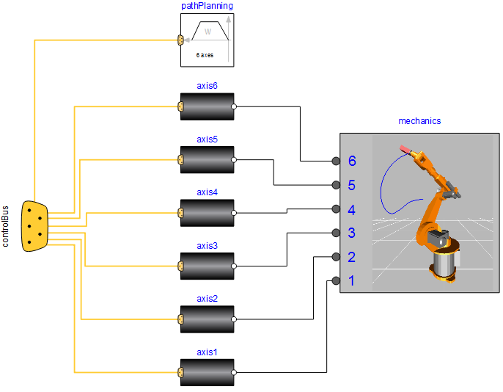
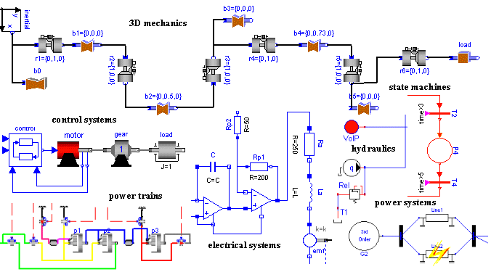
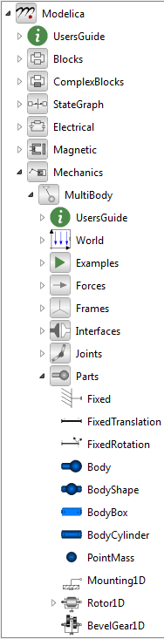
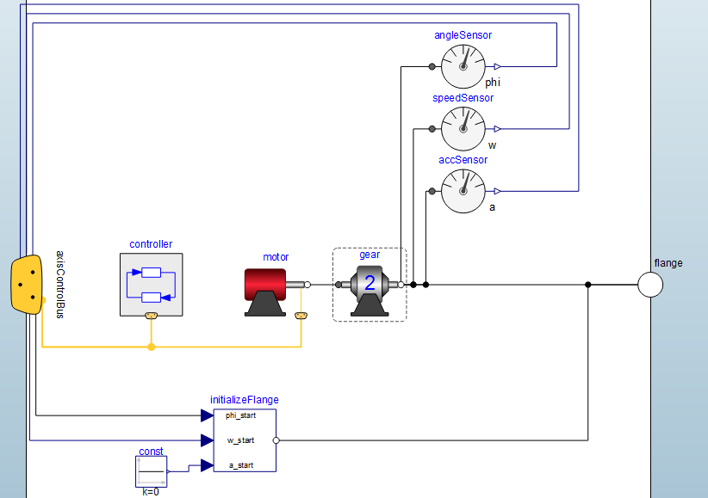
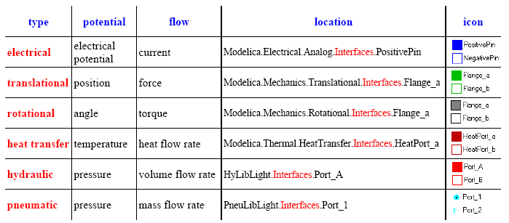
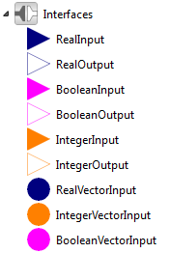
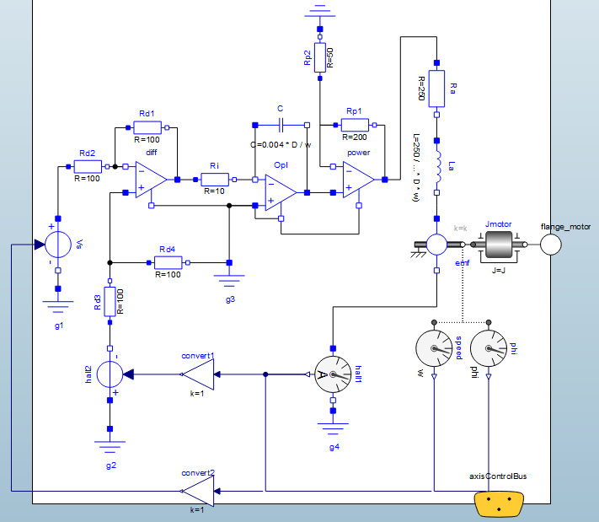
2. Modelica: A language in harmony with systems engineering principles
Recursive
break-down
Multi-Engineering
Reuse
COTS
Interfaces
Object-Oriented
Notes:
Except that the models stored in the libraries are not specified, there is no condition, assumptions

Slide 10
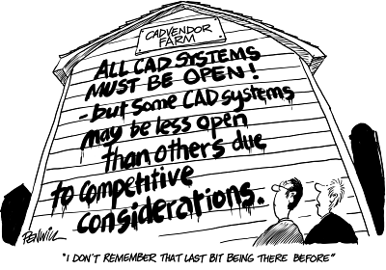





2. Modelica: Standardised interoperability and co-simulation with FMI
Multibody Dynamics
Control Systems
Computational Fluid Dynamics
Embedded Systems
Mechatronics
2016 - CAD Orwellism
FMI for
co-simulation
FMI for
co-simulation
FMI for
co-simulation
FMI FOR MODEL EXCHANGE

Slide 11
Outline
Property Model Methodology
Modelica
PMM with Modelica
Related work
Future work

Slide 12
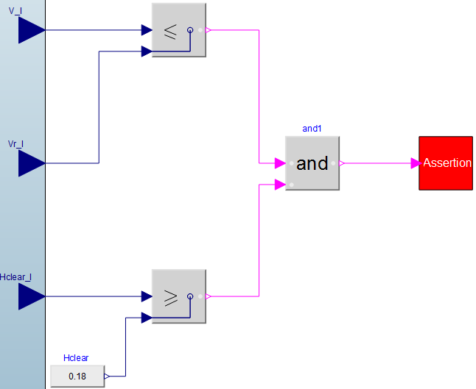
3. PMM with Modelica: SPECIFICATION - Property-Based Requirement
When C → val(O.P) ∈ D
When condition C is true, property P of object O is actual and its value shall belong to domain D
  Micouin, P. (2008) Toward a property based requirements theory: system requirements structured as a semilatice. Systems Engineering 11(3).

Slide 13
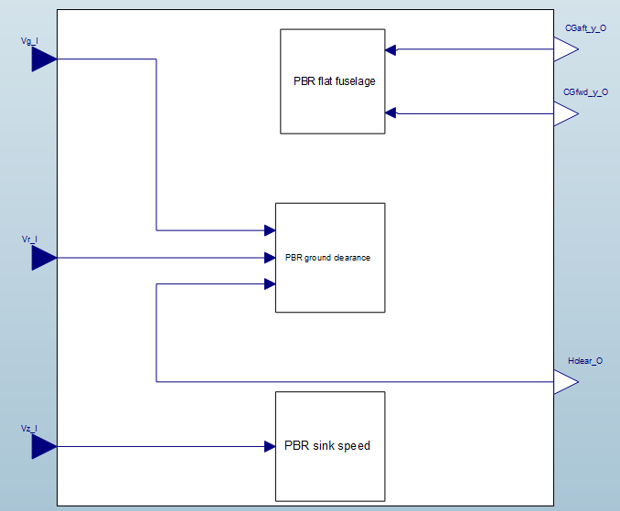
3. PMM with Modelica: SPECIFICATION - Specification Model
PBRs
Intended
effects
Inputs coming from the environment for an operational scenario

Slide 14
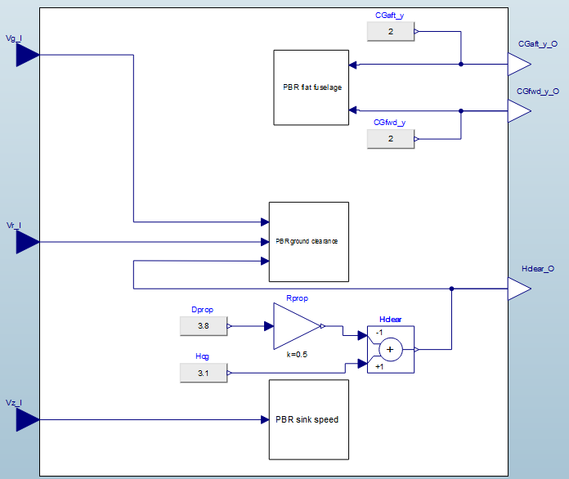
3. PMM with Modelica: DESIGN - Equation Design Model
Design models INHERIT Specification models
Inherited PBRs
Inherited
intended
effects
Extended Inputs coming from the environment for an operational scenario
Design parameters

Slide 15
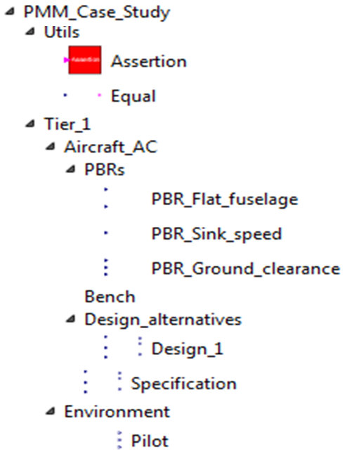
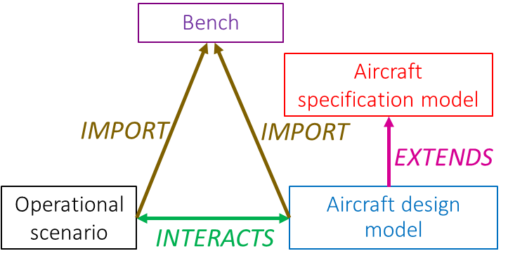
3. PMM with Modelica: Architecture - Tier 1

Slide 16
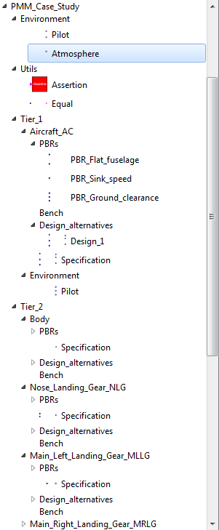
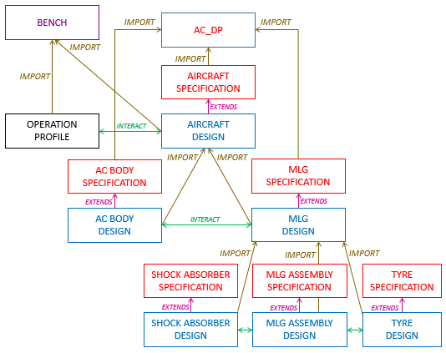
3. PMM with Modelica: Architecture - Tier 1, 2 and 3
Notes:
- Top down breaking-down systematic method

Slide 17
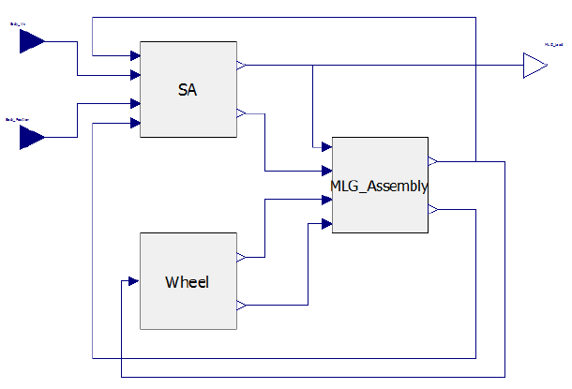
3. PMM with Modelica: DESIGN - Structural Design Model
Notes:
- Integration
- SDM = Architecture

Slide 18
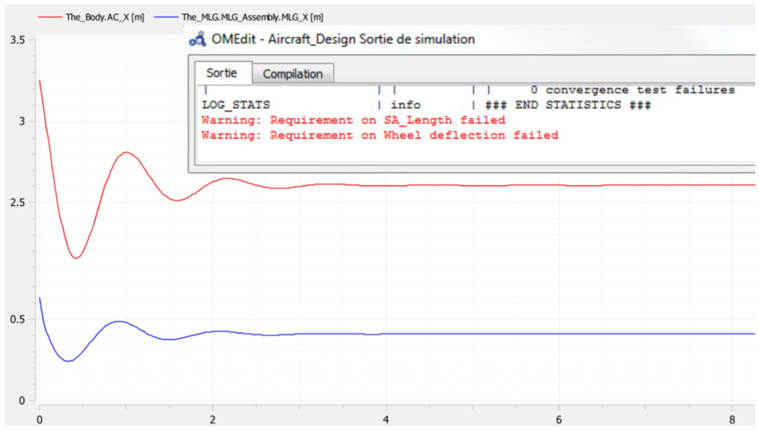
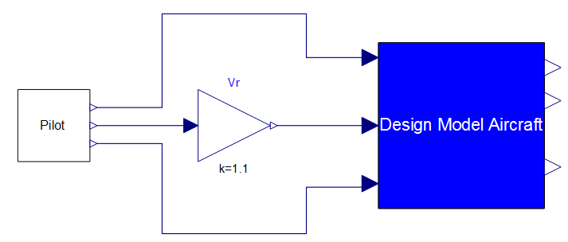
3. PMM with Modelica: VERIFICATION - Simulation Bench
Notes:
Integration up to the system level

Slide 19
Outline
Property Model Methodology
Modelica
PMM with Modelica
Related work
Future work

Slide 20

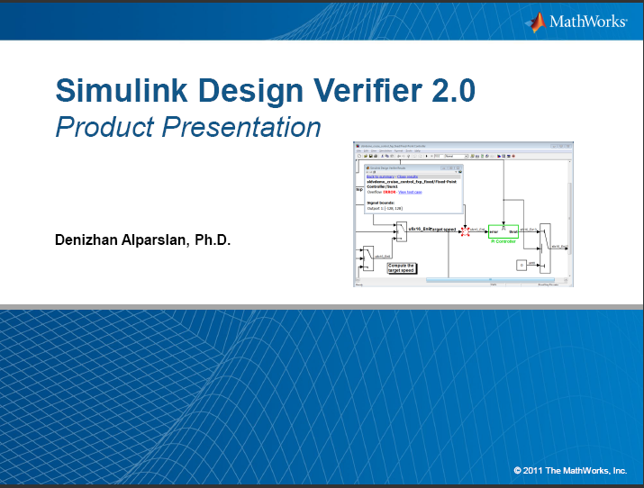

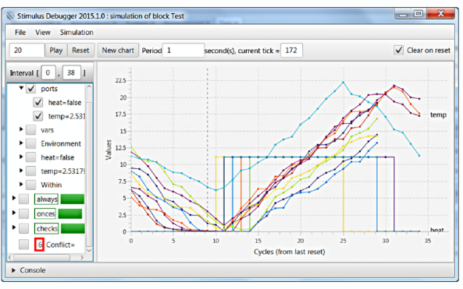
4. Related work
Although we all side with the formal approach, there are 2 major differences between PMM and the related work.
Above all else, PMM is a method: PMM is a MBSE method that complies with systems engineering standards, especially EIA 632 and ARP4754A.
PMM is language- and tool-agnostic: PMM doesn’t require language invention or extension, it adheres to the principles of simplicity and parsimony avoiding the introduction of supplementary complicated features for end users – e.g three valued logic.
Notes:
Bonini's Paradox:
The difficulty in constructing models or simulations that fully capture the workings of complex systems.
John M. Dutton and William H. Starbuck[2]"As a model of a complex system becomes more complete, it becomes less understandable. Alternatively, as a model grows more realistic, it also becomes just as difficult to understand as the real-world processes it represents" (Computer Simulation of Human Behaviour, 1971).
Simpler maps are less accurate though more useful representations of the territory; however, imagine a map of a scale of 1:1 (the same size as the territory), which is precise but unusable.

Slide 21
Outline
Property Model Methodology
Modelica
PMM with Modelica
Related work
Future work

Slide 22
5. Future work
  We MUST…
    Model other types of engineered systems such as discrete and hybrid systems.
    Support additional systems engineering activities such as safety-reliability.
    Address co-simulation issues to integrate simulation assets coming from various sources.
  We SHOULD…
    Continue our case study by modelling finer-grained capabilities and operational scenarios.
  We MAY…
    Evaluate on demand other simulation languages and environment such as AMESIM.

Slide 23
Property Model Methodology: a case study with Modelica
Romain PINQUIÉ, PhD Student, Arts & Métiers ParisTech, LSIS UMR CNRS 7296, France
Patrice MICOUIN, PhD, Arts & Métiers ParisTech, LSIS UMR CNRS 7296, France
Philippe VÉRON, Full Professor, Arts & Métiers ParisTech, LSIS UMR CNRS 7296, France
Frédéric SEGONDS, Assistant Professor, Arts & Métiers ParisTech, LCPI, France
Presented at: TMCE16, Tools and Methods of Competitive Engineering, 09-13 May 2016, Aix-en-Provence, France
11th May, 2016
Property Model Methodology: a case study with Modelica

Slide 24
BACK-UP SLIDES

Slide 25
1. PMM: A 4-activity process that embraces systems engineering principles

Slide 26

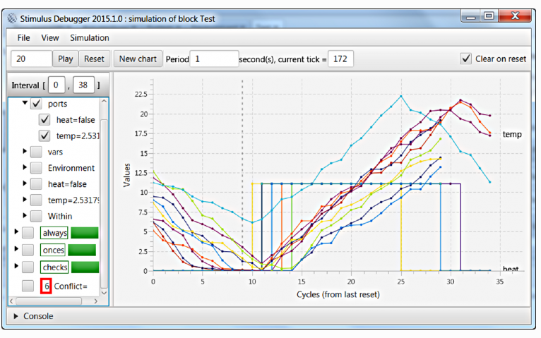
4. Related work: Stimulus is a software, not a method!
Stimulus is a tool, not a method!
What about design?

Slide 27

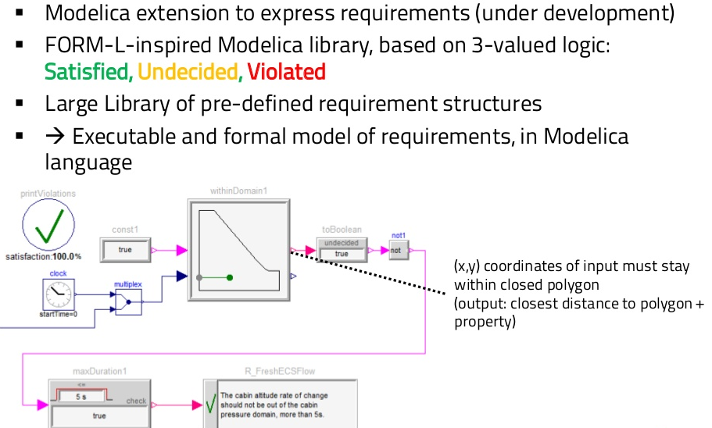
4. Related work: Why do it the easy way when you can do it the hard way?

