Slide 1






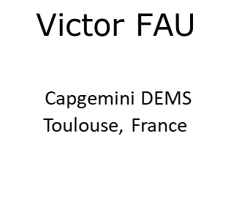


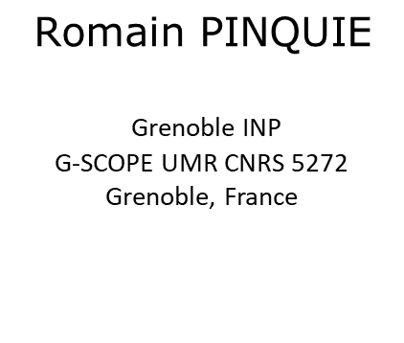
Design rules application in manufacturing industries: a state of the art survey and proposal of a context-aware approach
$$\text{Armand} \text{HUET}$$
Arts et Métiers Institute
of Technology
LCPI, HESAM Université
Paris, France
$$\text{Romain} \text{PINQUIE}$$
Grenoble INP
G-SCOPE UMR CNRS 5272
Grenoble, France
$$\text{Philippe} \text{VERON}$$
Arts et Métiers Institute
of Technology
LISPEN, HESAM Université
Aix-en-Provence, France
$$\text{Fr}\text{é}\text{d}\text{é}\text{ric} \text{SEGONDS}$$
Arts et Métiers Institute
of Technology
LCPI, HESAM Université
Paris, France
$$\text{Victor} \text{FAU}$$
Capgemini DEMS
Toulouse, France
armand.huet@ensam.eu
romain.pinquie@grenoble-inp.fr
philippe.veron@ensam.eu
frederic.segonds@ensam.eu
victor.fau@capgemini.com
Notes:
Hello everyone and welcome to this presentation for JCM 2020
I am armand huet, PHD student at Arts et Metiers school and this work is the collaboration of myself, Romain PINQUIE from Grenoble INP, Philippe Veron and FrédéricSEGONDs from Arts et Metiers as well as Victor FAU from the company Capgemnin DEMS.

Slide 2






INTRODUCTION
It is impossible to be aware of every constraints
Flawed design
Norms and legal constraints
Best practices of the company
Designer
CAD design
Product life cycle planning
Mechanical constraints and dimensioning
2

Slide 3



INTRODUCTION
Flawless design
Norms and legal constraints
Best practices of the company
Design rules
CAD design
Product life cycle planning
Mechanical constraints and dimensioning
Designer
3

Slide 4
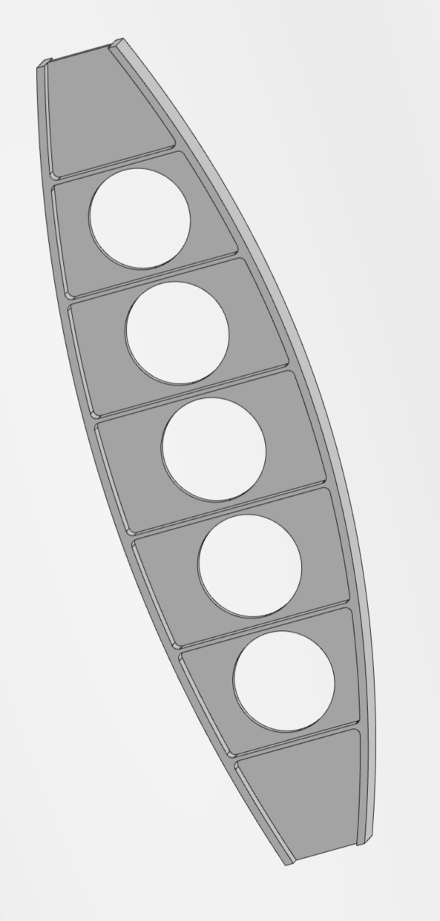
Introduction
Wing design principles
Generic design principles
212 Pages
239 Pages
Metallic design principles
Fuselage design principles
Designer
CAD design
83 Pages
853 Pages
Design rules Big Data
4

Slide 5
Table of content
How to simplify design rules management and application while maintaining design quality?
State of the Art
  Design rules
  Procedural approach
  Semantic approach
Proposal
  Context-awareness
  Context-aware for design rule application
5

Slide 6
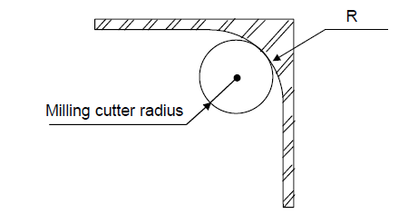
State of the Art : Design rules
(1): Fu et al.
Design rule definition (1)
It
It is stated in the grammatical imperative form.
It includes a prescriptive action for a designer to take
It increases the likelihood of reaching a desirable consequence
It is situated within a particular context and point in time
Design rule example:
Chapter title in natural language :
Standard Values of Wall Corner
Main statement in natural language :
It is necessary to have between wall corners a radius higher than the milling cutter radius
Drawing :
Equation :
6

Slide 7
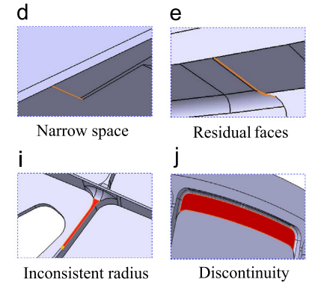
State of the Art : Procedural approach
(1) : Bo Huang et al.
Geometry checking
algorithms
(1)
Design rule set
Design errors detection
Informal design rules can not be processed
Design rule edition require specific skills
Reactive design rule application

Slide 8
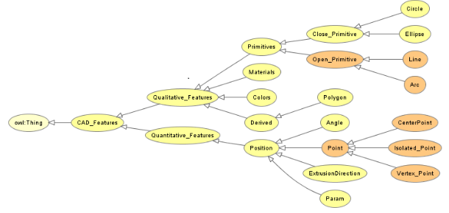
State of the Art : Semantic approach
(1) : L. E. R. Garcia et al.
CAD design
(1)
Design rule set
Domain ontology modeling of CAD information
Ontologies are difficult to design and maintain
Small domain specific design rule set
Reactive design rule application
8

Slide 9


Proposal : context-awareness
(1) : A. K. Dey
A system is context-aware if it uses context to provide relevant information and/or services to the user, where relevancy depends on the user’s task (1)
User centric approach
A cognitive assistant for the user
Presenting the right information on the right form on the right time
9

Slide 10



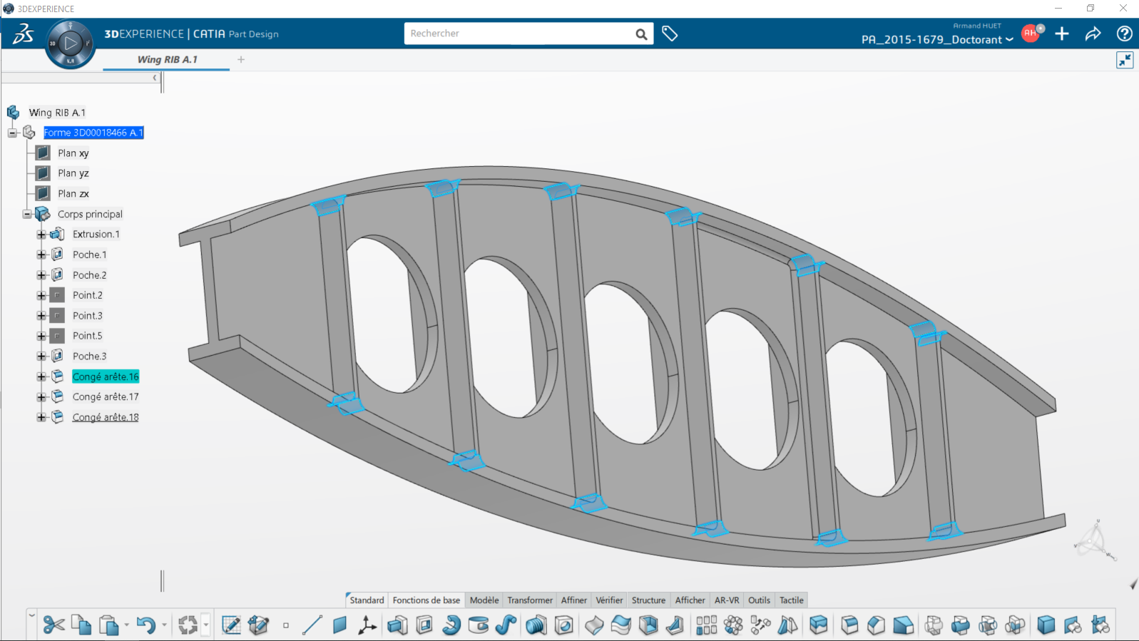

Proposal : A knowledge graph
On the fly design rule recommendations
Design rule set
Design rule retrieval in context
Social
context
IT environment
knowledge graph
Engineering context
Semantic context
R
Design rule application guidance
Design context
10

Slide 11
Proposal : Context-aware services
Design rule retrieval in context to process a large set
Small domain specific design rule set
Proactive design rule application:
Obtaining the best design at the first attempt
Reactive design rule application
A semi-automated knowledge capture from design manuals
Informal design rules can not be processed
Design rule edition require specific skills

Slide 12
Thank you
armand.huet@ensam.eu

