Slide 1




Natural Language Processing of Requirements for
Model-Based Product Design with ENOVIA/CATIA V6
Romain PINQUIÉ, PhD Student, Arts & Métiers ParisTech, LSIS UMR CNRS 7296, France
Philippe VÉRON, Full Professor, Arts & Métiers ParisTech, LSIS UMR CNRS 7296, France
Frédéric SEGONDS, Assistant Professor, Arts & Métiers ParisTech, LCPI, France
Nicolas CROUÉ, Director Solutions & Consulting, Keonys, France
Presented at: PLM15, International Conference on Product Lifecycle Management, 19-21 October 2015, Doha, Qatar
22-Sept-2015
Natural Language Processing of Requirements for Model-Based Product Design with ENOVIA/CATIA V6

Slide 2
Outline
OEMS specify PPBRs manually
Parametric
Property-Based Requirements
Digital NLP pipeline to generate PPBR
2
1
Problem
3
Background
Solution
Q & A
Results
7
Future work
4
Any question?
6
160 pages
Recall: 1
Precision: 0.76
≈ 3 min
Machine learning
Unit converter

Slide 3
Background: What is a Property-Based Requirement (PBR) ?
When C → val(O.P) ∈ D
When the condition C is true, the property P of object O is actual and its value shall belong to the domain D
When the temperature of water in the Boiler is less than 85 °C, the Control_Subsystem shall open the Inlet_Valve in less than 3 seconds.
Micouin, P. (2008), Toward a property based requirements theory: system requirements structured as a semilattice. Systems Engineering, 11(3), p. 235-245.

Slide 4
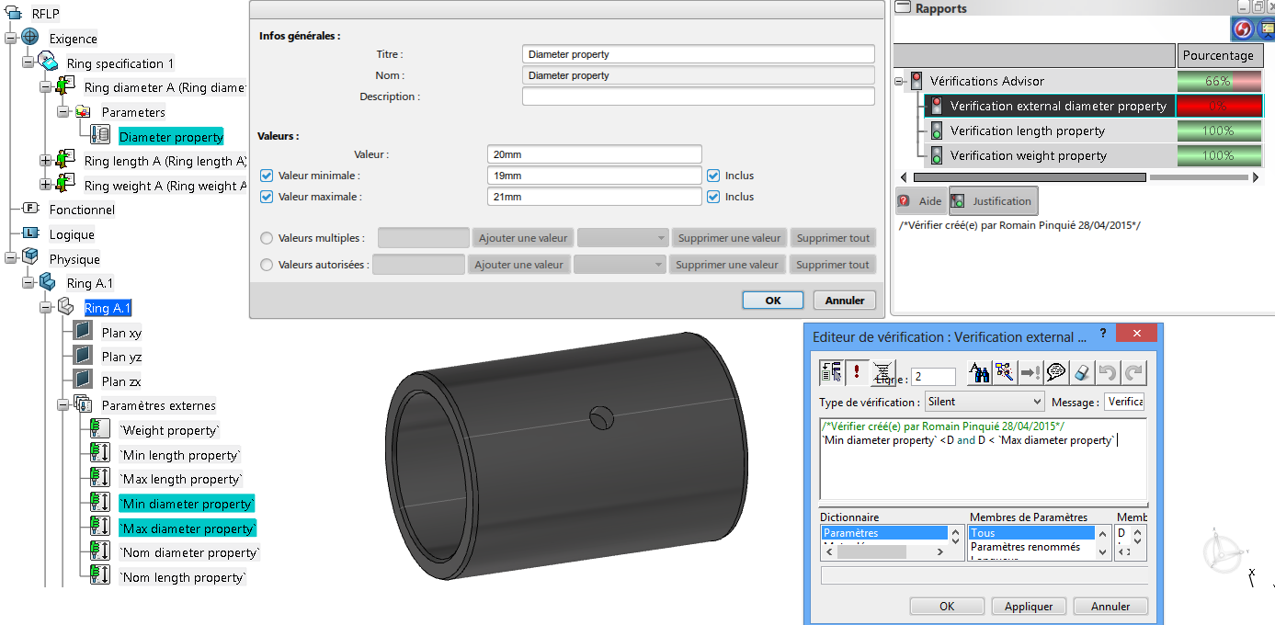
Background: What is a Parametric Property-Based Requirement (PPBR)?
A PPBR is a PBR implemented with a parametric CAD modeller
PBR theory | Parametric CAD modelling
P
D
O
When C → val(O.P) ∈ D
C

Slide 5
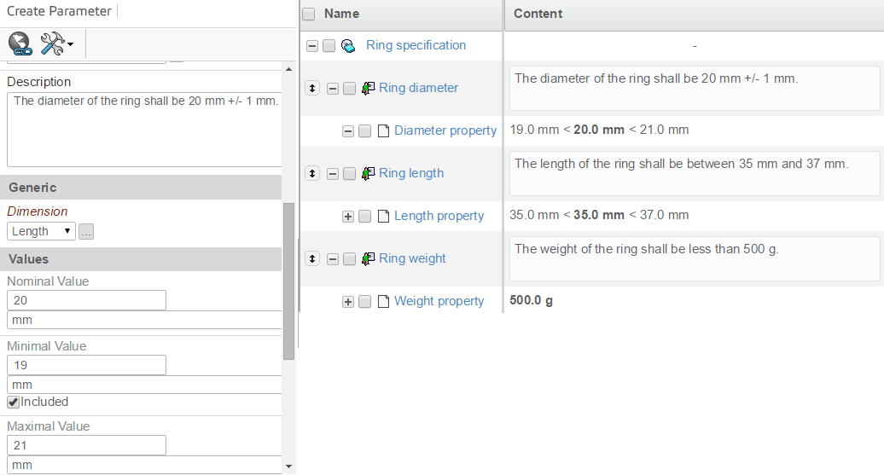
Background: How do we model and verify a PPBR in ENOVIA/CATIA V6?
O
P
D

Slide 6
Background: How do we model and verify a PPBR in ENOVIA/CATIA V6?
V
V
C

Slide 7
Outline
OEMS specify PPBRs manually
Parametric
Property-Based Requirements
2
1
Problem
Background

Slide 8
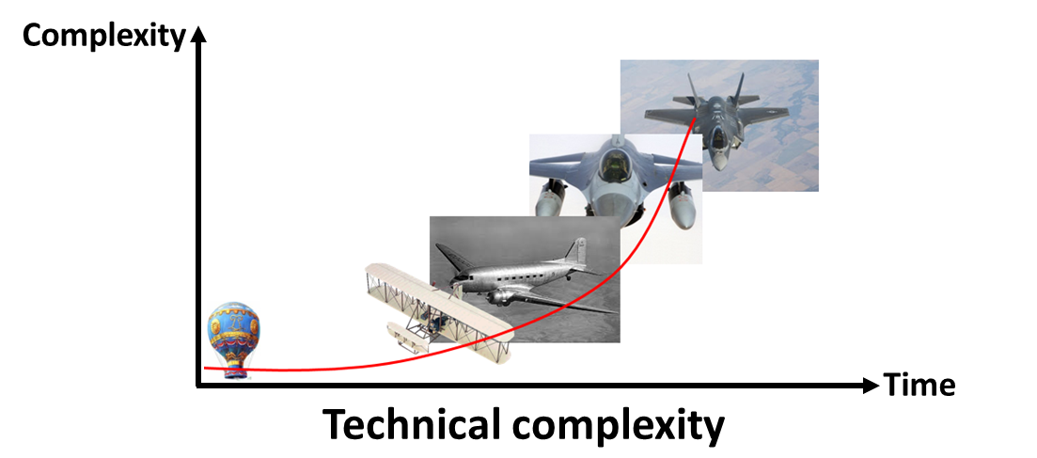
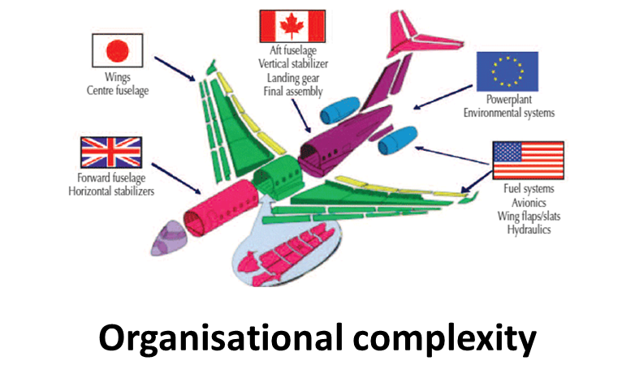
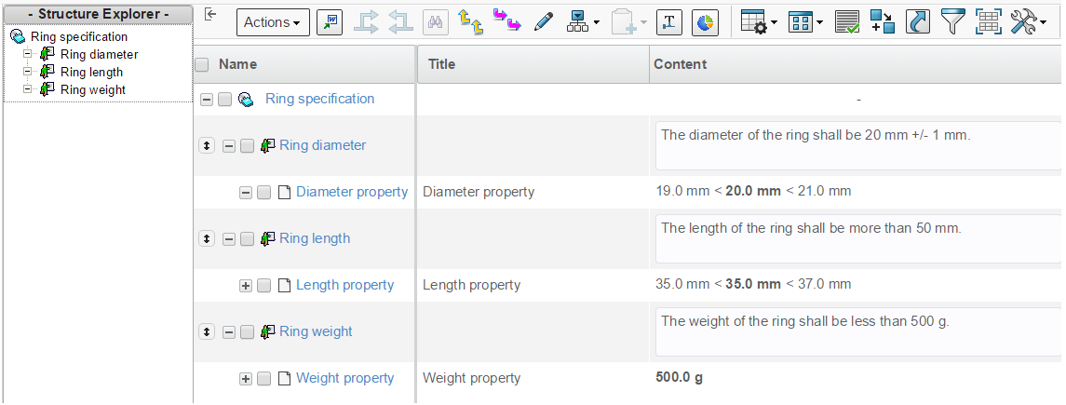


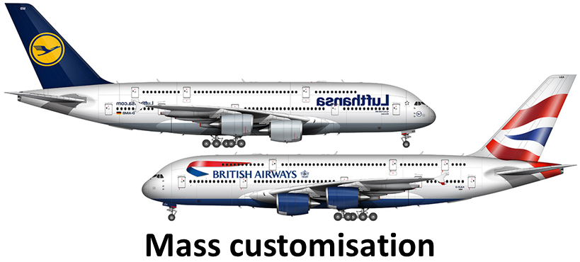
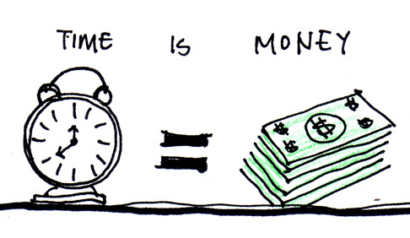
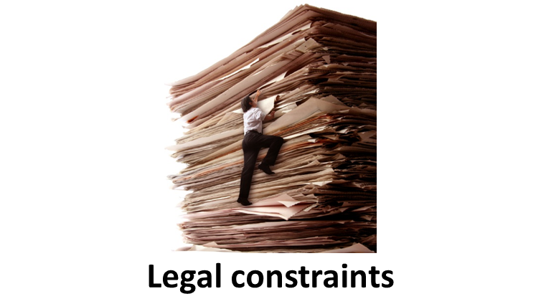

Problem: How OEMs generate PPBR from unstructured specifications?
AS-IS
Process « AS-IS »:
Identify requirements
Rewrite requirements in ENOVIA V6
Specify property, domain and condition
How can we supports OEMs ?
Notes:
Data mining → looking for patterns in data
Text mining → looking for patterns in text
Data mining → extraction of implicit, previously unknown, and potentially useful information from data.
Text mining → extraction of clearly and explicitly stated information but “previously unknown” because human resource restrictions make it infeasible for people to read the text themselves.

Slide 9
Outline
OEMS specify PPBRs manually
Parametric
Property-Based Requirements
Digital NLP pipeline to generate PPBR
2
1
Problem
3
Background
Solution

Slide 10


Solution: What do we propose for supporting OEMs?
AS-IS
TO-BE
Process « AS-IS »:
Identify requirements
Rewrite requirements in ENOVIA V6
Specify property, domain and condition
Process « TO-BE »:
Extract textual content
Identify sentences
Classify sentences as « Requirement » VS. « Information »
Analyse requirements to extract property, domain and condition
Notes:
Data mining → looking for patterns in data
Text mining → looking for patterns in text
Data mining → extraction of implicit, previously unknown, and potentially useful information from data.
Text mining → extraction of clearly and explicitly stated information but “previously unknown” because human resource restrictions make it infeasible for people to read the text themselves.

Slide 11






Solution: Extract textual content, Identify & Classify sentences
NLP pipeline
Tokenization
POS-tagging
Lemmatization
Sentence splitting
Specification textual content
This is not a requirement. The system must do this. The system should do that.
Requirements
Requirements
The system must do this.
The system should do that.
Requirements
The system must do this.
The system should do that.
The system shall do this.
The system has to do that.
Requirements
The system must do this.
The system should do that.
The system shall do this.
The system has to do that.
The system will do this.
The user requires that.
Decision rule
If lemma ∈ {prescriptive lemmas},
then prescriptive statement
This is not a requirement.
The system shall do this.
The system has to do that.
The system will do this.
The user requires that.

Slide 12
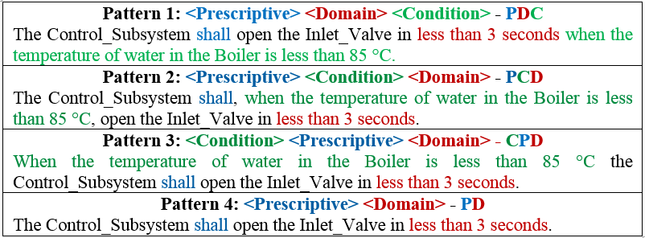

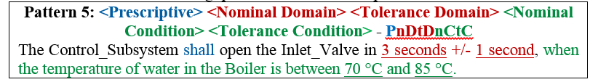
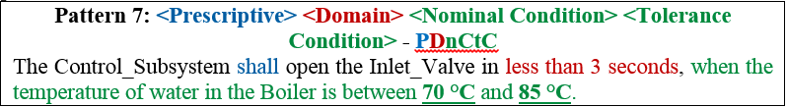
Solution: Though unconstrained NL requirements, there are patterns!
Ok, but how do we extract these patterns?
If tolerance,
4 more patterns:
e.g. pattern 5 from pattern 1
If tolerance & no tol,
6 more patterns:
e.g. pattern 7 from 1 & 5
Notes:
5) Explicit VS Implicit tolerance

Slide 13
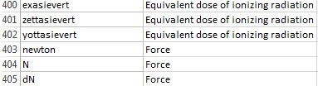
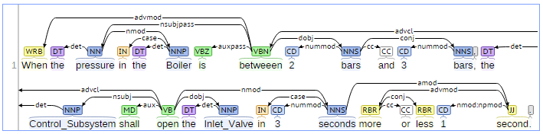
Solution: Dependency analysis of requirements
List of « conditional terms », e.g.:
      If the temperature…
      When the pressure…
      While the system is…
List of < Unit, Dimension >, e.g.:
?
?
?
Patterns to express the tolerance, e.g.:
                X +/-Y
                “X more or less Y”
                “from X to Y”
                “between X and Y”, etc…

Slide 14
Outline
OEMS specify PPBRs manually
Parametric
Property-Based Requirements
Digital NLP pipeline to generate PPBR
2
1
Problem
3
Background
Solution
Results
4
160 pages
Recall: 1
Precision: 0.76
≈ 3 min

Slide 15
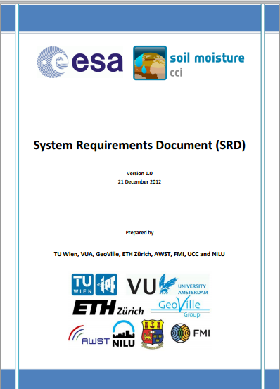
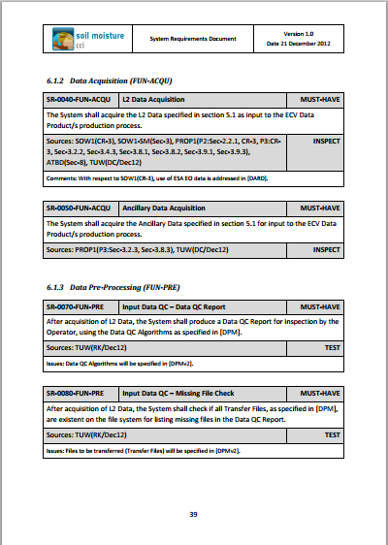
Results
Processing time: 39 seconds
  10 seconds to parse the specification,
  5 seconds to classify the sentences,
  24 seconds to analyse the requirements & generate PBRs
Evaluation of the sentence classifier:
  Precision = tp/(tp+fp) = 0.73
  Recall = tp/(tp+fn) = 1
Limit:
    “99 %” poor requirements - Unskilled requirements analysts…
    Probabilistic dependency analysis
    Nom, Max & Min Domain/Condition when units are different
Specification from the ESA:
106 pages
194 requirements
 | Requirement | Information
Classified as Requirement | 194 (tp) | 72 (fp)
Classified as Information | 0 (fn) | ? (tn)

Slide 16
Solution: Dependency analysis of requirements
k

Slide 17
Outline
OEMS specify PPBRs manually
Parametric
Property-Based Requirements
Digital NLP pipeline to generate PPBR
2
1
Problem
3
Background
Solution
Results
Future work
4
6
160 pages
Recall: 1
Precision: 0.76
≈ 3 min
Machine learning
Unit converter

Slide 18
Future work
  We MUST…
    Embed a unit convert to compute the nominal, min & max values when units are different
    Test our solution on several datasets from different industrial contexts.
  We SHOULD…
    Develop a plug-in in ENOVIA V6 to read the XML specification of PPBRs
  We MAY…
    Develop the NLP pipeline in ENOVIA V6 to have a fully integrated solution
    Investigate a Machine Learning approach to compare with our rules-based solution

Slide 19
Outline
OEMS specify PPBRs manually
Parametric
Property-Based Requirements
Digital NLP pipeline to generate PPBR
2
1
Problem
3
Background
Solution
Q & A
Results
7
Future work
4
Any question?
6
160 pages
Recall: 1
Precision: 0.76
≈ 3 min
Machine learning
Unit converter

Slide 20
Natural Language Processing of Requirements for
Model-Based Product Design with ENOVIA/CATIA V6
Romain PINQUIÉ, PhD Student, Arts & Métiers ParisTech, LSIS UMR CNRS 7296, France
Philippe VÉRON, Full Professor, Arts & Métiers ParisTech, LSIS UMR CNRS 7296, France
Frédéric SEGONDS, Assistant Professor, Arts & Métiers ParisTech, LCPI, France
Nicolas CROUÉ, Director Solutions & Consulting, Keonys, France
Presented at: PLM15, International Conference on Product Lifecycle Management, 19-21 October 2015, Doha, Qatar
22-Sept-2015
Natural Language Processing of Requirements for Model-Based Product Design with ENOVIA/CATIA V6

