Slide 1


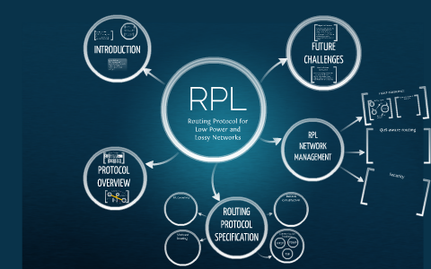
A Lightweight Trust Management Framework in the Networking Layer of IoT Devices
25_26J_009
Prof. Anuradha Jayakody
Co-supervisor
Ms. Shashika Lokuliyana
Supervisor

Slide 2
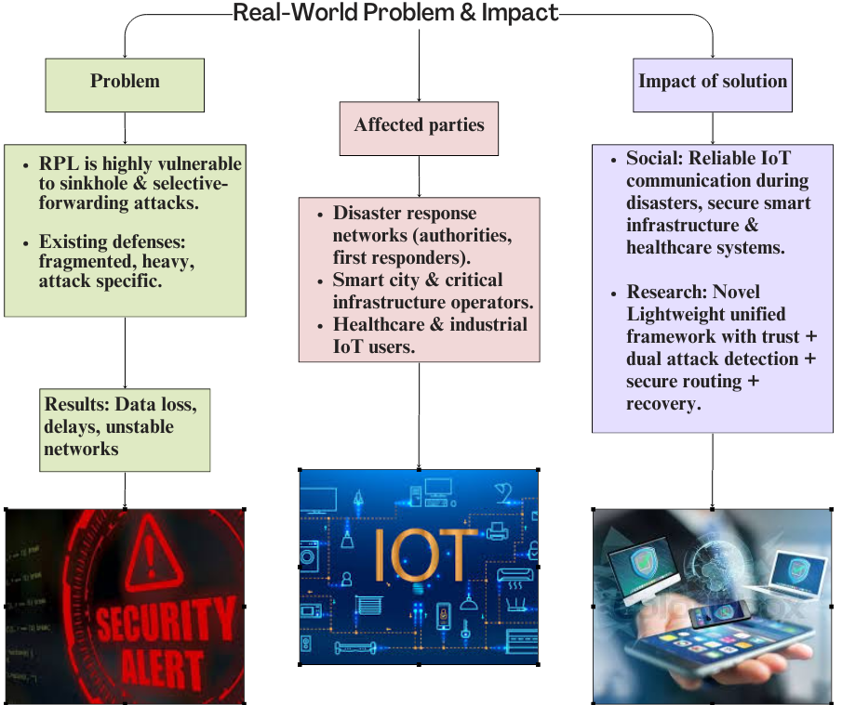
Introduction to the overall project

Slide 3
Research Gaps, Questions & Objectives
Category | Key Points
Research Gaps | • High computational overhead in existing trust solutions • Lack of an integrated framework for IoT security • Static parent selection approaches are unsuitable for dynamic environments • No integrated Isolate, Mitigate, Recovery mechanism
Research Questions | • How to develop lightweight trust management for IoT? • Can real-time multi-attack detection balance security and performance? • How to integrate trust, Security in routing decisions? • Can an Infected node Isolate, mitigate an attack and recover?
Main Objective | Develop comprehensive lightweight trust management framework for RPL-based IoT networks
Sub-Objectives | • Energy-efficient trust computation • Real-time attack detection • Trust-aware secure routing • Automated Resilience mechanisms
Key Constraints | • Resource-constrained IoT devices • Real-time performance requirements • Scalability across network sizes • Simulation-based evaluation

Slide 4
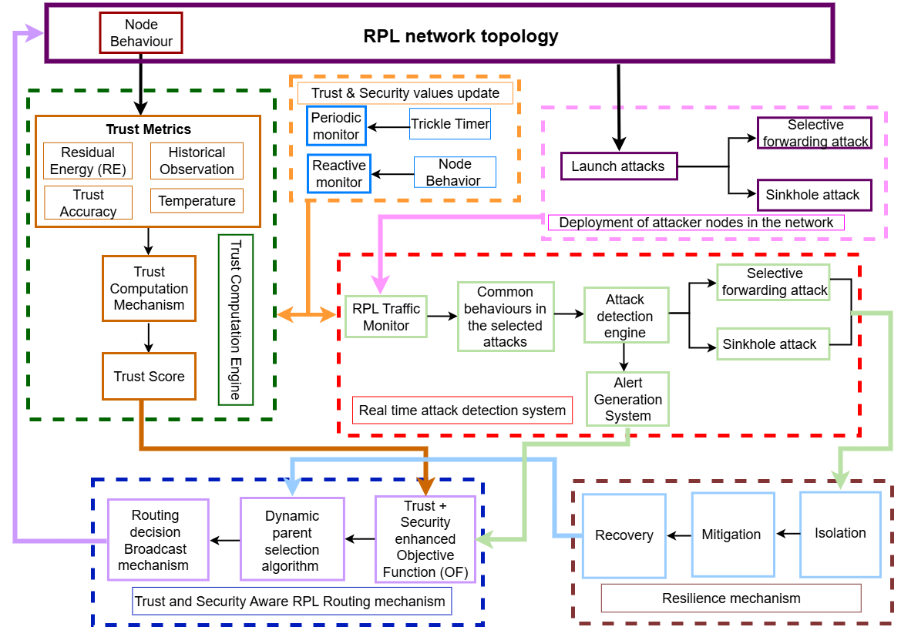
Proposed Solution: Overall System Diagram

Slide 5

IT22144362 | Kaluarachchi D.N.
Title of the Individual Component: Energy-Efficient Trust Computation Engine for Lightweight Trust Management in RPL-based IoT Networks
Specialization: Computer Systems and Network Engineering (CSNE)
IT22144362 | Kaluarachchi D.N. | 25_26J_009

Slide 6
Baseline IoT Network Setup using RPL in Contiki-NG
Simulation environment: Contiki-NG with Cooja
Network protocol: RPL (IPv6 for Low-Power and Lossy Networks)
Topology:
Multi-hop DAG
Single RPL Root (Sink node)
Application layer:
udp-server.c → RPL Root
udp-client.c → Sensor nodes
Communication model:
Clients periodically send UDP requests to root
Root sends UDP responses back
Purpose of baseline setup:
Establish stable RPL routing
Enable automatic parent selection
Collect link quality metrics (ETX)
IT22144362 | Kaluarachchi D.N. | 25_26J_009

Slide 7
Trust Metric 1: Historical Observation (HO)
Trust metric based on past communication behavior
Measures link reliability over time
Uses ETX (Expected Transmission Count)
Data sources:
link-stats.h
RPL neighbor table (uip-ds6-nbr)
Working logic:
Scan all neighboring nodes
Identify minimum ETX value
Lower ETX → Higher trust
Trust calculation:
T_HO = 1 / min(ETX)
Implementation:
Implemented in both udp-client.c and udp-server.c
Validation:
Trust values printed in Cooja mote output
Computed dynamically during runtime
IT22144362 | Kaluarachchi D.N. | 25_26J_009

Slide 8
Trust Metric 2: Residual Energy (ER) & Current Progress
Trust metric based on remaining node energy
Uses Contiki ENERGEST module
Energy components monitored:
CPU active time
Low Power Mode (LPM)
Radio Transmission (TX)
Radio Reception (RX)
Energy model:
E_used = V × I × t
T_ER = 1 − (E_used / E_initial)
Implementation:
Implemented in udp-client.c and udp-server.c
Output in simulation:
Residual energy value
Energy consumed (mJ)
Normalized trust value (0–1)
IT22144362 | Kaluarachchi D.N. | 25_26J_009

Slide 9
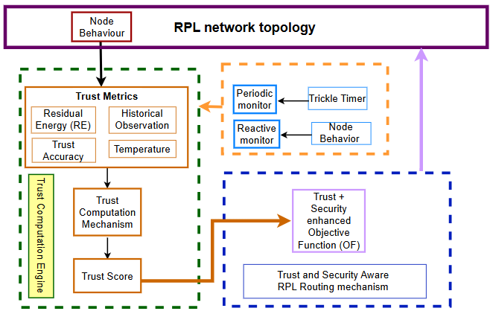




Methodology: High-level System Architecture
IT22144362 | Kaluarachchi D.N. | 25_26J_009

Slide 10

IT22342126 | Wijetunga s.s.
Title of the Individual Component: ​ Lightweight IDS for Simultaneous Detection of Sinkhole & Selective Forwarding Attacks in RPL
Specialization: Computer Systems and Network Engineering (CSNE)
IT22342126 | Wijetunga S. S. | 25_26J_009

Slide 11
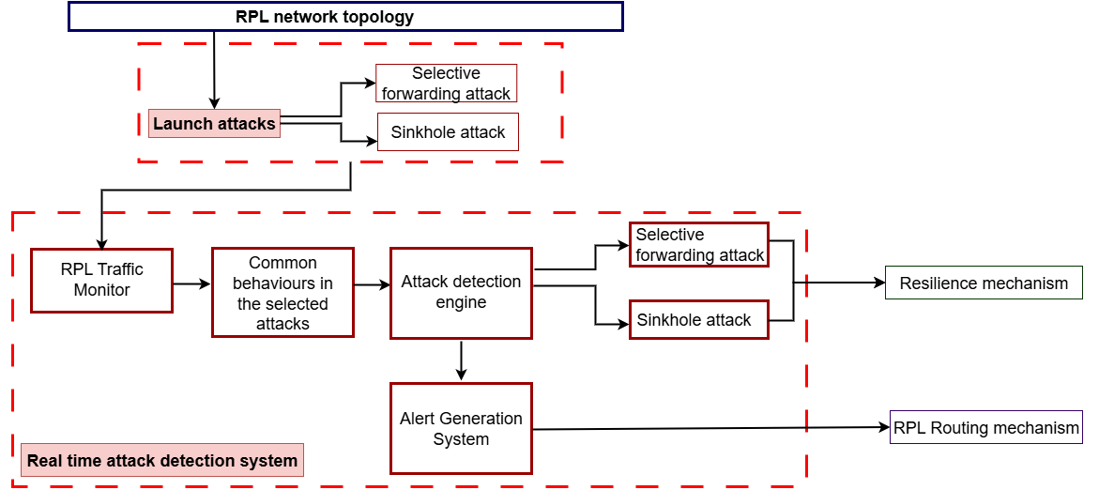
OBJECTIVE: HIGH-LEVEL SYSTEM ARCHITECTURE
Lightweight IDS for Simultaneous Detection of Sinkhole & Selective Forwarding Attacks in RPL
IT22342126 | Wijetunga S. S. | 25_26J_009

Slide 12
CONTRIBUTION
Lightweight IDS for Simultaneous Detection of Sinkhole & Selective Forwarding Attacks in RPL
Already Implemented: First phase builds the IDS logic and validates its behavior under normal and mobility conditions.
Designed and implemented a lightweight, threshold-based IDS for RPL-based IoT networks, suitable for resource-constrained devices.
Implemented 3 complementary detection metrics: CDFR (Control-to-Data Flow Ratio) , PTI (Packet Time Interval), SIS (Sequence Integrity Score).
Metrics selected to observe routing behavior, timing behavior, and data delivery integrity with low overhead
Each metric computed over a fixed observation window and compared against empirically derived thresholds based on normal (attack-free) simulations and prior RPL IDS literature.
Implemented real-time node-level alerts for threshold violations
Introduced a severity scoring mechanism by aggregating binary anomaly flags from CDFR, PTI, and SIS into a single unified IDS output
Evaluated the IDS in:
Static topology (baseline behavior)
Mobility-enabled topology (stress-testing under dynamic routing conditions)
IT22342126 | Wijetunga S. S. | 25_26J_009

Slide 13
CONTRIBUTION
Lightweight IDS for Simultaneous Detection of Sinkhole & Selective Forwarding Attacks in RPL
To be Implemented: Second phase injects real sinkhole and selective forwarding attacks to classify them using metric patterns and evaluate detection accuracy.
Implement sinkhole attack , selective forwarding attack and simultaneous attack detection of these two attacks into the simulation of RPL network by launching the attacks simultaneously.
Evaluate metric response patterns (CDFR, PTI, SIS) under each attack
Classify attacks based on metric combinations and severity score
Measure True Positives, False Positives, False Negatives, and True Negatives.
Introduce dynamic threshold adaptation, especially under mobility.
Validate IDS robustness for simultaneous attack detection in static vs mobile network environments
IT22342126 | Wijetunga S. S. | 25_26J_009

Slide 14
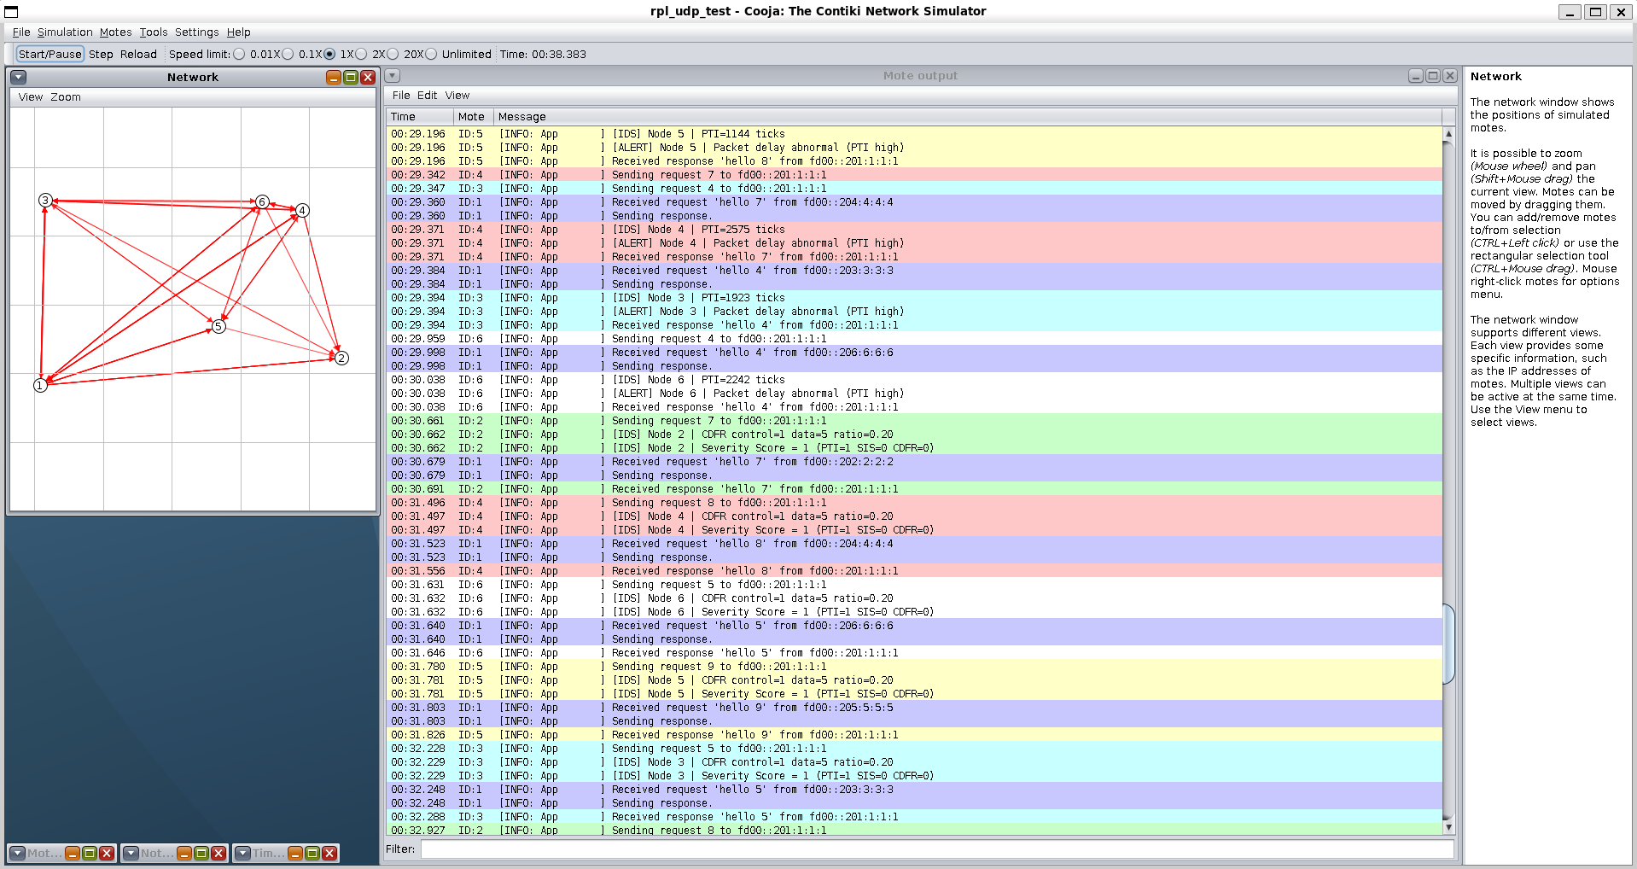
DESIGN EXCELLENCE
Lightweight IDS for Simultaneous Detection of Sinkhole & Selective Forwarding Attacks in RPL
Metric Selection Based on Attack Behavior.
Lightweight and Resource-Aware IDS Design.
Multi-Dimensional Detection Strategy.
Window-Based Detection Architecture.
Threshold-Based, fully distributed, node-level detection without centralized control.
Unified Severity Scoring Mechanism.
Robustness Validation via Mobility.
IT22342126 | Wijetunga S. S. | 25_26J_009

Slide 15
USER/FUNCTIONAL REQUIREMENTS
Lightweight IDS for Simultaneous Detection of Sinkhole & Selective Forwarding Attacks in RPL
User requirements:
Provide a lightweight IDS suitable for resource-constrained RPL-based IoT nodes.
Detect abnormal routing and forwarding behavior without ML or heavy computation.
Enable real-time, node-level anomaly detection in RPL networks.
Support monitoring under both static and mobility-enabled environments.
Produce clear alerts and a single severity indication for easier analysis.
Functional requirements:
Compute CDFR to detect abnormal RPL control dominance (sinkhole behavior).
Compute PTI to detect abnormal packet delays during forwarding.
Compute SIS to detect packet loss and out-of-order delivery.
Evaluate metrics using window-based threshold comparison.
Generate metric-specific IDS alerts at node level.
Aggregate metric outcomes into a severity score per node.
Reset metrics and flags after each observation window.
IT22342126 | Wijetunga S. S. | 25_26J_009

Slide 16

IT22065162 | WIJEKOON H.m.r.k.
Title of the Individual Component: Trust and Security-Aware RPL Routing Mechanism​
Specialization: Computer Systems and Network Engineering (CSNE)
IT22065162 | WIJEKOON H.M.R.K. | 25_26J_009

Slide 17
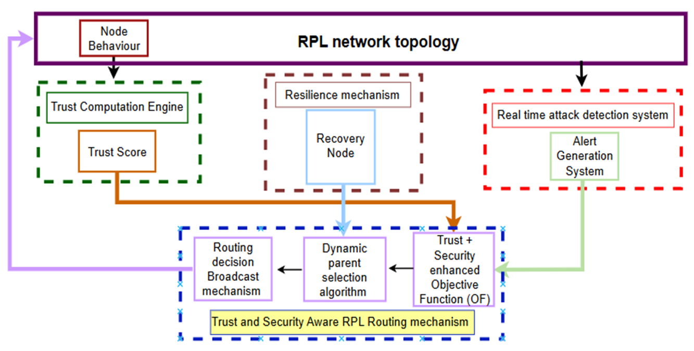
Methodology
IT22065162 | WIJEKOON H.M.R.K. | 25_26J_009

Slide 18
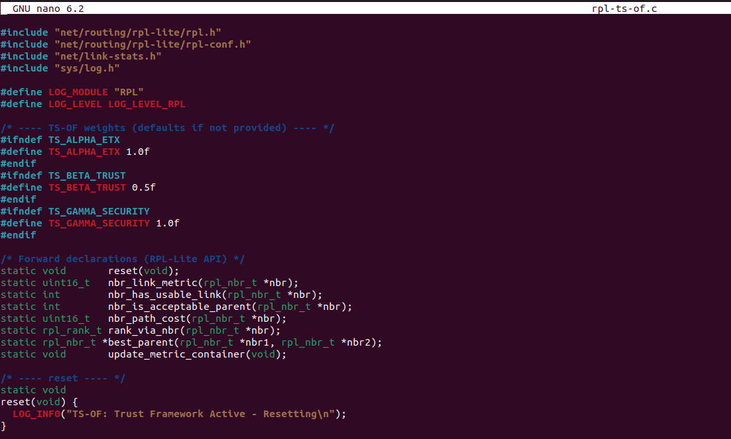
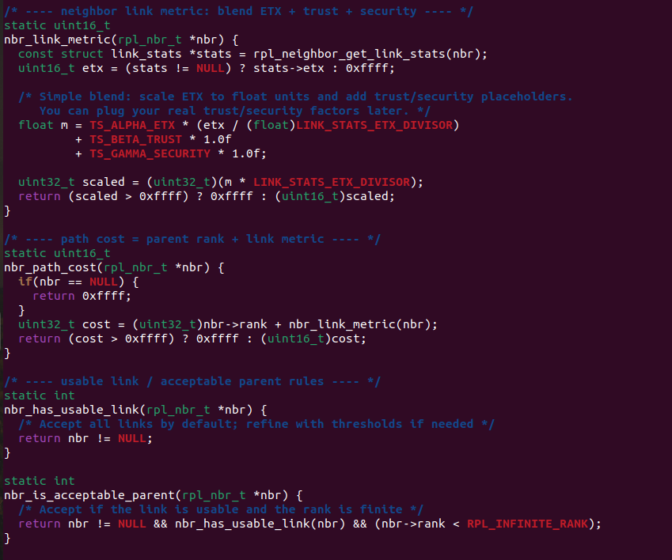
Integration calculation to ‘rpl-ts-of.c’
IT22065162 | WIJEKOON H.M.R.K. | 25_26J_009

Slide 19
Defaults (trust, security, ETX, weights)
Trust (trust): initial 0.80 (moderately trusted); range 0.0 - 1.0
Decays slowly toward 0.80 if no alerts; drops when simulating misbehavior.
Security factor (secf): 1.00 means “no alert” > 1.0 adds a penalty.
For a sinkhole alert, or selective forwarding, set secf = 2.0–3.0.
Avoid 0.0 here—use “no alert” = 1.0 (clearer arithmetic).
ETX: If not available from link stats yet, use 1.0 as neutral (scaled to 128 in Contiki’s integer ETX scale).
store a float ETX = 1.0 and convert to Contiki scale when needed.
Weights (α/β/γ): start conservative so MRHOF behavior dominates while logging works:
TS_ALPHA_ETX = 1.0 (primary cost is ETX)
TS_BETA_TRUST = 0.5 (small penalty if trust is low)
TS_GAMMA_SECURITY = 1.0 (penalty proportional to security factor − 1.0)
IT22065162 | WIJEKOON H.M.R.K. | 25_26J_009

Slide 20

IT18065640 | BANDARA R.M.T.
Resilience Mechanism For RPL
BSc (Hons) in Information Technology Computer Systems &
Network Engineering
IT18065640 | Bandara R.M.T | 25_26J_009

Slide 21
Ability of Commercialization & Budget
Investment / Cost Labor: R&D, testing Materials: Open-source tools (Contiki-NG, Cooja) Extra: Cloud resources (~LKR 45,000) | Cost Recovery / Pricing License to IoT vendors Security add-on for IoT platforms
Market & Customers Sectors: Disaster management centers, Smart cities, healthcare, industrial IoT Customers: IOT Device makers, network operators, Integrators | Value Proposition Lightweight, scalable, low-cost Protects against combined routing attacks Ensures continuous + trusted IoT service

Slide 22
THANK YOU !

