Slide 1
Powerpoint from Rmarkdown
Richard Martin

Slide 2

4 wrapper functions:
create plot with a one-liner function call.
functions found in package aest which can be installed from github.
devtools::install_github("rpmartin/aest")

Slide 3
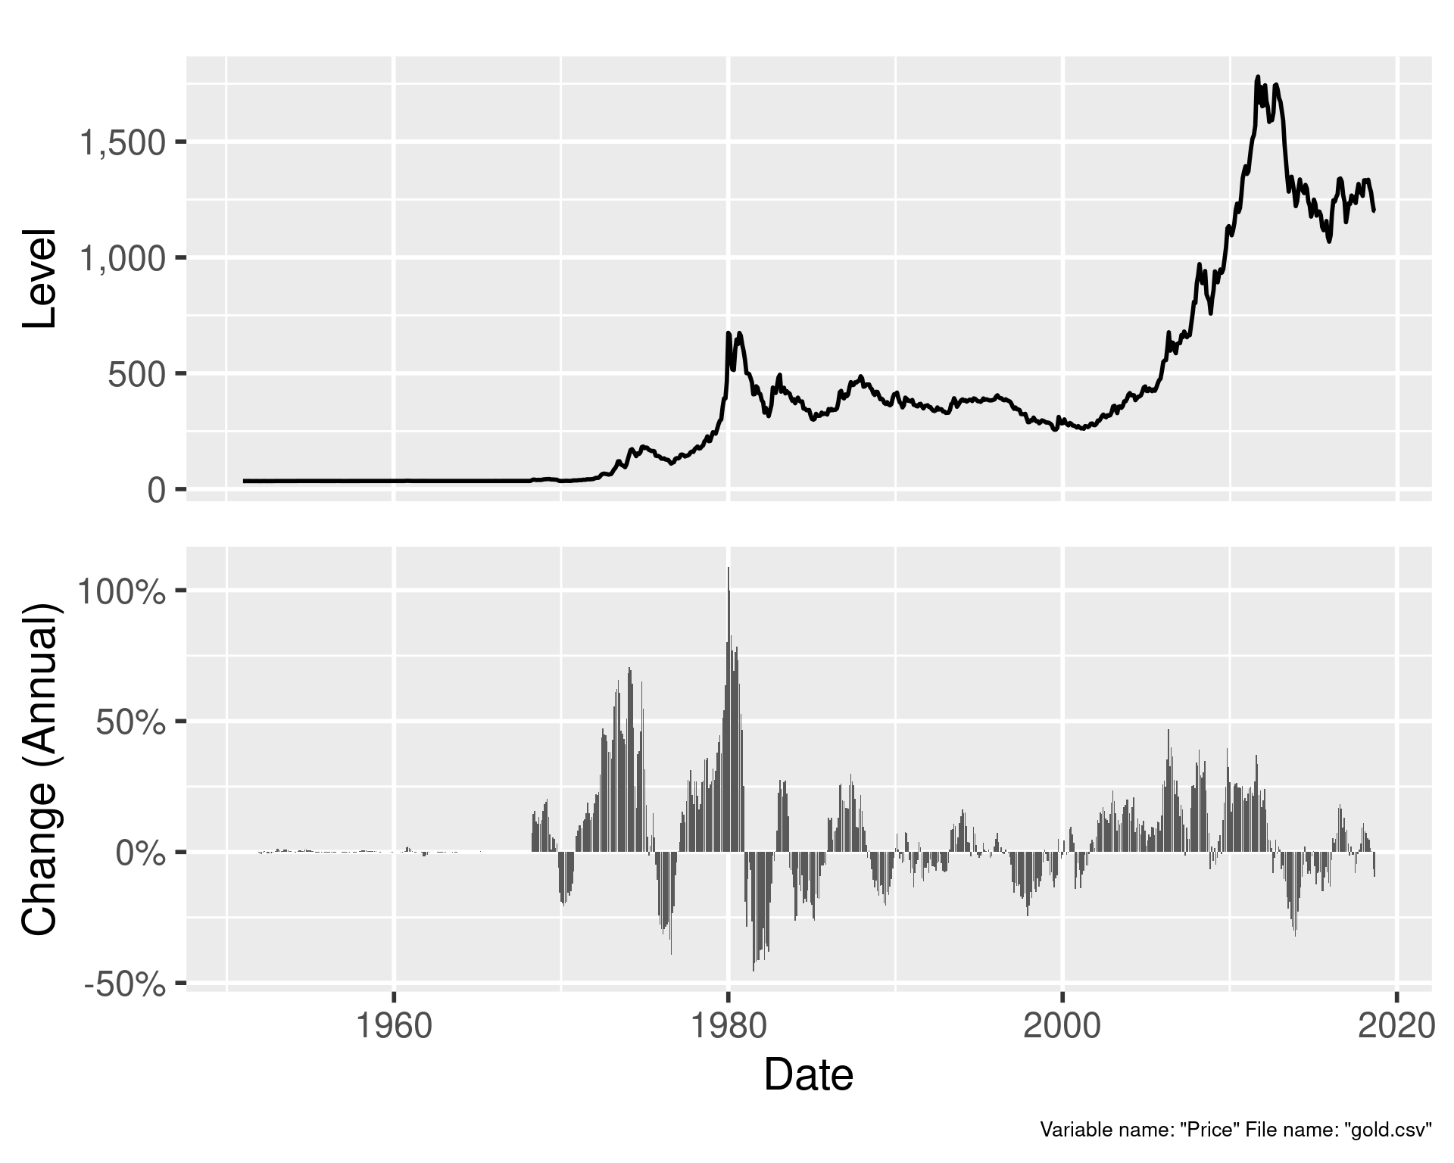
Levels and Changes.
aest_level_and_change( gold, Price, Date, "ym", "annual" )
Default caption indicates variable name and originating file name.

Slide 4
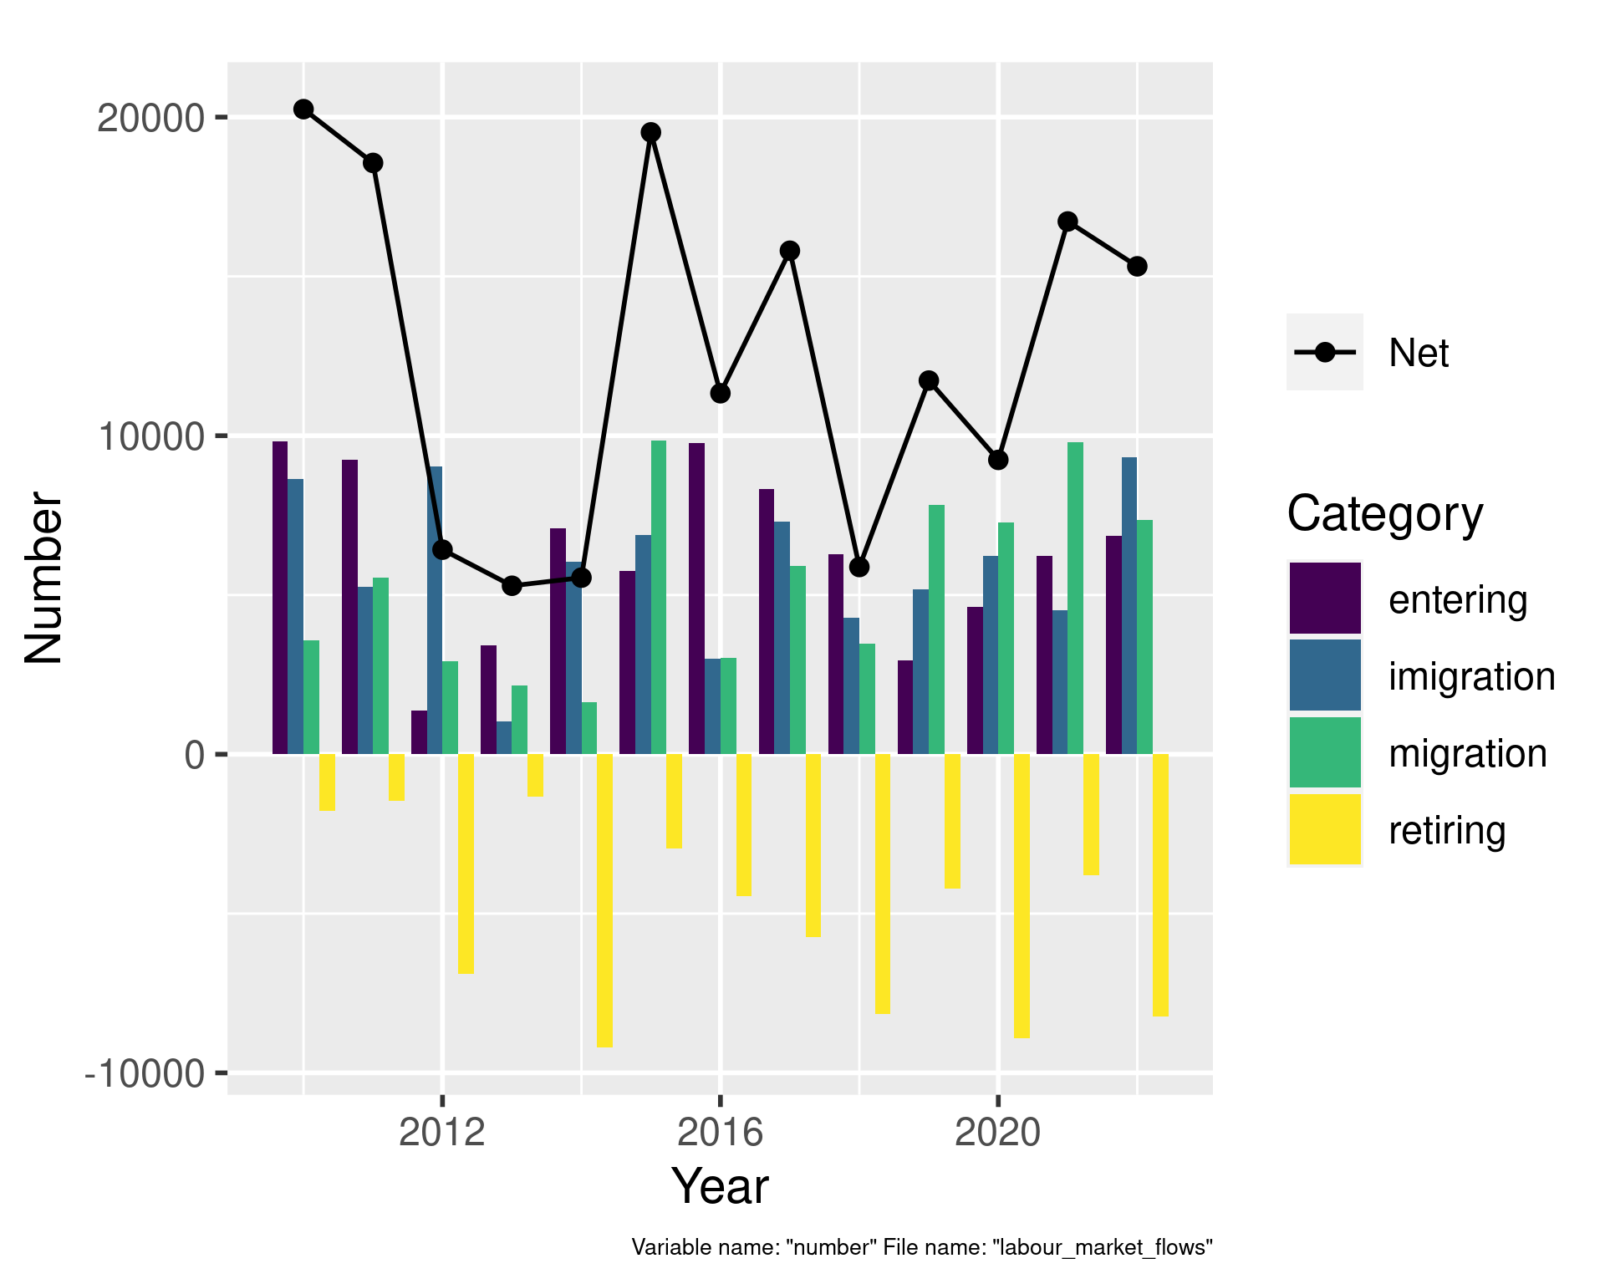
Parts and Whole:
aest_parts_and_whole( flows, year, category, number )
Default caption can be overridden by providing a caption.

Slide 5
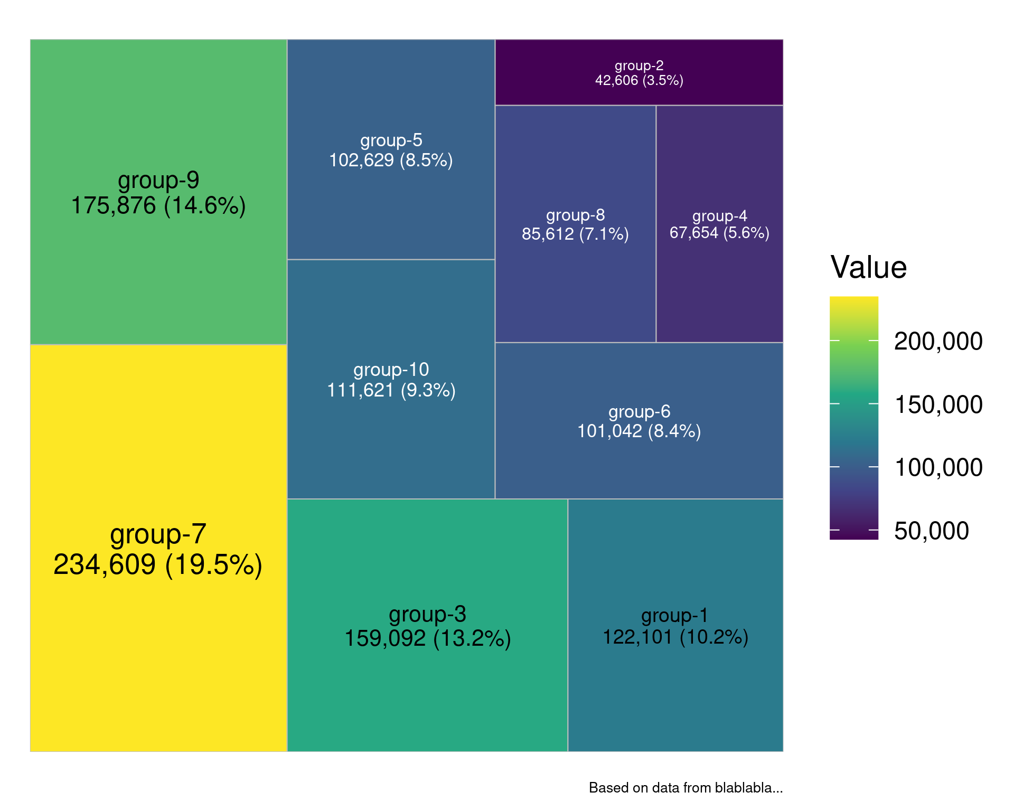
Treemap.
aest_treemap(lmo, category, number, caption = "Based on data from blablabla..." )

Slide 6
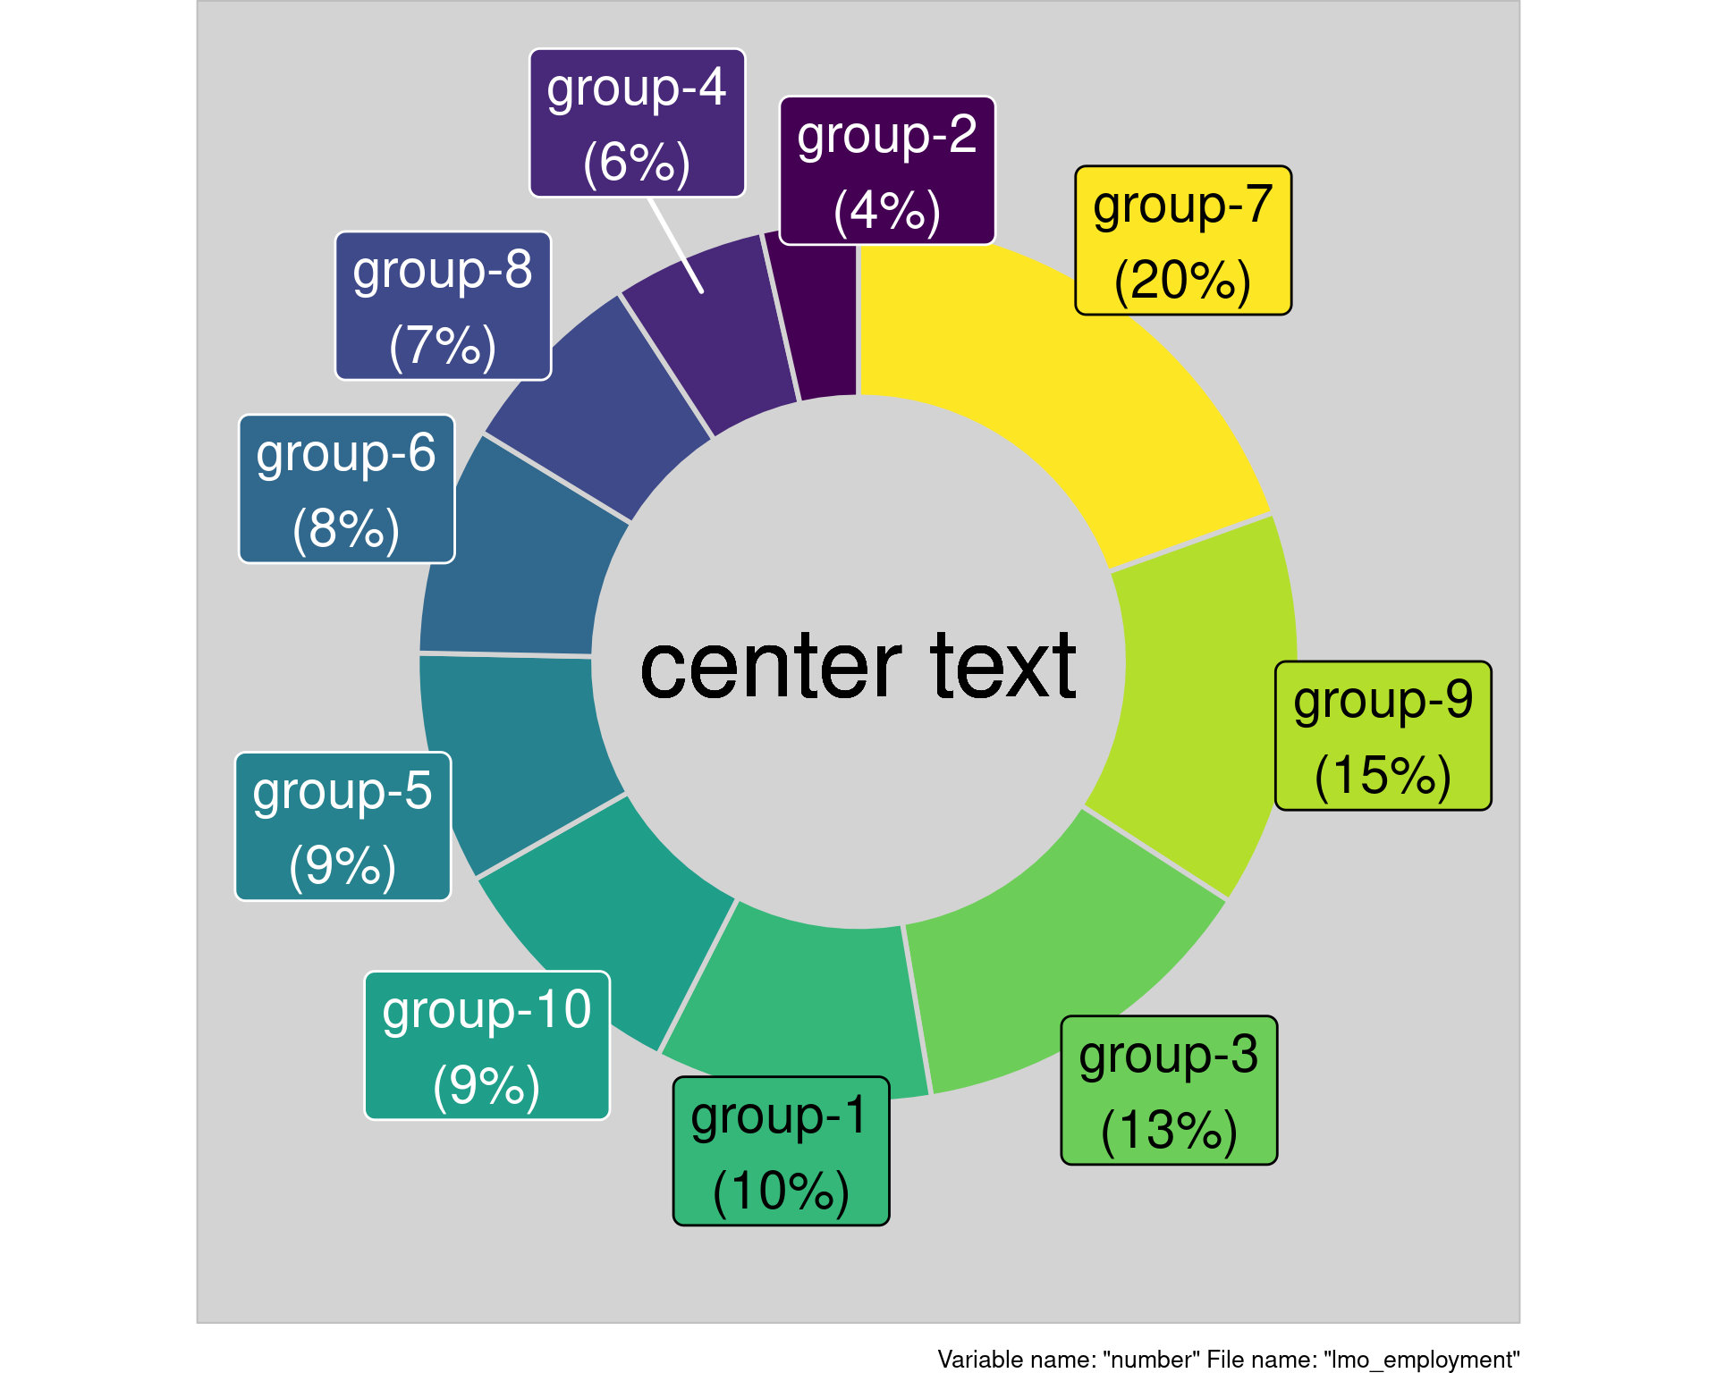
Mmmm donuts…
aest_donut( lmo, category, number, "center text" )

