Slide 1
Powerpoint from Rmarkdown
Richard Martin

Slide 2
Reproducible Research:
Entire chain from raw data to output is documented/coded… no “by hand” modifications that are impossible to re-create.
Ensures that changes to either data or methodology get automatically reflected in the output.
The priority is on accuracy rather than aesthetics.

Slide 3
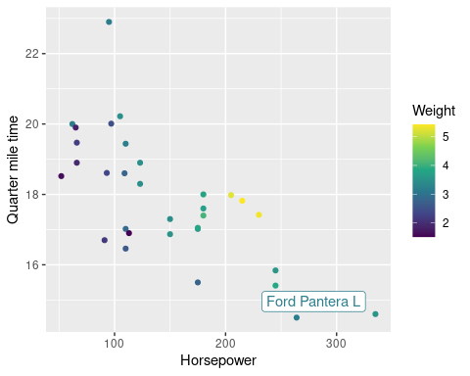
Motortrend cars from 1974:
The fastest car is the Ford Pantera L which gets 15.8 Miles per gallon, and has 264 horsepower.

Slide 4
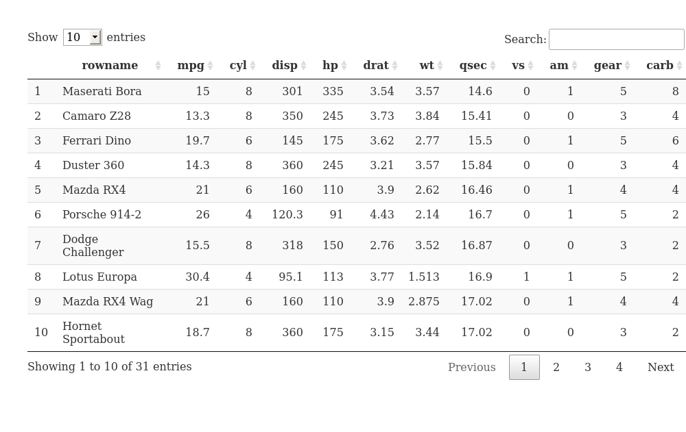
Suppose Pantera is dropped (for some reason)
car_data <- anti_join(car_data,fastest)%>% arrange(qsec)

Slide 5
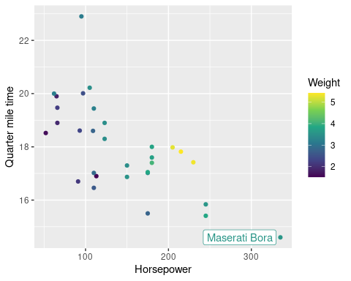
And run the same code again.
Now there is a new fastest car, and the plot and the prose automatically reflect this.
The fastest car is the Maserati Bora which gets 15 Miles per gallon, and has 335 horsepower.

Slide 6
Drawbacks:
Any modifications to .ppt would be lost if the analysis had to be rerun.
So no aesthetic modifications to ppt should be made until numbers finalized.

