Slide 1
Computational Photography
Assignment #6: HDR
Ryan Miller
Spring 2018

Slide 2
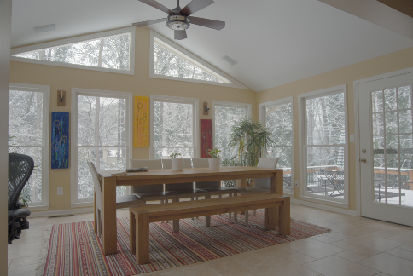
Result from Example Input
Did you get a good result? If yes/no, what specifically were you happy/unhappy with? Be detailed.
Originally I did not get a result I was happy with. My code has some type issue bugs that generated very weird artifacts in the output. However, by enforcing type and work the np.float64 values for the linear algebra and least squares equation my code generated the output to the right. Overall I’m pretty happy with the output as it conveys detail in both the interiors as well as the exterior through the window without losing any detail. That being said it does have a “soft” appearance to it, which makes some of the dynamics of the shadows appear to lack weight, and generates a “flatter” look. While I don’t find this as appealing I am happy with the output.

Slide 3
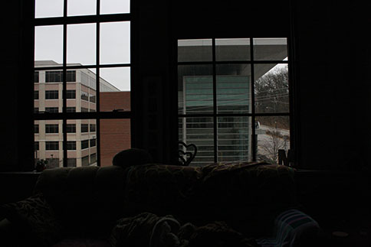
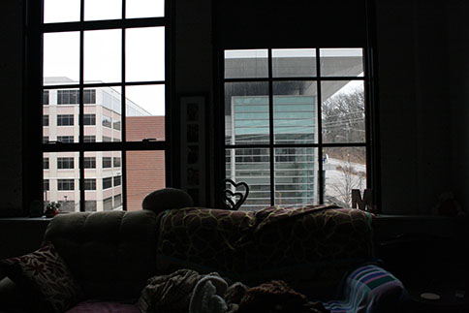
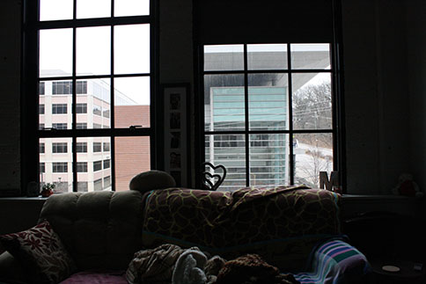
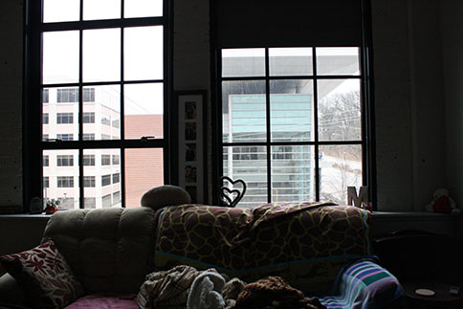
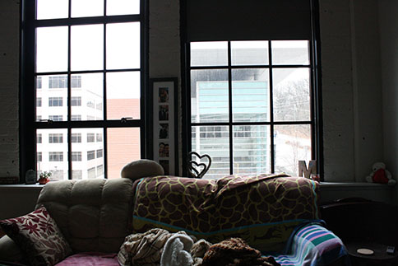
HDR Image Components Thumbnails
For my photos I leveraged my Canon Rebel and tripod and captured a 10 images from my apartment, a converted manufacturing building, capturing light from the large industrial windows in my main room.
Exposure: 1/2,000
Aperture: 5.6
ISO: 1600
Exposure: 1/640
Aperture: 5.6
ISO: 1600
Exposure: 1/400
Aperture: 5.6
ISO: 1600
IMG_0820.jpg
IMG_0822.jpg
IMG_0823.jpg
Exposure: 1/250
Aperture: 5.6
ISO: 1600
Exposure: 1/160
Aperture: 5.6
ISO: 1600
IMG_0824.jpg
IMG_0825.jpg

Slide 4
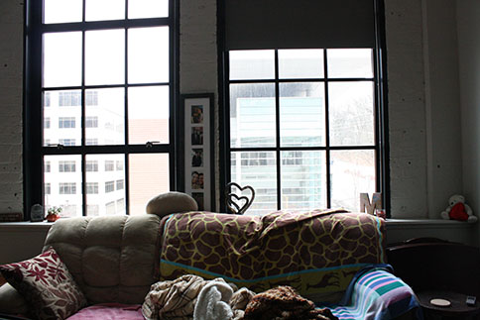
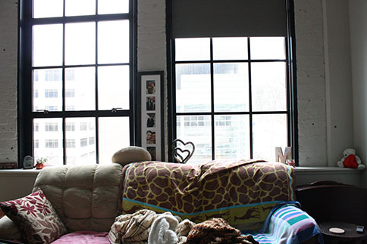
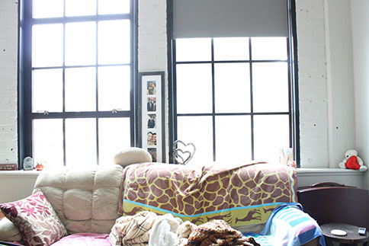
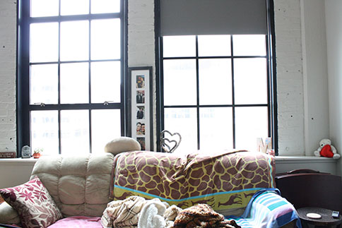
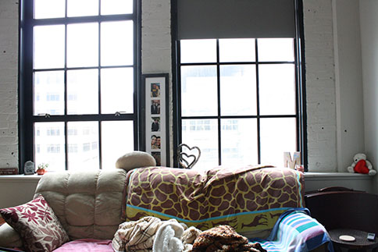
HDR Image Components Thumbnails
Exposure: 1/100
Aperture: 5.6
ISO: 1600
Exposure: 1/60
Aperture: 5.6
ISO: 1600
Exposure: 1/40
Aperture: 5.6
ISO: 1600
IMG_0826.jpg
IMG_0827.jpg
IMG_0828.jpg
Exposure: 1/25
Aperture: 5.6
ISO: 1600
Exposure: 1/15
Aperture: 5.6
ISO: 1600
IMG_0829.jpg
IMG_0830.jpg

Slide 5
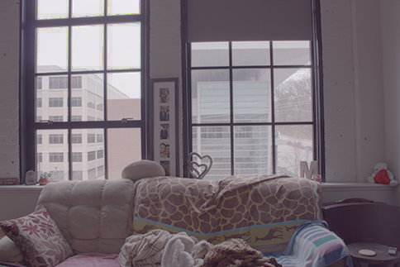
Final HDR Image

Slide 6
HDR Image Requirements
Discuss the camera setting requirements for an HDR image set in general. What settings should be the same for all images? Why?
The camera settings should remain the same for an HDR image for all variables apart from exposure time. The aperture should remain static as altering the f-stop would result in varying levels of focus, this could lead to artifacts in the resultant image as there are varying depth of fields between the images, and selecting only the middle images keypoints would result in large differences in focus. Similarly, the lens, ISO, scene lighting, shot angle should remain the same as adjusting any of them results in the light no longer being uniformly captured at the same angle, and thusly, working backward through linear equations to grab the irradiance values would no longer be accurate to the scene being captured. By adjusting only the exposure we’re effectively controlling the amount that light is exposed to the sensor. The longer the sensor’s exposed, the more light is captured, and inversely the less it is, the less light. Thusly HDR’s goal is to capture the dynamic range of light in an area, that is lost when images are captured from the perspective of a single angle, and with a set period of exposure. By adjusting the exposure across a range it allows for caputuring details in higher light exposure areas, and lower light exposure areas, that would normally be lost in trying to find a neutral exposure for the shot.

Slide 7
HDR Image Requirements
What is the relevance of the number series (-2, -1, 0, 1, 2) for the exposure times for an HDR image set? Did your images follow this exposure relationship? Explain using your image exposure times.
Dynamic ranging is measured in exposure value differences or “stops”. An increase/decrease of 1 EV indicates a doubling/halving of light. The series of numbers represents the steps between the exposure values and this relationshiop of light, it is a single stop set. By setting the step to be uniform, the 0, or middle value, should be the ideal exposure for the image. Thusly the stops on either side will capture the light at a defined interval which will allows for an accurate capture of light throughout the scene. The wider the step, the more change in light captured in the scene between the steps. A doubling or halving of shutter speed counts as a single stop, which the is what the set above indicates. Below is my capture set:
I targeted to adhere to a half a step to see if the accuracy of the image would improve, as my thought was more captures of light, more detail; however, my first few pictures had some issues hence I left the first shot in the set but removed a few in between. The paper and general HDR readings recommend a step of 1 or 2 for best accuracy. By defining a step interval between shots, it allows for uniform capture of light in a scene.
 | img1 | img2 | img3 | Img4 | Img5 | Img6 | Img7 | Img8 | Img9 | img10
Exposure | 1/2000 | 1/640 | 1/400 | 1/250 | 1/160 | 1/100 | 1/60 | 1/40 | 1/25 | 1/15
Step Diff |  | 3.1 | 1.6 | 1.6 | 1.6 | 1.6 | 1.6 | 1.5 | 1.6 | 1.6

Slide 8
HDR Image Requirements
What else besides camera settings must be controlled for an HDR image set?
Movement in any way in with regards to the scene must controlled for successful implementation of HDR. This includes but is not limited to: camera movement, camera angle, number of light sources, angle of light sources, position of light sources, movement of objects in the scene, change of intensity of light in the scene, etc… This is all due to the fact that images must be combined as part of the HDR workflow. Any movement between images will prevent success in an accurate combination representative of the original scene as changes in positioning drastically affects the light captured by the light sensor.

Slide 9
Discussion of Results
How well does your HDR output represent the input image set? Discuss!
My HDR output represents the input image set fairly accurately. In fact, it conveys the scene a bit better than a single shot with static exposure. This is due to the scene selected. My shot is similar to the default selected sample, it’s an indoor setting with it’s own letting set a against a backdrop of large windows that have a much higher light intensity from the sun. This results in heavy shadowing at higher exposure values in the foreground, and heavy blooming at lower exposure values in the background. The only image that accurately represented the light in the room was the HDR artifact as it captured the detailed through the windows as well as the light shadow and detail in the foreground, maintaining the details of both parts of the scene. This is accurately scene the details of the building through the window and the couch in the foreground. At higher shutter speeds, the couch detail is mostly lost with dark shadows, while the features in the buildings are extremely clear through the window. At lower shutter speeds the couch is bright and vibrant with detail; however, the window loses all detail and the buidlings are hardly seen. The HDR artifact retains both of these areas unlike the other images.

Slide 10
Discussion of Results
What worked well? What didn’t? (Be specific. Were there any problems you couldn’t solve? What were they? If you had more time, how would you solve these problems? etc.)
As I noted in the slide before I think the overall composite of detail between the foreground and background worked very well. The color also is mostly balanced throughout the images and relatively accurate to the scene itself. While I was overall happy with the output, the details of the buildings through the window were still not as clear as they appeared in the live scene. Looking at the HDR image on the right, I’ve circled the area of the sky through the window specifically as it shows artifacts of light blooming due to the amount of light in this area of the artifact. I played with different steps but never got this to where I liked it. With more time I’d like to have taken more photos at higher shutter speeds, and less at lower speeds, this likely would’ve balanced the light in these areas. I also think the image appears a bit ”soft” or washed out. I didn’t have a chance to tackle either issue but with more time I’d like to have explored tone mapping as that reduces dynamic range/contrast which likely could help with both of these issues.

Slide 11
Discussion of Results
Reflect on the project: Knowing what you do now (at the end), if you were to start over what would you do differently and how would you go about doing it?
Defining the steps between exposures for the scene that is captured would be the first thing I would spend time on. This would allow for the proper ranges of light to be captured relative to the light in the scene. As I discussed in the previous slide, my final artifact struggled with this as I leaned too far on the lower side of shutter speeds and exposure relative to the scene in question. Also I would like to have had time/exercises to dive a little deeper into a linear algebra refresher. So much of this project was focused on linear algebra, and while I was able to get the code working I was heavily reliant on the comments to assist with direction. Parts of this project still confuse me even after completing it, and more time understanding the underlying math would be hugely beneficial. Finally, I would start reading into tone mapping as I didn’t get a chance to explore it and would like to see the effect it has on the final artifact.

Slide 12
Resources
https://en.wikipedia.org/wiki/High-dynamic-range_imaging
https://piazza.com/class/jc55krnjbsgm9?cid=825
https://drive.google.com/file/d/0B-R79qEgiV9dVERQQ1Z4R1NDOUE/view
https://gatech.instructure.com/files/128008/download?download_frd=1 https://stackoverflow.com/questions/34667282/numpy-where-detailed-step-by-step-explanation-examples
https://docs.scipy.org/doc/numpy/reference/generated/numpy.random.randint.html
https://docs.scipy.org/doc/numpy-1.13.0/reference/generated/numpy.linalg.pinv.html
https://www.outdoorphotographer.com/tips-techniques/nature-landscapes/the-universal-exposure-strategy/
https://www.easyhdr.com/documentation/exposure-value/

