Slide 1
Preparing breast cancer cases for tumor board
Customer
Lakeview Cancer Institute, a fictional regional cancer center with about 500 new breast cancer cases a year.
Who does the work
Breast medical oncologists and nurse navigators, before the weekly tumor board.
The problem
For each case, someone reads pathology, imaging, genomics, clinic notes and the problem list in separate places, then checks the institution's treatment pathway. It is slow, and a disagreement between two sources is easy to miss.
60 to 90 min
to prepare one case today
5
places a reviewer reads for each case
1
wrong HER2 label hidden in the demo case
Prep time is an assumption to confirm in a pilot. All patient data in the demo is synthetic.
Notes:
Introduce the customer and the two users. The point is not that charts are hard to read. It is that the reviewer has to look in five places and compare them by eye. In this demo case the navigator's note says HER2 positive, while the signed pathology report says HER2 negative. That kind of mismatch is what we want caught before the meeting.

Slide 2
The workflow, before and after
Today
With the OpenAI API
Open pathology, imaging, genomics and notes one by one
Copy the key facts into a summary
Look up the current treatment pathway
Compare sources by eye and chase gaps
Present from memory and the summary
Oncologist asks for the case to be prepared
Specialists read each record and the pathway documents
A draft lists facts, pathway text and inference separately
A second check flags conflicts and unsupported claims
The oncologist reviews and approves before anything is saved
Product surface: OpenAI Platform and APIs. Responses API for the model calls, Agents SDK for the manager and specialists, File Search for pathway documents, MCP for the patient record, tracing for review.
Notes:
Left side is what the team does now. Right side is what the demo does. Stress that the oncologist is still the decision maker: the tool prepares and checks, and a person approves. The product surface is the OpenAI Platform. Everything you will see is built from the Responses API and the Agents SDK, with File Search and MCP as the tools.

Slide 3
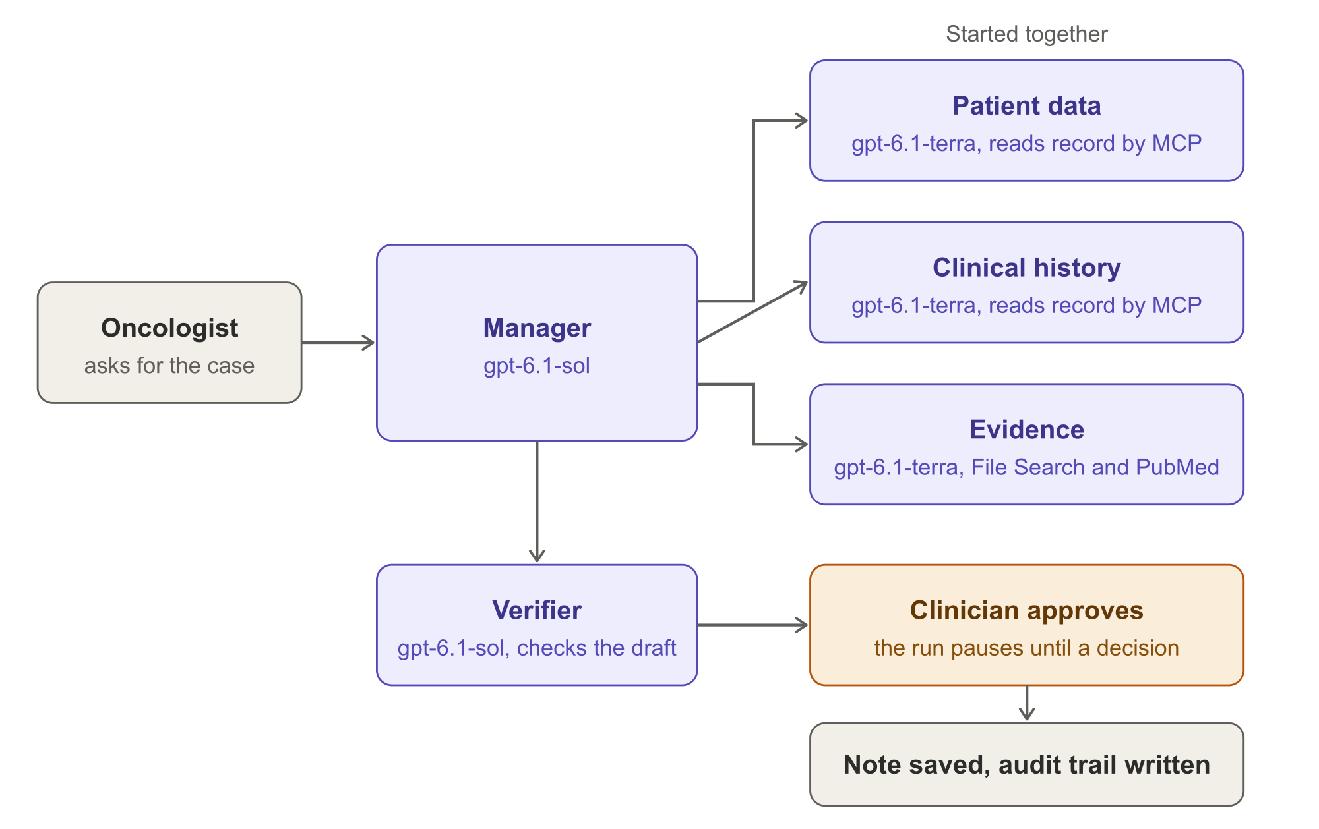
How it works
What happens in a run
1
Three specialists start together and read the record and the pathway documents
2
The manager drafts a packet that keeps patient facts, pathway text and inference apart
3
A separate verifier checks every claim against its source
4
The run pauses. Nothing is saved until the oncologist approves
Runs in the customer's AWS account: Cognito sign-in, AgentCore Runtime, an MCP server for the record, and DynamoDB for run state and the audit trail.
Notes:
This slide is the OpenAI side. A manager agent on gpt-6.1-sol starts three specialists together. The patient data and history specialists read the record through an MCP server. The evidence specialist searches the pathway documents with File Search and looks up PubMed. The specialists use gpt-6.1-terra, which is faster and cheaper, because they are reading and extracting. A separate verifier checks the draft. Then the run pauses for the oncologist. Everything runs in the customer's own AWS account; only model calls and pathway search go to OpenAI.

Slide 4
Expected value
88 seconds
of agent work per case, measured over 10 runs
About 10 cents
of model cost per case at list prices, measured
6 of 6 checks
on the planted problems passed in all 10 runs
About 33 hours a month
of clinician time saved (assumed: 40 cases, 75 down to 25 min)
Time and cost are measured on the synthetic case. Hours saved is an assumption, editable in the value model. A pilot would measure real preparation times.
Notes:
Separate measured from assumed. Measured on the synthetic case: about 88 seconds of agent work and under ten cents of model cost per case, and the checks on the planted problems passed in every one of ten runs. Assumed: forty cases a month and preparation dropping from seventy-five minutes to twenty-five, which gives about thirty-three hours a month. The dollar value of that time is modest. The bigger reason is catching conflicts before the meeting, which a pilot would measure.

Slide 5
Guardrails and next steps
Guardrails
Next steps
A clinician approves before anything is saved
No write to the patient record
Every run and approval is logged
The agent sees patient data only through scoped record tools
Synthetic data only in this demo
Before real patient data: confirm the business associate agreement and data retention terms with OpenAI
Weeks 1 to 4: run on 50 de-identified past cases and compare with the tumor board notes
Weeks 5 to 8: read-only connection to the record system, with oncologist feedback
Measure prep time, conflicts caught and how often clinicians edit the draft
Then decide whether to add more cancer types or trial matching
Notes:
Close on safety first, then the plan. The tool prepares and checks. A clinician decides. Nothing is written to a record. For real patient data we would first confirm the contract terms and run on de-identified past cases, so we can compare the assistant against what the tumor board actually concluded.

