Slide 1



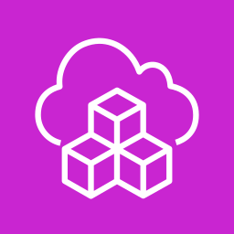




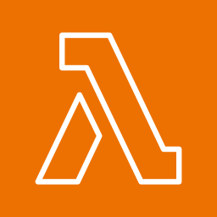
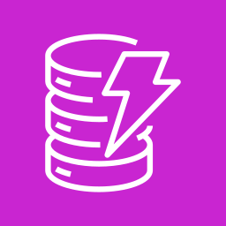

Architecture: AI-augmented tumor board case prep
People, AWS services and the OpenAI Platform. Numbers follow one request.
AWS Cloud: customer account, us-east-1
OpenAI Platform
Front end and sign-in
Build and operate
Responses API
gpt-6.1-sol: coordinator, verifier
gpt-6.1-terra: specialists
1
AWS Amplify Hosting
React app
Amazon Cognito
Sign-in, JWT
Amazon ECR
Amazon CloudWatch
AWS CDK
File Search
Oncology Care Guidelines, versioned
2
Amazon Bedrock AgentCore Runtime
OpenAI Agents SDK in a container. Six agents:
6
Tracing
Run traces for review
Tumor board panel
Navigators and clinicians, in a browser
Case coordinator agent
Patient data agent
Clinical history agent
Evidence agent
Similar cases agent
Verifier agent
The coordinator starts the four specialists together, then the verifier checks the draft.
7
Public sources
3
4
5
PubMed Recent literature
AWS Lambda
MCP server: masked record and past cases
Amazon DynamoDB
Run state, audit trail, daily run cap
AWS Secrets Manager
OpenAI key and MCP token
ClinicalTrials.gov Open trials, on request
1 Open the app and sign in. 2 Call the agents with the sign-in token. 3 Read the masked record and past cases by MCP. 4 Save run state and audit trail. 5 Fetch keys at start-up. 6 Model calls and guideline search. 7 Literature and trials.
Safeguards: names, record numbers and birth dates masked before any model call. Sign-in required on every request. A clinician approves before anything is saved. No write-back to patient records. Every step is logged.
Source code and deployment: github.com/rpmish99/oncology-case-prep-demo
Notes:
One request, left to right. A panel member opens the React app (hosted on AWS Amplify) and signs in with Amazon Cognito. The app calls the agents on Amazon Bedrock AgentCore Runtime with the sign-in token. The agents read a masked record and past cases through an MCP server on AWS Lambda, call the OpenAI Platform for the models and for File Search over the Oncology Care Guidelines, and query PubMed. Run state and the audit trail go to Amazon DynamoDB. Keys come from AWS Secrets Manager. Images, logs and deployment use Amazon ECR, Amazon CloudWatch and the AWS CDK.

