Slide 1
(First, let’s finish off MCTS…)

Slide 2
Planning with Partial Observability
Tom Silver
Robot Planning Meets Machine Learning
Princeton University
Fall 2025

Slide 3


Slide 4
Building Toward POMDPs

Slide 5


















Fully Observed
Partially Observed
$$S_{t}$$
$$S_{t+1}$$
$$S_{t}$$
$$S_{t+1}$$
Hidden Markov Model
(HMM)
Markov Chain
Passive
$$O_{t}$$
$$O_{t+1}$$
$$R_{t}$$
$$A_{t}$$
$$R_{t+1}$$
$$R_{t}$$
$$A_{t}$$
$$R_{t+1}$$
Partially Observed Markov
Decision Process
(POMDP)
Markov Decision Process
(MDP)
Active
$$S_{t}$$
$$S_{t+1}$$
$$S_{t}$$
$$S_{t+1}$$
$$O_{t}$$
$$O_{t+1}$$

Slide 6
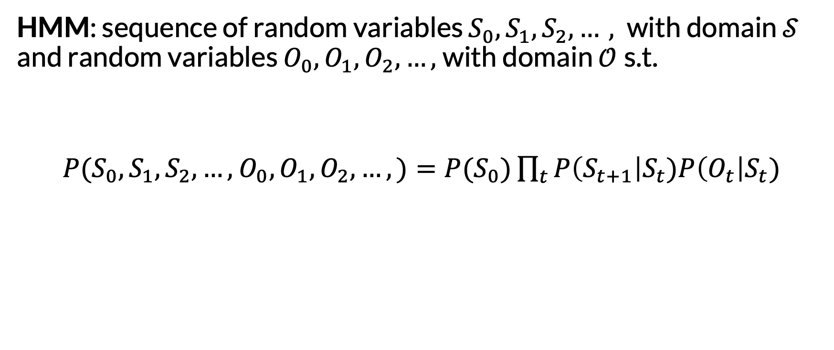
Hidden Markov Model (HMM)
HMM: sequence of random variables $S_{0}, S_{1}, S_{2},…,$with domain $𝒮$ and random variables $O_{0}, O_{1}, O_{2},…,$with domain $𝒪$s.t.
$P(S_{0}, S_{1}, S_{2},…,$ $O_{0}, O_{1}, O_{2},…,)=P(S_{0})\prod_{t}{P\left(S_{t+1}\right|S_{t})P\left(O_{t}\right|S_{t})}$

Slide 7
Hidden Markov Model (HMM)
HMM: sequence of random variables $S_{0}, S_{1}, S_{2},…,$with domain $𝒮$ and random variables $O_{0}, O_{1}, O_{2},…,$with domain $𝒪$s.t.
$P(S_{0}, S_{1}, S_{2},…,$ $O_{0}, O_{1}, O_{2},…,)=P(S_{0})\prod_{t}{P\left(S_{t+1}\right|S_{t})P\left(O_{t}\right|S_{t})}$
Initial state distribution

Slide 8
Hidden Markov Model (HMM)
HMM: sequence of random variables $S_{0}, S_{1}, S_{2},…,$with domain $𝒮$ and random variables $O_{0}, O_{1}, O_{2},…,$with domain $𝒪$s.t.
$P(S_{0}, S_{1}, S_{2},…,$ $O_{0}, O_{1}, O_{2},…,)=P(S_{0})\prod_{t}{P\left(S_{t+1}\right|S_{t})P\left(O_{t}\right|S_{t})}$
Initial state distribution
Transition model

Slide 9
Hidden Markov Model (HMM)
HMM: sequence of random variables $S_{0}, S_{1}, S_{2},…,$with domain $𝒮$ and random variables $O_{0}, O_{1}, O_{2},…,$with domain $𝒪$s.t.
$P(S_{0}, S_{1}, S_{2},…,$ $O_{0}, O_{1}, O_{2},…,)=P(S_{0})\prod_{t}{P\left(S_{t+1}\right|S_{t})P\left(O_{t}\right|S_{t})}$
Initial state distribution
Transition model
Observation model

Slide 10
Hidden Markov Model (HMM)
HMM: sequence of random variables $S_{0}, S_{1}, S_{2},…,$with domain $𝒮$ and random variables $O_{0}, O_{1}, O_{2},…,$with domain $𝒪$s.t.
$P(S_{0}, S_{1}, S_{2},…,$ $O_{0}, O_{1}, O_{2},…,)=P(S_{0})\prod_{t}{P\left(S_{t+1}\right|S_{t})P\left(O_{t}\right|S_{t})}$
The observation space
Initial state distribution
Transition model
Observation model

Slide 11

Example
How would we represent this scenario as a Hidden Markov Model?

Slide 12
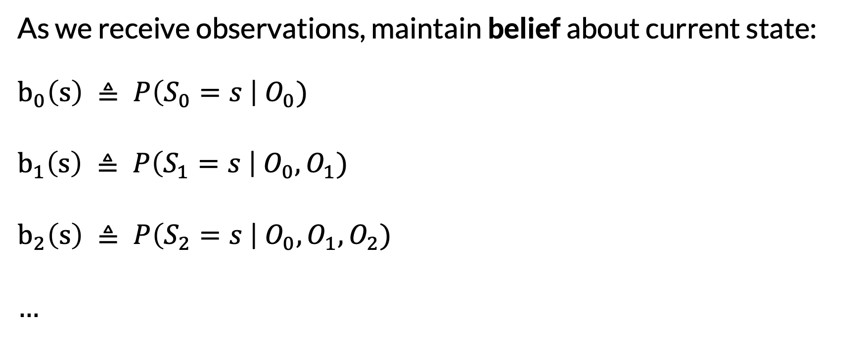
HMM Inference: Filtering
As we receive observations, maintain belief about current state: $$b_{0}\left(s\right) ≜ P\left(S_{0}=s \right| O_{0})$$
$$b_{1}\left(s\right) ≜ P\left(S_{1}=s \right| O_{0},O_{1})$$
$$b_{2}\left(s\right) ≜ P\left(S_{2}=s \right| O_{0},O_{1},O_{2})$$
…

Slide 13
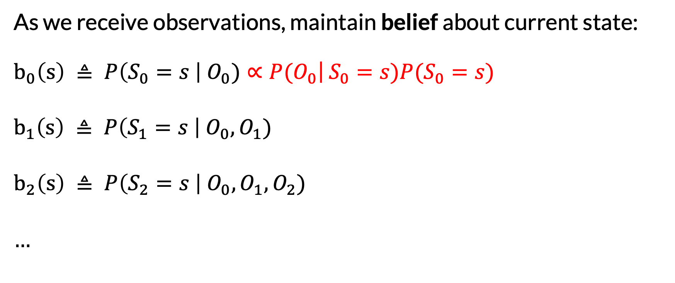
HMM Inference: Filtering
As we receive observations, maintain belief about current state: $b_{0}\left(s\right) ≜ P\left(S_{0}=s \right| O_{0})∝P(O_{0}$| $S_{0}=s)P(S_{0}=s)$
$$b_{1}\left(s\right) ≜ P\left(S_{1}=s \right| O_{0},O_{1})$$
$$b_{2}\left(s\right) ≜ P\left(S_{2}=s \right| O_{0},O_{1},O_{2})$$
…
Bayes’ Theorem

Slide 14
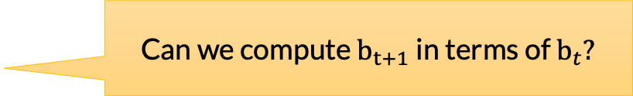
HMM Inference: Filtering
As we receive observations, maintain belief about current state: $b_{0}\left(s\right) ≜ P\left(S_{0}=s \right| O_{0})∝P(O_{0}$| $S_{0}=s)P(S_{0}=s)$
$$b_{1}\left(s\right) ≜ P\left(S_{1}=s \right| O_{0},O_{1})$$
$$b_{2}\left(s\right) ≜ P\left(S_{2}=s \right| O_{0},O_{1},O_{2})$$
…
Bayes’ Theorem
Can we compute $b_{t+1}$ in terms of $b_{t}?$

Slide 15
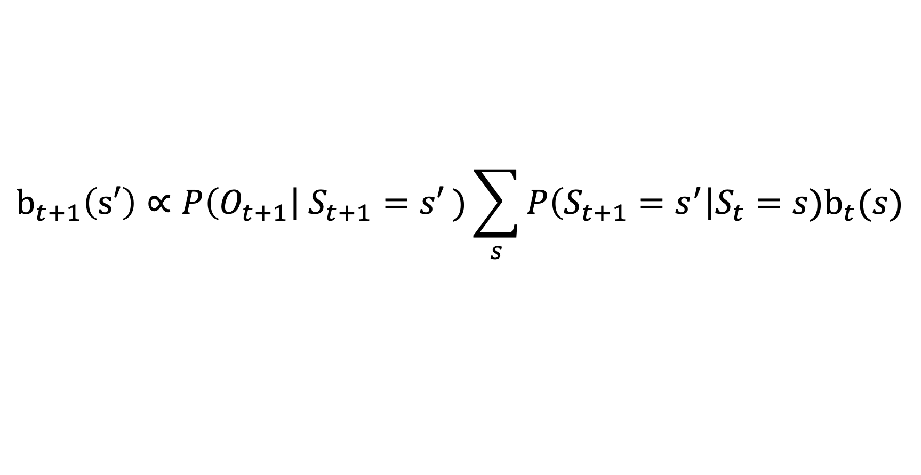
HMM Inference: Filtering
$$b_{t+1}\left(s′\right)∝P\left(O_{t+1}\right| S_{t+1}=s′ )\sum_{s}{P\left(S_{t+1}=s^{′}\right|S_{t}=s)b_{t}(s)}$$
Follows from definition of HMM
Forward algorithm or Viterbi

Slide 16

HMM Example: Moody Friend
States: mood in {0, 1, 2}
Observations: face in {smile, frown}
Transition distribution:
Stay the same with 0.8 probability
Otherwise, move to adjacent mood with uniform probability
Observation model:
P(smile | mood = 0) = 0.1
P(smile | mood = 1) = 0.5
P(smile | mood = 2) = 0.9

Slide 17
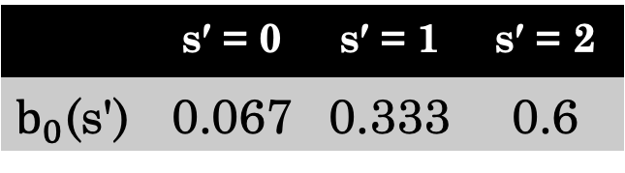
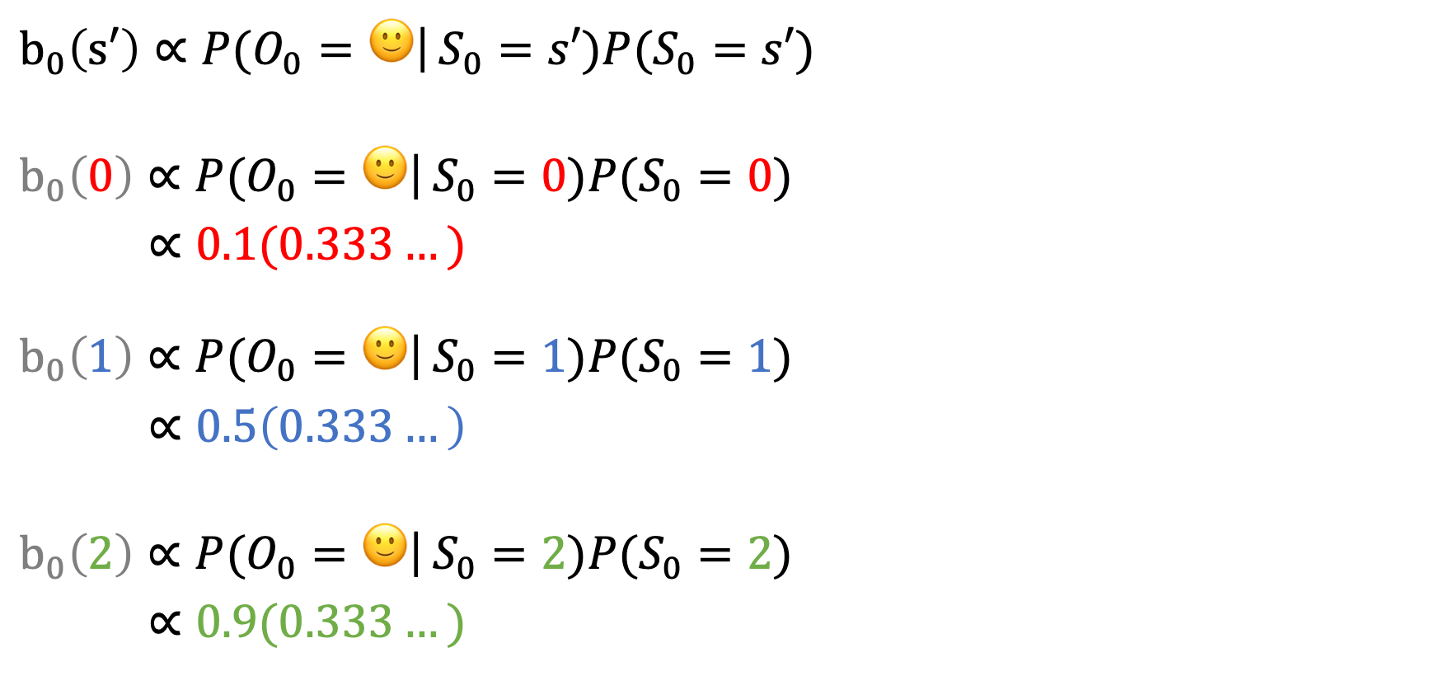

$b_{0}\left(s′\right)∝P(O_{0}=🙂$| $S_{0}=s′)P(S_{0}=s′)$
$b_{0}\left(0\right)∝P(O_{0}=🙂$| $S_{0}=0)P(S_{0}=0)$
$∝0.1(0.333…)$ $b_{0}\left(1\right)∝P(O_{0}=🙂$| $S_{0}=1)P(S_{0}=1)$
$∝0.5\left(0.333…\right)$
$b_{0}\left(2\right)∝P(O_{0}=🙂$| $S_{0}=2)P(S_{0}=2)$
$∝0.9(0.333…)$
 | $$\text{s}\text{′}\text{ = 0}$$ | $$\text{s}\text{′}\text{ = 1}$$ | $$\text{s}\text{′}\text{ = 2}$$
$b_{0}$(s') | 0.067 | 0.333 | 0.6
$$🙂$$

Slide 18
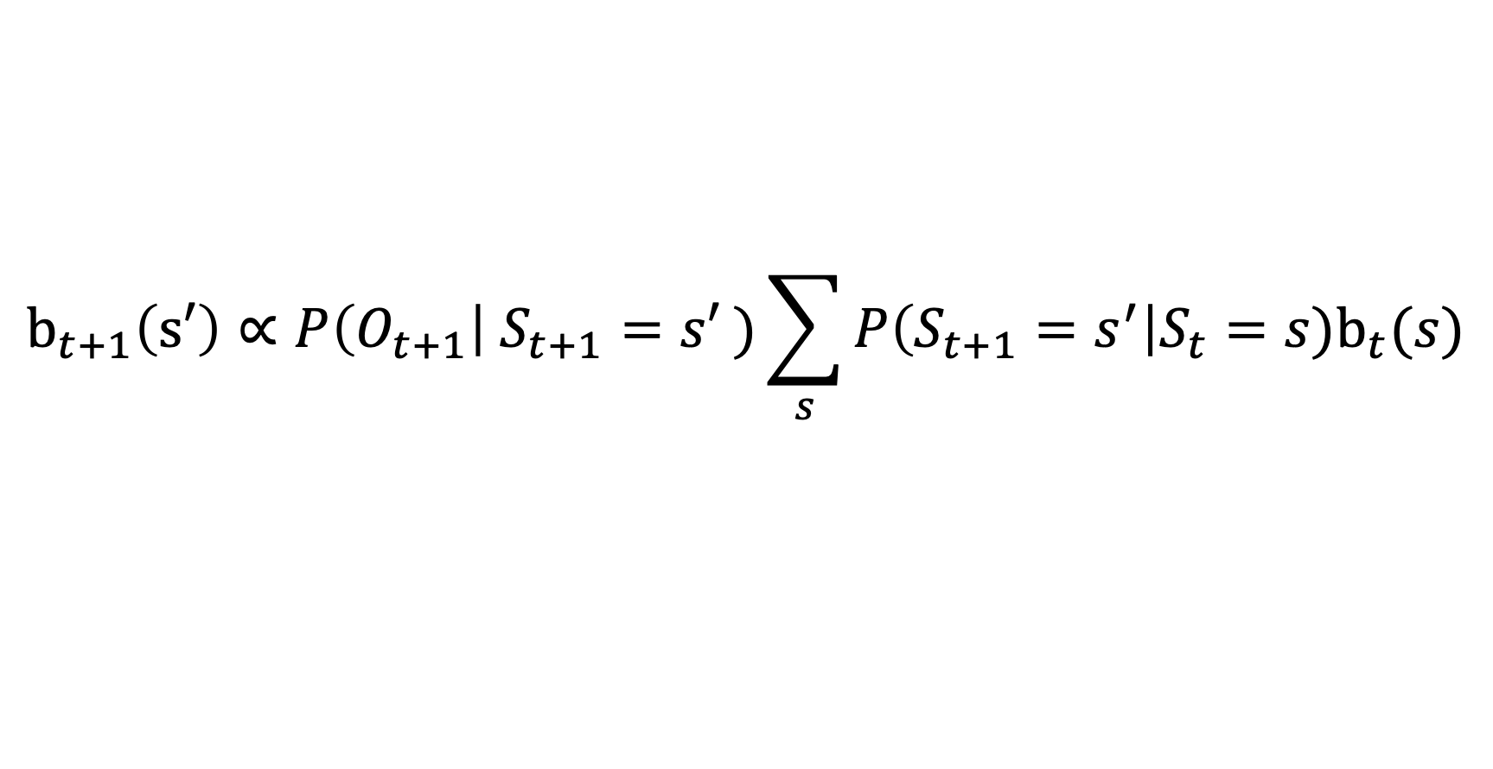



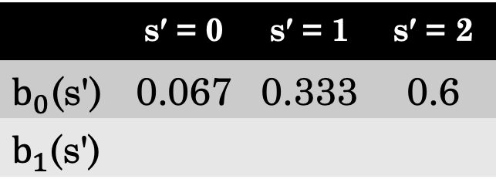
Practice On Your Own: Compute $b_{t+1}$Given Next Observation: $☹️$
 | $$\text{s}\text{′}\text{ = 0}$$ | $$\text{s}\text{′}\text{ = 1}$$ | $$\text{s}\text{′}\text{ = 2}$$
$b_{0}$(s') | 0.067 | 0.333 | 0.6
$b_{1}$(s')
$$🙂$$
$$☹️$$
$$b_{t+1}\left(s′\right)∝P\left(O_{t+1}\right| S_{t+1}=s′ )\sum_{s}{P\left(S_{t+1}=s^{′}\right|S_{t}=s)b_{t}(s)}$$

Slide 19
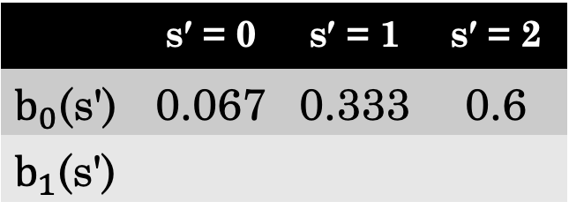
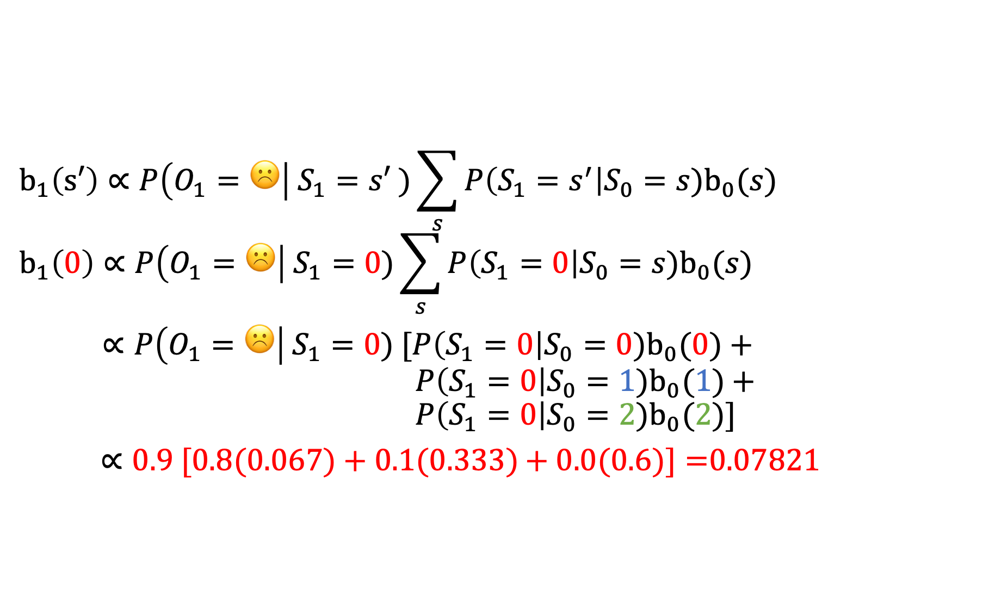


 | $$\text{s}\text{′}\text{ = 0}$$ | $$\text{s}\text{′}\text{ = 1}$$ | $$\text{s}\text{′}\text{ = 2}$$
$b_{0}$(s') | 0.067 | 0.333 | 0.6
$b_{1}$(s')
$$🙂$$
$$☹️$$
$$b_{1}\left(s′\right)∝P\left(O_{1}=☹️\right| S_{1}=s′ )\sum_{s}{P\left(S_{1}=s^{′}\right|S_{0}=s)b_{0}(s)}$$
$$b_{1}\left(0\right)∝P\left(O_{1}=☹️\right| S_{1}=0)\sum_{s}{P\left(S_{1}=0\right|S_{0}=s)b_{0}(s)}$$
$∝P\left(O_{1}=☹️\right| S_{1}=0) [P\left(S_{1}=0\right|S_{0}=0)b_{0}(0)+$ $P\left(S_{1}=0\right|S_{0}=1)b_{0}(1)$ $+$ $$P\left(S_{1}=0\right|S_{0}=2)b_{0}(2)]$$
$∝0.9 [0.8(0.067)+0.1(0.333)$ $+ 0.0(0.6)]=$0.07821

Slide 20
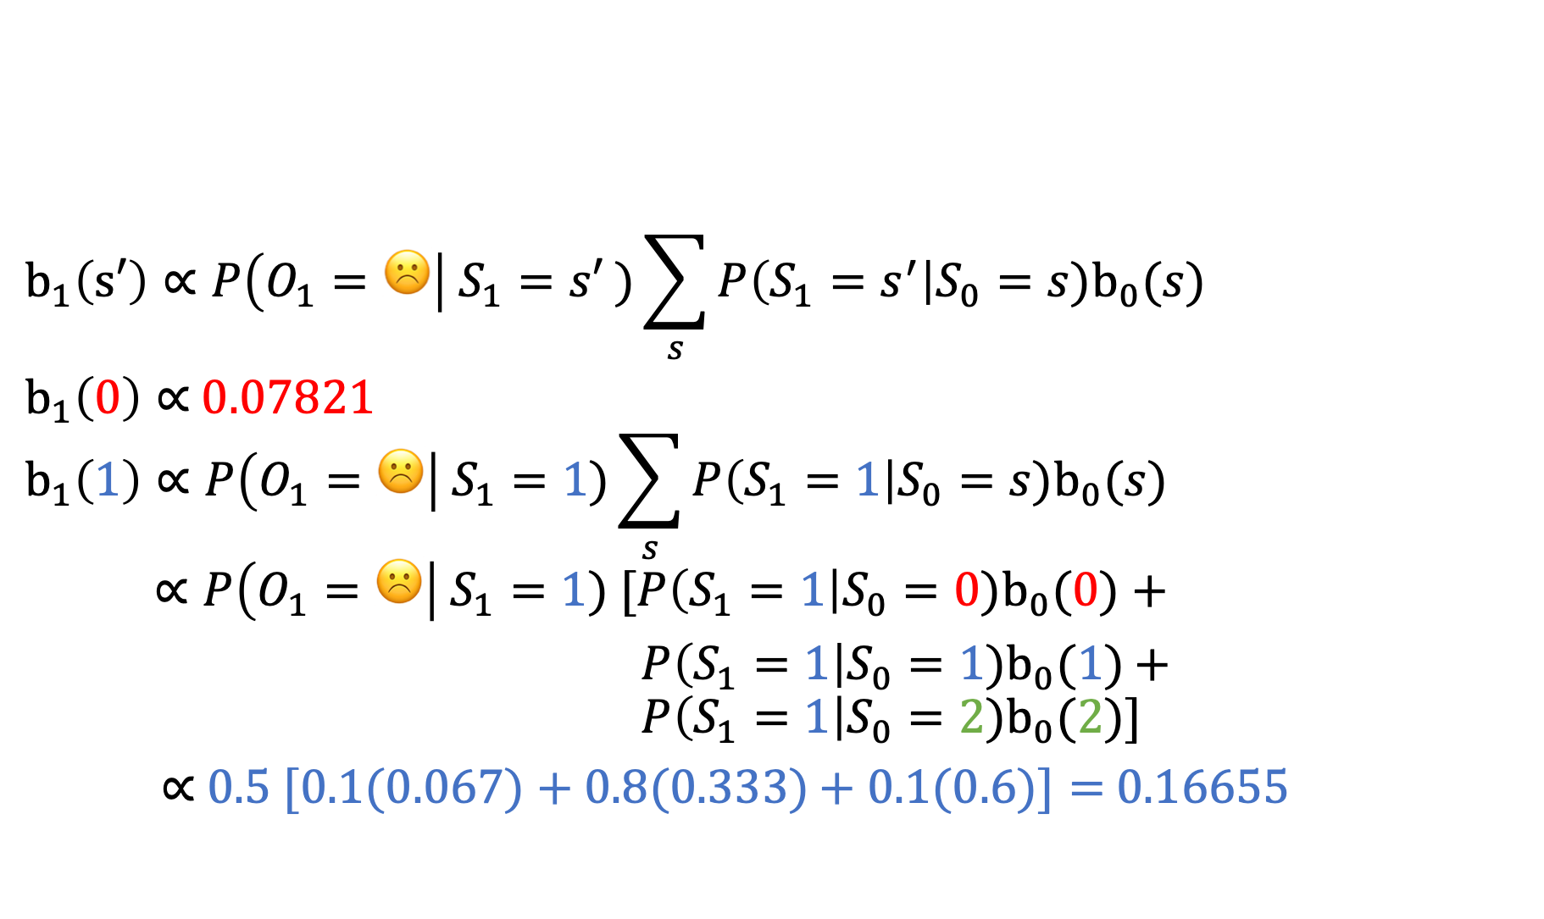
 | $$\text{s}\text{′}\text{ = 0}$$ | $$\text{s}\text{′}\text{ = 1}$$ | $$\text{s}\text{′}\text{ = 2}$$
$b_{0}$(s') | 0.067 | 0.333 | 0.6
$b_{1}$(s')
$$🙂$$
$$☹️$$
$$b_{1}\left(s′\right)∝P\left(O_{1}=☹️\right| S_{1}=s′ )\sum_{s}{P\left(S_{1}=s^{′}\right|S_{0}=s)b_{0}(s)}$$
$b_{1}\left(0\right)∝$0.07821
$$b_{1}\left(1\right)∝P\left(O_{1}=☹️\right| S_{1}=1)\sum_{s}{P\left(S_{1}=1\right|S_{0}=s)b_{0}(s)}$$
$$∝P\left(O_{1}=☹️\right| S_{1}=1) [P\left(S_{1}=1\right|S_{0}=0)b_{0}(0)+$$ $P\left(S_{1}=1\right|S_{0}=1)b_{0}(1)$ $+$ $$P\left(S_{1}=1\right|S_{0}=2)b_{0}(2)]$$
$∝$ $0.5 [0.1(0.067)+0.8(0.333)$ $+ 0.1(0.6)]=$ 0.16655

Slide 21
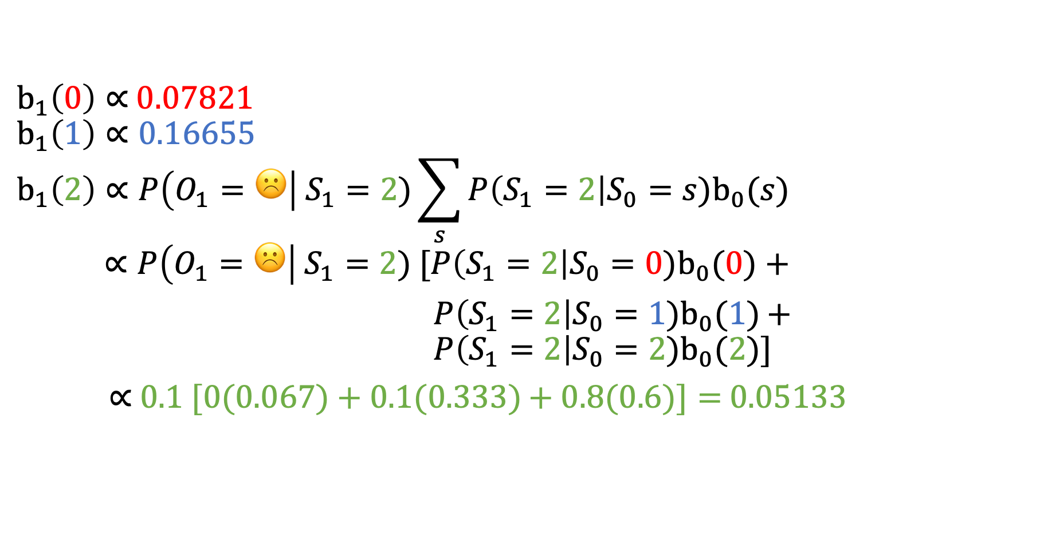
 | $$\text{s}\text{′}\text{ = 0}$$ | $$\text{s}\text{′}\text{ = 1}$$ | $$\text{s}\text{′}\text{ = 2}$$
$b_{0}$(s') | 0.067 | 0.333 | 0.6
$b_{1}$(s')
$$🙂$$
$$☹️$$
$b_{1}\left(0\right)∝$0.07821
$$b_{1}\left(1\right)∝\text{0.16655}$$
$$b_{1}\left(2\right)∝P\left(O_{1}=☹️\right| S_{1}=2)\sum_{s}{P\left(S_{1}=2\right|S_{0}=s)b_{0}(s)}$$
$$∝P\left(O_{1}=☹️\right| S_{1}=2) [P\left(S_{1}=2\right|S_{0}=0)b_{0}(0)+$$ $P\left(S_{1}=2\right|S_{0}=1)b_{0}(1)$ $+$ $$P\left(S_{1}=2\right|S_{0}=2)b_{0}(2)]$$
$∝$ $0.1 [0(0.067)+0.1(0.333)$ $+ 0.8(0.6)]=$ 0.05133

Slide 22
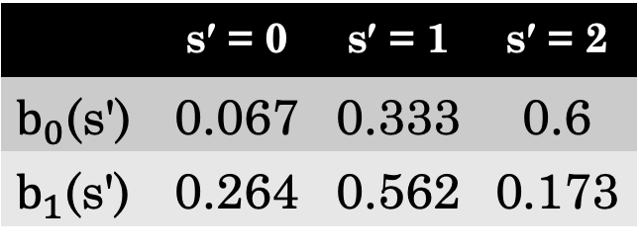

 | $$\text{s}\text{′}\text{ = 0}$$ | $$\text{s}\text{′}\text{ = 1}$$ | $$\text{s}\text{′}\text{ = 2}$$
$b_{0}$(s') | 0.067 | 0.333 | 0.6
$b_{1}$(s') | 0.264 | 0.562 | 0.173
$$🙂$$
$$☹️$$
Normalize
$b_{1}\left(0\right)∝$0.07821
$$b_{1}\left(1\right)∝\text{0.16655}$$
$b_{1}\left(2\right)∝$0.05133

Slide 23
Partially Observable MDP (POMDP)
POMDP: MDP + HMM.

Slide 24

Partially Observable MDP (POMDP)
POMDP: MDP + HMM.
State space $𝒮$
Action space $𝒜$
Reward function $R :𝒮×𝒜×𝒮→$ $ℝ$
Transition distribution $P(S_{t+1}∣A_{t}, S_{t})$
No longer observed!

Slide 25
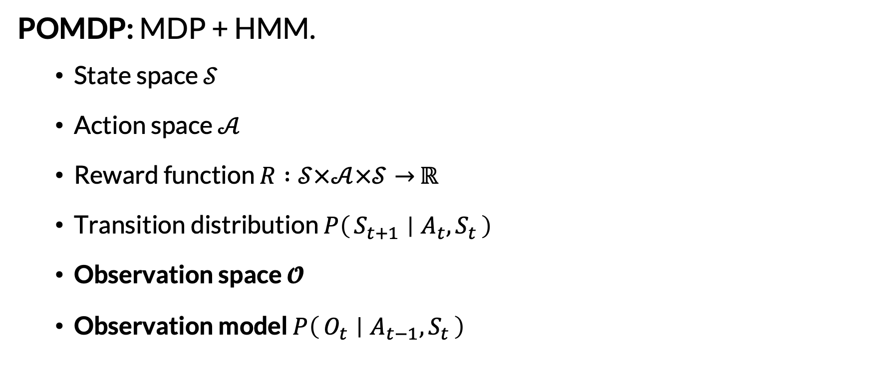
Partially Observable MDP (POMDP)
POMDP: MDP + HMM.
State space $𝒮$
Action space $𝒜$
Reward function $R :𝒮×𝒜×𝒮→$ $ℝ$
Transition distribution $P\left(S_{t+1} ∣ A_{t}, S_{t}\right)$
Observation space $𝓞$
Observation model $P\left(O_{t} ∣ A_{t−1}, S_{t}\right)$
Note: can depend on previous action

Slide 26
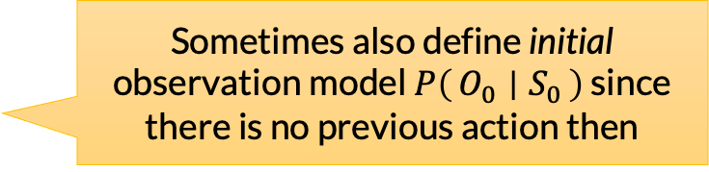
Partially Observable MDP (POMDP)
POMDP: MDP + HMM.
State space $𝒮$
Action space $𝒜$
Reward function $R :𝒮×𝒜×𝒮→$ $ℝ$
Transition distribution $P\left(S_{t+1} ∣ A_{t}, S_{t}\right)$
Observation space $𝓞$
Observation model $P\left(O_{t} ∣ A_{t−1}, S_{t}\right)$
Sometimes also define initial observation model $P\left(O_{0} ∣ S_{0}\right)$ since there is no previous action then

Slide 27







POMDP Influence Diagram
$$R_{t}$$
$$A_{t}$$
$$R_{t+1}$$
$$S_{t}$$
$$S_{t+1}$$
$$O_{t}$$
$$O_{t+1}$$

Slide 28
Things Carried Over from MDP Land
Assume finite state, action, and now observation spaces
Discrete time; possibly finite, infinite, or indefinite horizon
Still want to maximize expected utility

Slide 29
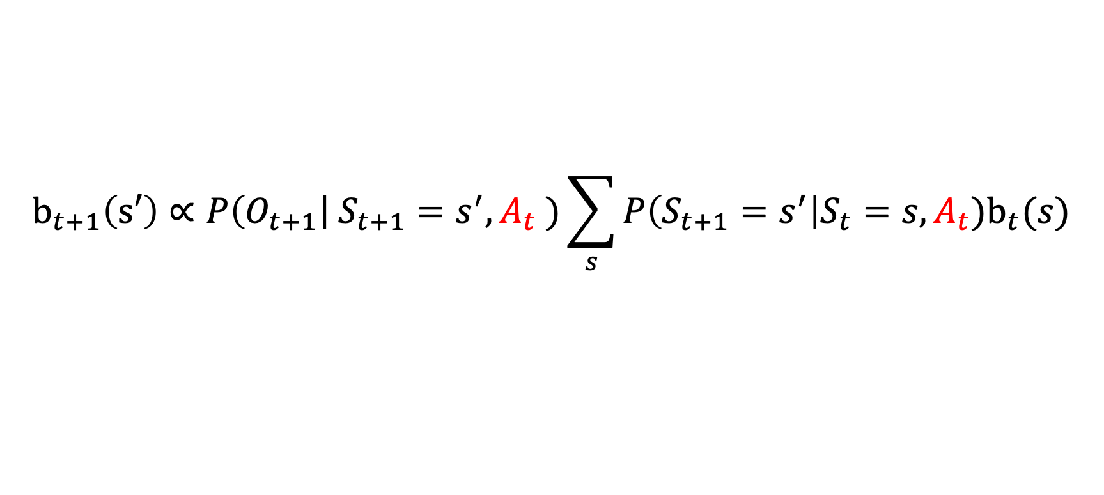
POMDP State Estimation
As with HMMs, we will want to maintain belief about current state.
$$b_{t+1}\left(s′\right)∝P\left(O_{t+1}\right| S_{t+1}=s^{′}, A_{t} )\sum_{s}{P\left(S_{t+1}=s^{′}\right|S_{t}=s, A_{t})b_{t}(s)}$$
Now conditioned on actions
Sometimes called state estimation

Slide 30

Example: Treasure Hunt
States: (robot-loc, treasure-loc) in 3-cell grid
Actions: move-left, move-right, scan-left, scan-right
Observations: (robot-loc, scan-response)
Scan responses: got-response, got-no-response, not-applicable
Rewards: 100 if robot at treasure, -1 for each step
Horizon: indefinite (terminate when treasure obtained)
Transition distribution:
Move actions: succeed with 0.95 probability. Otherwise, move in the other direction
Scan actions result in no state change
Observation model:
Scan actions: get accurate response with 0.9 probability
Both actions: always observe correct robot location
Initial timestep: observe robot location only
?
?

Slide 31
Example: Treasure Hunt
Under what circumstances should the robot scan before moving?
States: (robot-loc, treasure-loc) in 3-cell grid
Actions: move-left, move-right, scan-left, scan-right
Observations: (robot-loc, scan-response)
Scan responses: got-response, got-no-response, not-applicable
Rewards: 100 if robot at treasure, -1 for each step
Horizon: indefinite (terminate when treasure obtained)
Transition distribution:
Move actions: succeed with 0.95 probability. Otherwise, move in the other direction
Scan actions result in no state change
Observation model:
Scan actions: get accurate response with 0.9 probability
Both actions: always observe correct robot location
Initial timestep: observe robot location only
?
?

Slide 32
Planning in POMDPs
Offline Planning
Value iteration for POMDPs
Policy iteration for POMDPs
See: PBVI, Witness Algorithm
Online Planning
Expectimax search for POMDPs
Sparse sampling for large transitions
Bandits / MCTS for smarter exploration
See: POMCP, DESPOT

Slide 33
Planning in POMDPs
Offline Planning
Value iteration for POMDPs
Policy iteration for POMDPs
See: PBVI, Witness Algorithm
Online Planning
Expectimax search for POMDPs
Sparse sampling for large transitions
Bandits / MCTS for smarter exploration
See: POMCP, DESPOT
We’ll start here this time

Slide 34


POMDP Planning Online (In the Wild)
We ship the robot with the POMDP and have it plan online.
Don’t plan at all
I know POMDP!
Plan in POMDP
Factory
Wild
Shipping

Slide 35
0.5
0.5
Initial Belief State
?
?

Slide 36
0.5
0.5
Initial Belief State
?
?
👂
👂
Actions

Slide 37
0.5
0.5
Initial Belief State
?
?
👂
👂
Actions
Observations
🔔
🔕
🔔
🔕

Slide 38
0.5
0.5
Initial Belief State
?
?
👂
👂
Actions
Observations
🔔
🔕
🔔
🔕
Next Belief States
0.9
0.1
0.1
0.9
0.5
0.5
0.5
0.5
0.5
0.5
0.5
0.5
0.1
0.9
0.9
0.1
?
?
?
?
?
?
?
?
?
?
?
?

Slide 39
If we combine these, we get back to MDP land! But continuous states
0.5
0.5
Initial Belief State
?
?
👂
👂
Actions
Observations
🔔
🔕
🔔
🔕
Next Belief States
0.9
0.1
0.1
0.9
0.5
0.5
0.5
0.5
0.5
0.5
0.5
0.5
0.1
0.9
0.9
0.1
?
?
?
?
?
?
?
?
?
?
?
?

Slide 40
POMDP → Belief MDP
0.5
0.5
0.9
0.1
0.1
0.9
State space: beliefs
?
?
?
?
?
?
Three example states in the belief MDP

Slide 41
POMDP → Belief MDP
0.5
0.5
0.9
0.1
0.1
0.9
State space: beliefs
Action space: same
?
?
?
?
?
?

Slide 42
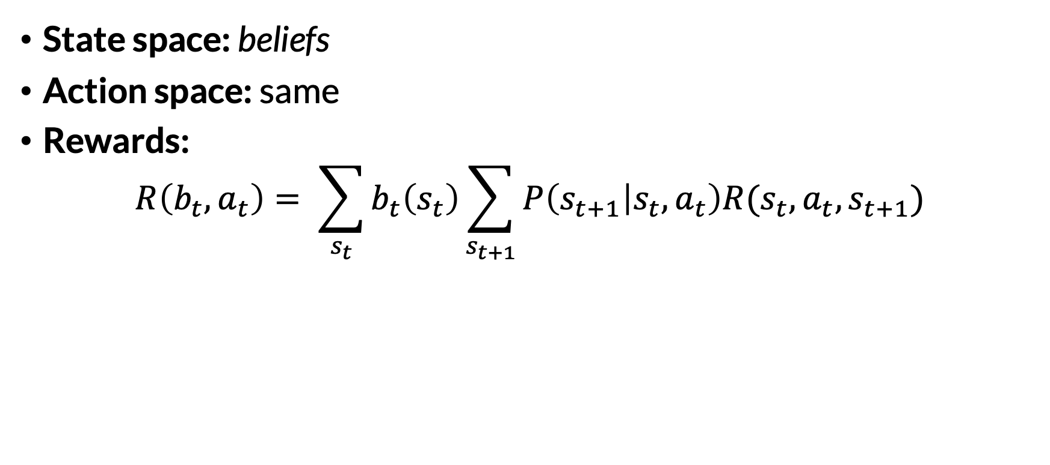
POMDP → Belief MDP
0.5
0.5
0.9
0.1
0.1
0.9
State space: beliefs
Action space: same
Rewards:
$$R\left(b_{t}, a_{t}\right)= \sum_{s_{t}}{b_{t}\left(s_{t}\right)}\sum_{s_{t+1}}{P\left(s_{t+1} | s_{t}, a_{t}\right)R(s_{t}, a_{t}, s_{t+1})}$$
?
?
?
?
?
?

Slide 43
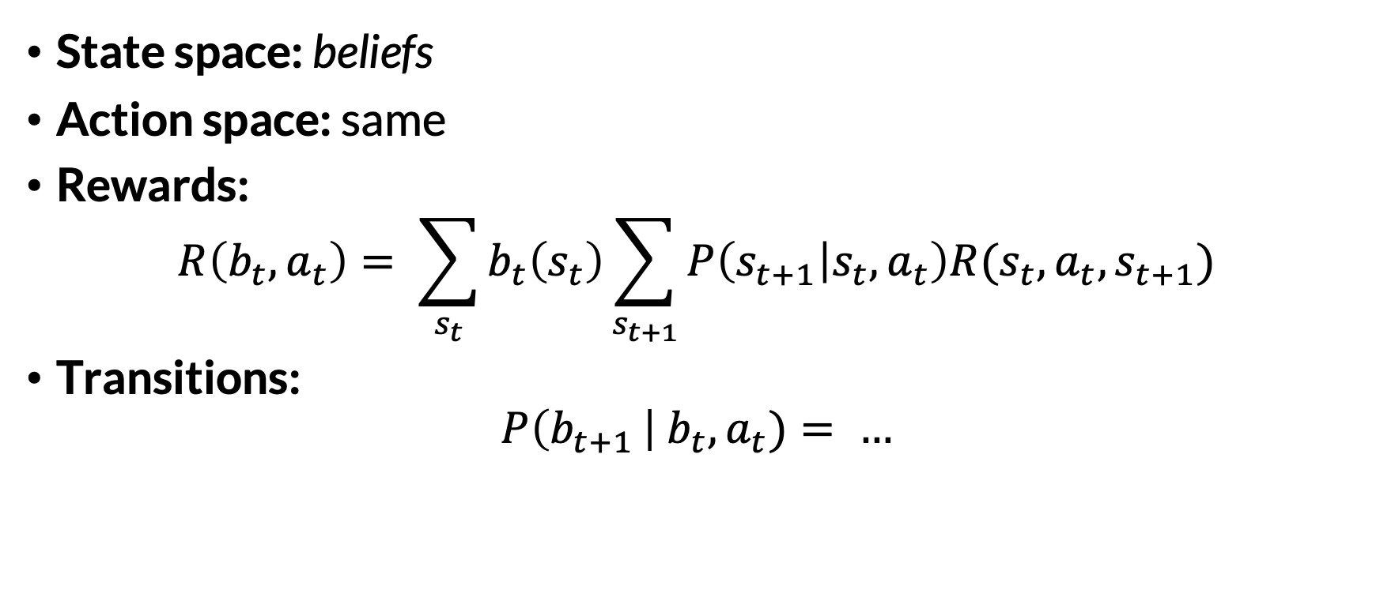
POMDP → Belief MDP
0.5
0.5
0.9
0.1
0.1
0.9
State space: beliefs
Action space: same
Rewards:
$$R\left(b_{t}, a_{t}\right)= \sum_{s_{t}}{b_{t}\left(s_{t}\right)}\sum_{s_{t+1}}{P\left(s_{t+1} | s_{t}, a_{t}\right)R(s_{t}, a_{t}, s_{t+1})}$$
Transitions:
$$P\left(b_{t+1 }\right| b_{t}, a_{t})= …$$
?
?
?
?
?
?

Slide 44
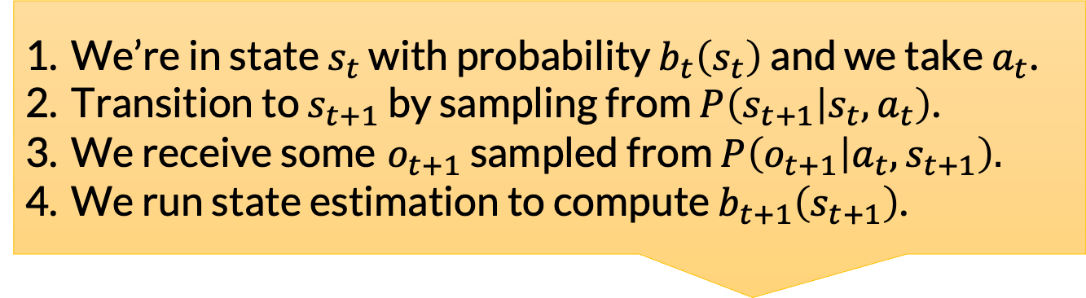
POMDP → Belief MDP
0.5
0.5
0.9
0.1
0.1
0.9
State space: beliefs
Action space: same
Rewards:
$$R\left(b_{t}, a_{t}\right)= \sum_{s_{t}}{b_{t}\left(s_{t}\right)}\sum_{s_{t+1}}{P\left(s_{t+1} | s_{t}, a_{t}\right)R(s_{t}, a_{t}, s_{t+1})}$$
Transitions:
$$P\left(b_{t+1 }\right| b_{t}, a_{t})= …$$
?
?
?
?
?
?
We’re in state $s_{t}$ with probability $b_{t}\left(s_{t}\right)$ and we take $a_{t}$.
Transition to $s_{t+1}$ by sampling from $P\left(s_{t+1} | s_{t}, a_{t}\right)$.
We receive some $o_{t+1}$ sampled from $P\left(o_{t+1} | a_{t},s_{t+1}\right).$
We run state estimation to compute $b_{t+1}\left(s_{t+1}\right)$.

Slide 45
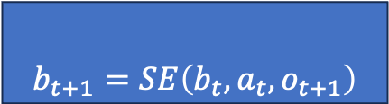
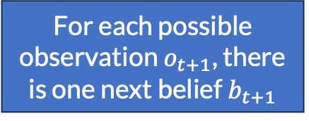
POMDP → Belief MDP
0.5
0.5
0.9
0.1
0.1
0.9
State space: beliefs
Action space: same
Rewards:
$$R\left(b_{t}, a_{t}\right)= \sum_{s_{t}}{b_{t}\left(s_{t}\right)}\sum_{s_{t+1}}{P\left(s_{t+1} | s_{t}, a_{t}\right)R(s_{t}, a_{t}, s_{t+1})}$$
Transitions:
$$P\left(b_{t+1 }\right| b_{t}, a_{t})= …$$
?
?
?
?
?
?
We’re in state $s_{t}$ with probability $b_{t}\left(s_{t}\right)$ and we take $a_{t}$.
Transition to $s_{t+1}$ by sampling from $P\left(s_{t+1} | s_{t}, a_{t}\right)$.
We receive some $o_{t+1}$ sampled from $P\left(o_{t+1} | a_{t},s_{t+1}\right).$
We run state estimation to compute $b_{t+1}\left(s_{t+1}\right)$.
For each possible observation $o_{t+1}$, there is one next belief $b_{t+1}$
$b_{t+1}=SE\left(b_{t}, a_{t}, o_{t+1}\right)$
Notation:

Slide 46
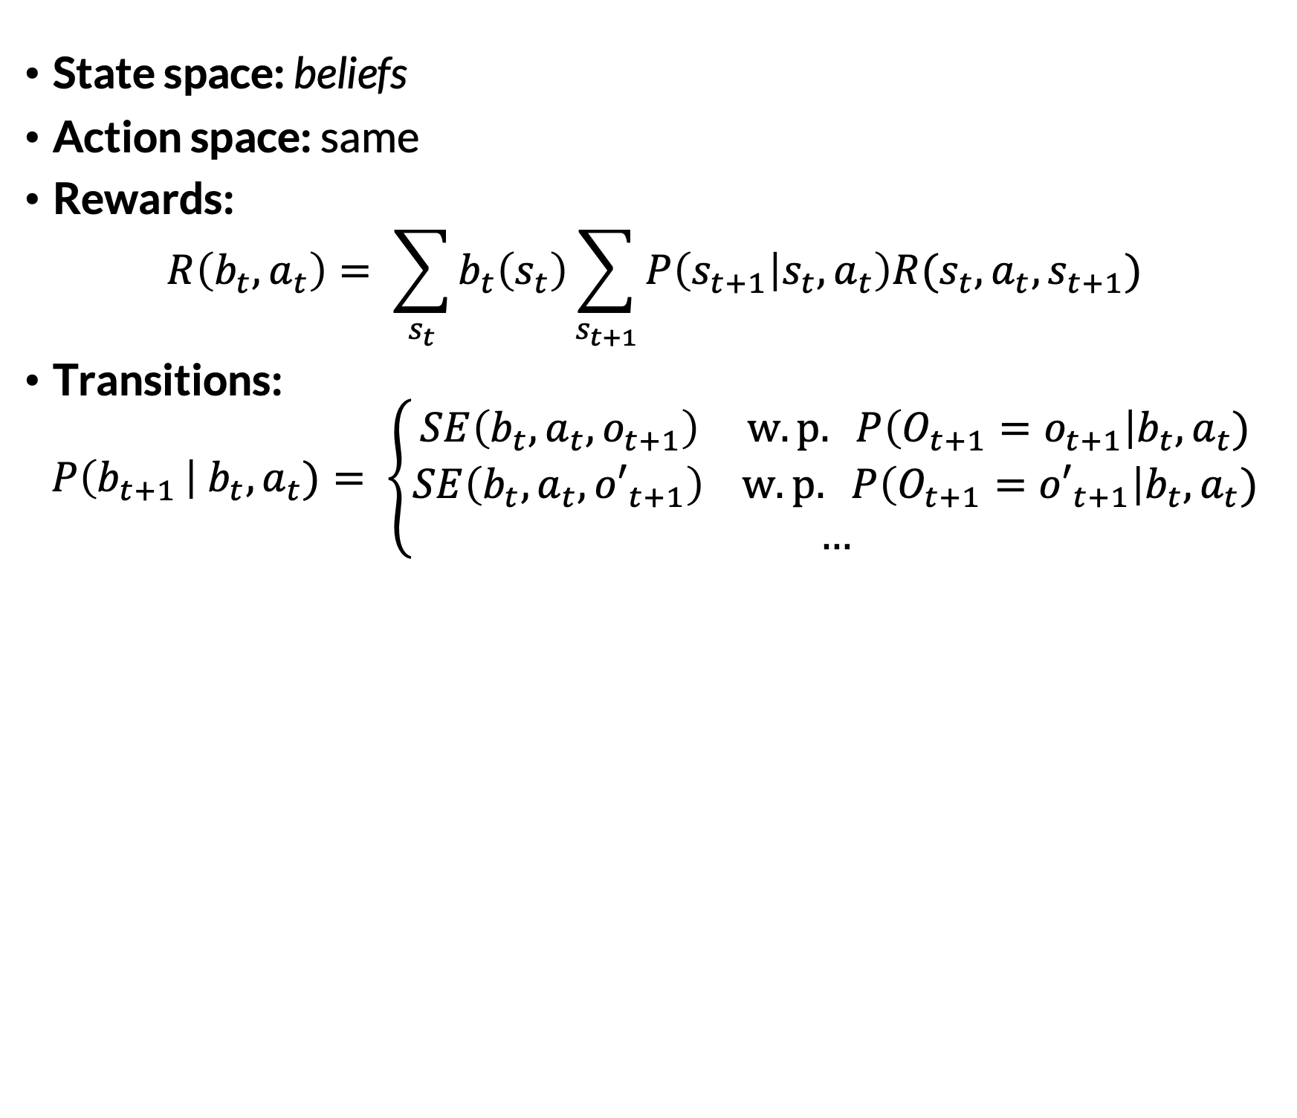
POMDP → Belief MDP
0.5
0.5
0.9
0.1
0.1
0.9
State space: beliefs
Action space: same
Rewards:
$$R\left(b_{t}, a_{t}\right)= \sum_{s_{t}}{b_{t}\left(s_{t}\right)}\sum_{s_{t+1}}{P\left(s_{t+1} | s_{t}, a_{t}\right)R(s_{t}, a_{t}, s_{t+1})}$$
Transitions:
$$P\left(b_{t+1 }\right| b_{t}, a_{t})= \left\{\begin{aligned}SE\left(b_{t}, a_{t}, o_{t+1}\right) w.p. P\left(O_{t+1}=o_{t+1}\right|b_{t}, a_{t}) \\ SE\left(b_{t}, a_{t}, {o′}_{t+1}\right) w.p. P\left(O_{t+1}={o′}_{t+1}\right|b_{t}, a_{t}) \\ …\end{aligned}\right.$$
?
?
?
?
?
?
What is this?

Slide 47
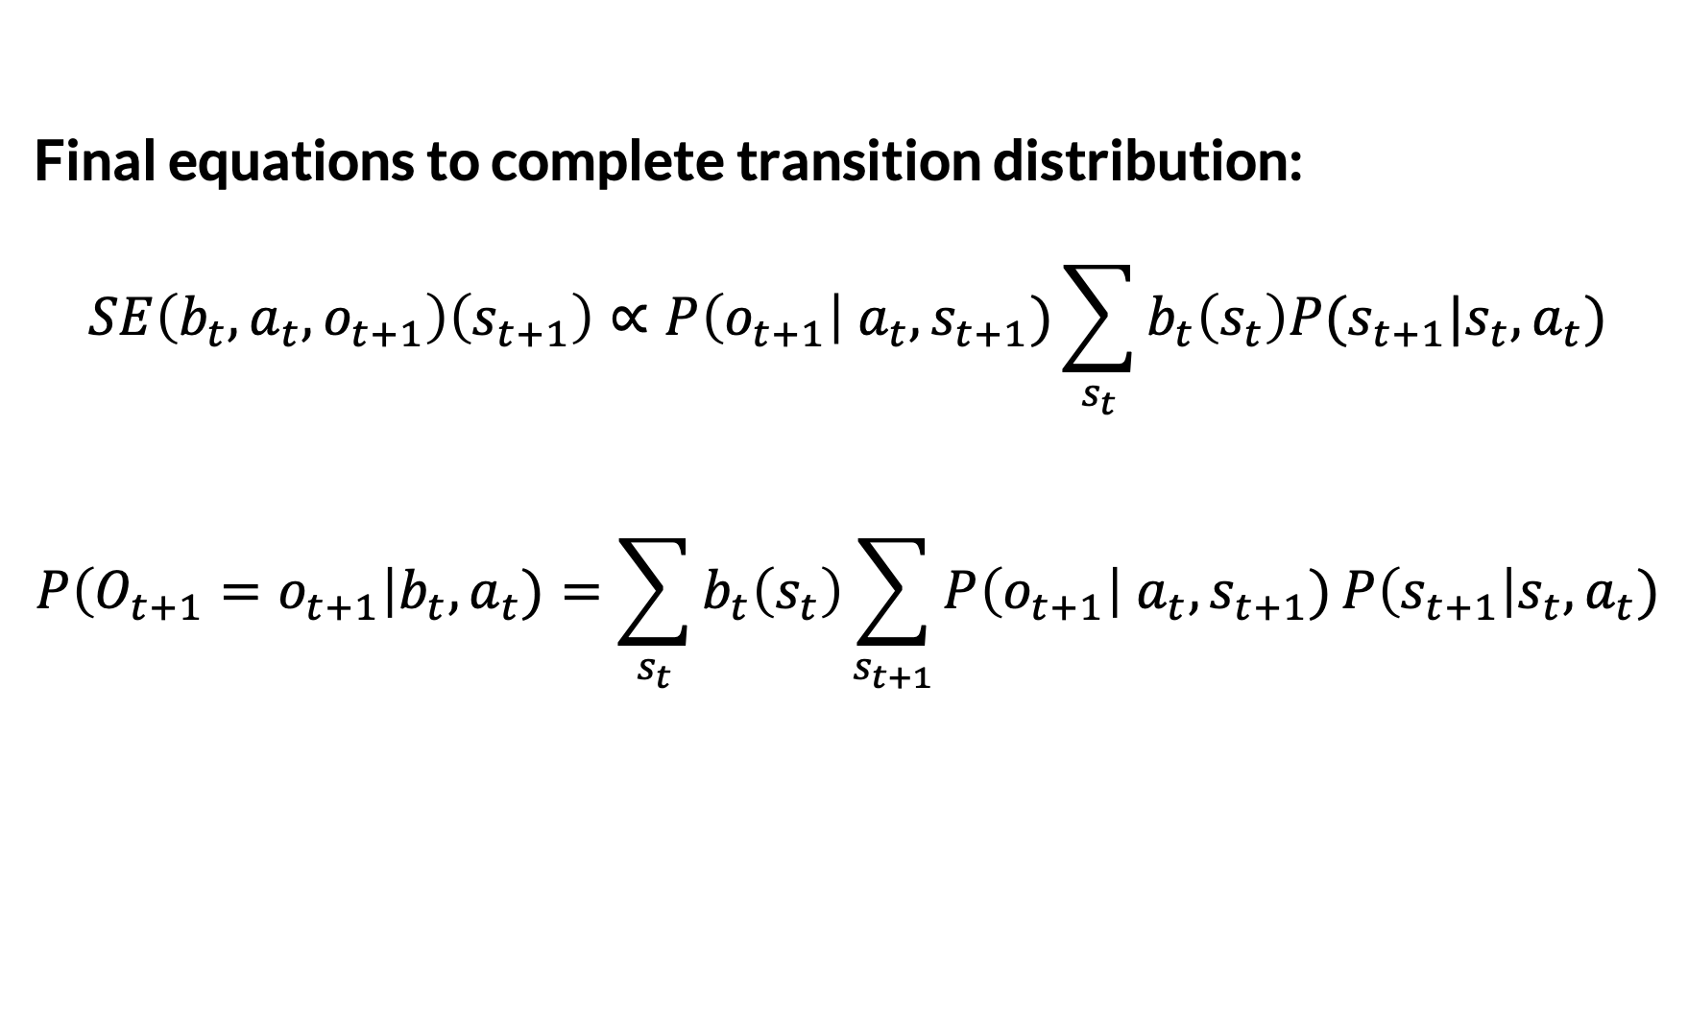
POMDP → Belief MDP
Final equations to complete transition distribution: $$SE\left(b_{t}, a_{t}, o_{t+1}\right)\left(s_{t+1}\right)∝P\left(o_{t+1}\right|{ a_{t}, s}_{t+1})\sum_{s_{t}}{b_{t}\left(s_{t}\right)P(s_{t+1}|s_{t}, a_{t}})$$ $$P\left(O_{t+1}=o_{t+1}\right|b_{t}, a_{t})=\sum_{s_{t}}{b_{t}\left(s_{t}\right)}\sum_{s_{t+1}}{P\left(o_{t+1}\right|{ a_{t}, s}_{t+1})}P\left(s_{t+1}\right|s_{t}, a_{t})$$
Same as “state estimation” slide

Slide 48
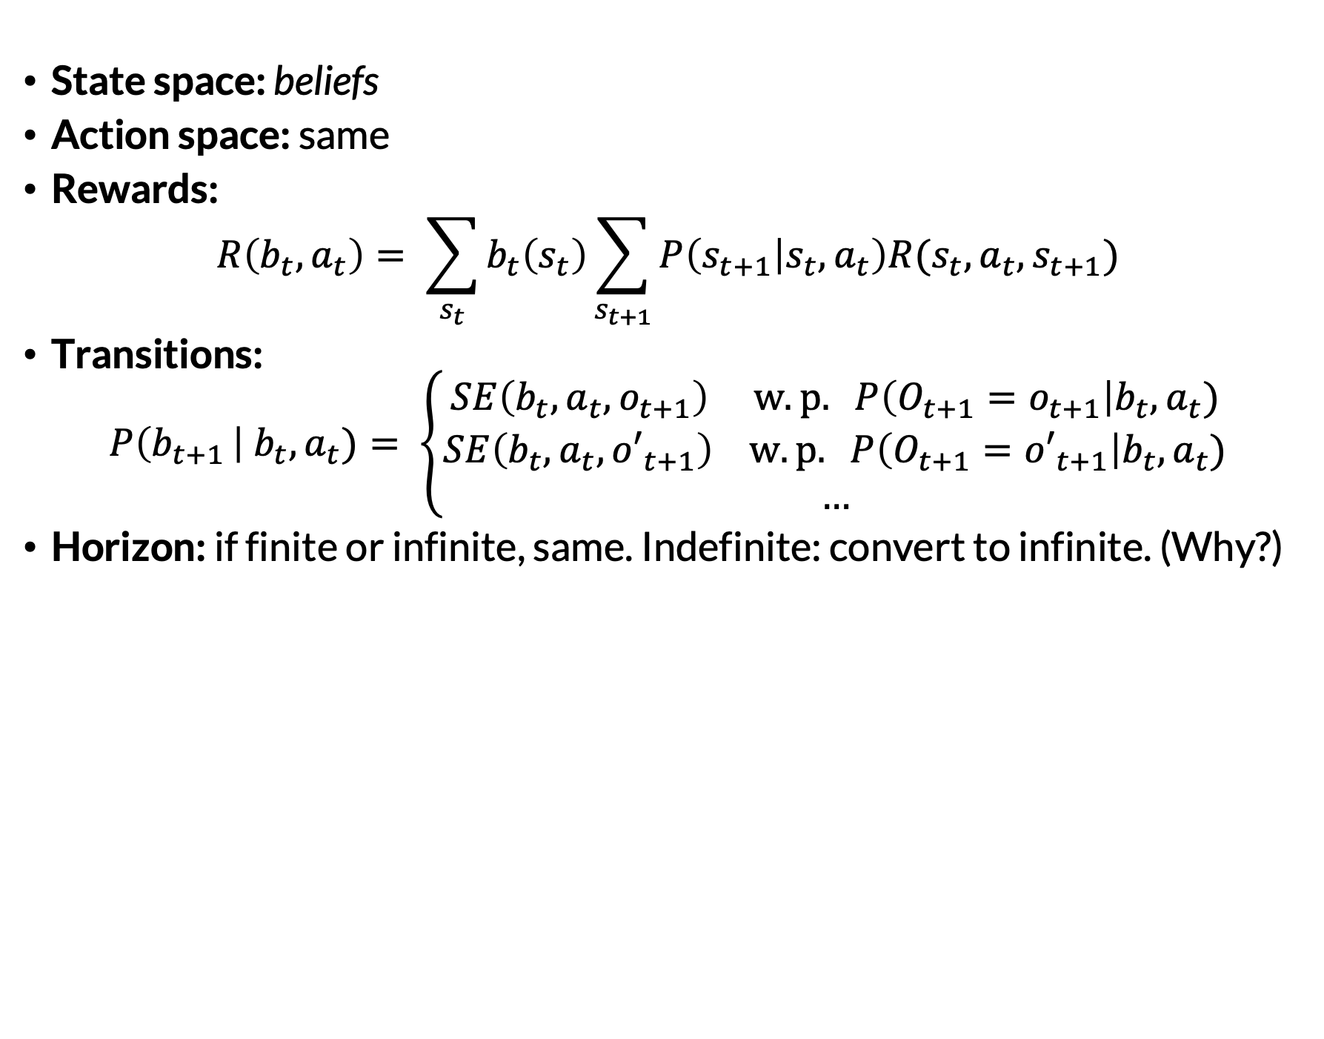
POMDP → Belief MDP
0.5
0.5
0.9
0.1
0.1
0.9
State space: beliefs
Action space: same
Rewards:
$$R\left(b_{t}, a_{t}\right)= \sum_{s_{t}}{b_{t}\left(s_{t}\right)}\sum_{s_{t+1}}{P\left(s_{t+1} | s_{t}, a_{t}\right)R(s_{t}, a_{t}, s_{t+1})}$$
Transitions:
$$P\left(b_{t+1 }\right| b_{t}, a_{t})= \left\{\begin{aligned}SE\left(b_{t}, a_{t}, o_{t+1}\right) w.p. P\left(O_{t+1}=o_{t+1}\right|b_{t}, a_{t}) \\ SE\left(b_{t}, a_{t}, {o′}_{t+1}\right) w.p. P\left(O_{t+1}={o′}_{t+1}\right|b_{t}, a_{t}) \\ …\end{aligned}\right.$$
Horizon: if finite or infinite, same. Indefinite: convert to infinite. (Why?)
?
?
?
?
?
?

Slide 49
https://github.com/rpmml/rpmml-code/blob/main/scripts/treasure_hunt_pomdp_walkthrough.py

Slide 50
POMDP Expectimax Search
Run expectimax search in the belief MDP. …
That’s pretty much it!

Slide 51
0.5
0.5
?
?

Slide 52
0.5
0.5
?
?
👂
👂

Slide 53
0.5
0.5
?
?
👂
👂
🔔
🔕
🔔
🔕

Slide 54









$P\left(o_{1}\right|b_{0}, a_{0})$ =$\sum_{s_{0}}{b_{0}(s_{0})}\sum_{s_{1}}{P\left(o_{1}\right|s_{1}, a_{0})P\left(s_{1}\right|s_{0},a_{0})}$
0.5
0.5
?
?
👂
👂
$$0.5$$
$$0.5$$
$$0.95$$
$$0.05$$
$$0.05$$
$$0.95$$
$$0.5$$
$$0.5$$
🔔
🔕
🔔
🔕

Slide 55

0.5
0.5
?
?
👂
👂
$$0.5$$
$$0.5$$
$$0.95$$
$$0.05$$
$$0.05$$
$$0.95$$
$$0.5$$
$$0.5$$
🔔
🔕
🔔
🔕
$$P\left(s_{1} | b_{0}, a_{0}, o_{1}\right)=\frac{P\left(o_{1}| b_{0}, a_{0}, s_{1}\right)P\left(s_{1}\right|b_{0},a_{0})}{P\left(o_{1}| b_{0}, a_{0}\right)}∝P\left(o_{1}\right|s_{1}, a_{0})\sum_{s_{0}}{P\left(s_{1}\right|s_{0},a_{0})b_{0}(s_{0})}$$
$$P\left(s_{1}=L | b_{0}, a_{0}, o_{1}\right)∝0.9\left(1 ∗0.5+1 ∗0.5\right)=0.9$$
$$P\left(s_{1}=R | b_{0}, a_{0}, o_{1}\right)∝0.1\left(1 ∗0.5+1 ∗0.5\right)=0.1$$

Slide 56
0.5
0.5
?
?
👂
👂
$$0.5$$
$$0.5$$
$$0.95$$
$$0.05$$
$$0.05$$
$$0.95$$
$$0.5$$
$$0.5$$
🔔
🔕
🔔
🔕
0.9
0.1
0.1
0.9
0.5
0.5
0.5
0.5
0.5
0.5
0.5
0.5
0.1
0.9
0.9
0.1
?
?
?
?
?
?
?
?
?
?
?
?

Slide 57
0.5
0.5
?
$$0.95$$
Intuitively, what do you expect?
?

Slide 58


0.5
0.5
?
$$0.95$$
$$P\left(s_{2} | b_{1}, a_{1}, o_{2}\right)∝P\left(o_{2}\right|s_{2}, a_{1})\sum_{s_{1}}{P\left(s_{2}\right|s_{1},a_{1})b_{1}(s_{1})}$$
$P\left(s_{2}=L | b_{1}, a_{1}, o_{2}\right)∝$ 1.0 $∗$ (1.0 $∗$ 0.5) = 0.5
?
$$P\left(s_{2}=R | b_{1}, a_{1}, o_{2}\right)∝1.0 ∗\left(0.95 ∗0.5\right)=0.475$$

Slide 59
Completing the Expectimax Agent
Receive initial observation
Initialize belief
Repeat:
Run expectimax search in belief MDP
Execute action and receive observation
Run state estimation to update belief

Slide 60
Example: Home Inspection
Solve!
States: home-value in {100, 300}
Actions: buy, do-not-buy, cheap-inspect, premium-inspect
Observations: good-deal or bad-deal or none
Rewards:
+$100 if buy and home-value=300
-$100 if buy and home-value=100
-$10 to cheap-inspect
-$50 to premium-inspect
Horizon: indefinite (terminate after buy or do-not-buy)
Transition distribution:
There is a 5% chance that inspecting will make home-value 100
Observation model:
Cheap-inspect is 75% accurate
Premium-inspect is 90% accurate

Slide 61
Planning in POMDPs
Offline Planning
Value iteration for POMDPs
Policy iteration for POMDPs
See: PBVI, Witness Algorithm
Online Planning
Expectimax search for POMDPs
Sparse sampling for large transitions
Bandits / MCTS for smarter exploration
See: POMCP, DESPOT
Now this

Slide 62

POMDP Planning Offline (In the Factory)
Run POMDP value iteration offline (in the factory) and compute $π$.
Run value iteration once
I know $π!$
Execute $π$
Factory
Wild
Shipping

Slide 63

A Stupidest Possible Algorithm
$$π_{MLS}\left(b\right) ≜π_{MDP}^{∗}\left({argmax}_{s} b\left(s\right)\right)$$
where
MLS = “Most Likely State” approximation
$π_{MDP}^{∗}$is an optimal policy for the underlying MDP
Why is this “stupid”?

Slide 64
Another Stupidest Possible Algorithm
Enumerate candidate policies
Evaluate each candidate and keep the best

Slide 65
Another Stupidest Possible Algorithm
Enumerate candidate policies
Evaluate each candidate and keep the best
Wait, how? Aren’t these continuous functions?

Slide 66
Policy Trees
Actions 0
👂
a.k.a. conditional plans
🔔
🔕
Repeat:
Take root action
Receive observation
Child is new root
For finite horizon, there are finitely many policy trees
Observations 1
Actions 1
Observations 2
Actions 2
How many exactly?

Slide 67

Another Stupidest Possible Algorithm
Notation:
$Γ$ is a policy tree
$[Γ]$ is the action at the root
$Γ[o]$ is the new policy tree after receiving observation $o$
Enumerate candidate policies
Evaluate each candidate and keep the best

Slide 68
Another Stupidest Possible Algorithm
Notation:
$Γ$ is a policy tree
$[Γ]$ is the action at the root
$Γ[o]$ is the new policy tree after receiving observation $o$
Enumerate candidate policies
Evaluate each candidate and keep the best
How?

Slide 69

POMDP Policy Tree Evaluation
Finite Horizon
$$V_{t}^{Γ}\left(s\right)=\sum_{s^{′}}{P(s^{′}∣s, [Γ])[R\left(s,[Γ], s′\right)+\sum_{o}{O\left(o \right|s^{′},[Γ]) V_{t+1}^{Γ[o]}\left(s^{′}\right)}]}$$
$$V_{H}^{Γ}\left(s\right)=0$$
$V_{t}^{Γ}\left(b\right)=\sum_{s}{b(s)}$ $V_{t}^{Γ}\left(s\right)$

Slide 70
POMDP Policy Tree Evaluation
Finite Horizon
$$V_{t}^{Γ}\left(s\right)=\sum_{s^{′}}{P(s^{′}∣s, [Γ])[R\left(s,[Γ], s′\right)+\sum_{o}{O\left(o \right|s^{′},[Γ]) V_{t+1}^{Γ[o]}\left(s^{′}\right)}]}$$
$$V_{H}^{Γ}\left(s\right)=0$$
$V_{t}^{Γ}\left(b\right)=\sum_{s}{b(s)}$ $V_{t}^{Γ}\left(s\right)$
This is a linear function of b!

Slide 71

POMDP Policy Tree Evaluation
Finite Horizon
$$V_{t}^{Γ}\left(s\right)=\sum_{s^{′}}{P(s^{′}∣s, [Γ])[R\left(s,[Γ], s′\right)+\sum_{o}{O\left(o \right|s^{′},[Γ]) V_{t+1}^{Γ[o]}\left(s^{′}\right)}]}$$
$$V_{H}^{Γ}\left(s\right)=0$$
$V_{t}^{Γ}\left(b\right)=\sum_{s}{b(s)}$ $V_{t}^{Γ}\left(s\right)≜α_{Γ}⋅b$
“Alpha vector”

Slide 72

POMP Value Functions Have Special Structure
$$V^{∗}\left(b\right)=\max_{Γ}{α_{Γ}⋅b}$$
The optimal value function is piecewise linear
It’s also convex (more certainty → higher value)

Slide 73






Example: 2-State POMDP
$$α$$
$$α$$
$$V(b)$$
$$α$$
$$α$$
0
$$b(state 1)$$
1

Slide 74




Example: Toy POMDP
States: s1, s2
Actions: a1, a2
Observations: z1, z2, z3
Rewards:
R(s1, a1) = 0
R(s1, a2) = 1.5
R(s2, a1) = 1
R(s2, a2) = 0
Horizon = 1
Suppose: $b_{0}=[0.75, 0.25]$
$$V(b)$$
$$b(s1)$$
https://pomdp.org/tutorial/pomdp-vi-example.html

Slide 75

Recall: Value Iteration in MDPs
Iteration 1: Horizon 1 (rewards only)
Iteration 2: Horizon 2 in terms of Horizon 1

Slide 76
Extending This Intuition To POMDPs
First, compute values for horizon = 1
Policy trees are just actions
Values are just rewards
Then, compute values for horizon = 2 using horizon = 1!
Policy trees are depth 2
Values are rewards + horizon 1 values
Etc…
But how?

Slide 77







Value Iteration Intuition
$$α^{0}=\left(0, …, 0\right)$$
$$α_{a}^{1}=(R(s_{1},a), …, R(s_{n}, a))$$
$$α_{Γ}^{2}=\left(R\left(s_{1},a\right), …, R\left(s_{n}, a\right)\right)+M_{ao_{1}}^{}\left(α_{a_{1}}^{1}\right)+M_{ao_{2}}^{}\left(α_{a_{2}}^{1}\right)$$
…
For each
$$a$$
Linear transform
For each
$$a$$
$$o_{1}$$
$$o_{2}$$
Using previous step
$$a_{1}$$
$$a_{2}$$
Guaranteed to converge
Can prune dominated vectors after each step

Slide 78
More Planning in POMDPs
Offline Planning
Value iteration for POMDPs
Policy iteration for POMDPs
See: PBVI, Witness Algorithm
Online Planning
Expectimax search for POMDPs
Sparse sampling for large transitions
Bandits / MCTS for smarter exploration
See: POMCP, DESPOT
Need to be careful about policy representation and evaluation

Slide 79
More Planning in POMDPs
Offline Planning
Value iteration for POMDPs
Policy iteration for POMDPs
See: PBVI, Witness Algorithm
Online Planning
Expectimax search for POMDPs
Sparse sampling for large transitions
Bandits / MCTS for smarter exploration
See: POMCP, DESPOT
Pineau, Gordon, Thrun (2003)

Slide 80
More Planning in POMDPs
Offline Planning
Value iteration for POMDPs
Policy iteration for POMDPs
See: PBVI, Witness Algorithm
Online Planning
Expectimax search for POMDPs
Sparse sampling for large transitions
Bandits / MCTS for smarter exploration
See: POMCP, DESPOT
Littman et al. (1994)

Slide 81
More Planning in POMDPs
Offline Planning
Value iteration for POMDPs
Policy iteration for POMDPs
See: PBVI, Witness Algorithm
Online Planning
Expectimax search for POMDPs
Sparse sampling for large transitions
Bandits / MCTS for smarter exploration
See: POMCP, DESPOT
Key idea: need sparse belief updates too

Slide 82
More Planning in POMDPs
Offline Planning
Value iteration for POMDPs
Policy iteration for POMDPs
See: PBVI, Witness Algorithm
Online Planning
Expectimax search for POMDPs
Sparse sampling for large transitions
Bandits / MCTS for smarter exploration
See: POMCP, DESPOT
Key idea: store histories in nodes, rather than just states

Slide 83
More Planning in POMDPs
Offline Planning
Value iteration for POMDPs
Policy iteration for POMDPs
See: PBVI, Witness Algorithm
Online Planning
Expectimax search for POMDPs
Sparse sampling for large transitions
Bandits / MCTS for smarter exploration
See: POMCP, DESPOT
Silver & Veness (2010)

Slide 84
More Planning in POMDPs
Offline Planning
Value iteration for POMDPs
Policy iteration for POMDPs
See: PBVI, Witness Algorithm
Online Planning
Expectimax search for POMDPs
Sparse sampling for large transitions
Bandits / MCTS for smarter exploration
See: POMCP, DESPOT
Somani et al. (2013)

Slide 85
POMDP Planning: Takeaways
POMDPs are hard
POMDPs → continuous-state MDPs with structure
Litmus test for candidate planners: information-gathering
For more, highly recommend: https://pomdp.org/

