Slide 1
Planning and Reinforcement Learning
Tom Silver
Robot Planning Meets Machine Learning
Princeton University
Fall 2025

Slide 2
Today’s Agenda
Finish discussion of POMDPs
Talk about relationship between planning and RL
Discuss details for part 2 of course: papers and projects

Slide 3
Planning and Reinforcement Learning
Tom Silver
Robot Planning Meets Machine Learning
Princeton University
Fall 2025

Slide 4
What’s the Connection to RL?

Slide 5
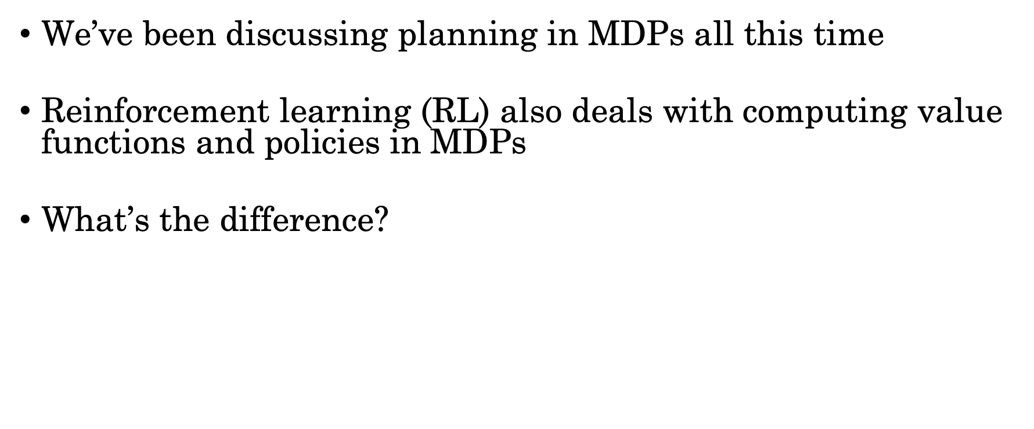
What’s the Connection to RL?
We’ve been discussing planning in MDPs all this time
Reinforcement learning (RL) also deals with computing value functions and policies in MDPs
What’s the difference?
In RL, we don’t know the MDP. Specifically, $P(s^{′}∣s, a)$ and $R$.
So what do we know?

Slide 6
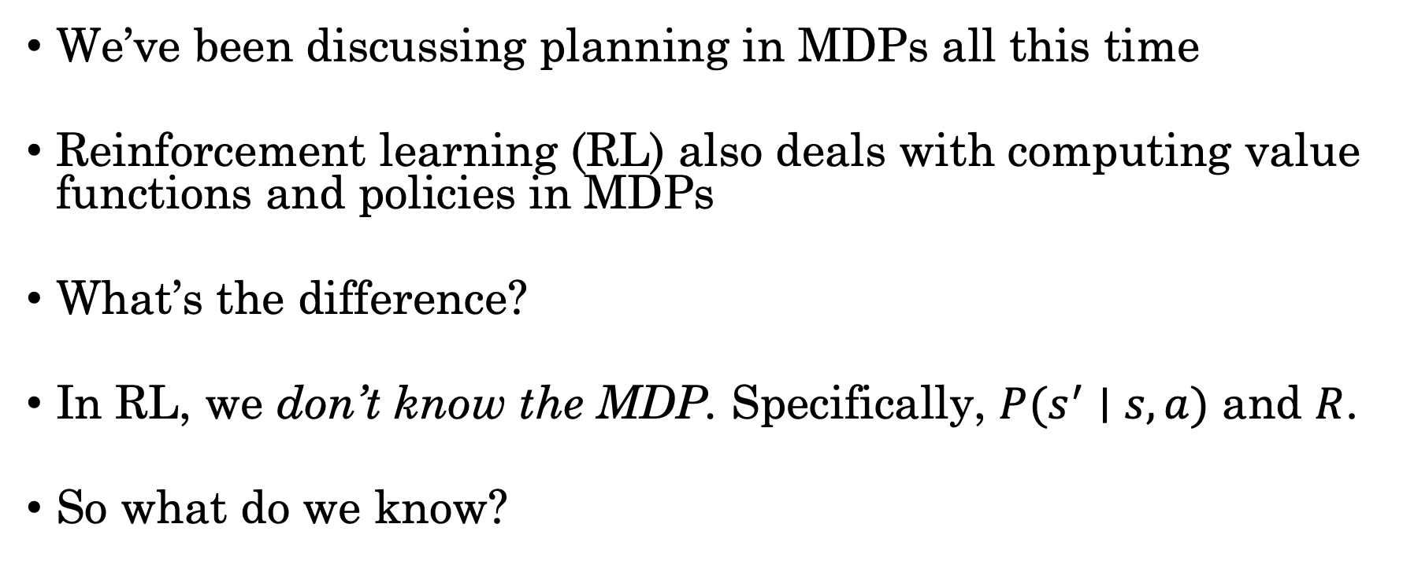
What’s the Connection to RL?
We’ve been discussing planning in MDPs all this time
Reinforcement learning (RL) also deals with computing value functions and policies in MDPs
What’s the difference?
In RL, we don’t know the MDP. Specifically, $P(s^{′}∣s, a)$ and $R$.
So what do we know?

Slide 7






The Basic RL Model*
Action $a∈𝒜$
State $s$ $∈𝒮$
Reward $r$ $∈ ℝ$
*Assuming states are fully observed, which is not always assumed in RL

Slide 8

RL Model vs Simulator Access
Recall simulator access to MDP: we can only sample from transition model, $s^{′}∼P(⋅∣s, a)$.
RL has this assumption too.

Slide 9
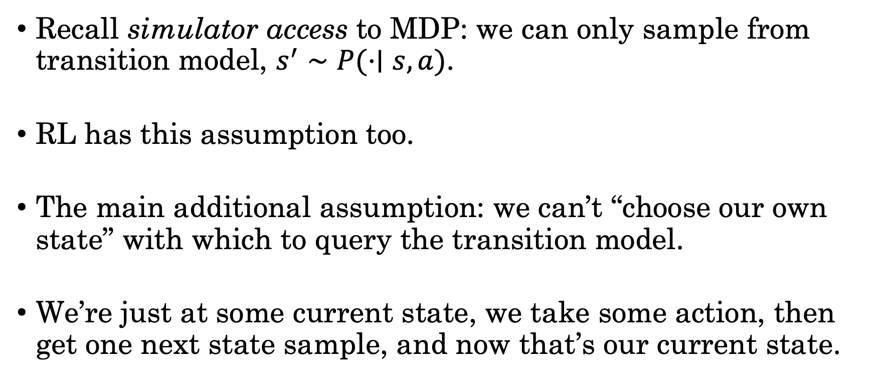
RL Model vs Simulator Access
Recall simulator access to MDP: we can only sample from transition model, $s^{′}∼P(⋅∣s, a)$.
RL has this assumption too.
The main additional assumption: we can’t “choose our own state” with which to query the transition model.
We’re just at some current state, we take some action, then get one next state sample, and now that’s our current state.

Slide 10
RL Model vs Simulator Access
Recall simulator access to MDP: we can only sample from transition model, $s^{′}∼P(⋅∣s, a)$.
RL has this assumption too.
The main additional assumption: we can’t “choose our own state” with which to query the transition model.
We’re just at some current state, we take some action, then get one next state sample, and now that’s our current state.
However! In almost all RL work, it is assumed that you can “start over” (reset). Experience collected in episodes.

Slide 11
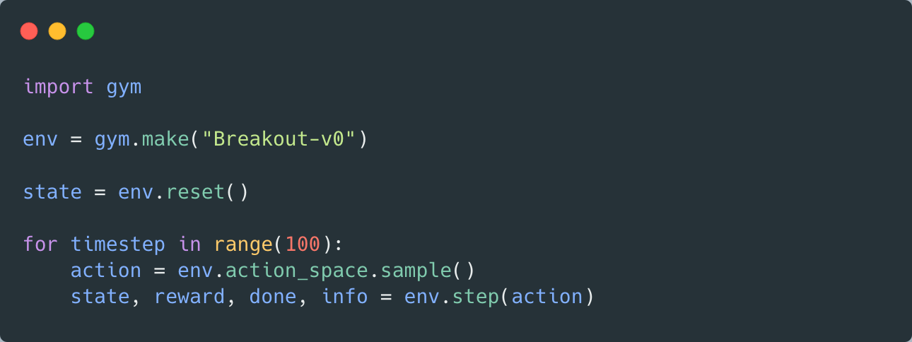
An API for “RL Access” to MDPs
https://github.com/openai/gym/blob/master/gym/core.py

Slide 12
Planning by Reinforcement Learning
There are many RL methods!
Could we use them to do planning?
Pretend that we only have RL model, even if we actually have (at least) simulator access to the MDP
Yes, and people do this.

Slide 13
Planning by Reinforcement Learning
There are many RL methods!
Could we use them to do planning?
Pretend that we only have RL model, even if we actually have (at least) simulator access to the MDP
Yes, and people do this.
State-setting might be practically difficult.
Arguably, anyone who does RL in a simulator is doing this...
The benefit of state-setting might be small.

Slide 14
Planning by Reinforcement Learning
Is this synthetic or analytic learning?
There are many RL methods!
Could we use them to do planning?
Pretend that we only have RL model, even if we actually have (at least) simulator access to the MDP
Yes, and people do this.
State-setting might be practically difficult.
Arguably, anyone who does RL in a simulator is doing this...
The benefit of state-setting might be small.

Slide 15
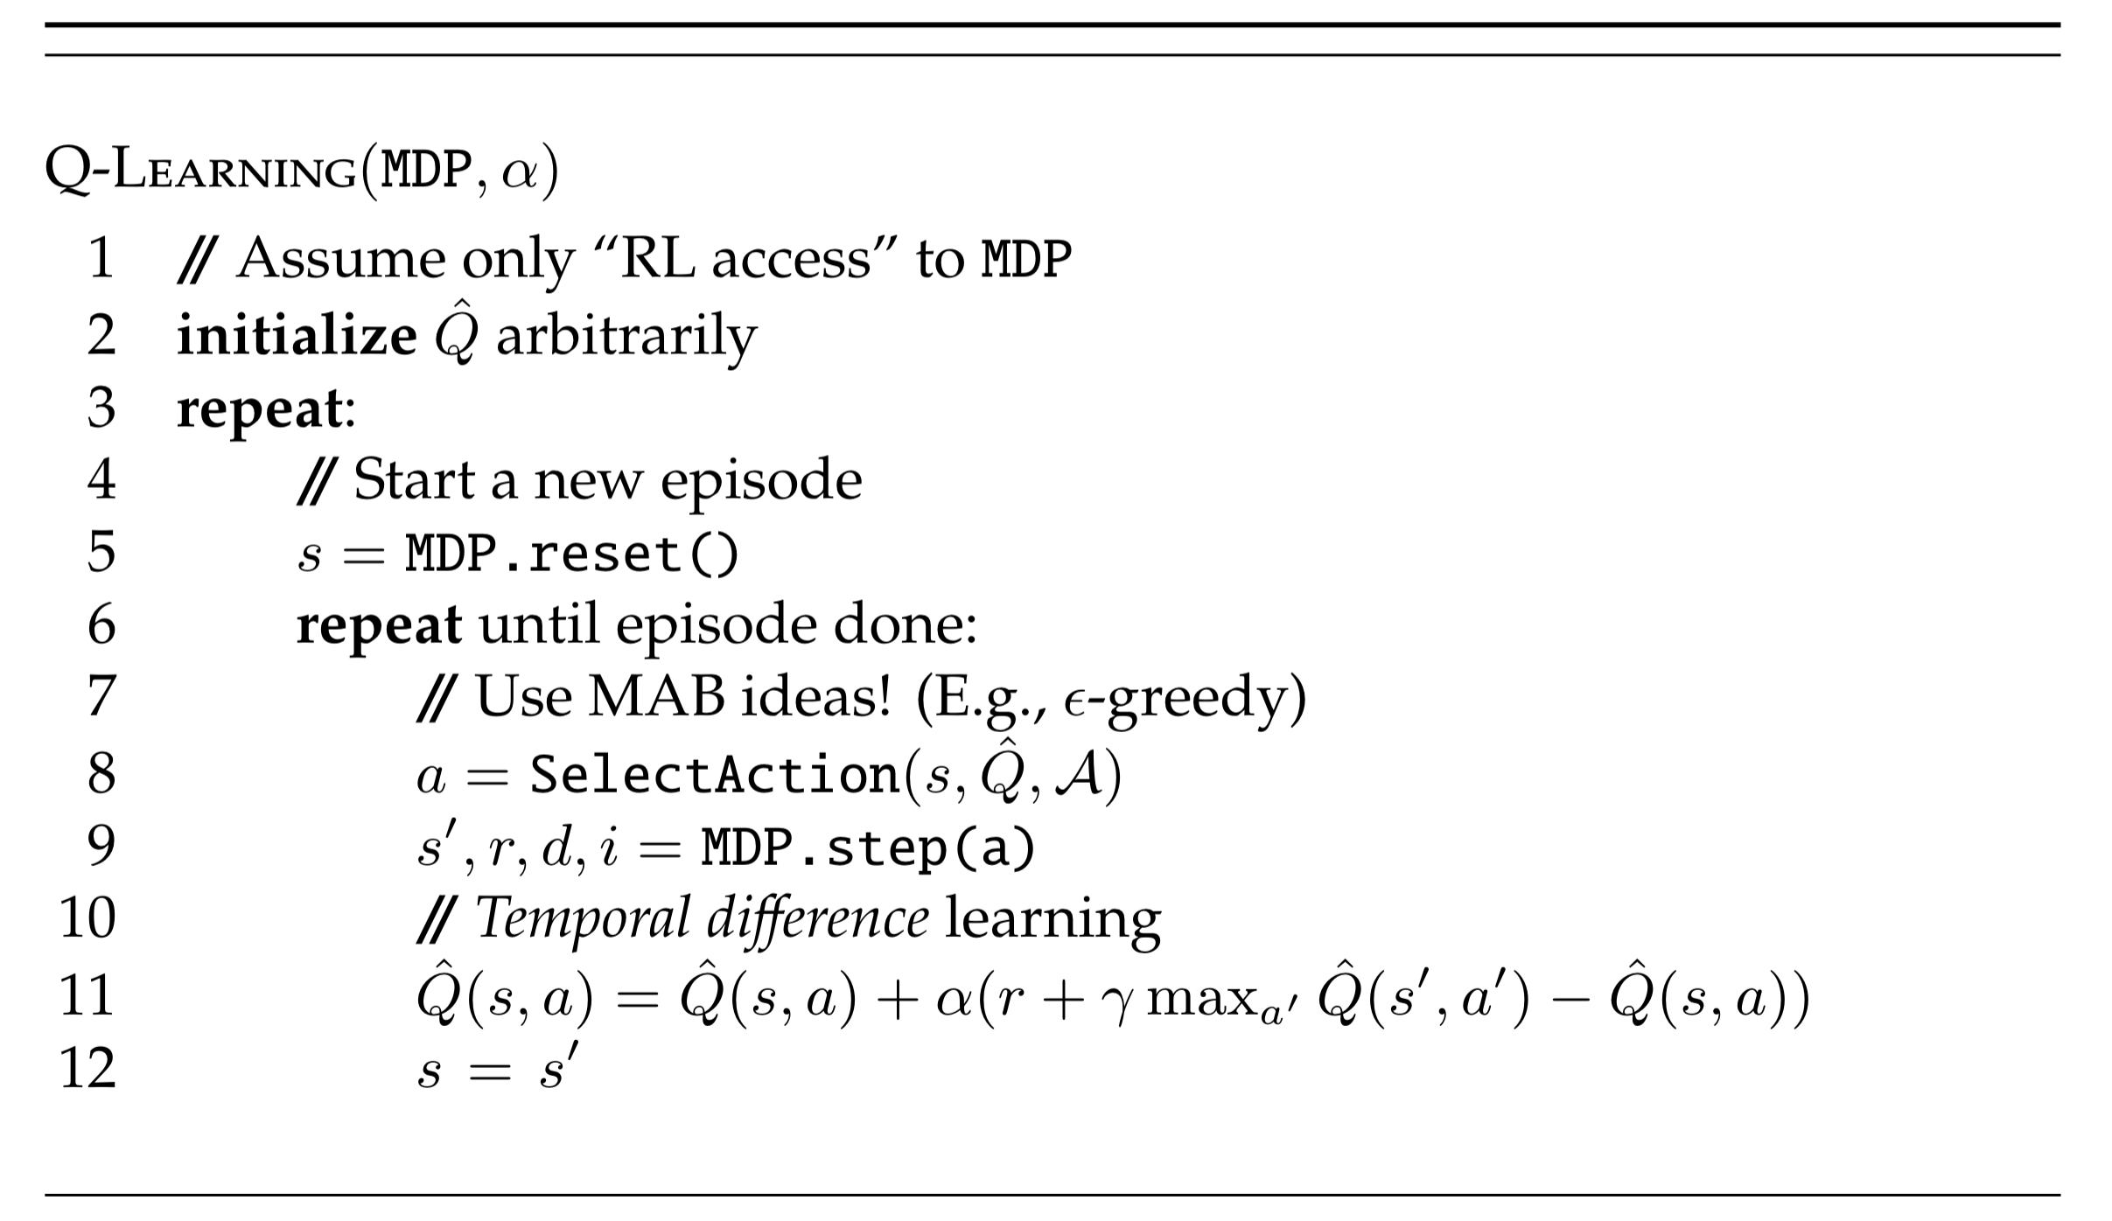
Q-Learning: “Hello World” for RL

Slide 16
Temporal Difference (TD) Learning

Slide 17
Temporal Difference (TD) Learning
Looking ahead 1 step, like in Bellman backups

Slide 18
Temporal Difference (TD) Learning
Looking ahead 1 step, like in Bellman backups
Temporal difference error

Slide 19
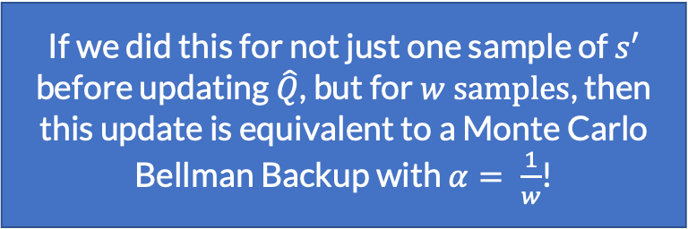
Temporal Difference (TD) Learning
If we did this for not just one sample of $s′$ before updating $\hat{Q}$, but for $w samples$, then this update is equivalent to a Monte Carlo Bellman Backup with $α= \frac{1}{w}$!
Looking ahead 1 step, like in Bellman backups
Temporal difference error

Slide 20
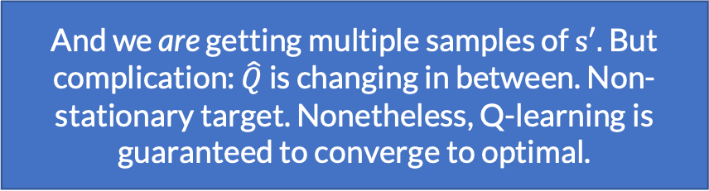
Temporal Difference (TD) Learning
If we did this for not just one sample of $s′$ before updating $\hat{Q}$, but for $w samples$, then this update is equivalent to a Monte Carlo Bellman Backup with $α= \frac{1}{w}$!
Looking ahead 1 step, like in Bellman backups
Temporal difference error
And we are getting multiple samples of $s′.$ But complication: $\hat{Q}$ is changing in between. Non-stationary target. Nonetheless, Q-learning is guaranteed to converge to optimal.

Slide 21


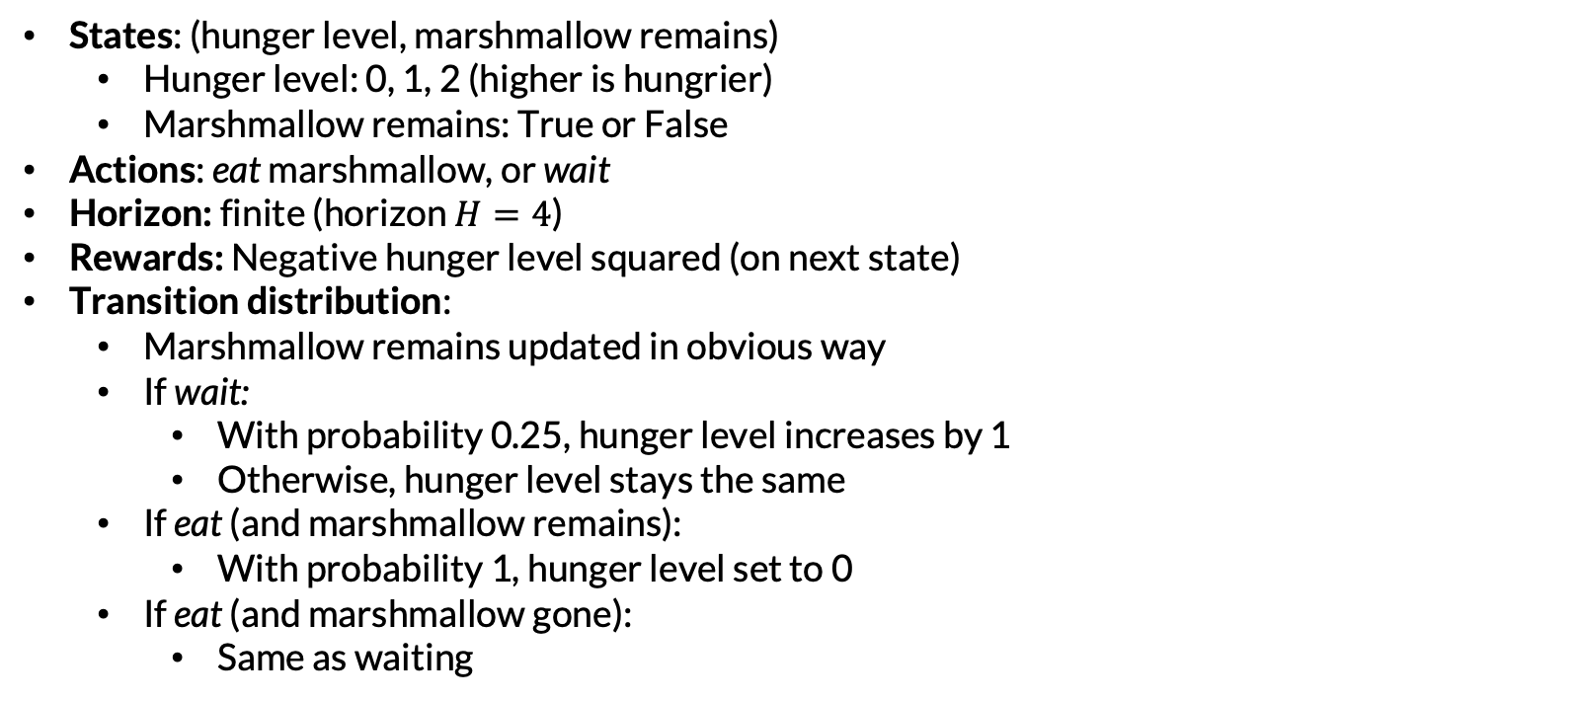
Example: Marshmallows
States: (hunger level, marshmallow remains)
Hunger level: 0, 1, 2 (higher is hungrier)
Marshmallow remains: True or False
Actions: eat marshmallow, or wait
Horizon: finite (horizon $H=4$)
Rewards: Negative hunger level squared (on next state)
Transition distribution:
Marshmallow remains updated in obvious way
If wait:
With probability 0.25, hunger level increases by 1
Otherwise, hunger level stays the same
If eat (and marshmallow remains):
With probability 1, hunger level set to 0
If eat (and marshmallow gone):
Same as waiting

Slide 22
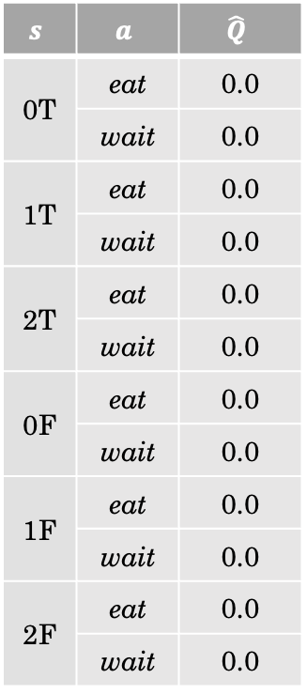
$$s$$ | $$a$$ | $$\hat{Q}$$
0T | eat | 0.0
 | wait | 0.0
1T | eat | 0.0
 | wait | 0.0
2T | eat | 0.0
 | wait | 0.0
0F | eat | 0.0
 | wait | 0.0
1F | eat | 0.0
 | wait | 0.0
2F | eat | 0.0
 | wait | 0.0

Slide 23
$$s$$ | $$a$$ | $$\hat{Q}$$
0T | eat | 0.0
 | wait | 0.0
1T | eat | 0.0
 | wait | 0.0
2T | eat | 0.0
 | wait | 0.0
0F | eat | 0.0
 | wait | 0.0
1F | eat | 0.0
 | wait | 0.0
2F | eat | 0.0
 | wait | 0.0
0T

Slide 24
$$s$$ | $$a$$ | $$\hat{Q}$$
0T | eat | 0.0
 | wait | 0.0
1T | eat | 0.0
 | wait | 0.0
2T | eat | 0.0
 | wait | 0.0
0F | eat | 0.0
 | wait | 0.0
1F | eat | 0.0
 | wait | 0.0
2F | eat | 0.0
 | wait | 0.0
0T
Random tiebreaking
eat

Slide 25

$$s$$ | $$a$$ | $$\hat{Q}$$
0T | eat | 0.0
 | wait | 0.0
1T | eat | 0.0
 | wait | 0.0
2T | eat | 0.0
 | wait | 0.0
0F | eat | 0.0
 | wait | 0.0
1F | eat | 0.0
 | wait | 0.0
2F | eat | 0.0
 | wait | 0.0
0T
eat
0F
$$r=0$$

Slide 26


$$s$$ | $$a$$ | $$\hat{Q}$$
0T | eat | 0.0
 | wait | 0.0
1T | eat | 0.0
 | wait | 0.0
2T | eat | 0.0
 | wait | 0.0
0F | eat | 0.0
 | wait | 0.0
1F | eat | 0.0
 | wait | 0.0
2F | eat | 0.0
 | wait | 0.0
0T
eat
0F
$$r=0$$
$0$.0
$0$.0

Slide 27

$$s$$ | $$a$$ | $$\hat{Q}$$
0T | eat | 0.0
 | wait | 0.0
1T | eat | 0.0
 | wait | 0.0
2T | eat | 0.0
 | wait | 0.0
0F | eat | 0.0
 | wait | 0.0
1F | eat | 0.0
 | wait | 0.0
2F | eat | 0.0
 | wait | 0.0
0T
eat
0F
$$r=0$$
$0$.0
$0$.0
$0$.0

Slide 28

$$s$$ | $$a$$ | $$\hat{Q}$$
0T | eat | 0.0
 | wait | 0.0
1T | eat | 0.0
 | wait | 0.0
2T | eat | 0.0
 | wait | 0.0
0F | eat | 0.0
 | wait | 0.0
1F | eat | 0.0
 | wait | 0.0
2F | eat | 0.0
 | wait | 0.0
0T
eat
0F
$$r=0$$
$0$.0
$0$.0
$0$.0
$0$.0

Slide 29
$$s$$ | $$a$$ | $$\hat{Q}$$
0T | eat | 0.0
 | wait | 0.0
1T | eat | 0.0
 | wait | 0.0
2T | eat | 0.0
 | wait | 0.0
0F | eat | 0.0
 | wait | 0.0
1F | eat | 0.0
 | wait | 0.0
2F | eat | 0.0
 | wait | 0.0
0F

Slide 30
$$s$$ | $$a$$ | $$\hat{Q}$$
0T | eat | 0.0
 | wait | 0.0
1T | eat | 0.0
 | wait | 0.0
2T | eat | 0.0
 | wait | 0.0
0F | eat | 0.0
 | wait | 0.0
1F | eat | 0.0
 | wait | 0.0
2F | eat | 0.0
 | wait | 0.0
0F
eat
Random tiebreaking

Slide 31

$$s$$ | $$a$$ | $$\hat{Q}$$
0T | eat | 0.0
 | wait | 0.0
1T | eat | 0.0
 | wait | 0.0
2T | eat | 0.0
 | wait | 0.0
0F | eat | 0.0
 | wait | 0.0
1F | eat | 0.0
 | wait | 0.0
2F | eat | 0.0
 | wait | 0.0
0F
eat
1F
$$r=−1$$

Slide 32
$$s$$ | $$a$$ | $$\hat{Q}$$
0T | eat | 0.0
 | wait | 0.0
1T | eat | 0.0
 | wait | 0.0
2T | eat | 0.0
 | wait | 0.0
0F | eat | 0.0
 | wait | 0.0
1F | eat | 0.0
 | wait | 0.0
2F | eat | 0.0
 | wait | 0.0
0F
eat
1F
$$r=−1$$
$0$.0
$0$.0

Slide 33

$$s$$ | $$a$$ | $$\hat{Q}$$
0T | eat | 0.0
 | wait | 0.0
1T | eat | 0.0
 | wait | 0.0
2T | eat | 0.0
 | wait | 0.0
0F | eat | 0.0
 | wait | 0.0
1F | eat | 0.0
 | wait | 0.0
2F | eat | 0.0
 | wait | 0.0
0F
eat
1F
$$r=−1$$
$0$.0
$$−1.0$$
$0$.0

Slide 34

$$s$$ | $$a$$ | $$\hat{Q}$$
0T | eat | 0.0
 | wait | 0.0
1T | eat | 0.0
 | wait | 0.0
2T | eat | 0.0
 | wait | 0.0
0F | eat | 0.0
 | wait | 0.0
1F | eat | 0.0
 | wait | 0.0
2F | eat | 0.0
 | wait | 0.0
0F
eat
1F
$$r=−1$$
$0$.0
$$−1.0$$
$0$.0
$0$.0

Slide 35
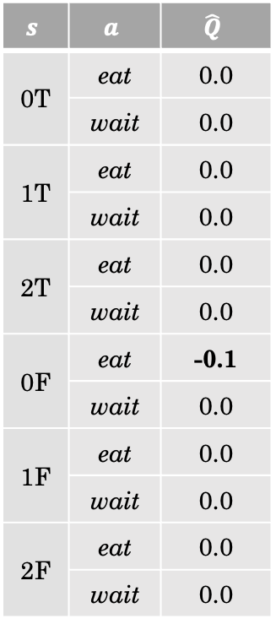

$$s$$ | $$a$$ | $$\hat{Q}$$
0T | eat | 0.0
 | wait | 0.0
1T | eat | 0.0
 | wait | 0.0
2T | eat | 0.0
 | wait | 0.0
0F | eat | -0.1
 | wait | 0.0
1F | eat | 0.0
 | wait | 0.0
2F | eat | 0.0
 | wait | 0.0
0F
eat
Suppose $α=0.1$
1F
$$r=−1$$
$0$.0
$$−1.0$$
$0$.0
$0$.0

Slide 36
$$s$$ | $$a$$ | $$\hat{Q}$$
0T | eat | 0.0
 | wait | 0.0
1T | eat | 0.0
 | wait | 0.0
2T | eat | 0.0
 | wait | 0.0
0F | eat | -0.1
 | wait | 0.0
1F | eat | 0.0
 | wait | 0.0
2F | eat | 0.0
 | wait | 0.0
0T
Episode reset

Slide 37
$$s$$ | $$a$$ | $$\hat{Q}$$
0T | eat | 0.0
 | wait | 0.0
1T | eat | 0.0
 | wait | 0.0
2T | eat | 0.0
 | wait | 0.0
0F | eat | -0.1
 | wait | 0.0
1F | eat | 0.0
 | wait | 0.0
2F | eat | 0.0
 | wait | 0.0
0T
Random tiebreaking
eat

Slide 38
$$s$$ | $$a$$ | $$\hat{Q}$$
0T | eat | 0.0
 | wait | 0.0
1T | eat | 0.0
 | wait | 0.0
2T | eat | 0.0
 | wait | 0.0
0F | eat | -0.1
 | wait | 0.0
1F | eat | 0.0
 | wait | 0.0
2F | eat | 0.0
 | wait | 0.0
0T
eat
0F
$$r=0$$

Slide 39
$$s$$ | $$a$$ | $$\hat{Q}$$
0T | eat | 0.0
 | wait | 0.0
1T | eat | 0.0
 | wait | 0.0
2T | eat | 0.0
 | wait | 0.0
0F | eat | -0.1
 | wait | 0.0
1F | eat | 0.0
 | wait | 0.0
2F | eat | 0.0
 | wait | 0.0
0T
eat
0F
$$r=0$$
$0$.0
$0$.0

Slide 40
$$s$$ | $$a$$ | $$\hat{Q}$$
0T | eat | 0.0
 | wait | 0.0
1T | eat | 0.0
 | wait | 0.0
2T | eat | 0.0
 | wait | 0.0
0F | eat | -0.1
 | wait | 0.0
1F | eat | 0.0
 | wait | 0.0
2F | eat | 0.0
 | wait | 0.0
0T
eat
0F
$$r=0$$
$0$.0
$0$.0
$0$.0

Slide 41

$$s$$ | $$a$$ | $$\hat{Q}$$
0T | eat | 0.0
 | wait | 0.0
1T | eat | 0.0
 | wait | 0.0
2T | eat | 0.0
 | wait | 0.0
0F | eat | -0.1
 | wait | 0.0
1F | eat | 0.0
 | wait | 0.0
2F | eat | 0.0
 | wait | 0.0
0T
eat
0F
$$r=0$$
$0$.0
$0$.0
$0$.0
$0$.0

Slide 42
$$s$$ | $$a$$ | $$\hat{Q}$$
0T | eat | 0.0
 | wait | 0.0
1T | eat | 0.0
 | wait | 0.0
2T | eat | 0.0
 | wait | 0.0
0F | eat | -0.1
 | wait | 0.0
1F | eat | 0.0
 | wait | 0.0
2F | eat | 0.0
 | wait | 0.0
0F

Slide 43
$$s$$ | $$a$$ | $$\hat{Q}$$
0T | eat | 0.0
 | wait | 0.0
1T | eat | 0.0
 | wait | 0.0
2T | eat | 0.0
 | wait | 0.0
0F | eat | -0.1
 | wait | 0.0
1F | eat | 0.0
 | wait | 0.0
2F | eat | 0.0
 | wait | 0.0
0F
wait
Suppose we exploit

Slide 44
$$s$$ | $$a$$ | $$\hat{Q}$$
0T | eat | 0.0
 | wait | 0.0
1T | eat | 0.0
 | wait | 0.0
2T | eat | 0.0
 | wait | 0.0
0F | eat | -0.1
 | wait | 0.0
1F | eat | 0.0
 | wait | 0.0
2F | eat | 0.0
 | wait | 0.0
0F
wait
1F
$$r=−1$$

Slide 45
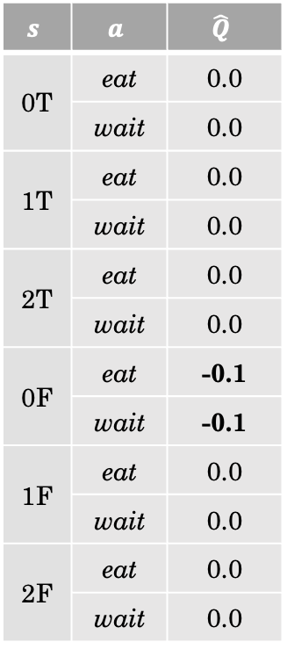
$$s$$ | $$a$$ | $$\hat{Q}$$
0T | eat | 0.0
 | wait | 0.0
1T | eat | 0.0
 | wait | 0.0
2T | eat | 0.0
 | wait | 0.0
0F | eat | -0.1
 | wait | -0.1
1F | eat | 0.0
 | wait | 0.0
2F | eat | 0.0
 | wait | 0.0
0F
wait
1F
$$r=−1$$

Slide 46
$$s$$ | $$a$$ | $$\hat{Q}$$
0T | eat | 0.0
 | wait | 0.0
1T | eat | 0.0
 | wait | 0.0
2T | eat | 0.0
 | wait | 0.0
0F | eat | -0.1
 | wait | -0.1
1F | eat | 0.0
 | wait | 0.0
2F | eat | 0.0
 | wait | 0.0
0T
Episode reset

Slide 47
$$s$$ | $$a$$ | $$\hat{Q}$$
0T | eat | 0.0
 | wait | 0.0
1T | eat | 0.0
 | wait | 0.0
2T | eat | 0.0
 | wait | 0.0
0F | eat | -0.1
 | wait | -0.1
1F | eat | 0.0
 | wait | 0.0
2F | eat | 0.0
 | wait | 0.0
0T
Random tiebreaking
eat

Slide 48
$$s$$ | $$a$$ | $$\hat{Q}$$
0T | eat | 0.0
 | wait | 0.0
1T | eat | 0.0
 | wait | 0.0
2T | eat | 0.0
 | wait | 0.0
0F | eat | -0.1
 | wait | -0.1
1F | eat | 0.0
 | wait | 0.0
2F | eat | 0.0
 | wait | 0.0
0T
eat
0F
$$r=0$$

Slide 49
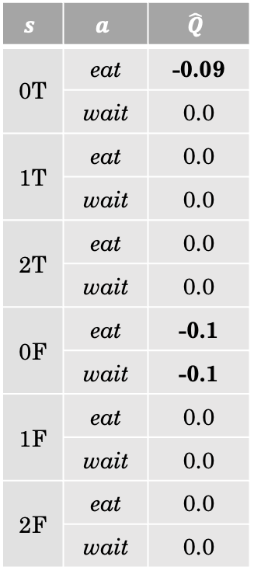

$$s$$ | $$a$$ | $$\hat{Q}$$
0T | eat | -0.09
 | wait | 0.0
1T | eat | 0.0
 | wait | 0.0
2T | eat | 0.0
 | wait | 0.0
0F | eat | -0.1
 | wait | -0.1
1F | eat | 0.0
 | wait | 0.0
2F | eat | 0.0
 | wait | 0.0
0T
Suppose $γ=0.9$
eat
0F
$$r=0$$

Slide 50
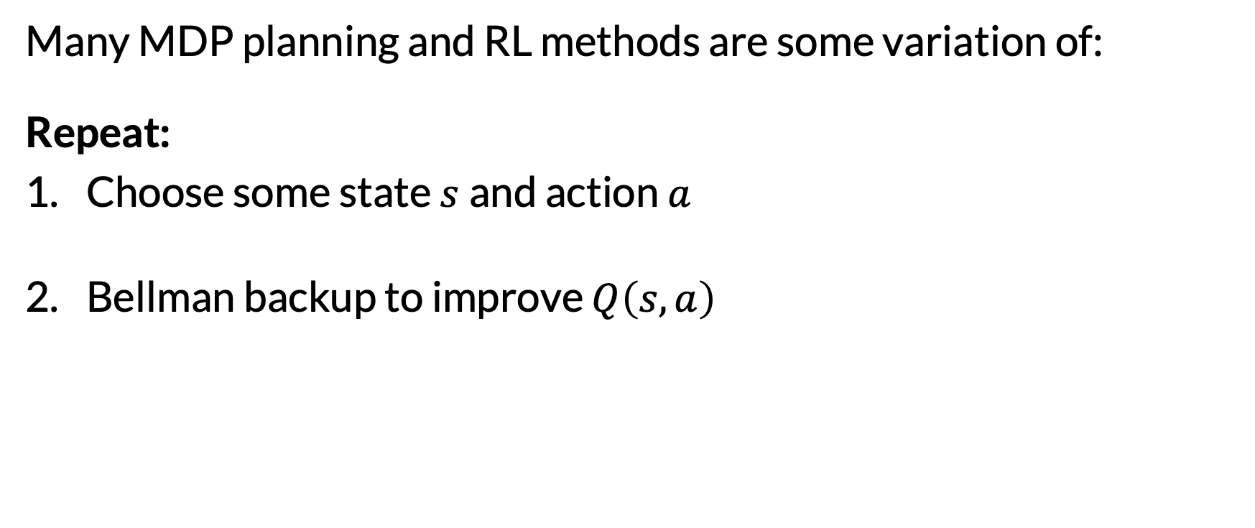
Bellman Backups: The ❤️ of MDP Planning and RL
Many MDP planning and RL methods are some variation of: Repeat:
Choose some state $s$and action $a$
Bellman backup to improve $Q\left(s, a\right)$

Slide 51

Bellman Backups: The ❤️ of MDP Planning and RL
Repeat:
Choose some state $s$and action $a$
Bellman backup to improve $Q\left(s, a\right)$
Value Iteration
Loop over all
Compute exactly

Slide 52
Bellman Backups: The ❤️ of MDP Planning and RL
Repeat:
Choose some state $s$and action $a$
Bellman backup to improve $Q\left(s, a\right)$
Expectimax Search
Consider reachable states backwards in time
Compute exactly

Slide 53
Bellman Backups: The ❤️ of MDP Planning and RL
Repeat:
Choose some state $s$and action $a$
Bellman backup to improve $Q\left(s, a\right)$
Real-Time Dynamic Programming
Sample trajectories using current greedy policy
Compute exactly

Slide 54
Bellman Backups: The ❤️ of MDP Planning and RL
Repeat:
Choose some state $s$and action $a$
Bellman backup to improve $Q\left(s, a\right)$
Sparse Sampling
Consider reachable states backwards in time
Compute approximately by sampling

Slide 55
Bellman Backups: The ❤️ of MDP Planning and RL
Repeat:
Choose some state $s$and action $a$
Bellman backup to improve $Q\left(s, a\right)$
Monte-Carlo Tree Search
Sample trajectories using explore-exploit policy
Compute approximately by sampling

Slide 56
Bellman Backups: The ❤️ of MDP Planning and RL
Repeat:
Choose some state $s$and action $a$
Bellman backup to improve $Q\left(s, a\right)$
Q-Learning
The single transition just witnessed
Compute approximately using single transition

Slide 57
Bellman Backups: The ❤️ of MDP Planning and RL
Many MDP planning and RL methods are some variation of: Repeat:
Choose some state $s$and action $a$
Bellman backup to improve $Q\left(s, a\right)$
Central question: how to schedule state-action updates?

Slide 58
Bellman Backups: The ❤️ of MDP Planning and RL
Many MDP planning and RL methods are some variation of: Repeat:
Choose some state $s$and action $a$
Bellman backup to improve $Q\left(s, a\right)$
Central question: how to schedule state-action updates?
In RL, would it ever make sense to choose a never-before-seen state / action?

Slide 59
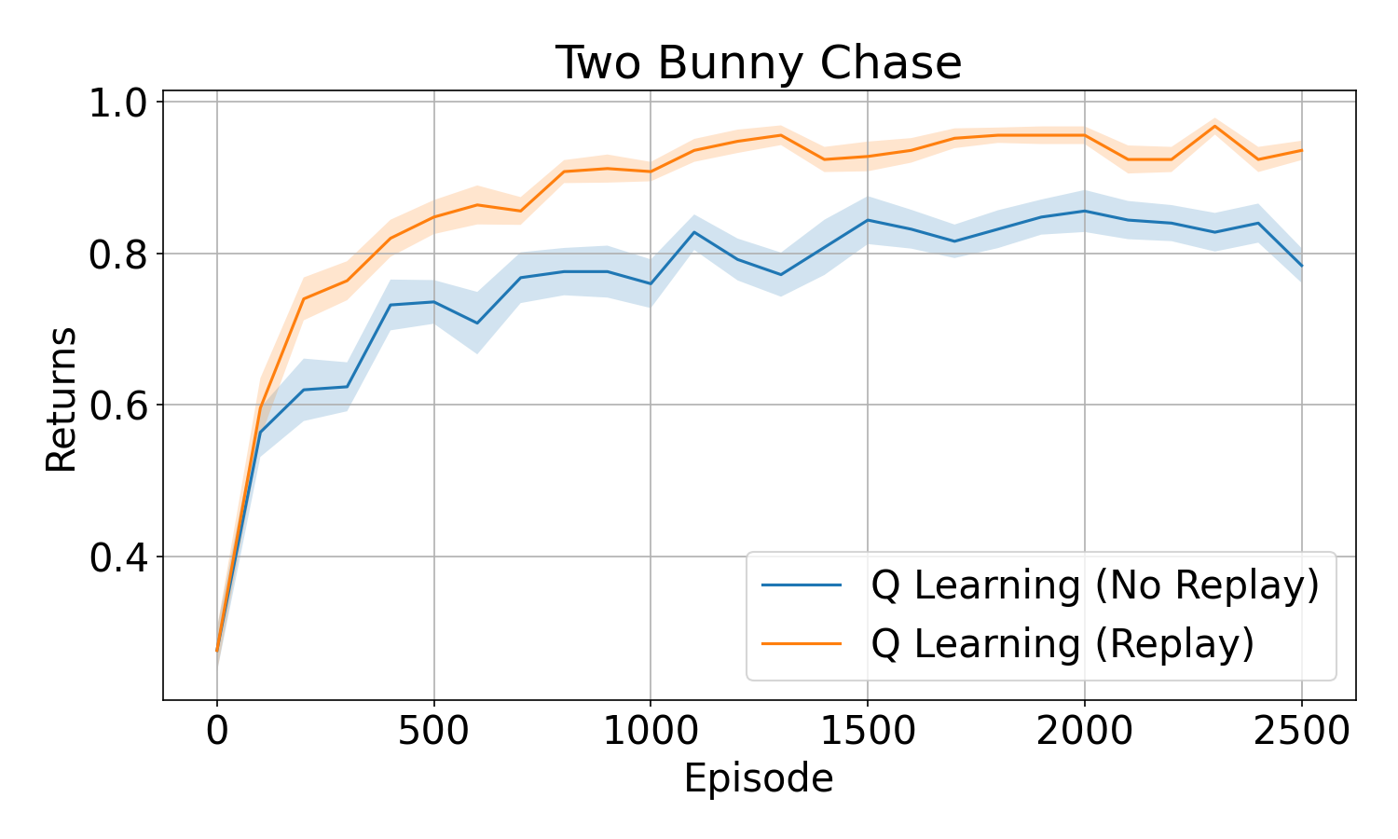
Experience Replay
Updating based only on most recent state and action is limiting
Instead, maintain history of transitions (“buffer”)
Randomly sample from the buffer and update Q accordingly

Slide 60
Prioritized Experience Replay
Experience replay is better, but sampling uniformly from the history is still limiting
Many transitions sampled will result in no change
Instead, sample based on expected learning progress
Approximate learning progress with TD error

Slide 61
Model-Free vs. Model-Based RL
Q-learning is model-free: it requires no explicit transition model
Other RL methods are model-based:
Use online experience to learn transition model
Plan in the learned transition model (offline or online)
Model-based RL

Slide 62
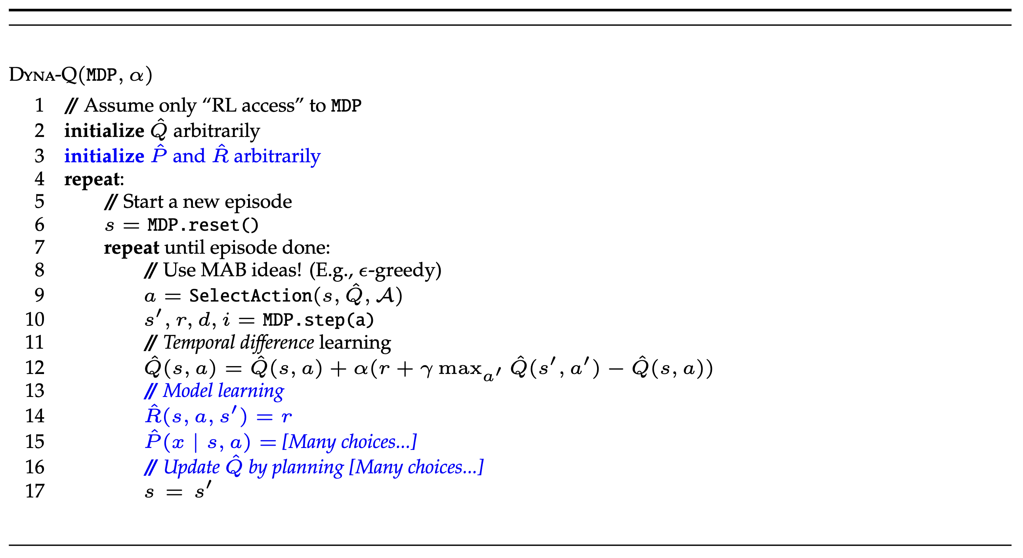
MBRL Example: Dyna-Q

Slide 63
MBRL Example: Dyna-Q
We are doing both model-free RL (Q learning) and model-based RL (planning)

Slide 64
MBRL Example: Dyna-Q
Brainstorm and discuss:
What are some reasonable choices for model learning and planning?
What are possible issues with those choices?

Slide 65
Model-Free vs. Model-Based RL
“Our view is that the contrast between the alternatives in all these debates has been exaggerated, that more insight can be gained by recognizing the similarities between these two sides than by opposing them.” Sutton & Barto (2018)
(The same can be said for planning vs. RL in general)

Slide 66
Today’s Agenda
Review what we’ve covered so far
Talk about relationship between planning and RL
Discuss details for part 2 of course: papers and projects

Slide 67
Paper Presentations
We will have 3 presenters and 3 papers per class
The presenters should present as a team! Here’s an ideal agenda:
Presenter 1 | Background (spanning all 3 papers, connecting to what we’ve seen previously in class)
 | Overview of a shorter/simpler paper
Presenter 2 | Deep dive into “main” paper
 | Optionally: some code, demo, interactive element, or other things above-and-beyond
Presenter 3 | Overview of the remaining paper
 | Reflecting on all the papers and lessons learned

Slide 68
Paper Presentations
The prepared presentation should last about 50 minutes in total
With remaining 25-30 minutes, we will have brainstorming breakouts, where the goal is to generate research project ideas (for some future, hypothetical time)
First, we will brainstorm individually for 5 minutes
Then, we will share (5 minutes) and try to cluster into 3-6 themes
Then, we will break off into theme groups and continue brainstorming for 10 minutes
With remaining time, we will report back to the class

Slide 69
Paper Presentations: Expectations and Grading
Grading will be based on:
Clarity of presentation
Overall effort
Connections between papers and topics
Audience engagement
Feedback from your fellow presenters (collected privately)
Total grade = 50% shared grade for group + 50% individual grade

Slide 70
Paper Matching
Complete the form sent through Ed
Deadline to complete: Friday, September 19

Slide 71
Pre-Class Paper Reviews
Everyone must read all 3 papers before each class
Choose 1 of the 3 papers to write a review
For reviews: imagine you are actually reviewing this paper for possible acceptance to a conference or journal!
Let’s look at the review outline…

Slide 72
Final Projects
Teams of 1-4 people (graded proportionately)
Scope: ambitious! Aim for “something that we would be proud to submit to a workshop, or even a conference / journal”
Failure is okay! Final projects are great for taking big research risks
Requirements:
Must involve planning and learning
Must involve a significant programming effort
Must be fun and cool

Slide 73
Final Projects: Possible Starting Points
Reimplement a planning + learning method from a paper and apply it to a new domain
Reimplement a planning + learning method and then try to “beat” it on a benchmark domain
Start with a really interesting domain and try a variety of planning + learning methods to see what works best
Something completely different… maybe something whacky…

Slide 74
Final Project: Timeline & Deliverables
October 6: Proposal Due (details to come)
Not too early to start thinking about teams and general topics!
October 31: Project Update 1 Due
November 24: Project Update 2 Due
December 15: Final Project Due

