Slide 1
Planning in Factored Spaces
Tom Silver
Robot Planning Meets Machine Learning
Princeton University
Fall 2025

Slide 2
Recap and Preview
Previously:
Planning in finite “tabular” state and action spaces
Careful treatment of uncertainty in transitions and observations
Offline planning and online planning
Now:
Planning in finite “factored” state and action spaces
No more uncertainty
Online planning only
Later:
Planning in continuous state and action spaces
Our focus turns to leveraging structure in the problem space

Slide 3
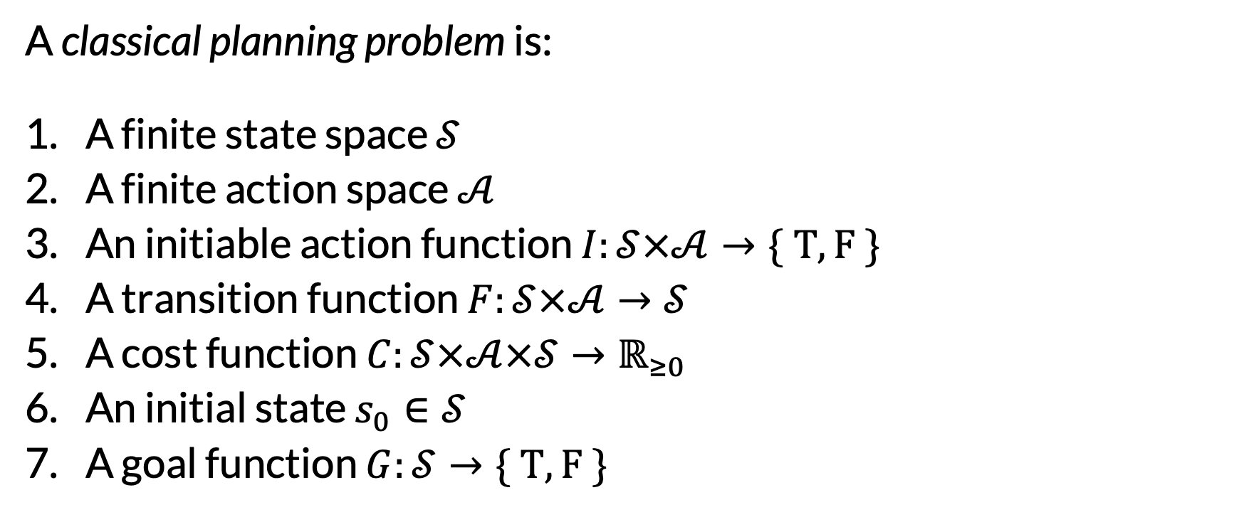
Classical Planning Problem Setting
A classical planning problem is:
A finite state space $𝒮$
A finite action space $𝒜$
An initiable action function $I:𝒮×𝒜→\{ T, F \}$
A transition function $F:𝒮×𝒜→𝒮$
A cost function $C:𝒮×𝒜×𝒮→ℝ_{≥0}$
An initial state $s_{0}∈𝒮$
A goal function $G:𝒮→\{ T, F \}$
Deterministic! Can be partial
Lower better. Could do rewards instead; just a convention.
Equivalent to a set of states

Slide 4
Example: Blocks World
States: each block is either on the table or on some other block
Actions: picking or placing a block
Initiation: can only pick and place on “clear” blocks
Transition function: as you’d expect
Cost function: always 1
Initial state: e.g., see right
Goal function: e.g., see right
Initial State
d
a
e
b
c
f
Table
Goal
e
The other blocks can be anywhere
a
Table

Slide 5
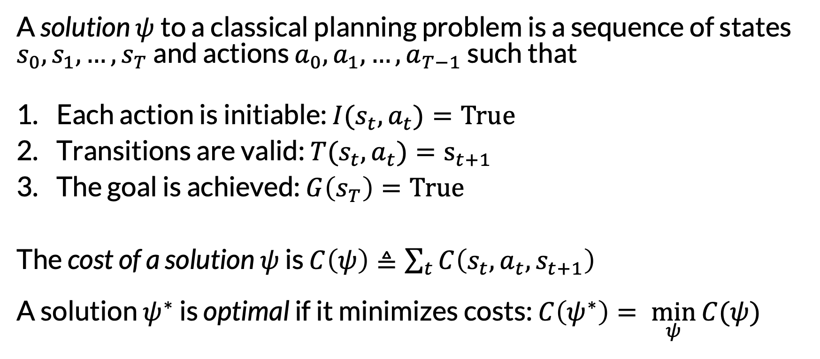
Definition of a Solution (Plan)
A solution $ψ$ to a classical planning problem is a sequence of states $s_{0},s_{1}, …, s_{T}$ and actions $a_{0},a_{1}, …, a_{T−1}$ such that
Each action is initiable: ${I(s_{t}, a}_{t})=True$
Transitions are valid: ${T(s_{t}, a}_{t})=s_{t+1}$
The goal is achieved: $G\left(s_{T}\right)=True$
The cost of a solution $ψ$ is $C\left(ψ\right)≜\sum_{t}{C\left(s_{t}, a_{t}, s_{t+1}\right)}$ A solution $ψ^{∗}$ is optimal if it minimizes costs: $C\left(ψ^{∗}\right)= \min_{ψ}{C(ψ)}$

Slide 6
Example: Blocks World
Goal
e
a
Table
An optimal plan
a
d
d
d
d
a
e
e
e
e
b
c
f
b
c
f
b
a
c
f
b
a
c
f
Table
Table
Table
Table
e
d
e
d
d
e
b
a
c
f
b
a
c
f
b
a
c
f
Table
Table
Table

Slide 7
Example: Blocks World
Goal
e
a
Table
A suboptimal plan
a
d
d
d
d
a
e
e
e
e
b
c
f
b
c
f
b
a
c
f
b
a
c
f
Table
Table
Table
Table
d
e
d
e
e
d
e
d
d
e
b
a
c
f
b
a
c
f
b
a
c
f
b
a
c
f
b
a
c
f
Table
Table
Table
Table
Table

Slide 8
A Stupidest Possible Algorithm
Randomly sample applicable actions until the goal is reached.

Slide 9
A Stupidest Possible Algorithm
Randomly sample applicable actions until the goal is reached.
What is this planner?
Definitions:
A planner is sound if its output is guaranteed to be a solution.
A planner is complete if it is guaranteed to return an output eventually.
A sound planner is optimal if its output is guaranteed to be optimal. Otherwise, the planner is satisficing.

Slide 10
A Better Approach: Graph Search
a
d
b
c
e
f
Table
Pick(a)
Pick(d)
Pick(c)
a
d
c
d
d
b
c
e
a
e
a
e
f
b
f
b
c
f
Table
Table
Table

Slide 11
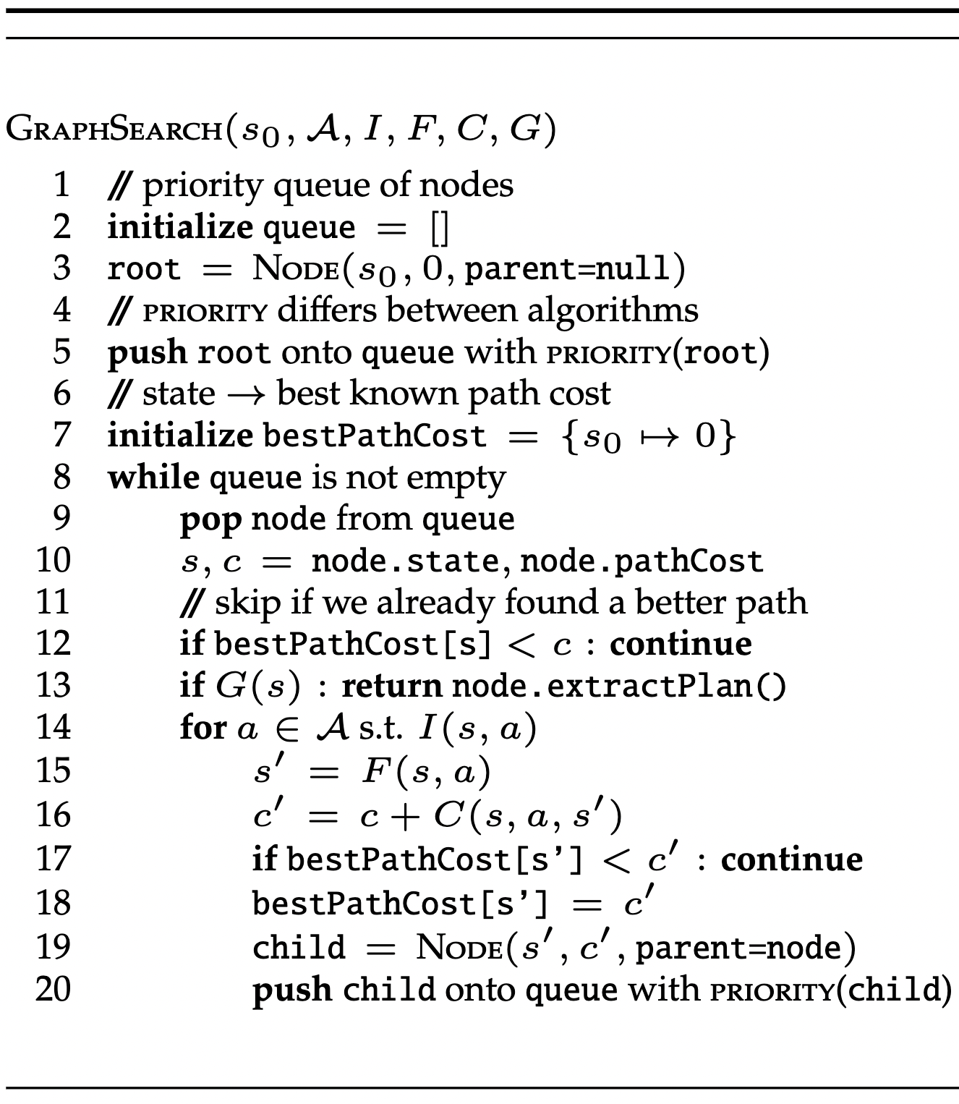
Graph Search

Slide 12
Goal: b on a
a
b
c
Table

Slide 13
queue

Slide 14
queue
a
b
c
Table

Slide 15
queue
( , 0)
For now, let’s say priority = path cost

Slide 16
queue
( , 0)
bestPathCost
a
0
b
c
Table

Slide 17
queue
bestPathCost
a
0
b
c
Table
a
b
c
Table

Slide 18
queue
bestPathCost
a
0
b
c
Table
a
b
c
Table

Slide 19
queue
bestPathCost
a
0
b
c
Table
a
b
c
Table

Slide 20
queue
bestPathCost
a
0
b
c
Table
a
b
c
Table

Slide 21
queue
bestPathCost
a
0
b
c
Table
a
b
c
Table
Pick(a)

Slide 22
queue
bestPathCost
a
0
b
c
Table
a
b
c
Table
Pick(a)
a
b
c
Table

Slide 23
queue
bestPathCost
a
0
b
c
Table
a
b
c
Table
Pick(a)
a
b
c
Table

Slide 24
queue
bestPathCost
a
0
b
c
Table
a
b
c
Table
Pick(a)
a
b
c
Table

Slide 25
queue
bestPathCost
a
0
a
1
b
c
b
c
Table
Table
a
b
c
Table
Pick(a)
a
b
c
Table

Slide 26
queue
bestPathCost
a
0
a
1
b
c
b
c
Table
Table
a
b
c
Table
Pick(a)
a
b
c
Table

Slide 27
queue
( , 1)
bestPathCost
a
0
a
1
b
c
b
c
Table
Table
a
b
c
Table
Pick(a)
a
b
c
Table

Slide 28
queue
( , 1)
bestPathCost
a
0
a
1
b
c
b
c
Table
Table
a
b
c
Table
Pick(a)
Pick(c)
a
b
c
Table

Slide 29
queue
( , 1)
( , 1)
bestPathCost
0
a
1
c
1
a
a
b
c
b
c
b
Table
Table
Table
a
b
c
Table
Pick(a)
Pick(c)
a
c
b
c
a
Table
b
Table

Slide 30
queue
( , 1)
bestPathCost
0
a
1
c
1
a
a
b
c
b
c
b
Table
Table
Table
a
b
c
Table

Slide 31
queue
( , 1)
bestPathCost
0
a
1
c
1
a
a
b
c
b
c
b
Table
Table
Table
a
b
c
Table
Place(a, b)
a
b
c
Table

Slide 32
queue
( , 1)
bestPathCost
0
a
1
c
1
a
a
b
c
b
c
b
Table
Table
Table
a
b
c
Table
Place(a, b)
a
Path cost is 2, which is worse than 0
b
c
Table

Slide 33
queue
( , 1)
( , 2)
bestPathCost
0
a
1
c
1
a
2
a
a
b
c
b
c
b
c
b
Table
Table
Table
Table
a
b
c
Table
Place(a, c)
b
a
c
Table

Slide 34
queue
( , 1)
( , 2)
( , 2)
bestPathCost
0
a
1
c
1
a
2
a
a
b
c
b
c
a
b
c
b
c
b
Table
Table
Table
Table
Table
a
b
c
Table
PlaceOnTable(a)
Place(a, c)
b
a
c
b
c
a
Table
Table

Slide 35
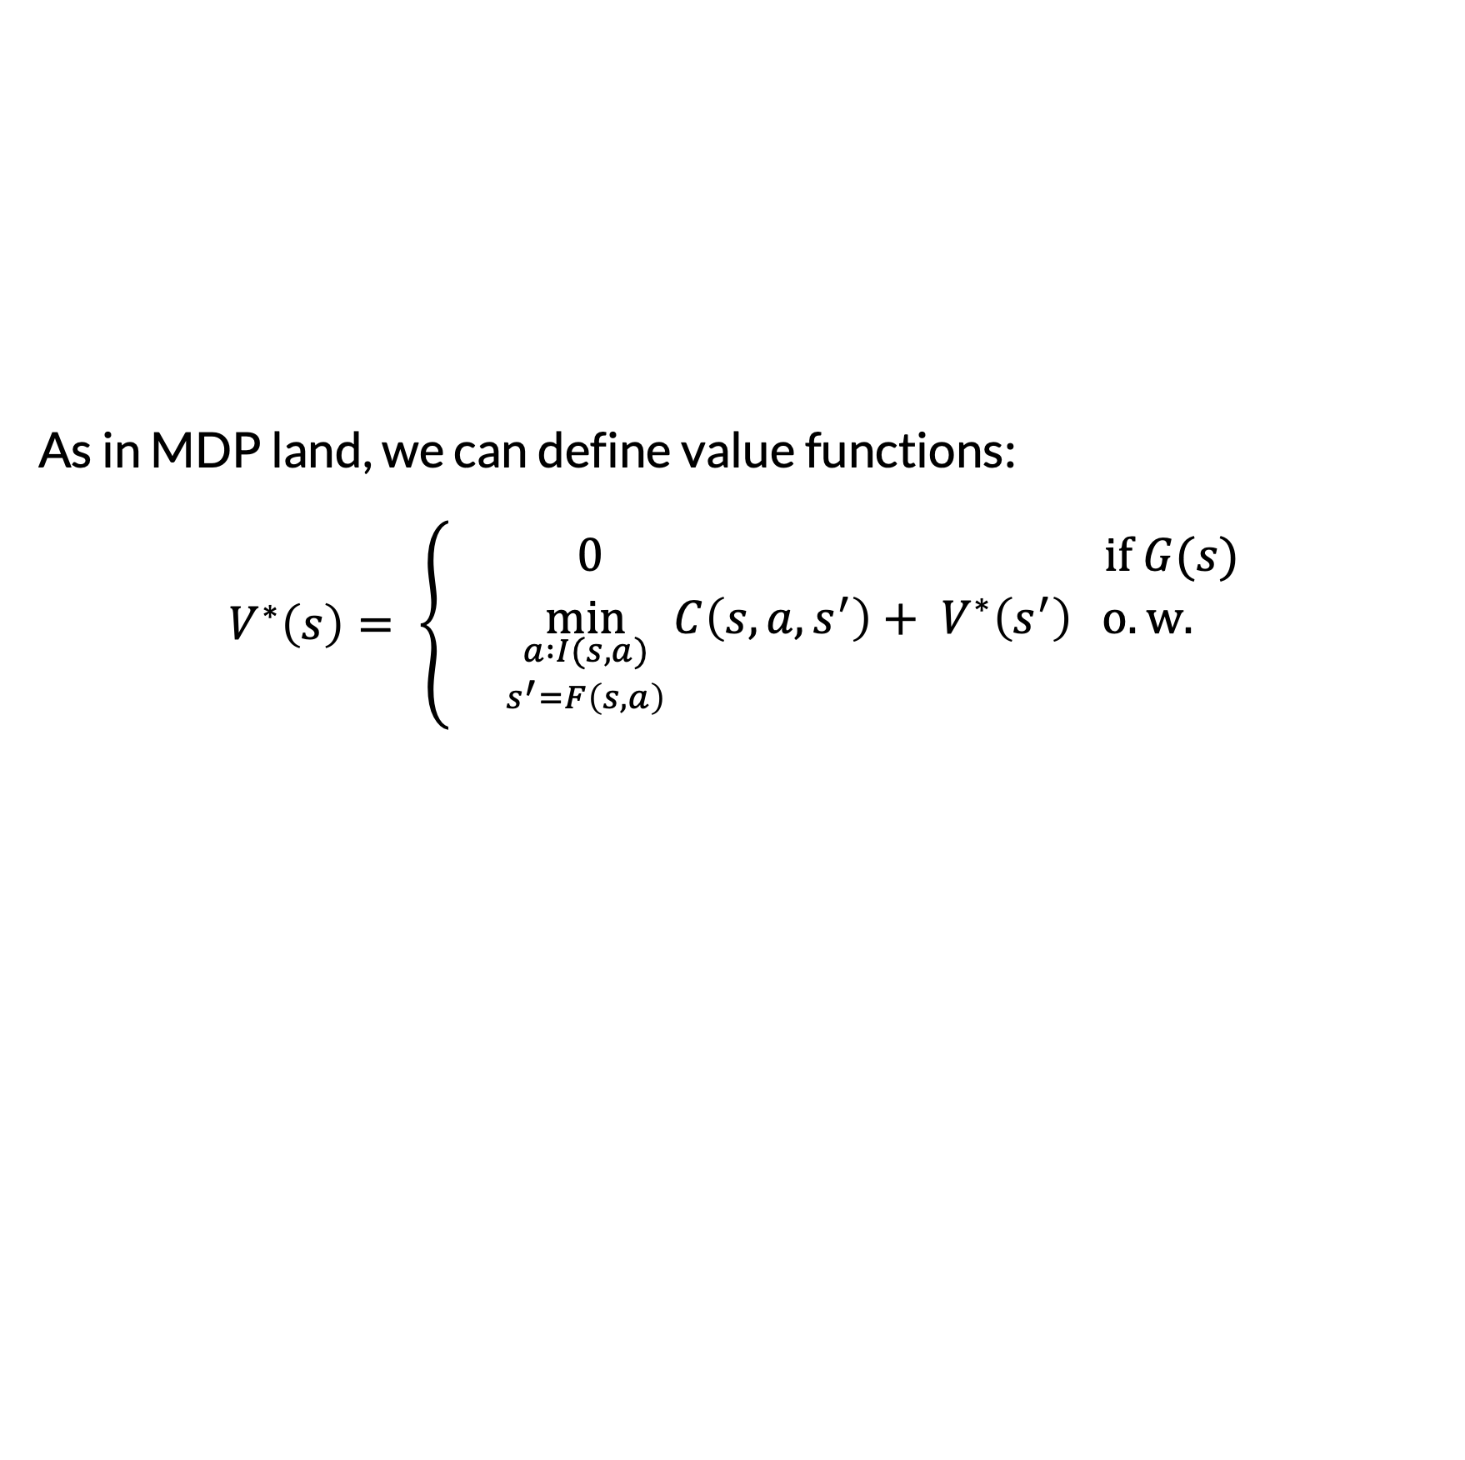
Heuristics and Value Functions
As in MDP land, we can define value functions:
$$V^{∗}\left(s\right)= \left\{\begin{aligned} 0 if G(s) \\ \min_{\begin{aligned}a :I(s, a) \\ s^{′}=F\left(s, a\right)\end{aligned}}{{C\left(s, a, s^{′}\right)+ V}^{∗}\left(s^{′}\right)} o.w.\end{aligned}\right.$$
“Cost-to-go”

Slide 36
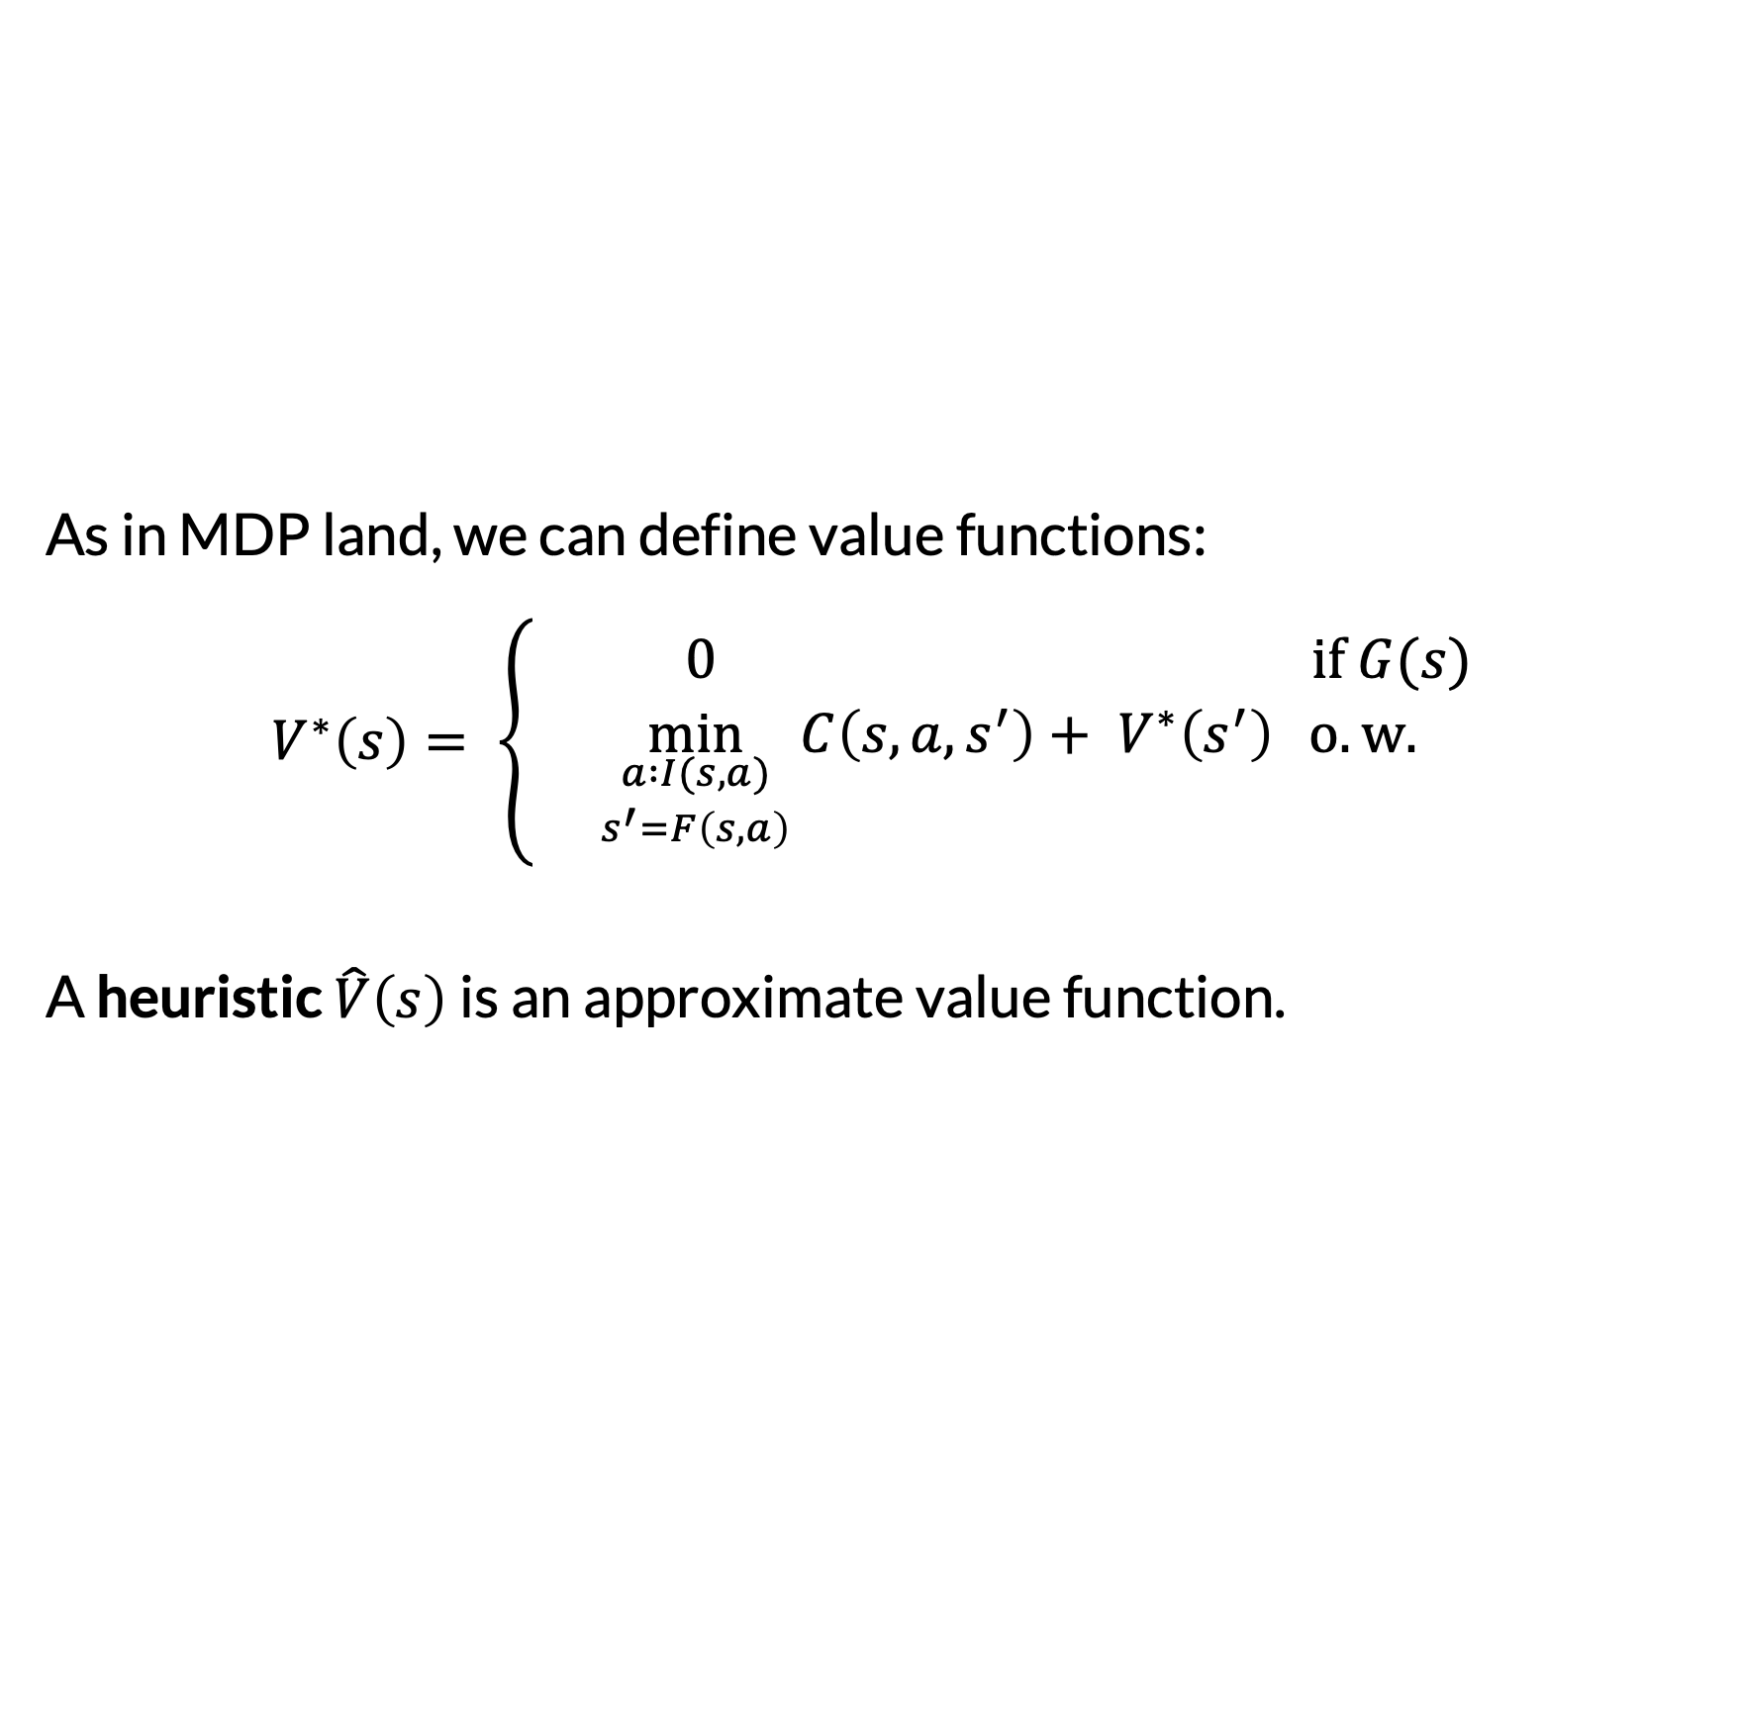
Heuristics and Value Functions
As in MDP land, we can define value functions:
$$V^{∗}\left(s\right)= \left\{\begin{aligned} 0 if G(s) \\ \min_{\begin{aligned}a :I(s, a) \\ s^{′}=F\left(s, a\right)\end{aligned}}{{C\left(s, a, s^{′}\right)+ V}^{∗}\left(s^{′}\right)} o.w.\end{aligned}\right.$$
A heuristic $\hat{V}\left(s\right)$is an approximate value function.
Same as MDP land

Slide 37
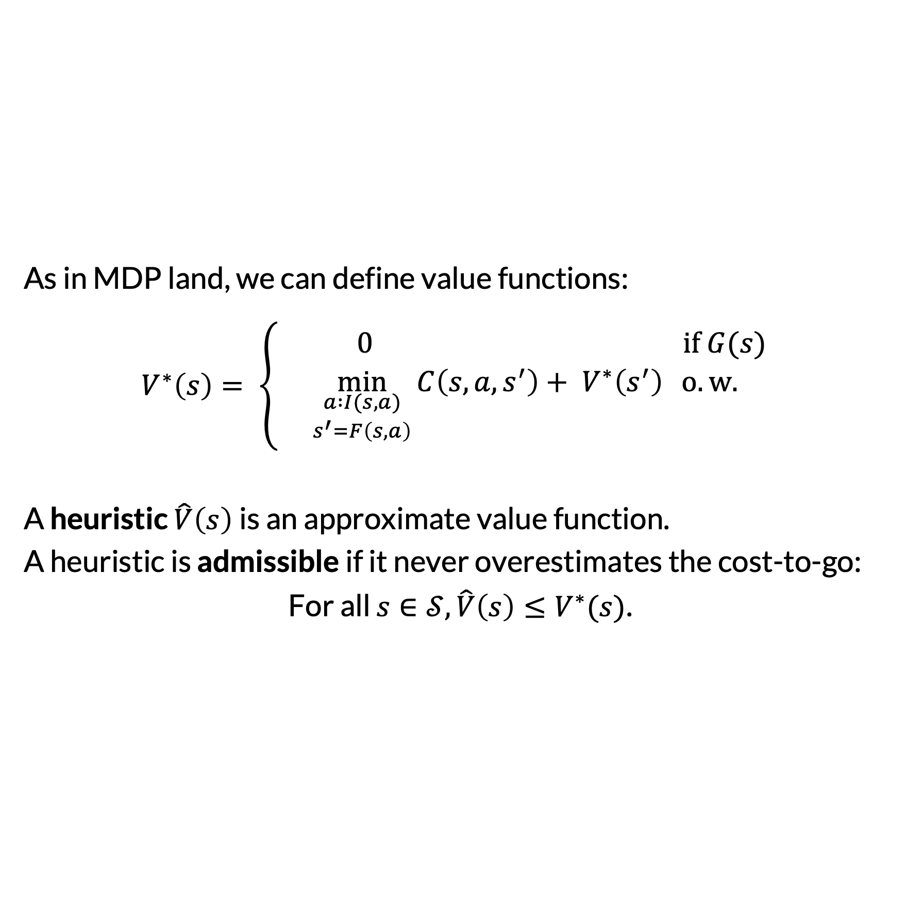
Heuristics and Value Functions
As in MDP land, we can define value functions:
$$V^{∗}\left(s\right)= \left\{\begin{aligned} 0 if G(s) \\ \min_{\begin{aligned}a :I(s, a) \\ s^{′}=F\left(s, a\right)\end{aligned}}{{C\left(s, a, s^{′}\right)+ V}^{∗}\left(s^{′}\right)} o.w.\end{aligned}\right.$$
A heuristic $\hat{V}\left(s\right)$is an approximate value function.
A heuristic is admissible if it never overestimates the cost-to-go:
For all $s∈𝒮,\hat{V}\left(s\right)≤V^{∗}(s)$.

Slide 38
Graph Search Variations
Algorithm | Priority Function | Optimal? | Notes
Uniform cost search | path cost | Yes | If costs are 1, this is breadth-first search. Like Dijkstra’s, but returns shortest path to goal, not shortest paths to all states
Greedy best-first search (GBFS) | heuristic(state) | No | Good choice for fast satisficing planning
A* search | path cost + heuristic(state) | Depends | Optimal if heuristic is admissible (never overestimates cost-to-go)
Depth first search | negative path cost | No | Can be more memory-efficient if implemented as a special case

Slide 39
Where do Heuristics Come From?
Hand-designed based on understanding of the problem
Learned from data (later in the course)
Automatically derived from the problem representation

Slide 40
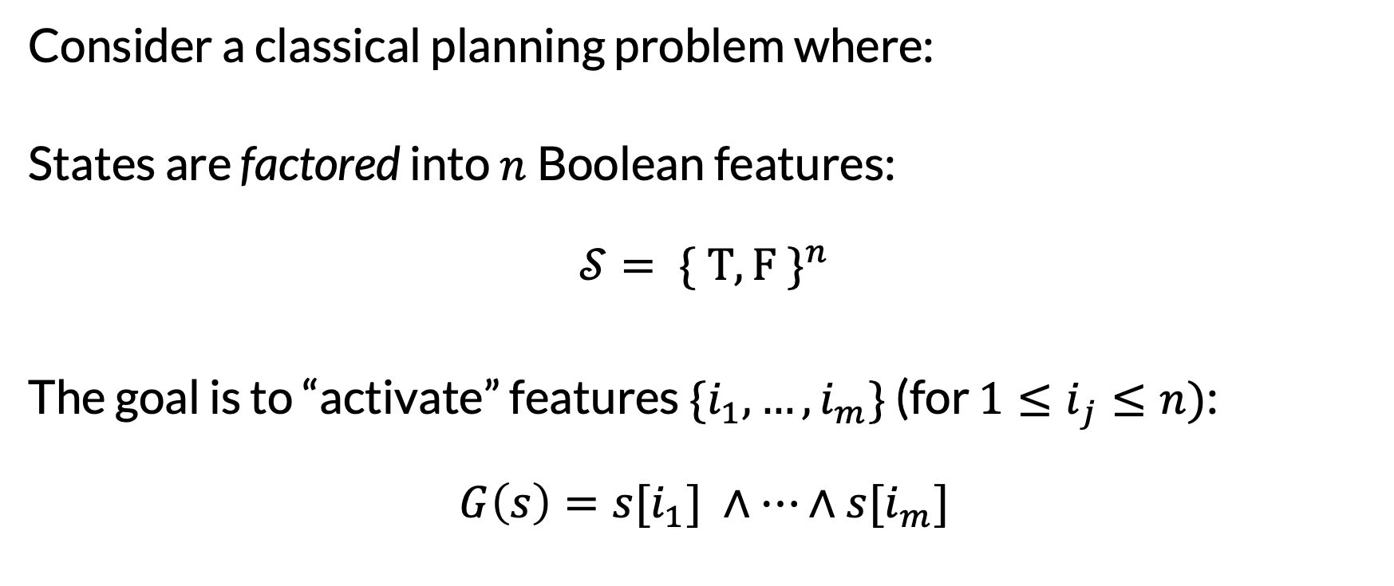
Factored Classical Planning Problems
Consider a classical planning problem where:
States are factored into $n$Boolean features:
$$𝒮= \{ T, F \}^{n}$$
The goal is to “activate” features $\{i_{1}, …,i_{m}\}$ (for ${1≤i}_{j}≤n)$:
$$G\left(s\right)=s[i_{1}] ∧…∧s[i_{m}]$$

Slide 41
Blocks World Example
Feature | Value
On-A-B | True
On-A-C | False
On-B-A | False
On-B-C | False
On-C-A | False
On-C-B | False
OnTable-A | False
OnTable-B | True
OnTable-C | True
Holding-A | False
Holding-B | False
Holding-C | False
HandEmpty | True
Goal: b on a
{On-B-A}
a
b
c
Table

Slide 42
Blocks World Example
Feature | Value
On-A-B | False
On-A-C | False
On-B-A | False
On-B-C | False
On-C-A | False
On-C-B | False
OnTable-A | True
OnTable-B | True
OnTable-C | True
Holding-A | False
Holding-B | False
Holding-C | False
HandEmpty | True
Goal: a on b & b on c
{On-A-B,
On-B-C}
b
c
a
Table

Slide 43
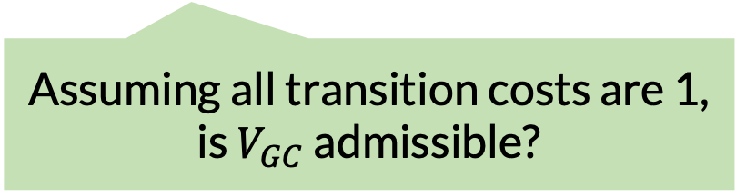

Goal-Count: Our First Problem-Derived Heuristic
The goal-count heuristic counts the number of goal features that are not yet activated:
$$V_{GC}\left(s\right)≜|\{i :¬s\left[i\right]∧i∈G\}|$$
Assuming all transition costs are 1, is $V_{GC}$ admissible?

Slide 44
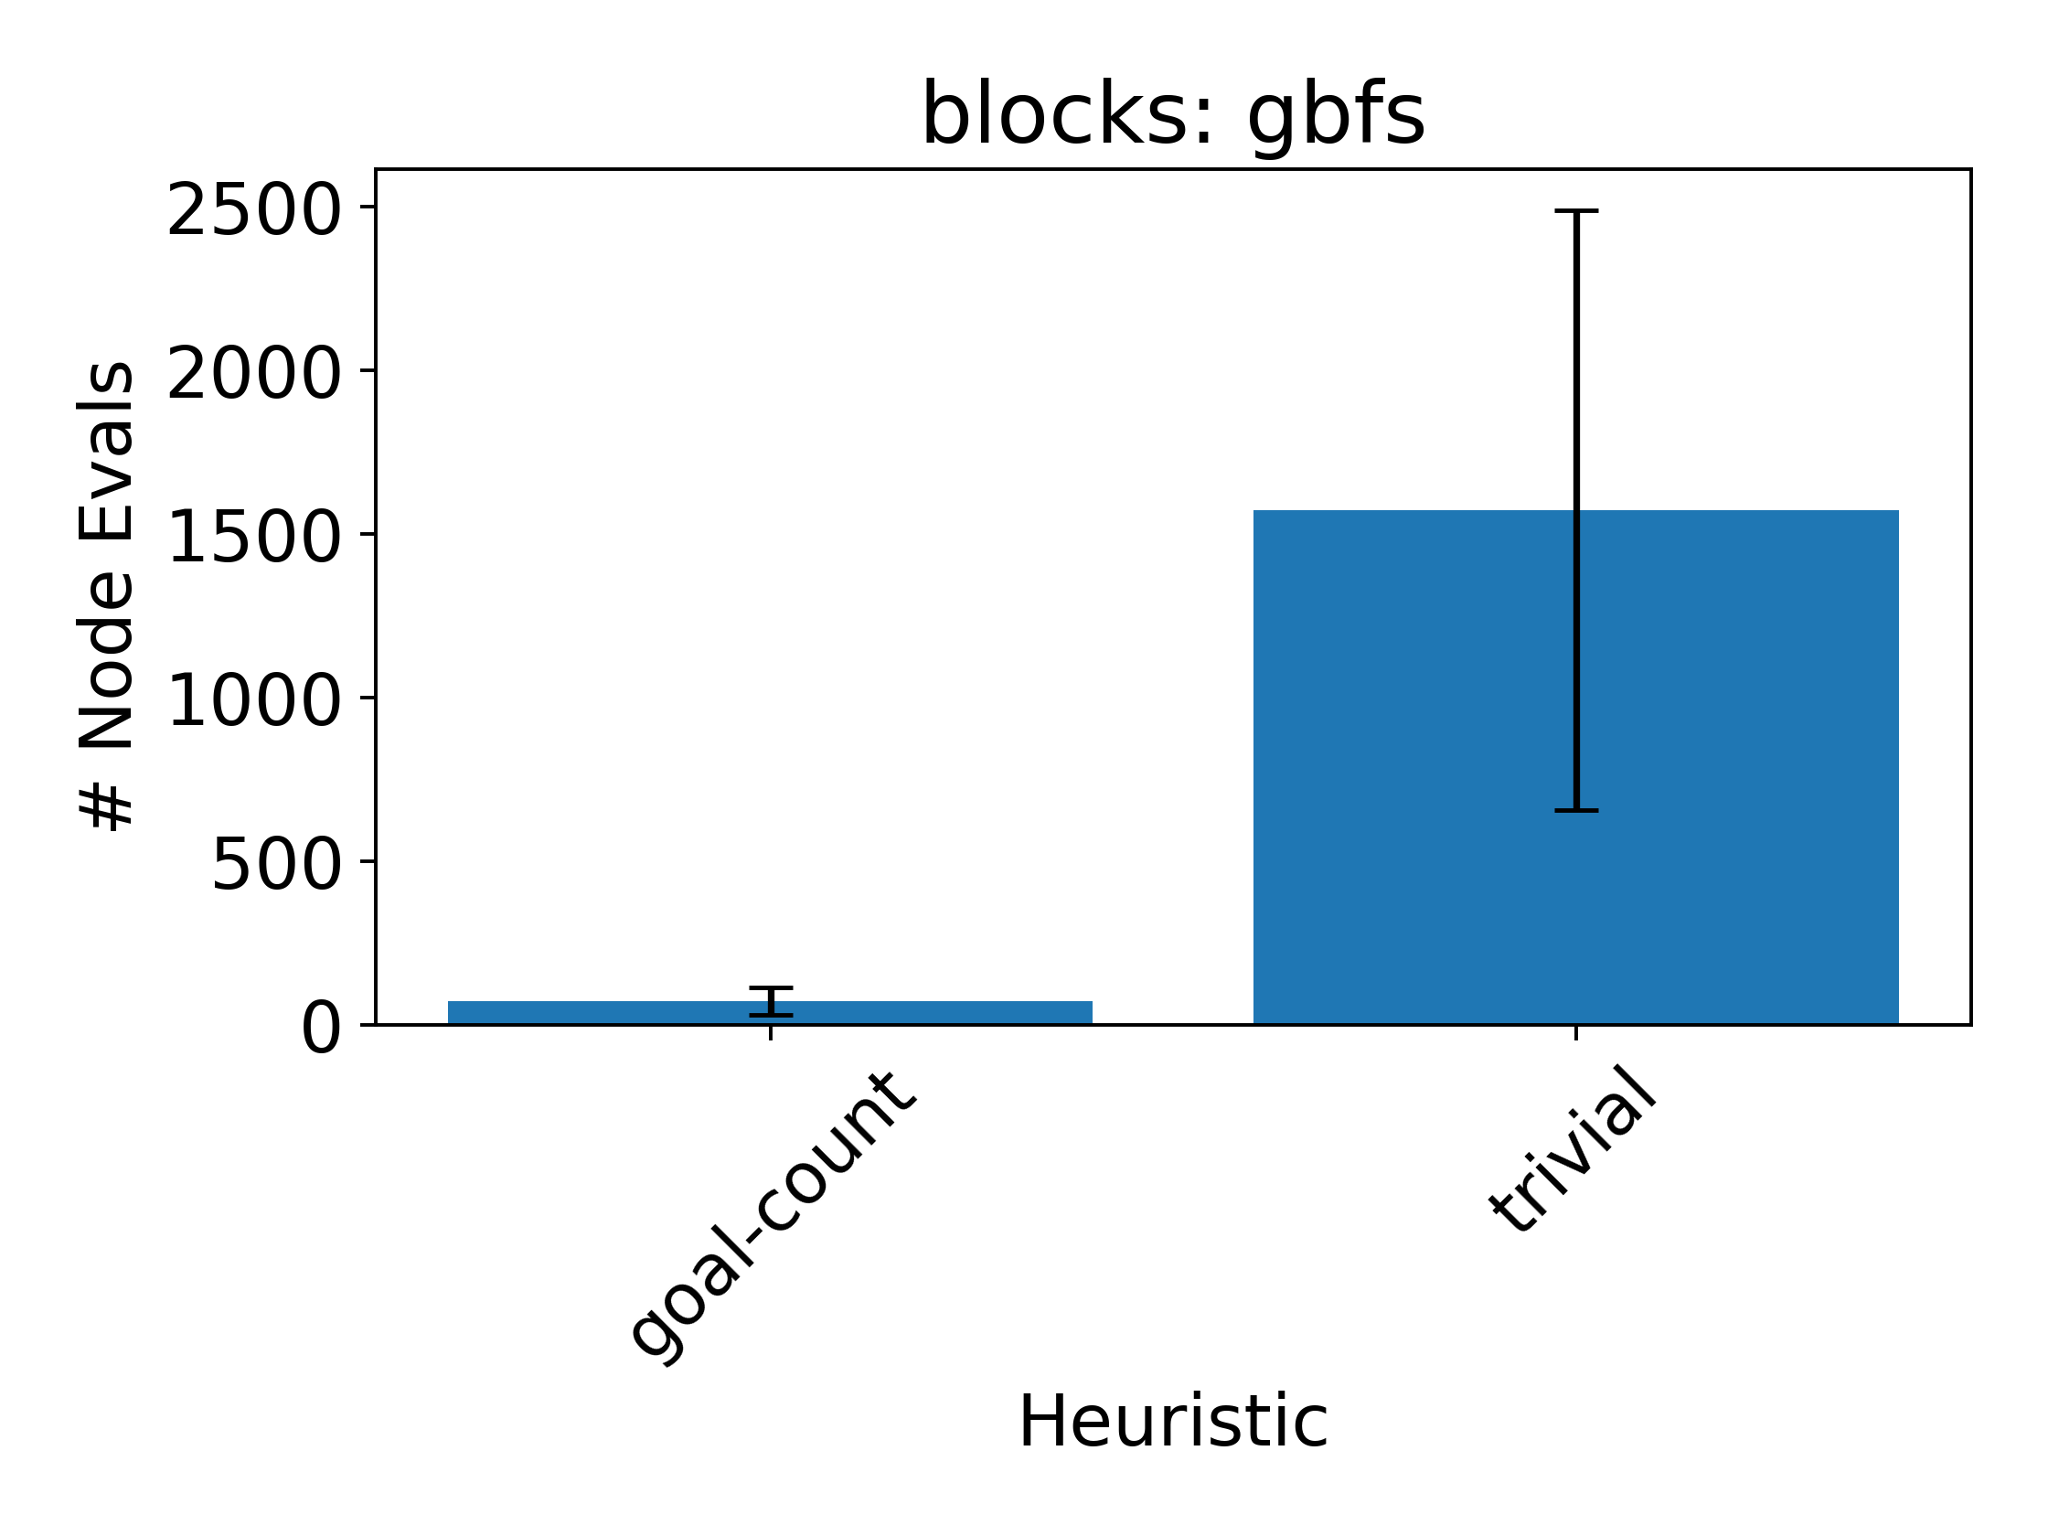
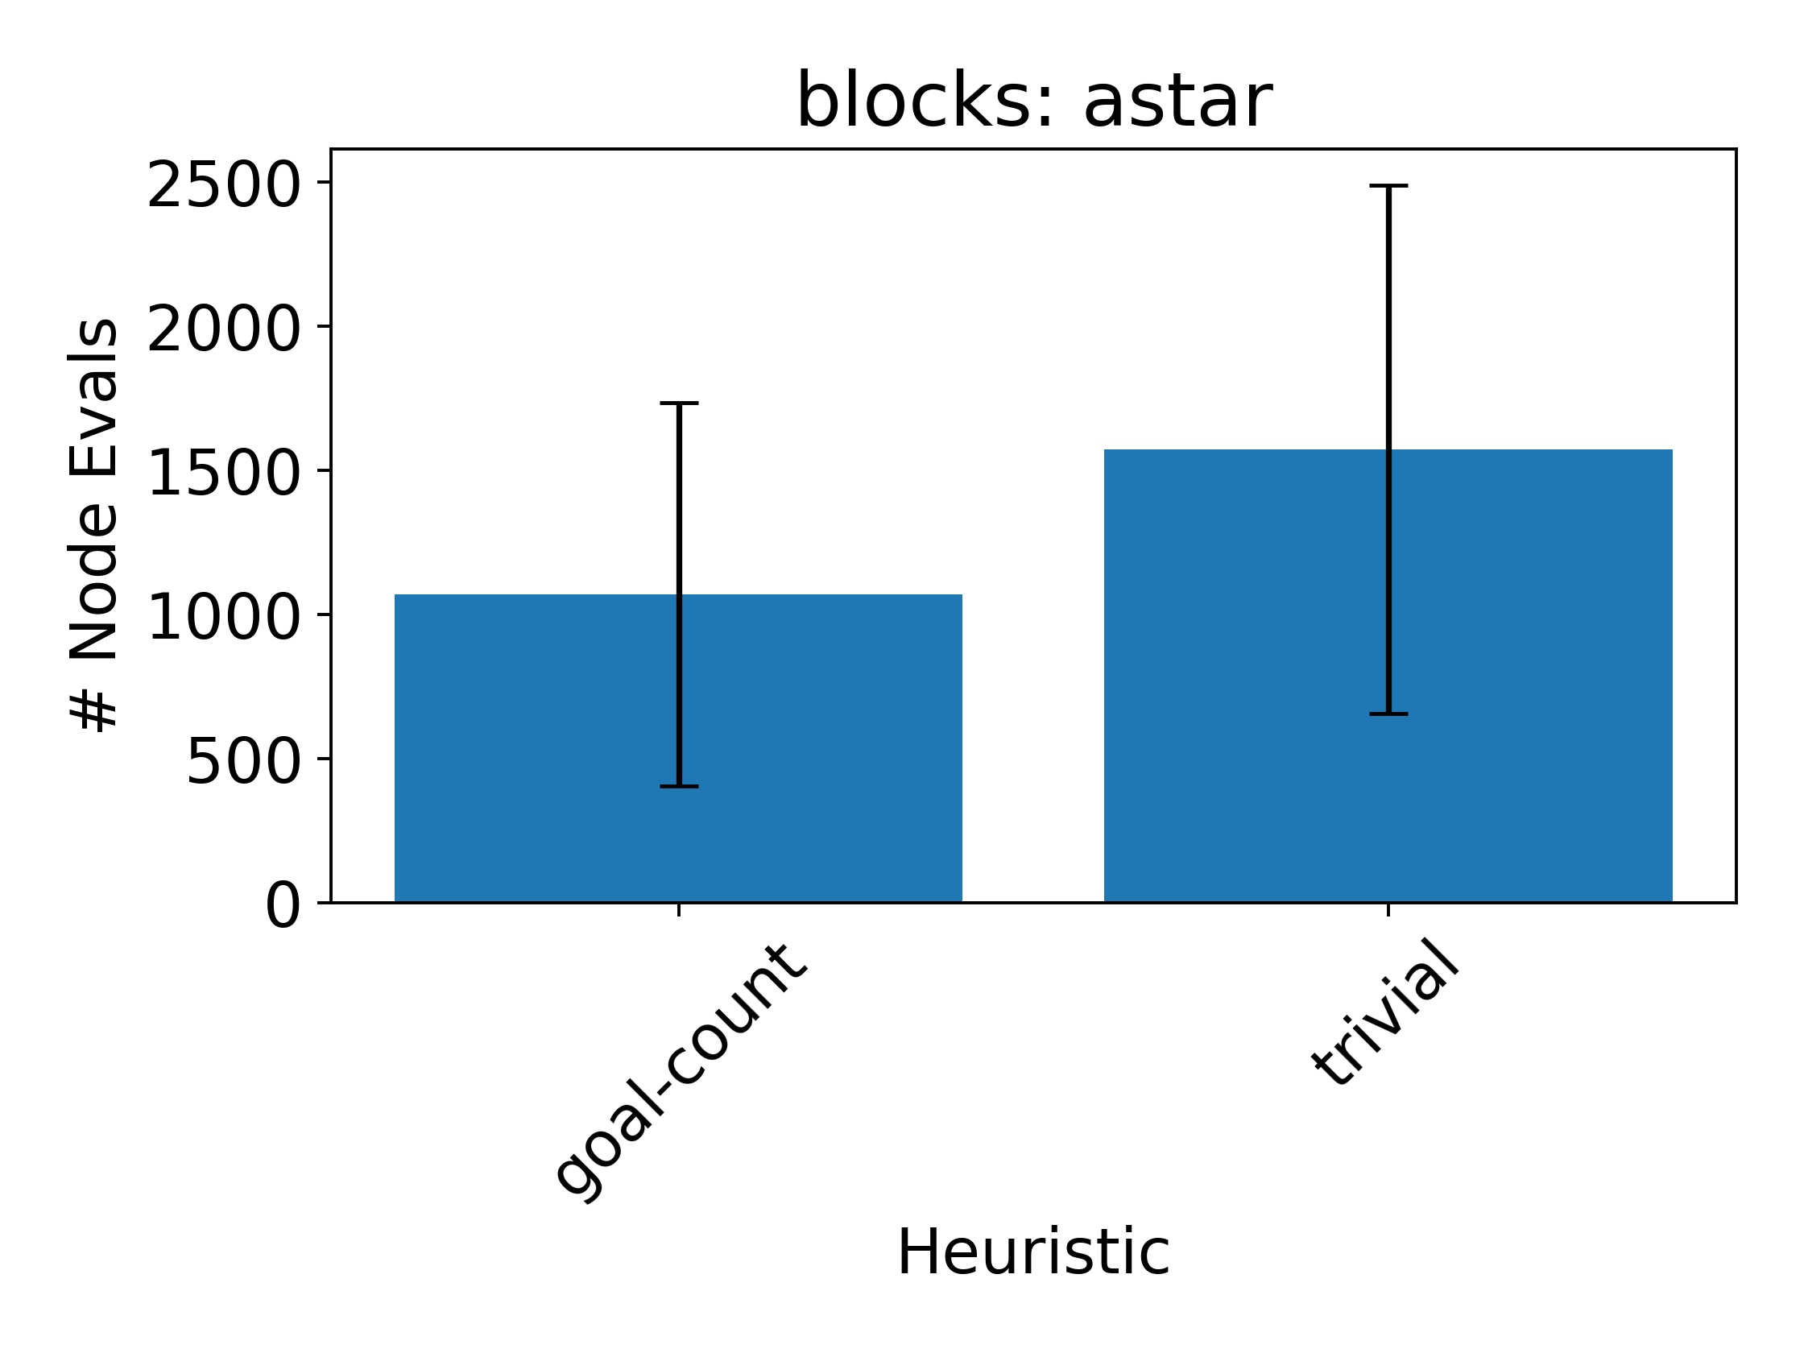
Goal-Count Can Help!

Slide 45
Limitations of Goal-Count
Very sparse
Can be “misleading”
Examples?

Slide 46
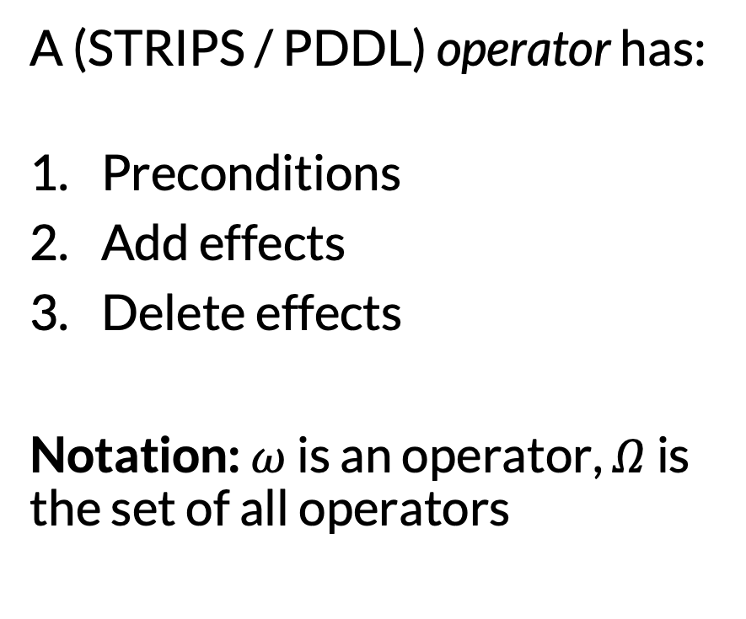
Factoring Further: Actions + Transitions
A (STRIPS / PDDL) operator has:
Preconditions
Add effects
Delete effects
Notation: $ω$ is an operator, $Ω$ is the set of all operators
Pick-A-from-C:
Preconditions: {HandEmpty, On-A-C, Clear-A}
Add effects: {Holding-A, Clear-C}
Delete effects: {HandEmpty, On-A-C, Clear-A}
Each is a set of features

Slide 47

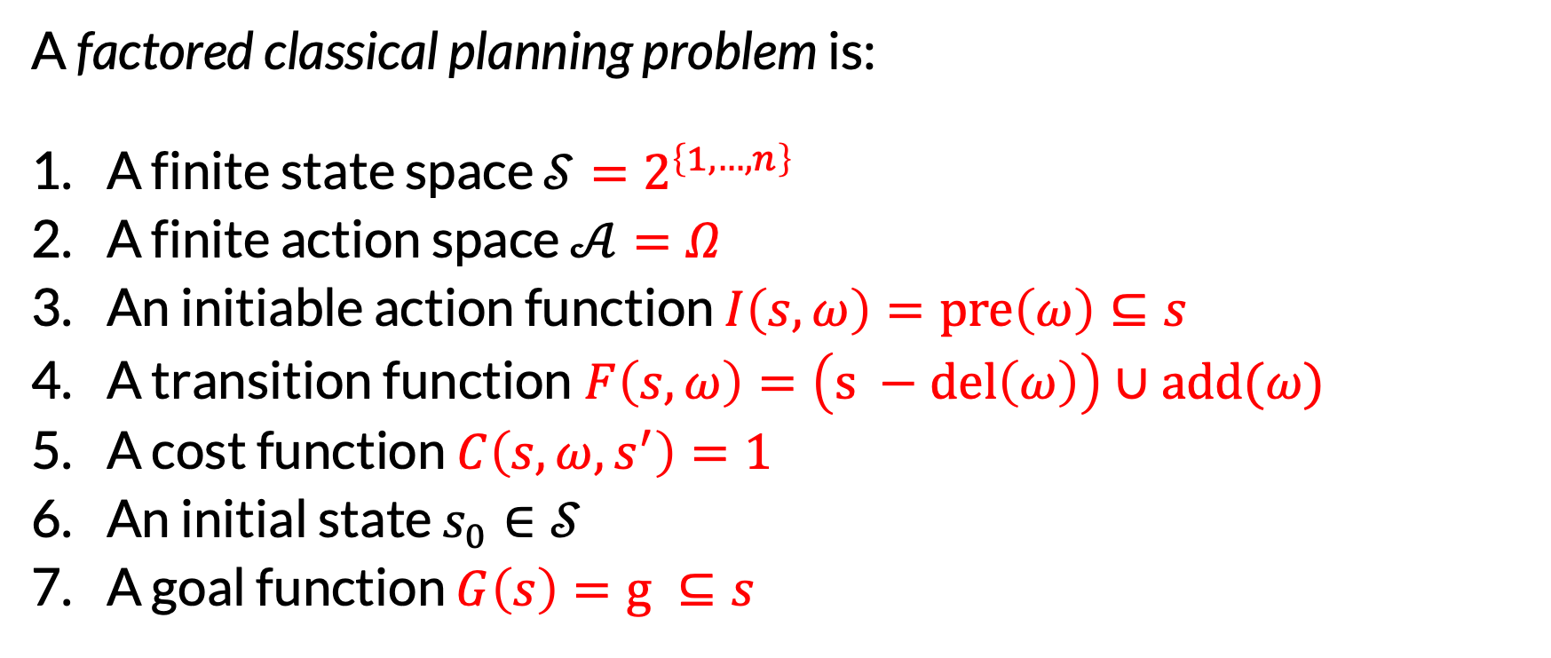
Factored Classical Planning Problems
A factored classical planning problem is:
A finite state space $𝒮=2^{\left\{1, …, n\right\}}$
A finite action space $𝒜=Ω$
An initiable action function $I\left(s, ω\right)=pre\left(ω\right)⊆s$
A transition function$F\left(s, ω\right)=\left(s −del\left(ω\right)\right)∪add(ω)$
A cost function $C\left(s, ω, s^{′}\right)=1$
An initial state $s_{0}∈𝒮$
A goal function $G\left(s\right)=g ⊆s$
Set of all true features
Actions = operators
Preconditions hold
Effects
For simplicity
$g$is another feature set

Slide 48
Lifted Operators
It is often convenient to define operators with parameters: placeholders for objects
Objects can also be typed
Preprocessing: ground all lifted operators with all combinations of objects (obeying types)
Pick(?x, ?y):
Preconditions: {HandEmpty(), On(?x, ?y), Clear(?x)}
Add effects: {Holding(?x), Clear(?y)}
Delete effects: {HandEmpty(), On(?x, ?y) Clear(?x)}

Slide 49
A Recipe for Heuristic Generation
Original Problem
Relaxed Problem
Relaxed Solution
Relax
Plan
Relaxed Value
Use as heuristic
Extract solution cost
Repeat at every state

Slide 50
Delete Relaxation
Pick(?x, ?y):
Preconditions: {HandEmpty(), On(?x, ?y), Clear(?x)}
Add effects: {Holding(?x), Clear(?y)}
Delete effects: {HandEmpty(), On(?x, ?y) Clear(?x)}
Pick(?x, ?y):
Preconditions: {HandEmpty(), On(?x, ?y), Clear(?x)}
Add effects: {Holding(?x), Clear(?y)}
Delete effects: {}
Relax

Slide 51
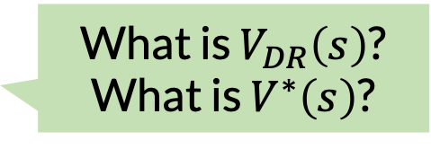

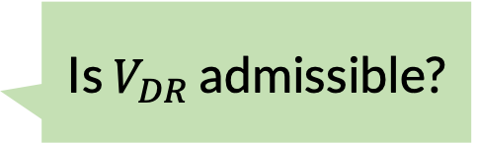
Delete-Relax: Our Second Problem-Derived Heuristic
The delete-relax heuristic $V_{DR}\left(s\right)$is the optimal cost of the relaxed planning problem with initial state $s$.
What is $V_{DR}\left(s\right)$? What is $V^{∗}\left(s\right)$?
Goal: holding(a) & holding(b)
b
c
a
Is $V_{DR}$ admissible?
Table

Slide 52
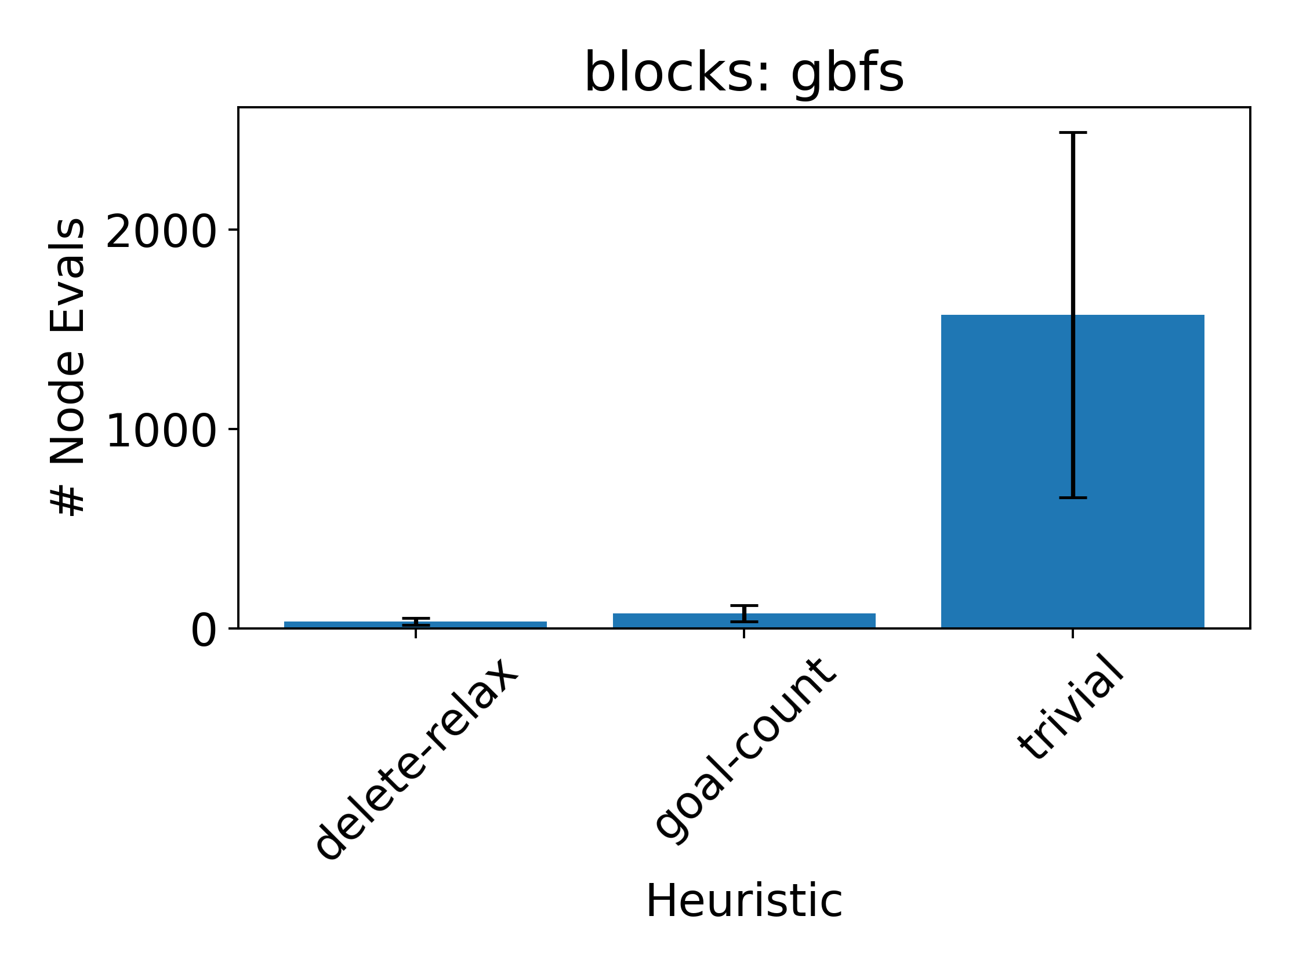
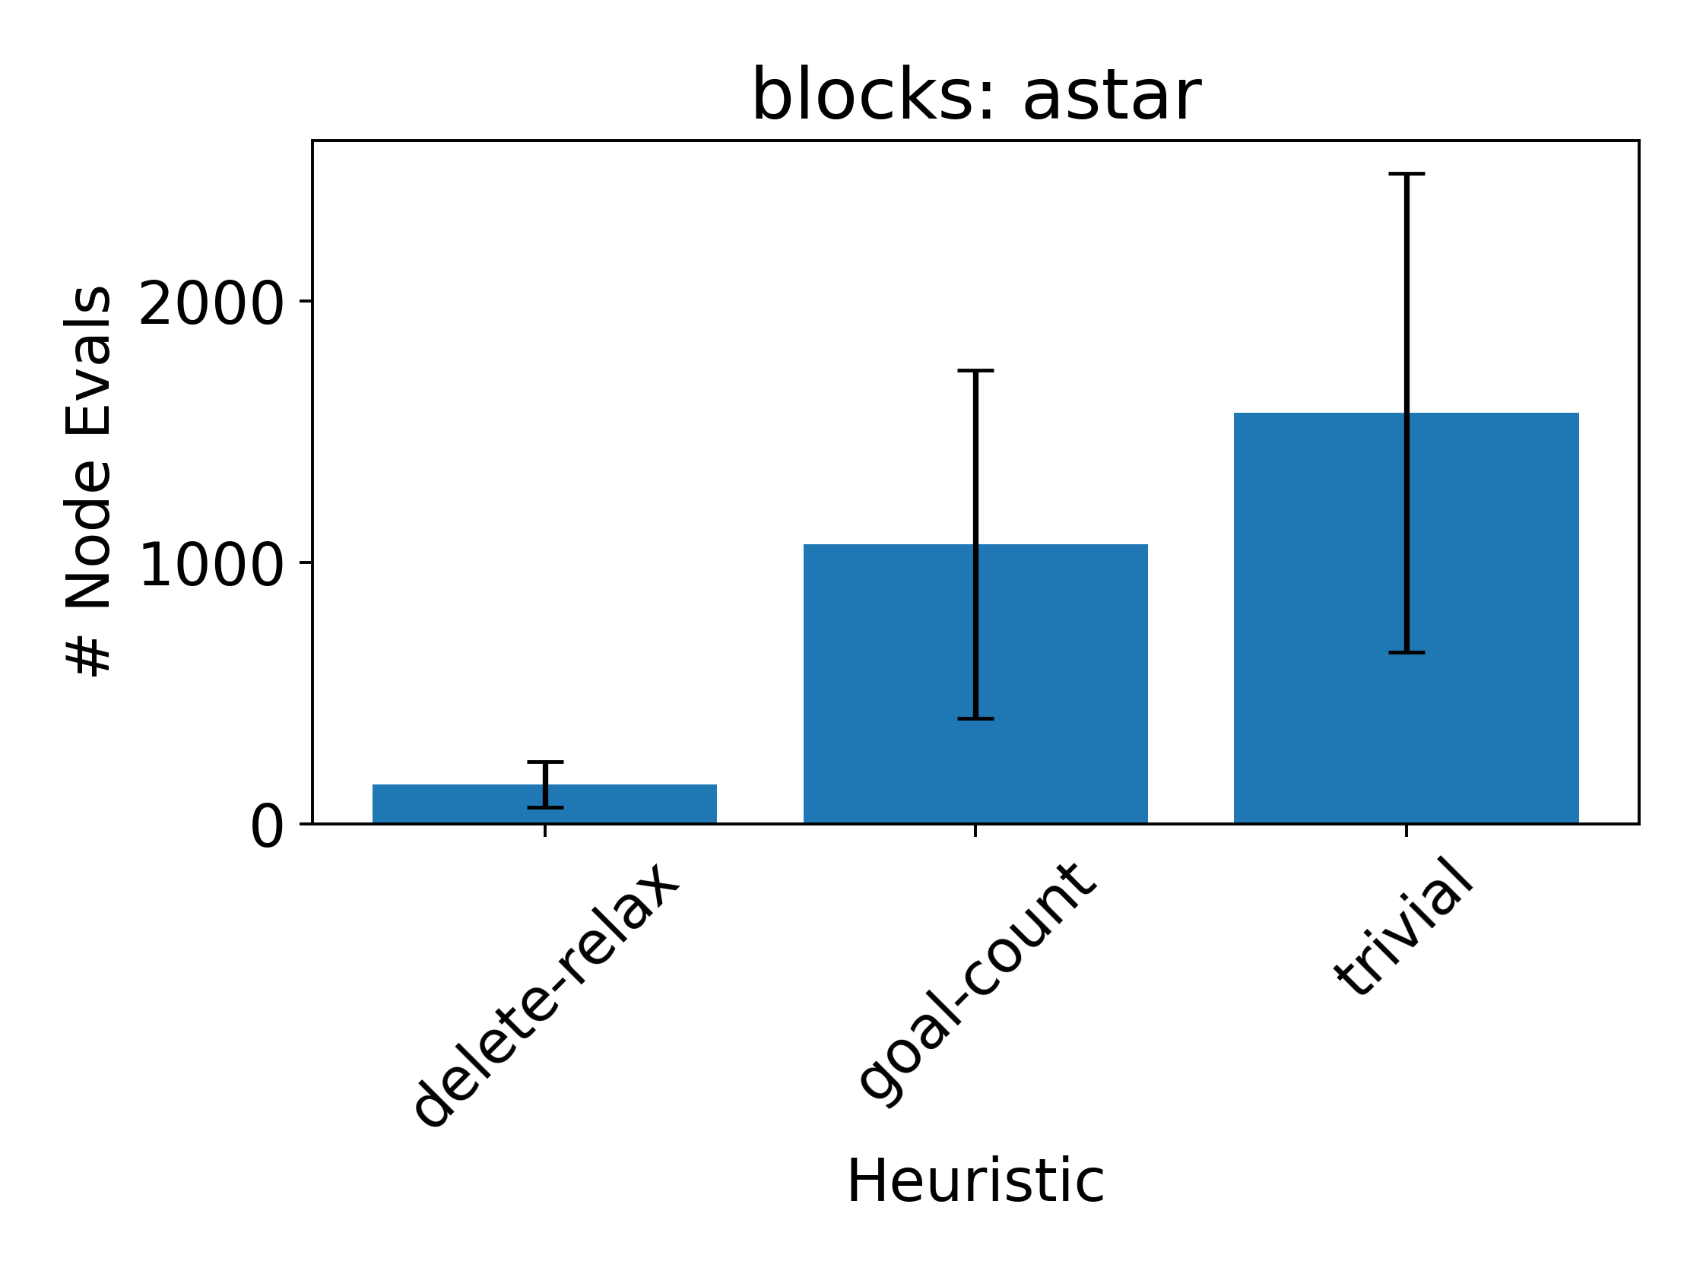
Delete Relaxation Can Help!
But these plots are extremely misleading. Why?

Slide 53
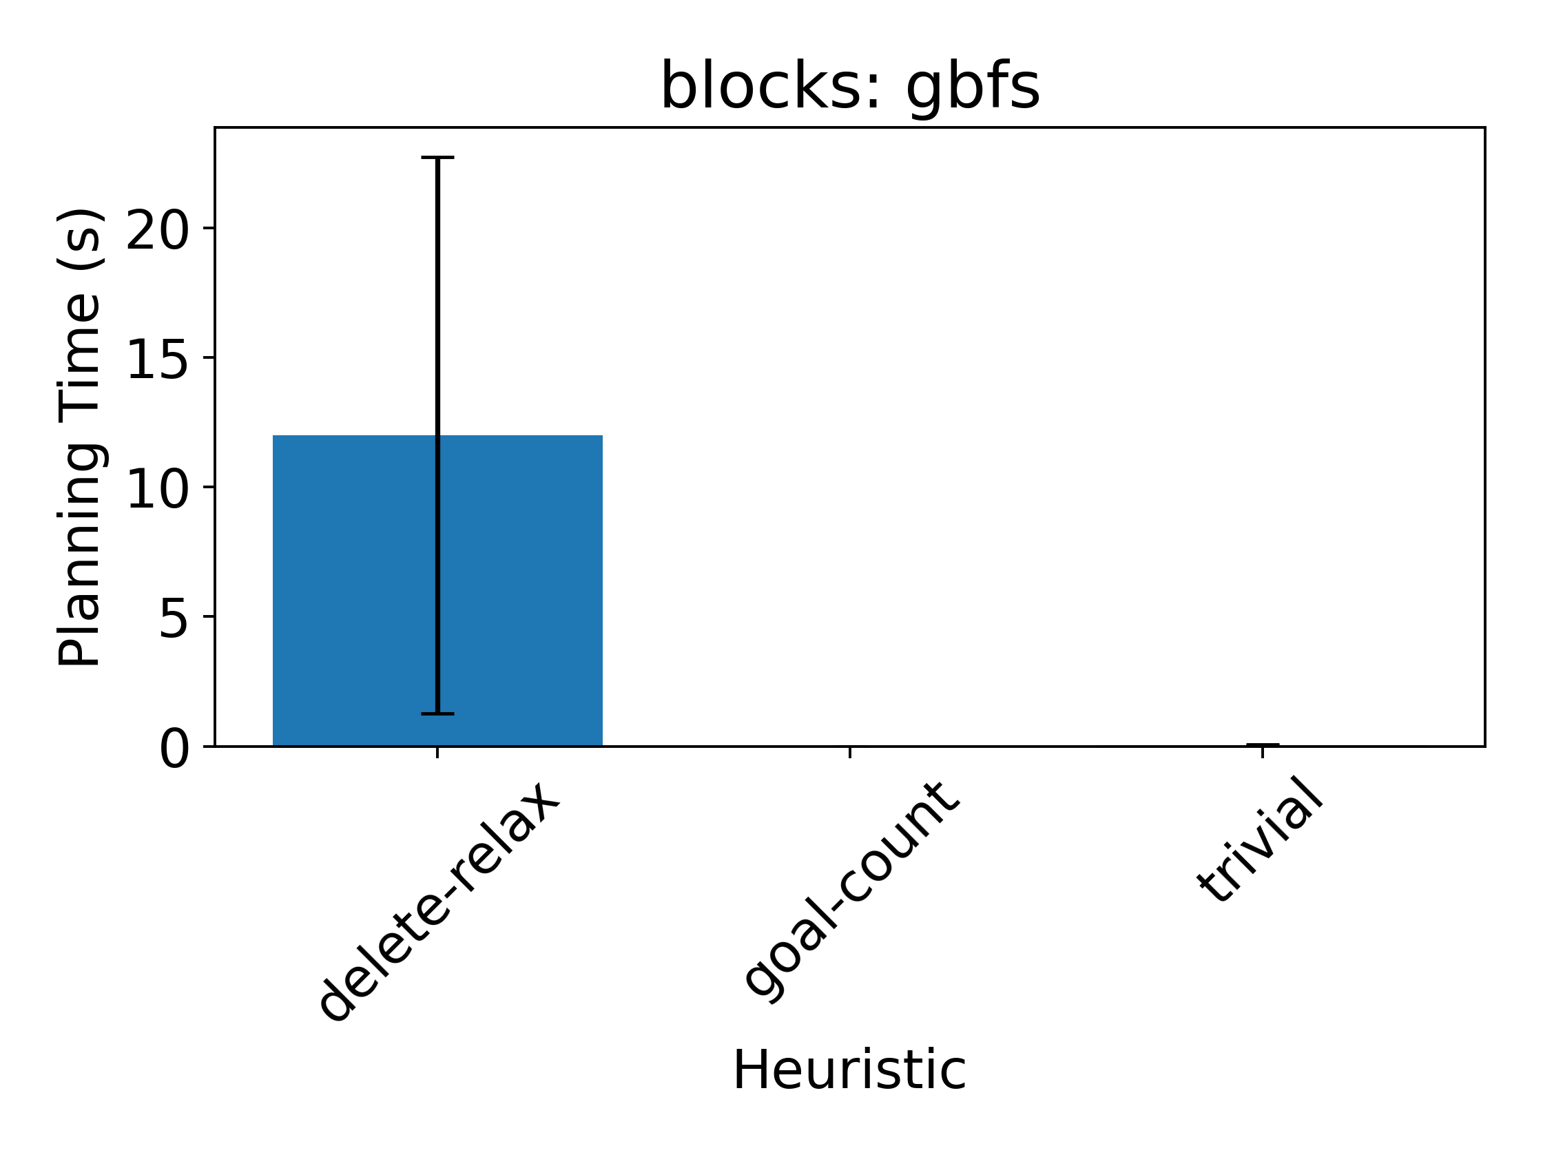
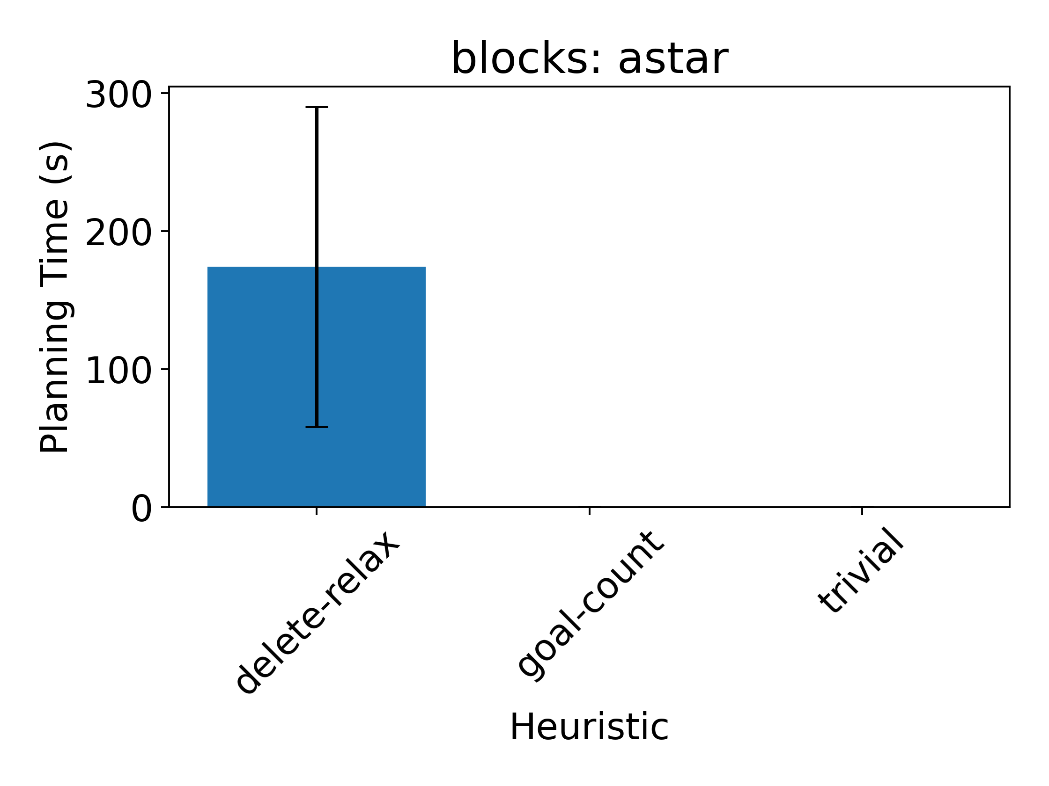
More Revealing Plots
Solving delete-relaxed problems exactly is formally hard (NP-complete)
😱
😱

Slide 54
hFF: A Better Delete Relaxation Heuristic
Construct a non-optimal relaxed plan in a particular way:
Forward pass:
Imagine we could execute all initiable actions simultaneously
Aggregate the next states into superset of all active features
Repeat (1) and (2) until convergence (or goal is active)
Backward pass:
Build a relaxed plan by selecting “necessary” actions

Slide 55
Feature 1
(active)
★
Feature 2
(active)
★
Feature 3
(inactive)
Goal
★

Slide 56
★
★
★

Slide 57
Operators
★
★
★
★
★

Slide 58
Operators
★
★
★
★
★
★
★

Slide 59
★
★
★
★
★
★
★
★
★
★

Slide 60
★
★
★
★
★
★
Convergence Forward Pass Complete
★
★
★
★
★
★

Slide 61
★
★
★
★
★
★
★
★
Starting Backward Pass
★
★
Goal
★
★

Slide 62
★
★
★
★
★
★
★
★
★
★
Goal
★
★

Slide 63
★
★
★
★
★
★
★
★
★
★
Goal
★
★

Slide 64
★
★
★
★
★
★
★
★
★
★
Goal
★
★

Slide 65
★
★
★
★
★
★
★
★
★
★
Goal
★
★

Slide 66
★
★
★
★
★
★
★
★
★
★
Goal
★
★

Slide 67
★
★
★
★
★
★
★
★
★
★
Goal
★
★

Slide 68
★
★
★
★
★
★
★
★
★
★
Goal
★
★

Slide 69
★
★
★
★
★
★
★
★
★
★
Goal
★
★

Slide 70
★
★
★
★
★
★
★
★
★
★
Goal
★
★

Slide 71
★
★
★
★
★
★
Relaxed
Plan
★
★
★
★
★
★

Slide 72

★
★
★
★
★
★
Relaxed
Plan
★
★
$$V_{hFF}=4$$
★
★
★
★

Slide 73
★
Terminology:
Relaxed Planning
Graph
★
★
★
★
★
★
★
Also useful for testing reachability
★
Also useful for pruning actions
★
★
★

Slide 74
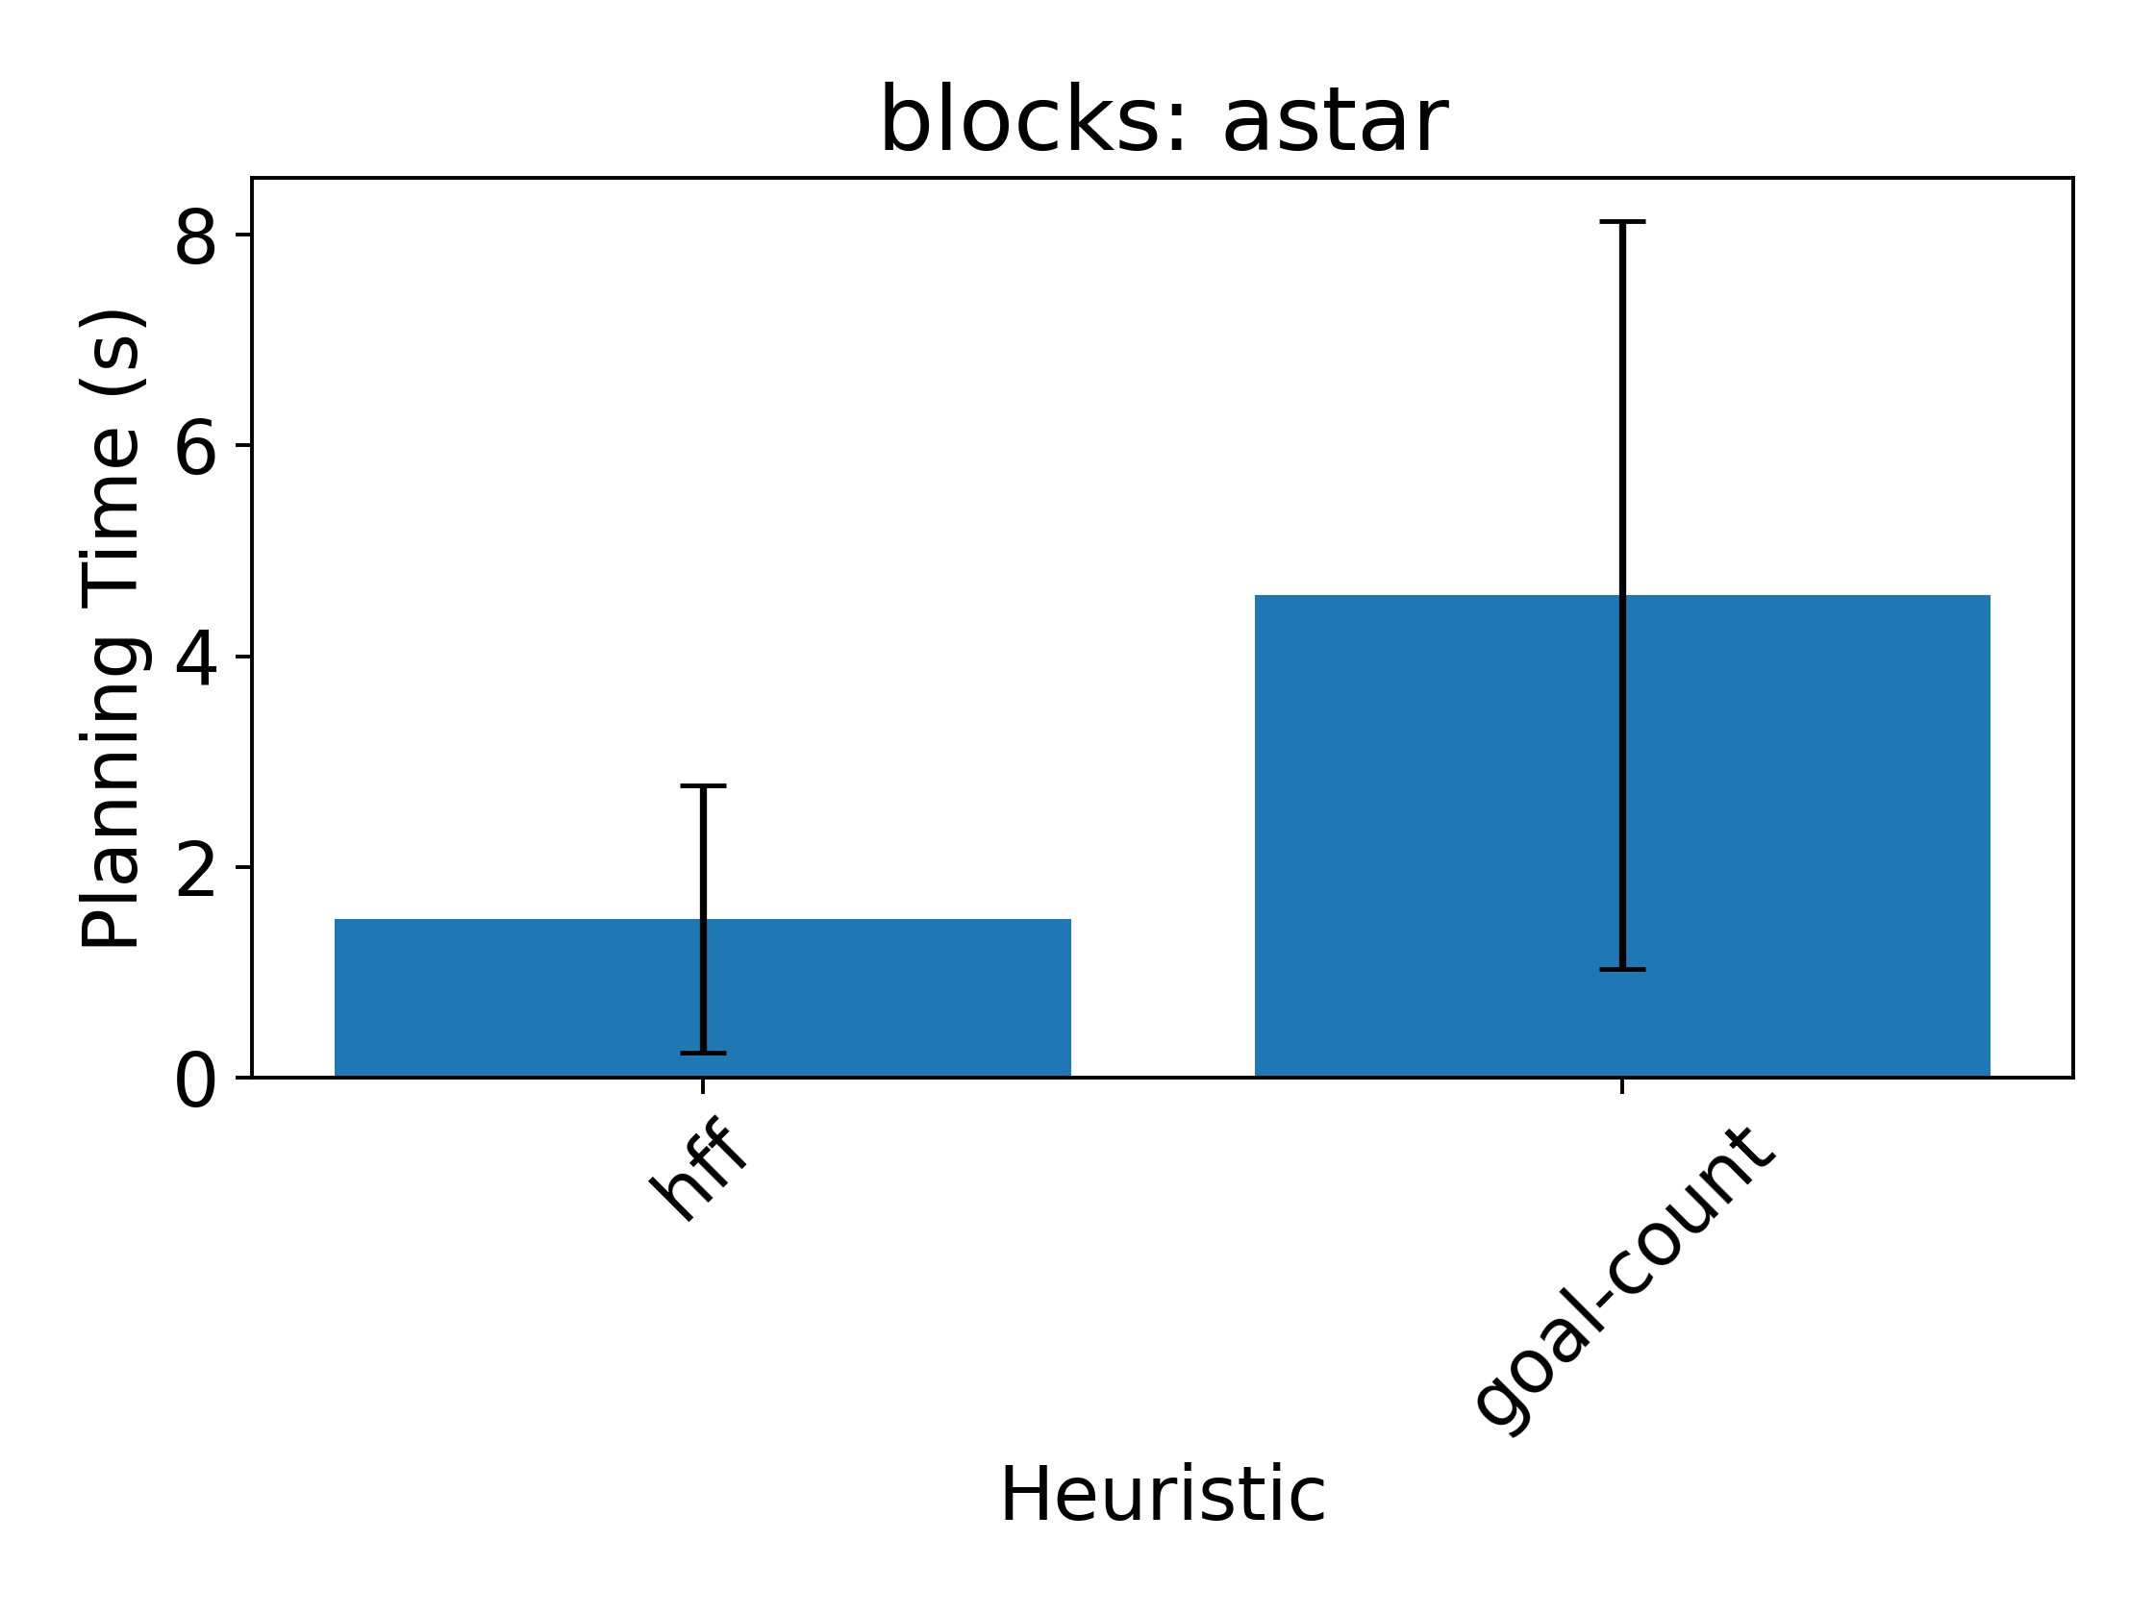
hFF Can Really Help!

