Slide 1
Megaman 2 Survey
Customer: Eric Nantz

Slide 2
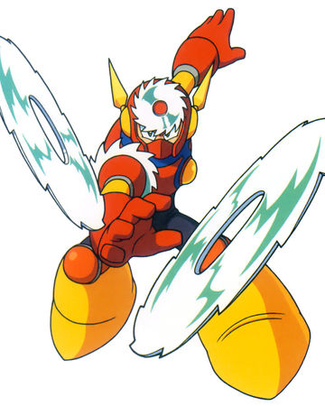
Easiest Robot Master
Metal Man's stage had fairly simple enemies to elimnate, and his attack patterns were not sophisicated
Metal Man

Slide 3
Attempts for all robots
6
4
Attempts
2
0
Air Man
Bubble Man
Crash Man
Flash Man
Heat Man
Metal Man
Quick Man
Wood Man
Robot Master

