Slide 1
Trusted Mini-Agents:
Leveraging AI Where Correctness Matters
Will Landau

Slide 2
Goal: engineer hallucinations out of AI agents
Reason: clinical work needs to be correct.
Strategy: trusted mini-agents
Example: clinical trial simulation
Documentation: trustedminiagents.dev

Slide 3
Parts of an agent

Slide 4
Agent = model + harness
MODEL
HARNESS
LLM
Context window
Registered tools
Agent loop
Simply predicts text.
Data on which the LLM makes predictions.
How the agent perceives the world and acts on it.
Loop between the LLM and tools.
”The quick brown fox”
User prompt
web_search()
Gather context.
1
history + system prompt + tools
System prompt
read_file()
Take action.
run_code()
2
Maybe call a tool.
Conversation history
query_database()
Verify results.
Tool definitions
3
Prompt the LLM for a decision.
send_email()
Prompt
Tool results
Repeat until done.
”jumped over the lazy dog.”
edit_document()
4
Feed output back into context.

Slide 5
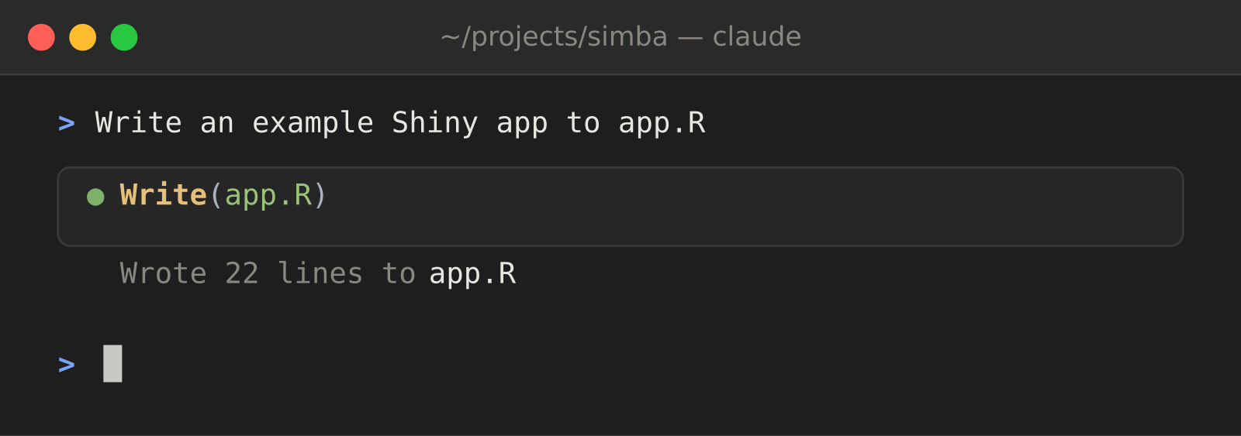
Example: Claude Code
Claude Code is an agent with tools like Write(), Edit(), Bash(), etc.

Slide 6
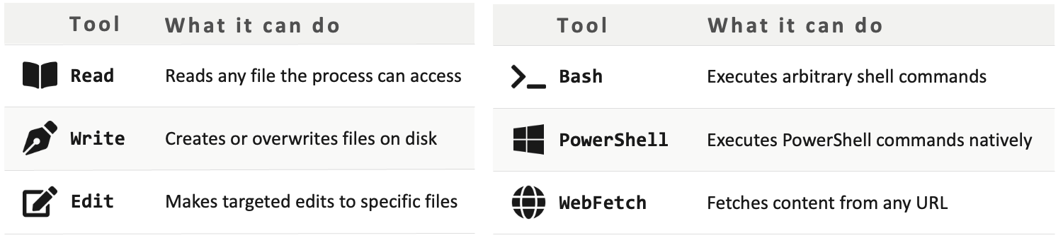
Claude Code is not designed to control hallucinations.
Claude Code tools are too broad, too privileged, and too hard to check.
Prompts and skills cannot prevent hallucinations.
***PROMPTS AND SKILLS ARE ABOUT CONVENIENCE, NOT CORRECTNESS!***

Slide 7
Controlling hallucinations

Slide 8
Large language models hallucinate.
User
LLM
“What’s the weather in Chicago?”
HALLUCINATION!!!
It’s 50°F and rainy in Indianapolis.
9/24/2026
8

Slide 9
Tools add context but may not prevent hallucinations.
User
LLM
Tool
“What’s the weather in Chicago?”
VULNERABLE!!!
get_weather(lat = 41.8, long = -87.6)
{”temperature”: 72, “weather”: “Sunny”}
HALLUCINATION!!!
It’s 50°F and rainy in Indianapolis.
9/24/2026
9

Slide 10
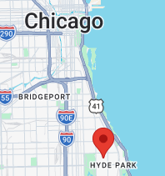
Fix 1 of 3: help the human review the location.
User
LLM
Tool
“What’s the weather in Chicago?”
https://www.google.com/maps?q=41.8,-87.6
get_weather(lat = 41.8, long = -87.6)
{”temperature”: 72, “weather”: “Sunny”}
HALLUCINATION!!!
It’s 50°F and rainy in Indianapolis.
9/24/2026
10

Slide 11
Fix 2 of 3: bypass the LLM to report the weather.
User
LLM
Tool
“What’s the weather in Chicago?”
https://www.google.com/maps?q=41.8,-87.6
get_weather(lat = 41.8, long = -87.6)
{”temperature”: 72, “weather”: “Sunny”}
9/24/2026
11

Slide 12
Beware untrusted tools! (Claude Code has many!)
User
LLM
Tool
“What’s the weather in Chicago?”
HALLUCINATION!!!
Write(“post_fake_weather.sh”)
Bash(“post_fake_weather.sh”)
{”temperature”: 72, “weather”: “Sunny”}
9/24/2026
12

Slide 13
Fix 3 of 3: never bypass the get_weather() tool.
User
LLM
Tool
“What’s the weather in Chicago?”
https://www.google.com/maps?q=41.8,-87.6
get_weather(lat = 41.8, long = -87.6)
{”temperature”: 72, “weather”: “Sunny”}
9/24/2026
13

Slide 14
Trusted mini-agents

Slide 15
What is a trusted mini-agent?
A least-privilege AI agent that engineers out hallucinations.
3 rules:
1. Trusted tools directly produce all results.
2. Each result only comes from one trusted tool.
3. Inputs to trusted tools have trusted human oversight.
The core idea: AI operates where:
  An LLM proposes solutions better than a human.
  A human easily checks those solutions.

Slide 16
The 3 rules in the weather example
Trusted mini-agent rule | Weather app fix
1. Trusted tools directly produce all results. | Bypass the LLM to report the weather.
2. Each result only comes from one trusted tool. | Never bypass the get_weather() tool.
3. Inputs to trusted tools have trusted human oversight. | Help the human review the location.

Slide 17
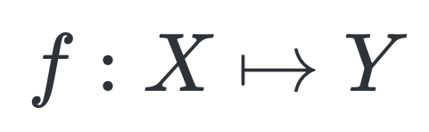
A trusted mini-agent is a bijective function.
X: tools
Y: types of results
get_weather()
Weather data
write_code()
Surjective: Trusted tools directly produce all results.
Injective: Each result only comes from one trusted tool.
Bijectivity ensures results are trusted given validated tools and inputs.
Z: other sources
LLM

Slide 18
Trusted mini-agent workflow
Agent Loop
Trust
LLM
Trusted Tools
Proposed
Inputs
Reviewed
Inputs
Human Review
Rejected
Proposals
Nontrivial
Computation
Autonomous
reasoning
Untrusted Tools
Trusted Results

Slide 19
Building trust
1
2
3
Prompt the LLM.
Create input for tools.
Call validated tools.
GOAL
GOAL
GOAL
Productivity and convenience.
Capture user intent.
Structure input to help humans check.
Ensure results are correct (given input).
TRUST
TRUST
TRUST
Never trust! Expect hallucinations!
Depends on the checking process.
Depends on the tool input.
Productive chaos
Catch hallucinations.
Trust results given input.

Slide 20
Impact on human users
Instead of:
  Are these results correct?
users ask:
  Is the agent solving the right problem?
which is much easier to verify.

Slide 21
Implementing trusted mini-agents

Slide 22

Implementing trusted mini-agents in R
✅ Prompt LLMs with R code.
✅ Manages conversation history.
✅ Only register tools you trust.
✅ Put a chat window in a Shiny app.
✅ Stream the chat into {ellmer}.

Slide 23
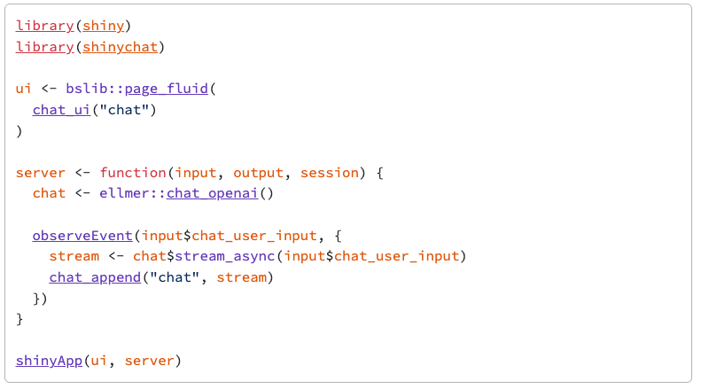
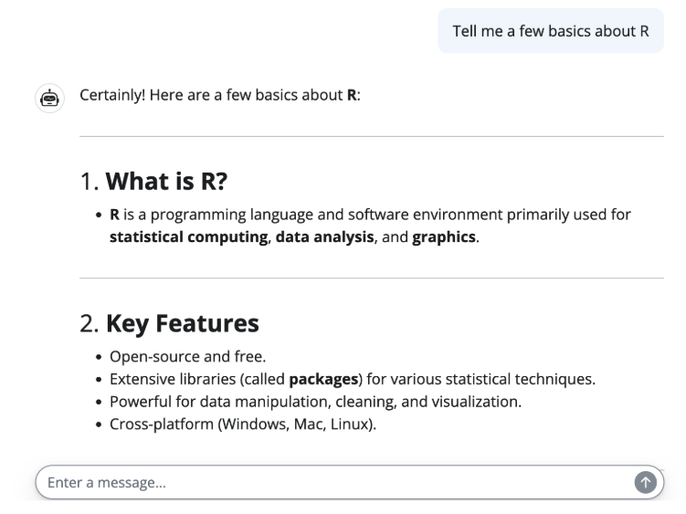
Shiny + shinychat + ellmer
From https://posit-dev.github.io/shinychat/r/articles/get-started.html

Slide 24
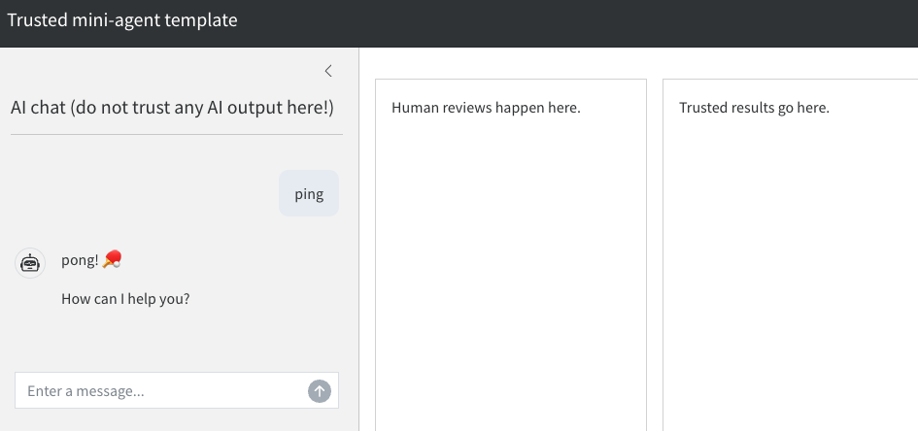
Separate regions for skepticism, review, and trust

Slide 25
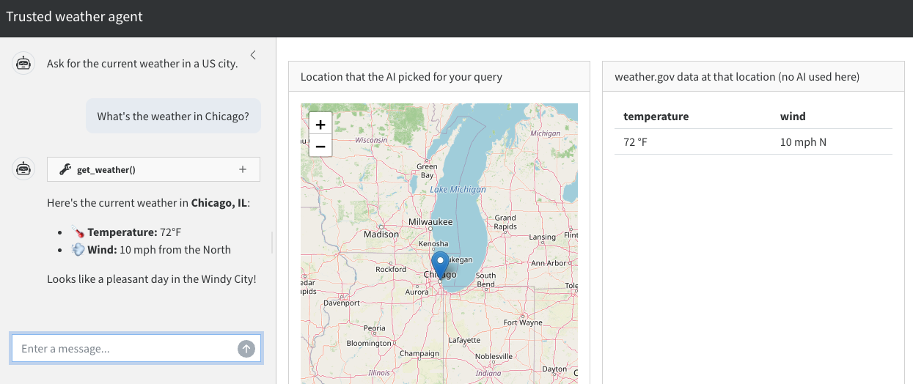
Example: weather app design

Slide 26
Example: clinical trial simulation

Slide 27
A clinical trial simulation trusted mini-agent
1
2
3
Describe a clinical design.
Check assumptions from LLM.
Run trusted simulations.
“I am designing a parallel phase 2A trial with 2 study arms. Scrape PubMed and ClinicalTrials.gov to give me scenarios that cover the competitive landscape of my drug.”
n_{t} | 60 | Number of treatment patients
π_{t} | 0.5 | Treatment group response rate
Trusted tools actually run the simulations:
  simulate_binary(design)
  simulate_continuous(design)
Impossible to get results
any other way!
Read the table instead of clicking through Shiny UI widgets.
Unfettered brainstorming
Is this the design you want?
Trusted results given the design.
User checks for hallucinated designs, and hallucinated simulations are impossible.

Slide 28
Architecture and flow
User prompt
Assumptions table (human reviews)
Agent
reasoning
Binary endpoint tool
Shiny reactive values list
Continuous endpoint tool
Results table
PubMed + ClinicalTrials.gov tools (not currently implemented)

Slide 29
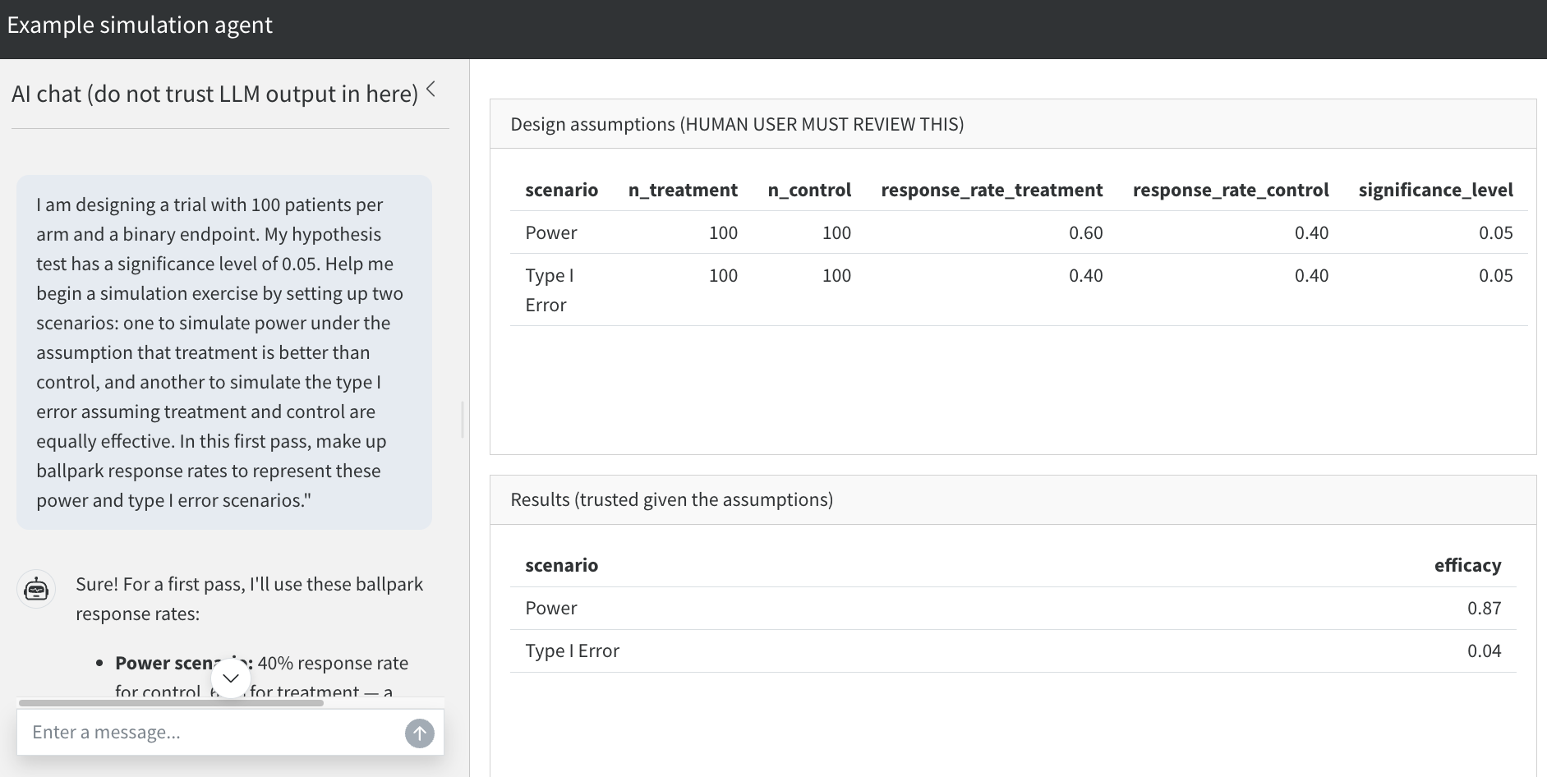
User interface

Slide 30
Key message

Slide 31
Key message
Trusted mini-agents are reliable AI systems that preserve the productivity of LLMs.
They excel in precision scenarios with:
Complex agent reasoning upstream.
Targeted nontrivial computation downstream.
A bottleneck where humans easily check LLM-generated proposals.

Slide 32
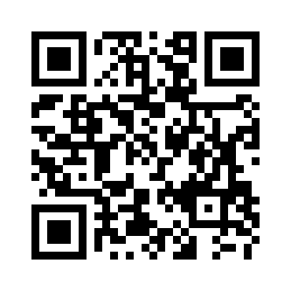
trustedminiagents.dev

