Slide 1
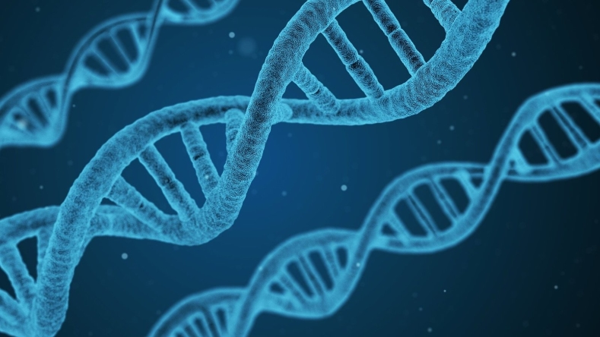

UPGG Computational Bootcamp
21 August 2024

Slide 2
Schedule
Day 1 – Aug. 21
Day 2 – Aug. 22
Day 3 – Aug. 23
Before | Welcoming words from Allison Ashley-Koch
09:00 | Introduction to the Unix Shell
11:45 | Lunch break
12:45 | Introduction to R and R Markdown
15:30 | END
09:00 | Data Manipulation and Organization in R
11:45 | Lunch break
12:45 | Introduce student committees by co-chairs
12:50 | Data Visualization in R
15:30 | END
09:00 | Group Project
11:45 | Lunch break
12:45 | Group Project Presentation
13:45 | Resources
14:30 | END

Slide 3
Group project
Show what you’ve learned over the course of the bootcamp!
Group project guidelines:
Choose a unique dataset to work with
Can be from your research, published data, or just publicly available datasets
Make a markdown report summarizing a unique dataset
Include some plots, some data tidying, etc. Were you able to learn anything new about your dataset?
Present your knitted markdown to the group (5-10 min presentation)
Did you find anything interesting?
What future questions/analyses would you want to pursue?

Slide 4
Groups
Group 1
Erick Figueroa
Brielle-Anne Michel
Kate Jaggi
Group 2
Eric Nguyen
Max Bucklan
Melissa Aldana
Group 3
Eric Nguyen
Max Bucklan
Melissa Aldana

Slide 5
Group project resources
Datasets
https://www.kaggle.com/datasets
https://rsh249.github.io/semester-biology/materials/datasets/
https://datacarpentry.org/semester-biology/materials/datasets/
https://www.zoology.ubc.ca/~whitlock/ABD/teaching/datasets.html
https://github.com/rfordatascience/tidytuesday
R resources
Cheatsheets (https://posit.co/resources/cheatsheets/)
R for Data Science (https://r4ds.had.co.nz/index.html)
Big book of R (https://www.bigbookofr.com/)
R color palette packages
Viridis (https://cran.r-project.org/web/packages/viridis/vignettes/intro-to-viridis.html)
RColorBrewer (https://r-graph-gallery.com/38-rcolorbrewers-palettes.html)
ggsci (https://nanx.me/ggsci/)
wesanderson (https://github.com/karthik/wesanderson)
ghibli (https://github.com/ewenme/Ghibli)
palettetown (https://github.com/timcdlucas/palettetown)

