Slide 1
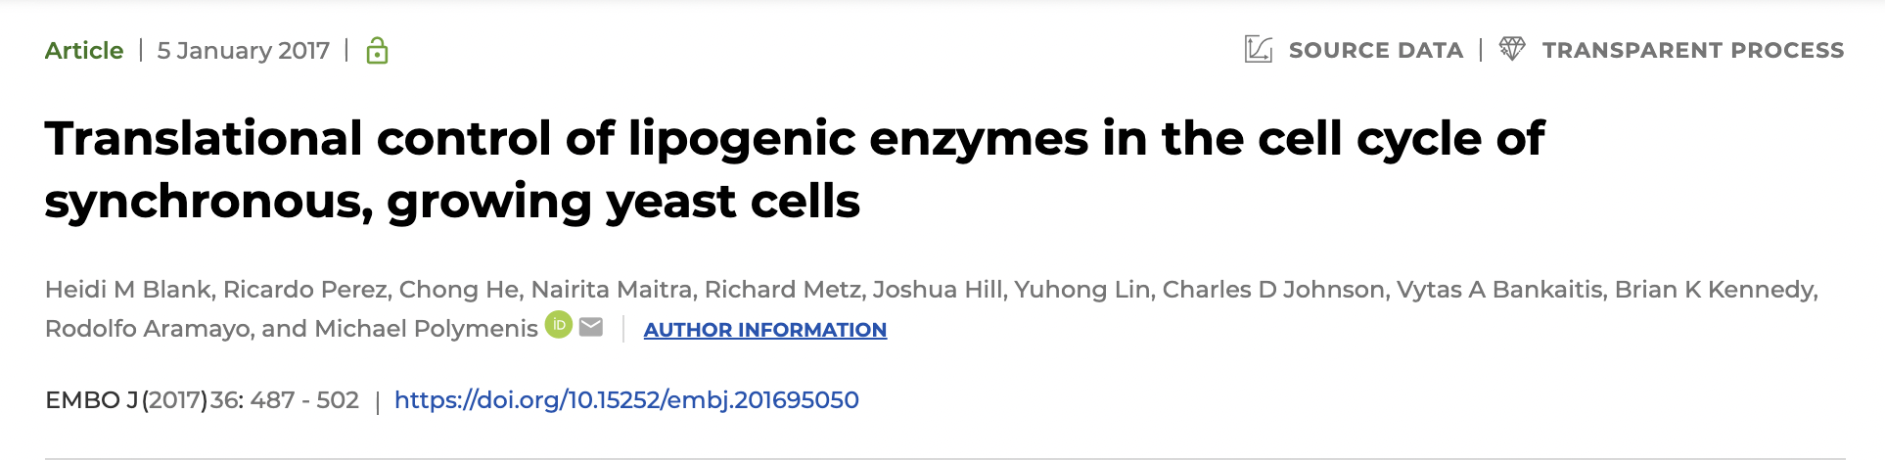

Slide 2
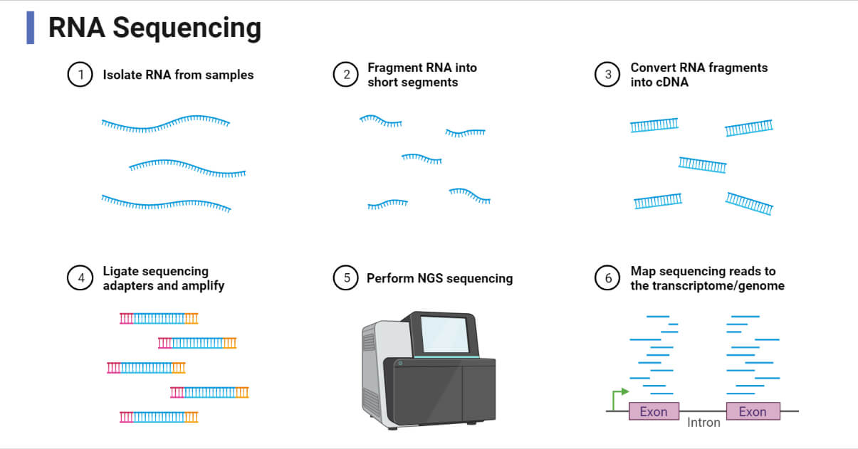
mRNA sequencing

Slide 3
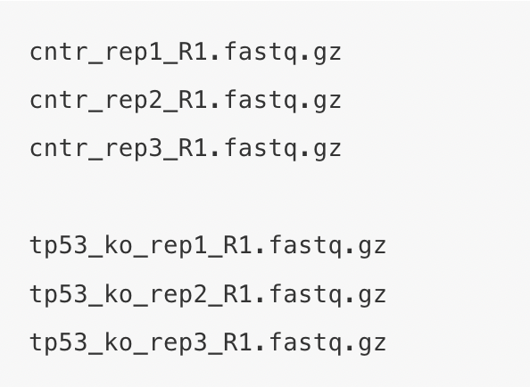
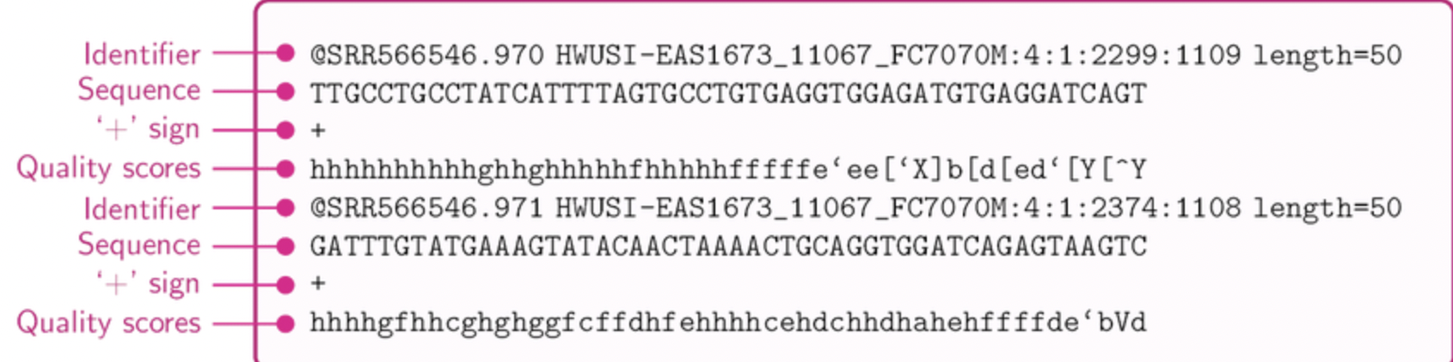
What would your raw data file look like?

Slide 4
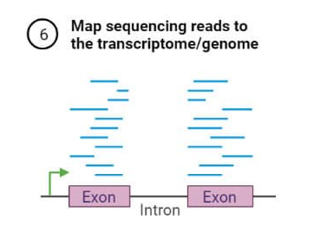
Count reads,
get transcript IDs

Slide 5
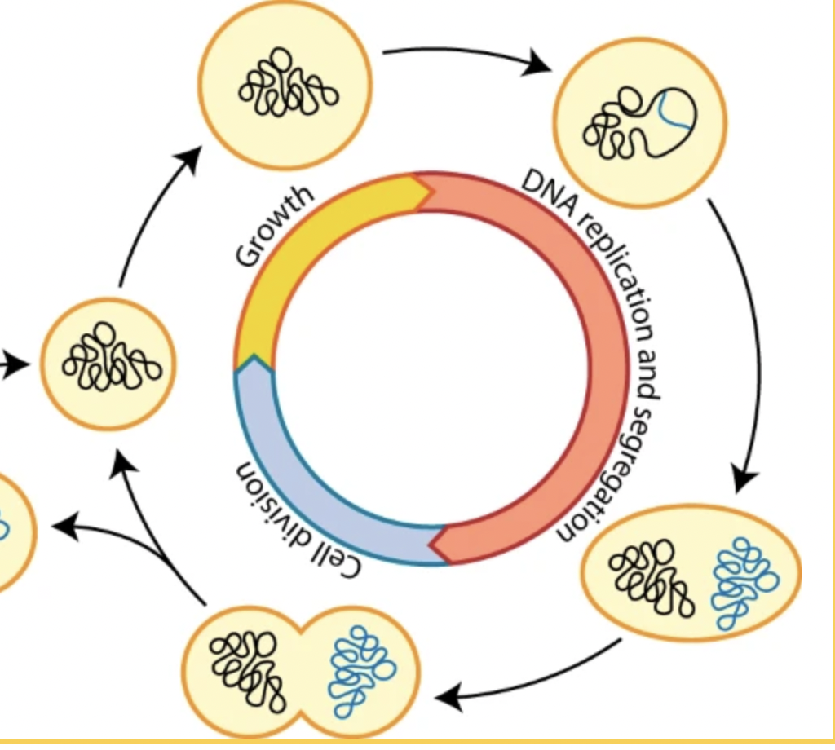
What happens to mRNA levels over the course of the cell cycle in yeast?

Slide 6
What happens to mRNA levels over the course of the cell cycle in yeast?
ex: Gene A

Slide 7
What happens to mRNA levels over the course of the cell cycle in yeast?
5
10
ex: Gene A
GSE81932_Dataset01
3
25
8

Slide 8
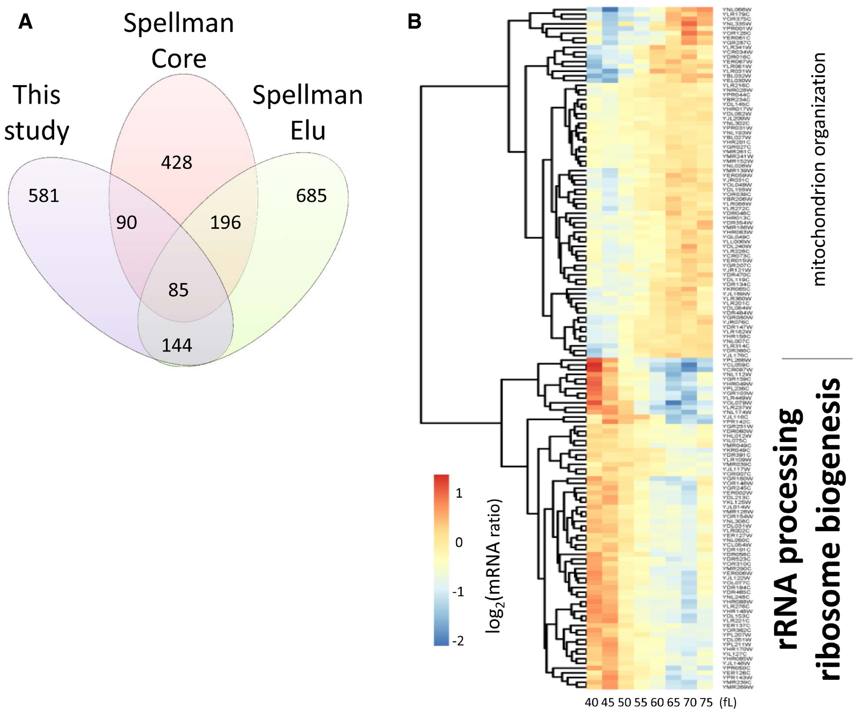
Changing mRNA levels over the course of the cell cycle
GSE81932_Dataset01
Figure 2

Slide 9
Changing mRNA levels over the course of the cell cycle
GSE81932_Dataset02
Figure 2A

