Slide 1
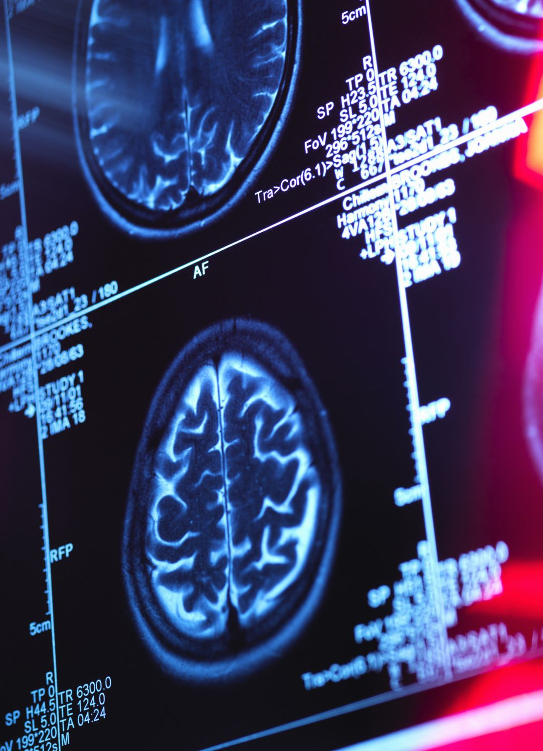
Identifying and Locating Multiple Sclerosis (MS) Lesions in Brain MRI Scans
W.MSCIDS_CVI03.F2 Computer Vision - Group 2
Adrian Imfeld, adrian.imfeld@stud.hslu.ch
Robin Portmann, robin.portmann@stud.hslu.ch
Emir Odic, emir.odic@stud.hslu.ch

Slide 2

Agenda
Introduction
Objective
Dataset
Methodology
Evaluation
Conclusion

Slide 3
INTRODUCTION
MS affects function in cognitive, emotional, motor, sensory, or visual areas.
A person’s own immune system attacks their brain and spinal cord.
According to Walton et al. (2020), MS prevalence has increased in every world region since 2013, with an estimated number of 2.8 million people with MS in 2020 worldwide.

Slide 4
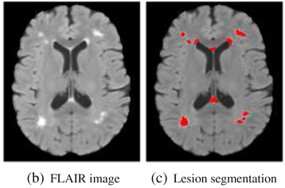
INTRODUCTION
Volumetric brain MR imaging, as shown in Figure 1, as a common method to treating MS patients.
The figure only shows one layer - this approach results in hundreds of images, making detection or changes very time-consuming.
Diagnosis also influenced by Inter- and Intra-observer Variability (Conti et al., 2023).
Figure 1. Layer of MRI scan with lesion segmentation (Zhao et al., 2017)

Slide 5









Intra-observer Variability
Inter-observer Variability
Consistency of a single expert
Differences between experts
Lesion present?

Slide 6

OBJECTIVE
Develop an automated machine learning model for accurate segmentation of multiple sclerosis (MS) lesions from MRI scans.
Evaluation by using the Dice similarity coefficient, which measures the overlap between predicted segmentation and ground truth.
Commonly used in medical image applications, which helps with comparison of results

Slide 7
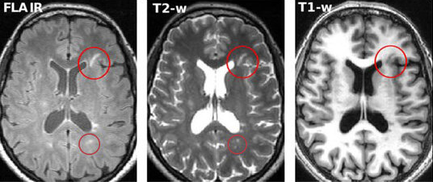
DATASET
Primary dataset by Muslim et al. (2022)
Brain MRI scans from 60 patients, confirmed to have MS including manual lesion segmentation
Provided by Baghdad Teaching Hospital, Iraq
Each patient folder contains:
The patient’s brain-scans (T1, T2, Flair)
Corresponding lesion segmentation for each of the brain-scans
Figure 2. Layer from MRI scan represented in multiple sequences: Flair, T2 and T1 (Ma et al., 2022)

Slide 8
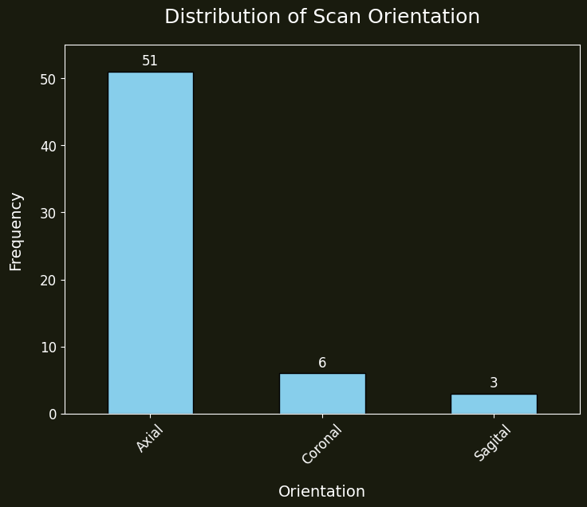
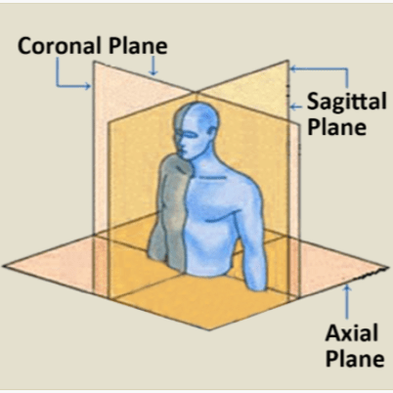
DATASET - EDA
Insights regarding MRI scan properties
Unique Voxel Dimensions: 1
Unique Image Shapes (HxW): 13
Unique Scan Orientations: 3
Figure 3. Distribution of scan orientation in dataset

Slide 9
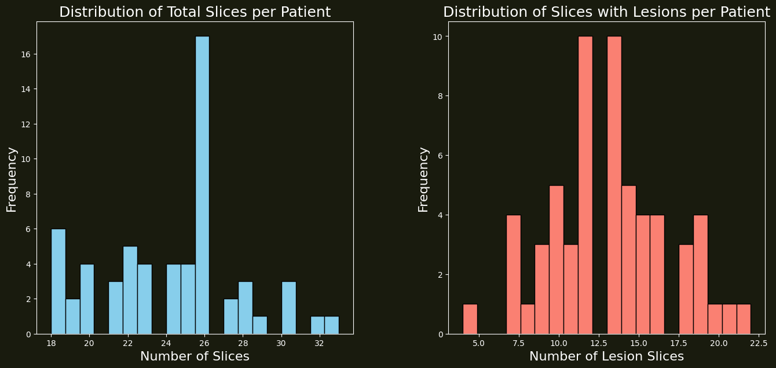
Figure 4. Statistical analysis regarding slice properties

Slide 10

Methodology

Slide 11
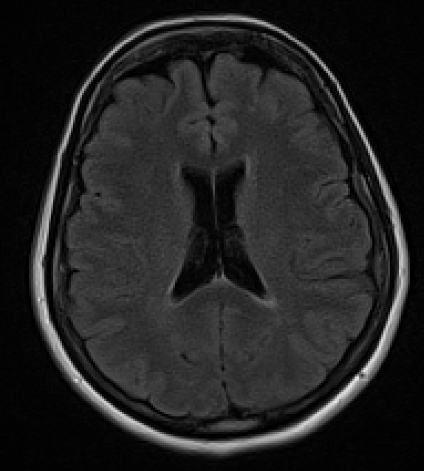
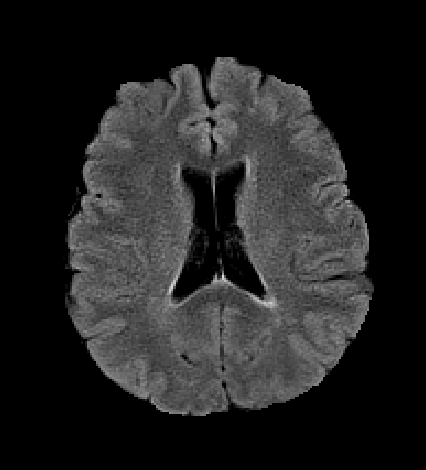
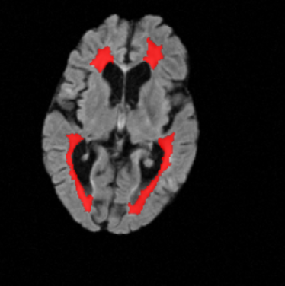
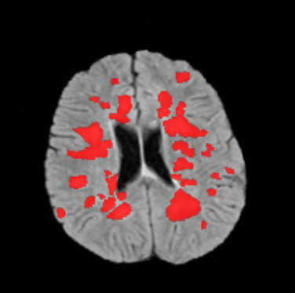
PREPROCESSING
Train-test split: 41 vs. 10 scans
Brain extraction (Deepbet)
Resize slices to 256x256
Min-max normalization to 0-1 within scan
Select only slices with lesions
Paired data augmentation: rotation, shift, zoom, flip, shear, noise
Figure 5. Top: Brain extraction, Bottom: Augmented slice-mask pairs

Slide 12
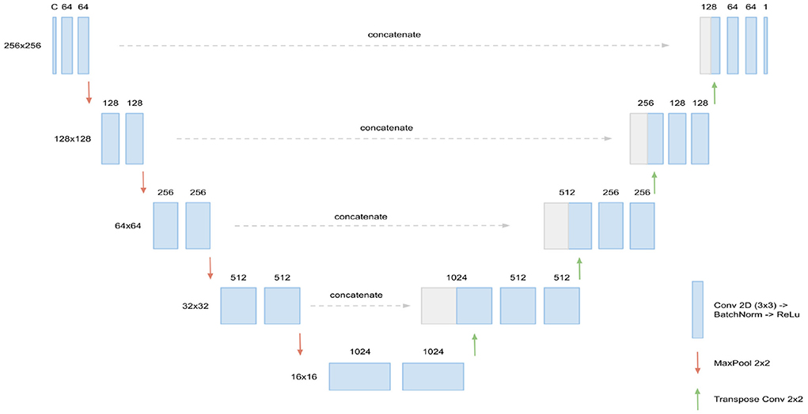
U-NET
CNN, optimized for medical image segmentation
Input: 256x256 slice Output: Segmentation
Encoder (left): Pretrained ResNet50, MaxPool 2x2
Decoder (right): Upsampling 2x2
Skip Connections: preserve fine spatial details and better gradient flow
Figure 6. U-Net architecture by Hitziger et al. (2022)
Notes:
U-Net architecture
The U-Net architecture is a powerful convolutional neural network design specifically optimized for medical image segmentation. L2 regularization
Penalizes large weight values more heavily than small ones
Prevents any single feature from dominating predictions
Improves model stability and generalization to new data

Slide 13
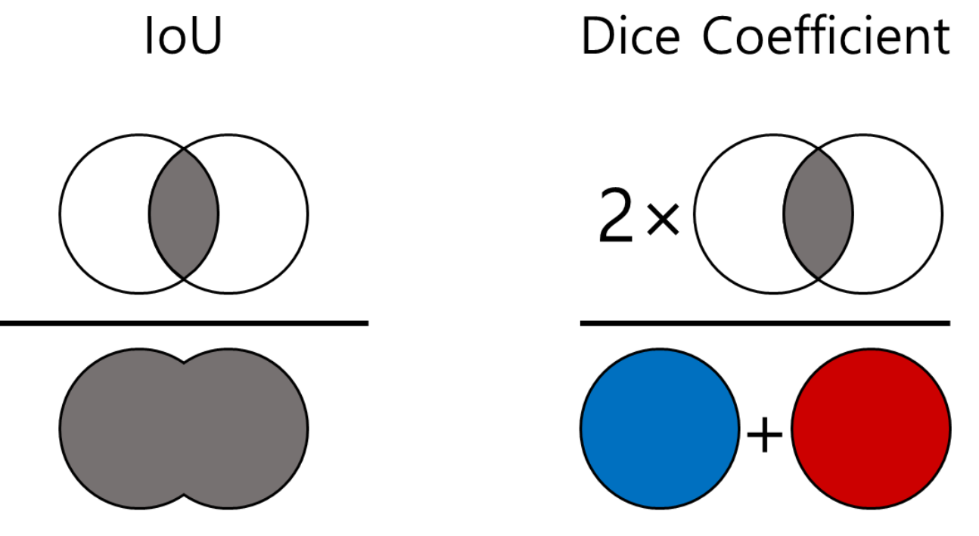
TRAINING
Dice coefficient: better for imbalanced segmentation than IoU
Combined loss: dice and crossentropy loss
Prevent overfitting:
Decreasing learning rate
L2 regularization
Dropout
Batch normalization
Layer freezing
Early stopping
Use best model
Figure 7. Comparison of IoU and Dice Coefficient (Fakecan, 2023)
Notes:
Key Advantages of Dice Coefficient
Loss Function Suitability
The Dice coefficient is differentiable, making it suitable as a loss function for training
IoU is not differentiable, limiting its use primarily to evaluation metrics
Class Imbalance
Dice coefficient is more robust to class imbalance
It gives twice the weight to the intersection, which helps with imbalanced segmentation tasks
Penalty Characteristics
IoU penalizes under- and over-segmentation more heavily than Dice
Dice provides a more balanced evaluation of segmentation quality
Medical Image Segmentation
Dice coefficient is the most widely used metric in medical image segmentation
It's considered the main metric for validation and performance interpretation
Object Detection
IoU is more commonly used in object detection tasks
This usage pattern emerged more from convention than technical necessity
Combined loss benefits
CE loss treats each pixel as an independent prediction, focusing on pixel-level accuracy
Dice loss evaluates the segmentation mask holistically, focusing on overall shape and structure
Dice loss tends to produce over-segmented regions
CE loss tends to produce under-segmented regions
Combining both helps achieve a better balance
Cosine annealing
Initial Exploration: Starting with a higher learning rate (1e-4) allows the model to explore the parameter space broadly and make rapid initial progress.
Fine-Tuning: Gradually decreasing the learning rate enables more precise parameter updates as training progresses, helping the model converge to better optima
Training Benefits:
Smoother convergence by avoiding abrupt learning rate changes
Better escape from local minima through periodic learning rate variatio
Improved final model performance through controlled parametepdates

Slide 14
Evaluation

Slide 15
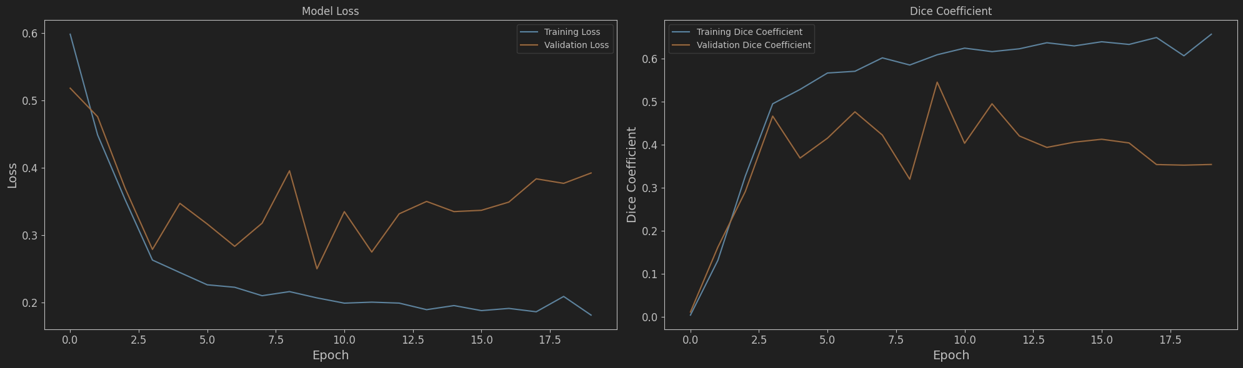
BASE MODEL
Figure 8. Training using default ResNet50 architecture
Model overfits after a couple of epochs
Notes:
Pre-trained Resnet50 (Unet)
Full tuning -> Encoder freeze did not produce nice results
Model overfits after some time -> does not generalize well

Slide 16
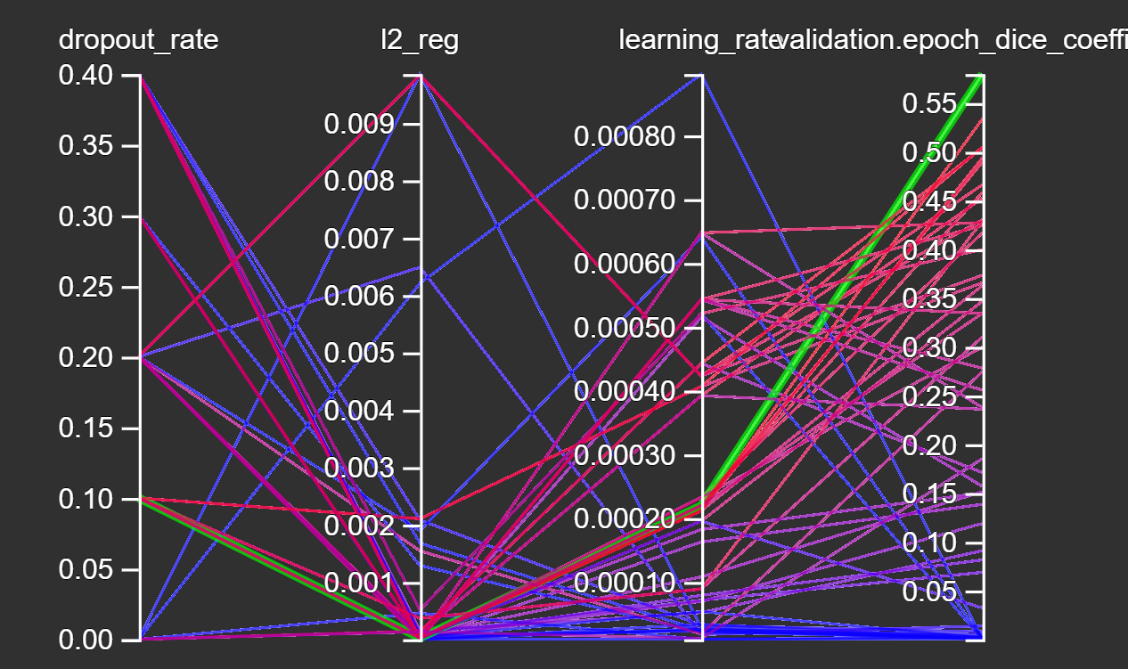
PARAMETER TUNING
Optimizing the following Params:
Dropout
Regularization (L2)
Learning rate
Parameter | Value
Dropout | 0.1
Regularization (L2) | 2.3e-5
Learning rate | 2.2e-4
Table 1. Optimal parameters for final model
Figure 9. Tensorboard tuning overview
Notes:
Combat overfitting:
L2 regularization (in decoder at Conv Layers)
Penalizes large weight values more heavily than small ones
Prevents any single feature from dominating predictions
Improves model stability and generalization to new data
Added Dropout (in decoder after Conv Layers)
Deactivate neurons to prevent overfitting

Slide 17
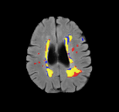
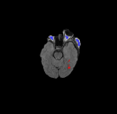
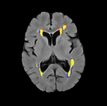
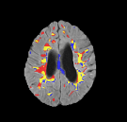
Good Predictions
Potential for Improvement
Wrong predictions around the eyes and the ventricles
Lesion Mask
Predicted Lesion
Overlap (correct prediction)
Notes:
Explain different colours and predictions (based on threshold)
Explain where the model does not work that well (eyes, ventricles)

Slide 18
MODEL PERFORMANCE COMPARISON
Model | Dice Coefficient
DeepScan (McKinley et al., 2020) | 0.6
CLAIMS (La Rosa et al., 2022) | 0.49
Segmentation of multiple sclerosis lesions using deep neural networks (Sasko, 2021) | 0.6
Best model from our group | 0.59
Table 2. DSC study comparison
Notes:
Problem with Consesus Between Raters:
Consensus between raters in generally not that high for MS

Slide 19

CONCLUSION

Slide 20
CONCLUSION
Complex MRI scan preprocessing represented a critical challenge in this project
We successfully trained a U-net model to predict MS lesions on MRI scans
The quality as well as the quantity of MRI scans makes a big difference
Model tends to overfit on small amount of training data
Difficult to acquire a large amount of high- quality MS MRI scans
Large differences between scans adds another difficulty (e.g. voxel sizes, masks)
Notes:
Preprocessing Challenge:
Same pixel size (shape/dimension)
Voxel size
Same plane
Mask
Problems with 2. Dataset:
Differing Voxel sizes
Masks are different
Uniformity is missing (makes it tedious and difficult)

Slide 21

Thank you

Slide 22
References
Bell, D. & Moore, C. (2020). Dice similarity coefficient. Radiopaedia.org. https://doi.org/10.53347/rid-75056
Conti, A., Treaba, C. A., Mehndiratta, A., Barletta, V. T., Mainero, C., & Toschi, N. (2023). An Interpretable Machine Learning Model to Predict Cortical Atrophy in Multiple Sclerosis. Brain sciences, 13(2), 198. https://doi.org/10.3390/brainsci13020198
Fakecan. (2023, 3. Juli). IOU와 dice coefficient. not bad한 개발자 일기. https://fakecan.tistory.com/64
Harrison, D. M., Roy, S., Oh, J., Izbudak, I., Pham, D., Courtney, S., Caffo, B., Jones, C. K., van Zijl, P., & Calabresi, P. A. (2015). Association of Cortical Lesion Burden on 7-T Magnetic Resonance Imaging With Cognition and Disability in Multiple Sclerosis. JAMA neurology, 72(9), 1004–1012. https://doi.org/10.1001/jamaneurol.2015.1241
Hitziger, S., Ling, W. X., Fritz, T., D'Albis, T., Lemke, A., and Grilo, J. (2022). Triplanar u-net with lesion-wise voting for the segmentation of new lesions on longitudinal mri studies. Front. Neurosci. 16:964250. https://doi.org/10.3389/fnins.2022.964250
La Rosa, F., Beck, E. S., Maranzano, J., Todea, R. A., van Gelderen, P., de Zwart, J. A., Luciano, N. J., Duyn, J. H., Thiran, J. P., Granziera, C., Reich, D. S., Sati, P., & Bach Cuadra, M. (2022). Multiple sclerosis cortical lesion detection with deep learning at ultra-high-field MRI. NMR in biomedicine, 35(8), e4730. https://doi.org/10.1002/nbm.4730
Ma, Y., Zhang, C., Cabezas, M., Song, Y., Tang, Z., Liu, D., ... & Wang, C. (2022). Multiple sclerosis lesion analysis in brain magnetic resonance images: techniques and clinical applications. IEEE Journal of Biomedical and Health Informatics, 26(6), 2680-2692.
McKinley, R., Wepfer, R., Grunder, L., Aschwanden, F., Fischer, T., Friedli, C., Muri, R., Rummel, C., Verma, R., Weisstanner, C., Wiestler, B., Berger, C., Eichinger, P., Muhlau, M., Reyes, M., Salmen, A., Chan, A., Wiest, R., & Wagner, F. (2020). Automatic detection of lesion load change in Multiple Sclerosis using convolutional neural networks with segmentation confidence. NeuroImage. Clinical, 25, 102104. https://doi.org/10.1016/j.nicl.2019.102104
Muslim, A. M., Mashohor, S., Gawwam, G. A., Mahmud, R., Hanafi, M. B., Alnuaimi, O., Josephine, R., & Almutairi, A. D. (2022). Brain MRI dataset of multiple sclerosis with consensus manual lesion segmentation and patient meta information. Data in brief, 42, 108139. https://doi.org/10.1016/j.dib.2022.108139
Walton, C., King, R., Rechtman, L., Kaye, W., Leray, E., Marrie, R. A., Robertson, N., La Rocca, N., Uitdehaag, B., van der Mei, I., Wallin, M., Helme, A., Angood Napier, C., Rijke, N., & Baneke, P. (2020). Rising prevalence of multiple sclerosis worldwide: Insights from the Atlas of MS, third edition. Multiple sclerosis (Houndmills, Basingstoke, England), 26(14), 1816–1821. https://doi.org/10.1177/1352458520970841
World Health Organization: WHO & World Health Organization: WHO. (2023, 7. August). Multiple sclerosis. https://www.who.int/news-room/fact-sheets/detail/multiple-sclerosis
Yeap, P. L., Wong, Y. M., Ong, A. L. K., Tuan, J. K. L., Pang, E. P. P., Park, S. Y., Lee, J. C. L., & Tan, H. Q. (2023). Predicting dice similarity coefficient of deformably registered contours using Siamese neural network. Physics in medicine and biology, 68(15), 10.1088/1361-6560/ace6f0. https://doi.org/10.1088/1361-6560/ace6f0
Zhao, Y., Guo, S., Luo, M., Liu, Y., Bilello, M., & Li, C. (2017). An energy minimization method for MS lesion segmentation from T1-w and FLAIR images. Magnetic resonance imaging, 39, 1–6. https://doi.org/10.1016/j.mri.2016.04.003
Code on Github: https://github.com/rportm/cv_hslu_24

