Slide 1
Bibliography: review articles
Introduction to Machine Learning for Chemists: Visualization, Data Processing, Analysis, Molecular Design

Slide 2
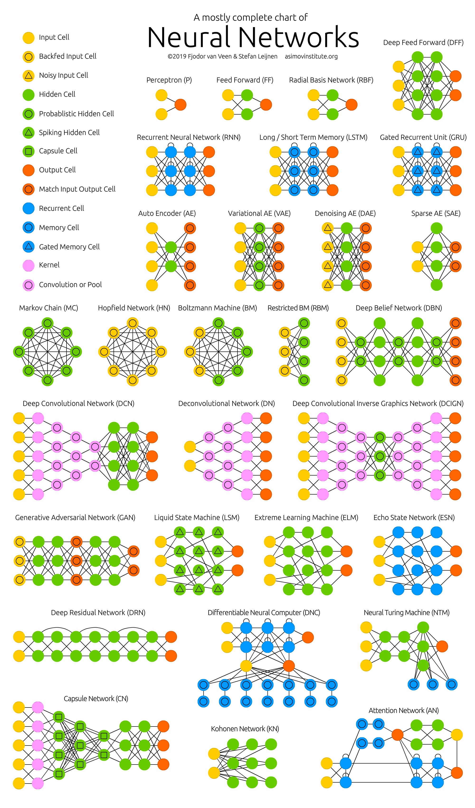
The NN zoo

Slide 3
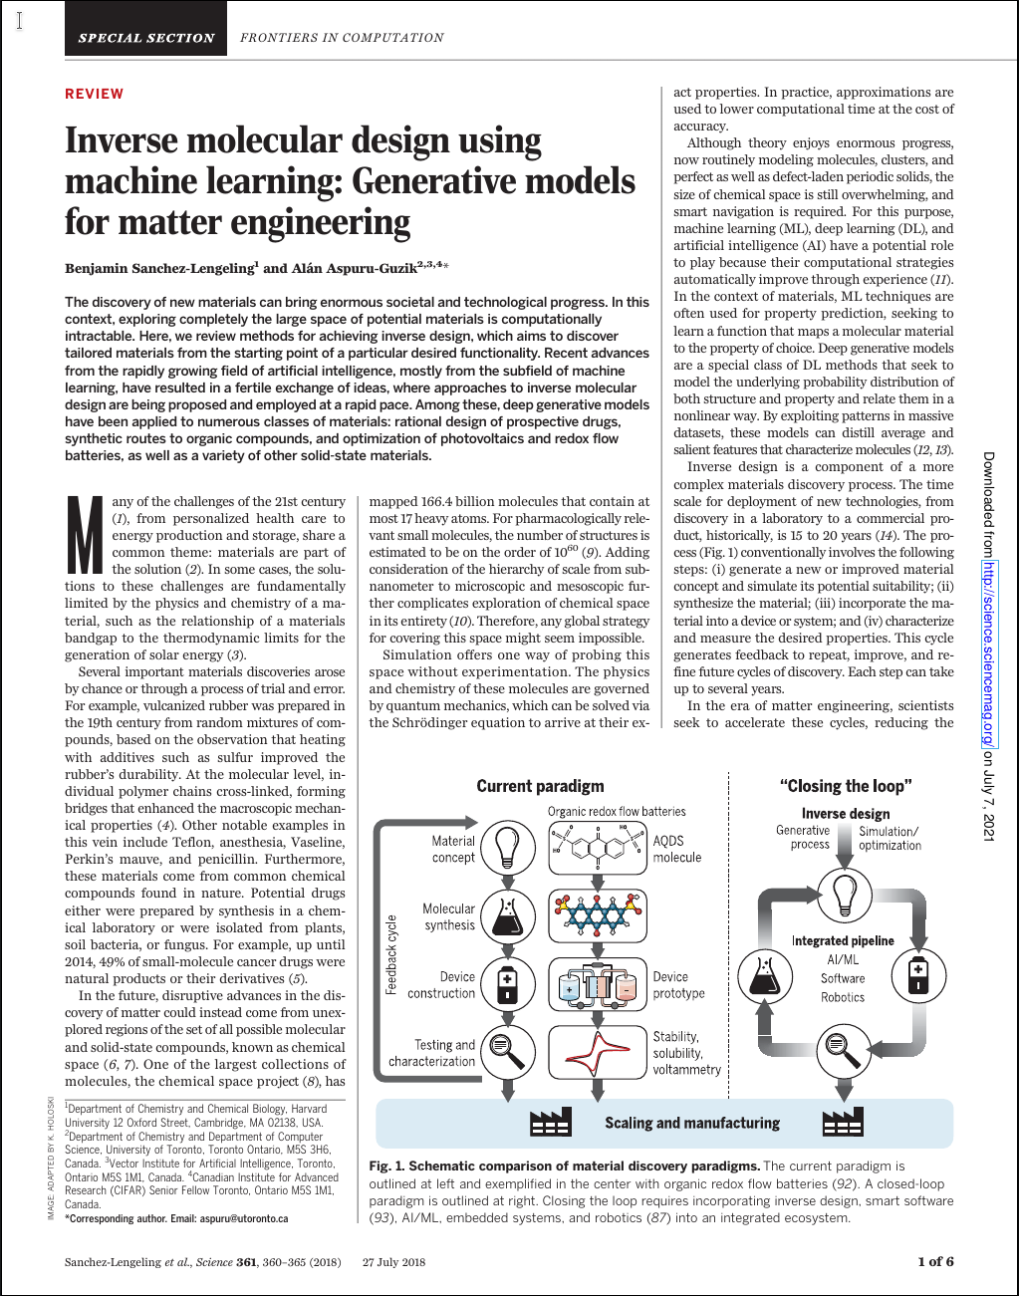
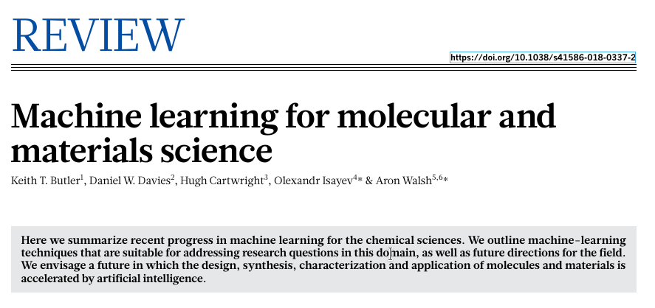


AI in chemistry (AIChem)
dizzying – and somewhat demoralizing - array of ML applications to chemistry
Review articles
K. T. Butler, D. W. Davies, H. Cartwright, O. Isayev & A. Walsh (2018)
Machine learning for molecular and materials science
Nature 559, 547-555
B. Sanchez-Lengeling & A. Aspuru-Guzik (2018)
Inverse molecular design using machine learning: Generative models for matter engineering
Science 361, 360-365
P. Schlexer Lamoureux, K. T. Winther, J. A. Garrido Torres, V. Streibel, M. Zhao, M. Bajdich, F. Abild-Pedersen & T. Bligaard (2019)
Machine Learning for Computational Heterogeneous Catalysis
ChemCatChem 11, 3581-3601
J. A. Keith, V. Vassilev-Galindo, B. Cheng, S. Chmiela, M. Gastegger, K.-R. Müller & A. Tkatchenko (2021)
Combining Machine Learning and Computational Chemistry for Predictive Insights Into Chemical Systems
Chem. Rev. 121, 9816–9872

Slide 4
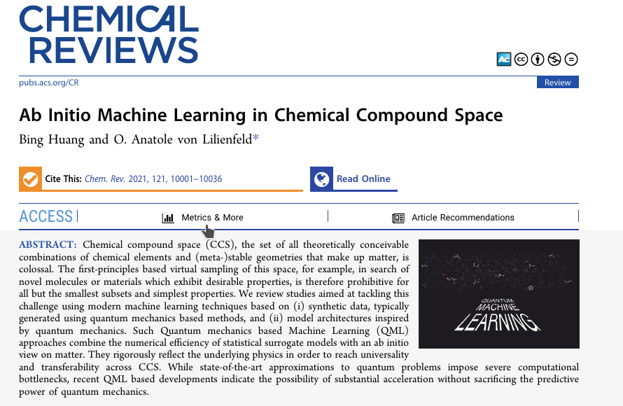
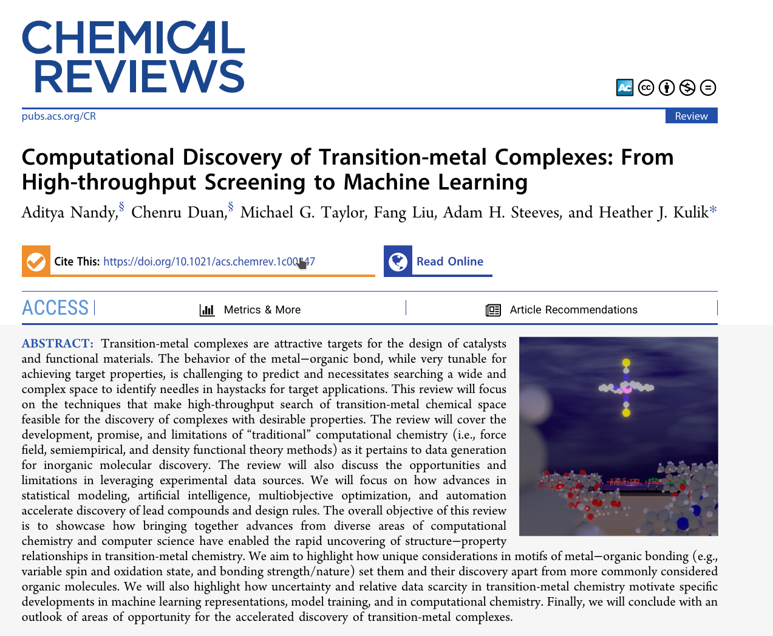
AI in chemistry (AIChem)
Review articles
B. Huang & O. A. von Lilienfeld (2021)
Ab Initio Machine Learning in Chemical Compound Space
Chem. Rev. 121, 10001-10036
Nandy, A.; Duan, C.; Taylor, M. G.; Liu, F.; Steeves, A. H.; Kulik, H. J. (2021)
Computational Discovery of Transition-Metal Complexes: From High-Throughput Screening to Machine Learning.
Chem. Rev. 121, 9927–10000

Slide 5
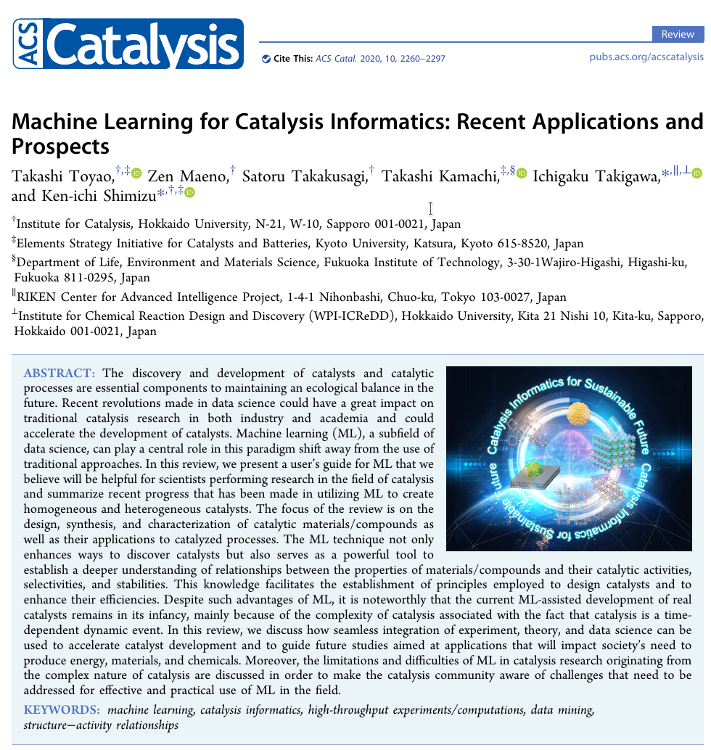
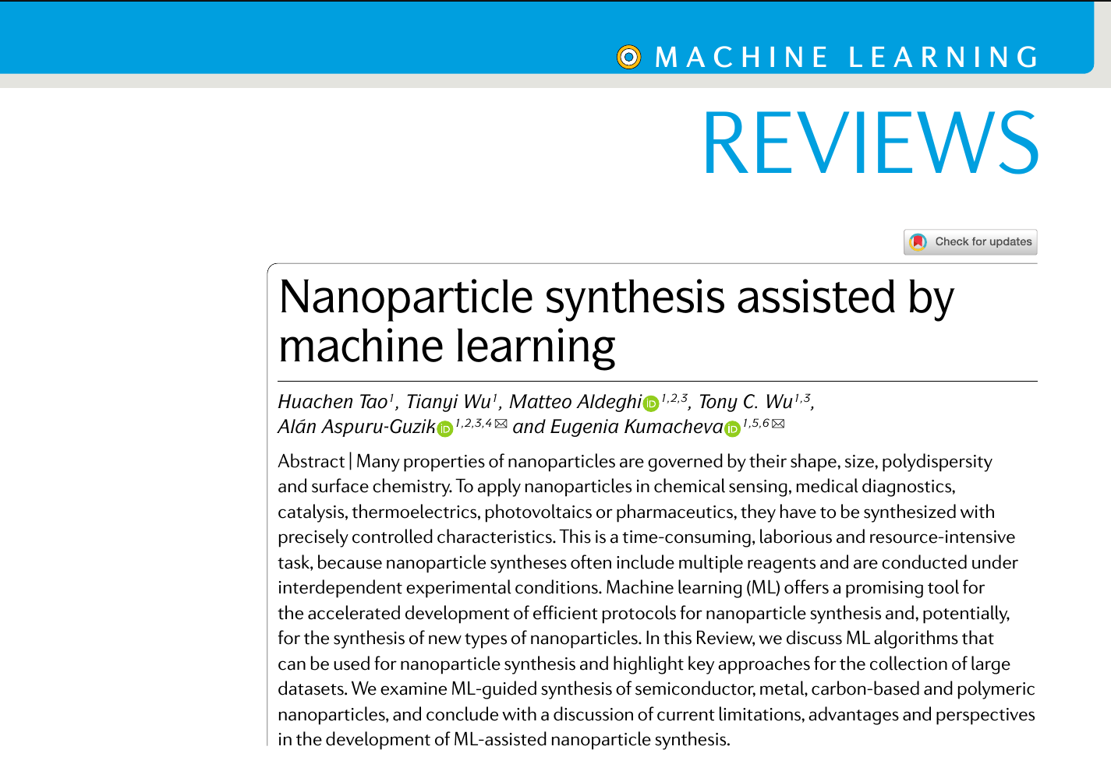
AI in chemistry (AIChem)
Review articles
H. Tao, T. Wu, M. Aldeghi, T. C. Wu, A. Aspuru-Guzik & E. Kumacheva (2021)
Nanoparticle synthesis assisted by machine learning
Nat. Rev. Mater. 6: 701-716
Toyao, T.; Maeno, Z.; Takakusagi, S.; Kamachi, T.; Takigawa, I.; Shimizu, K.-i. (2020)
Machine Learning for Catalysis Informatics: Recent Applications and Prospects
ACS Catal. 10 (3), 2260–2297.

Slide 6
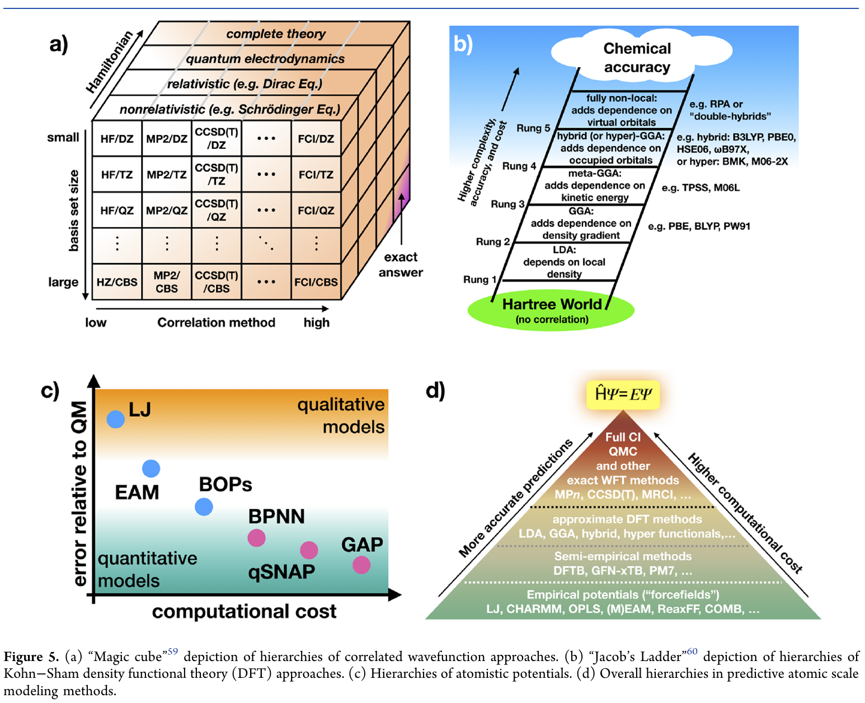
AI in chemistry (AIChem)
AIChem ← is also currently used to reduce the cost of computational [quantum] chemistry
DFT
WFT
Calculation of energies
& forces (MD / geometry optimization)
J. A. Keith, V. Vassilev-Galindo, B. Cheng, S. Chmiela, M. Gastegger, K.-R. Müller & A. Tkatchenko (2021)
Combining Machine Learning and Computational Chemistry for Predictive Insights Into Chemical Systems. Chem. Rev. 121, 9816–9872

Slide 7
Short selection of [simple] applications of
supervised learning to chemistry

Slide 8
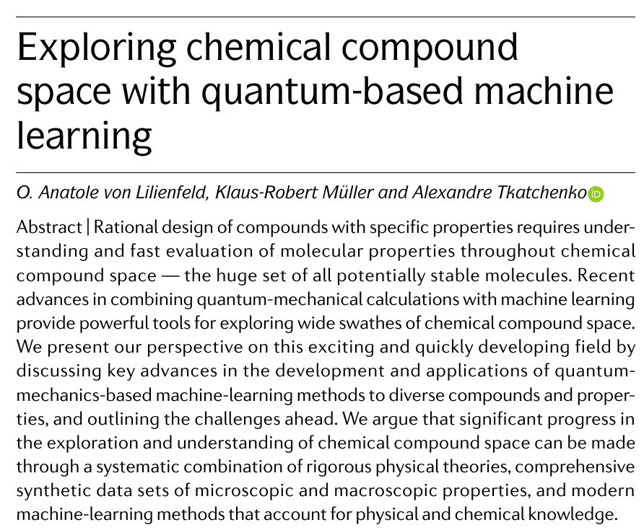

All these applications face the same problem
ML is only as good as the data it learned from
when ML is applied for
prediction purpose (ML-QSPR)
quality
diversity
volume
O. A. von Lilienfeld, K.-R. Müller & A. Tkatchenko (2020)
Exploring chemical compound space with quantum-based machine learning
Nat. Rev. Chem. 4: 347-358
but it is also a remarkable tool
to find correlations between data

Slide 9
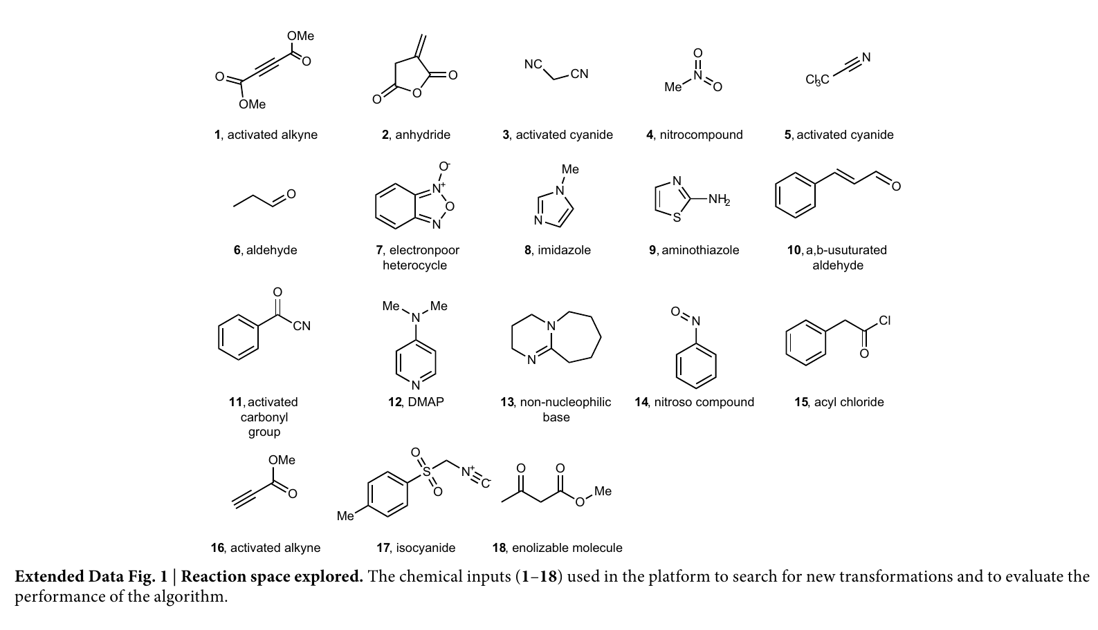
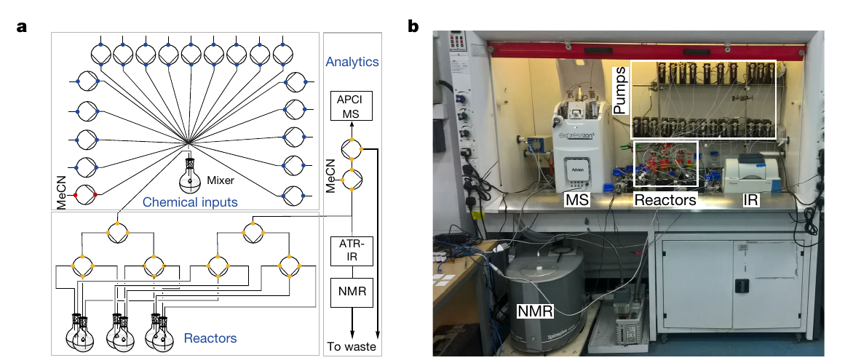
AI in chemistry (AIChem)
Control of an organic
synthesis robot
robot equipped with real-time sensors to record the spectra of the reaction mixtures:
flow benchtop NMR system
mass spectrometer
IR system
reactions mixtures classified as reactive (1) or non reactive (0) by the robot (uses a support vector machine (SVM) algorithm with a linear kernel model)
space of chemical reactions explored quickly
organic synthesis robot performs chemical reactions and analysis faster than a human
prediction of the reactivity of possible reagent combinations after conducting a small number of experiments
decision making by ML
J. M. Granda, L. Donina, V. Dragone, D.-L. Long & L. Cronin (2018). Controlling an organic synthesis robot with machine learning to search for new reactivity
Nature 559, 377-381

Slide 10
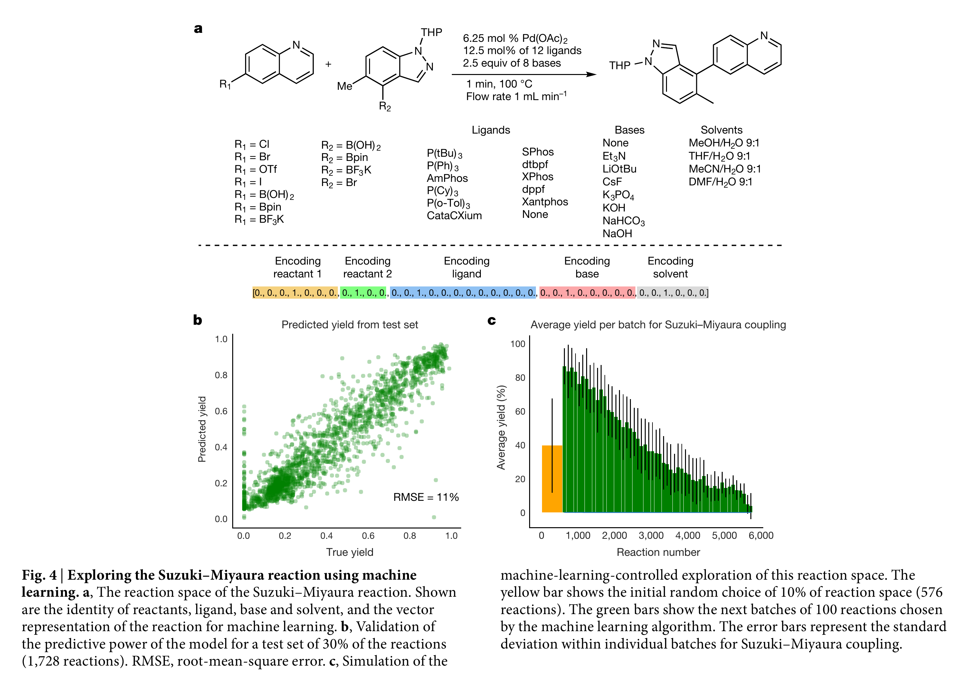
AI in chemistry (AIChem)
flattening of the data →
J. M. Granda, L. Donina, V. Dragone, D.-L. Long & L. Cronin (2018). Controlling an organic synthesis robot with machine learning to search for new reactivity
Nature 559, 377-381

Slide 11
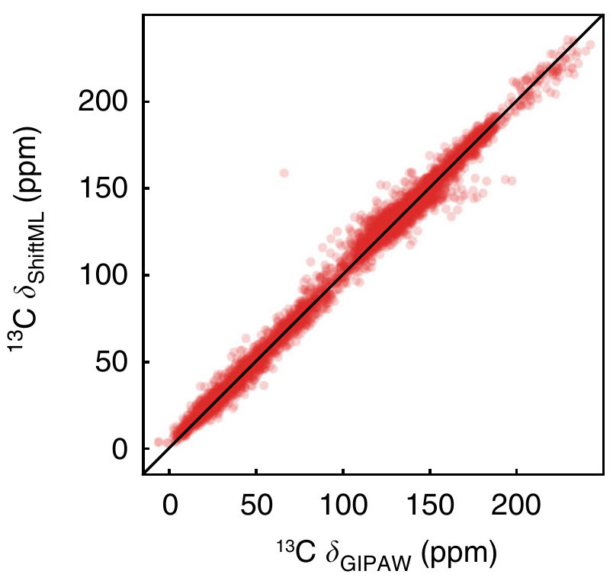
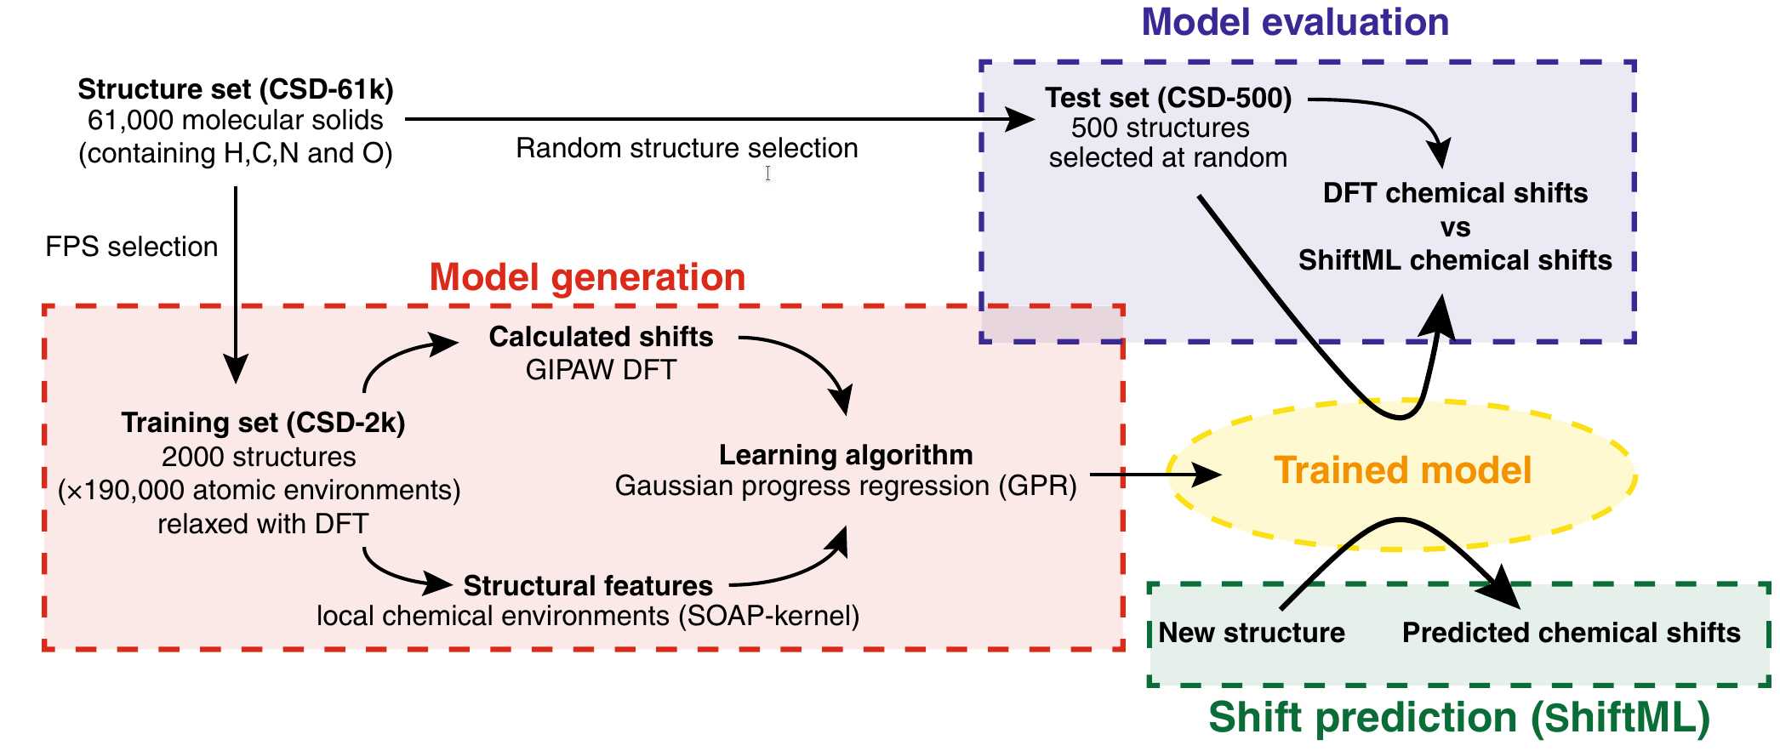
AI in chemistry (AIChem)
Test
Prediction of spectroscopic parameters
predicted values as a function of the actual values
F. M. Paruzzo, A. Hofstetter, F. Musil, S. De, M. Ceriotti & L. Emsley (2018)
Chemical shifts in molecular solids by machine learning
Nat. Commun. 9, 4501

Slide 12
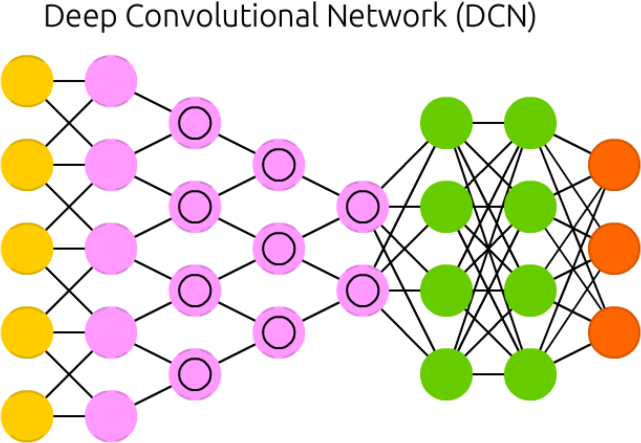
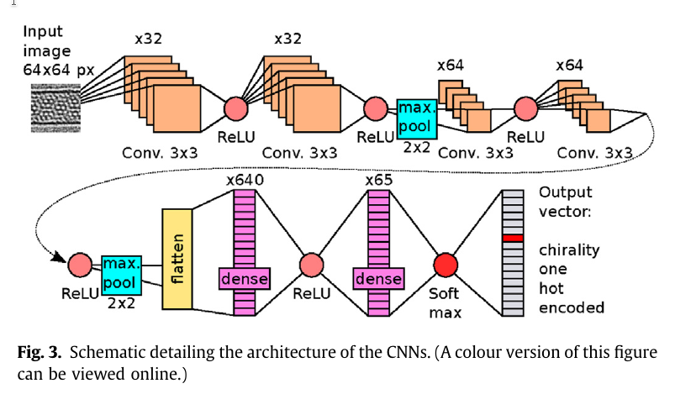
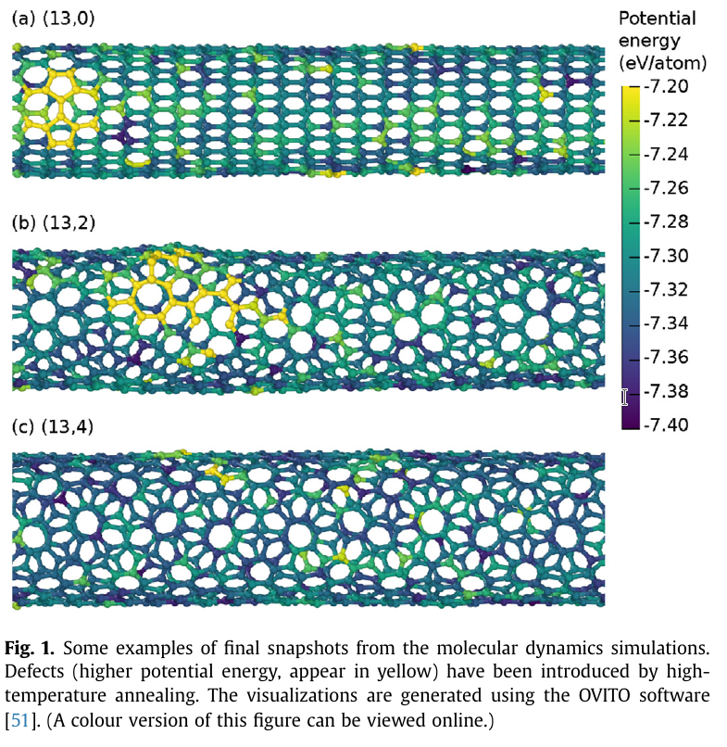
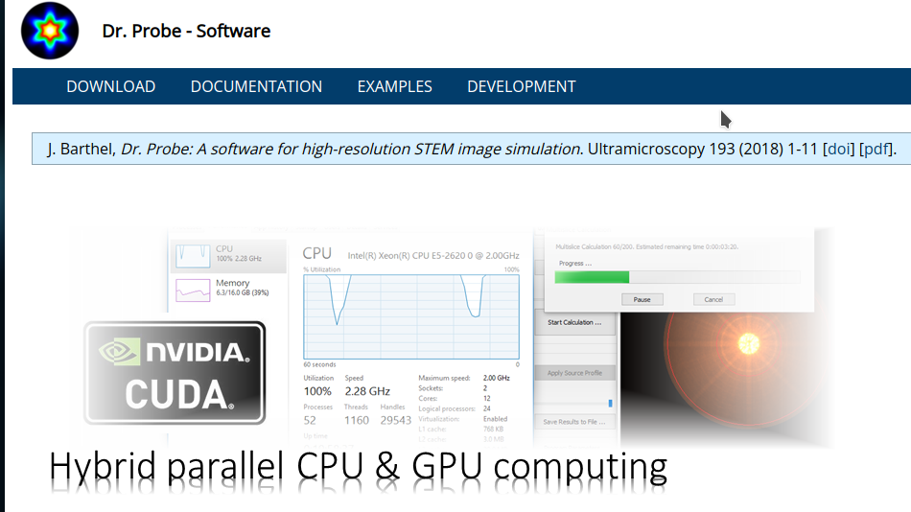
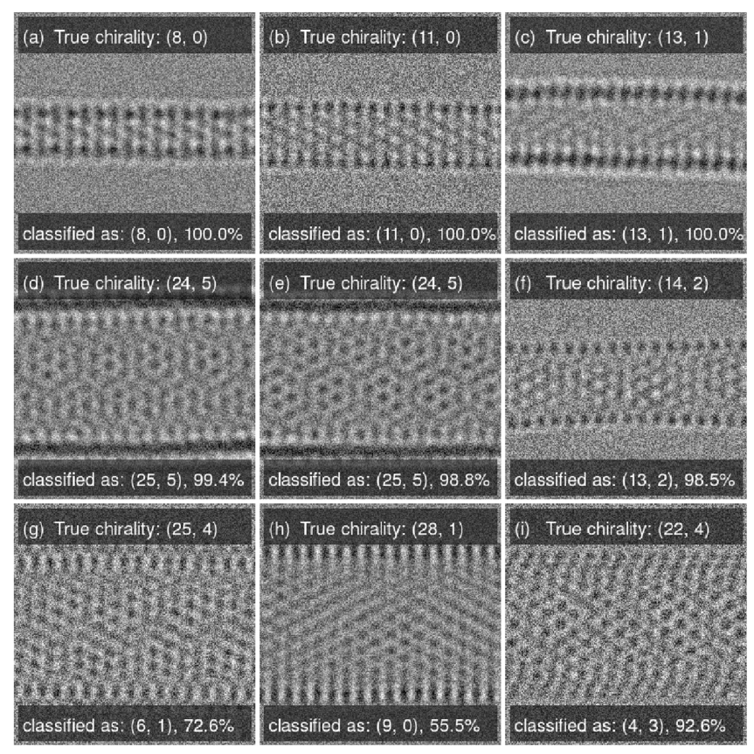
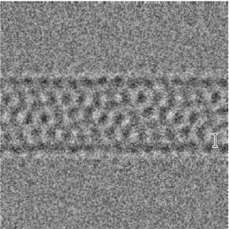
AI in chemistry (AIChem)
keras software
4 convolutional layers + 2 fully connected layers
Image recognition
Feature extraction
Classification
Molecular Dynamics + STEM image simulation
5000 images per chirality
~1.3 10⁶ images in total
G. D. Förster, A. Castan, A. Loiseau, J. Nelayah, D. Alloyeau, F. Fossard, C. Bichara & H. Amara (2020)
A deep learning approach for determining the chiral indices of carbon nanotubes from high-resolution transmission electron microscopy images
Carbon 169, 465-474

Slide 13
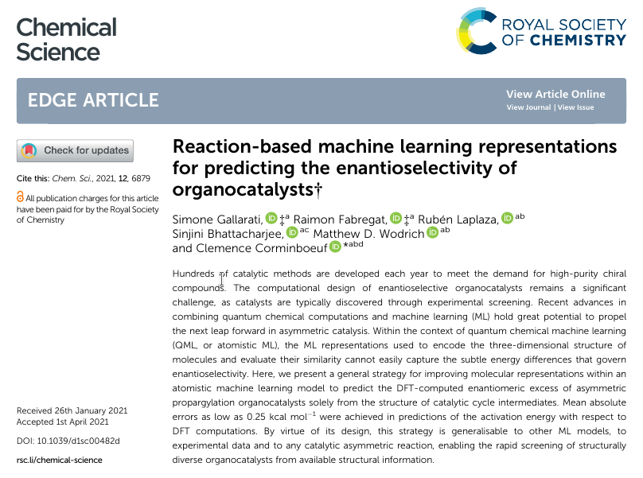
AI in chemistry (AIChem)
Reaction outcome prediction:
Prediction of enantiomeric excess
R¹
R¹
R³
R²
R²
R³
X
X
A
mirror
B
Computational chemistry
With ΔΔE‡ ≲ 5 kcal.mol⁻¹
S. Gallarati, R. Fabregat, R. Laplaza, S. Bhattacharjee, M. D. Wodrich & C. Corminboeuf (2021)
Reaction-based machine learning representations for predicting the enantioselectivity of organocatalysts, Chem. Sci. 12, 6879-6889

Slide 14
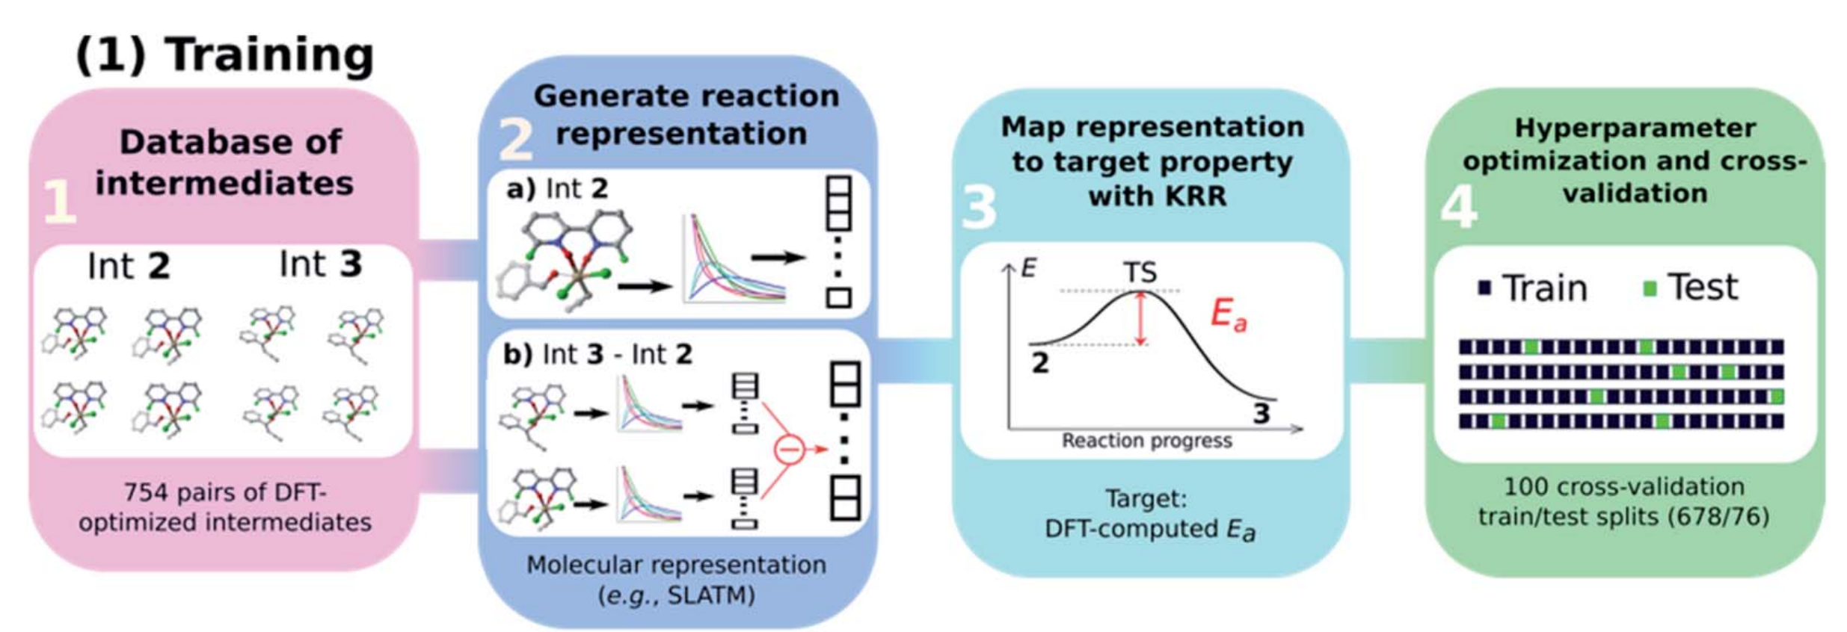
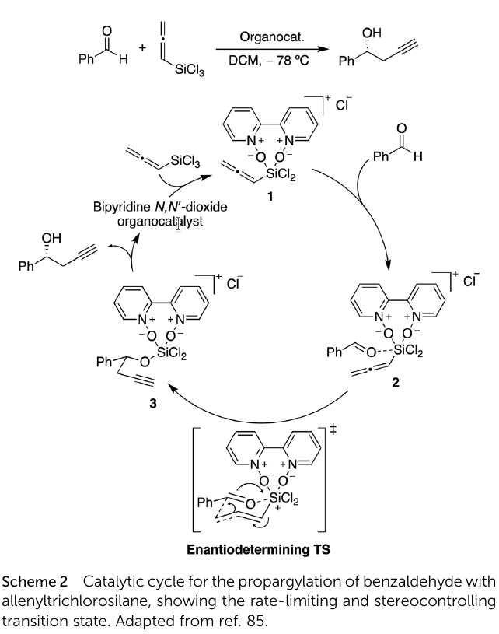
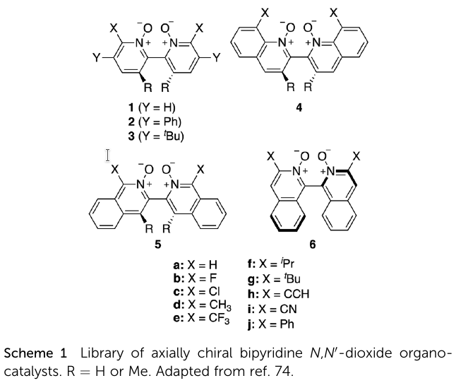
Reaction outcome prediction. Prediction of enantiomeric excess
Chemical context
Target reaction
KRR (not an ANN)
76 Lewis base organocatalysts
5 possible ligand arrangements
around the hexacoordinate silicon in the TS
+
the alkyl nucleophile can
add to either face of benzaldehyde
760 DFT TS geometries
and activation energies
S. Gallarati, R. Fabregat, R. Laplaza, S. Bhattacharjee, M. D. Wodrich & C. Corminboeuf (2021)
Reaction-based machine learning representations for predicting the enantioselectivity of organocatalysts, Chem. Sci. 12, 6879-6889

Slide 15
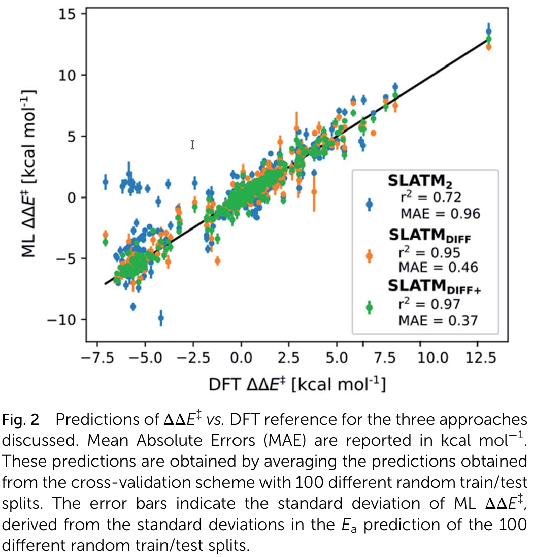
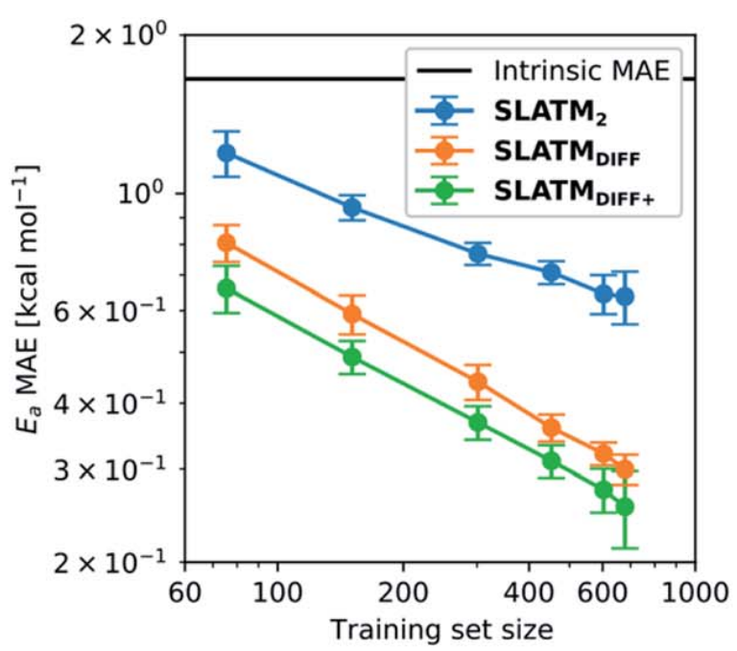
Reaction outcome prediction. Prediction of enantiomeric excess
Main results
Mean Absolute Error
SLATM = structural descriptors
0.54 ± 0.06 kcal mol⁻¹
(insufficient accuracy)
0.31 ± 0.20 kcal mol⁻¹
0.25 ± 0.40 kcal mol⁻¹
Learning curves:
MAE in test sets predictions of Ea
S. Gallarati, R. Fabregat, R. Laplaza, S. Bhattacharjee, M. D. Wodrich & C. Corminboeuf (2021)
Reaction-based machine learning representations for predicting the enantioselectivity of organocatalysts, Chem. Sci. 12, 6879-6889

Slide 16
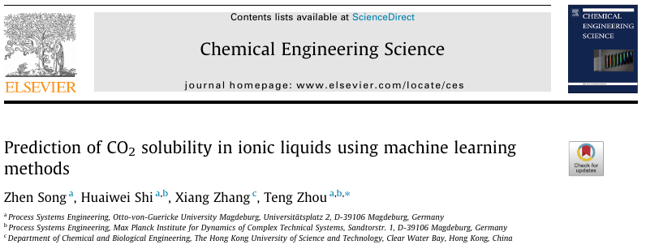
Phase behavior of ionic liquids
Prediction of CO2 solubility in ionic liquids
possible modelling approaches
Thermodynamic models
DFT studies in solvent
not accurate enough
Database = 10 116 experimental data points
124 different ILs
T: [243.2 K – 453.15 K]
p: [0.00798 bar – 499.9 bar]
training set, 80% of the data = 8093 values
test set, 20% of the data = 2023 values
cations: imidazolium, pyrrolidinium, pyridinium, piperidinium, ammonium, phosphonium, sulfonium
anions: tetrafluoroborate [BF4], chloride [Cl], dicyanamide [DCA], nitrate [NO3], hexafluorophosphate [PF6], thiocyanate [SCN], tri-cyanomethanide [C(CN)3], hydrogen sulfate [HSO4], bis(trifluoromethylsulfonyl)amide [Tf2N], methylsulfate [MeSO4], etc
other possibility
quantitative structure-property relationship (QSPR)
Machine Learning
(surrogate modeling)
Z. Song, H. Shi, X. Zhang & T. Zhou (2020)
Prediction of CO2 solubility in ionic liquids using machine learning methods, Chem. Eng. Sci. 223, 115752

Slide 17
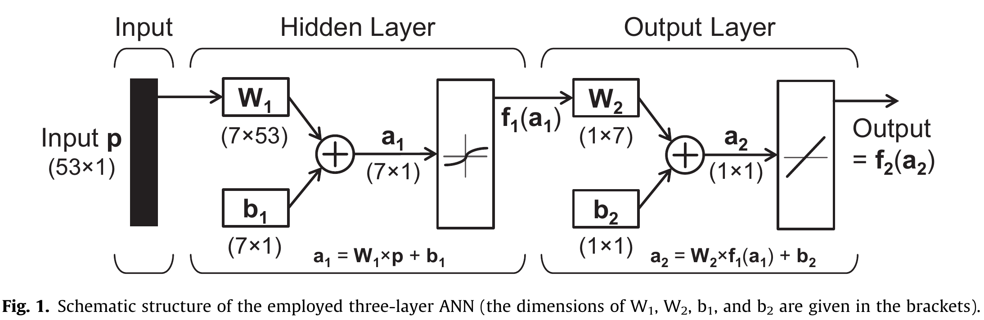
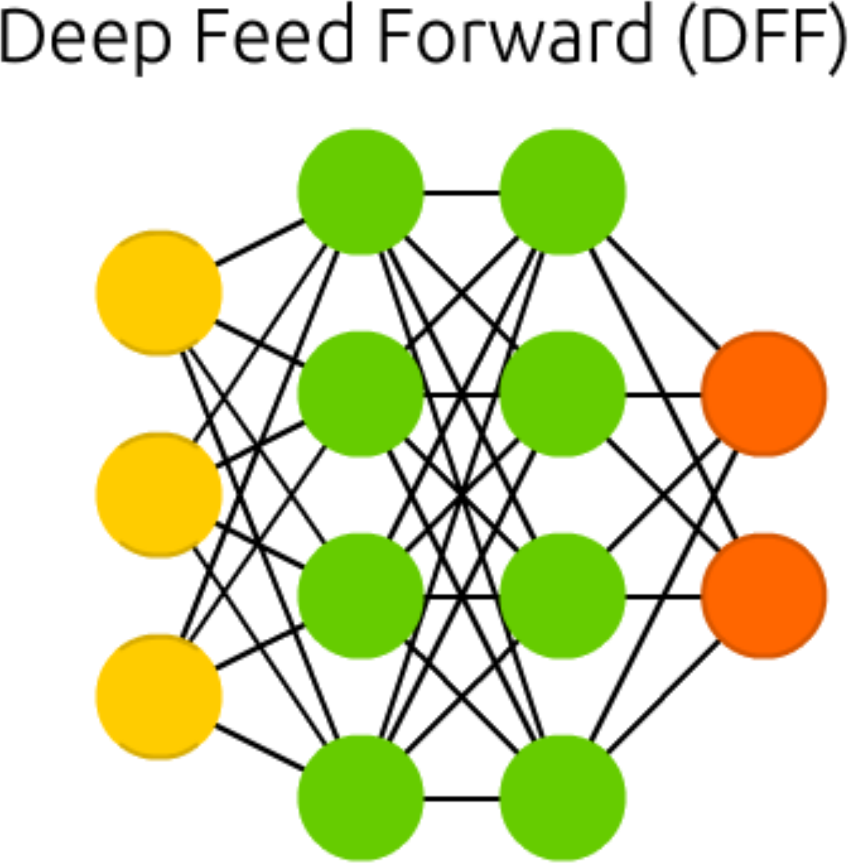
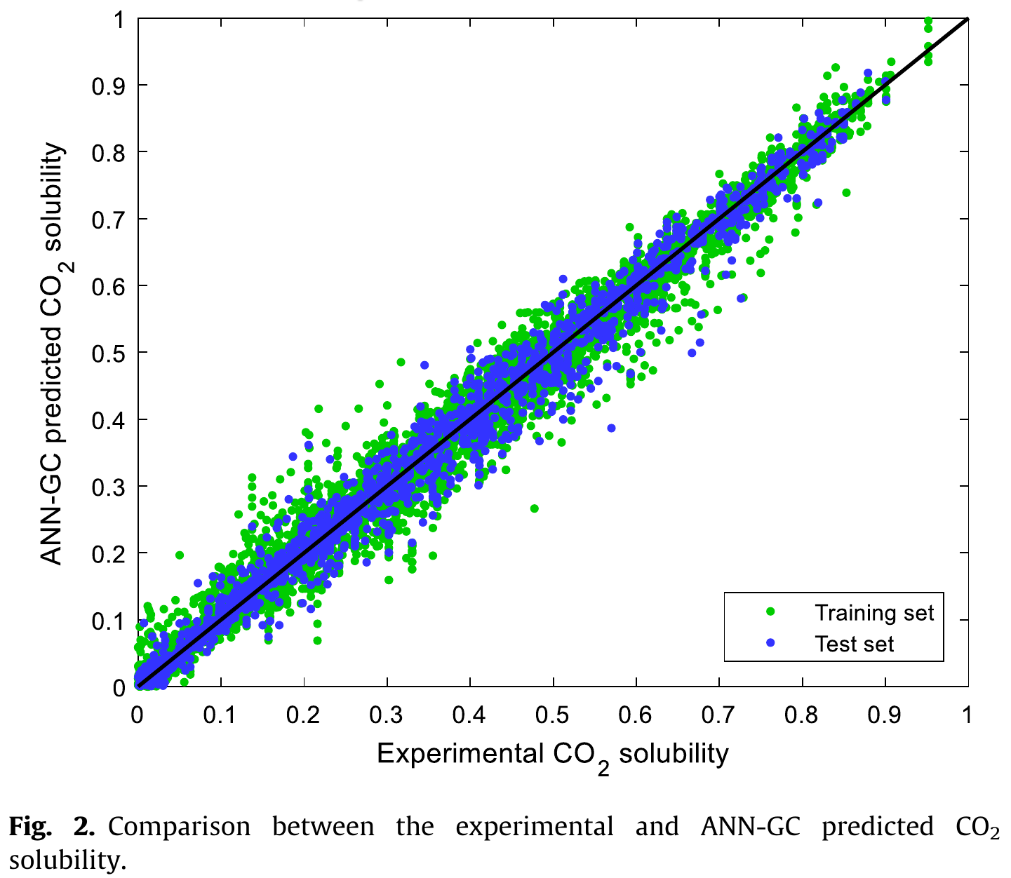
Phase behavior of ionic liquids
three-layer feed forward ANN
IL
structure
information
CO2-in-IL
solubility
data organized as vectors
IL structure information = occurrences of functional groups in the IL
training set: MAE = 0.0200, R² = 0.9842
test set: MAE = 0.0202, R² = 0.9836

Slide 18

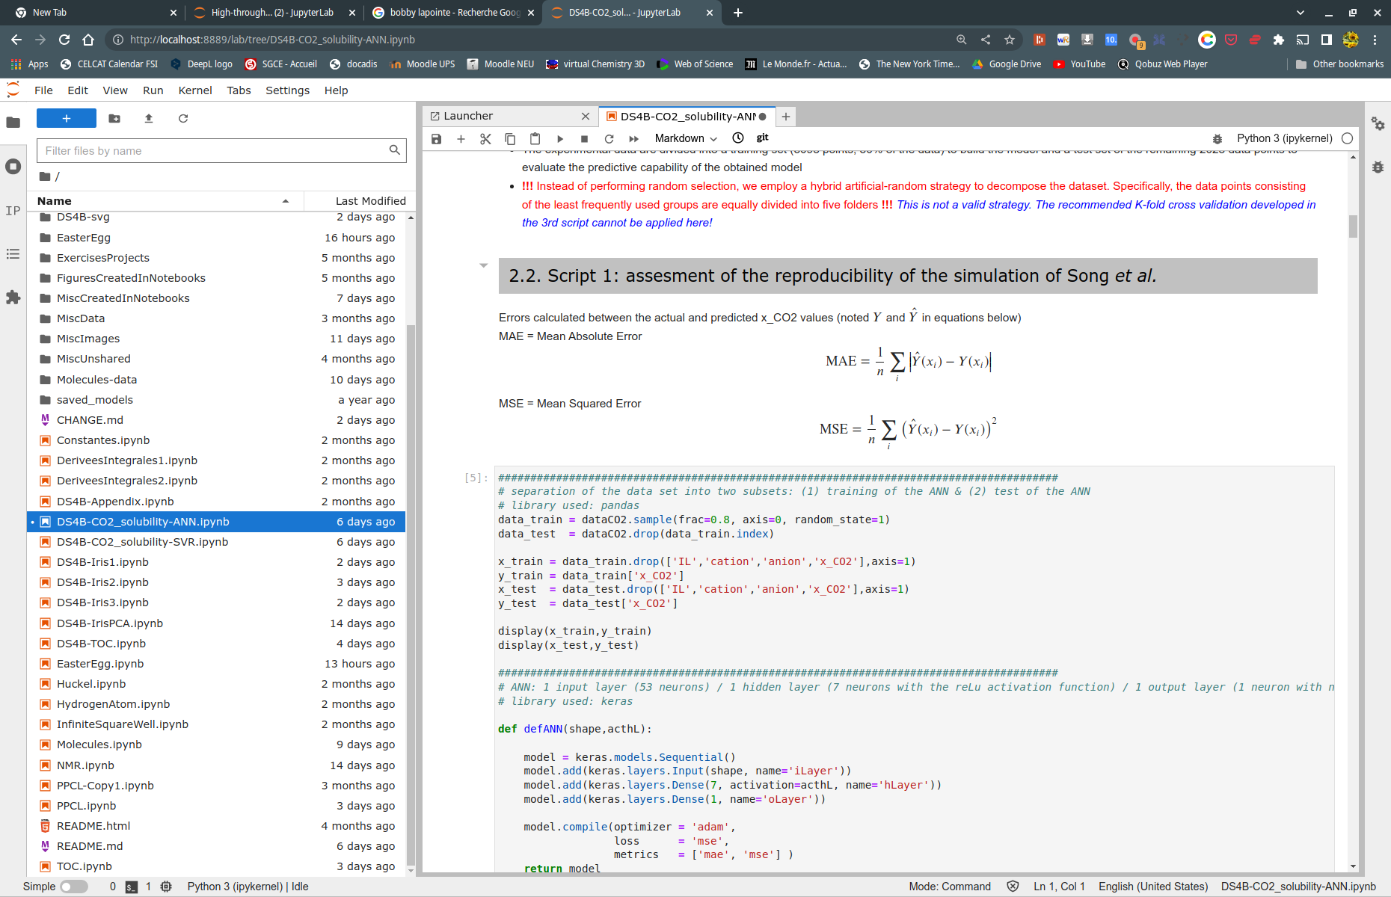
Phase behavior of ionic liquids
Two notebooks
DS4B-CO2_solubility-ANN.ipynb
DS4B-CO2_solubility-SVR.ipynb

Slide 19
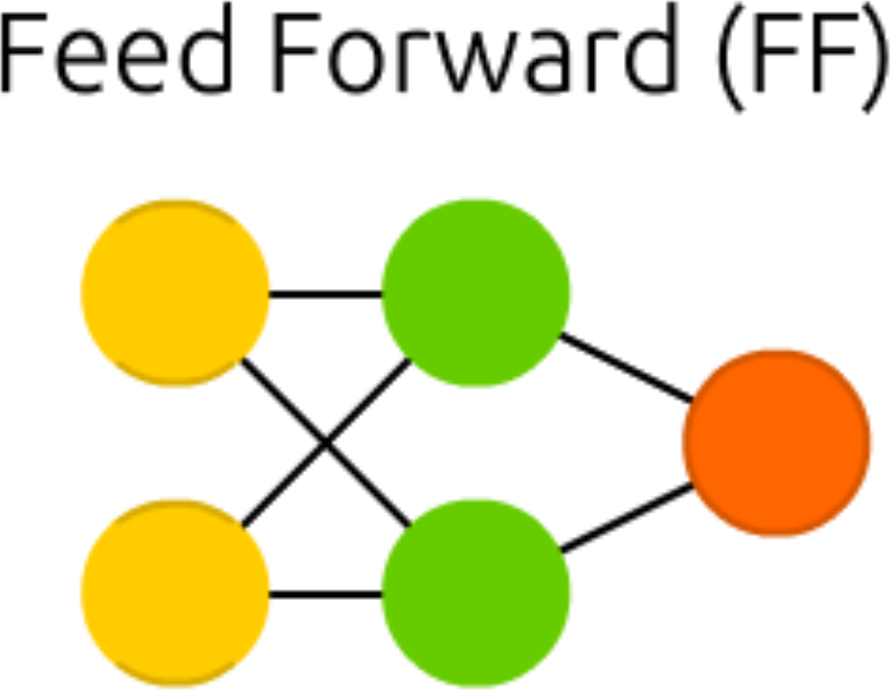
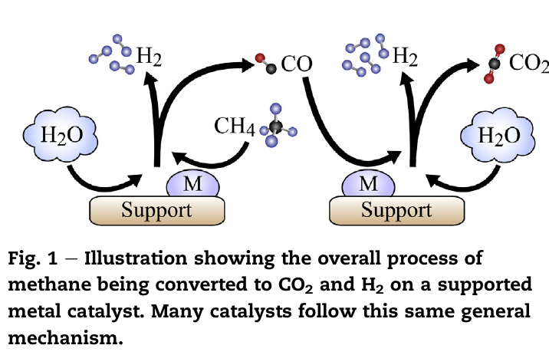
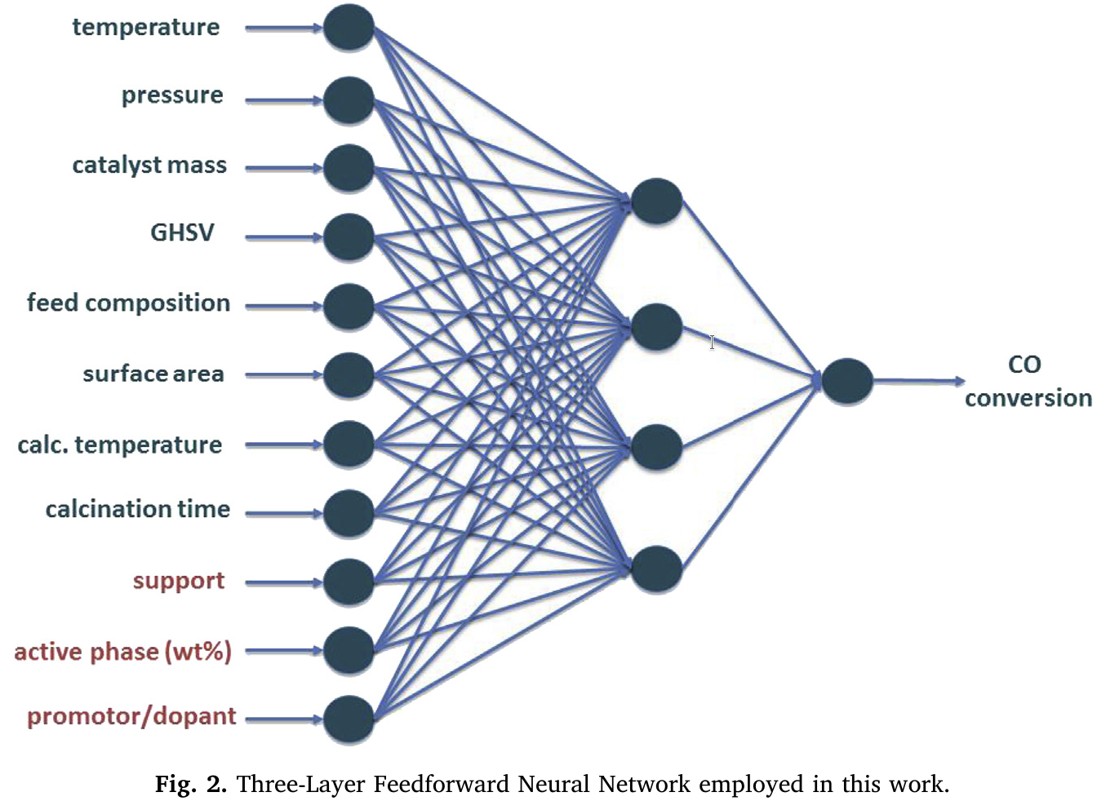
Catalyst selection for hydrogen production through WGS Reaction
General context: steam methane reforming
WGSR: CO + H2O ⟶ CO2 + H2
steam methane reforming
−41,1 kJ·mol⁻¹
+206,2 kJ·mol⁻¹
neuralnet package available in the R software environment
F. M. Cavalcanti, M. Schmal, R. Giudici & R. M. B. Alves (2019) A catalyst selection method for hydrogen production through Water-Gas Shift Reaction using artificial neural networks
J. Environ. Manage. 237, 585-594

Slide 20
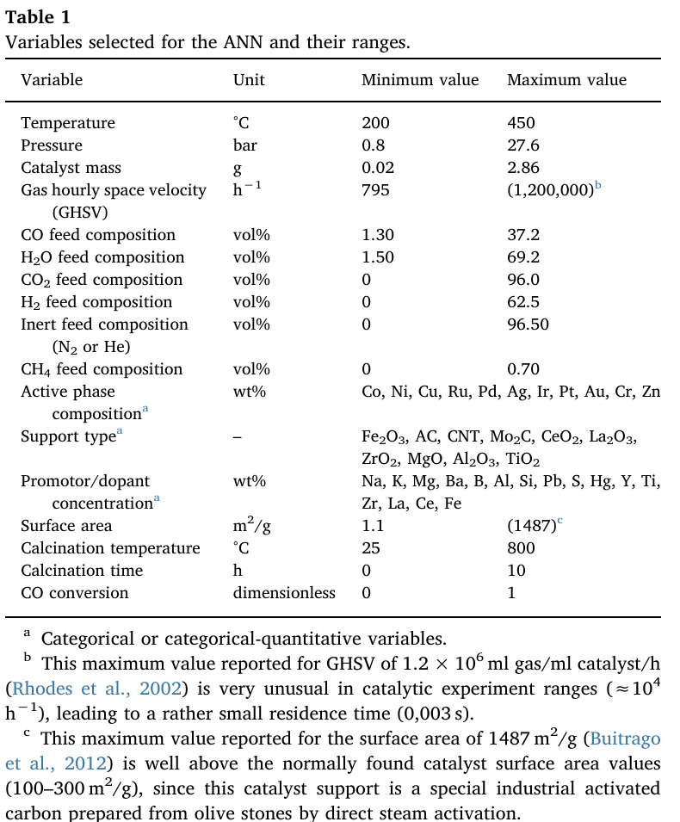
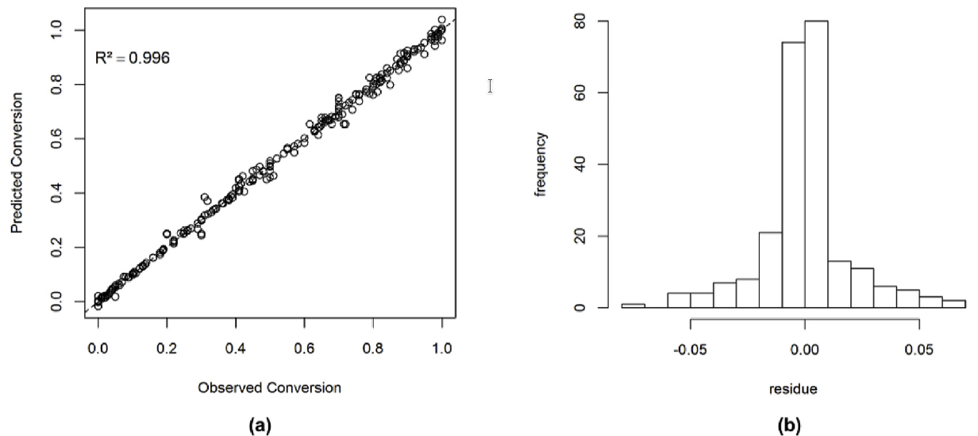
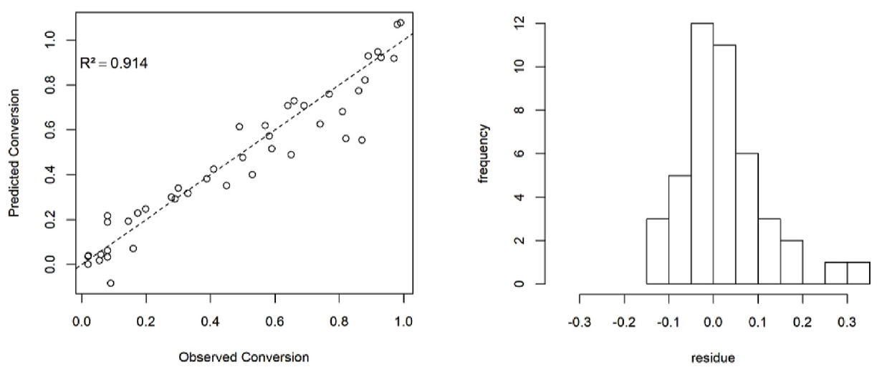
Catalyst selection for hydrogen production through WGS Reaction
Data and main outcome of the trained ANN
283 experimental data points
Training set
Taken from: T. L. LeValley, A. R. Richard & M. Fan (2014)
The progress in water gas shift and steam reforming hydrogen production technologies – A review
Int. J. Hydrogen Energy 39, 16983-17000
Test set

Slide 21
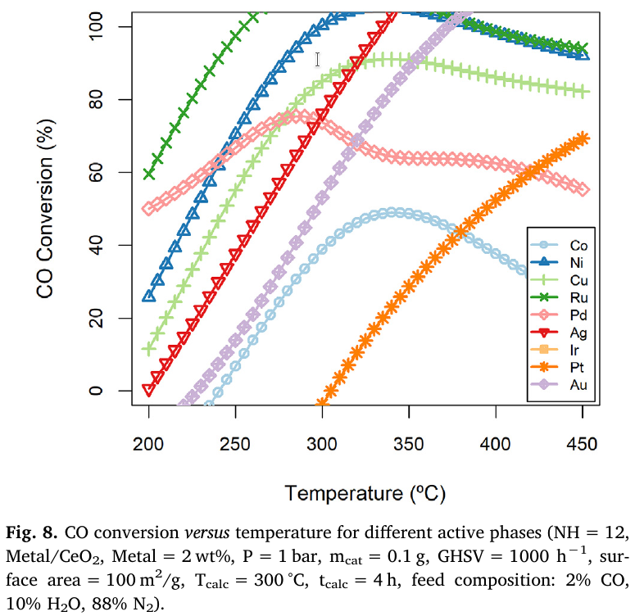
Catalyst selection for hydrogen production through WGS Reaction
Best conditions? 1. ANN at work
Pd and Co: inconsistencies in the ANN model
- lack of data for these conditions?
- or inconsistent kinetic data?
predicted
predicted
Best metals = Ru, Ni, and Cu

Slide 22
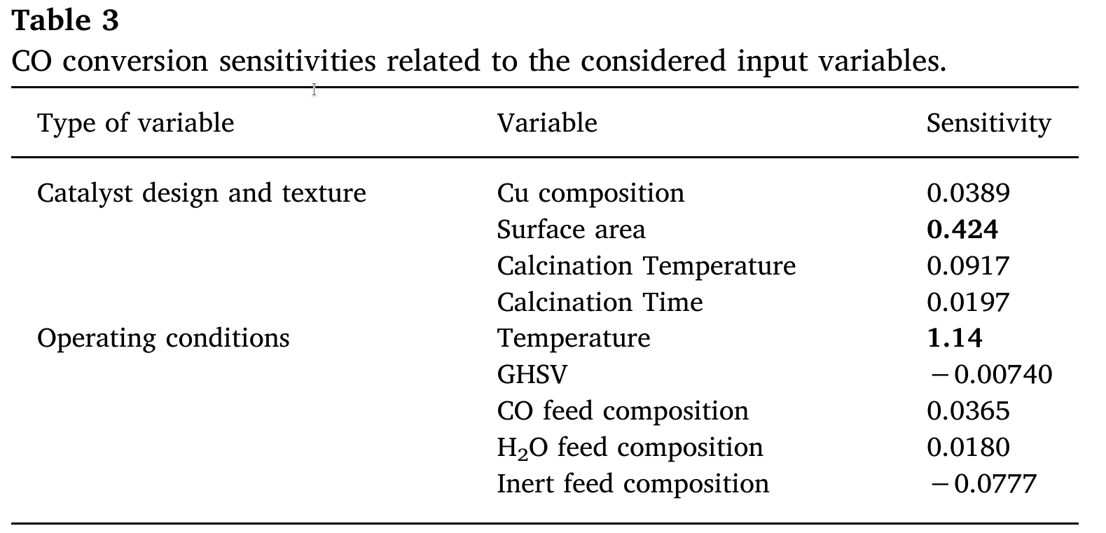
Catalyst selection for hydrogen production through WGS Reaction
Best conditions? 2. Sensitivity analysis using ANN predictions
if…
- relationships between inputs and outputs are poorly understood
- poor or partial understanding of the driving forces and mechanisms
⇒ limits our confidence in the output of the model
⇒ sensitivity analysis provides a kind of “quality assurance”
Is such analysis really necessary to demonstrate that surface area and temperature are important to the development of industrial catalysts for the WGS reaction?
→ actually, sensitivity analysis rather orders by importance the strength and relevance of the inputs in determining the variation in the output
Best conditions and evaluation of the most relevant variables? → “standard” statistics is needed

Slide 23
ML in chemistry (MLChem)
ML methods are becoming less understood while they are also more regularly used as black box tools.
Many publications show inadequate technical expertise in ML (e.g. inappropriate splitting of training, testing, and validation sets)
It can be difficult to compare different ML methods and know which is the best for a particular application or whether ML should even be used at all
Data quality and context are often missing from ML modeling, and data sets need to be made freely available and clearly explained
J. A. Keith, V. Vassilev-Galindo, B. Cheng, S. Chmiela, M. Gastegger, K.-R. Müller & A. Tkatchenko (2021)
Combining Machine Learning and Computational Chemistry for Predictive Insights Into Chemical Systems. Chem. Rev. 121, 9816–9872

