Slide 1




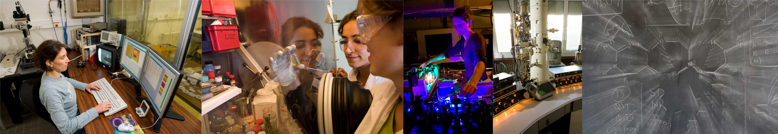
Introduction to Machine Learning for Chemists: Visualization, Data Processing, Analysis
S. Christodoulou, N. Bernard, I. C. Gerber, F. Jolibois and R. Poteau
Python in the Physical Chemistry lab (pyPhysChem) github repository, release v. 1.9.0 (2024), doi: 10.5281/zenodo.8396813
version: Monday 17 June 2024

Slide 2
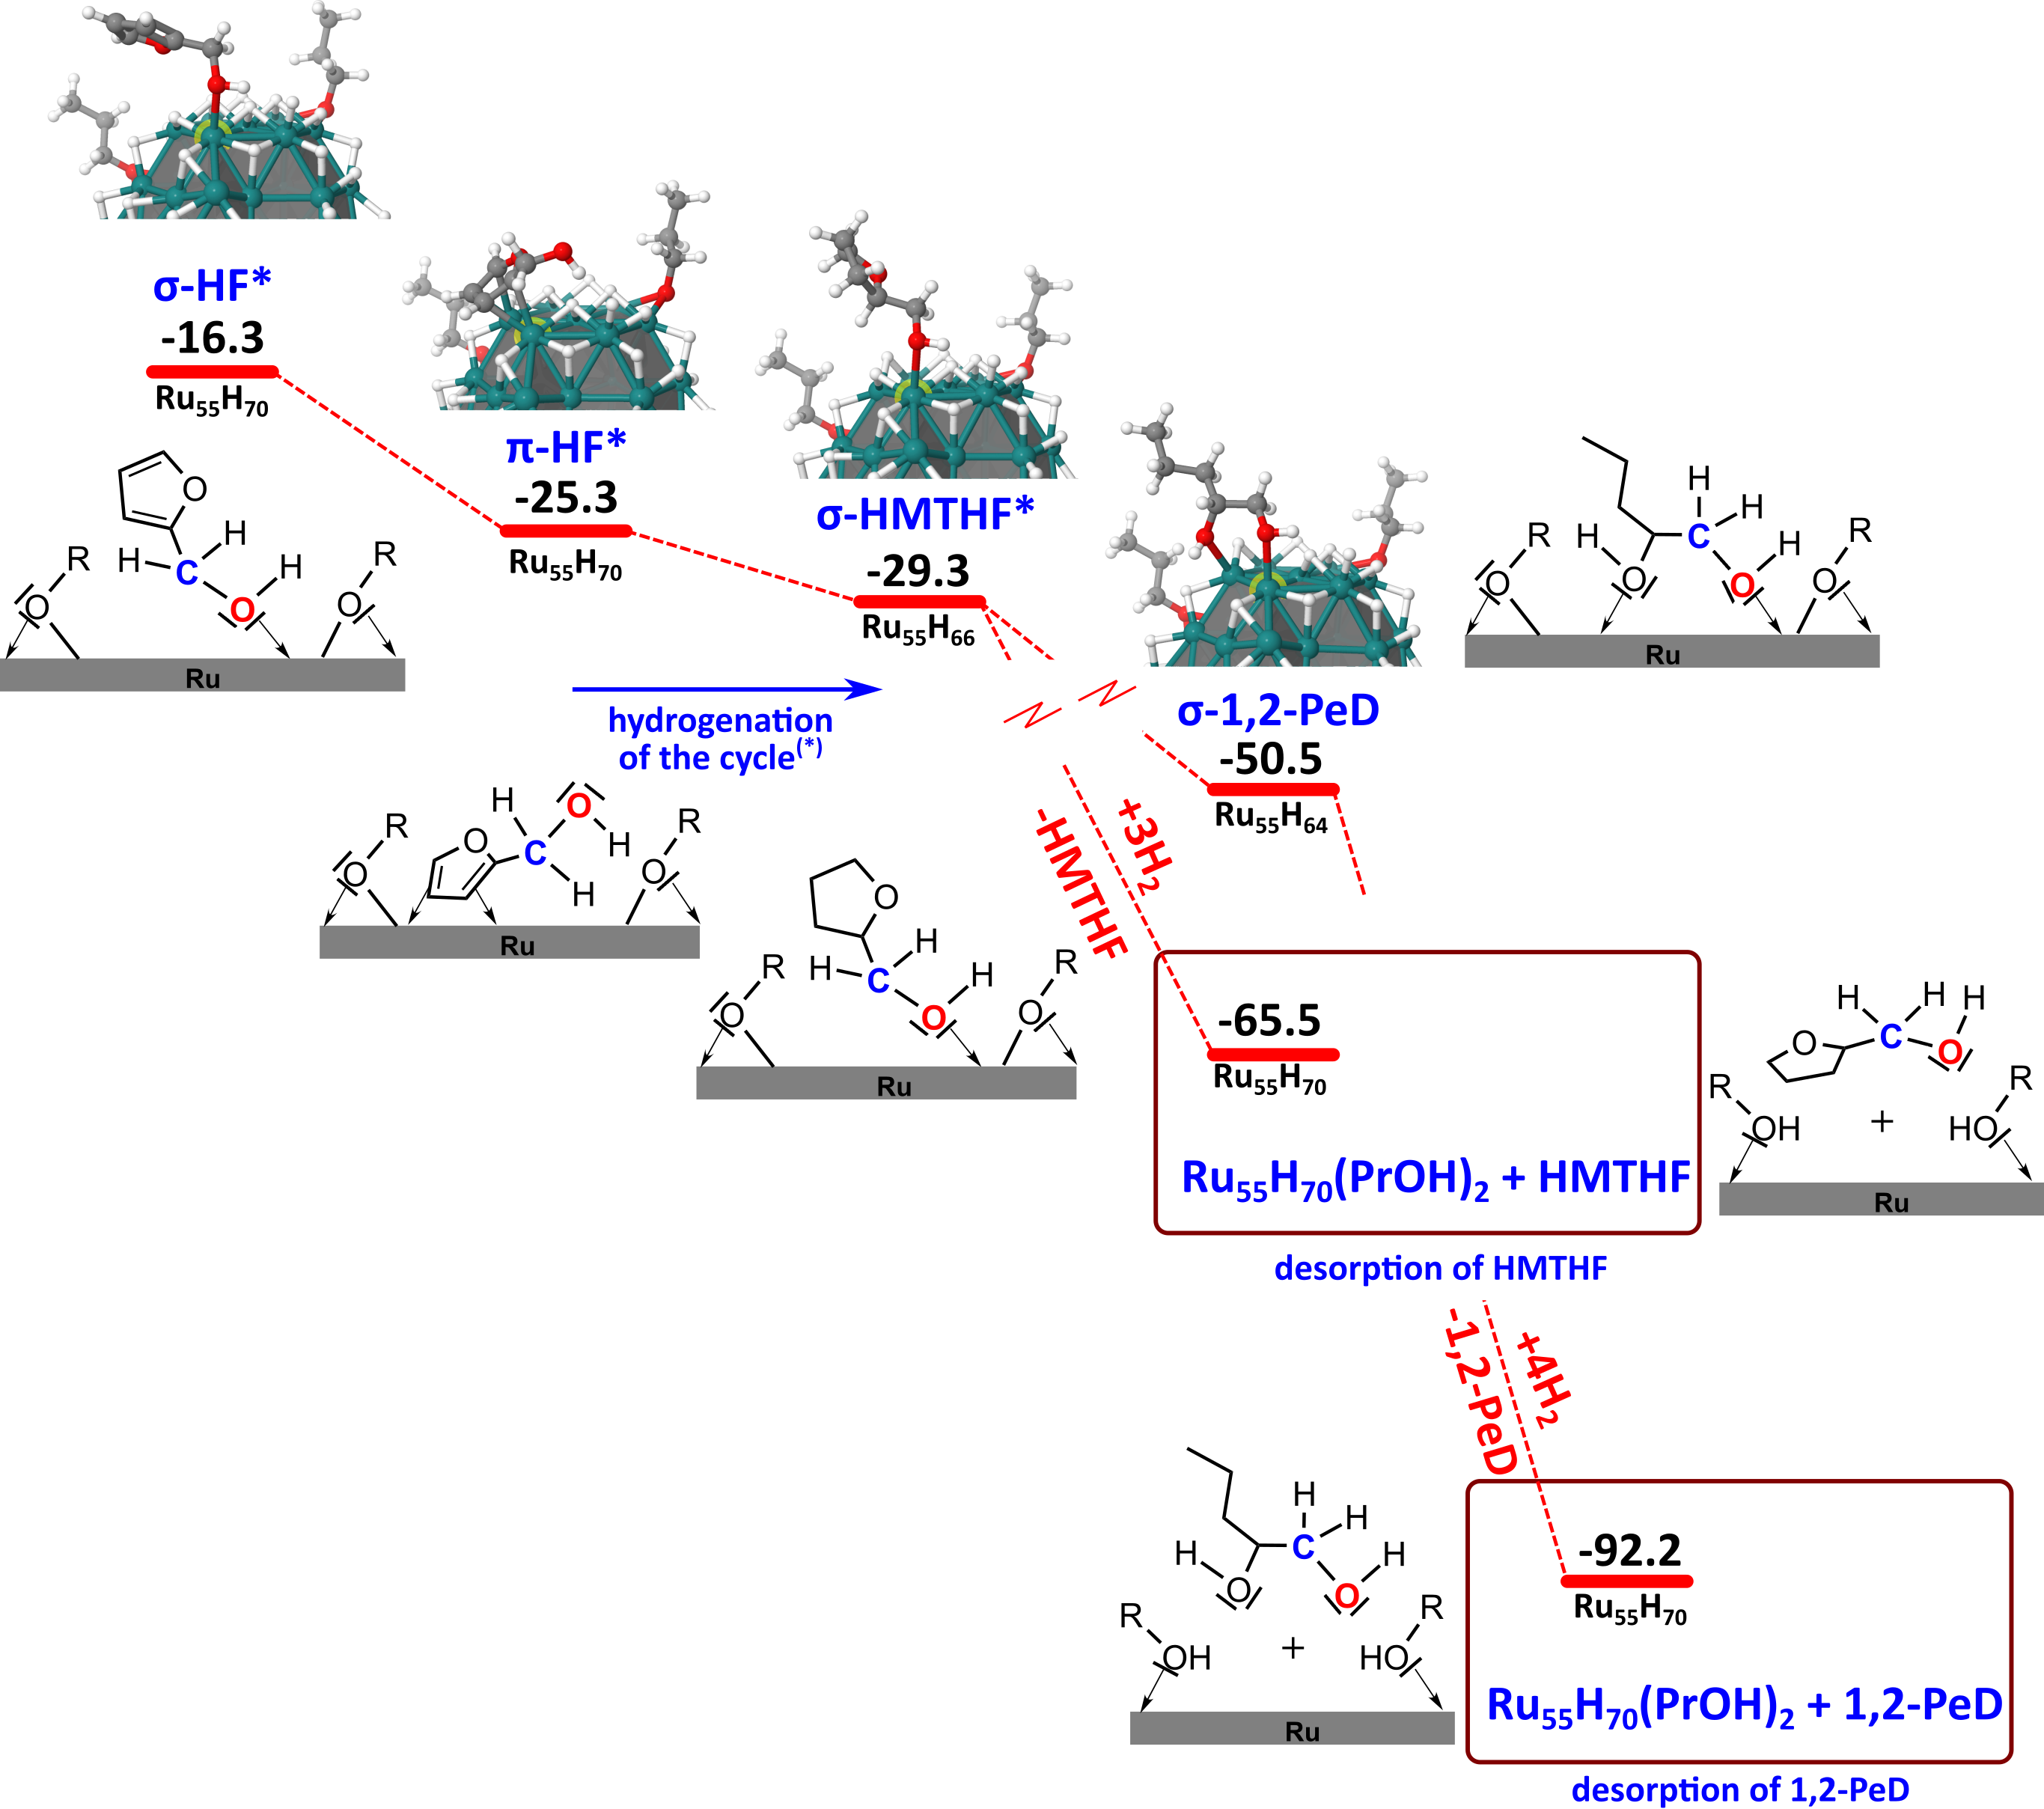
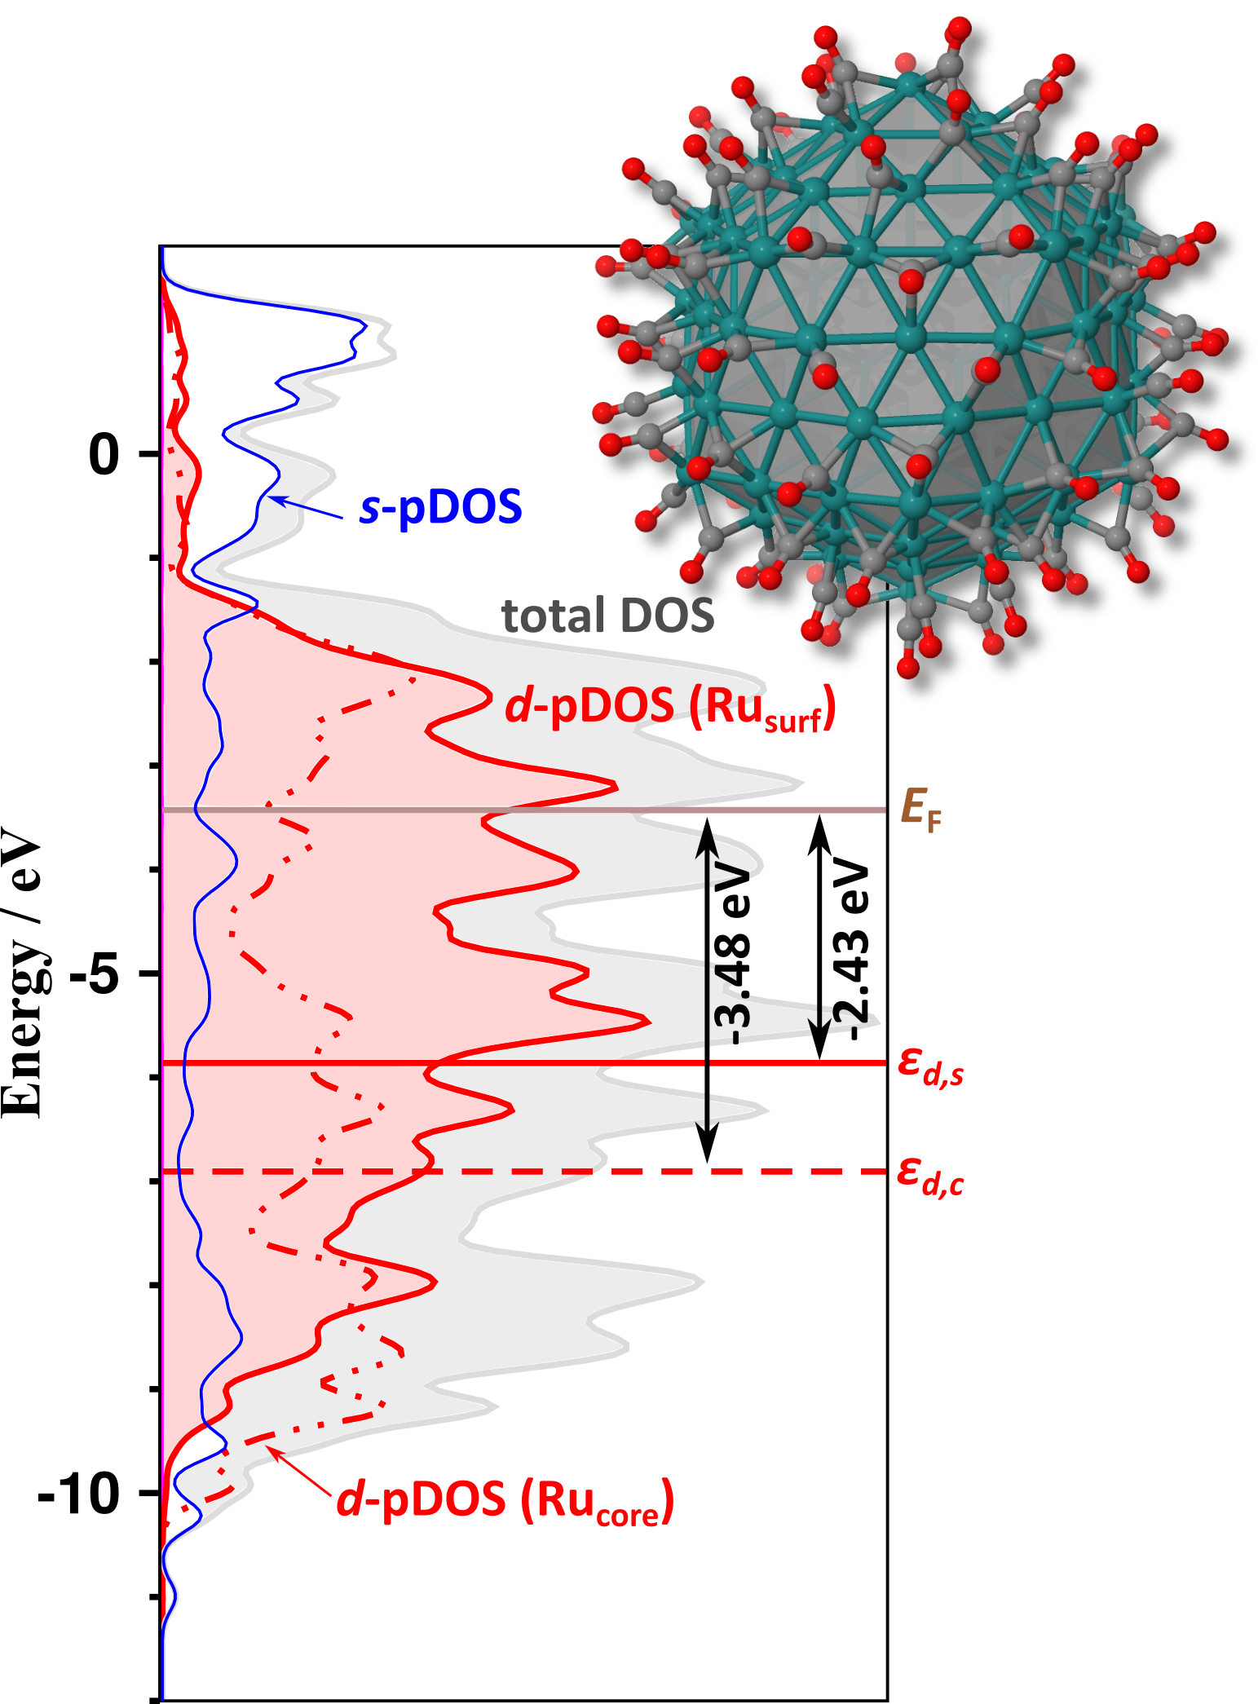
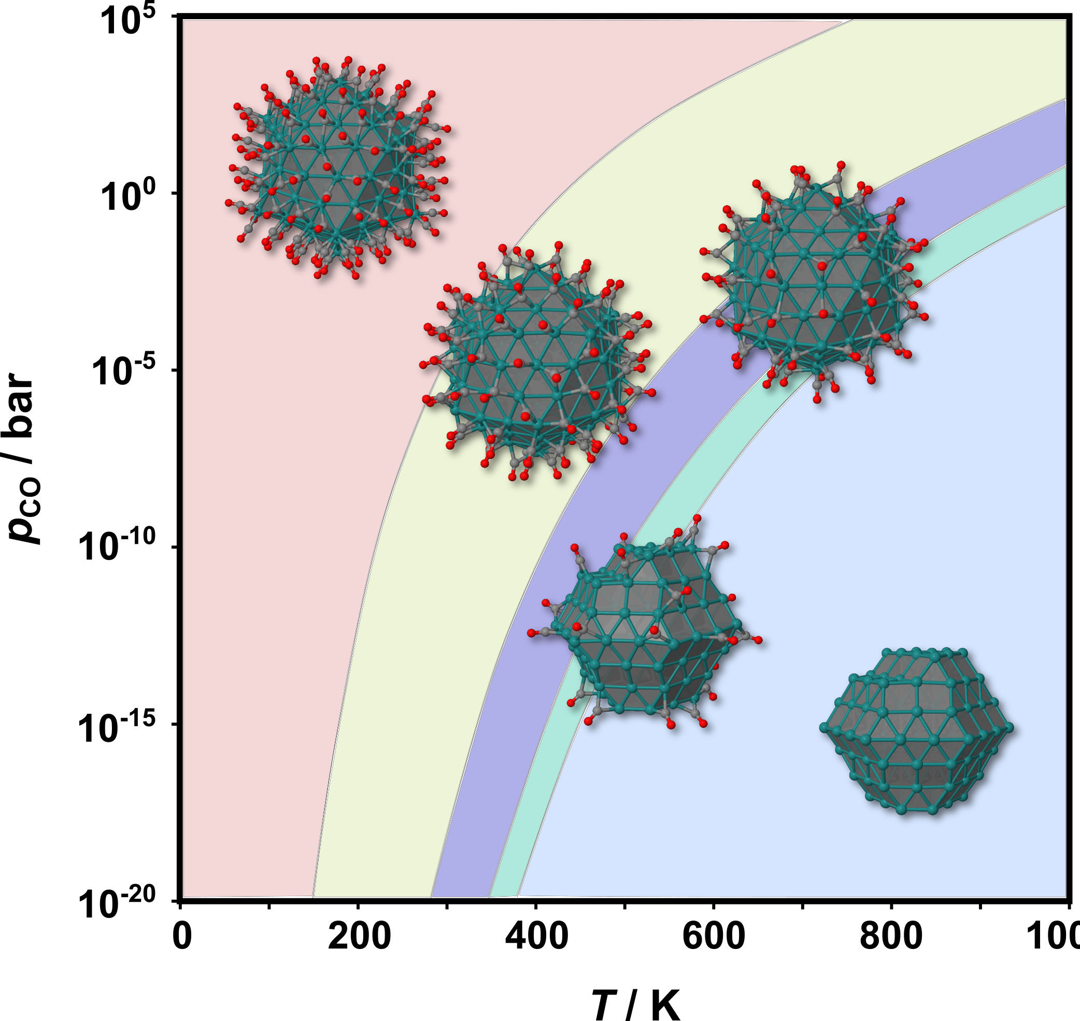
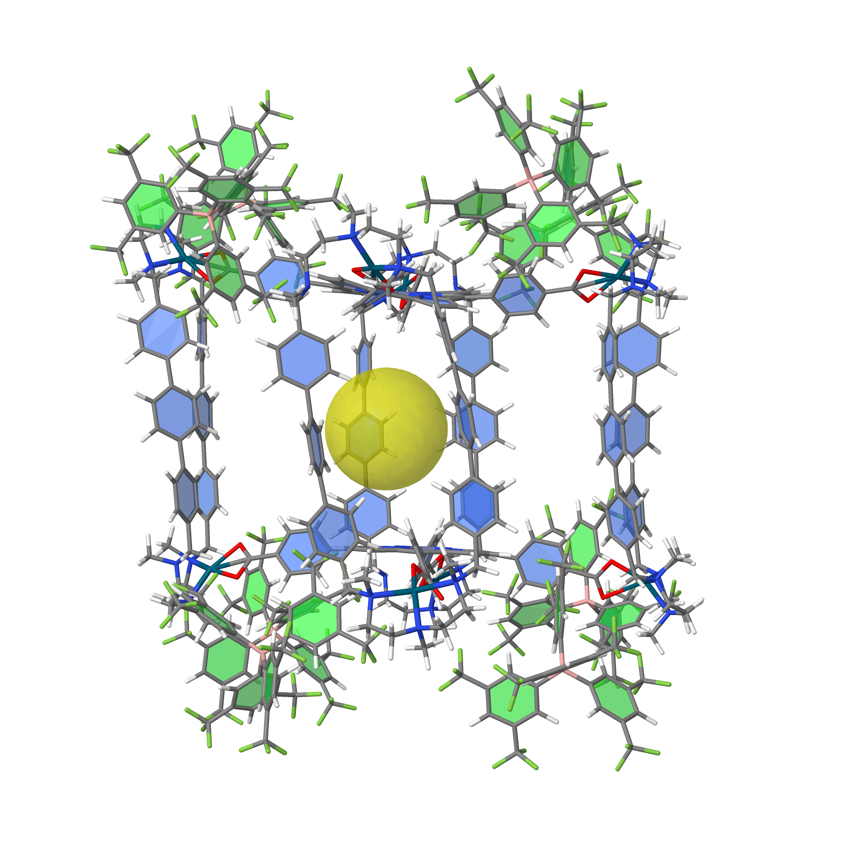
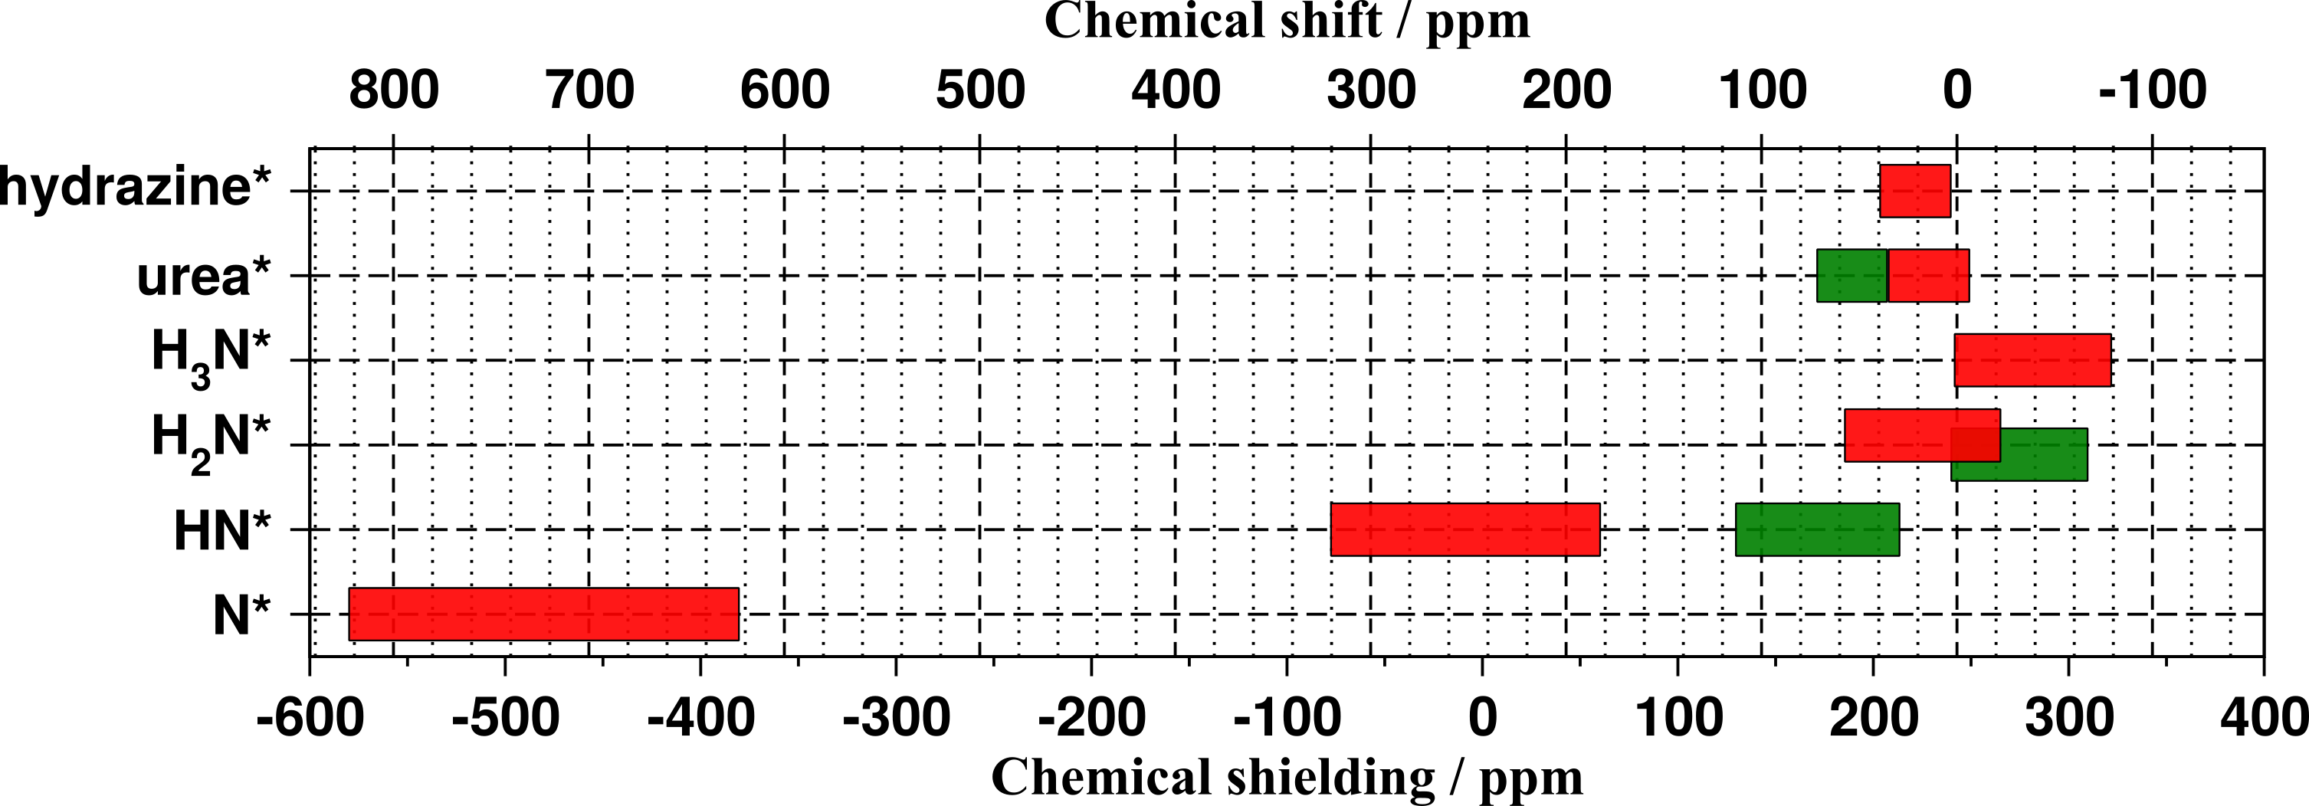
R. Poteau: Scientific activity in a nutshell
Green Chem. (2021) 23: 8480. Link
Applied Quantum Chemistry
DFT (Gaussian)
DFT with PBC (VASP)
(basic tools freely available)
nanocatalysis
electronic structure of MNPs
3D structure and stability of colloidal MNPs
Chem. Mater. (2022) 34: 2931-2944. Link
Nanoscale Horiz. (2022) 7: 607. Link
computational spectroscopy
Catal. Sci. Technol. (2021) 11: 4509. Link
“holistic” approach ← physical chemistry

