Slide 1
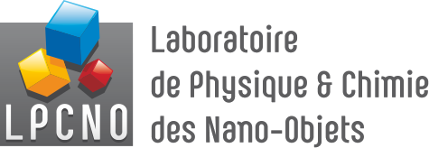

“Talktorials” in computational chemistry and data science
S. Christodoulou, R. Poteau

Slide 2
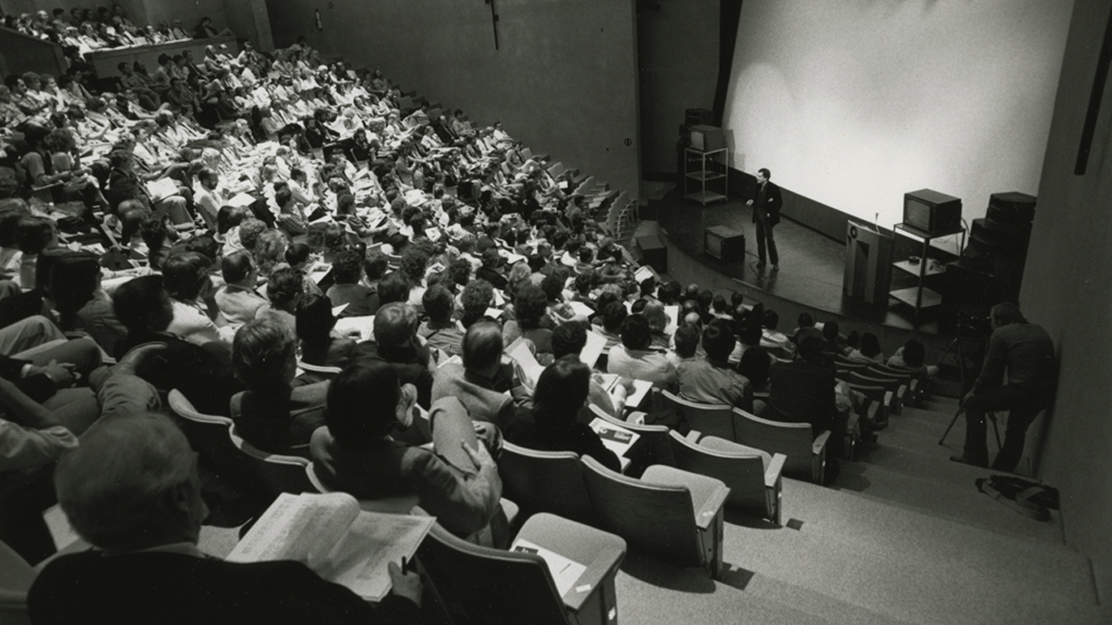
Motivation
integration of verbal explanations with numerical demonstrations or computer algebra system-based demonstrations proves to be an influential pedagogical tool
let’s call them “talktorials”
(portmanteau of "talks" and "tutorials")
such mixing is not new, but until recently it was restricted to rather simple applications that required a great deal of development effort
What is new is:
- the combination of Python's popularity and libraries
- the interactive nature of Jupyter - jupyterlab - notebooks
- personal computers performance
- the possibility to easily adapt real-world applications thanks to Python libraries available in a lot of domains
- the strong community support
- the ease of reproducibility that makes tutorials more effective, as learners can directly use the code provided to experiment and build upon it

Slide 3
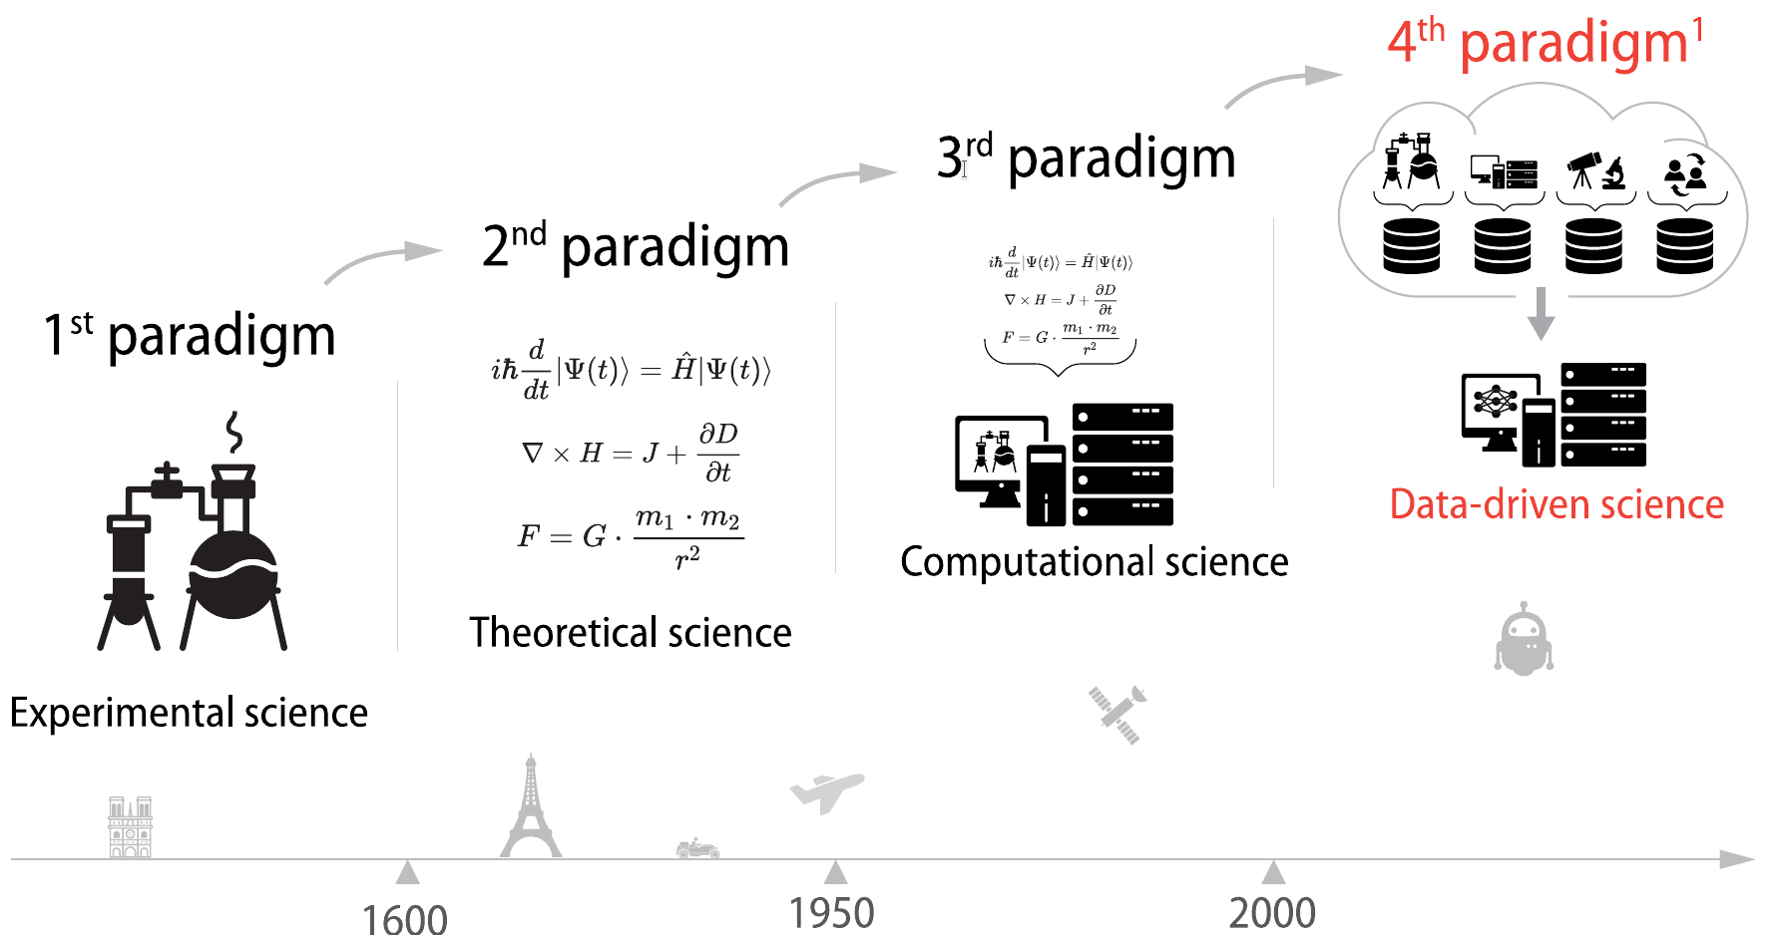


Motivation
The emergence of such innovative approaches in the realm of computational chemistry is truly encouraging
It not only enables learners to grasp theoretical concepts but also offers a practical perspective on their application
For students specialising in computational chemistry who develop their own scripts, they acquire a dual skill set
paradigms in research
https://fidle.cnrs.fr

Slide 4
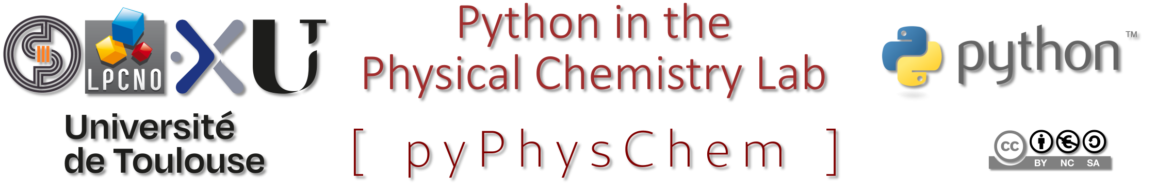

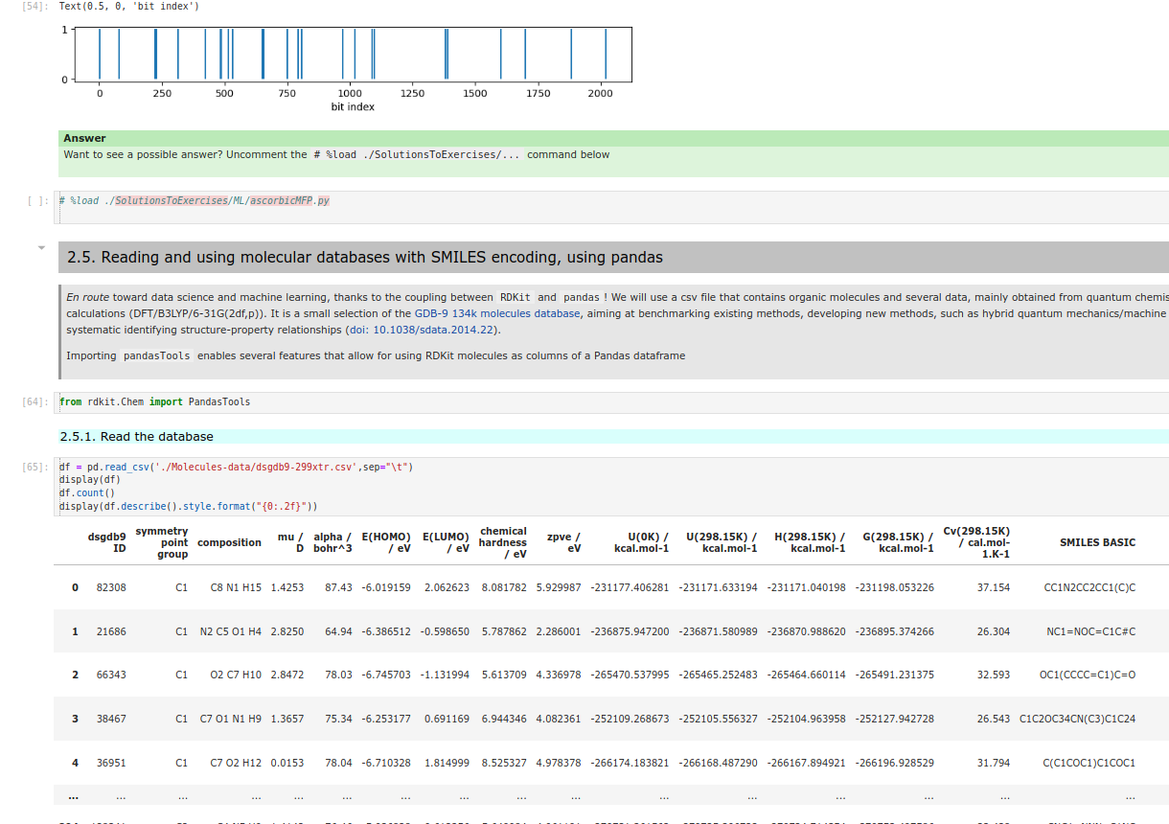
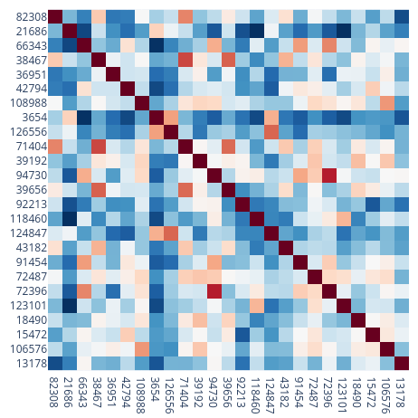
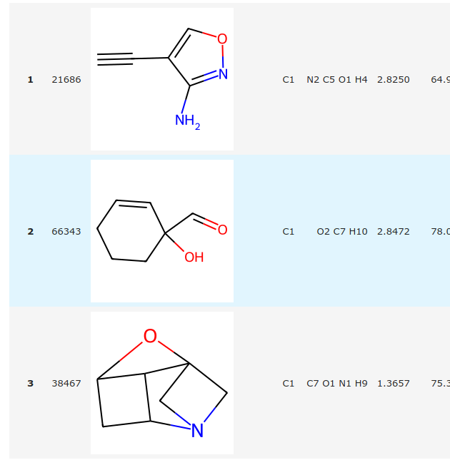
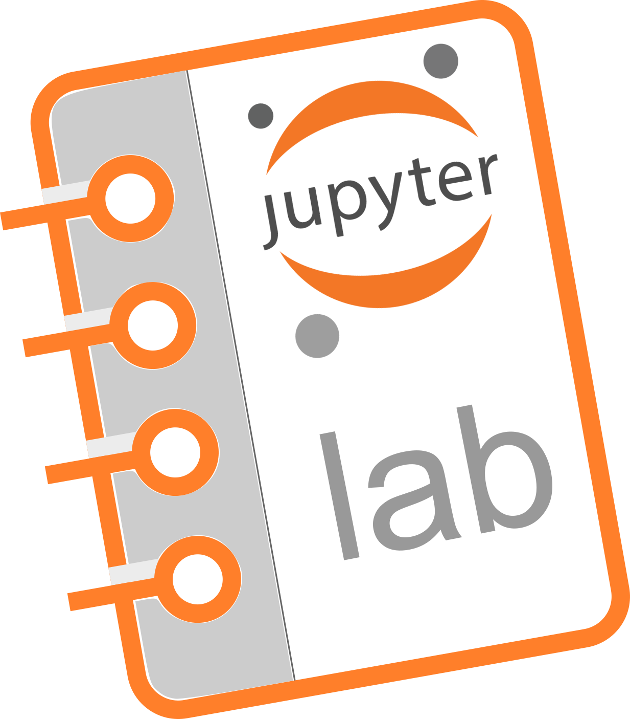
Tool
Github repository
Python in the Physical Chemistry lab (pyPhysChem) github repository, release v. 1.8.0 (2023)
Jupyterlab notebooks/talktorials-ready
specifically tailored for computational chemistry and data science/machine learning
- interactive python
- images / videos
- mathematical equations
- enriched text (markdown)
- hyperlinks > data / webpages
- embed pdf documents

Slide 5

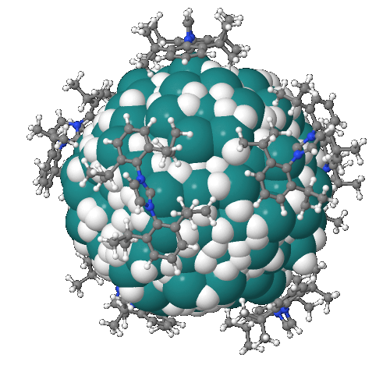

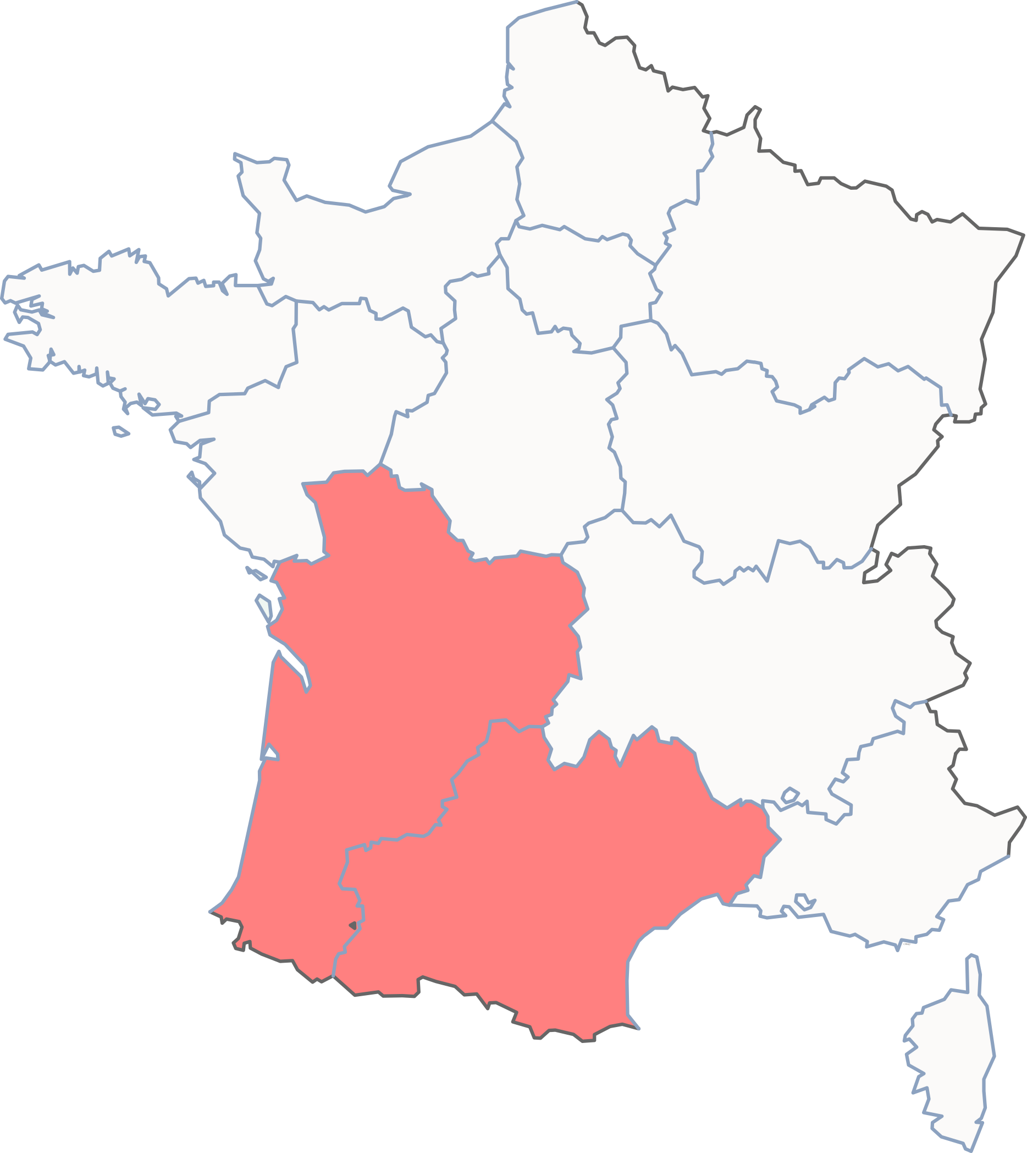
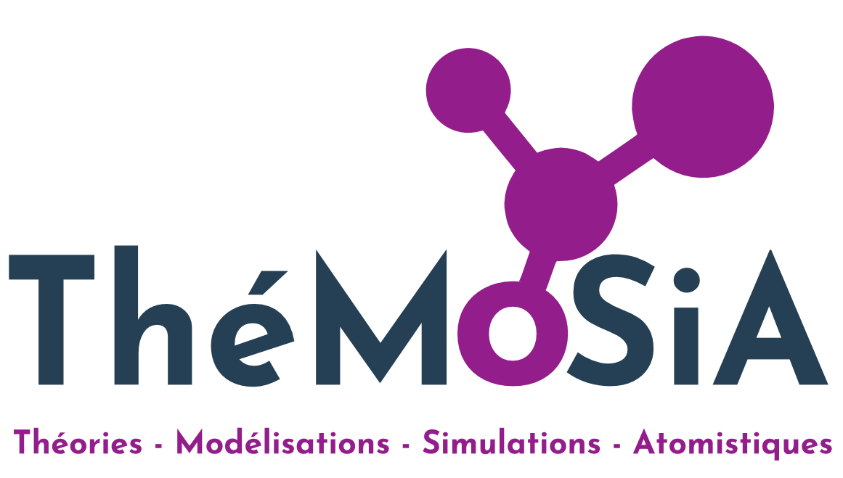

Which students (so far...)?
bachelor degree
all chemistry students, 2nd year (120 students)
masters’ (graduate) degrees
CCTMA
Réseau Français de
Chimie Théorique
International students of the Nanoscale Science and Engineering master’s degree, @Toulouse, France
European and French students in Computational Chemistry

Slide 6

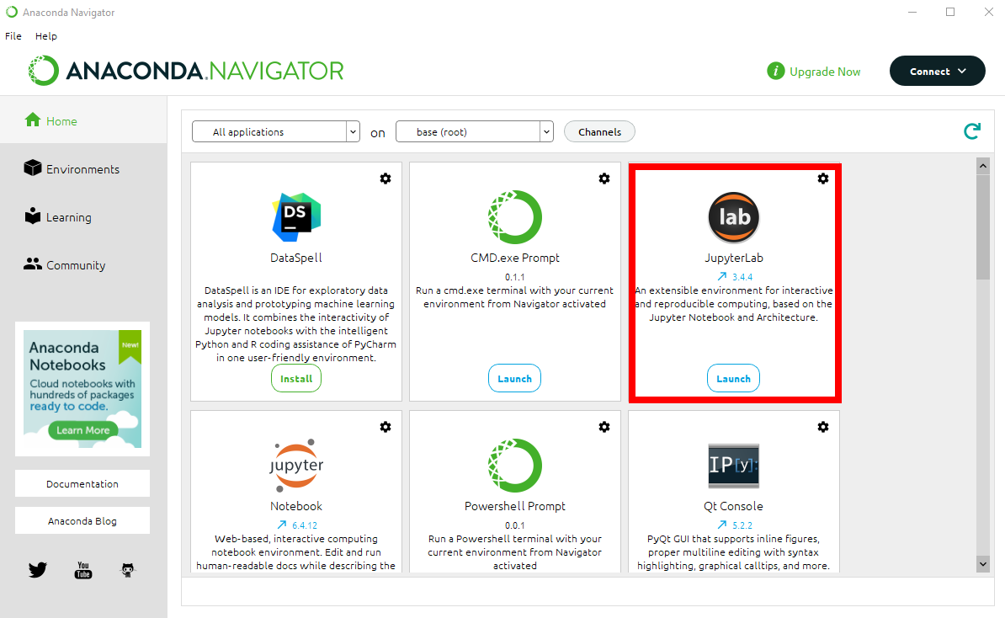


Educational scenario: introduction to data science and ANNs in chemistry
Technical prerequisite
Students can install on their computer a python distribution, such as anaconda
They must install a ready-to-use Linux virtual machine
or
educational activity
less educational...
an online install-party is organized afterwards
Remedial help

Slide 7
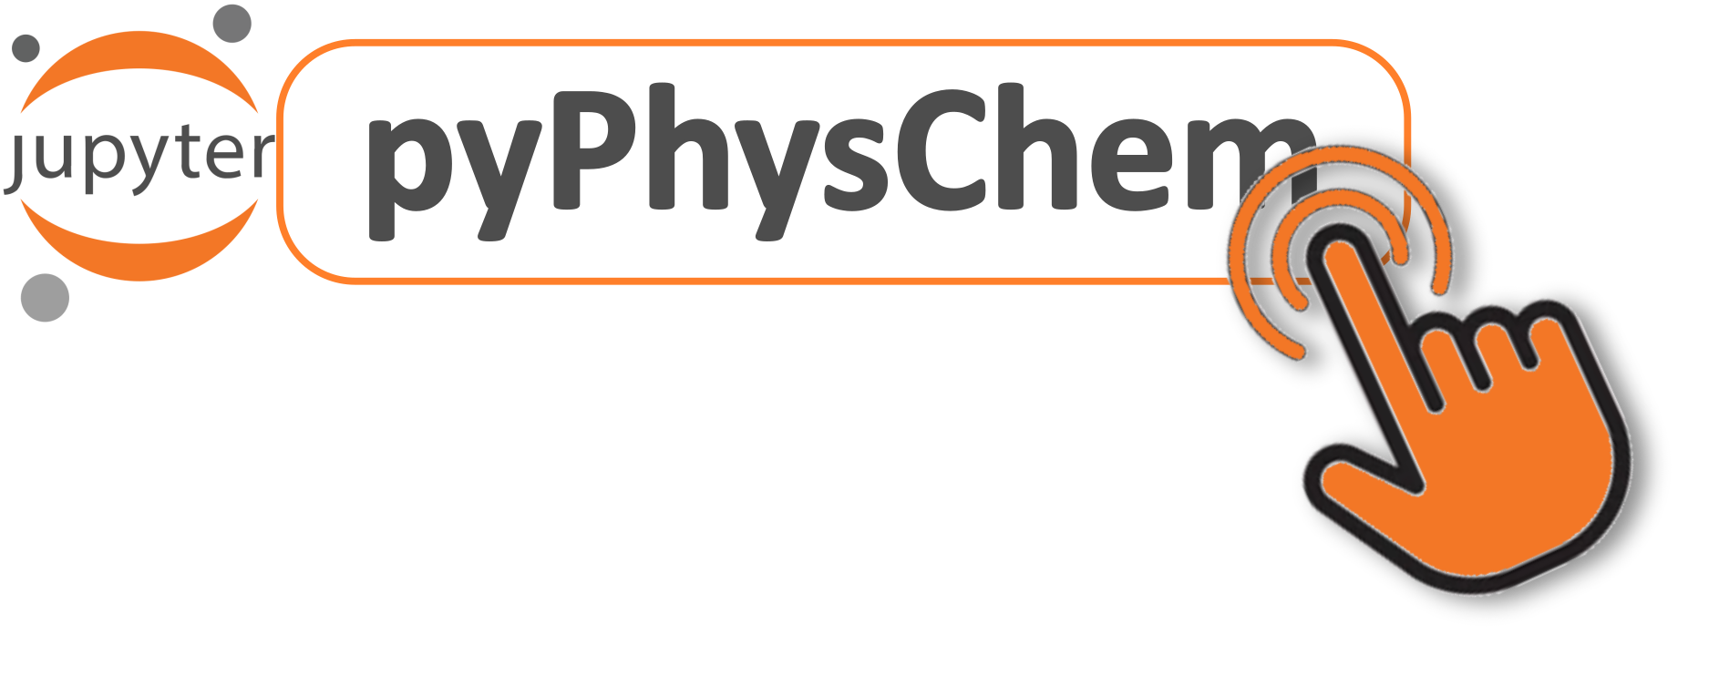
Educational scenario: introduction to data science and ANNs in chemistry
Prerequisite: a basic knowledge in python
Most of the students have already been exposed to python
A python in the physical chemistry lab in a nutshell notebook is part of pyPhysChem
→ revising python within a Phys. Chem. context
→ students become familiar with jupyterlab notebooks and with the spirit in which pyPhysChem notebooks are developed and can be used

Slide 8
Educational scenario: introduction to data science and ANNs in chemistry
Talktorial
Basics of Artificial Neural Networks (ANNs) for supervised learning
1 notebook
Self-learning with short questions
Reading and analyzis of the "iris flowers" database with the pandas library
Statistics and regression
Supervised Machine Learning applied to classification
eXplainable AI (XAI)
4 notebooks
Remedial help

Slide 9
Educational scenario: introduction to data science and ANNs in chemistry
Talktorial
Molecular representations
1 notebook
Self-learning and exercises
Self-learning: prediction by an artificial neural network of the solubility of CO2 in ionic liquids
after “Z. Song, H. Shi, X. Zhang & T. Zhou (2020), Prediction of CO2 solubility in ionic liquids using machine learning methods, Chem. Eng. Sci. 223: 115752”
Exercise: Assessment of the stability of the original ML algorithm of Song et al. by K-fold cross validation
solution is available on pyPhysChem → self-assessment and critical discussion about this study
2 notebooks
Remedial help

Slide 10
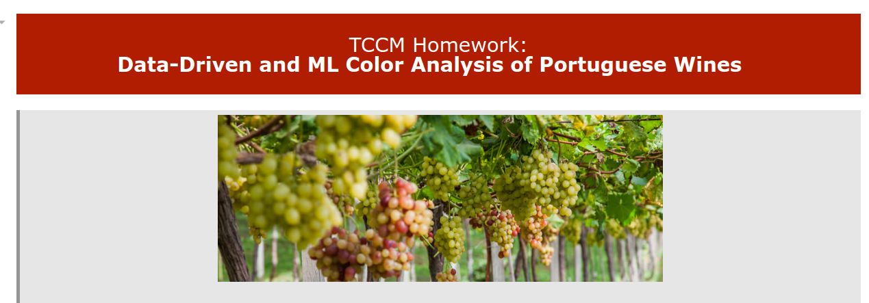
Educational scenario: introduction to data science and ANNs in chemistry
Project-based learning and assessment
Skills tested
- data analysis, curation, standardization
- building and training of a DNN
- holdout method
- hyperparameters optimization
- K-fold cross validation
- Shapley Additive exPlanations
= ML workflow
- critical thinking
students must submit their python code and report in the form of a notebook

Slide 11

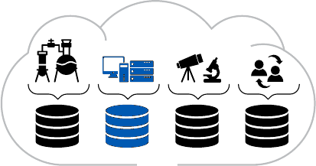


Summary & Outlook
https://github.com/rpoteau/pyPhysChem
Very important to give dual skill set to Comput. Chem. Students
→ strong convergence between quantum and computational chemistry, data science and machine learning
→ could be sought after in various areas of research and industry
- python for physicists and chemists in a nutshell
- Computer Algebra System
- Physical chemistry, including quantum chemistry
- coding and use of representations of molecular structures and related data
- Data science and ML (supervised and unsupervised learning, mainly NN)
AI = black boxes?
live talktorials
self-learning
project-based learning
[online]remediation help
Yes and NO!… better explainability of AI models than usually supposed
data-driven science

