Slide 1
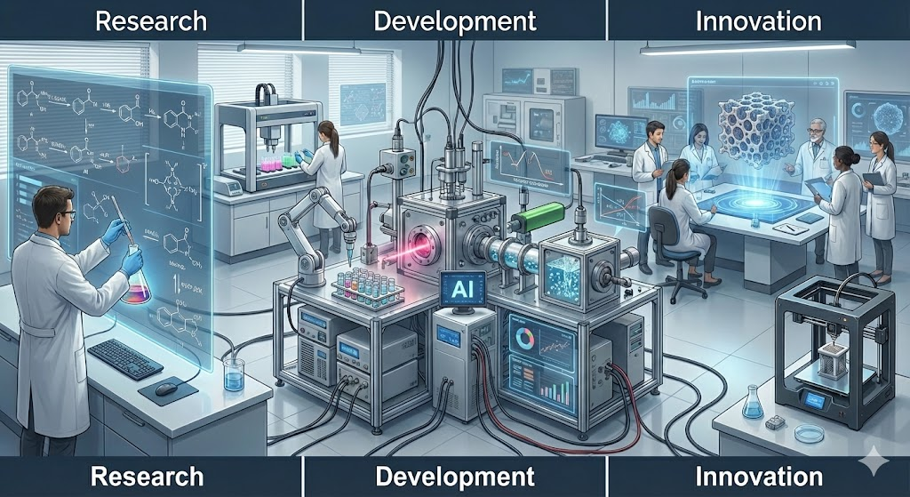

Slide 2
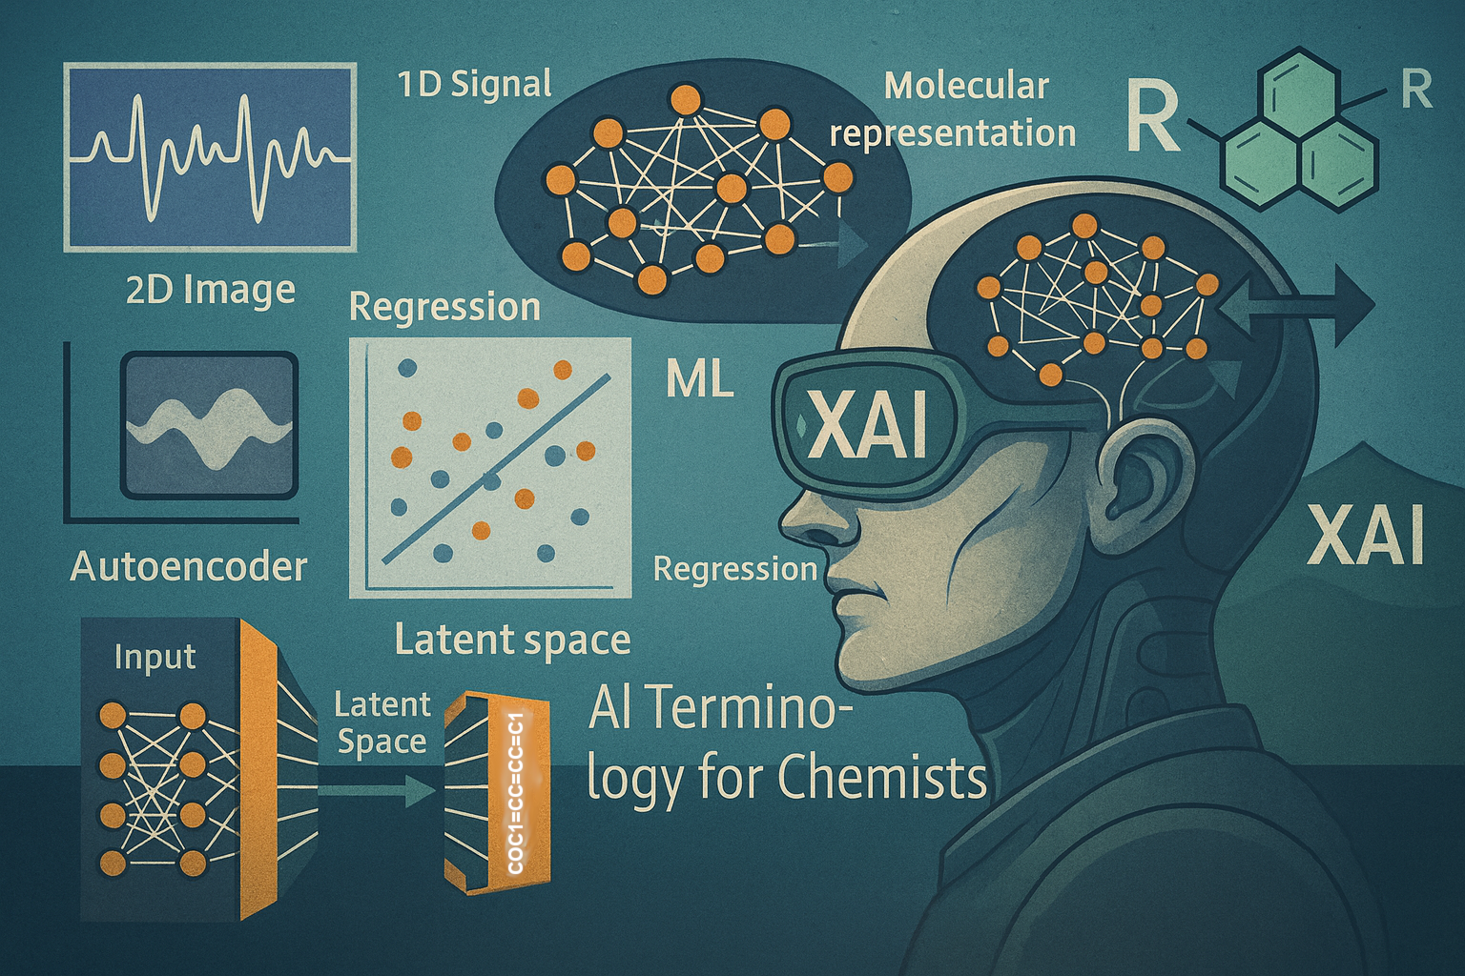


Typical workflow – with a bit of xAI
ML-Glossary.ipynb

Slide 3









Strategy
What did the model learn?
Which data ?
How much?
Explainable AI tools to see through the black box models
Collect data
Validate model performance
on new data
Analyze, curate and format data
Hidden patterns?
Train and optimize models
Which algorithm?

Slide 4
How many data?
There is no single magic number
Data requirements vary by several orders of magnitude depending on whether you are building a generalist “chemical brain” or a specialized expert tool
Typically
Generalist AI: 10⁹. Example = LLMs that can understanding the language and concepts of chemistry
Specialist AI: 10⁶. Example = Proprietary databases of chemical reactions
Expert AI: 10² - 10³. Example = Structure-Activity Relationships (SAR)
Don’t forget: quality is better than quantity

