Slide 1
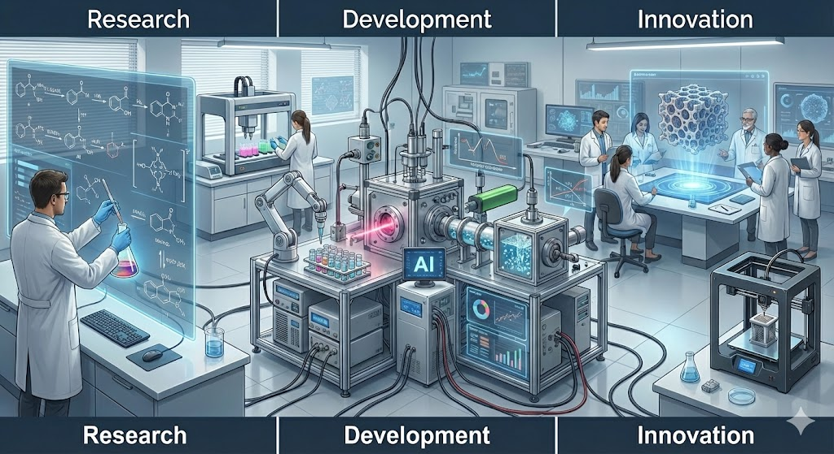

Slide 2
Outline of this lecture
1. General context
2. Supervised vs. unsupervised learning
3. Machine learning in Physical Chemistry
4. Python vs. other tools – at the era of generative AIs
5. Typical workflow – including xAI
6. Conclusion

Slide 3
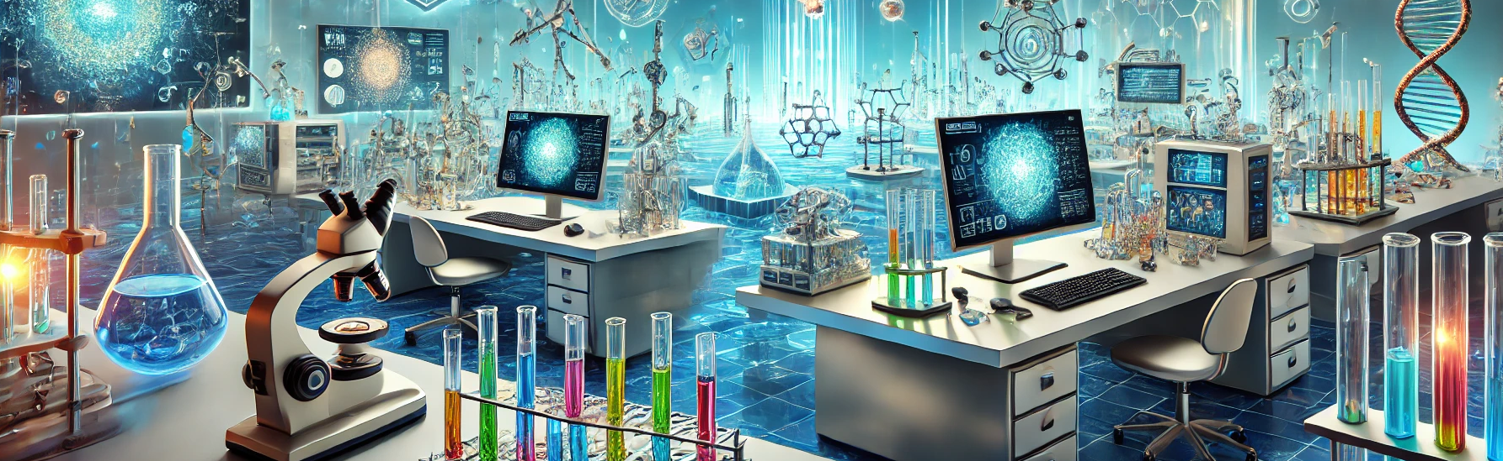

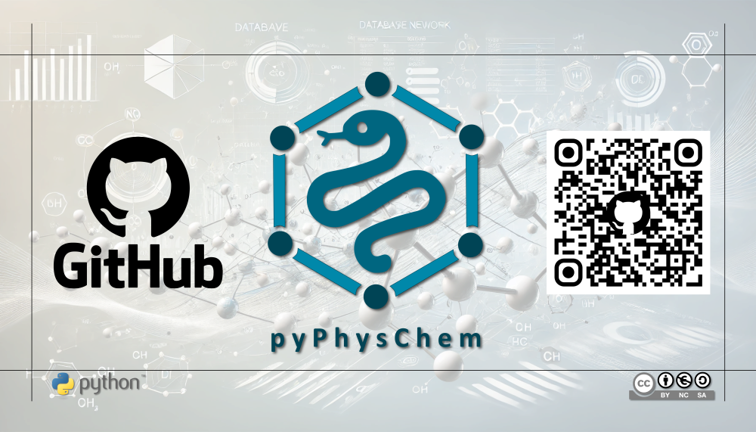
Part of this lecture will rely on live sessions using the data and Jupyter notebooks available in this GitHub repository
https://github.com/rpoteau/pyPhysChem

Slide 4
General context

Slide 5
Context
Artificial Intelligence (AI)
intelligence demonstrated by machines, as opposed to the natural intelligence displayed by humans or animals
Goals
reasoning & (basic) problem solving
knowledge representation
planning: making choices and hierarchy of events
learning (i.e. machine learning)
natural language processing
perception of the world from sensors
ability to move and manipulate objects
simulating human affects
long-term goal: ability to solve an arbitrary problem
N.B. in some fields "artificial intelligence" means "machine learning with neural networks"

Slide 6
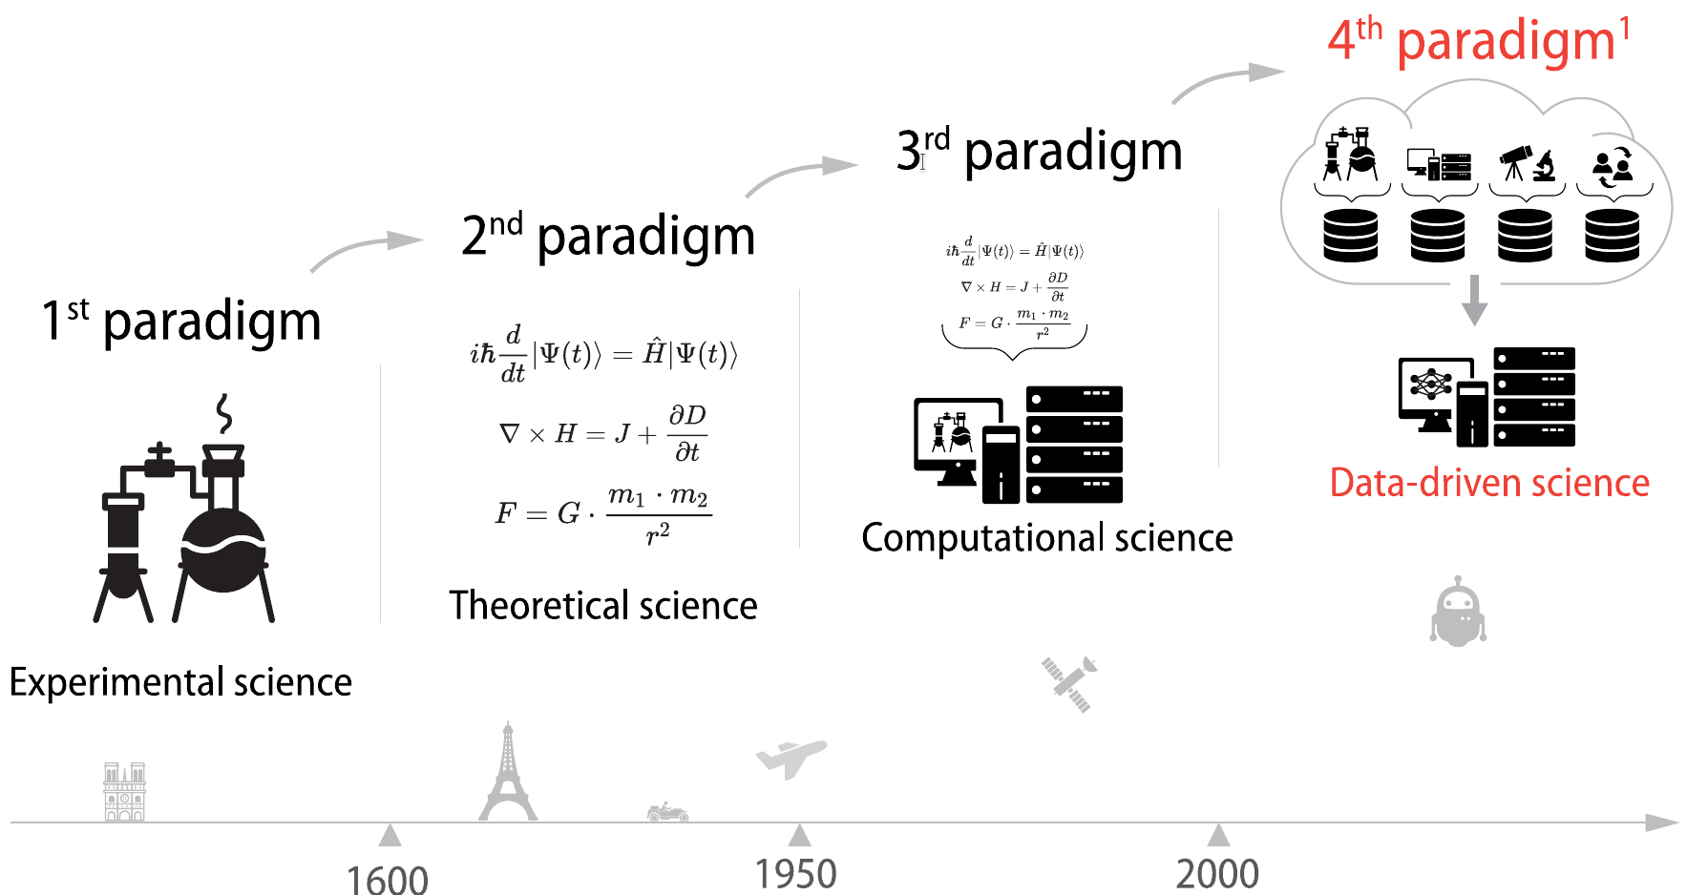

Context
Artificial Intelligence and Scientific Research
https://fidle.cnrs.fr
(1) Hey, T.; Tansley, S.; Tolle, K. The Fourth Paradigm: Data-Intensive Scientific Discovery; The Fourth Paradigm: Data-Intensive Scientific Discovery; Microsoft Research, 2009

Slide 7
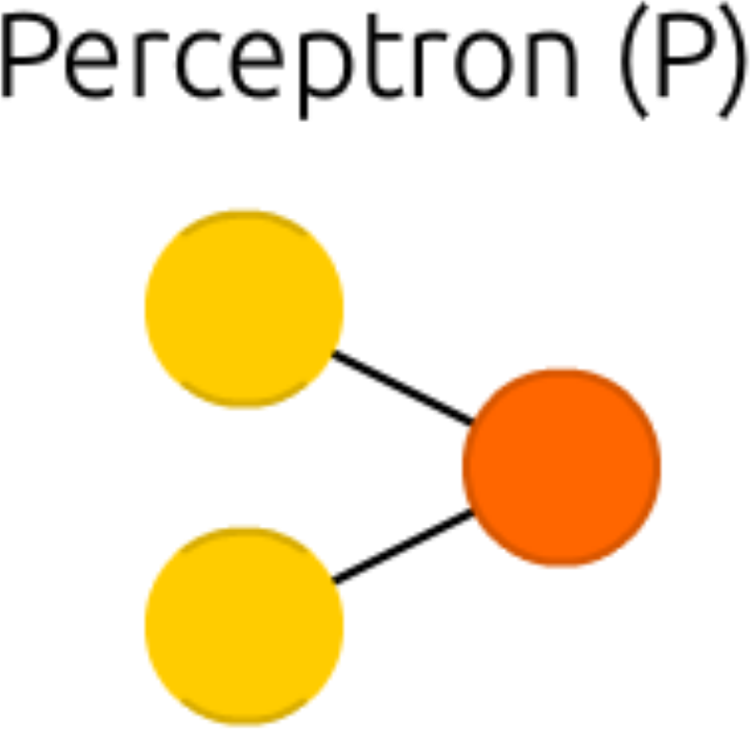
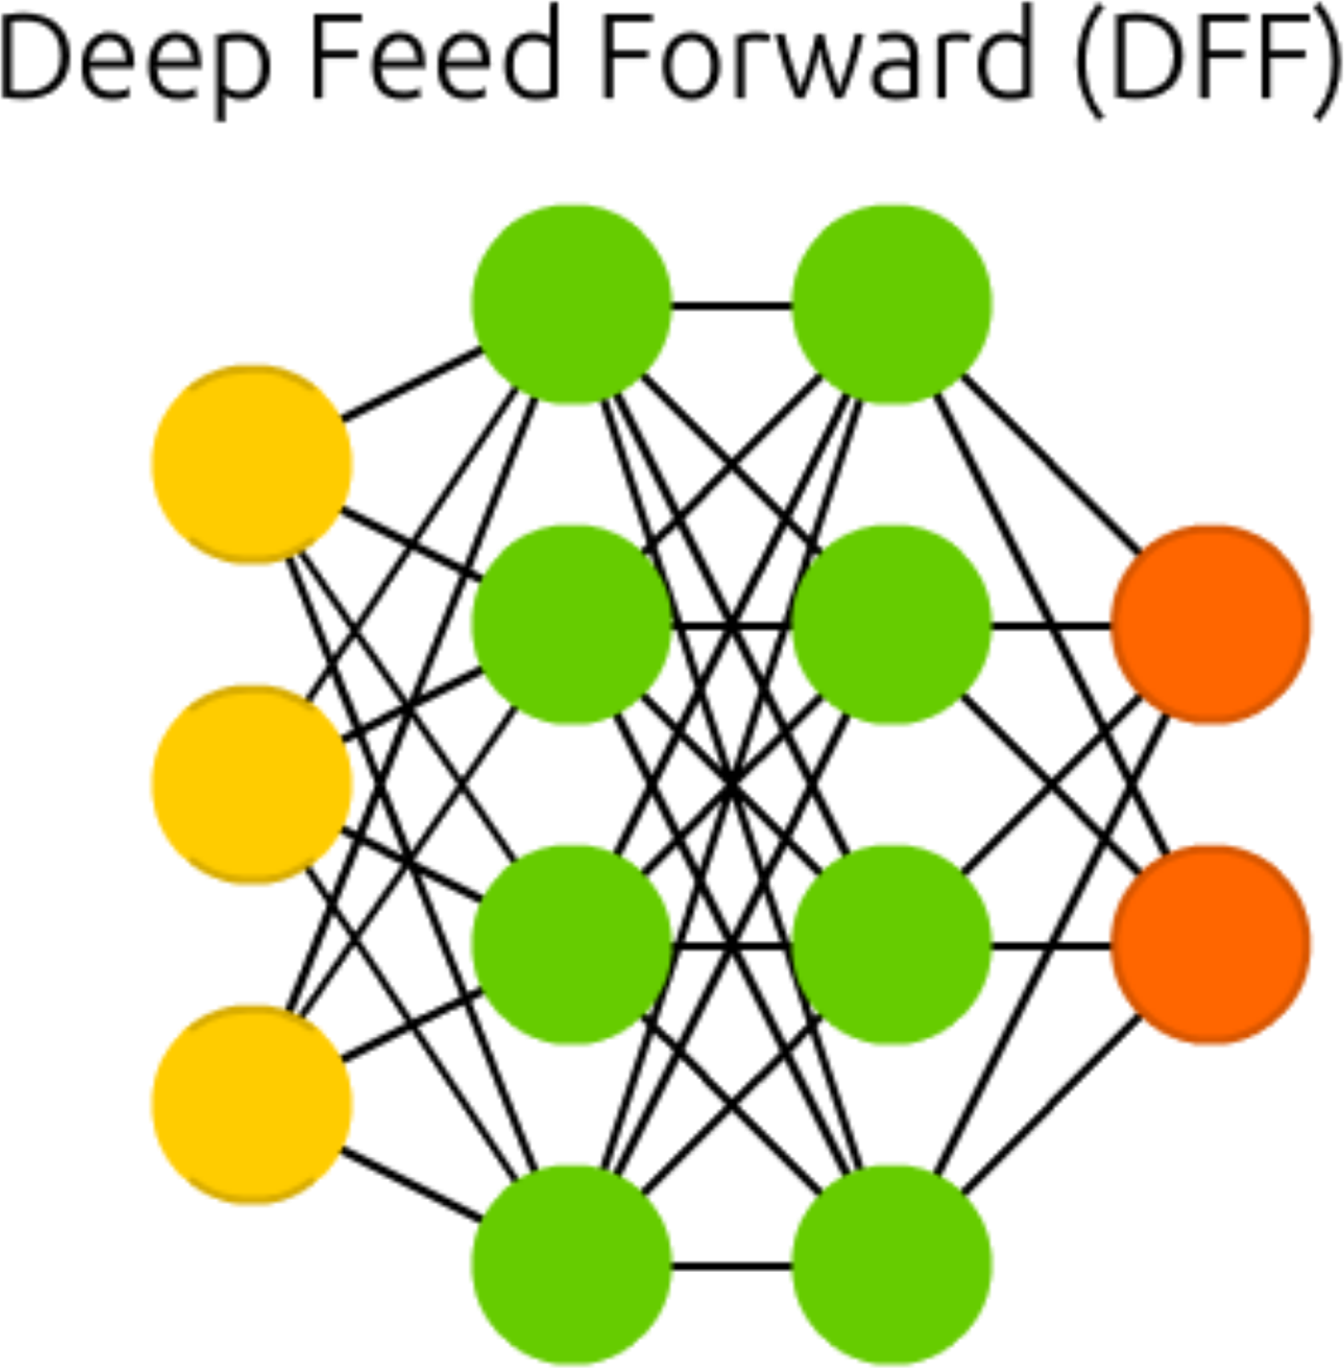
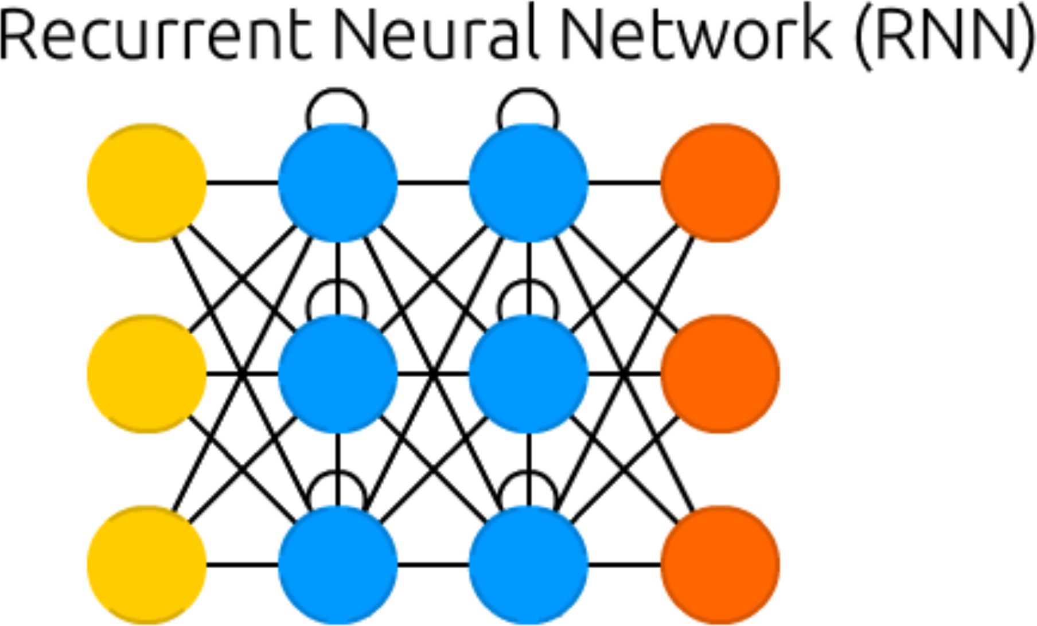
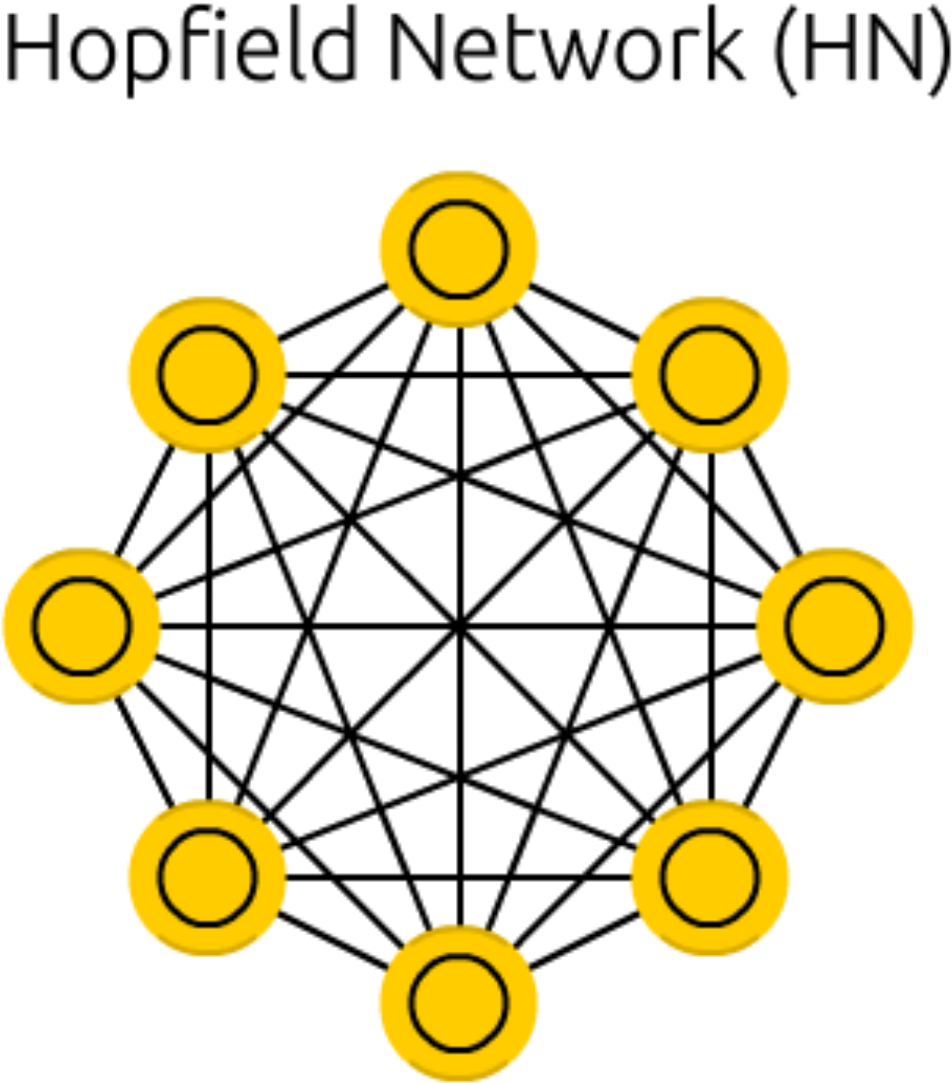


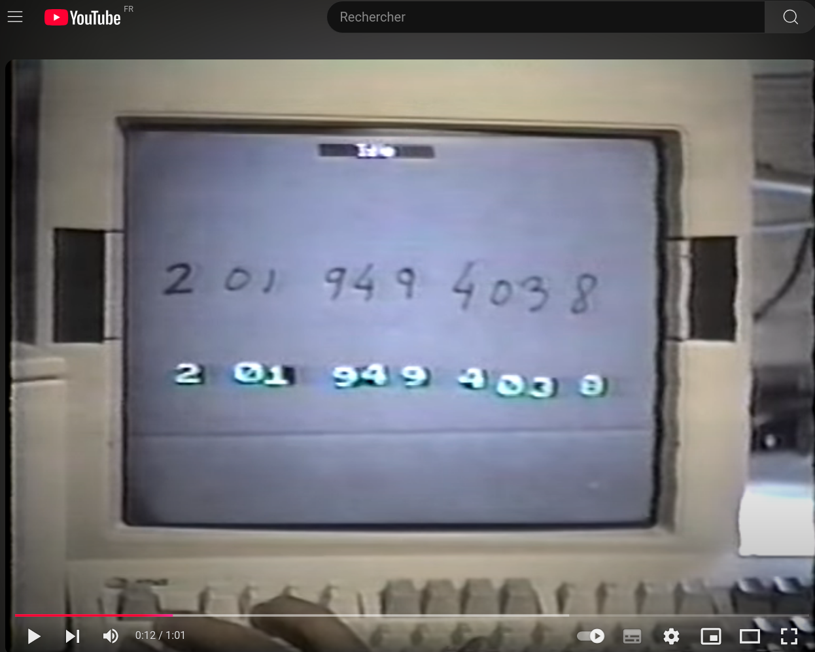
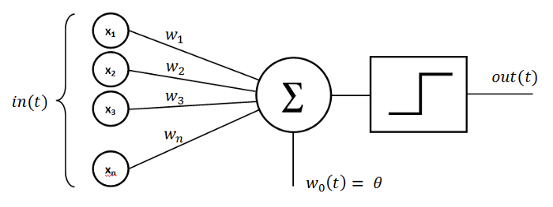
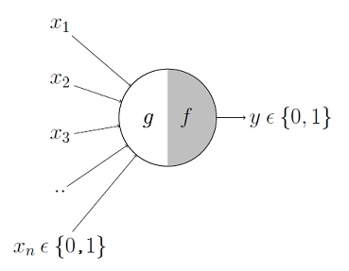
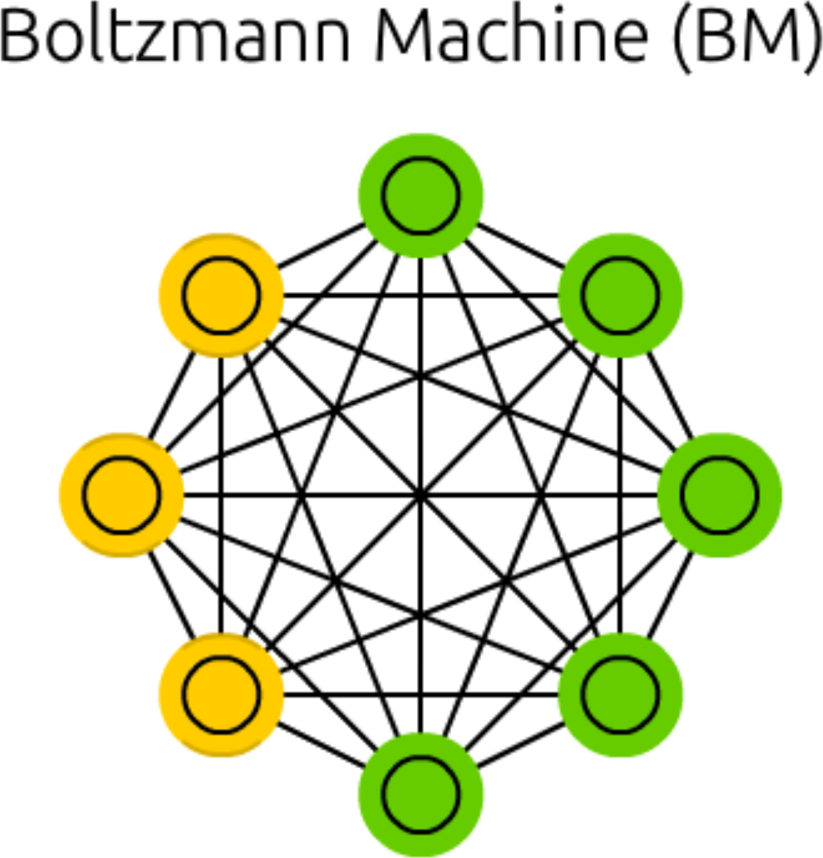
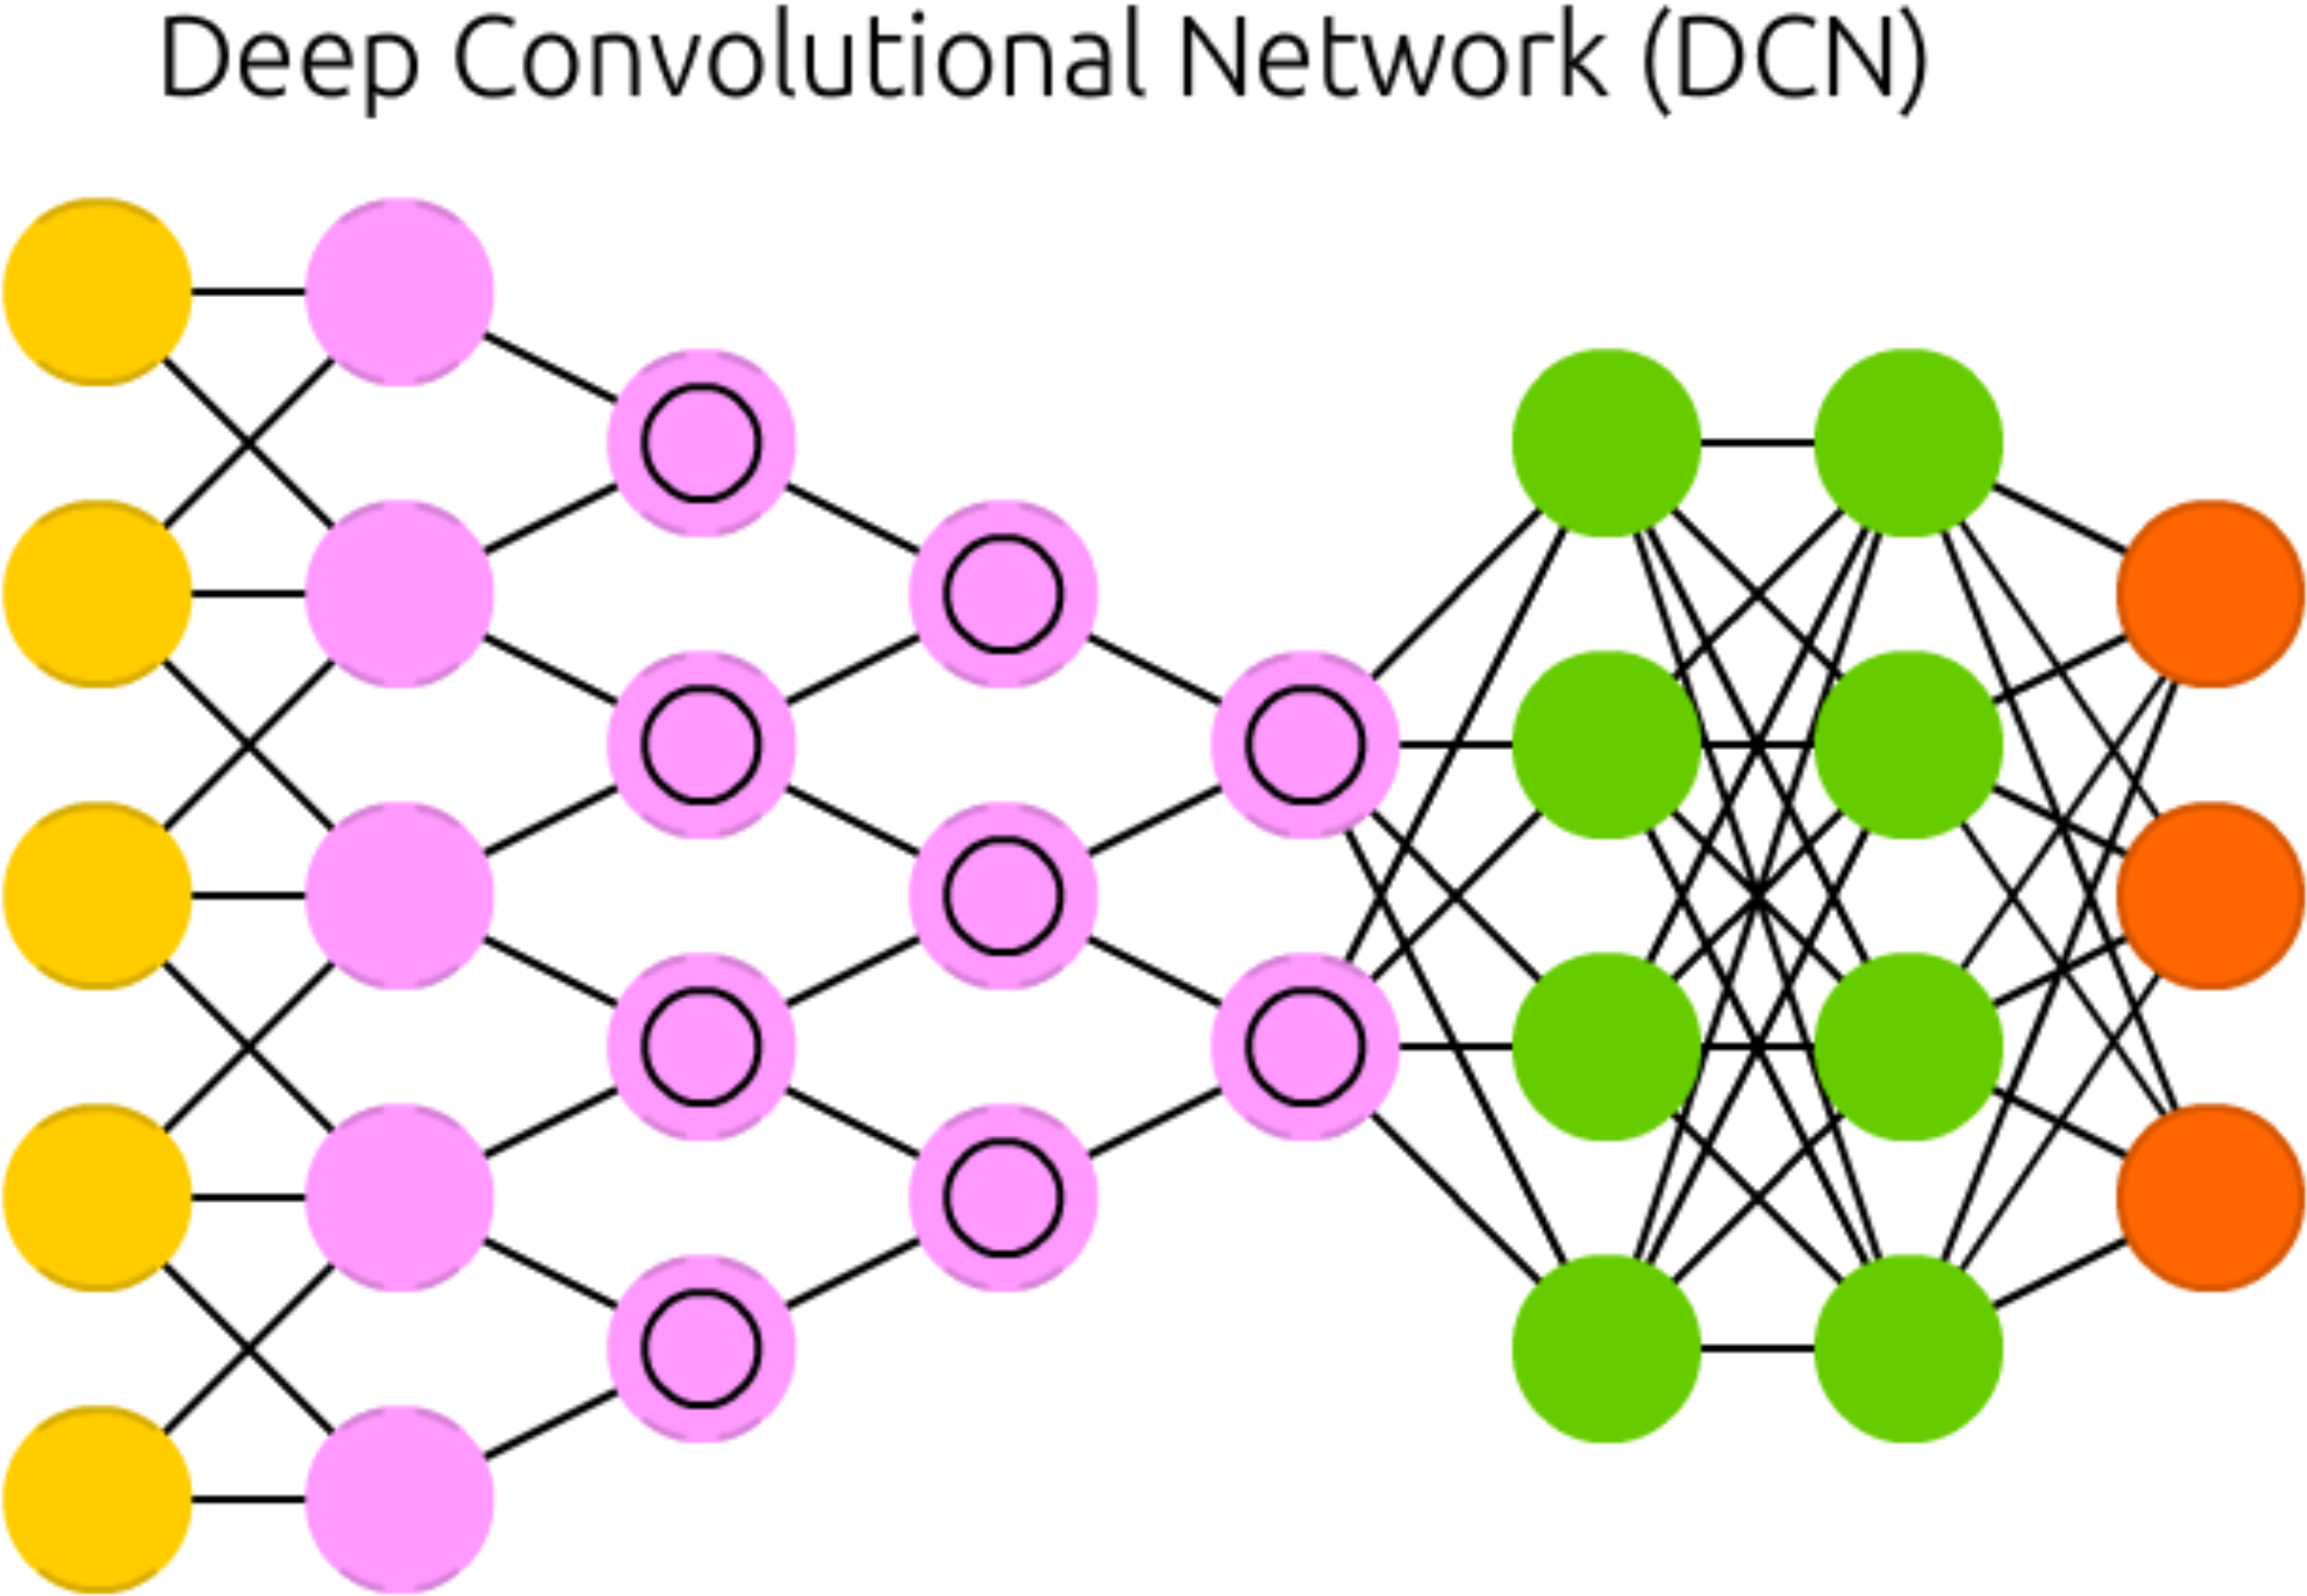
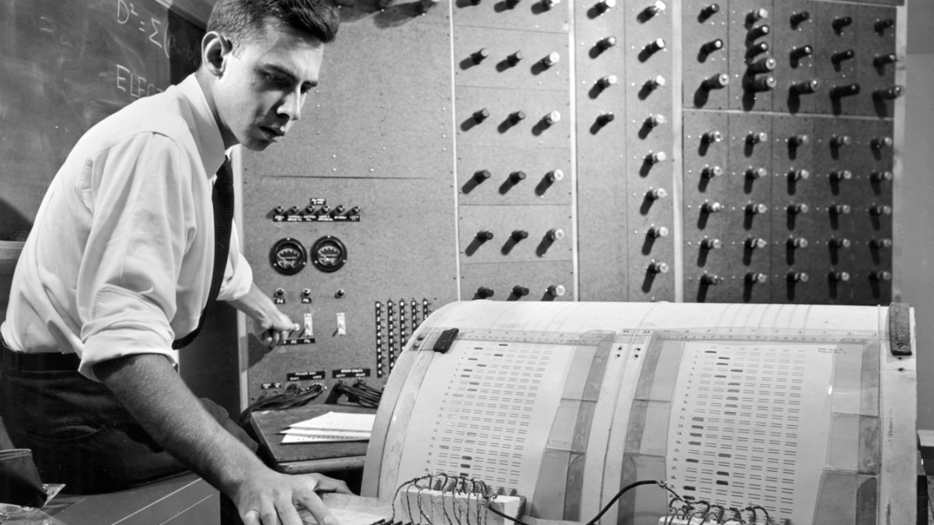
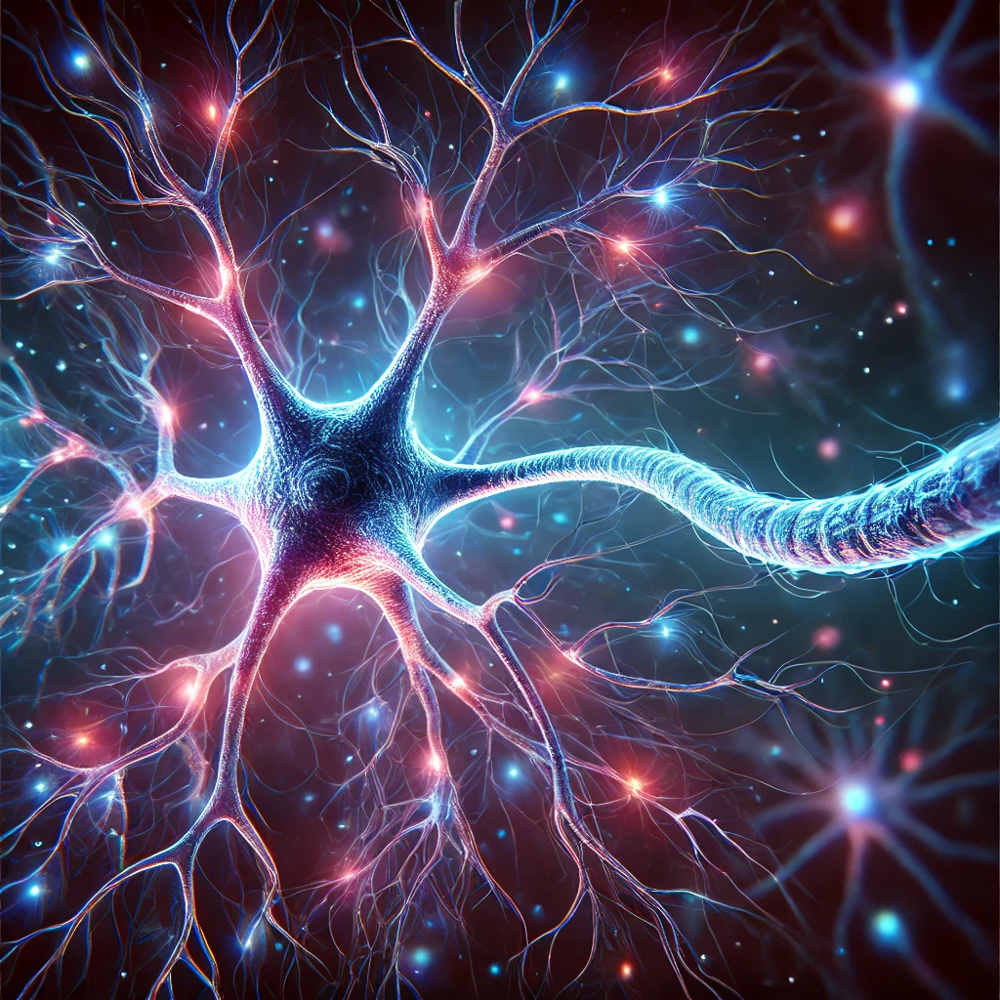
Outlook: data science and machine learning
Artificial Intelligence and Artificial Neural Networks (ANN) timeline
W. S. McCulloch & W. Pitts (1943)
A logical calculus of the ideas immanent in nervous activity
Bull. Math. Biophys. 5: 115-133
F. Rosenblatt (1958)
The perceptron: A probabilistic model for information storage and organization in the brain
Psychol. Rev. 65: 386-408
1950
Foundation of computation and intelligent algorithm
Turing
1986
Hidden layers
Rumelhart, Hinton & Williams
1986
Recurrent NN
Jordan
S. Linnainmaa (1970)
The representation of the cumulative rounding error of an algorithm as a Taylor expansion of the local rounding errors (Masters thesis, in Finnish), University of Helsinki. pp. 6–7
1943
Neural Nets
McCulloch & Pitt
1958
Perceptron model
Rosenblatt
1970
Backpropagation
Linnainmaa
1982
Hopfield network
Hopfield
1990
LeNet
LeCun
J. J. Hopfield (1982)
Neural networks and physical systems with emergent collective computational abilities
Proc. Natl. Acad. Sci. U S A. 79:2554
were the first to suggest that neural activity is computational
1985
Boltzmann machines
Ackley, Hinton & Sejnowski
D. H. Ackley, G. E. Hinton, G. E., T. J. Sejnowski (1985)
A learning algorithm for Boltzmann Machines
Cog. Sci. 9: 147
neuron
D. Rumelhart, G. Hinton & R. Williams (1986)
Learning representations by back-propagating errors
Nature 323: 533
positive or negative decision
M. I. Jordan (1986)
Serial order: A parallel distributed processing approach
ICS Report 8604. Institute for Cognitive Science, UCSD, La Jolla
Image made by R.P. with ChatGPT 4o, November 2024

Slide 8
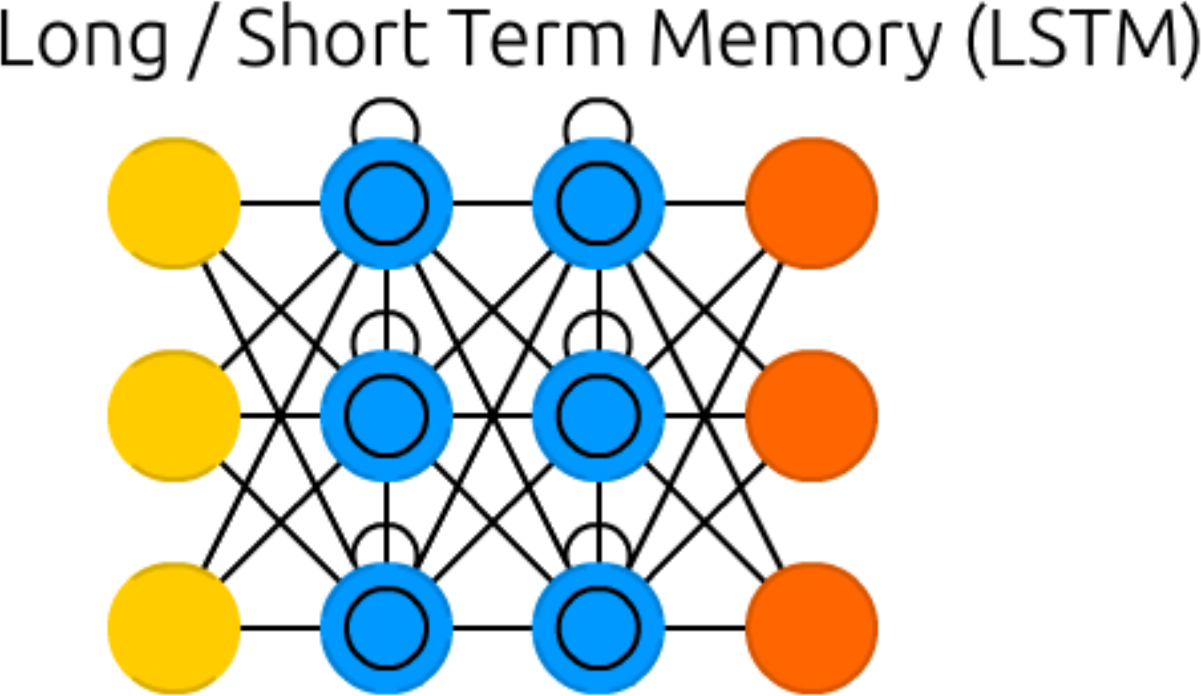
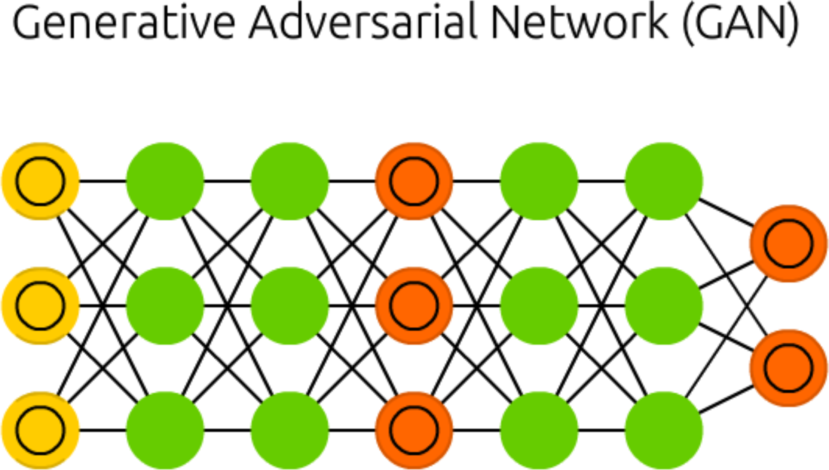
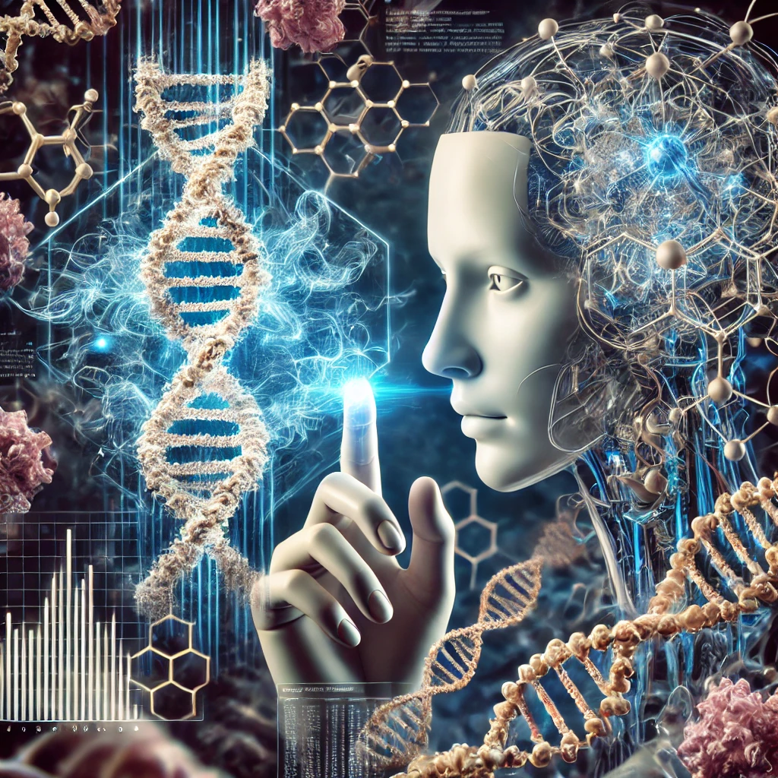

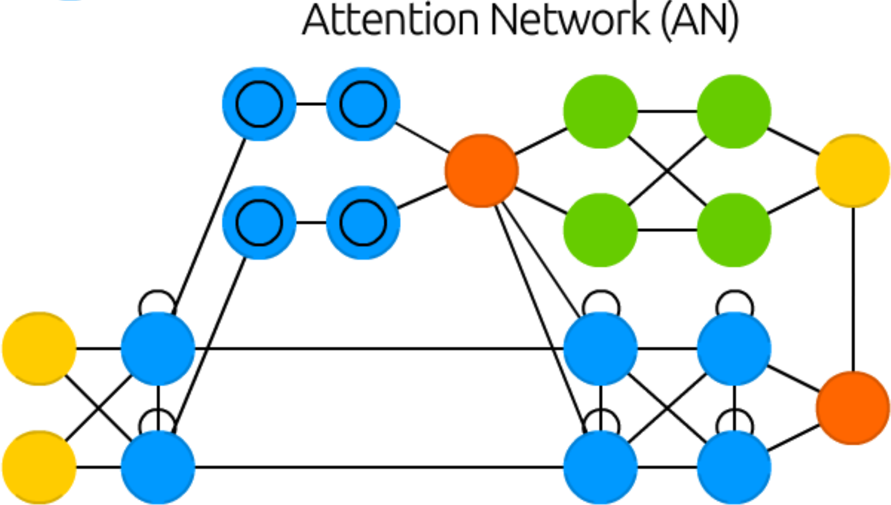
Outlook: data science and machine learning
Artificial Intelligence and Artificial Neural Networks (ANN) timeline
S. Hochreiter & J. Schmidhuber (1996)
LSTM can solve hard long time lag problems
Advances in Neural Information Processing Systems 9: Proceedings of The 1996 Conference, MIT Press 1997, p. 473
Levinthal's paradox solved!?
I. Goodfellow, J. Pouget-Abade, M. Mirza, B. Xu, D. Warde-Farley, S. Ozair, A. Courville, Y. Bengio (2014)
Generative Adversarial Nets. Proceedings of the International Conference on Neural Information Processing Systems (NIPS 2014), p. 2672
1996
LSTM RNN
Hochreiter & Schmidhuber
2014
GANs
Goodfellow
2018
AlphaFold 1
Google DeepMind
2024
AlphaFold 3
Google DeepMind
1990
LeNet
LeCun
2020
AlphaFold 2
Google DeepMind
A. Vaswani, N. Shazeer, N. Parmar, J. Uszkoreit, L. Jones, A. N. Gomez, Ł. Kaiser, I. Polosukhin (2017)
Attention is All you Need
in Advances in Neural Information Processing Systems. 30. Curran Associates, Inc.
2017
AlphaGo
Google DeepMind
J. Abramson, J. Adler, J. Dunger, R. Evans, T. Green, A. Pritzel, O. Ronneberger, L. Willmore, A. J. Ballard, J. Bambrick, S. W. Bodenstein, D. A. Evans, C.-C. Hung, M. O’Neill, D. Reiman, K. Tunyasuvunakool, Z. Wu, A. Žemgulytė, E. Arvaniti, C. Beattie, O. Bertolli, A. Bridgland, A. Cherepanov, M. Congreve, A. I. Cowen-Rivers, A. Cowie, M. Figurnov, F. B. Fuchs, H. Gladman, R. Jain, Y. A. Khan, C. M. R. Low, K. Perlin, A. Potapenko, P. Savy, S. Singh, A. Stecula, A. Thillaisundaram, C. Tong, S. Yakneen, E. D. Zhong, M. Zielinski, A. Žídek, V. Bapst, P. Kohli, M. Jaderberg, D. Hassabis & J. M. Jumper (2024)
Accurate structure prediction of biomolecular interactions with AlphaFold 3
Nature 630: 493
2017
Transformers, LLM
Google

Slide 9
Machine Learning

Slide 10
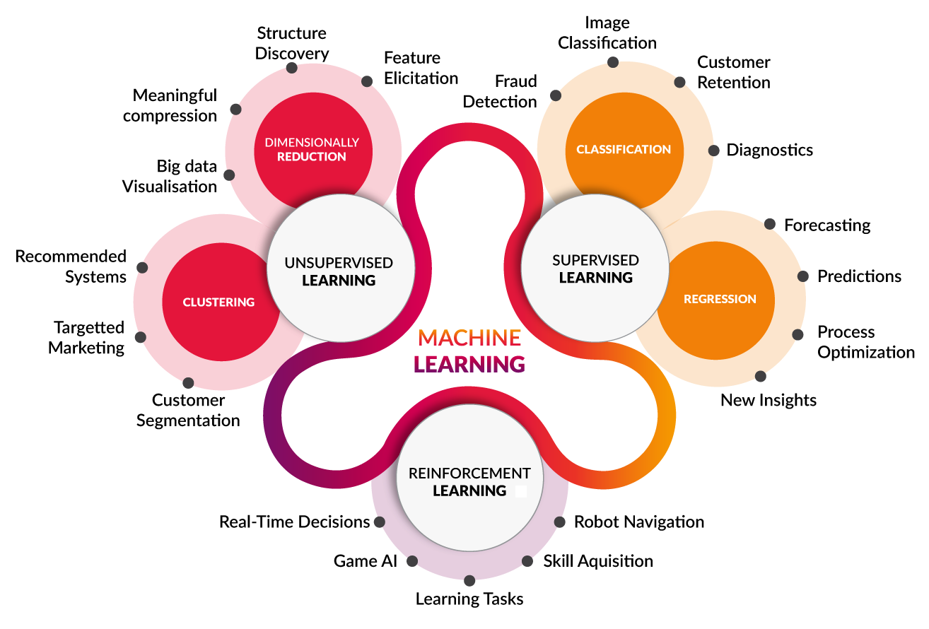
Machine learning
Learning from data alone
Learning from examples
https://towardsdatascience.com/coding-deep-learning-for-beginners-types-of-machine-learning-b9e651e1ed9d

Slide 11
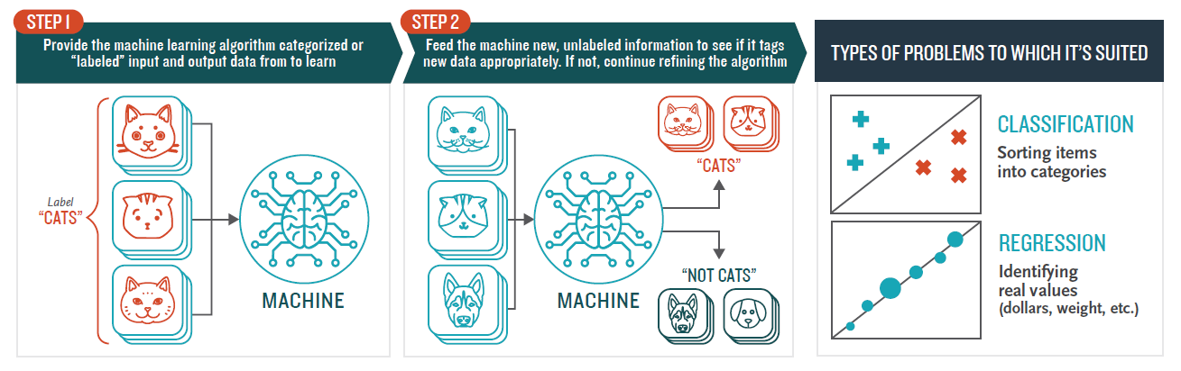
Machine learning
Supervised learning
Data are provided along with the desired output (i.e. labelled data)
Example of cats detection:
- collect thousands of images of cats
- draw a bounding box around each cat
- feed the entire dataset to the machine so it can learn all by itself
Learning from examples
https://towardsdatascience.com/wtf-is-machine-learning-a-quick-guide-39457e49c65b

Slide 12
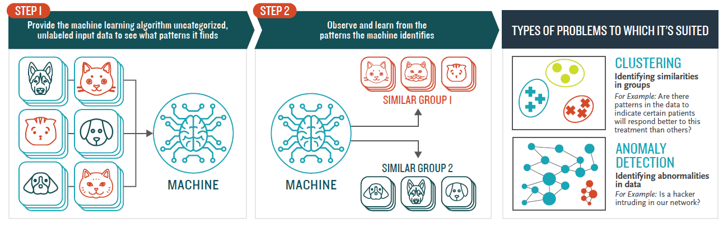
Machine learning
Unsupervised learning
Learning from data alone
- Just provide data
- Let the machine find out (or cluster) the patterns in the dataset
https://towardsdatascience.com/wtf-is-machine-learning-a-quick-guide-39457e49c65b

Slide 13
Machine Learning in Physical Chemistry

Slide 14
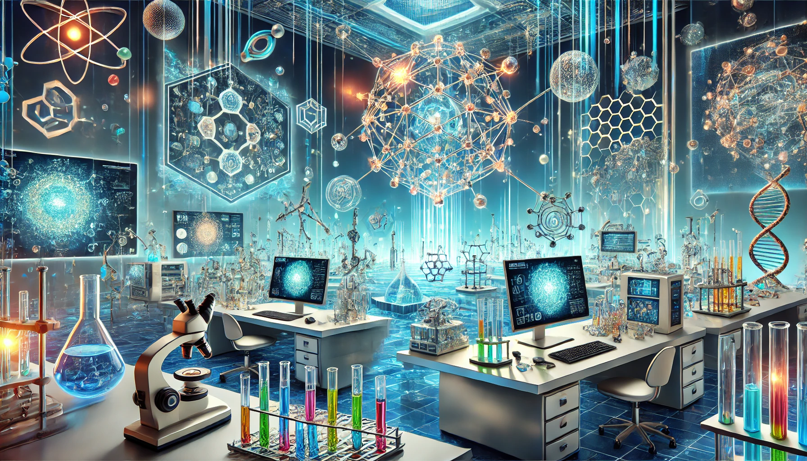
Transformative role of AI in sciences of matter research
Advanced Modeling
- Predictions comparable to ab initio calculations
- Simulations of physical and chemical processes at challenging scales
Design of Experiments
- Automated processing with robotic systems guided by AI and real-time analysis of experimental data
- Optimizing experimental setups through Design of Experiments (DoE)
Image made by R.P. with ChatGPT 4o, November 2024
Acceleration of Material Discovery
- Property prediction prior to laboratory synthesis
- Exploration of a broad parameter space
- Inverse design of materials
- Catalyst design
Data Exploration
- Detecting trends and anomalies using unsupervised methods
- Derive insights from diverse datasets like crystal structures or spectroscopy
Understanding mechanisms and multi-factorial processes through explainable AI (XAI)

Slide 15
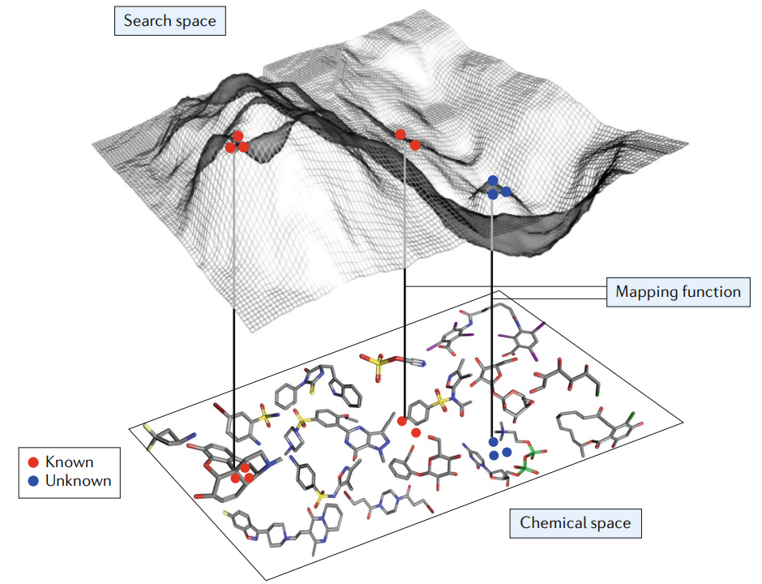

One of the numerous motivations: from data-rich chemistry to data-driven discovery
The chemical space is unimaginably vast
Experimental and quantum chemistry methods: accurate but slow or costly
Most of the chemical space remains unexplored
~ 10⁶⁰ drug-like molecules
The plan
- to exploit available data (experimental or DFT, small or large)
- to train data-driven models using ML
- and use explainability tools to open the black box of predictions
<numéro>
Gromski, P.S., Henson, A.B., Granda, J.M. et al. (2019) Nat Rev Chem 3: 119–128

Slide 16
Development of AI tools with python

Slide 17





















How to develop home-made ML tools?
The ML galaxy within is an exceptional ecosystem
Python is a high-level, interpreted, object-oriented, general-purpose programming language
https://scikit-learn.org/
https://keras.io/
https://www.tensorflow.org/
https://pytorch.org/
mathematica

Slide 18
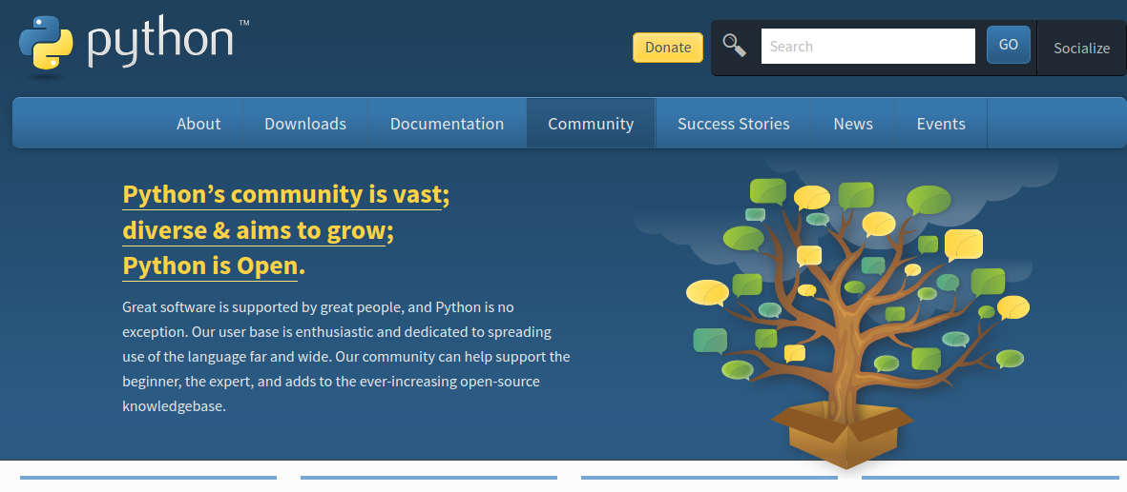
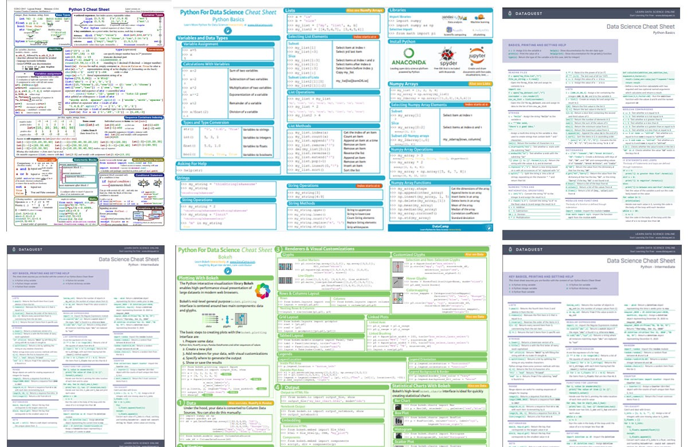
Python programming language
Using Python as an everyday tool for scientific calculation and computation
(it can even replace excel… by far)
→ basic knowledge of programming languages (variables, arrays, loops, conditional tests...)
→ enthusiastic and vast community
→ cheatsheets & cut/paste
Uneasy?
- yes and no
- important initial investment
- worth the effort

Slide 19


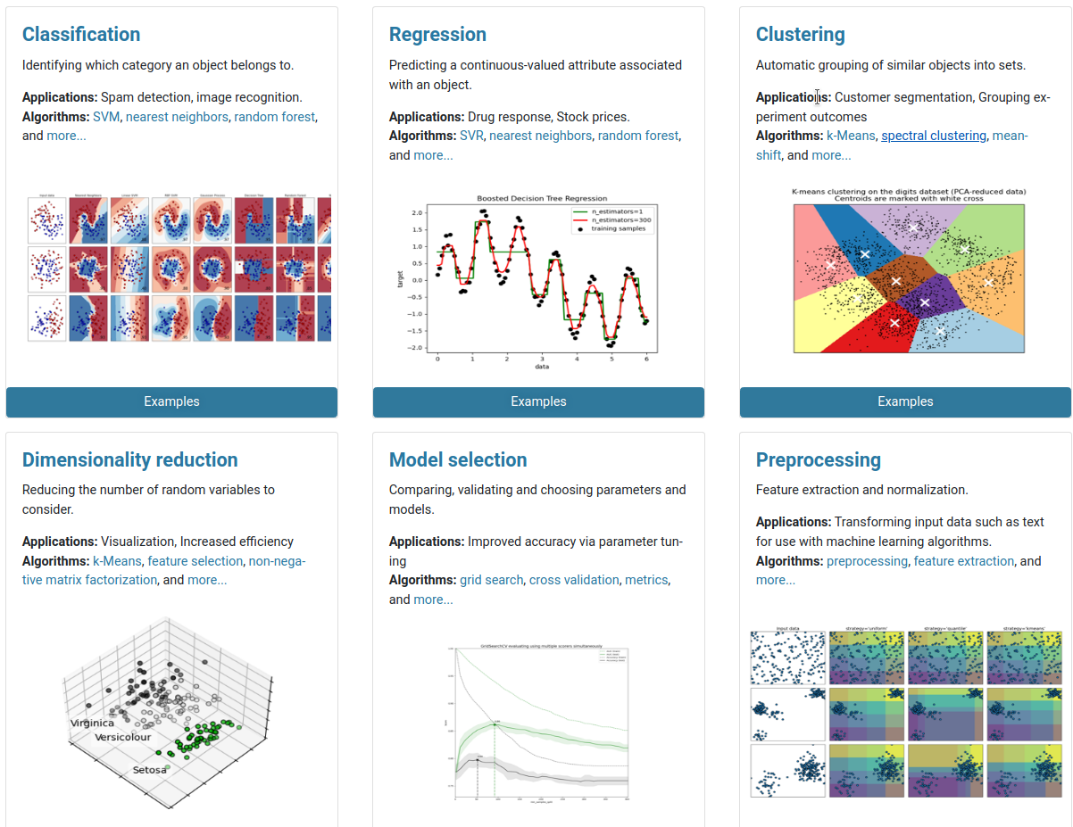
ML using the Python programming language
https://scikit-learn.org/
Machine learning in Python with scikit-learn
https://keras.io/
Simple and efficient tools for predictive data analysis
Accessible to everybody, and reusable in various contexts
Built on NumPy, SciPy, and matplotlib
High Level Deep Learning Application Programming Interface (API)
By François Cholet (Google)
Part on TensorFlow since 2017
MIT license (permissive free software license)
INRIA took leadership of the project and made the first public release on February 2010
3-clause BSD License (permissive free software license, compatible with the GNU GPL)
how to start?
import numpy as np
import tensorflow as tf
from tensorflow import keras
Google Brain's
second-generation system
Supported by Google
Low level API
Apache license (yet another permissive free software license)
https://www.tensorflow.org/

Slide 20
Python programming language or R software
https://pytorch.org/
From Torch library
Supported by Facebook
BSD licence
(permissive free software license)
An open source machine learning framework that accelerates the path from research prototyping to production deployment
Widely used in the field of AI research

Slide 21

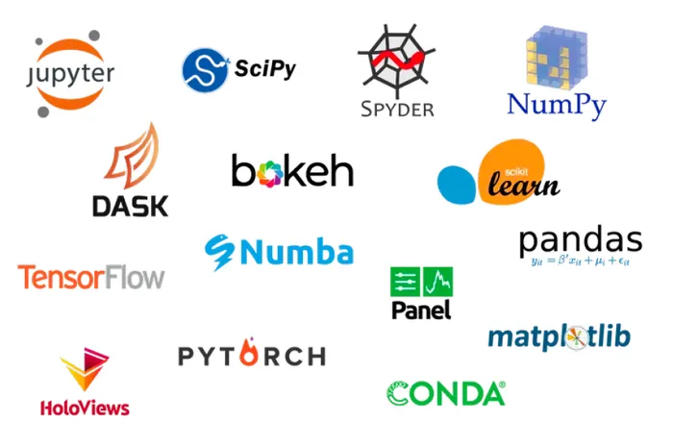

Python programming language
Anaconda is a distribution of the Python and R programming languages for scientific computing (data science, machine learning applications, large-scale data processing, predictive analytics, etc.), that aims to simplify package management and deployment
JupyterLab is a web-based interactive development environment for notebooks, code, and data
Users can arrange workflows in data science, scientific computing, and machine learning
you can save your everyday data manipulation / visualization as you do in your chemistry laboratory notebooks

Slide 22
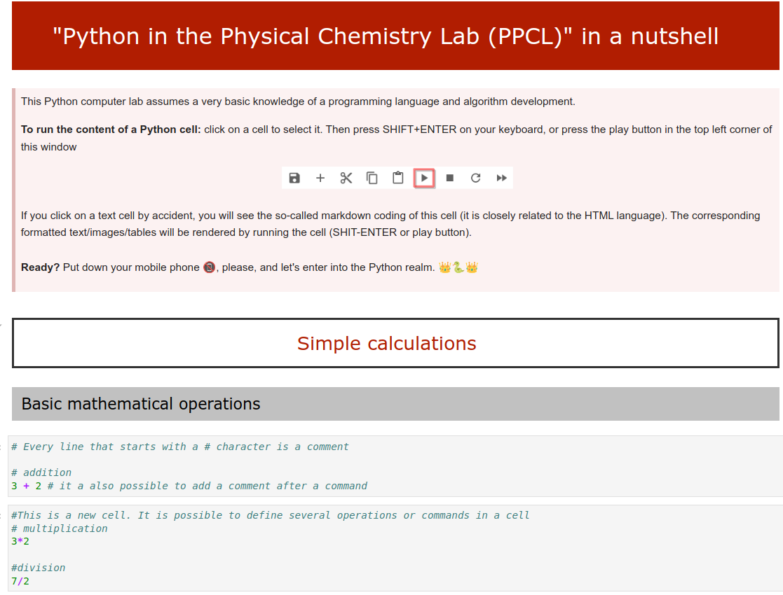
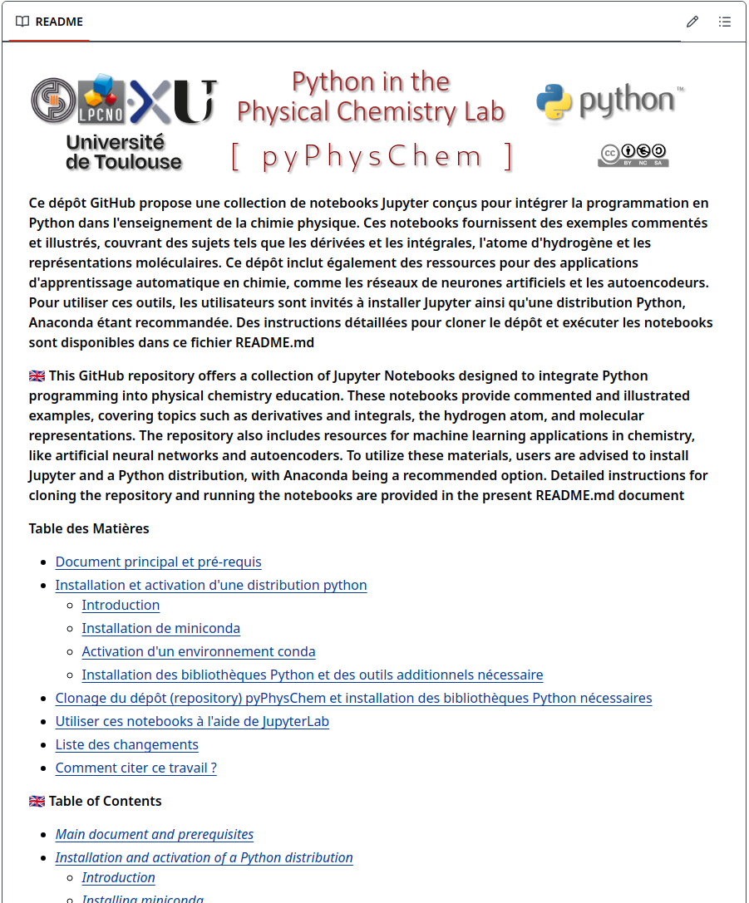
Python programming language
Not familiar with python… yet?
PPCL.ipynb
github repository
https://github.com/rpoteau/pyPhysChem
PPCL.ipynb

Slide 23
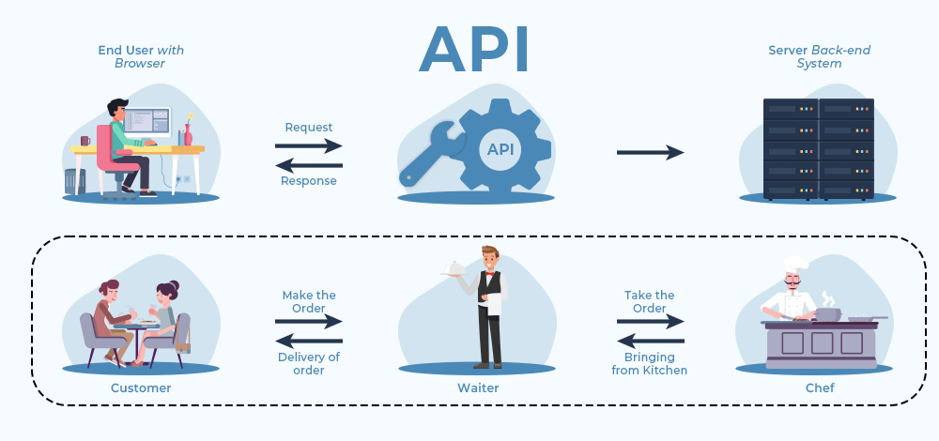
Python programming language: APIs
Most Python libraries expose powerful APIs that give access to advanced scientific tools
Analogy: an API is like a restaurant menu
You (the user) pick a dish → the request
The kitchen (the server) cooks it → the processing
The waiter (the API) brings it to your table → the response
You don’t need to know how the kitchen works or how to “flamber” a “crème brûlée” - you just need to read the menu (the API documentation)
Of course, having a bit of cooking knowledge helps: if you don’t know what “confit”, “al dente”, or “umami” means, your ordering experience may become… experimental. Same with APIs: a few basic programming, applied mathematics and [physical] chemistry notions prevent unexpected outcomes
Why APIs matter (for students and researchers)
1. Don’t reinvent the wheel
→ No need to re-implement algorithms or re-create datasets. Just use the API provided
2. Save time and reduce errors
→ APIs offer reliable, tested functionality
Example: solving a first- or second-order differential equation with scipy (integrate.solve_ivp) instead of coding your own numerical solver from scratch
3. Access complex resources
→ APIs connect you to huge databases (Materials Project, PubChem,...), remote servers, or specialised software (rdkit,...) that would be impossible to handle directly
4. Standardized communication
→ An API defines a clear, documented way to interact with a service. Everyone uses the same rules
5. Interoperability
→ APIs allow Python to interact with code in C, Fortran, Java, or with remote web services, without worrying about the underlying complexity
6. Rapid prototyping
→ APIs work like Lego bricks: you can quickly assemble advanced tools and test scientific ideas or proof-of-concepts with only “a few” lines of code

Slide 24
Python programming language
gAIs provide assistance to the development of simple or even advanced python codes
Opportunities / Useful Applications
Rapid prototyping of scientific workflows
Data parsing and mining, visualization, automation, small ML pipelines
Assistance for complex coding tasks
DFT parsing, spectroscopy analysis, HPC workflows, error-handling...
Automatic documentation & code explanations
Docstrings, comments, restructuring legacy scripts
Debugging support
Identifying logical errors, improving robustness, optimizing performance
Bridging multi-disciplinary knowledge
Linking chemistry concepts with algorithmic implementations
Risks / Limitations
Hallucinations and subtle errors
Syntactically correct but chemically or physically wrong code
Overtrust in outputs
Risk of using unverified code in production or scientific publications
Data leakage / confidentiality concerns
(if code or sensitive data are pasted in public LLMs)
Environmental impact
Training and inference of large models have a non-negligible carbon footprint
Loss of skill development
If over-used as a substitute for critical thinking instead of a tool
gAIs can accelerate code development, but the scientist remains responsible for validation, interpretation, and critical checking and thinking

Slide 25
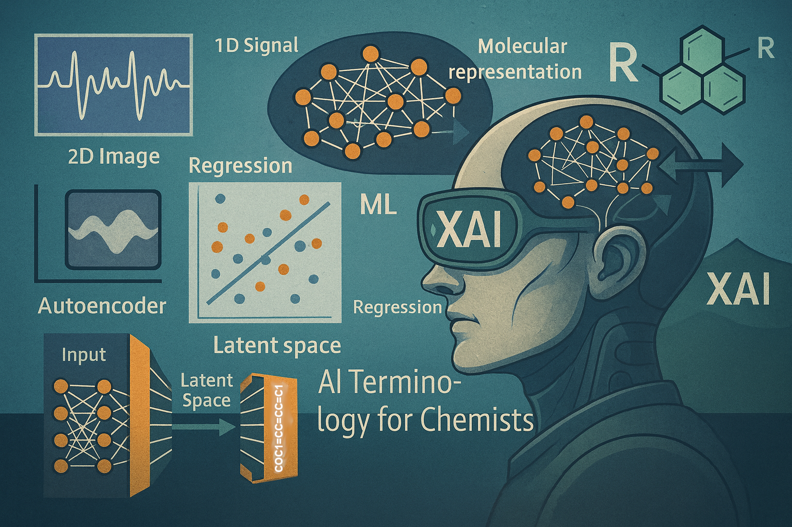

Typical workflow – with a bit of xAI
ML-Glossary.ipynb

Slide 26

General context
1D array
SAMPLES, each of them being described by
physical or chemical descriptors[*]
(or features)
ML algorithm
1D array
Output...
Regression
or
Classification
⁝
⁝
[*] electron-counting rules, local aromaticity, HOMO-LUMO gaps, d-band centers, Fermi energy, global or local structural parameters, atomic charges, electron density, BDE, experimental spectrum, kinetic curve, thermal conductivity, heat capacity, resistivity, ductility,….

Slide 27









Strategy
What did the model learn?
Which data ?
How much?
Explainable AI tools to see through the black box models
Collect data
Validate model performance
on new data
Analyze and format data
Hidden patterns?
Train and optimize models
Which algorithm?

Slide 28
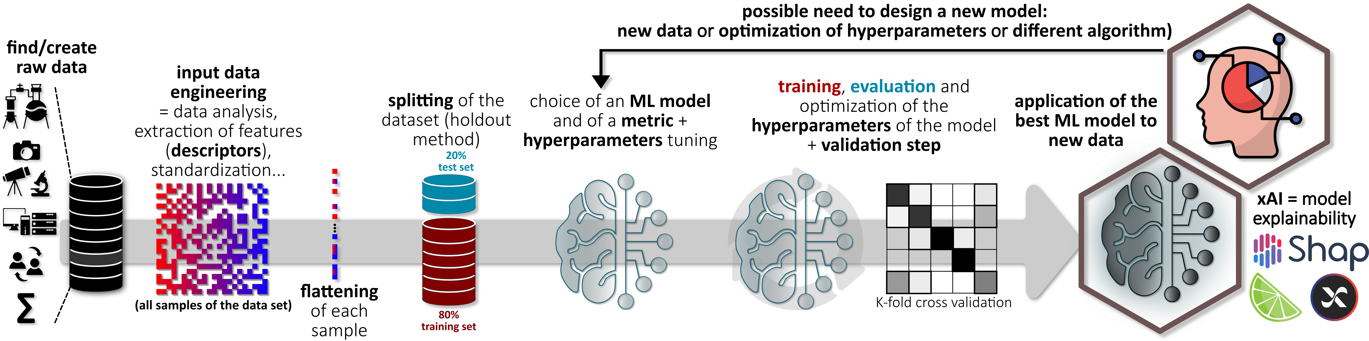

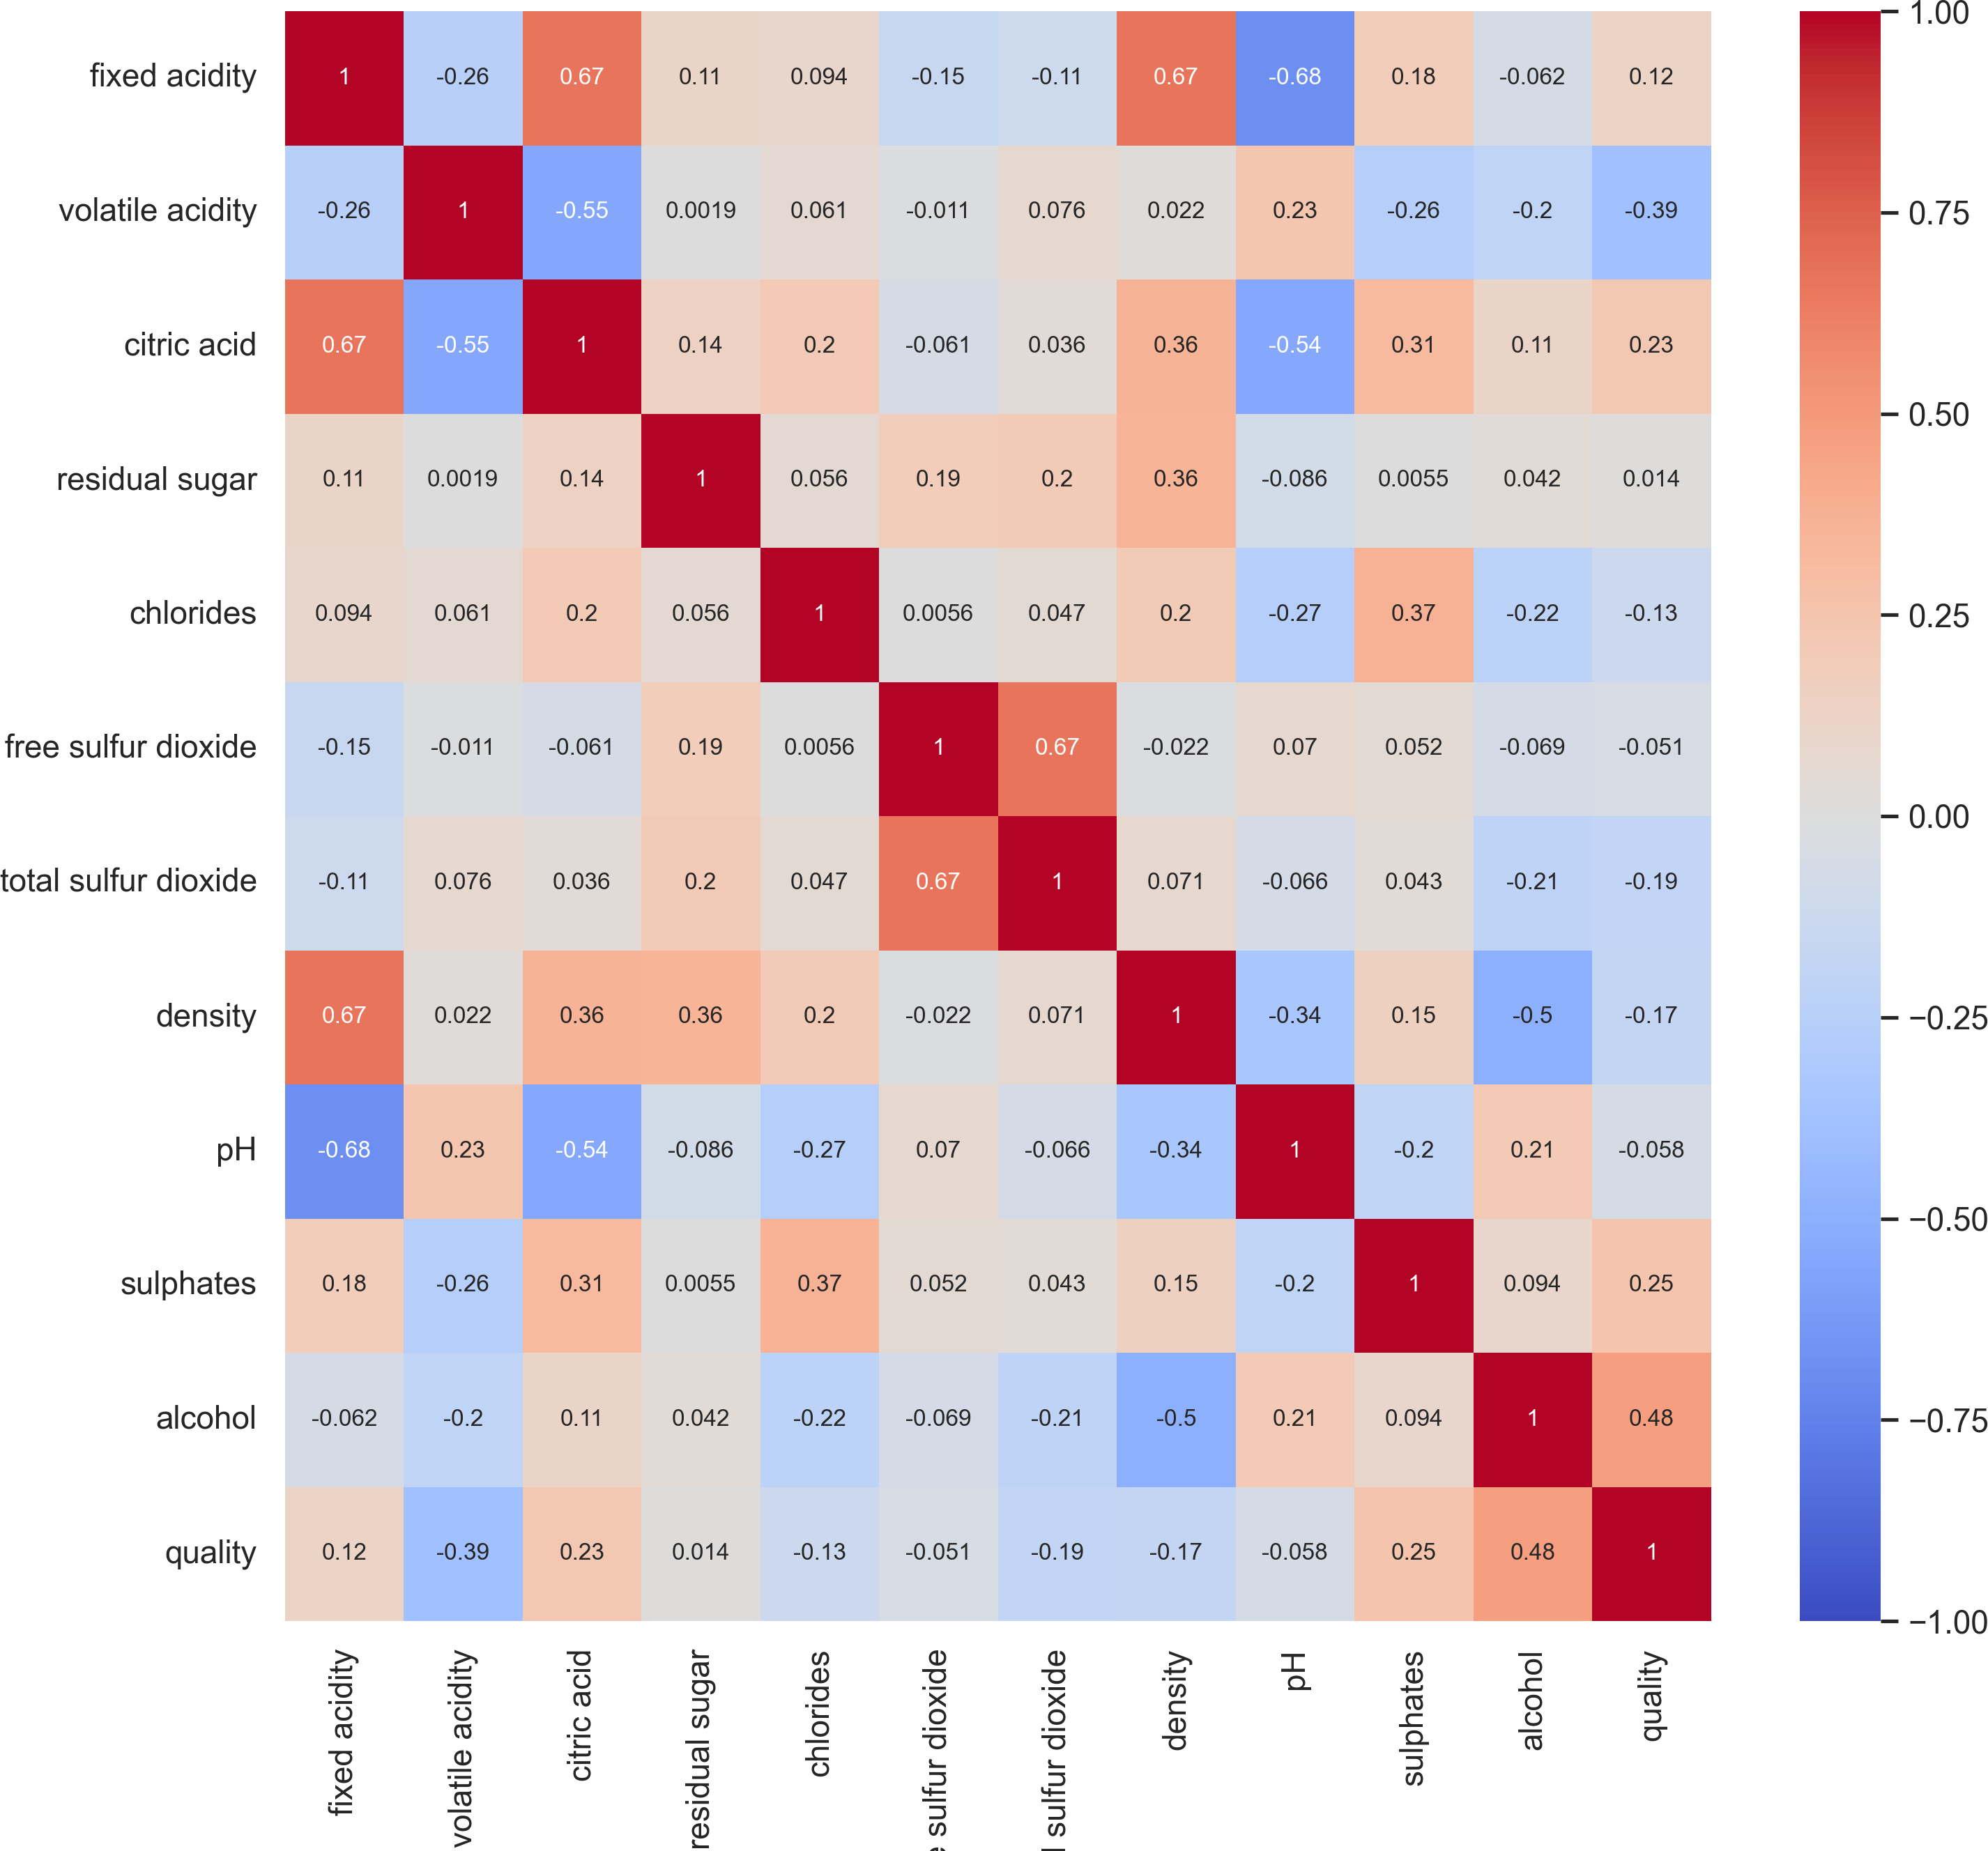
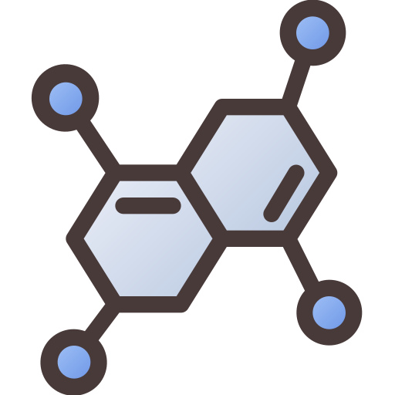
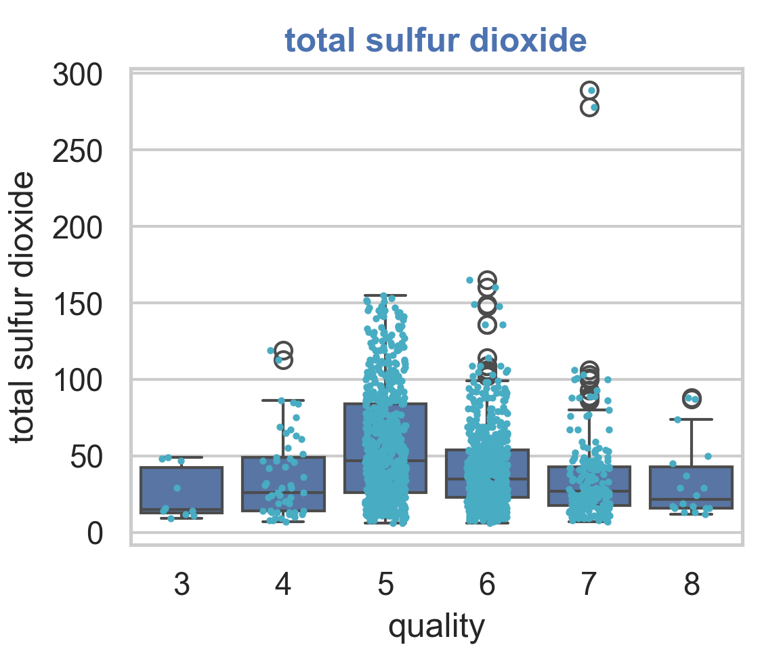


Simplified – but recommended – workflow
Data analysis & feature engineering
Exploratory Data Analysis
Understanding the Dataset
Data Quality Assessment
Molecular case: conversion of molecular structures into descriptors that numerically represent their features, e.g. vectors
format and transform the raw data into a machine-readable form
[0,0,1,0,1]
MolecularRepresentations.ipynb
Notes:
- Figure std

Slide 29
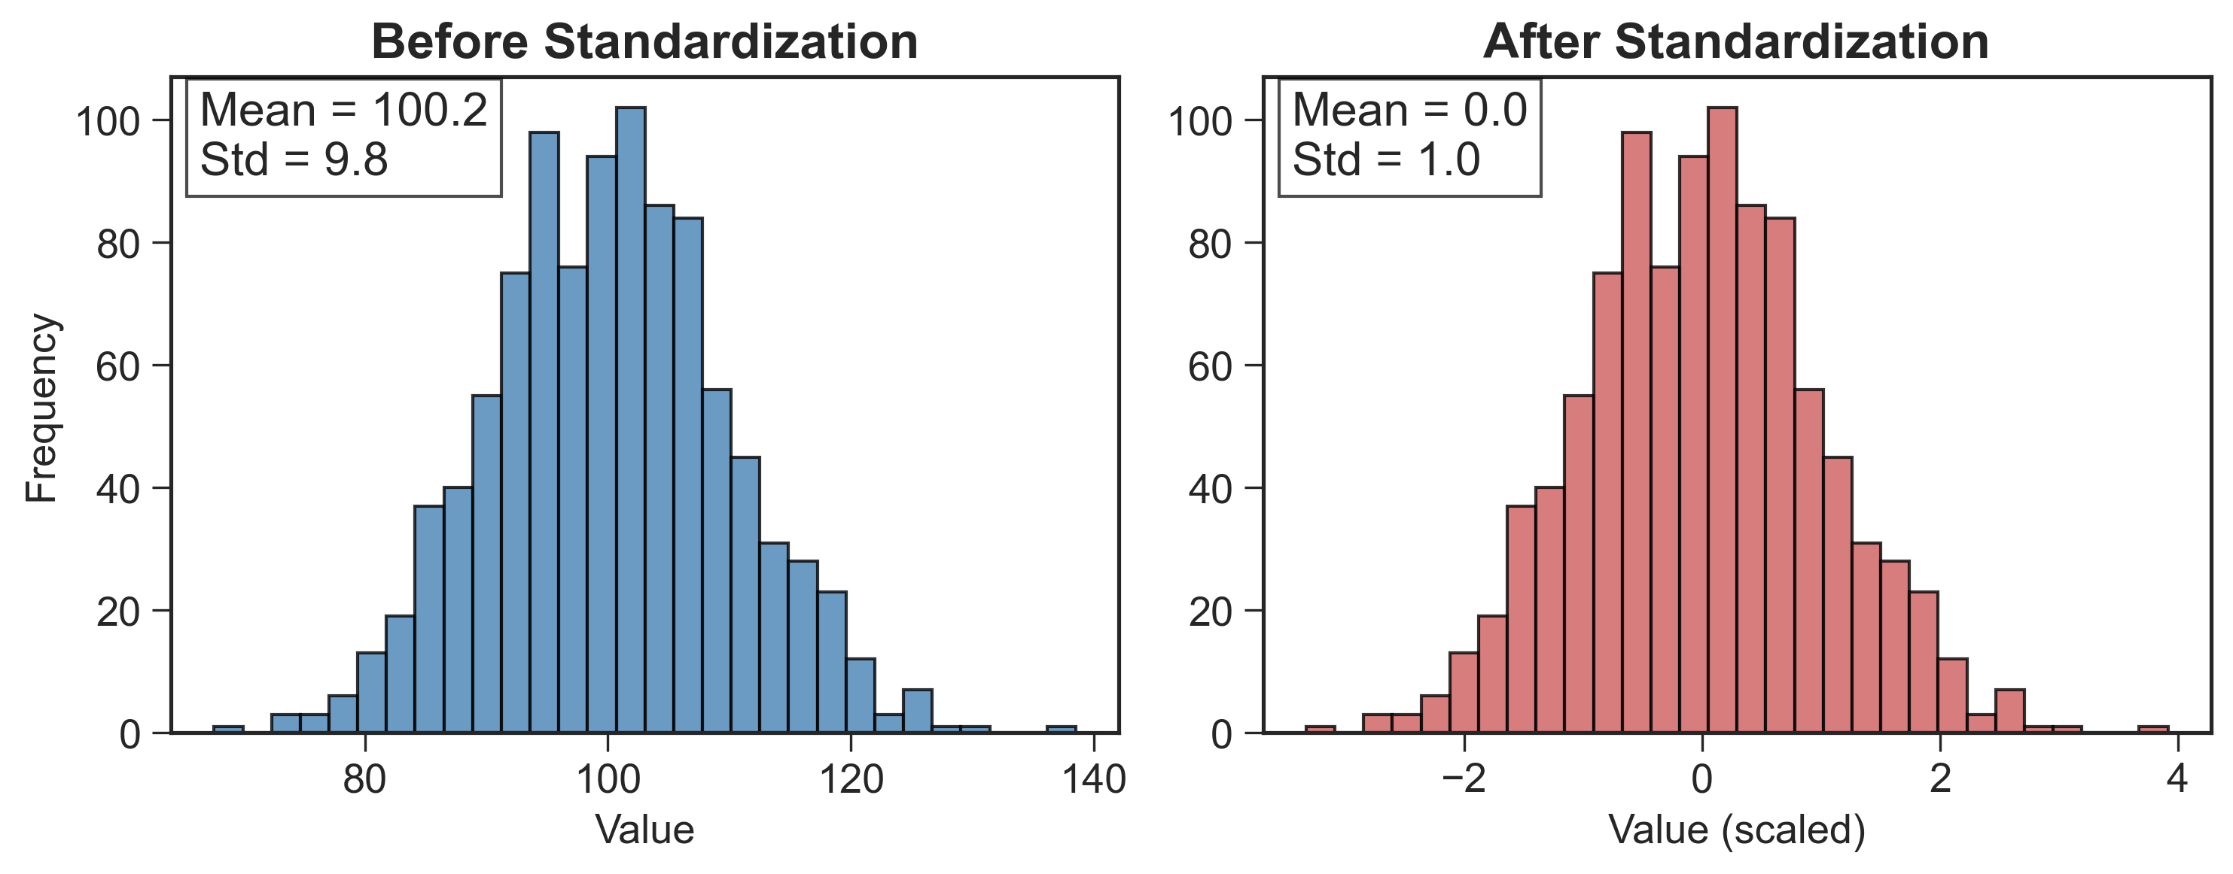

Simplified – but recommended – workflow
Data analysis & feature engineering
format and transform the raw data into a machine-readable form
data standardization
DS4B-Iris3.ipynb, DS4B-CO2_solubility-ANN.ipynb
Notes:
- Figure std

Slide 30
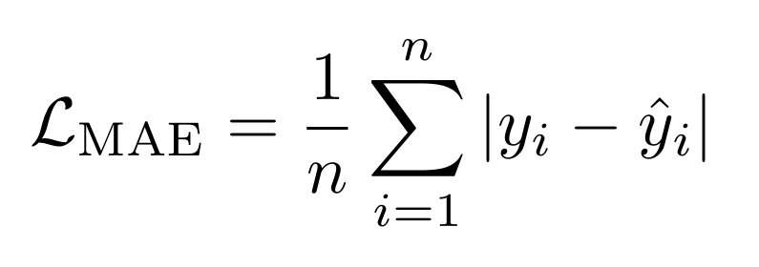
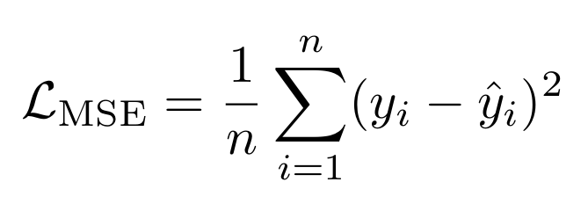
Simplified – but recommended – workflow
Choice of an algorithm & of its hyperparameters
Supervised learning
we want the model to learn the relationship between input features/descriptors (X) and outputs - target (Y)
We split the data:
  80 % for training → to teach the model
  20 % for test → to check how well it learned on new data
Hyperparameters? e.g. number of neurons, number of neuron layers...
Usual metrics (=loss function)
Notes:
In supervised learning we want the model to capture the relationship between features and target ppty – TALK ABT OVERFITTING

Slide 31
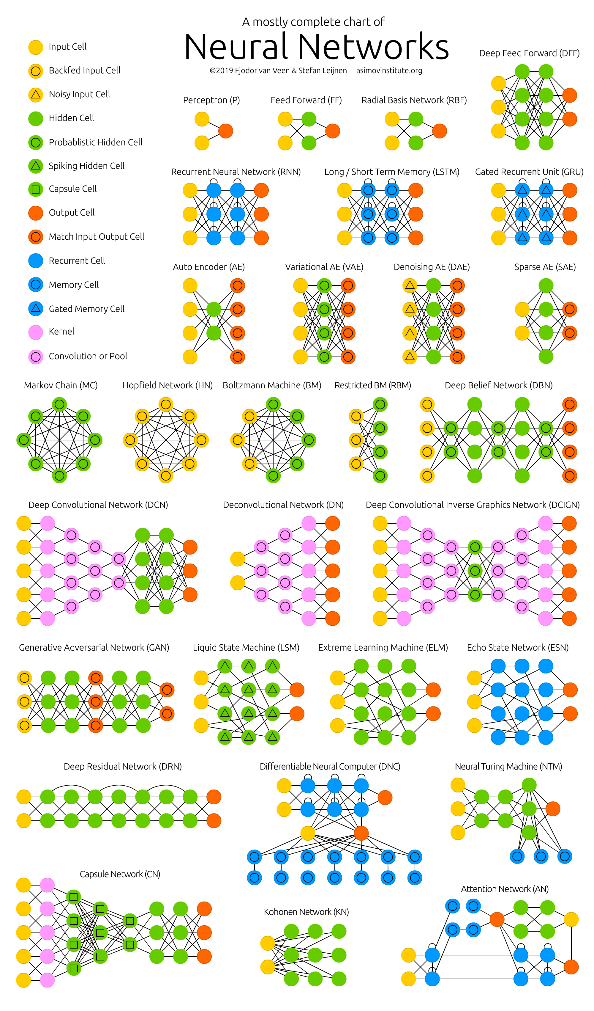
Simplified – but recommended – workflow
Choice of an algorithm: zoo of neural networks (NN)
DS4B-BasicsOfANN.ipynb, DS4B-CO2_solubility-ANN.ipynb (& ML-1DCNN.ipynb, ML-2DCNN.ipynb, ML-RNN.ipynb, ML-Autoencoders.ipynb)
Notes:
In supervised learning we want the model to capture the relationship between features and target ppty – TALK ABT OVERFITTING

Slide 32

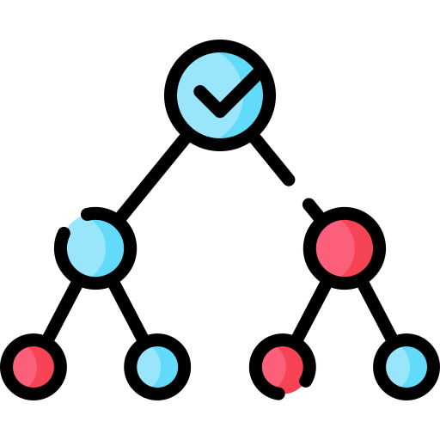
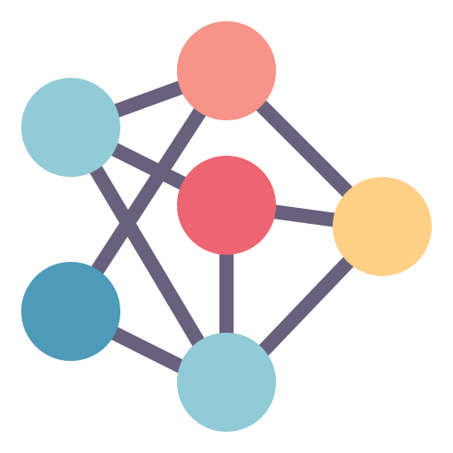



Simplified – but recommended – workflow
Choice of an algorithm: neuron-free algorithms
🟦 Linear methods
Fit a straight line through the data
Simple, fast, interpretable
Only for linear relationships
🟩 Kernel-based methods
Use a mathematical trick to capture non-linear patterns
Flexible, good for small datasets
Computationally expensive for large data
🟧 Tree-based methods
Make rule-based “if–then” decisions
Power + interpretability, good for small datasets
Cannot extrapolate, instability
🟥 Neural networks
Stack layers of “neurons” to learn complex patterns
Very powerful for large datasets
Need a lot of data, overfitting risk
kernel
Examples:
Linear regression
Ridge regression
Examples:
Support Vector Machines
Support Vector Regressors
Examples:
Decision Trees
Random Forests
Examples:
Deep Neural Networks
Autoencoders...
Notes:
1. Linear methods
🟦 Idea: Fit a straight line (or plane) through the data
→ Simple, fast, interpretable
(e.g. Linear Regression, Logistic Regression)
2. Kernel-based methods
🟩 Idea: Still linear — but in a transformed space
→ Can capture non-linear patterns
(e.g. Support Vector Machines / SVR)
3. Tree-based methods
🟧 Idea: Make if–then decisions based on feature values
→ Handle non-linearities, easy to interpret
(e.g. Decision Trees, Random Forests)
4. Neural networks
🟥 Idea: Layers of “artificial neurons” combine inputs to learn complex relationships
→ Very flexible, suited for large datasets
(e.g. Deep Learning models)
5. Bagging / Ensembles
🟨 Idea: Combine multiple models to get a stronger one
→ Reduces variance, improves robustness
(e.g. Random Forest = many decision trees)

Slide 33
Simplified – but recommended – workflow
🟦 Linear methods
Fit a straight line through the data
🟩 Kernel-based methods
Use a mathematical trick to capture non-linear patterns
🟧 Tree-based methods
Make rule-based “if–then” decisions
🟥 Neural networks
Stack layers of “neurons” to learn complex patterns
kernel
Examples:
Linear regression
Ridge regression
Examples:
Support Vector Machines
Support Vector Regressors
Examples:
Decision Tree
Random Forest
Examples:
Deep Neural Networks
Autoencoders
⬛ Bagging (Bootstrap Aggregating)
Train several models on random subsets of the data.
Then average their predictions.
Example: SVR-bagging = multiple SVRs trained on different samples, predictions averaged.
ML-10algorithms-AppliedToChemistry.ipynb
Notes:
Aller plus vite !
1. Linear methods
🟦 Idea: Fit a straight line (or plane) through the data
→ Simple, fast, interpretable
(e.g. Linear Regression, Logistic Regression)
2. Kernel-based methods
🟩 Idea: Still linear — but in a transformed space
→ Can capture non-linear patterns
(e.g. Support Vector Machines / SVR)
3. Tree-based methods
🟧 Idea: Make if–then decisions based on feature values
→ Handle non-linearities, easy to interpret
(e.g. Decision Trees, Random Forests)
4. Neural networks
🟥 Idea: Layers of “artificial neurons” combine inputs to learn complex relationships
→ Very flexible, suited for large datasets
(e.g. Deep Learning models)
5. Bagging / Ensembles
🟨 Idea: Combine multiple models to get a stronger one
→ Reduces variance, improves robustness
(e.g. Random Forest = many decision trees)

Slide 34
Simplified – but recommended – workflow
Model training – Supervised learning
We want the model to learn the relationship between input features/descriptors (X) and outputs - target (Y)
The model makes predictions Ŷ
Learning process: minimizing the error between actual values (Y) and pedicted values (Ŷ) by adjusting the model’s internal parameters
It can be iterative (NN case) or analytical (linear least square fit case)
Notes:
In supervised learning we want the model to capture the relationship between features and target ppty – TALK ABT OVERFITTING

Slide 35
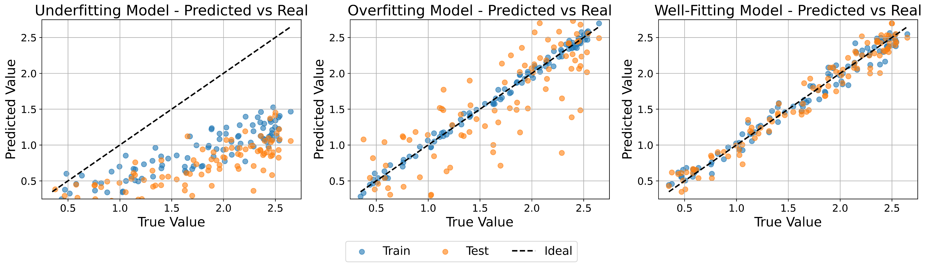
Simplified – but recommended – workflow
Model evaluation – at the end of the training process. Regression case
The model is too simple, fails to capture patterns in the training data → poor on both training and test sets
The model is too complex, memorizes the training data
→ good on training but poor on new data
The model captures the main trends in the data → good performance and generalization
Performance can possibly be improved by changing the hyperparameters of the model
DS4B-BasicsOfANN.ipynb
Notes:
In supervised learning we want the model to capture the relationship between features and target ppty – TALK ABT OVERFITTING

Slide 36
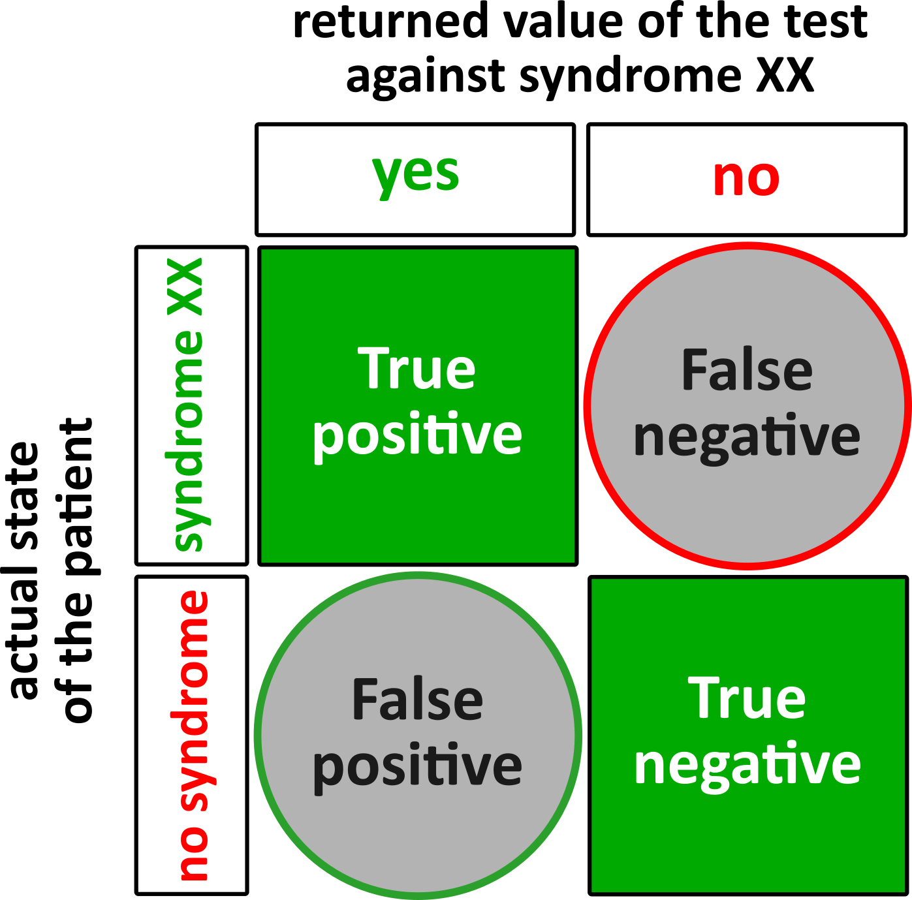
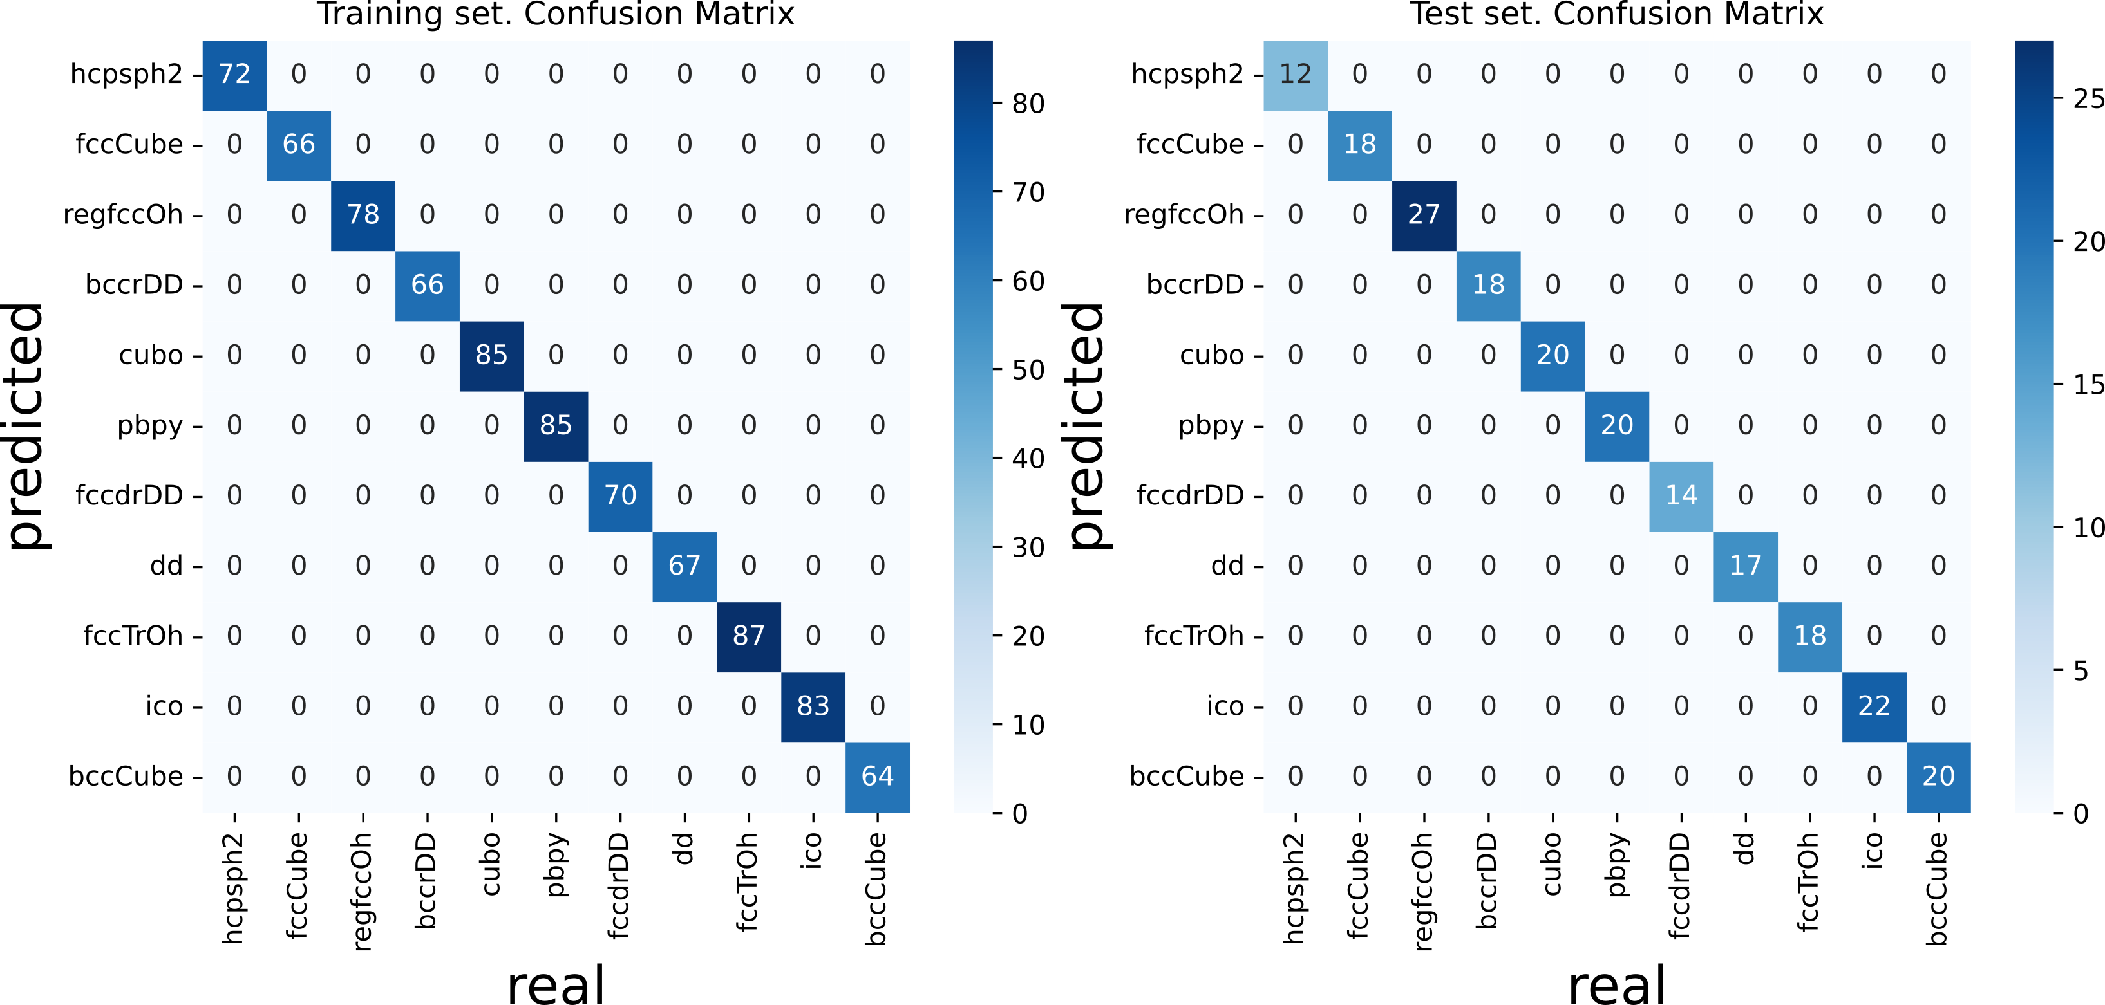
Simplified – but recommended – workflow
Model evaluation – at the end of the training process. Classification case
consists in plotting confusion matrices (CMs)
A confusion matrix is a 2×2 table (for binary classification) comparing the model’s predictions to the true labels
Same logic as a biological/medical diagnostic test for a syndrome
- A sensitive test minimizes false negatives → good for dangerous syndromes
- A specific test minimizes false positives → good when false alarms are costly
- ML models behave exactly like diagnostic tests: threshold tuning shifts balance between sensitivity and specificity
CM generalizes naturally to
multi-class classification
Training set
Test set
2x2 case
DS4B-Iris3.ipynb
Notes:
In supervised learning we want the model to capture the relationship between features and target ppty – TALK ABT OVERFITTING

Slide 37
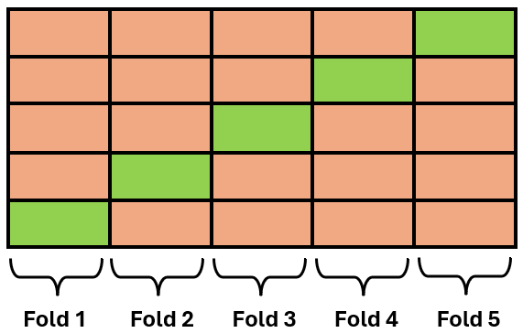


Simplified – but recommended – workflow
Model validation
Cross-Validation
Training
Testing
Generalizability?
Extrapolation
New “challenging” sets of data
DS4B-CO2_solubility-ANN.ipynb
Notes:
CV preparer une phrase concise: train and test the model multiple times on different data splits to get a trustworthy measure of performance.

Slide 38
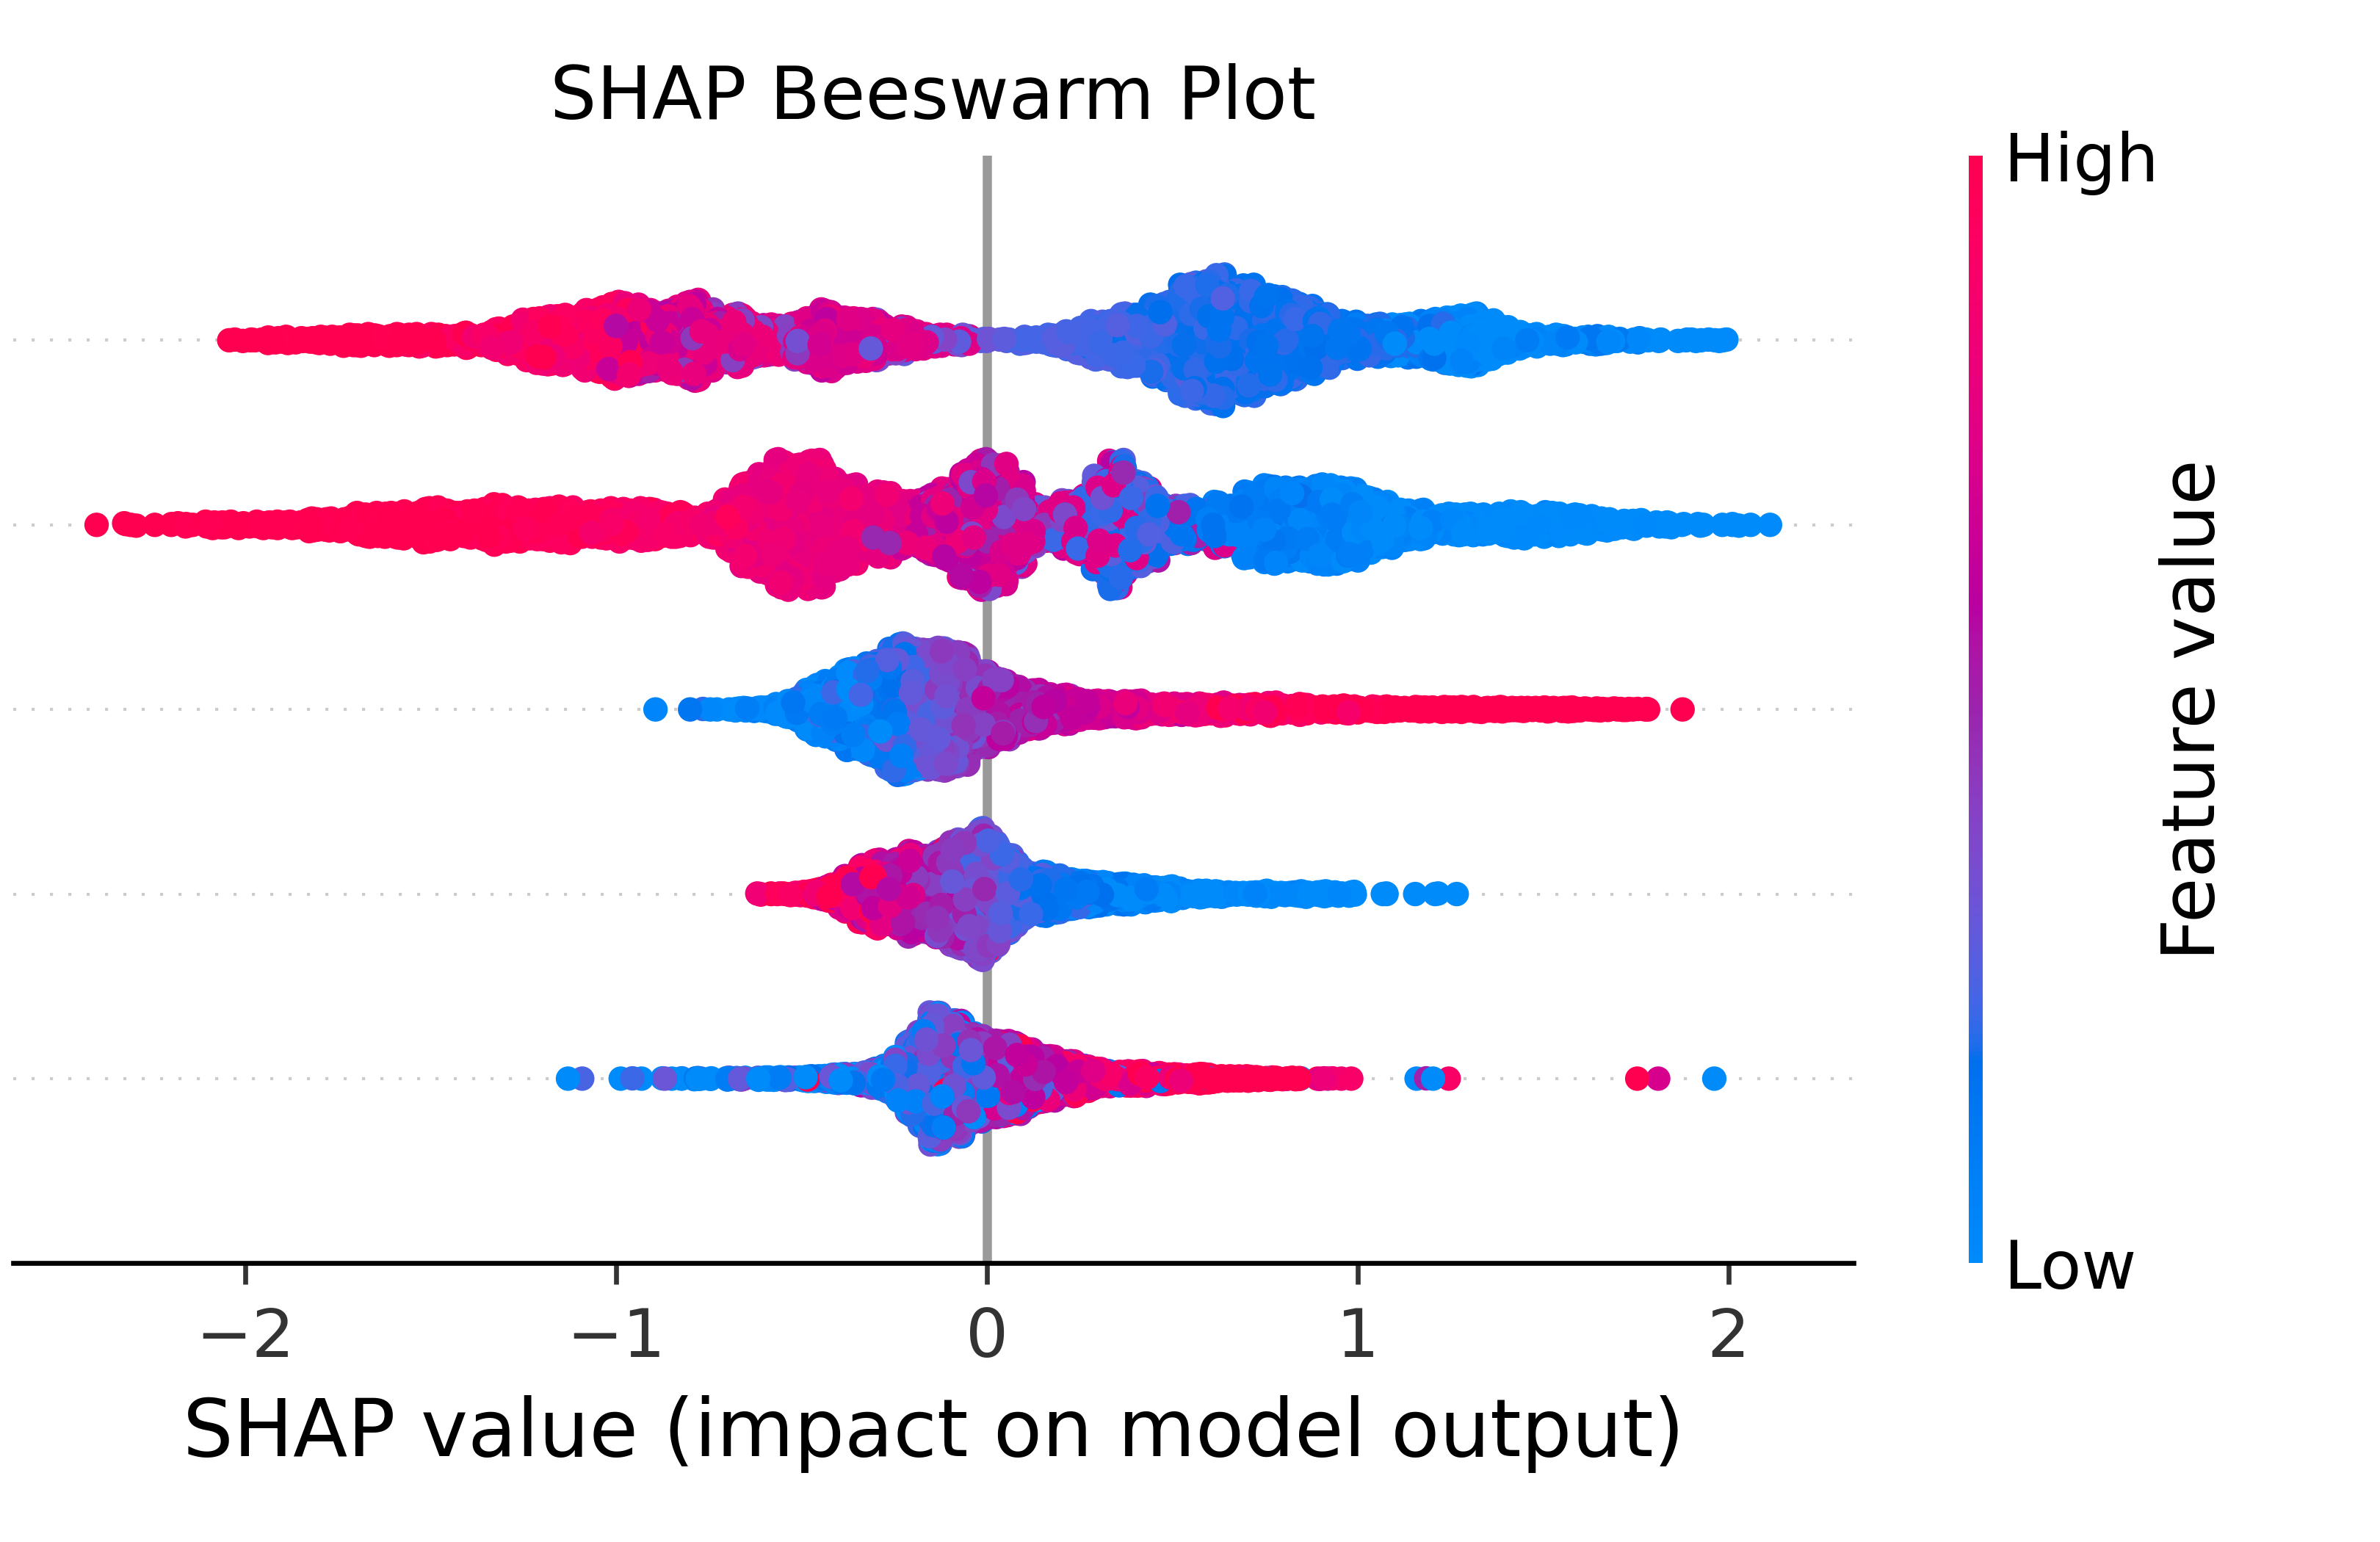
Simplified – but recommended – workflow
Model explainability = eXplainable AI (xAI)
Feature importance
Ensures that predictions are chemically grounded and trustworthy
Prediction variation with varying descriptor values
Might encourage to consider another model
Feature 1
Feature 2
Feature 3
Feature 4
Feature 5
DS4B-Iris4.ipynb, ML-2DCNN.ipynb
Notes:
Workflow
Detail each step of it for both projects
Explainability !

Slide 39
How many data?
There is no single magic number
Data requirements vary by several orders of magnitude depending on whether you are building a generalist “chemical brain” or a specialized expert tool
Typically
Generalist AI: 10⁹. Example = LLMs that can understanding the language and concepts of chemistry
Specialist AI: 10⁶. Example = Proprietary databases of chemical reactions
Expert AI: 10³. Example = Structure-Activity Relationships (SAR)
Don’t forget: quality is better than quantity

Slide 40
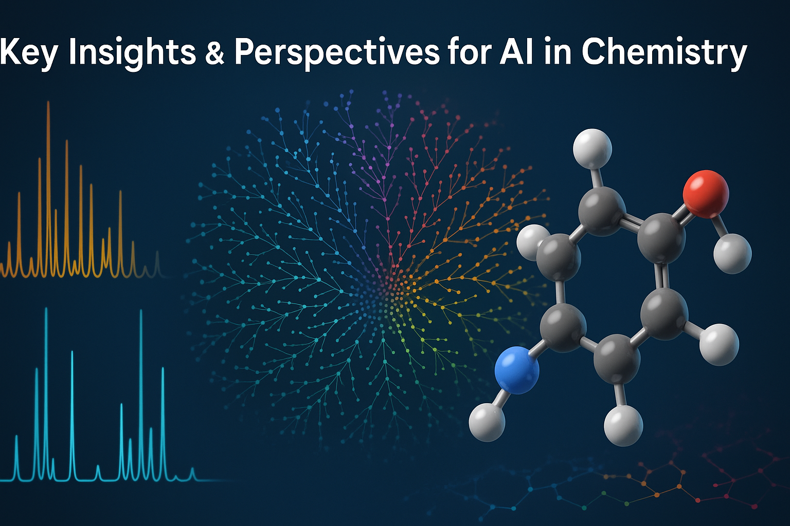
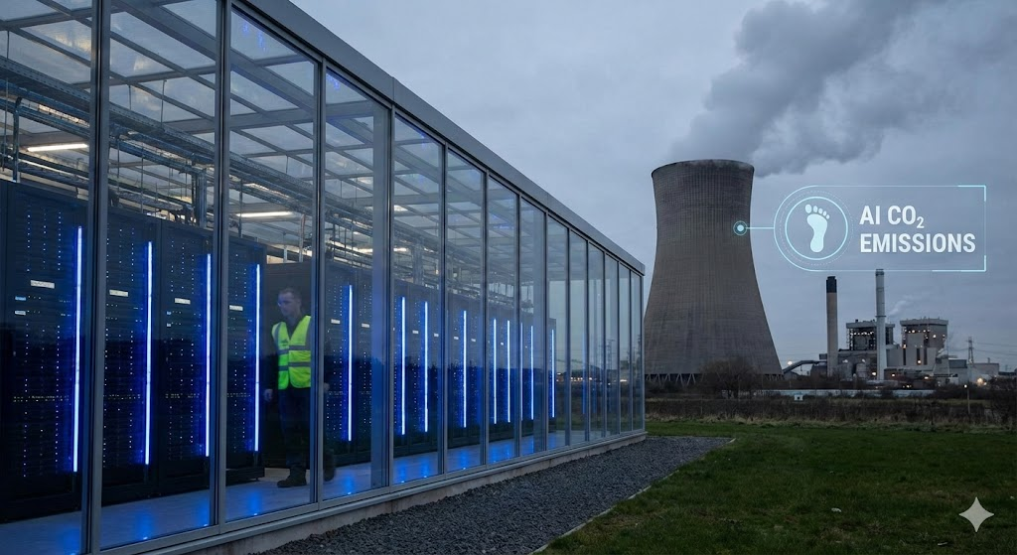
Conclusion
1. AI is not magic - it is amplified scientific reasoning
ML models uncover patterns that are often invisible to intuition, but their predictions remain hypotheses
Chemical sense, mechanistic thinking, bio/physics/chemistry knowledge are still central
2. Data quality defines everything
Better curation → better models. FAIR data, reproducibility, and transparent workflows are the foundations of trustworthy chemical ML.
3. Small-data chemistry needs explainability
xAI tools (SHAP, feature attribution, counterfactuals…) help connect predictions to molecular structure, enabling grounded, mechanism-informed interpretation.
Image generated with ChatGPT 5.0, December 2025
4. Models must be validated outside their comfort zone
Applicability domain, extrapolation limits, and chemical plausibility checks are essential, especially in materials design, catalysis, and solvent engineering.
5. “Assistive AI” can accelerate research
From designing new descriptors to writing code, general AIs, or – even better,
both in terms of energy cost and efficiency ? – specialized AIs can be a powerful assistant,
but requires human expertise to avoid biases, hallucinations, and misleading outputs.
6. AI is a tool for creativity in chemistry
When combined with theory, computation, and experiment, AI opens new ways to explore chemical space, test hypotheses, and design better molecules/materials.

