Slide 1
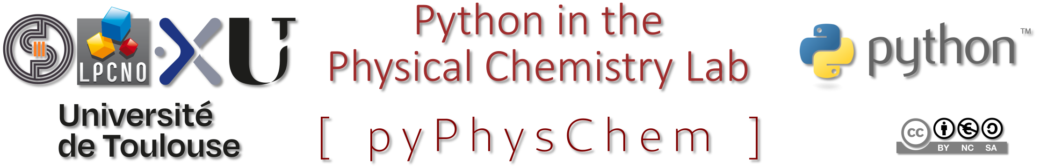
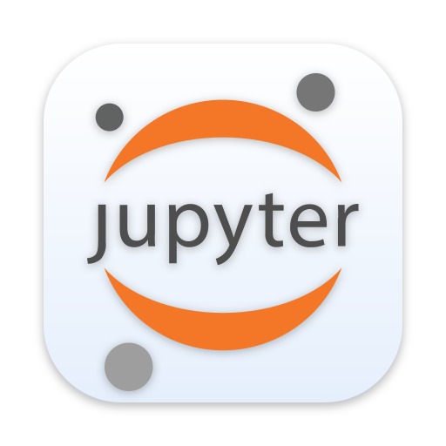
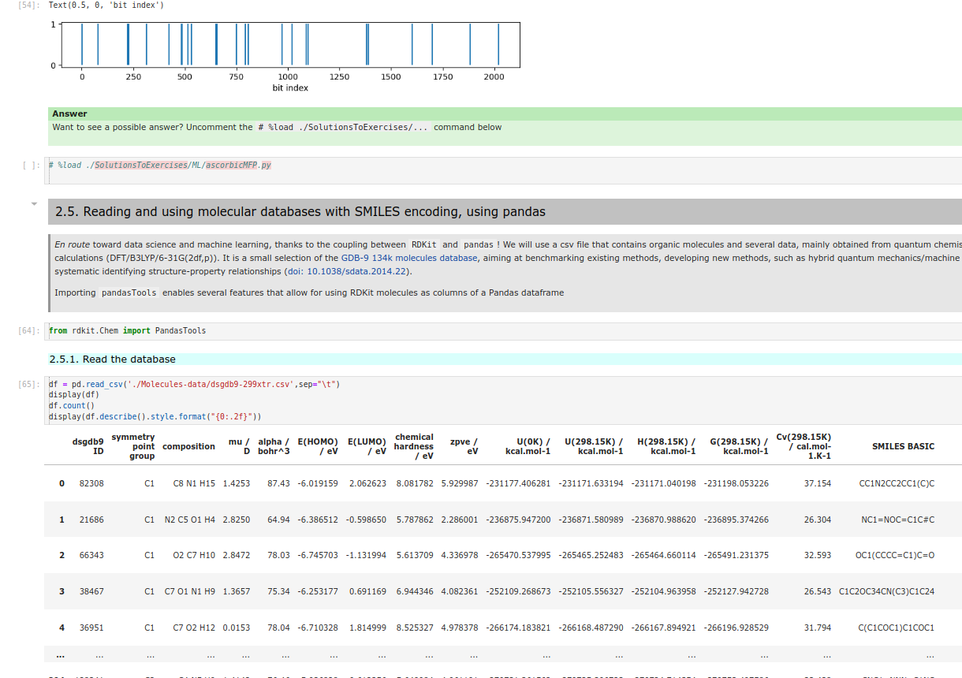
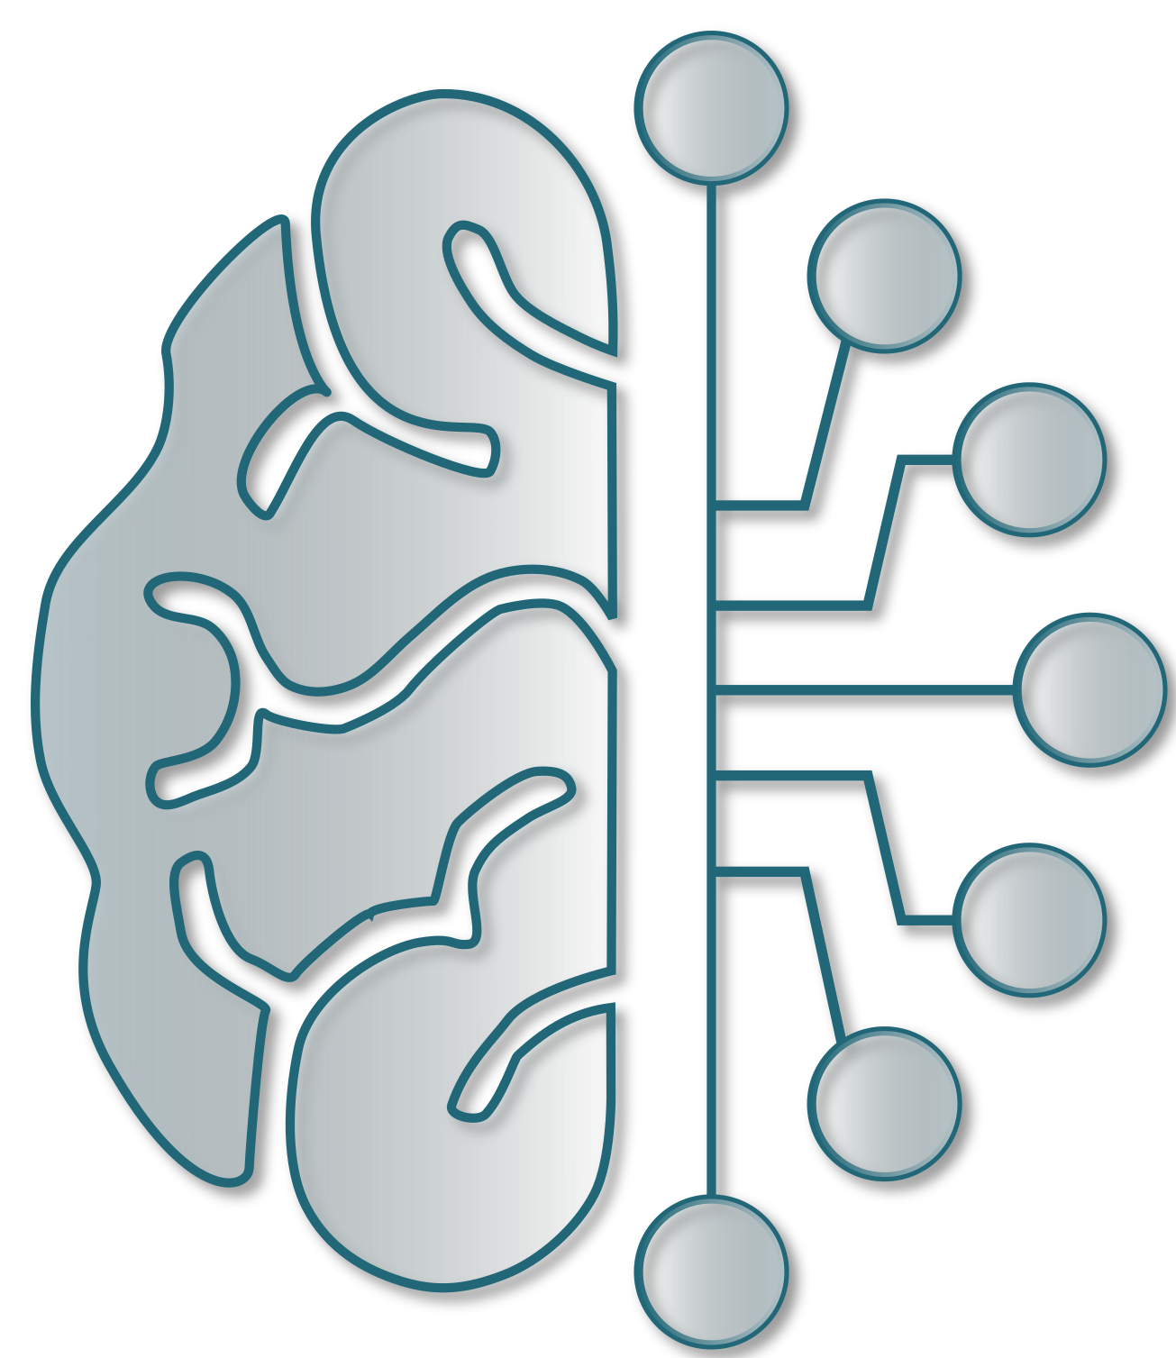
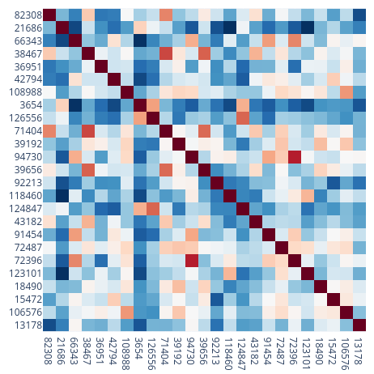
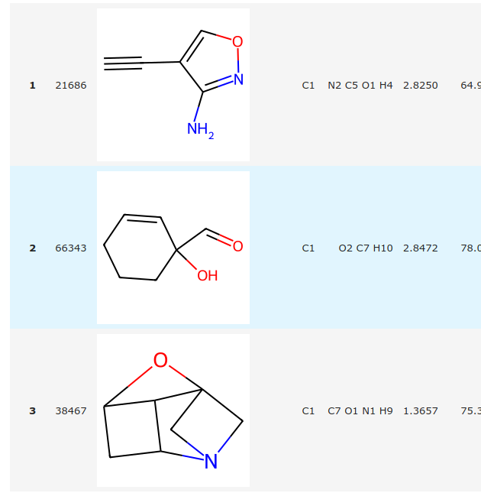
"Talktorials" in physical chemistry and data science
S. Christodoulou, Iann C. Gerber, F. Jolibois, R. Poteau
Python in the Physical Chemistry lab (pyPhysChem) github repository, release v. 1.8.0 (2023), doi: 10.5281/zenodo.8396813
- interactive python
- images / videos
- mathematical equations
- enriched text (markdown)

Slide 2
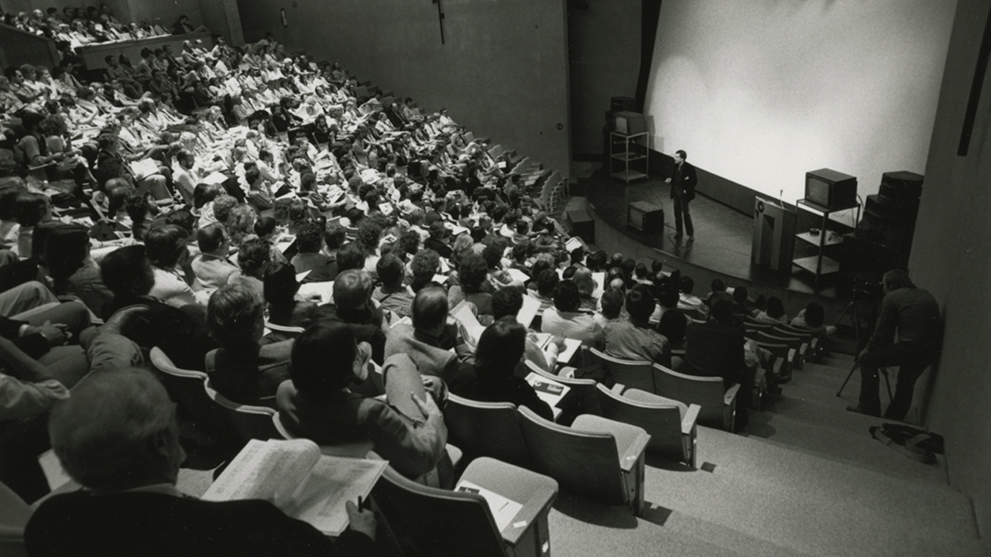
Motivation
integration of verbal explanations with numerical demonstrations or computer algebra system-based demonstrations proves to be an influential pedagogical tool
let’s call them “talktorials”
such mixing not new, but until recently it was restricted to rather simple applications that required a great deal of development effort
What is new is:
- the combination of Python's popularity and libraries
- the interactive nature of Jupyter Notebooks
- personal computers performance; the prevalence of real-world applications that can quite easily be adapted for students thanks to Python libraries available in a lot of domains
- the strong community support
- the ease of reproducibility that makes tutorials more effective, as learners can directly use the code provided to experiment and build upon it
talktorials specifically tailored for computational chemistry and data science/machine learning

Slide 3
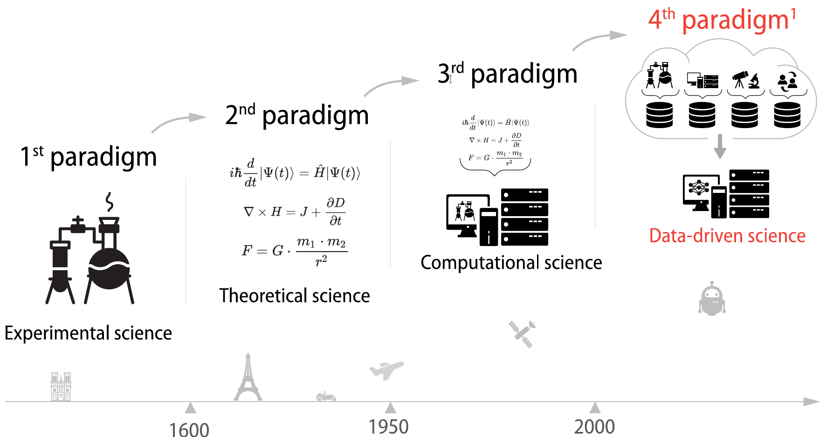

Motivation
The emergence of such innovative approaches in the realm of computational chemistry is truly encouraging
It not only enables learners to grasp theoretical concepts but also offers a practical perspective on their application
For students specialising in computational chemistry who develop their own scripts, they acquire a dual skill set that could be sought after in various areas of research and industry
https://fidle.cnrs.fr

Slide 4

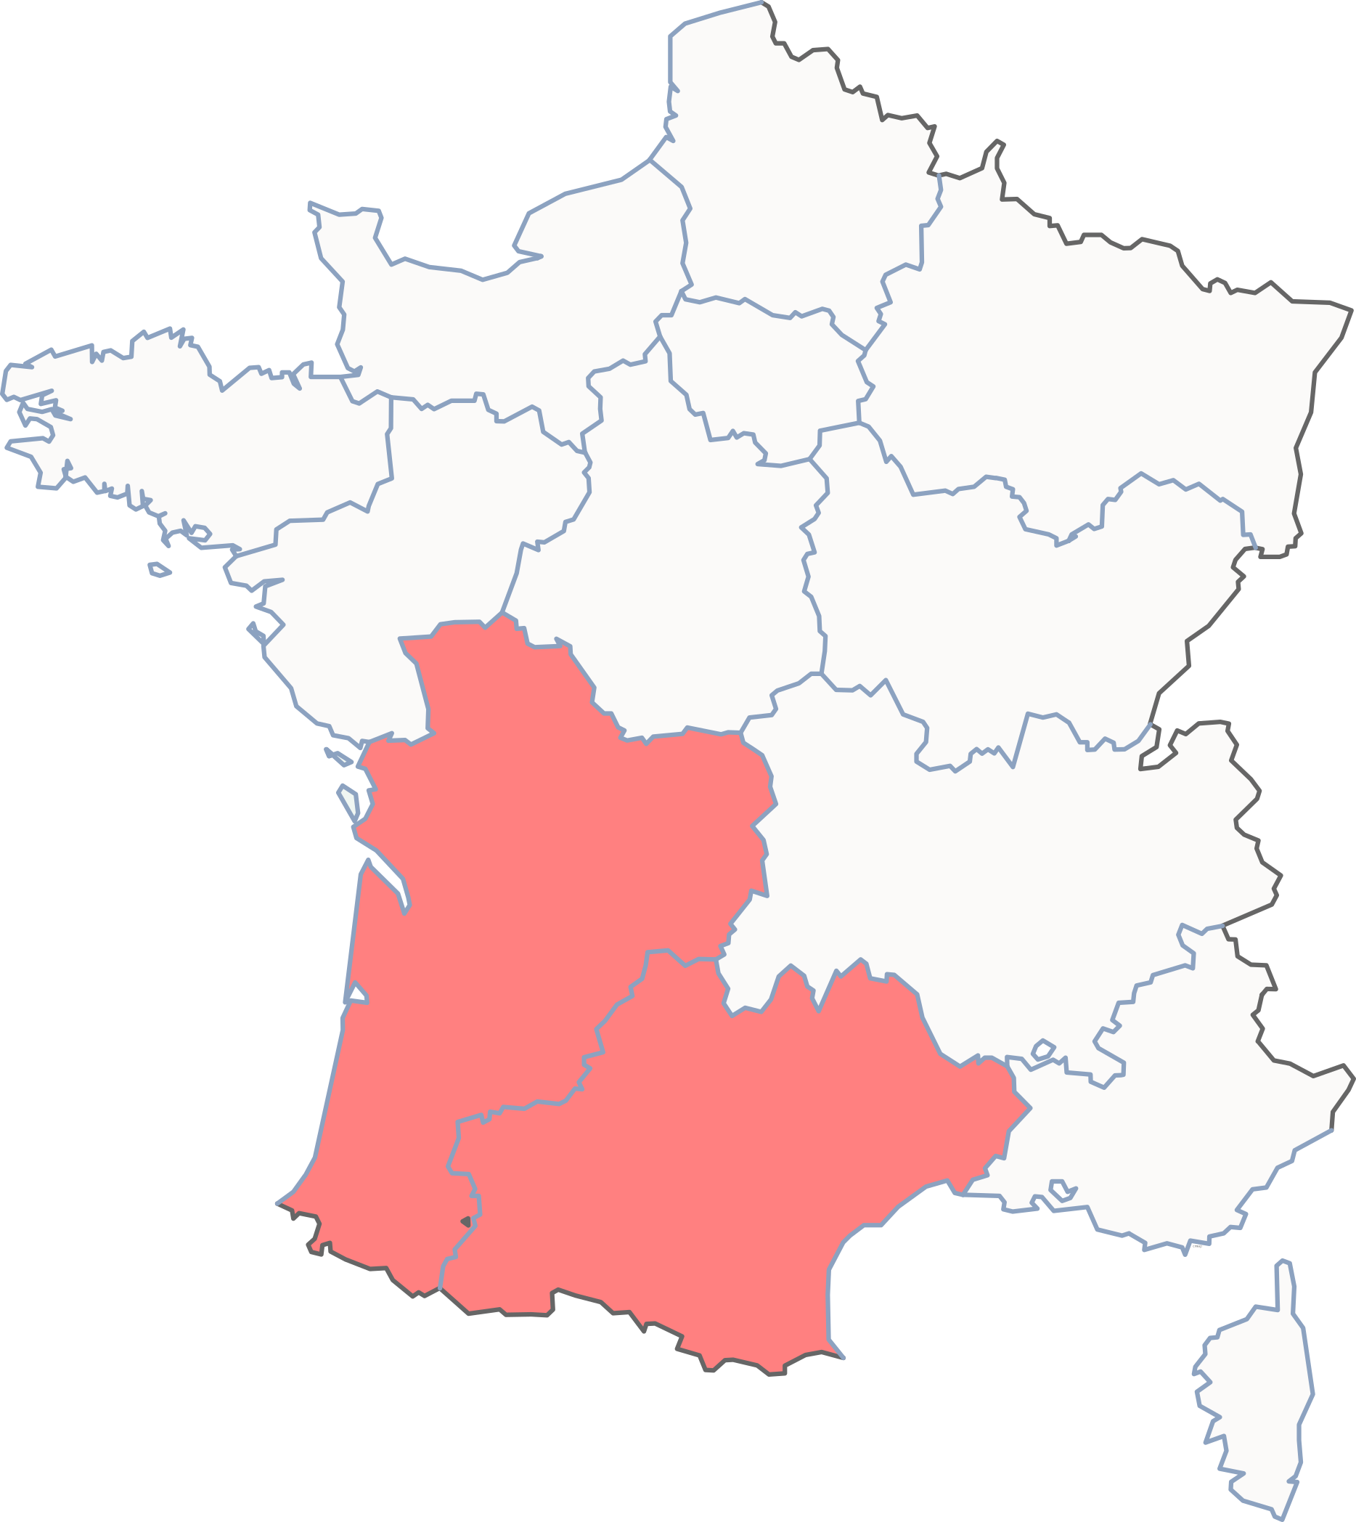

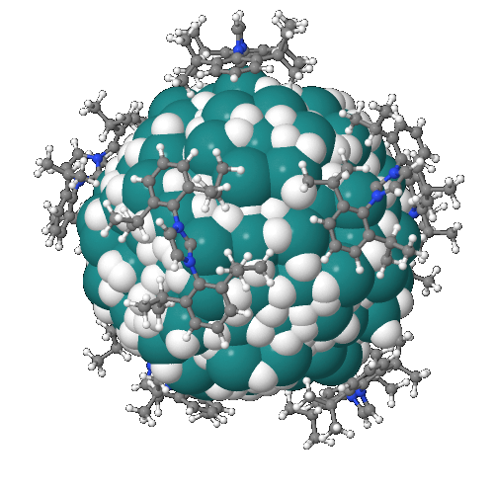
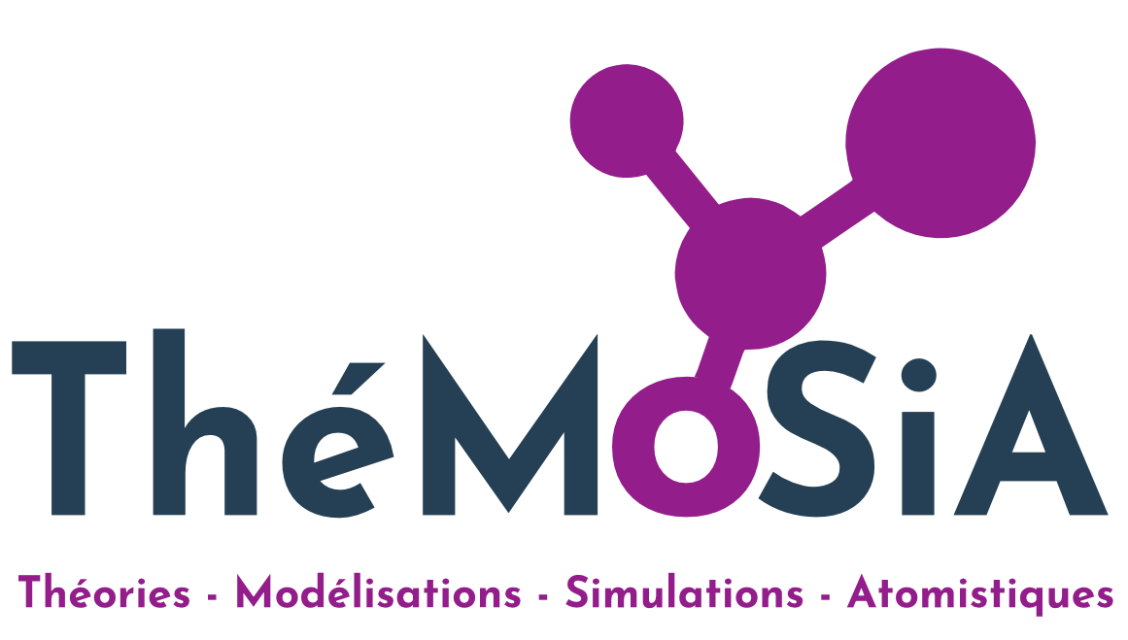

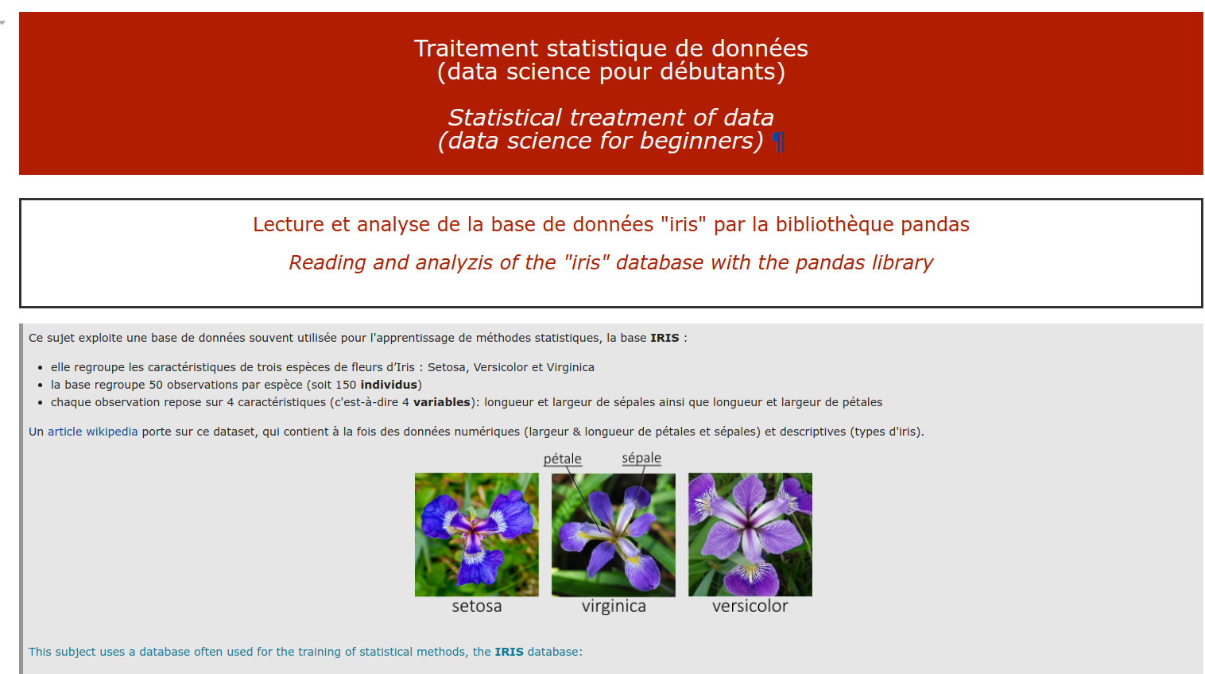

Which students (so far...)?
masters’ (graduate) degrees
Réseau Français de
Chimie Théorique
bachelor degree
all chemistry students, 2nd year

Slide 5
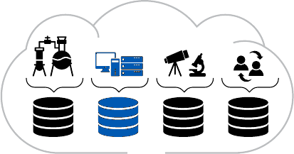

Summary & Outlook
can we expect a strong convergence between quantum and computational chemistry, data science and machine learning?
https://github.com/rpoteau/pyPhysChem
- python for physicists and chemists in a nutshell
- Computer Algebra System
- Physical chemistry (incl. quantum chemistry)
- coding and use of representations of molecular structures and related data
- Data science and ML
10.5281/zenodo.8396813
data-driven science
increase in the number of students in the master's programmes in theoretical and computational chemistry?
… unless we do not really give them a dual skill set that could be sought after in various areas of research and industry

