Slide 1


Slide 2
Use YAML files in Azure DevOps to manage the deployment of your solutions
Raphaël Pothin

Slide 3








Who am I?
Power Platform Enthusiast
Business Solutions Consultant
(Dynamics 365 Sales, Project Service Automation and Human Resources)
@RaphaelPothin
Raphaël Pothin
Raphael POTHIN
Raphaël Pothin
Raphael Pothin

Slide 4
Why should you use YAML? (or not)

Slide 5

CI/CD Pipelines – YAML or Classic UI?
YAML
Classic UI
It is the user-friendly way with an easy onboarding
It is code stored in your repo
Here you have some features not available in YAML (ex: gates)
It is the CI/CD industry standard
Some features are missing compared to Classic UI (ex: gates)
It is no longer the default option
You need to learn some basics to be operational
It is more difficult to manage changes, collaboration
Conclusion there is not a perfect answer (for now).
Choose wisely based on your team and what you need to do!

Slide 6
How to start with YAML?

Slide 7
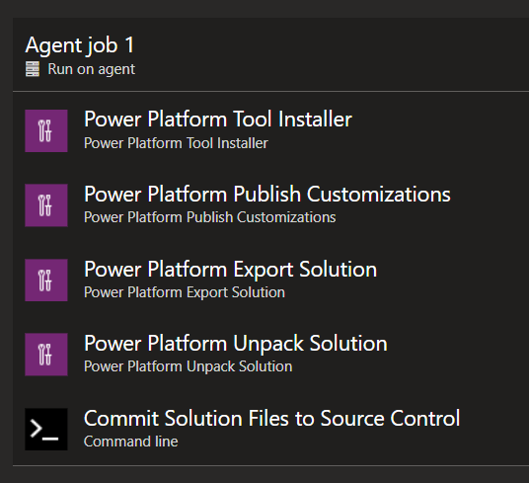
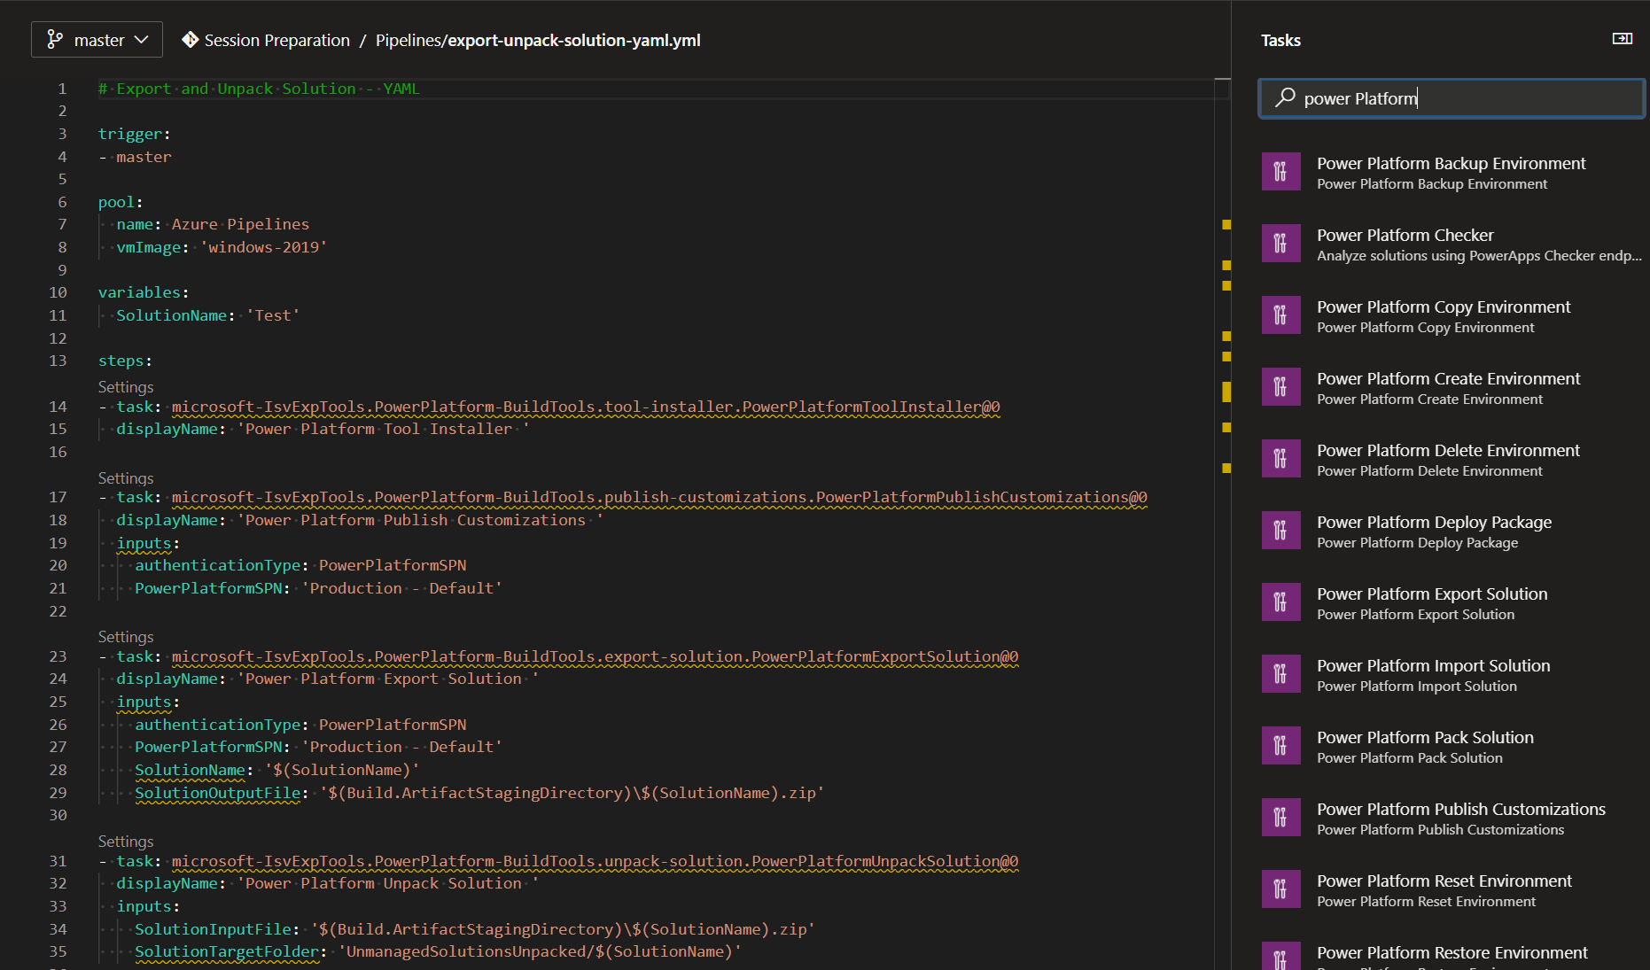
Convert Classic UI Pipelines to YAML
Notes:
https://devblogs.microsoft.com/premier-developer/converting-classic-azure-devops-pipelines-to-yaml/
Example of an existing pipeline for the export, unpack and commit to repos of a solution configured with the Classic UI in YAML
Add “trigger: none”
Specify “vmImage: 'windows-2019’” under “pool”
Rename and move the pipeline

Slide 8
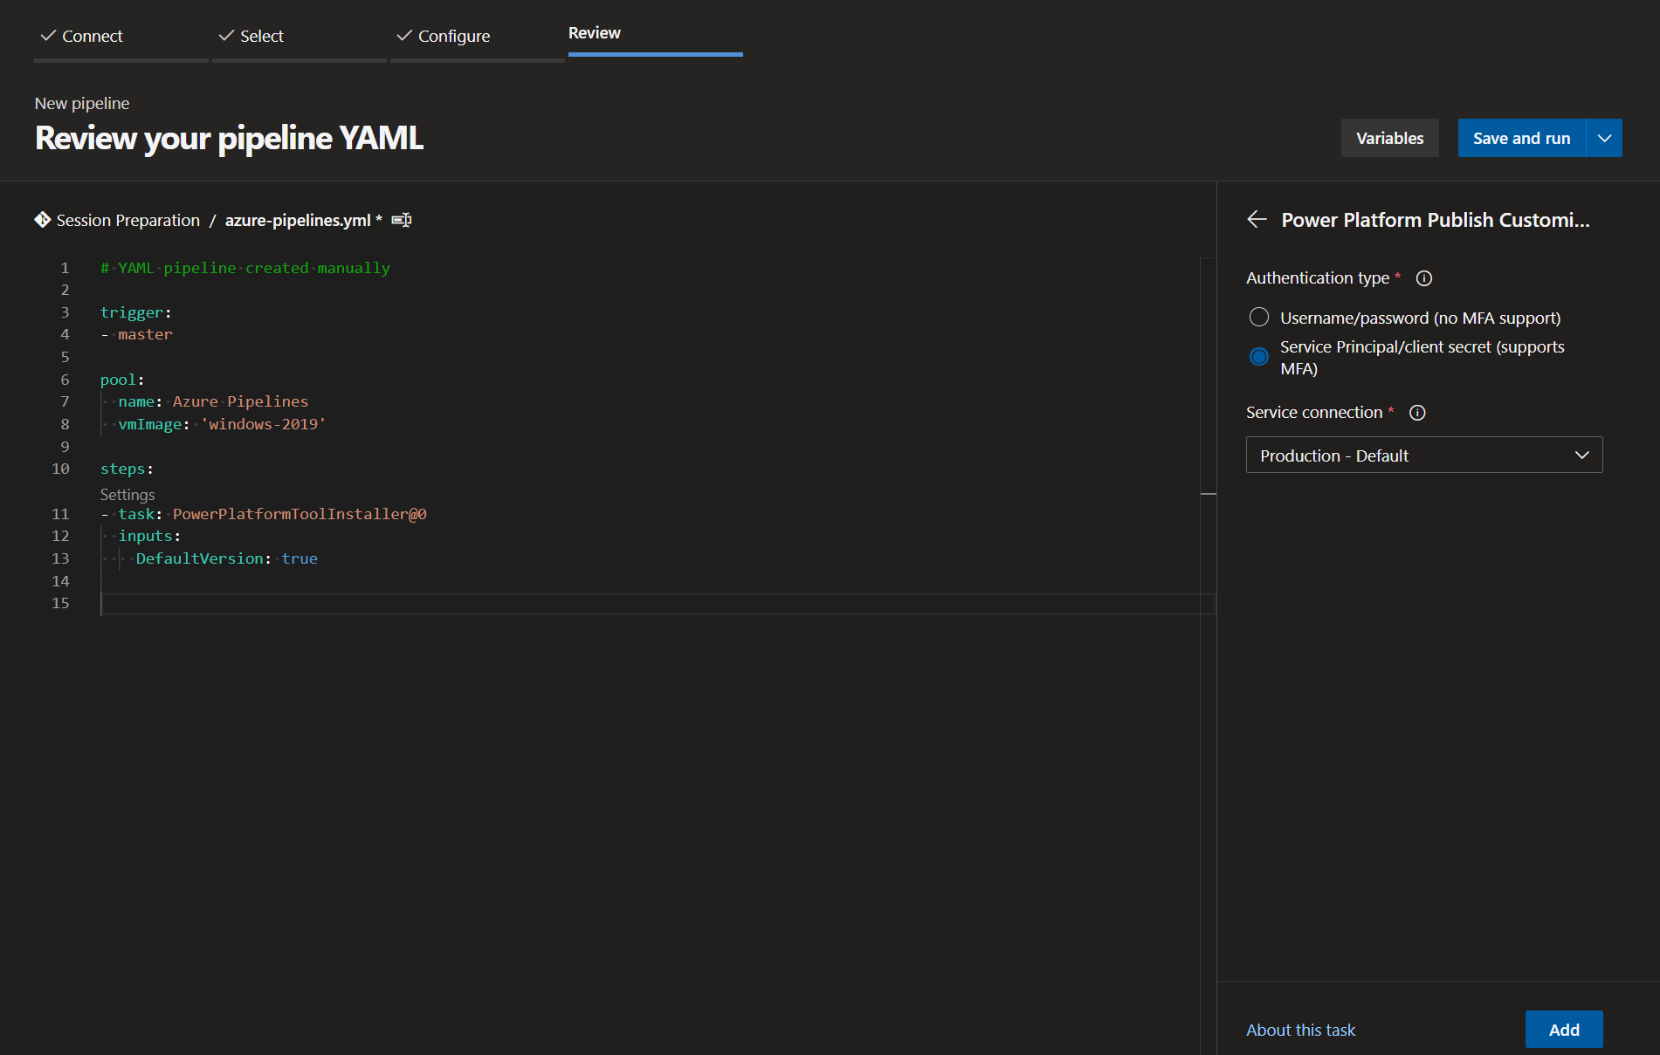
Create a YAML pipeline from scratch
Notes:
Example of a pipeline for the export, unpack and commit to repos of a solution created from scratch in YAML

Slide 9
An example of CI/CD strategy for solutions

Slide 10

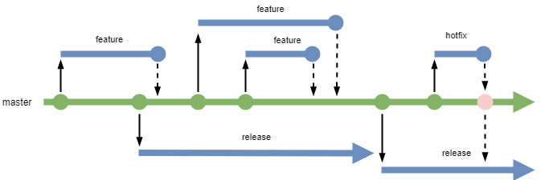
An example of CI/CD strategy for solutions (not yet tried in real conditions)
main
aka.ms/releaseflow
Notes:
[Manual] Pipeline for the export, unpack and commit to the work branch (with service connection and branch to use as variables)
[Automatic on the creation of a PR] Pipeline for the check of the pull request (aka “quality gate”) with for example: solution checker, code unit tests, UI unit tests, code test coverage, code checker…
[Automatic on the commit on the main branch after the approval of a PR] Pipeline to build an deploy a solution based on the files in the main branch to the QA environment for integration tests and manual tests
[Manual] Pipeline to:
Build managed solutions (artifacts) from the release branch (variable) using a build environment
Wait for an approval to import managed solutions to a production environment

Slide 11
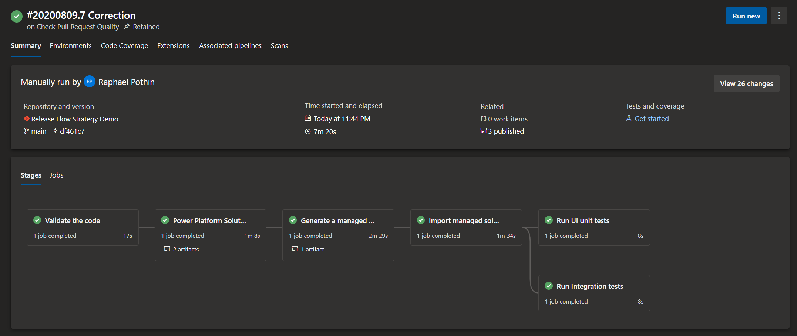
Multi-stage pipelines with YAML
Notes:
Conversion of the pipeline configured in the previous step as multi-stage

Slide 12
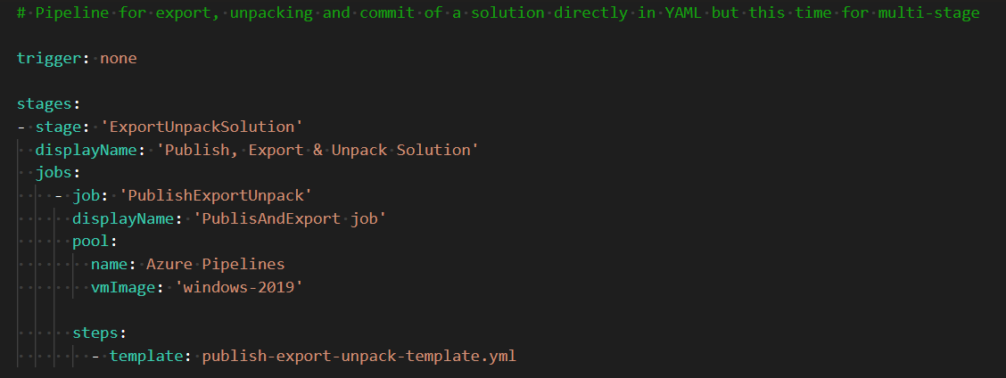
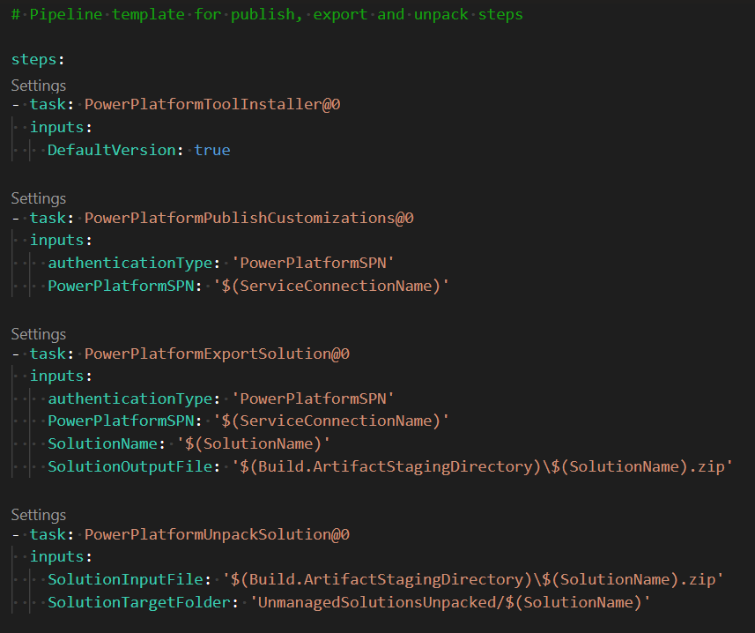
Make pipeline steps reusable with templates

Slide 13


Questions?

Slide 14


Business Applications
Communities
Connect · Learn · Share · Inspire
Join the Microsoft Business Applications Communities where you can connect with peers and experts and earn recognition for your contribution. Get answers to complex questions, learn from engaging discussions, read informative blogs, view webinars, and find product use examples in galleries.
Dynamics Communities
Power Platform Communities
https://community.dynamics.com
communities.dynamics.com
powerusers.microsoft.com
Notes:
Talking points:
Come to community to access discussions, forums, videos and blogs
Access key content such as Webinars, Events and Gallery
Get questions answered for free in both on-premise products and App forums

Slide 15

Save the date

