Slide 1
Replace Dynamics 365 Talent Onboard with the Power Platform
Raphaël Pothin – 02/22/2020

Slide 2








Join us at the Microsoft Offices in downtown Tampa on Feb 22, 2020!
Thank you ClickDimensions being a platinum sponsor
Visit https://www.365powerup.com/365poweruptampa for details!
Notes:
Tampa text Requires this font: https://www.fontsquirrel.com/fonts/permanent-marker

Slide 3





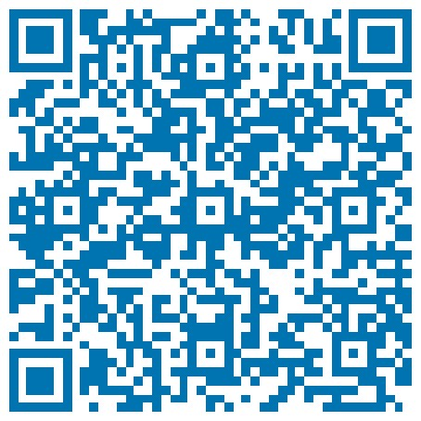


Who am I?
Power Platform Enthusiast
Business Solutions Consultant
(Dynamics 365 Sales, Project Service Automation and Human Resources)
@RaphaelPothin
Raphaël Pothin
Raphael POTHIN
Raphaël Pothin
raphael.pothin@gmail.com

Slide 4
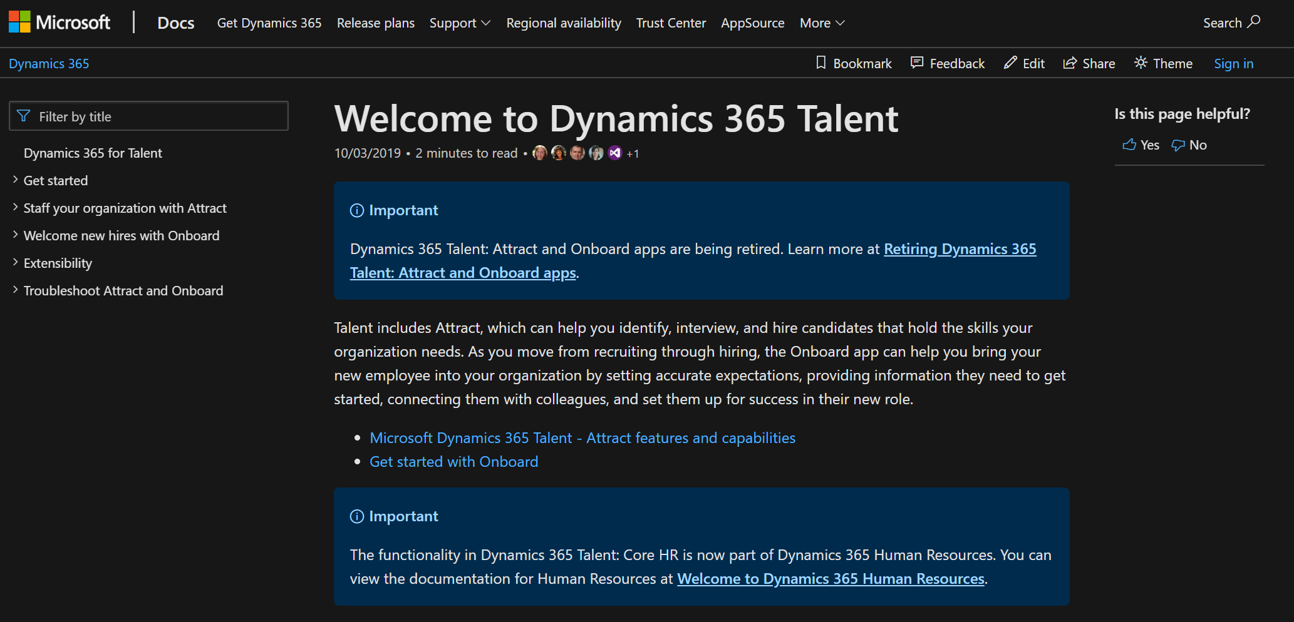
Sad news
Notes:
https://docs.microsoft.com/en-us/dynamics365/talent/
https://community.dynamics.com/365/talent/b/dynamics365fortalent/posts/retiring-dynamics-365-talent-attract-and-onboard-apps

Slide 5



People involved in our onboarding scenario
People in charge of Rose’s onboarding
Rose
New Employee - Test Pilot
Raphael
HR Team Member
Morgane
Team Manager
http://www.icons-land.com/

Slide 6
Our onboarding scenario
Job Offer
New employee information gathering
Interviews
Onboarding configuration
First day
Onboarding preparation
Talent Sourcing
Feedbacks on the onboarding
http://www.icons-land.com/

Slide 7
Our onboarding scenario
Job Offer
New employee information gathering
Interviews
Onboarding configuration
First day
Onboarding preparation
Talent Sourcing
Feedbacks on the onboarding
http://www.icons-land.com/

Slide 8



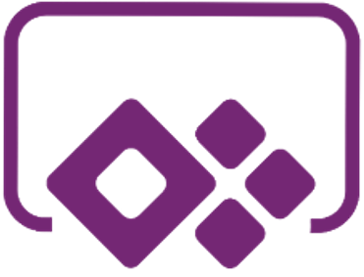

Job Offer reception for signature
Rose
New Employee - Test Pilot
http://www.icons-land.com/
Notes:
A canvas app for HR team members to find a candidate an send him a job offer for signature
A flow in charge of the sending of the job offer to the selected candidate
A flow that will trigger when the job offer will be sent and then wait the signature to notify the HR & Onboarding team in Teams with an adaptive card

Slide 9
Our onboarding scenario
Job Offer
New employee information gathering
Interviews
Onboarding configuration
First day
Onboarding preparation
Talent Sourcing
Feedbacks on the onboarding
http://www.icons-land.com/

Slide 10

Onboarding configuration
Raphael
HR Team Member
http://www.icons-land.com/
Notes:
Manual creation of the Worker record for the new employee in Dynamics 365 Human Resources with the hire feature on a candidate who accepted a job offer
A flow that will automatically generate a Worker Onboarding record associated to the new Worker on its creation
A model driven app build arround 2 custom entities: Worker Onboarding and Onboarding Activity
An HR Team member will be able to configure the Worker Onboarding record in the model driven app

Slide 11
Our onboarding scenario
Job Offer
New employee information gathering
Interviews
Onboarding configuration
First day
Onboarding preparation
Talent Sourcing
Feedbacks on the onboarding
http://www.icons-land.com/

Slide 12


Before the first day
Notes:
An embedded canvas app in the Worker Onboarding form for the management of interesting contacts for the new employee during is onboarding (configured by the new employee manager)
A flow that will automatically generate Onboarding Activity records when the status of the Worker Onboarding will be set to « In Preparation » and send a Forms (Pro) to the incoming employee to ask him some informations
A flow that will wait for the answers of the incoming employee and take actions in consequence

Slide 13
Our onboarding scenario
Job Offer
New employee information gathering
Interviews
Onboarding configuration
First day
Onboarding preparation
Talent Sourcing
Feedbacks on the onboarding
http://www.icons-land.com/

Slide 14


The first days at the company
Rose
New Employee - Test Pilot
Notes:
A flow that will send a link to the welcome package directly to the new employee in Teams in an adaptive card
A bot in Teams (built with Power Virtual Agent) that will be able to help the new employee find information and create a case for the installation of a software on her laptop

Slide 15
Our onboarding scenario
Job Offer
New employee information gathering
Interviews
Onboarding configuration
First day
Onboarding preparation
Talent Sourcing
Feedbacks on the onboarding
http://www.icons-land.com/

Slide 16
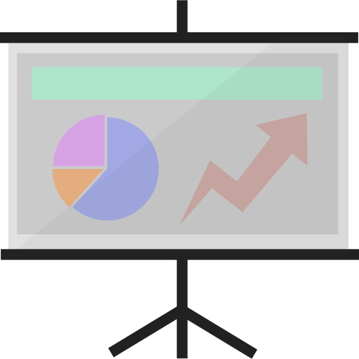

The end of the onboarding phase
Notes:
A flow that will send an adaptive card with inputs to the new employee in Teams to get his / her feedbacks on the onboarding process
A Power BI report that present some insights on the onboarding in the company

Slide 17
Questions?

Slide 18
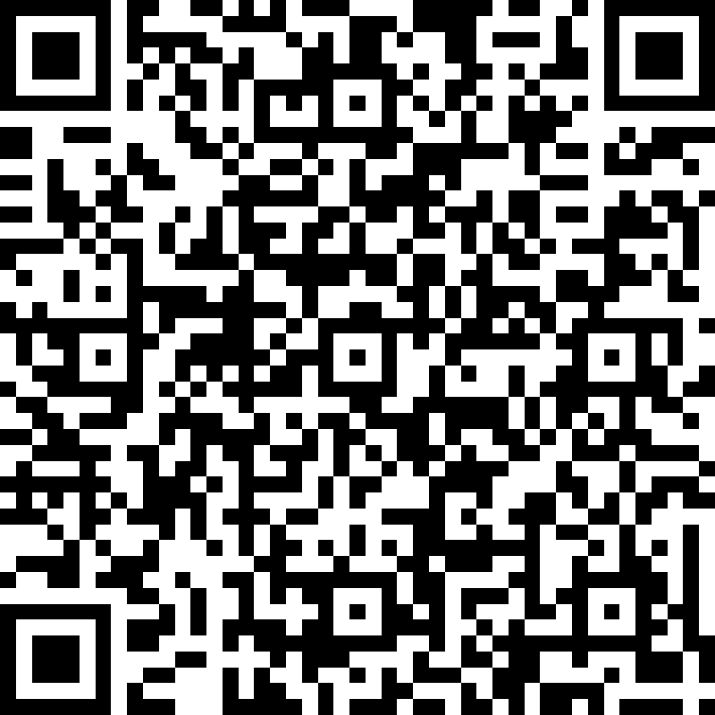
Thank You!

