Slide 1
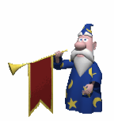
Voice Controlled Personal Computer
By: Rohit potter

Slide 2
History of Voice Recognition
Radio Rex (house trained dog), 1922
U.S Department of Defense, 1940’s
  Speech Understanding Research (SUR) program
    Carnegie Mellon University & MIT
  Automatic interception & translation of Russian radio transmissions (FAILURE)
    Original message: “the spirit is willing but the flesh is weak”
    Translated message: “the vodka is strong but the meat is disgusting.”

Slide 3
Why Voice Recognition?
Convenience
  Natural user interface: human speech
  Improved services for the disabled
  Wider range of users
Future possibilities and improvements
  Internet use over phones through voice portals
  Advanced applications implementing voice control in all areas

Slide 4

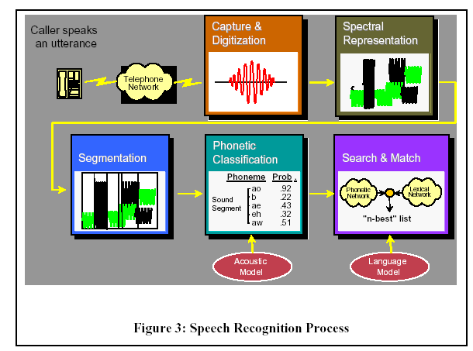
Technology behind Voice Recognition
Five major steps used by speech recognizer

Slide 5
Major steps in voice recognition
Capture and Digitalization
  System interacts with the telephony device to capture voice input at 8000 samples/sec
Spectral Representation
  Voice samples converted to graphical representation
Segmentation
  Speech signals are broken down into segmented parts.
  Improves accuracy
  Reduces computation: impossible to process entire signal in real time

Slide 6
What is Voice controlled PC?
Voice controlled personal computer is a software which makes our personal computer working on voice commands.
It takes human voice as a input, convert it into text and perform the task which human has given.

Slide 7
Benifits of Voice controlled PC
Helpful for phisically disabled person
Reduce system cost
No need additional devices
Works on voice
Interaction with system becomes easy

Slide 8
System and Hardware Requirements
System requirements
  Any operating system
  internet
Hardware requirements
  Microphone
  Speaker

Slide 9
Thank You

