Slide 1
ImageAlbum
Divo Lise, Rachel Poturich, Mirko Siljeg, Marko Zivko

Slide 2
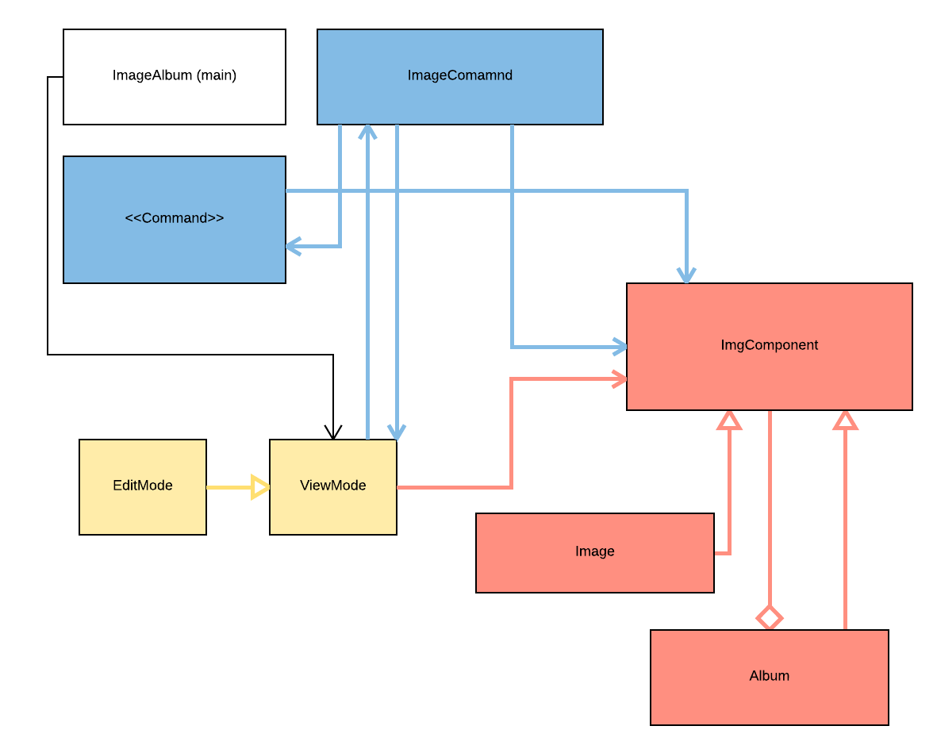

Slide 3
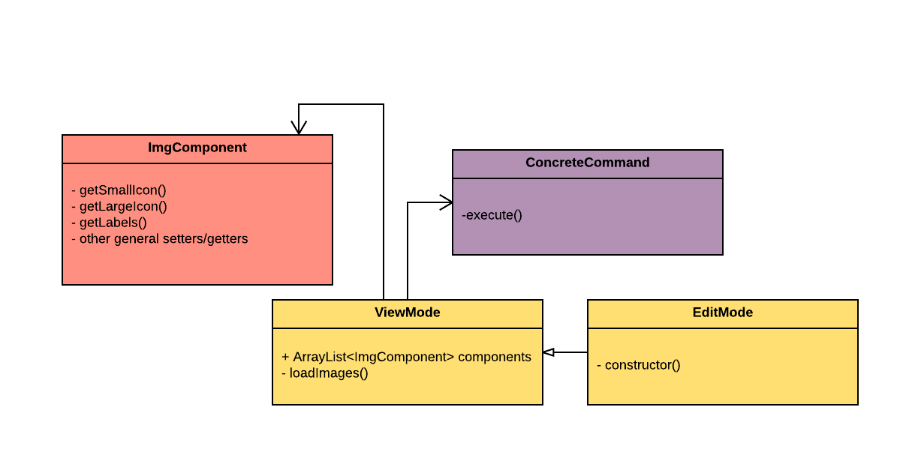

Slide 4
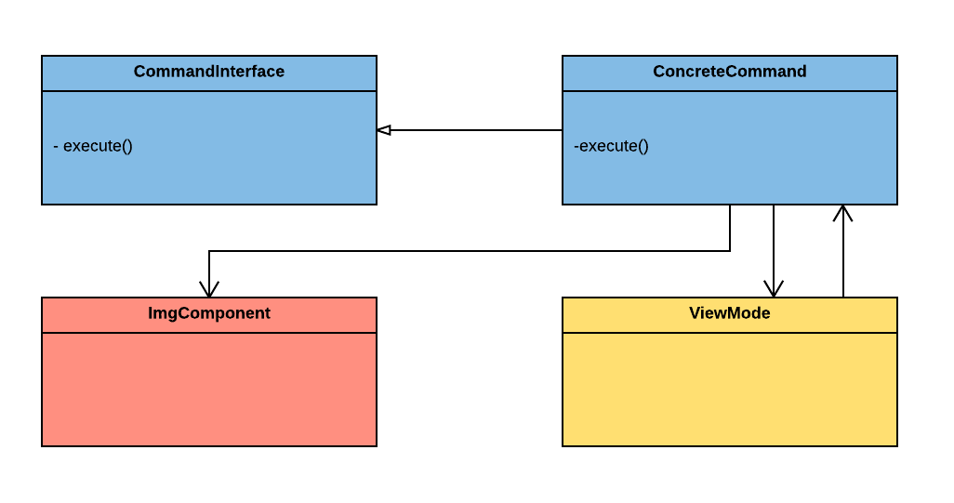

Slide 5
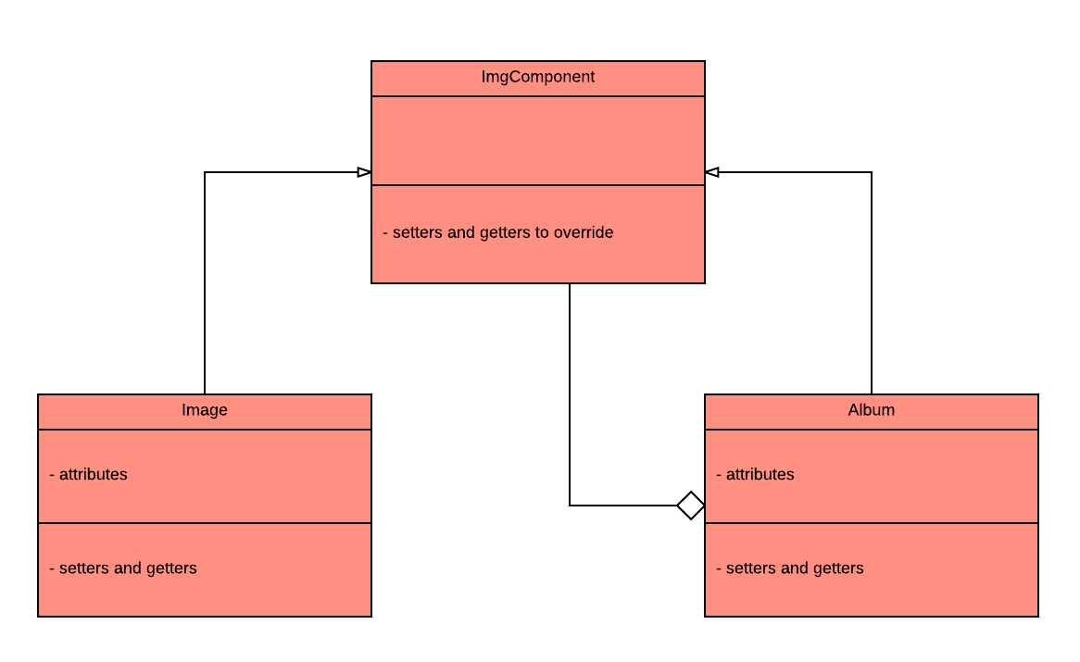

Slide 6
Demonstration

