Slide 1
Using Large Language Models to Facilitate Model Validation Report Writing
GFMI Model Risk Conference
December 1, 2022
Roderick A. Powell, FRM

Slide 2
Disclaimer
The views presented in this presentation are strictly those of the author and do not necessarily reflect the views of Ameris Bancorp or its subsidiaries.
Acknowledgements
Special Thanks to Genghua Li, FRM, Manager of Quantitative Analysis, and Charles Goolsby III, Model Risk Analyst, at Ameris Bank, for their contributions to this presentation.
2

Slide 3
Challenges with Model Validation Report Writing
Tedious
Time-Consuming
Grammar/Typos
Human Error
Formatting
Accuracy
3

Slide 4
Problem and Solution
Writing model validation reports is time consuming.
Quantitative-oriented individuals often find report writing to be tedious.
Difficult to write accurate and error-free model validation reports.
Problem
Large Language Models can be used to assist in quickly writing appropriate sections of model validation reports.
Solution
4

Slide 5
What are Large Language Models (LLMs)?
5

Slide 6
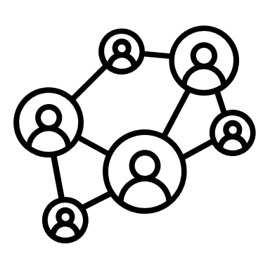
Artificial Intelligence
Natural Language Processing & Machine Learning
Neural Networks
Deep Learning
Large Language Models
6

Slide 7


Extracting text from large data set
Understanding the context using Neural Networks
Predicting which words come next
LLMs
Text Input
Extraction
Prediction
7

Slide 8


Pros and Cons of LLMs
Pros
Cons
Generates text much quicker than human writers with less grammatical and syntax errors.
Organizes, classifies, and identifies patterns in documents and other unstructured data.
Customizable with proprietary training data.
Public access to API for some LLMs; democratizing use of AI.
Close to passing the Turing Test.
Lack of transparency in underlying neural network.
Potential bias and misinformation in output.
Requires heavy computing power; energy intensive.
May generate information that is not factually accurate, because it is attempting to produce plausible text based on statistical patterns in its training data and context provided by the user, i.e., “hallucination.”
Close to passing the Turing Test.
8

Slide 9




Selected Large Language Models
“Language Model for Dialogue Applications”
Google’s Large Language Model for building chatbots
Able to compose large paragraphs and code from user prompts
Able to be fine-tuned for specific applications
“True” open access/open source LLM with more than 1000 contributors
Multilingual to support 46 human languages and 13 programming languages
“Open Pre-trained Transformers” with similar performance to GPT-3
A series of open-sourced LLMs released for research purposes only
9

Slide 10
Generative Pre-Trained Transformer 3
“GPT-3”
10

Slide 11
History of GPT-3
Co-founded by Elon Musk, Sam Altman, Greg Brockman, Peter Thiel, Reid Hoffman, and Ilya Sutskever to create a non-profit focused on AI research (now a capped-profit).
OpenAI: 2015
Foundational paper written by Alec Radford and his colleagues to show the potential of generative model of language.
GPT: 2018
Unsupervised transformer language model with limited release due to concerned of potential misuse, but eventually was released in its entirety.
GPT-2: 2019
One of the most comprehensive unsupervised transformer language models to date using 175 billion parameters to perform a myriad of tasks involving language and image generation.
GPT-3: 2020
11

Slide 12



Description of GPT-3
Uses Deep Learning with neural networks by imitating the process of human learning by identifying patterns or solving problems by trial and error.
Uses a massive data set of text to pre-train the model including Wikipedia, digitalized books, and other text-based documents from the internet.
Ingests larger amounts of data than earlier models to create deep layers of artificial neurons for training.
It is capable of learning to model complex linguistic phenomena, including syntactic dependencies and semantic relationships. Additionally, GPT-3 is designed for parallel training, allowing it to scale to large datasets.
Written by GPT-3!
12

Slide 13
Parameter Settings for GPT-3
Execution Engine: Sets one of four language models to use for execution.
Response Length: Sets a limit on the amount of text the API includes in
its completion.
Temperature: Controls the randomness of the response. Ranges from 0 to 1.
Top P: Determines the scope of randomness. Ranges from 0 to 1.
Frequency Penalty: Decreases the likelihood that the model will repeat the same line of text.
13

Slide 14
Parameter Settings for GPT-3 (cont’d)
Best of: Specifies the number of completions (n) to generate on the server-side and returns the best of the generated completions.
Stop Sequence: Specifies a set of characters that signals the API to stop generating completions.
Inject Start & Restart Text: These parameters allows you to insert text at the beginning or at the end of the completion, respectively.
Show Probabilities: Allows you to debug the text prompt by showing the probability of tokens that the model can generate for a given input.
14

Slide 15
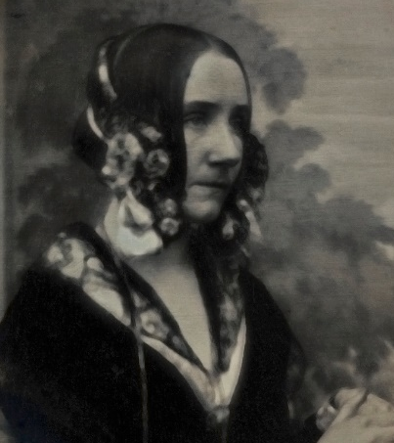
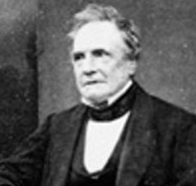
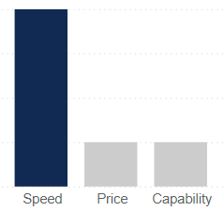
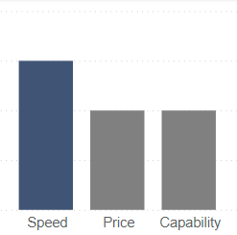
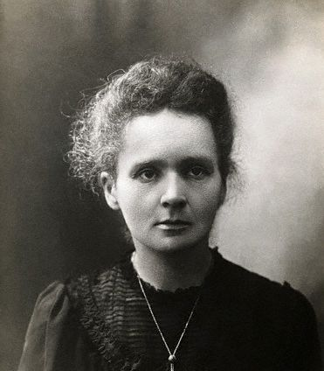
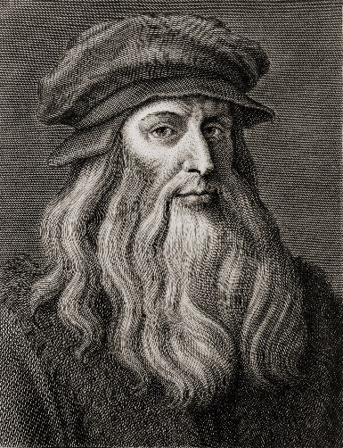
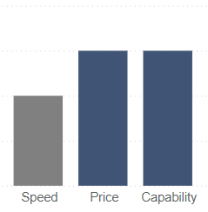
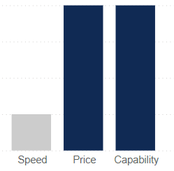
GPT-3 Model (Execution Engine Options)
Ada
Babbage
Curie
Davinci
15

Slide 16



Out-of-the Box Model Customized Model
Use the pre-trained GPT-3 Model “as-is.” This is appropriate for general text generation tasks.
You can customize the GPT-3 model by training it with your own text data. You can then use the new “fine-tuned” model for more specific applications.
For example, you can train the model using your own model validation reports to enable the model to generate more specific, higher quality output.
16

Slide 17




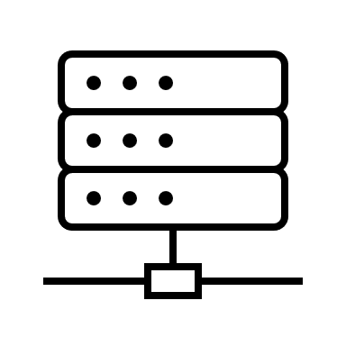



Automation Tool Configuration: Anvil + Python + GPT-3
s
API
17

Slide 18
GPT-3 Use Case
Model Validation Report Writing
18

Slide 19
First Step: Input Prompt (three iterations)
Prompt
Output #1
Output #2
Output #3
19

Slide 20


Second Step: Select Best Description
Prompt
Output #1
Output #2
Output #3
Model Validator selects the most appropriate description to insert into report.
20

Slide 21
Use Case #1a:
Write General Description of Model
21

Slide 22
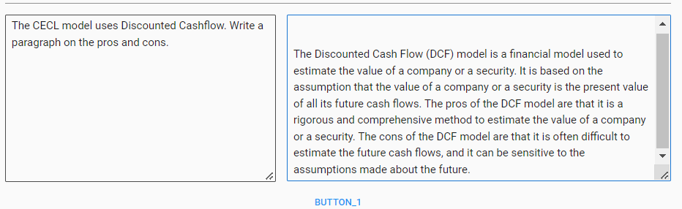
Use Case #1a: CECL Model DCF
The model validator wants to add a paragraph in the model validation report that describes the pros and cons of using a DCF model to value a loan pool in the CECL model.
Prompt
Output
Actual screenshot from Anvil
Default settings used in model
Using Davinci execution engine
22

Slide 23
First Step: Input Prompt (3 iterations)
The pros of using the DCF model for CECL are that it is a well-recognized and well-tested approach that can be used to estimate the lifetime cash flows for a loan. The cons of using the DCF model for CECL are that it can be complex and time consuming to estimate the lifetime cash flows for a loan, and it may be difficult to find appropriate market data to use in the analysis.
The CECL model uses Discounted Cashflow. Write a paragraph on the pros and cons.
#1
The major advantage of the DCF model is that it uses cash flow projections to estimate the value of a company. This makes the model more accurate than other valuation techniques, such as the PE ratio. The major disadvantage of the DCF model is that it is time-consuming and requires a lot of data.
#2
The Discounted Cash Flow (DCF) model is a financial model used to estimate the value of a company or security. It is based on the assumption that the value of a company or a security is the present value of all its future cash flows. The pros of the DCF model are that it is a rigorous and comprehensive method to estimate the value of a company or a security. The cons of the DCF model are that it is often difficult to estimate the future cash flows, and it can be sensitive to the assumptions made about the future.
#3
23

Slide 24
Second Step: Select Best Description
The pros of using the DCF model for CECL are that it is a well-recognized and well-tested approach that can be used to estimate the lifetime cash flows for a loan. The cons of using the DCF model for CECL are that it can be complex and time consuming to estimate the lifetime cash flows for a loan, and it may be difficult to find appropriate market data to use in the analysis.
#1
Model Validator selects most appropriate description to insert into report.
The major advantage of the DCF model is that it uses cash flow projections to estimate the value of a company. This makes the model more accurate than other valuation techniques, such as the PE ratio. The major disadvantage of the DCF model is that it is time-consuming and requires a lot of data.
#2
The Discounted Cash Flow (DCF) model is a financial model used to estimate the value of a company or security. It is based on the assumption that the value of a company or a security is the present value of all its future cash flows. The pros of the DCF model are that it is a rigorous and comprehensive method to estimate the value of a company or a security. The cons of the DCF model are that it is often difficult to estimate the future cash flows, and it can be sensitive to the assumptions made about the future.
#3
24

Slide 25
Use Case #1b:
Write Section on Conceptual Soundness
25

Slide 26
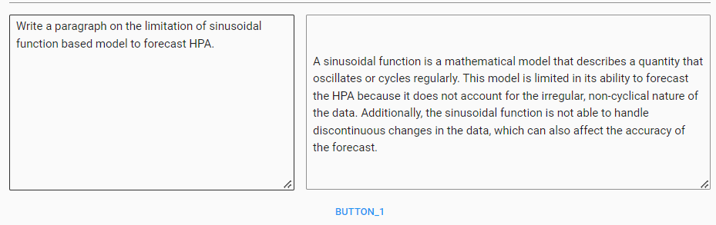
Use Case #1b : Conceptual Soundness of HPA Forecasts
The model validator wants to add a paragraph in the conceptual soundness section of the model validation report describing the limitations of using a sinusoidal function-based model to forecast HPA.
Prompt
Output
Actual screenshot from Anvil
Default settings used in model
Using Davinci execution engine
26

Slide 27
First Step: Input Prompt (three iterations)
The sinusoidal function-based model has certain limitations in forecasting HPA. This is because the model does not take into account the non-linear dynamics of the HPA system. Additionally, the model does not account for the stochastic nature of the HPA system, which can lead to inaccurate predictions.
Write a paragraph on the limitation of sinusoidal function-based model to forecast HPA.
#1
The sinusoidal function model is limited in its ability to forecast HPA. The model is based on the assumption that past behaviour is a good predictor of future behaviour, but this is not always the case. The model does not take into account the impact of unpredictable events, which can often cause fluctuations in the HPA.
#2
A sinusoidal function is a mathematical model that describes a quantity that oscillates or cycles regularly. This model is limited in its ability to forecast the HPA because it does not account for the irregular, non-cyclical nature of the data. Additionally, the sinusoidal function is not able to handle discontinuous changes in the data, which can also affect the accuracy of the forecast.
#3
27

Slide 28
Second Step: Select Best Description
The sinusoidal function-based model has certain limitations in forecasting HPA. This is because the model does not take into account the non-linear dynamics of the HPA system. Additionally, the model does not account for the stochastic nature of the HPA system, which can lead to inaccurate predictions.
#1
Model Validator selects most appropriate description to insert into report.
The sinusoidal function model is limited in its ability to forecast HPA. The model is based on the assumption that past behaviour is a good predictor of future behaviour, but this is not always the case. The model does not take into account the impact of unpredictable events, which can often cause fluctuations in the HPA.
#2
A sinusoidal function is a mathematical model that describes a quantity that oscillates or cycles regularly. This model is limited in its ability to forecast the HPA because it does not account for the irregular, non-cyclical nature of the data. Additionally, the sinusoidal function is not able to handle discontinuous changes in the data, which can also affect the accuracy of the forecast.
#3
28

Slide 29
Use Case #2:
Obtain Reference Material to Assist Writing
29

Slide 30
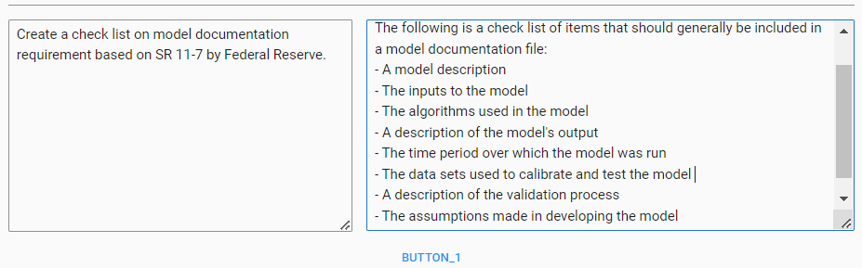
Use Case #2: SR 11-7 Reference
The model validator creates a checklist for evaluating the model documentation section of the validation report in accordance with SR 11-7.
Prompt
Output
Actual screenshot from Anvil
Default settings used in model
Using Davinci execution engine
30

Slide 31
Other LLM Use Cases
For MRM
31

Slide 32
Classify model validation findings to discover what type of findings are most prevalent across models.
Assess consistency and fairness of model validation finding severity levels across models.
Generate computer code to facilitate automating MRM tasks.
Correct grammatical errors in model validation reports.
Write MRM policies, programs, and procedures.
Create Chatbot to answer MRM questions from model owners.
32

Slide 33

Questions?
33

