Slide 1
A Markov Game Model for Valuing Player Actions in Ice Hockey
Kurt Routley
BSc, Simon Fraser University, 2013

Slide 2
Topics
Problem Overview
Related Works
Play-By-Play Event Data
Markov Game Models
Markov Game Model Construction Algorithm
Dynamic Programming Algorithm for Value Iteration
Evaluating Actions and Players
Model Validation
Results

Slide 3
Topics
Problem Overview
Related Works
Play-By-Play Event Data
Markov Game Models
Markov Game Model Construction Algorithm
Dynamic Programming Algorithm for Value Iteration
Evaluating Actions and Players
Model Validation
Results

Slide 4
Problem Overview
Sports are in the world of big data!
NHL records over 4 million events since 2001
Common statistics are not effectively using this data
e.g. +/-, Corsi, Fenwick
Advanced statistics don’t account for context or long-term effects of actions
Notes:
Corsi =

Slide 5
Contributions
First Markov Game model for a large ice hockey state space
A variant of AD-Trees as a data structure to compute and store sufficient statistics
Learning a Q-function to model hockey dynamics
A new context-aware method for evaluating players based on their actions

Slide 6
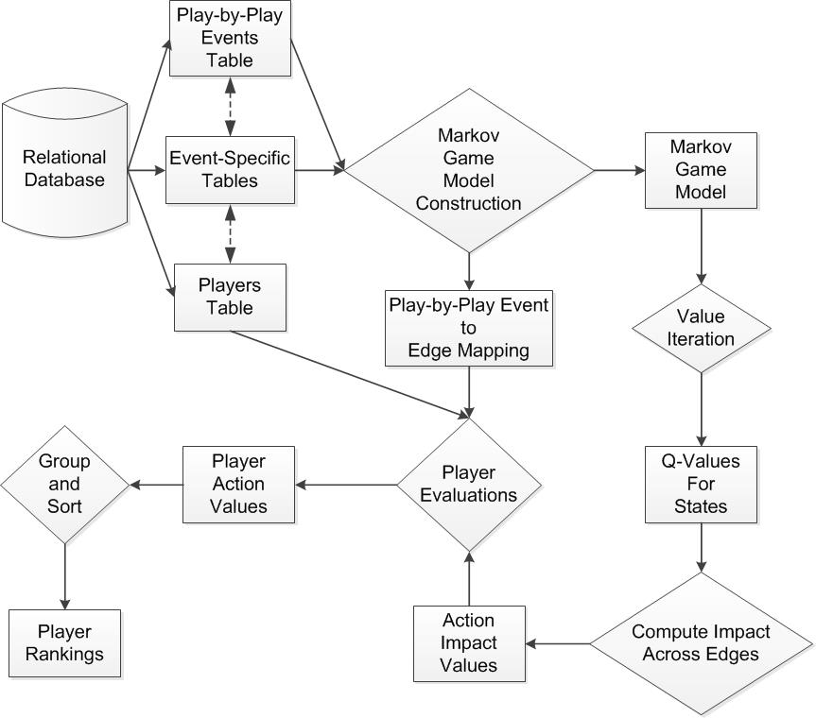
System Overview

Slide 7
Topics
Problem Overview
Related Works
Play-By-Play Event Data
Markov Game Models
Markov Game Model Construction Algorithm
Dynamic Programming Algorithm for Value Iteration
Evaluating Actions and Players
Model Validation
Results

Slide 8
Related Works
Markov Models in Other Sports
Hirotsu & Wright, 2002; Sidhu & Caffo, 2014
Markov Models in Ice Hockey
Buttrey et al, 2011; Thomas et al, 2013
Evaluating Actions and Players in Ice Hockey
Improved/Adjusted +/-
Lock & Shuckers, 2009; Macdonald, 2011; Gramacy et al, 2013; Spagnola, 2013
Impact of Actions on Goals: THoR
Schuckers and Curro, 2013
Impact of Goals on Winning: AGV
Pettigrew 2015
Notes:
+/-: indicator variable for being on the ice during goals.
Schuckers and Curro also have indicator variables

Slide 9
Topics
Problem Overview
Related Works
Play-By-Play Event Data
Markov Game Models
Markov Game Model Construction Algorithm
Dynamic Programming Algorithm for Value Iteration
Evaluating Actions and Players
Model Validation
Results

Slide 10
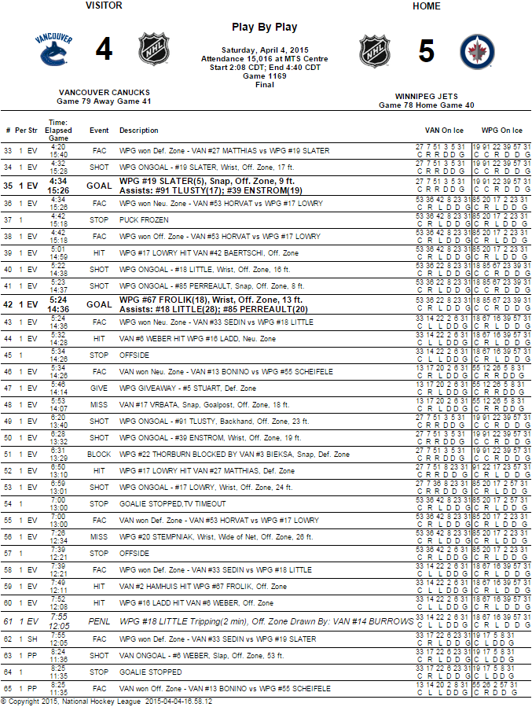
Play-By-Play Event Data

Slide 11
Topics
Problem Overview
Related Works
Play-By-Play Event Data
Markov Game Models
Markov Game Model Construction Algorithm
Dynamic Programming Algorithm for Value Iteration
Evaluating Actions and Players
Model Validation
Results

Slide 12
Markov Game Models
Transition Graph with 4 parts:
States S
Actions A
Transition Probabilities T
Rewards R

Slide 13
Markov Game Models: State Space
Context Features x
Goal Differential GD
Manpower Differential MD
Period P
Play Sequences
Action History h
[faceoff(Home,Offensive), takeaway(Away,Defensive), hit(Home,Offensive), shot(Home,Offensive)]
State s = <x,h>

Slide 14
Markov Game Models: Actions
8 Player Actions, 9 Start/End of Sequence Markers
Action-Events | Markers
Blocked Shot | Early Intermission End
Faceoff | Early Intermission Start
Giveaway | Game End
Goal | Game Off
Hit | Penalty
Missed Shot | Period End
Shot | Period Start
Takeaway | Shootout Completed
 | Stoppage

Slide 15
Markov Game Models: Actions
Use action language notation (Levesque et al, 1998)
Actions written in form a(T,Z)
Action a
Team T
Zone Z
faceoff(Home,Neutral)
shot(Home,Offensive)
hit(Away,Defensive)

Slide 16
Markov Game Models: Transitions
Transitions are mapping (s x a) → s’
If s=(x, h), then s’ = (x, h*a)
Transition probabilities are estimated from observances in play-by-play data
Record occurrences of state s as Occ(s)
Record occurrences of transition as Occ(s,s’)
Transition probabilities T estimated as:
Occ(s,s’) / Occ(s)

Slide 17
Markov Game Models: Rewards
9 Reward Functions:
Expected Goals
Probability that the Home Team Scores the Next Goal
Probability that the Away Team Scores the Next Goal
Expected Penalties
Probability that the Home Team Receives the Next Penalty
Probability that the Away Team Receives the Next Penalty
Expected Wins
Probability that the Home Team Wins
Probability that the Away Team Wins

Slide 18
Markov Game Models: Rewards
Goals
R(s) = 1 if s corresponds to a goal(Home,*)
R(s) = -1 if s corresponds to a goal(Away,*)
R(s) = 0 otherwise
Penalties
R(s) = 1 if s corresponds to a penalty(Home,*)
R(s) = -1 if s corresponds to a penalty(Away,*)
R(s) = 0 otherwise
Wins
R(s) = 1 if s corresponds to a Win(Home)
R(s) = -1 if s corresponds to a Win(Away)
R(s) = 0 otherwise

Slide 19
Markov Game Models: Rewards
Expected Goals
R(s) = 1 if s corresponds to a goal(Home,*)
R(s) = -1 if s corresponds to a goal(Away,*)
R(s) = 0 otherwise
Probability that the Home Team Scores the Next Goal
R(s) = 1 if s corresponds to a goal(Home,*)
R(s) = 0 otherwise

Slide 20
Topics
Problem Overview
Related Works
Play-By-Play Event Data
Markov Game Models
Markov Game Model Construction Algorithm
Dynamic Programming Algorithm for Value Iteration
Evaluating Actions and Players
Model Validation
Results

Slide 21
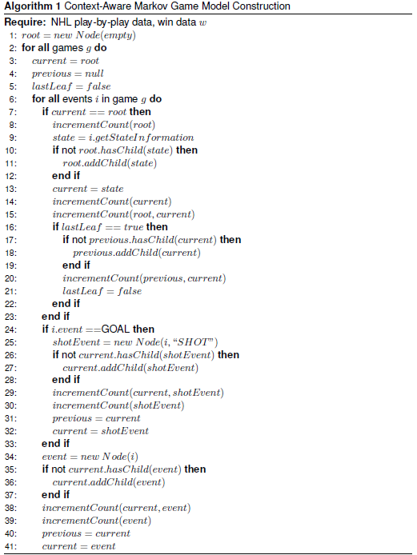
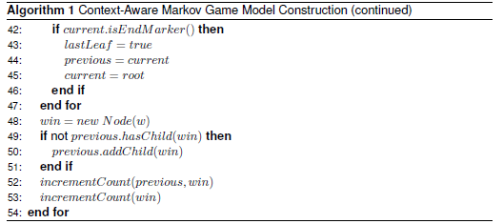
Markov Game Model Construction Algorithm

Slide 22
Markov Game Model Construction Algorithm
Start from Root Node with no context or action history
Add Context Node with context features and empty action history
Add Event Node for the first event
Add Event Node for the second event
Etc.
Add loopback edge to context node of following sequence
Notes:
Constructing Transition Graph.
Replace by animation?

Slide 23
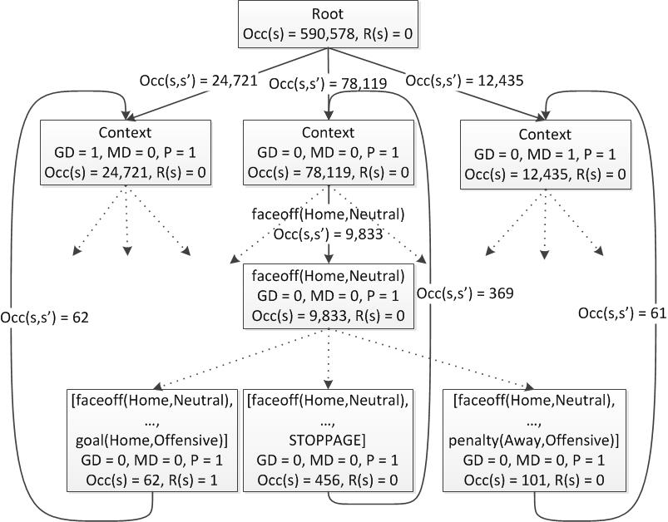
Markov Game Model Construction Algorithm
Notes:
animation?

Slide 24
Topics
Problem Overview
Related Works
Play-By-Play Event Data
Markov Game Models
Markov Game Model Construction Algorithm
Dynamic Programming Algorithm for Value Iteration
Evaluating Actions and Players
Model Validation
Results

Slide 25
The Q-function
Q(s) = expected reward starting in state s.
Reward | Absorbing States | Q(s) represents
Win | Game End | Win Probability Differential
Goals | Game End | Expected Goal Differential
Goals | Game End + Goal States | Next Goal Probability Differential
Penalties | Game End | Expected Penalty Differential
Penalities | Game End + Goal States | Next Penalty Probability Differential

Slide 26

Dynamic Programming Algorithm for Value Iteration
Q-function computation

Slide 27
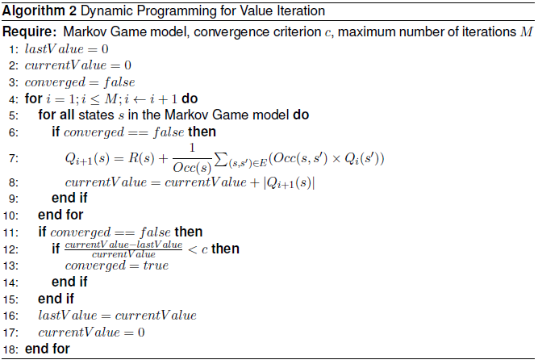
Dynamic Programming Algorithm for Value Iteration

Slide 28
Topics
Problem Overview
Related Works
Play-By-Play Event Data
Markov Game Models
Markov Game Model Construction Algorithm
Dynamic Programming Algorithm for Value Iteration
Evaluating Actions and Players
Model Validation
Results

Slide 29
Evaluating Actions and Players
Computing the impact of an action:
To evaluate a player:
Apply the impact of an action to the player performing the action
Sum the impact of his actions over a game to get his net game impact
Sum the net game impact of a player over a single season to get the his net season impact
Notes:
impact(s,a) = Q(s*a)-Q(a)
average any of these numbers?

Slide 30
Topics
Problem Overview
Related Works
Play-By-Play Event Data
Markov Game Models
Markov Game Model Construction Algorithm
Dynamic Programming Algorithm for Value Iteration
Evaluating Actions and Players
Model Validation
Results

Slide 31
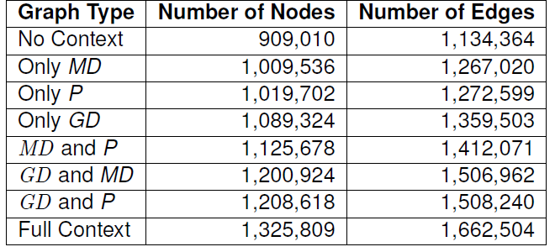
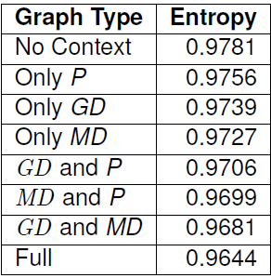
Model Validation
Lesion study: different context features
Entropy wrt which team scores the next goal.

Slide 32
Model Validation
Lesion study: effects of propagation
Local transitions: no loopback edges
Penalty transitions: only penalty leaf nodes loop back to context nodes
Full transitions: all leaf nodes loop back to context nodes

Slide 33
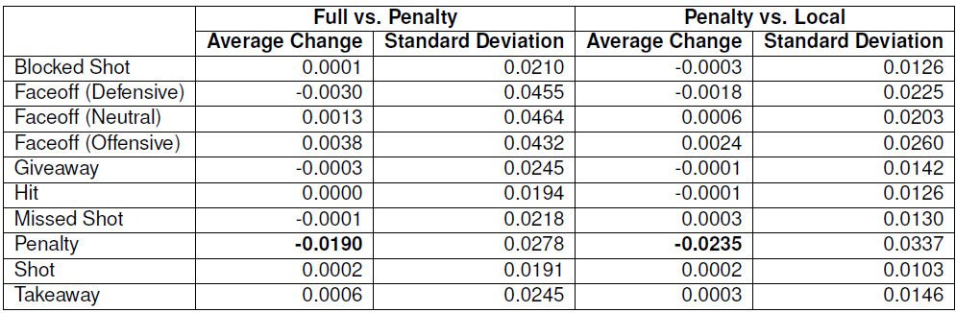
Model Validation
Lesion study: effects of propagation on entropy

Slide 34
Topics
Problem Overview
Related Works
Play-By-Play Event Data
Markov Game Models
Markov Game Model Construction Algorithm
Dynamic Programming Algorithm for Value Iteration
Evaluating Actions and Players
Model Validation
Results

Slide 35
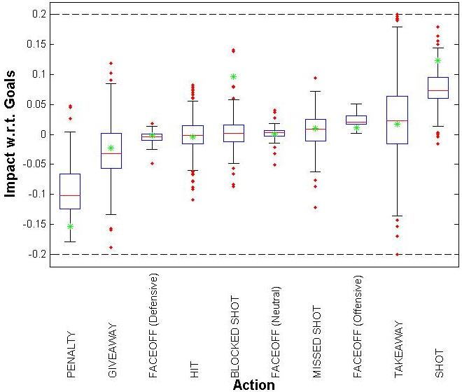
Results: Impact on Goals
green star = Thor
Exclude states with < 5% frequency
Notes:
large variance of impact depending on context.
What are the green values?
Explain boxplot

Slide 36
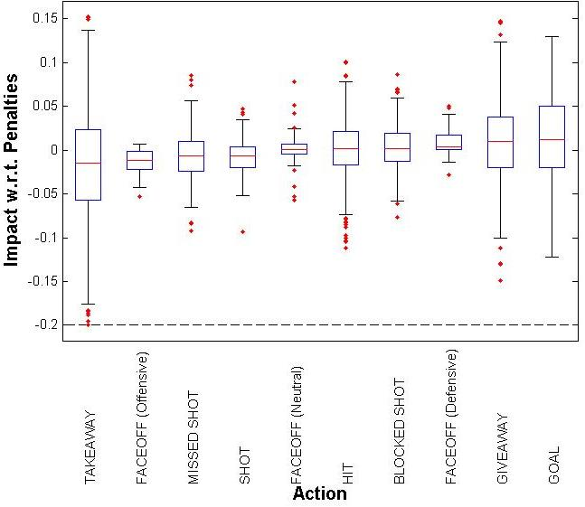
Results: Impact on Penalties

Slide 37
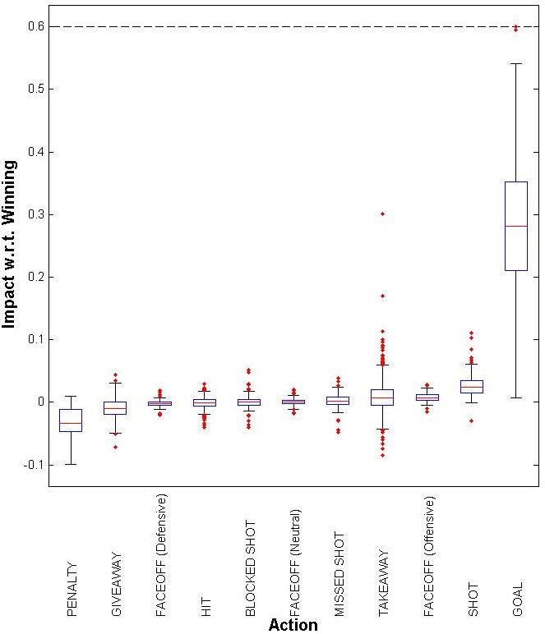
Results: Impact on Winning
Impact of an action on winning
Notes:
Interesting that neutral zone faceoffs won appear to be neutral.

Slide 38
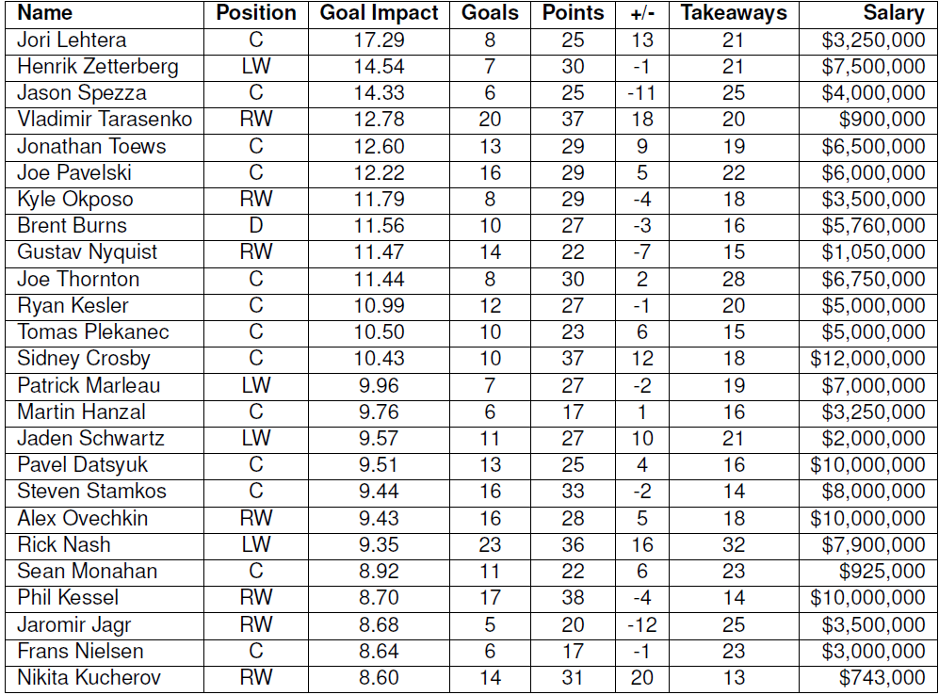
Player Impact on Goals
top 25 players by Goal Impact
High numbers are good.

Slide 39
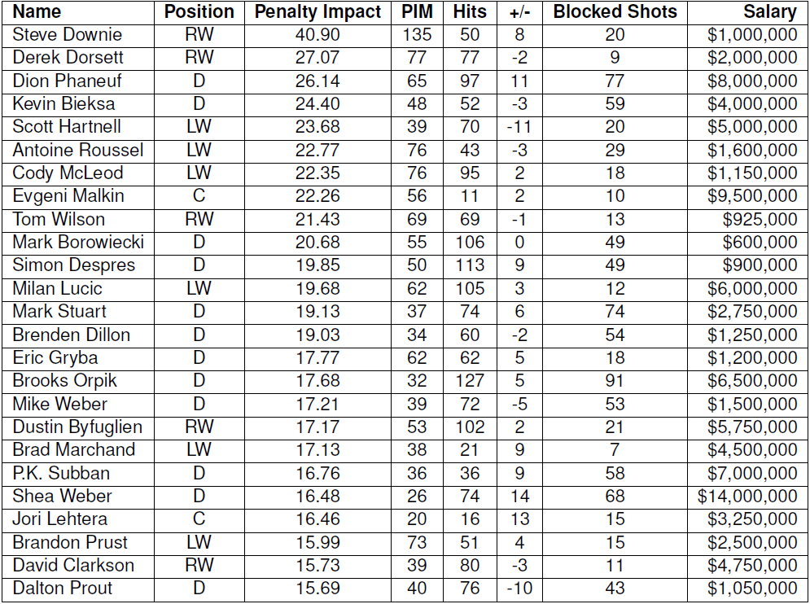
Player Impact on Penalties
top 25 players by Penalty Impact.
High numbers are bad.

Slide 40
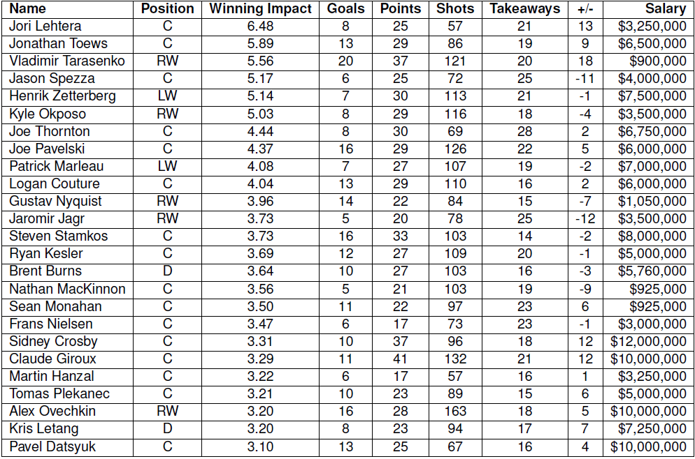
Player Impact on Wins
Notes:
Crosby and Ovechkin’s impact ranking falls from goals to wins, consistent with findings by Pettigrew, where they score many goals but have lower Added Goal Value

Slide 41
Q&A
Thank you
“A Markov Game Model for
Valuing Player Actions in Ice Hockey”
Kurt Routley
BSc, Simon Fraser University, 2013
MSc, Simon Fraser University, 2015?

