Slide 1
A Markov Game Model for Valuing Player Actions in Ice Hockey
Kurt Routley
BSc, Simon Fraser University, 2013

Slide 2
Topics
Problem Overview
Related Works
Play-By-Play Event Data
Markov Game Models
Markov Game Model Construction Algorithm
Dynamic Programming Algorithm for Value Iteration
Evaluating Actions and Players
Model Validation
Results

Slide 3
Topics
Problem Overview
Related Works
Play-By-Play Event Data
Markov Game Models
Markov Game Model Construction Algorithm
Dynamic Programming Algorithm for Value Iteration
Evaluating Actions and Players
Model Validation
Results

Slide 4
Problem Overview
Sports are in the world of big data!
NHL records over 4 million events since 2001
Common statistics are not effectively using this data
e.g. +/-, Corsi, Fenwick
Advanced statistics don’t account for context or long-term effects of actions
Notes:
Corsi = (Shots For + Missed Shots For + Blocked Shots Against) – (Shots Against + Missed Shots Against + Blocked Shots For)
Fenwick = (Shots For + Missed Shots For) – (Shots Against + Missed Shots Against)

Slide 5
Contributions
First Markov Game model for a large ice hockey state space
A variant of AD-Trees as a data structure to compute and store sufficient statistics
Learning a Q-function to model hockey dynamics
A new context-aware method for evaluating players based on their actions
Notes:
AD-Tree: no zero counts, but we include leaf nodes and don’t remove counts that can be deduced

Slide 6
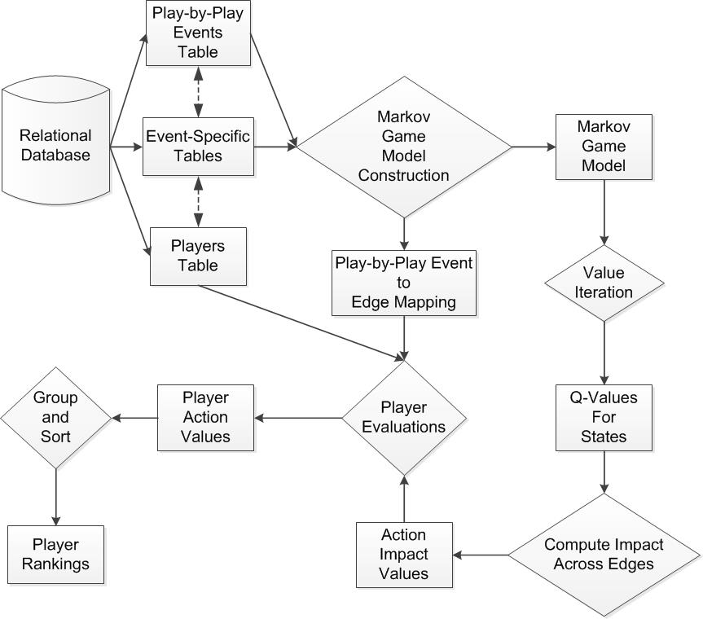
System Overview

Slide 7
Topics
Problem Overview
Related Works
Play-By-Play Event Data
Markov Game Models
Markov Game Model Construction Algorithm
Dynamic Programming Algorithm for Value Iteration
Evaluating Actions and Players
Model Validation
Results

Slide 8
Related Works
Markov Models in Other Sports
Hirotsu & Wright, 2002; Sidhu & Caffo, 2014
Markov Models in Ice Hockey
Buttrey et al, 2011; Thomas et al, 2013
Evaluating Actions and Players in Ice Hockey
Improved/Adjusted +/-
Lock & Shuckers, 2009; Macdonald, 2011; Gramacy et al, 2013; Spagnola, 2013
Impact of Actions on Goals: THoR
Schuckers and Curro, 2013
Impact of Goals on Winning: AGV
Pettigrew, 2015
Notes:
Buttrey uses manpower differential for scoring rates
Thomas uses goal differential and only looked at even strength,
They don’t examine actions
+/-: indicator variable for being on the ice during goals, can’t separate the contributions of players who play together often
Schuckers: Fixed action values give a team bias, fixed lookahead window of 20 seconds
Pettigrew: Only looked at goals, Missing manpower differentials

Slide 9
Topics
Problem Overview
Related Works
Play-By-Play Event Data
Markov Game Models
Markov Game Model Construction Algorithm
Dynamic Programming Algorithm for Value Iteration
Evaluating Actions and Players
Model Validation
Results

Slide 10
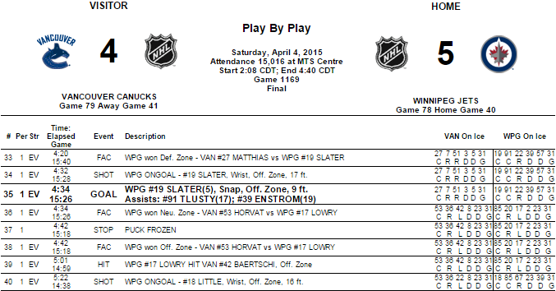
Play-By-Play Event Data

Slide 11
Topics
Problem Overview
Related Works
Play-By-Play Event Data
Markov Game Models
Markov Game Model Construction Algorithm
Dynamic Programming Algorithm for Value Iteration
Evaluating Actions and Players
Model Validation
Results

Slide 12
Markov Game Models
Transition graph with 4 parts:
States S
Actions A
Transition Probabilities T
Rewards R
Notes:
We use a variant of AD-Trees as a data structure for the Markov Game model
States correspond to nodes
Actions correspond to edges

Slide 13
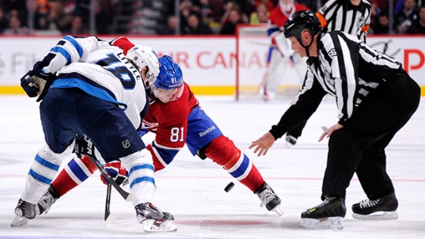
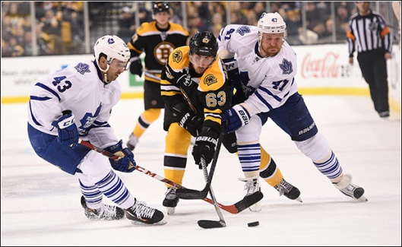
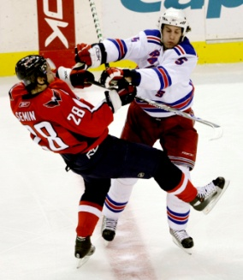

Markov Game Models: State Space
Context Features x
Goal Differential GD
Manpower Differential MD
Period P
Play Sequences
Action History h
[faceoff(Home,Offensive), takeaway(Away,Defensive), hit(Home,Offensive), shot(Home,Offensive)]
State s = <x,h>

Slide 14
Markov Game Models: Actions
8 Player Actions, 9 Start/End of Sequence Markers
Action-Events | Markers
Blocked Shot | Early Intermission End
Faceoff | Early Intermission Start
Giveaway | Game End
Goal | Game Off
Hit | Penalty
Missed Shot | Period End
Shot | Period Start
Takeaway | Shootout Completed
 | Stoppage

Slide 15
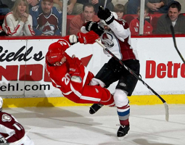
Markov Game Models: Actions
Use action language notation (Levesque et al, 1998)
Actions written in form a(T,Z)
Action a
Team T
Zone Z
faceoff(Home,Neutral)
shot(Home,Offensive)
hit(Away,Defensive)

Slide 16
Markov Game Models: Transitions
Transitions are mapping (s x a) → s’
If s=(x, h), then s’ = (x, h*a)
Transition probabilities are estimated from observances in play-by-play data
Record occurrences of state s as Occ(s)
Record occurrences of transition as Occ(s,s’)
Transition probabilities T estimated as:
Occ(s,s’) / Occ(s)

Slide 17
Markov Game Models: Rewards
Goals
R(s) = 1 if s corresponds to a goal(Home,*)
R(s) = -1 if s corresponds to a goal(Away,*)
R(s) = 0 otherwise
Penalties
R(s) = 1 if s corresponds to a penalty(Home,*)
R(s) = -1 if s corresponds to a penalty(Away,*)
R(s) = 0 otherwise
Wins
R(s) = 1 if s corresponds to a Win(Home)
R(s) = -1 if s corresponds to a Win(Away)
R(s) = 0 otherwise

Slide 18
Topics
Problem Overview
Related Works
Play-By-Play Event Data
Markov Game Models
Markov Game Model Construction Algorithm
Dynamic Programming Algorithm for Value Iteration
Evaluating Actions and Players
Model Validation
Results

Slide 19
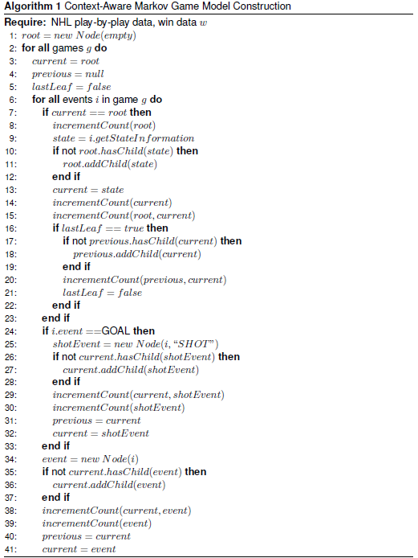
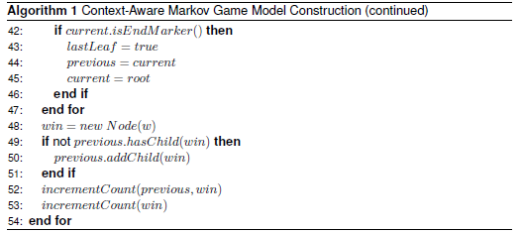
Markov Game Model Construction Algorithm
Notes:
NHL play-by-play event logs don’t record shot leading to goal, we add this in as in Schuckers
We also add a win node to the end of the match for backing up winning.

Slide 20

Markov Game Model Construction Algorithm

Slide 21
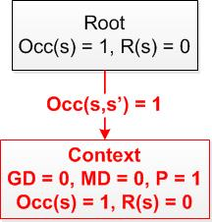
Markov Game Model Construction Algorithm

Slide 22
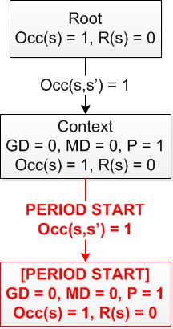
Markov Game Model Construction Algorithm

Slide 23
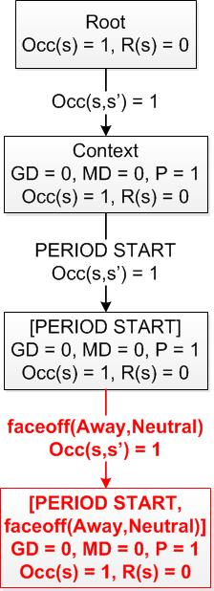
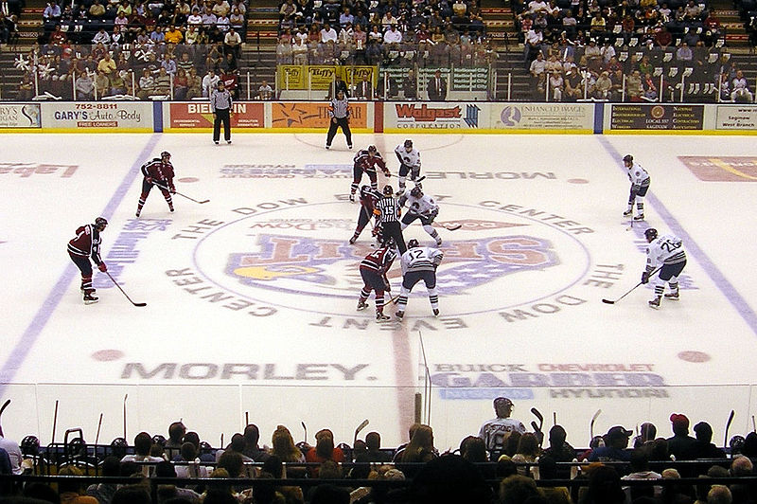
Markov Game Model Construction Algorithm

Slide 24
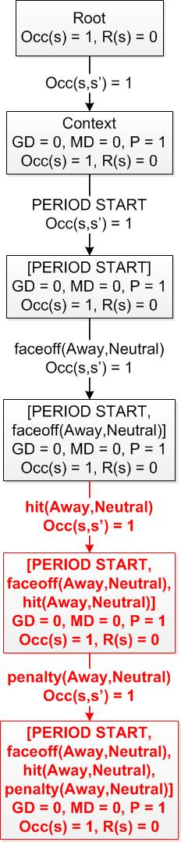
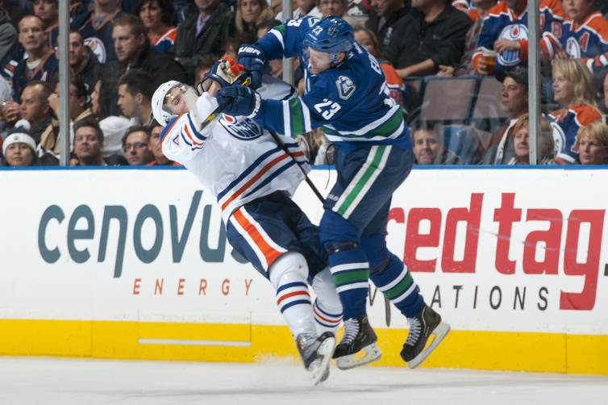
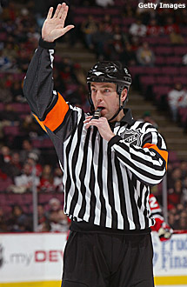
Markov Game Model Construction Algorithm

Slide 25
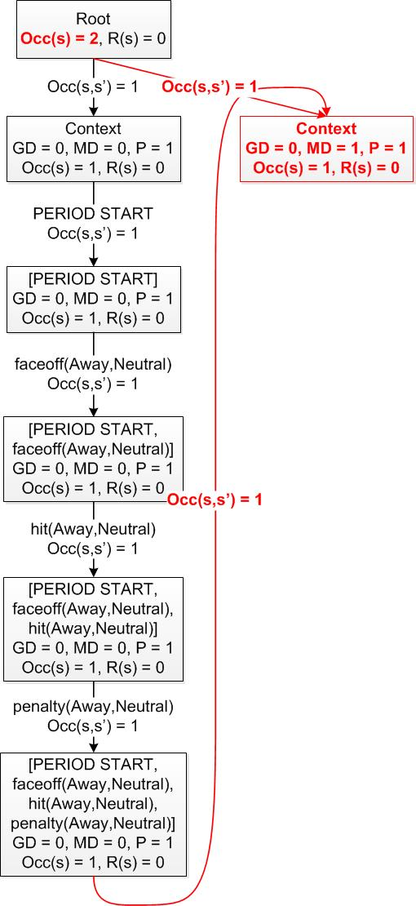
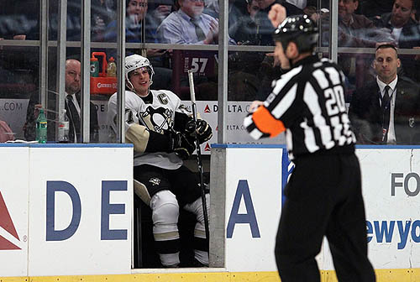
Markov Game Model Construction Algorithm

Slide 26
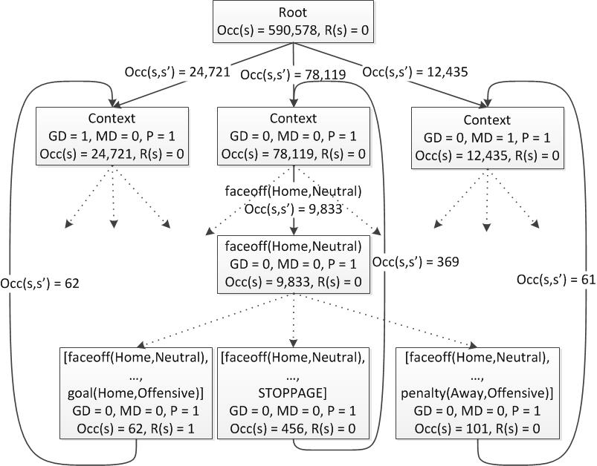
Markov Game Model Construction Algorithm

Slide 27
Topics
Problem Overview
Related Works
Play-By-Play Event Data
Markov Game Models
Markov Game Model Construction Algorithm
Dynamic Programming Algorithm for Value Iteration
Evaluating Actions and Players
Model Validation
Results

Slide 28
The Q-Function
Q(s) = Expected reward starting in state s
Reward | Absorbing States | Q(s) represents
Win | Game End | Win Probability Differential
Goals | Game End | Expected Goal Differential
Goals | Game End + Goals | Next Goal Probability Differential
Penalties | Game End | Expected Penalty Differential
Penalties | Game End + Penalties | Next Penalty Probability Differential
Notes:
Modifying the absorbing state changes what Q(s) represents

Slide 29

Dynamic Programming Algorithm for Value Iteration
Q-function computation:
Notes:
Factor out occurrences of state to prevent potential issues from numerical instability

Slide 30
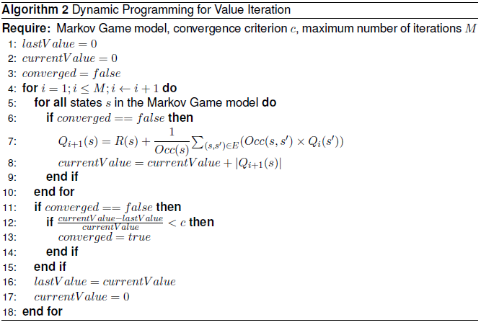
Dynamic Programming Algorithm for Value Iteration

Slide 31
Topics
Problem Overview
Related Works
Play-By-Play Event Data
Markov Game Models
Markov Game Model Construction Algorithm
Dynamic Programming Algorithm for Value Iteration
Evaluating Actions and Players
Model Validation
Results

Slide 32

Evaluating Actions and Players
Computing the impact of an action:
To evaluate a player:
Apply the impact of an action to the player performing the action
Sum the impact of his actions over a game to get his net game impact
Sum the net game impact of a player over a single season to get his net season impact

Slide 33
Topics
Problem Overview
Related Works
Play-By-Play Event Data
Markov Game Models
Markov Game Model Construction Algorithm
Dynamic Programming Algorithm for Value Iteration
Evaluating Actions and Players
Model Validation
Results

Slide 34
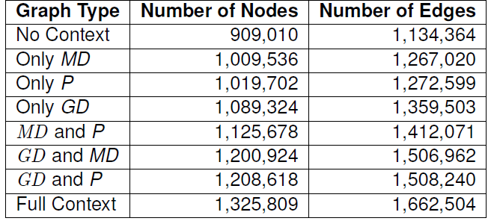
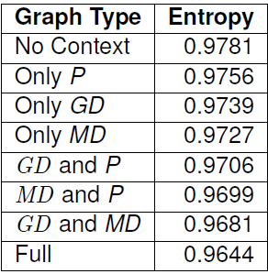
Model Validation
Lesion study: different context features
Entropy computed with respect to the probability of scoring the next goal

Slide 35
Model Validation
Lesion study: effects of propagation
Local transitions: no loopback edges
Penalty transitions: only penalty leaf nodes loop back to context nodes
Full transitions: all leaf nodes loop back to context nodes

Slide 36
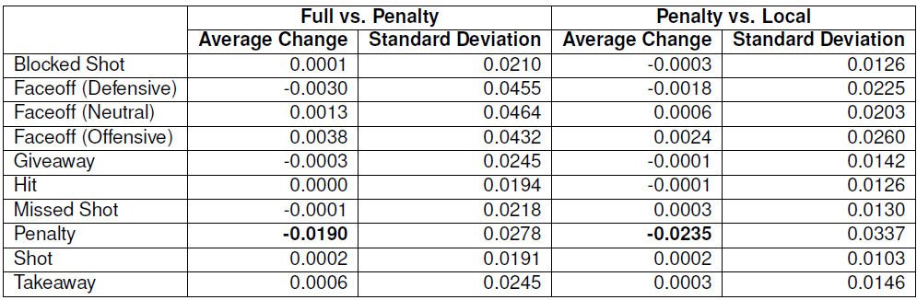
Model Validation
Lesion study: effects of propagation

Slide 37
Topics
Problem Overview
Related Works
Play-By-Play Event Data
Markov Game Models
Markov Game Model Construction Algorithm
Dynamic Programming Algorithm for Value Iteration
Evaluating Actions and Players
Model Validation
Results

Slide 38
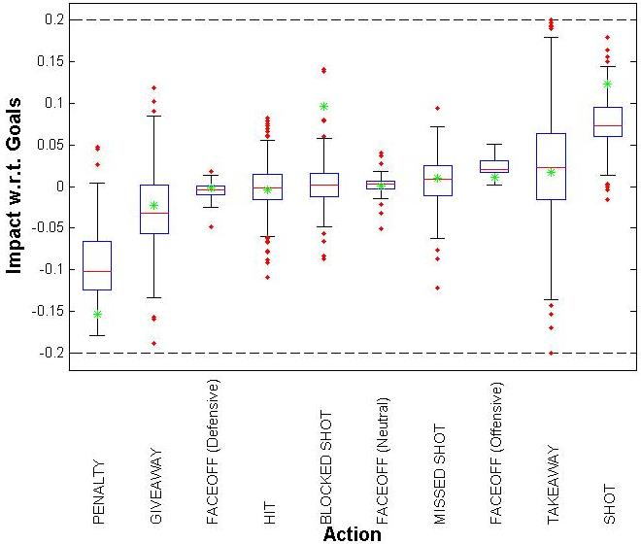
Results: Impact on Goals
Green asterisks represent THoR action values
Notes:
Exclude states with less than 5% frequency
Red line is median value, box is interquartile range, red dots are outliers
Schuckers makes adjustment for shot efficiency

Slide 39
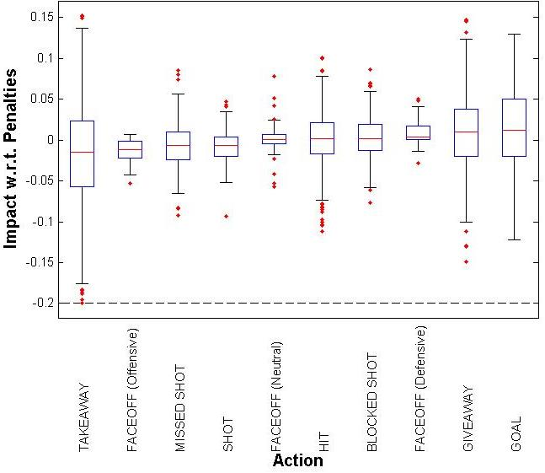
Results: Impact on Penalties

Slide 40
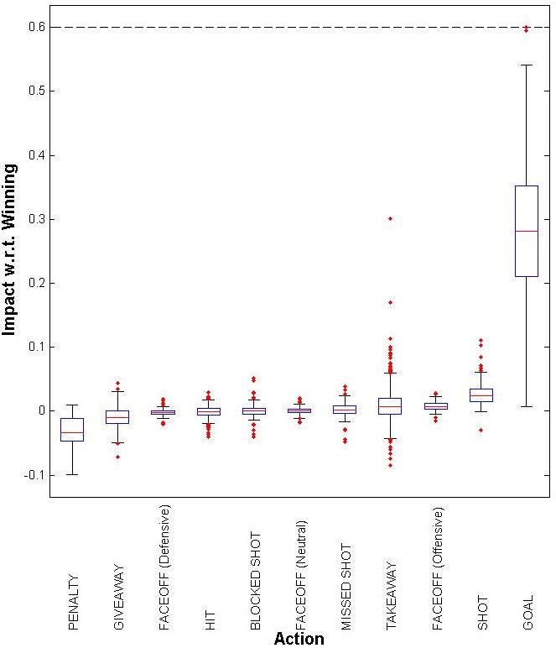
Results: Impact on Winning
Notes:
Interesting that neutral zone faceoffs won appear to be neutral.

Slide 41
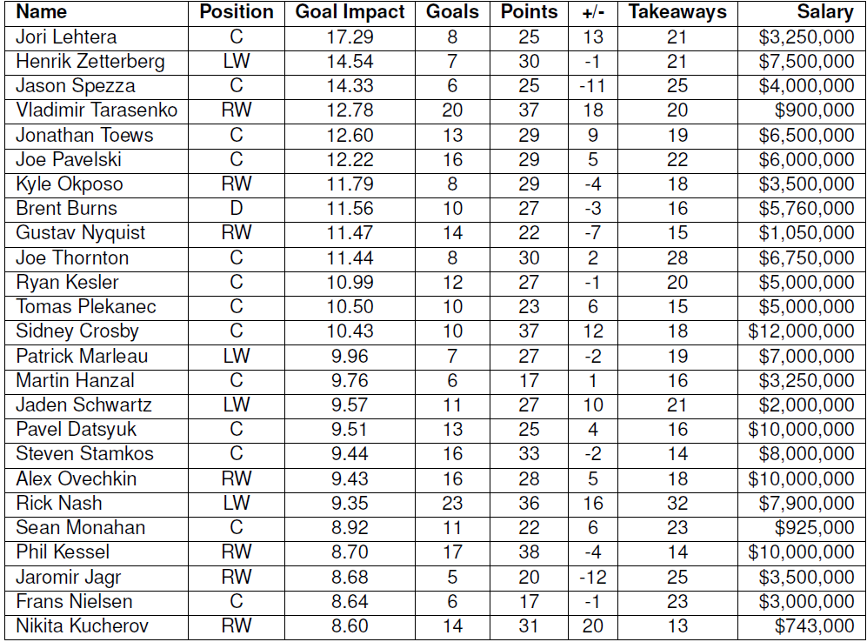
Player Impact on Goals
Notes:
Sort player values for 2014-2015 regular season and display top-25
No Canucks!

Slide 42
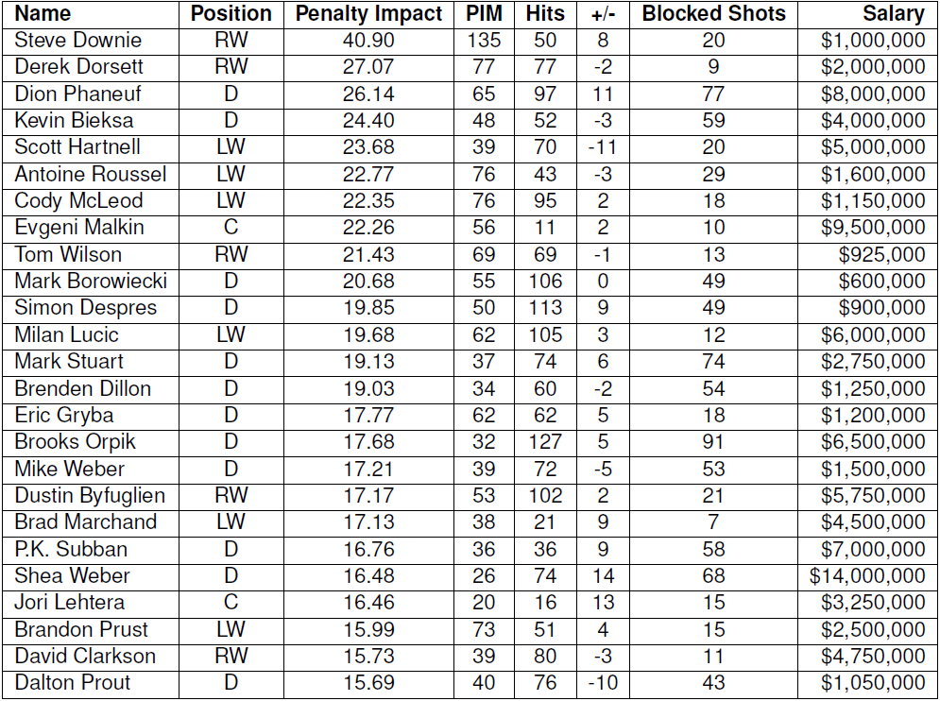
Player Impact on Penalties
Notes:
Penalties are cost, so high value is bad
2 Canucks in top 4: Derek Dorsett and Kevin Bieksa

Slide 43
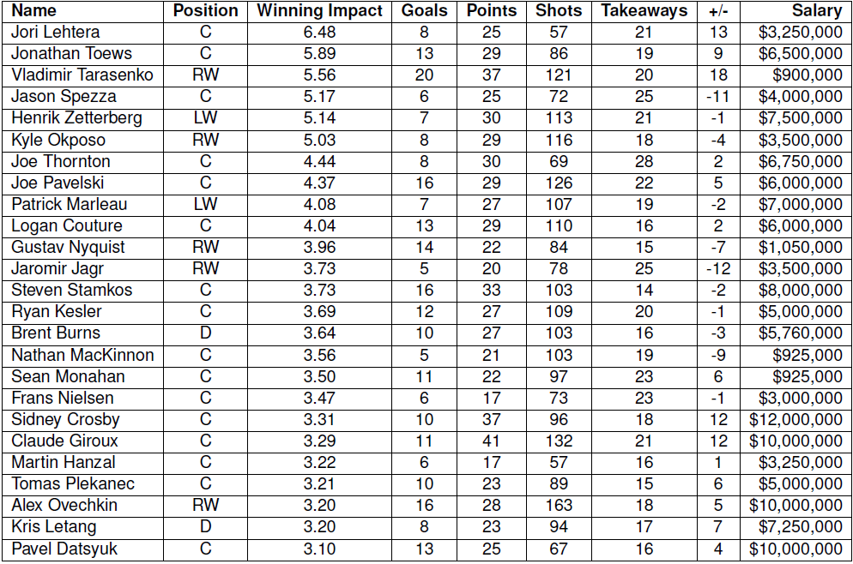
Player Impact on Wins
Notes:
Crosby and Ovechkin’s impact ranking falls from goals to wins, consistent with findings by Pettigrew, where they score many goals but have lower Added Goal Value

Slide 44
Conclusion
We have developed a new context-aware method for evaluating actions and players.
We have created a configurable and scalable Markov Game model that incorporates context and long-term effects of actions.

Slide 45
Q&A
Thank you
“A Markov Game Model for
Valuing Player Actions in Ice Hockey”
Kurt Routley
BSc, Simon Fraser University, 2013
MSc, Simon Fraser University, 2015?

