Slide 1

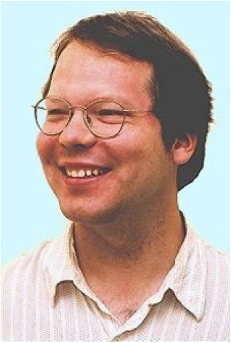
School of Computing Science
Simon Fraser University
Vancouver, Canada
Oliver Schulte | Hassan Khosravi | Arthur Kirkpatrick | Tianxiang Gao | Yuke Zhu
Notes:
If you use “insert slide number” under “Footer”, that text box only displays the slide number, not the total number of slides. So I use a new textbox for the slide number in the master.
This is a version of “Equity”.

Slide 2
final classification score
classifier: SVM, logistic reg.
classification
by
aggregating
features
(propositionalization)
single aggregate FV
aggregator/
aggregate function
FV of neighbor 1
FV of neighbor 2
FV of neighbor n
...
data
classifier: SVM,
logistic reg.
classifier: SVM,
logistic reg.
classifier: SVM,
logistic reg.
classification by aggregating predictions (combining rules)
score 1
score 2
score 3
aggregator/
combining rule
final classification score

Slide 3
do Bayes net figure with predictors.

