Slide 1
System Overview
“Flat” Feature Count Vector
Target Object
aggregation
Outlier Metric = Mutual Information Divergence
Object Tree
Object Profile
Object Distribution
Path Types
Class Distribution

Slide 2

System Flow
Structure
Learning
Class
Database
Class
Model Structure
Parameter
Learning
Parameter
Learning
restrict to target individual
Class
Parameter
Values
Object Parameter
Values
Object Database
model likelihood
model likelihood
outlier score= log-likelihood distance
Notes:
can use any parameter learning algorithm

Slide 3
Class
Model Structure
Parameter
Learning
Structure
Learning
Parameter
Learning
Class
Parameter
Values
Class
Database
Object Parameter
Values
Object Database
model likelihood
on object database
model likelihood on object database
outlier score=
log-likelihood distance
Notes:
can use any parameter learning algorithm

Slide 4
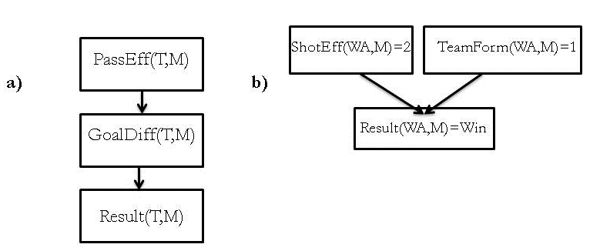
goals(MC, Match)
FirstGoal(Silva, Match)
goals(MC, Match)
FirstGoal(Nasri, Match)
goals(MC,Match)
TeamFormation(MC, Match)
(c)
(a)
Result(Match)
(b)
Result(Match)
Result(Match)
TimePlayed(Silva, Match)
WinningGoal(Player, Match)
PassEff(T,M)
ShotEff(WA,M)=2
TeamForm(WA,M)=1
a)
GoalDiff(T,M)
b)
Result(Wa,M)=Win
Result(T,M)

Slide 5
node1
node 2
node n
node 3
...
Node | Score-Delta
1 | 12.5
2 | 5.7
... | ...
n | 8.3
TotalScoreDiff | Σ above
Child Node | Child value | Parent1 value | Parent2 value | Score
1 | high | a | A | -2.5
1 | high | a | B | -2.7
... | ... | ... | ... | ...
1 | low | b | A | -1.2
 |  |  | Total Score | Σ above

Slide 6
population
individual
CompleteDatabase
restrict to target
individual
IndividualDatabase
Bayes net Learning Algorithm
Bayes net Learning Algorithm
Generic Bayes Net
Individual Bayes Net
generic model likelihood L
individual model likelihood
model likelihood
ratio LR

Slide 7
Anomaly Detection
unsupervised
supervised
new topic
data type
out of paper scope
relational data
not iid
iid data
feature vectors
generative model
for relational data
generative model
for iid data
new method
new method
anomaly score =
pseudo likelihood ratio
anomaly score =
pseudo likelihood
generalizes
anomaly score =
likelihood

Slide 8
Novelty Diagram
Outlier Detection
supervised
unsupervised
out of paper scope
data model
attribute vectors data matrix
structured
“flattening” aggregation
unstructured
new method
paper topic: object-oriented
XML
multi-relational SQL
multi-dimensional OLAP
Divergence Outliers
Attribute Outliers
density-based distance-based subspace clustering
contextual outliers
Explore Data Cubes
Association Rules Community Discovery

Slide 9
Novelty Diagram
Outlier Detection
supervised
unsupervised
out of paper scope
data model
attribute vectors data matrix
object-relational
“flattening” aggregation
i.i.d.
model-based
model-based
paper topic
density-based distance-based subspace clustering
contextual outliers
Community Discovery
Association Rules
outlier score =
log-likelihood distance
Outlier score =
log-likelihood

Slide 10
PassEff(T,M)
ShotEff(WA,M)=2
TeamForm(WA,M)=1
a)
GoalDiff(T,M)
a)
Result(Wa,M)=Win
Result(T,M)

Slide 11
P(S(Y) = T |S(X) =T,F(X,Y)=T) = 70%
P(S(Y) = T |S(X) =F,F(X,Y)=F) = 75%
…
P(C(Y) = T |S(Y) =T) = 70%
…
Friend(X,Y)
Smokes(X)
Smokes(Y)
Cancer(Y)

Slide 12
Bayesian Network Example
P(shotEff=high)=0.38
P(shotEff=low)=0.62
P(passEff=high)=0.43
P(passEff=low)=0.57
P(shotEff=high)=0.50
P(shotEff=low)=0.50
P(passEff=high)=0.61
P(passEff=low)=0.39
ShotEff(T,M)
PassEff(T,M)
ShotEff(WA,M)
PassEff(WA,M)
Result(T,M)
Result(WA,M)
P(Result=Win|shotEff=high, passEff=high)=0.44 P(Result=Win|shotEff=high, passEff=low)=0.22
P(Result=Win|shotEff=low, passEff=low)=0.18
P(Result=Win|shotEff=low, passEff=high)=0.07
P(Result=Win|shotEff=high, passEff=high)=0.53 P(Result=Win|shotEff=high, passEff=low)=0.50
P(Result=Win|shotEff=low, passEff=low)=0.00
P(Result=Win|shotEff=low, passEff=high)=0.11

Slide 13
P(shotEff=high)=0.38
P(shotEff=low)=0.62
P(passEff=high)=0.43
P(passEff=low)=0.57
P(shotEff=high)=0.50
P(shotEff=low)=0.50
P(passEff=high)=0.61
P(passEff=low)=0.39
ShotEff(T,M)
PassEff(T,M)
ShotEff(WA,M)
PassEff(WA,M)
Result(T,M)
Result(WA,M)
P(Result=Win|shotEff=high, passEff=high)=0.44 P(Result=Win|shotEff=high, passEff=low)=0.22
P(Result=Win|shotEff=low, passEff=low)=0.18
P(Result=Win|shotEff=low, passEff=high)=0.07
P(Result=Win|shotEff=high, passEff=high)=0.53 P(Result=Win|shotEff=high, passEff=low)=0.50
P(Result=Win|shotEff=low, passEff=low)=0.00
P(Result=Win|shotEff=low, passEff=high)=0.11

Slide 14
Exceptional Model Mining: I.I.D Single-Table Data
Entire Population Data
Subgroup Data
attribute 1 | attribute 2 | attribute 3
attribute 1 | attribute 2 | attribute 3
learning
subgroup model
learning
Outlierness Metric (quality measure) = Measures dissimilarity between population and subgroup models
population model

Slide 15
Exceptional Model Mining: Multi-Relational Data
Entire Population Database
Individual Object Database
learning
learning
statistical-relational model for population
statistical-relational model for individual object
Parametrized Bayesian Network
Parametrized Bayesian Network
Outlierness Metric (quality measure) = Measures dissimilarity between population and object models
Kullback-Leibler divergence
Expected log-distance (new)

