Slide 1
Managing Massive Machine Learning Models within an RDBMS

Slide 2
Related Work
Data Type
Multi-Relational
Single-Table
Data Management
Data Management
Files+
Main Memory
Database
Files+
Main Memory
Database
Alchemy PSL
Boostr
ProbLog
MADLib
MLBase
Bismarck
Unipivot
MauveDB
Weka
R
Task
Inference
Parameter
Learning
Structure Learning
BayesStore
Tuffy
Felix
Tuffy
Felix
FactorBase

Slide 3
Data Type
Single-Table
Multi-Relational
Data Management
Data Management
Database
Files+
Main Memory
Database
Files+
Main Memory
MADLib
MLBase
Bismarck
Unipivot
MauveDB
Weka
R
Task
Alchemy PSL
Boostr
ProbLog
Structure Learning
Parameter
Learning
Inference
FactorBase
Tuffy
Felix
BayesStore
Tuffy
Felix
Notes:
Single machine computation vs cluster: while cluster based computation has many advantages in terms of the amount of data it can process.
from the energy saving point of view, it only costs much less energy but with competitive statistical power.
Related works in the field.
Our system supports learning factors that define a log-linear multi-relational model
The PS paradigm could be considered as general-purpose framework, it focuses on improving the ``systems'' code
(notably, communication and synchronization protocols for model state) to increase the efficiency of machine learning algorithms.
In contrast, the FactorBase System combines both systems code improvements and algorithmic learning improvements tailor-made for log-linear model of multi-relational data.

Slide 4
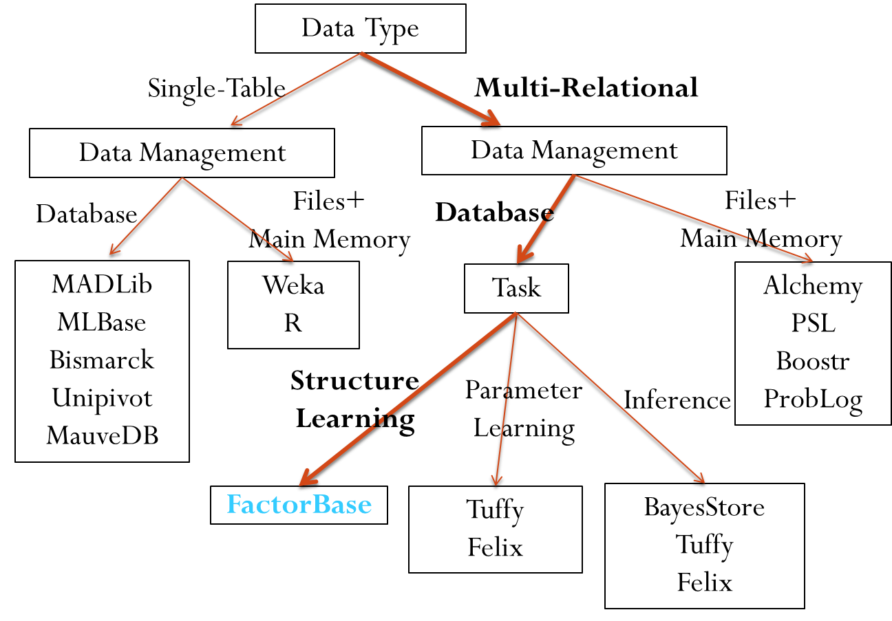
Notes:
Single machine computation vs cluster: while cluster based computation has many advantages in terms of the amount of data it can process.
from the energy saving point of view, it only costs much less energy but with competitive statistical power.
Related works in the field.
Our system supports learning factors that define a log-linear multi-relational model
The PS paradigm could be considered as general-purpose framework, it focuses on improving the ``systems'' code
(notably, communication and synchronization protocols for model state) to increase the efficiency of machine learning algorithms.
In contrast, the FactorBase System combines both systems code improvements and algorithmic learning improvements tailor-made for log-linear model of multi-relational data.

Slide 5

Graphical Model +
Parameter Values
Parameters
Models Database: MDB
Model Structure
Learns Model Structure
Model Manager
Cross-Table Counts/
Sufficient Statistics
Contingency Table
Count Database:
CDB
Computes Sufficient Statistics
Count Manager
MetaData about Random Variables
Random Variable
DataBase: VDB
Analyzes Schema
Variable Manager
Multi-Relational Raw Data
Input DataBase

Slide 6
Registration, RA, Teaches
Level 3
Registration, RA
Registration, Teaches
RA, Teaches
Level 2
Registration
RA
Teaches
Level 1
Student
Course
Professor
Level 0
Lattice of Relationship Chains (Meta-paths) + Entity Tables
Notes:
DP

Slide 7
Data Type
Single-Table
Multi-Relational
Data Management
Data Management
Database
Files+
Main Memory
Database
Files+
Main Memory
MADLib
MLBase
Bismarck
Unipivot
MauveDB
Weka
R
Task
Alchemy PSL
Boostr
ProbLog
Structure Learning
Parameter
Learning
Inference
FactorBase
Tuffy
Felix
BayesStore
Tuffy
Felix
Notes:
DSAA2015, related work, Oct 14th

Slide 8
Tentative plan
Relatonal database functionality vs traditional machine learning IID assumption
BayesBase system overview (both statistics and models are first-class citizen, scalable to large data)
Relational databases, relational BN, and sufficient statistics
Default Random variable (how to extract the RV in a generative way and store effectively)
Relational CT tables (focus on the side of how to store it?)
Meta-queries
Model Manager for BN learning and RDN close-form computation
Experiments (CT time, BN Learning time; RDN grounding time; or Feature construction?)
Discussion
Notes:
Grounding time, instance by instance → batch given Markov Blanket (MB) → batch given Family Configuration (FC)
Self-relationship??
CT time reuse part of the results from cikm; do not need the compression ratio
BN learning time: BBH vs. flat ; do not need to report this for other two since that’s for scoring comparison
Pseudo BIC?

Slide 9
General Machine Learning for Single-Table Data
e.g. Weka, R, Matlab.
Input is single flat data matrix .
Represents independent and identically distributed data points (i.i.d. data).
No need to describe connections between tables (e.g., no foreign key constraints).
Default set of random variables = attribute columns.
Computing sufficient statistics = counting matching rows in data table.
Notes:
Preprocessing that data into a flat table: lose important information or introduce some redundancy infor, and usually time-consuming
Getoor2001. :
real data often contain strong correlations between attributes (For example a census database might contain highly correlated attributes such as Income and Home-Owner. The attribute value independence assumption would lead to an overestimate of the result size of a query that asks for low-income home-owners.)

Slide 10
Relational Learning With Multiple Database Tables
Models information from different related tables simultaneously.
Uses both links and attributes to discover probabilistic dependencies.
Applications: Visualizing correlations, query optimization, missing/uncertain data (BayesStore).
Data is not i.i.d. -> statistical issues discussed elsewhere.
We are focusing on developing general learning algorithms that can be applied to different databases directly.
No preprocessing.
No feature engineering.
Use of SQL for development and optimization.
Notes:
look up domingos’ paper on relational learning challenges.
maybe mention recursive dependencies here

Slide 11
General and Scalable Machine Learning with Relational Databases: SQL
Graphical model = structured object with structured components.
All structured objects are treated as 1st-class citizens, represented in database meta-tables.
Can be manipulated using SQL.
Can be combined with machine learning algorithms using SQL.
Notes:
linear algebra = relational algebra for implementation.
if you make good use of database techniques, can achieve general scalable machine learning.

Slide 12
DataBase
original data
SQL Script Utilizing information schema
DataBase_RV
Random variables
Node id | FunctorName | Type
intelligence(S) | intelligence | 1Node
satisfaction(C,S) | satisfaction | 2Node
Registration(C,S) | Registration | Rnode
Edge Constraints
Model Manager
Lattice Search
Virtual Join Algorithm
PathBayesNet
DataBase_CT
Contingency Tables
Count | Pop | Teach | Intel | Rank
1 | 1 | 2 | 3 | 1
1 | 1 | 2 | 2 | 2
1 | 2 | 2 | 2 | 4
… | … | … | … | …
Rchain | Child | Parent
Registration(C,S), RA (S,P) | ranking(S) | intelligence(S)
RA(S,P) | popularity(P) | teachingability(P)
Registration(C,S) | diff(C) | grade(C,S)
DataBase_BN
Bayes Nets
Notes:
Feb 25, 2014
general-flow-chart.png
Expend the bayes net table and replace Student and Course with S,C

Slide 13
Functionality
Store and Score

Slide 14
Architecture
DataBase
original data
Schema Analyzer
Model Manager
Parameter Manager
Score Computation
DataBase_RV
MetaData about Random variables
Count Manager
Auxilliary Structure
Background Knowledge
DataBase_Models
DataBase_Count
Counts/Sufficient Statistics
Model Structure
Parameters
Score
Notes:
Learning Support Layers

Slide 15
Massive-Model-System Architecture
Score
Model Manager
Parameter Manager
Score Computation
Models Database MDB
Model Structure
Parameters
Auxilliary Structure
Background Knowledge
Count Database CDB
Counts/Sufficient Statistics
Counts
Count Manager
Dynamic Program
Schema Analyzer
DataBase
original data
Random Variable DataBase VDB
MetaData about Random variables
Notes:
architecture.pdf
Learning Support Layers
Buttom up, layer by laryer

Slide 16
System Pipeline
Input DataBase
Variable Manager
Random Variable
DataBase: VDB
Count Manager
Count Database:
CDB
Model Manager
Models Database: MDB
Parameters
Counts
Model Structure
analyzes schema
MetaData about Random variables
computes sufficient statistics
Cross-table Counts/
Sufficient Statistics
Learns Model Structure
Graphical Model +
Parameter Values
Notes:
pipeline.pdf

Slide 17
System Pipeline
Input DataBase
Variable Manager
Random Variable
DataBase: VDB
Count Manager
Count Database:
CDB
Model Manager
Models Database: MDB
Parameters
Contingency Table
Model Structure
analyzes schema
MetaData about Random variables
computes sufficient statistics
Cross-table Counts/
Sufficient Statistics
Learns Model Structure
Graphical Model +
Parameter Values
Counts

Slide 18
VDB
Input DataBase
Variable Manager
Random Variable
DataBase: VDB
Count Manager
Count Database:
CDB
Model Manager
Models Database: MDB
Parameters
Contingency Table
Model Structure
analyzes schema
MetaData about Random variables
computes sufficient statistics
Cross-table Counts/
Sufficient Statistics
Learns Model Structure
Graphical Model +
Parameter Values
output:
parametrized random variables
domain of par-RVs
pointer to column/table
implementation:
SQL script for analyzing input data schema

Slide 19
VDB
Random Variable
DataBase: VDB
Variable Manager
Input DataBase
analyzes schema
constructs
parametrized random variables
domain of par-RVs
pointer to column/table

Slide 20
CDB
Input DataBase
Variable Manager
Random Variable
DataBase: VDB
Count Manager
Count Database:
CDB
Model Manager
Models Database: MDB
Parameters
Contingency Table
Model Structure
analyzes schema
MetaData about Random variables
computes sufficient statistics
Cross-table Counts/
Sufficient Statistics
Learns Model Structure
Graphical Model +
Parameter Values
output:
contingency tables
implementation:
pointers to par-RVs in VDB
SQL metaqueries that build count(*) queries

Slide 21
CDB
Random Variable
DataBase: VDB
Count Database:
CDB
accesses
MetaData about Random variables
Count Manager
Contingency Table
constructs
with metaqueries
Cross-table Counts/
Sufficient Statistics
runs count queries against
Input DataBase

Slide 22
MDB
Input DataBase
Variable Manager
Random Variable
DataBase: VDB
Count Manager
Count Database:
CDB
Model Manager
Models Database: MDB
Parameters
Contingency Table
Model Structure
analyzes schema
MetaData about Random variables
computes sufficient statistics
Cross-table Counts/
Sufficient Statistics
Learns Model Structure
Graphical Model +
Parameter Values
output:
graphical model stored in table
parameter values stored in factor tables
model scores
implementation:
pointers to par-RVs in VDB
SQL queries that use contingence tables from CDB to compute parameters and model scores

Slide 23
MDB
Random Variable
DataBase: VDB
Models Database: MDB
accesses
MetaData about Random variables
Model Manager
Parameters
constructs
using model search
Model Structure
Count Database CDB
Graphical Model +
Parameter Values
runs SQL queries against
Contingency Table
Cross-table Counts/
Sufficient Statistics

Slide 24
Model Manager: Learning
Model Structure
Parameters
Model Score
Contingency Table

Slide 25
Table Name | Column Headers in Random Variable Database
Pvariables | Pvid | TABLE_NAME
 | C | course
 | P | prof
 | S | student
1Variables | 1VarID | COLUMN_NAME |  |  | Pvid
 | diff(C) | diff |  |  | C
 | intelligence(S) | intelligence |  |  | S
 | popularity(P) | popularity |  |  | P
 | ranking(S) | ranking |  |  | S
 | rating(C) | rating |  |  | C
 | teachingability(P) | teachingability |  |  | P
2Variables | 2VarID | COLUMN_NAME1 | COLUMN_NAME2 |  | Pvid1 | Pvid2
 | capability(P,S) | p_id | s_id |  | P | S
 | grade(C,S) | c_id | s_id |  | C | S
 | salary(P,S) | p_id | s_id |  | P | S
 | sat(C,S) | c_id | s_id |  | C | S
Relationship | RVarID | TABLE_NAME | COLUMN_NAME1 | COLUMN_NAME2 | Pvid1 | Pvid2
 | RA(P,S) | RA | p_id | s_id | P | S
 | Registered(C,S) | Registered | c_id | s_id | C | S
Notes:
Random variable database (set up )
rv_db_tables.pdf

Slide 26
INFORMATION_SCHEMA
COLUMNS
TABLES
KEY_COLUMN_USAGE
Schema_Position_Info
Schema_Key_Info
KeyColumns
AttributeColumns
EntityTables
ForeignKeyColumns
2Variables
PVariables
1Variables
ForeignKeys_pvars
RelationTables
RNodes_MM_Selff
RNodes_MM_NotSelf
Relationship
Notes:
rv_db.pdf

Slide 27
Metaqueries | Entries
CREATE VIEW Select_List AS SELECT RVarID, CONCAT(‘COUNT(*)',' as "count"') AS Entries FROM VDB.Relationship UNION DISTINCT SELECT RVarID, AVarID AS Entries FROM VDB.Relationship_Attributes; | COUNT(*) as “count"
 | `Popularity(P)`
 | `Teachingability(P)`
 | `Intelligence(S)`
 | `Ranking(S)`
CREATE VIEW From_List AS SELECT RVarID, CONCAT('@database@.',TABLE_NAME) AS Entries FROM VDB.Relationship_FOvariables UNION DISTINCT SELECT RVarID, CONCAT('@database@.',TABLE_NAME) AS Entries FROM VDB.Relationship; | @database@.prof AS P
 | @database@.student AS S
 | @database@.RA AS `RA`
CREATE VIEW Where_List AS SELECT RVarID, CONCAT(RVarID,'.',COLUMN_NAME,' = ', FO-ID,'.', REFERENCED_COLUMN_NAME) AS Entries FROM VDB.Relationship_FOvariables; | `RA`.p_id = P.p_id
 | `RA`.s_id =S.s_id
Notes:
meta-query.pdf with VIEW
Consistent with \ref{table:vdb-schema}

Slide 28
Metaqueries | Entries
CREATE VIEW Select_List AS SELECT RVarID, CONCAT(‘COUNT(*)',' as "count"') AS Entries FROM VDB.Relationship UNION DISTINCT SELECT RVarID, 1VarID AS Entries FROM VDB.Relationship_1Variables; | COUNT(*) as “count"
 | `popularity(P)`
 | `teachingability(P)`
 | `intelligence(S)`
 | `ranking(S)`
CREATE VIEW From_List AS SELECT RVarID, CONCAT('@database@.',TABLE_NAME) AS Entries FROM VDB.Relationship_Pvariables UNION DISTINCT SELECT RVarID, CONCAT('@database@.',TABLE_NAME) AS Entries FROM VDB.Relationship; | @database@.prof AS P
 | @database@.student AS S
 | @database@.RA AS `RA`
CREATE VIEW Where_List AS SELECT RVarID, CONCAT(RVarID,'.',COLUMN_NAME,' = ', Pvid,'.', REFERENCED_COLUMN_NAME) AS Entries FROM VDB.Relationship_Pvariables; | `RA`.p_id = P.p_id
 | `RA`.s_id =S.s_id
Notes:
meta-query.pdf with VIEW

Slide 29
Metaqueries | Entries
CREATE TABLE Select_List AS SELECT RVarID, CONCAT(‘COUNT(*)',' as "count"') AS Entries FROM VDB.Relationship UNION DISTINCT SELECT RVarID, 1VarID AS Entries FROM VDB.Relationship_1Variables; | COUNT(*) as “count"
 | `popularity(P)`
 | `teachingability(P)`
 | `intelligence(S)`
 | `ranking(S)`
CREATE TABLE From_List AS SELECT RVarID, CONCAT('@database@.',TABLE_NAME) AS Entries FROM VDB.Relationship_Pvariables UNION DISTINCT SELECT RVarID, CONCAT('@database@.',TABLE_NAME) AS Entries FROM VDB.Relationship; | @database@.prof AS P
 | @database@.student AS S
 | @database@.RA AS `RA`
CREATE TABLE Where_List AS SELECT RVarID, CONCAT(RVarID,'.',COLUMN_NAME,' = ', Pvid,'.', REFERENCED_COLUMN_NAME) AS Entries FROM VDB.Relationship_Pvariables; | `RA`.p_id = P.p_id
 | `RA`.s_id =S.s_id
Notes:
meta-query.pdf

Slide 30
Count | Diff. | Rat. | Pop. | Teach. | Intel. | Rank. | Cap. | Sal. | Grade | Sat. | RA | Reg.
1 | 1 | 1 | 1 | 2 | 3 | 1 | 3 | High | 1 | 1 | T | T
1 | 1 | 2 | 1 | 2 | 2 | 2 | n/a | n/a | 2 | 2 | F | T
3 | 1 | 2 | 1 | 2 | 2 | 2 | 1 | Med | n/a | n/a | T | F
24 | 2 | 1 | 1 | 2 | 1 | 5 | n/a | n/a | n/a | n/a | F | F
… | … | … | … | … | … | … | … | … | … | … | … | …
1 | 2 | 1 | 2 | 2 | 1 | 4 | n/a | n/a | 3 | 2 | F | T
Notes:
uni-ct-table.pdf

Slide 31
Cap.(P,S) | RA(P,S) | Salary(P,S) | CP
n/a | F | n/a | 1.00
4 | T | high | 0.45
5 | T | high | 0.36
3 | T | high | 0.18
3 | T | low | 0.20
2 | T | low | 0.40
1 | T | low | 0.40
2 | T | med | 0.22
3 | T | med | 0.44
1 | T | med | 0.33
Count | Cap.(P,S) | RA(P,S) | Salary(P,S)
203 | N/A | N/A | F
5 | 4 | high | T
4 | 5 | high | T
2 | 3 | high | T
1 | 3 | low | T
2 | 2 | low | T
2 | 1 | low | T
2 | 2 | med | T
4 | 3 | med | T
3 | 1 | med | T
(a)
(b)
Capability(P,S)
Salary(P,S)
RA(P,S)
Salary(P,S) | RA(P,S) | Capa(P,S) | CP
High | T | High | 1.0
Low | T | Low | 0.5
Med | T | Low | 0.5
... | ... | ... | ...
intelligence(S)
Popularity(P)
Teachingability(P)
Ranking(S)
Notes:
pbn.pdf
ct-cp-table.pdf

Slide 32
sid | Count | Cap.(P,S) | RA(P,S) | Salary(P,S)
Jack | 203 | N/A | N/A | F
Jack | 5 | 4 | high | T
…. | …. | …. | …. | ….
Jill | 192 | N/A | N/A | F
Jill | 7 | 4 | high | T
… | …. | …. | …. | ….
Notes:
pbn.pdf
ct-cp-table.pdf

Slide 33
Target Contingency Tables
jack_Capability_(P,S)_CT
sid | Count | Cap.(P,S) | RA(P,S) | Salary(P,S)
Jack | 5 | N/A | N/A | F
Jack | 5 | 4 | high | T
…. | …. | …. | …. | ….
jill_Capability_(P,S)_CT
sid | Count | Cap.(P,S) | RA(P,S) | Salary(P,S)
Jill | 3 | N/A | N/A | F
Jill | 7 | 4 | high | T
… | …. | …. | …. | ….
Notes:
pbn.pdf
ct-cp-table.pdf

Slide 34
Capability(P,S)
Salary(P,S)
RA(P,S)
intelligence(S)
Count | Capa(P,S) | RA(P,S) | Salary(P,S)
5 | 4 | T | high
4 | 5 | T | high
2 | 3 | T | high
1 | 3 | T | low
2 | 2 | T | low
2 | 1 | T | low
2 | 2 | T | med
4 | 3 | T | med
3 | 1 | T | med
Popularity(P)
Teachingability(P)
Ranking(S)
(a)
Capa(P,S) | RA(P,S) | Salary(P,S) | CP
n/a | F | n/a | 1.00
4 | T | high | 0.45
5 | T | high | 0.36
3 | T | high | 0.18
3 | T | low | 0.20
2 | T | low | 0.40
1 | T | low | 0.40
2 | T | med | 0.22
3 | T | med | 0.44
1 | T | med | 0.33
Count | Capa(P,S) | RA(P,S) | Salary(P,S)
203 | n/a | F | n/a
5 | 4 | T | high
4 | 5 | T | high
2 | 3 | T | high
1 | 3 | T | low
2 | 2 | T | low
2 | 1 | T | low
2 | 2 | T | med
4 | 3 | T | med
3 | 1 | T | med
Child | Parent
Capability(P,S) | RA(P,S)
Capability(P,S) | Salary(P,S)
Teachingability(P) | Popularity(P)
Teachingability(P) | RA(P,S)
(b)
(c)
Notes:
pbn.pdf
ct-cp-table.pdf

Slide 35
S in Student
Capability(P,S)
Intelligence(S)
Salary(P,S)
RA(P,S)
Ranking(S)
Popularity(P)
P in Professor
Teachingability(P)
(a)
Capa(P,S) | RA(P,S) | Salary(P,S) | CP
n/a | F | n/a | 1.00
4 | T | high | 0.45
5 | T | high | 0.36
3 | T | high | 0.18
3 | T | low | 0.20
2 | T | low | 0.40
1 | T | low | 0.40
2 | T | med | 0.22
3 | T | med | 0.44
1 | T | med | 0.33
Count | Capa(P,S) | RA(P,S) | Salary(P,S)
203 | n/a | F | n/a
5 | 4 | T | high
4 | 5 | T | high
2 | 3 | T | high
1 | 3 | T | low
2 | 2 | T | low
2 | 1 | T | low
2 | 2 | T | med
4 | 3 | T | med
3 | 1 | T | med
(b)
(c)
Notes:
Add plate Nov. 16. 2015 for NIPS workshop.
pbn.pdf
ct-cp-table.pdf

Slide 36
Store
Store in database tables.
metainformation about random variables.
data type, pointer to database schema
structured models
graphical model, sets of graphical models, submodels.
Features
parameters
sufficient statistics

Slide 37
Advantages
disk storage for large structured models.
can use SQL as high-level language for describing, manipulating, retrieving structured models.

Slide 38
Functionality
Model Manager: generate models for random variables. Using lattice structure.
CT Manager: generate sufficient statistics for a model and original data.
Parameter Manager: generate parameter estimates from sufficient statistics and for a model.
Parameters correspond to local features.

Slide 39
Score
Make prediction for test instances.
Given model, parameters, sufficient statistics for each test instance.
Metric: time and space to compute model score.

Slide 40
Advantages
Optimized SQL joins for score computation (blocked access).
Execute data retrieval and computation in server space.

Slide 41
Random Variables

Slide 42
Finding Functor Nodes
Relational Data tables are not self-describing.
Schema information needs to be accessed dynamically during learning.
Relational data tables do not fix a set of random variables.

Slide 43
Finding Random Variables
In single table case, can just use attribute columns.
Can’t just use attribute columns.
Need Rnodes for relationships.
Autocorrelation: make “copies” of nodes.
Need to exploit meta data to detect self-relationships automatically.
Show examples of SQL queries (setup queries).
Notes:
Prepare the sample set-up queries?

Slide 44
Metainformation about R.V.s.
Translate basic information from database schema into 1st-order logic notation, functor-based.
type of attributes (unary, binary).
Input types for attributes.
number of possible values for each attribute.
number of relationships, type of each relationship (self-relationship, same type, many-one).
Populations.
Logic relates to domain relational calculus.
Notes:
*descriptive attributes of links?
*functors?
self-relationship: relation tables involve the same entity table, border(country1,country2)
same type :different relation tables involve two same entity tables, bond(a_id,m_id), moleatm(a_id,m_id)

Slide 45
SQL Implementation
SQL script extracts schema information from system catalog.
Builds table with meta information about random variables.
Default choice; can be configured by user.

Slide 46
Model Manager

Slide 47
Structured Models
Graphical Models: Graphs with R.V.s as random variables.
More examples?:
decision trees?
time series?
Manage multiple models.
Include background knowledge from user.

Slide 48
Maintain constraints between models
CT
Reg,RA
BN
Reg,RA
View
Constraints
CT
RA
BN
RA
View
Constraints
CT
student
BN
student
Learning
Notes:
view-flow.png

Slide 49
SQL Implementation
Store model graphs in tables.
Use view mechanism to propagate constraints, background knowledge.

Slide 50
Managing Sufficient Statistics

Slide 51
Managing Sufficient Statistics
Sufficient statistics link model to original data.
For single table, can use group by. (examples/screenshot)
Sufficient statistics must be computed for derived tables not given in the database.
Provide sufficient statistics on demand during model learning.
Normalization: store parameters for different model components separately, join as required.

Slide 52
SQL Implementation
Representation: Contingency Table.
Use Meta-SQL query: construct query represented in table. Maybe construct view?
Dynamically exploit schema and r.v. information during learning.

Slide 53
Computing Sufficient Statistics
Representation: Contingency Table.
For single table, can use group by. (examples/screenshot)
Use Meta-SQL query: dynamically exploit schema during learning.
Problems:
need to count events in join tables.
need to count events in complement tables.
For 1), can still use group by. [highly optimized even for joins]. (examples/screenshot)
For 2), no optimization available (unsafe query).
propose CT-algebra, extension of relational algebra.
Notes:
Meta-SQL query: [Column-List(Table)]
[Column-List(student)]:
[Column-List(prof)]:
[Column-List(course)]:
[Column-List(RA)]:
[Column-List(Reg)]:

Slide 54
Managing Parameters

Slide 55
Parameter Space
Depend on Model.
Can be large (millions).
Estimated from sufficient statistics.
Normalization: store parameters for different model components separately, join as required.

Slide 56
SQL Implementation
Representation: Tables. (not vector?)
Construct from CT-table.
Use Meta-SQL query or view? Or both?

Slide 57
Scoring

Slide 58
SQL Implementation
Compute sufficient statistics for each test instance.
Merge into single table.
Use natural join to combine with parameter tables.

Slide 59
Evaluation

Slide 60
Random Variable Database
Database Name | Total #Tuples
Movielens
Mutagenesis
UW-CSE
Mondial
Financial
Hepatitis
Metainformation is small, fast to compute.

Slide 61
Count Manager
Database Name | #of Database Tuples | #of Sufficient Statistics | SS Computing Time (s) | #Bayes Net Parameters | Parameter Learning Time (s)
Movielens | 1,010,051 | 252 | 2.70 | 292 | 0.566
Mutagenesis | 14,540 | 1,631 | 1.67 | 721 | 0.977
UW-CSE | 712 | 2,828 | 3.84 | 241 | 1.139
Mondial | 870 | 1,746,870 | 1,112.84 | 339 | 60.550
Financial | 225,932 | 3,013,011 | 1,421.87 | 2433 | 88.974
Hepatitis | 12927 | 12,374,892 | 3,536.76 | 569 | 429.145
IMDB | 1,354,134 | 15,538,430 | 7,467.85 | 60059 | 505.607
Link Analysis On
Parameter Learning Time assumes CT-tables are given.

Slide 62
Model Manager
For multiple BN case only.
Database Name | Total #Tuples In RRVD | Total #Tuples in Path Bayes Net | #Bayes Net Parameters
Movielens |  | 12 | 292
Mutagenesis |  | 57 | 721
UW-CSE |  | 118 | 241
Mondial |  | 126 | 339
Hepatitis |  | 142 | 569
IMDB |  | 217 | 60,059
Notes:
merge with random variable database

Slide 63
Model Predictions for Test instances
Model Parameter + sufficient statistics for test instances -> prediction.
Usual approach: loop through test instance.
database approach: block access to all test instances.
1Variables.
Scoring Method | Movielens | Mutagenesis | Mondial | UW-CSE | Hepatitis | IMDB
Blocked Instances | 54.44 | 61.79 | 109.20 | 80.18 | 693.42 | 5.21 h
Instance-by-instance | 5544.01 | 4052.43 | 957.37 | 1064.12 | 23210.52 | >20 h
Notes:
make a log-log figure.

Slide 64
Notes:
test-timing.pdf

Slide 65
Test Scoring Statistics
How many sufficient statistics for test instances?
How long to score using
loop over instances.
blocked access using SQL.

Slide 66

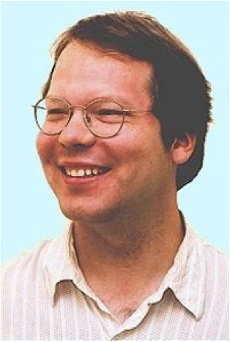
BayesBase: Learning Bayes Nets with Relational Algebra
School of Computing Science
Simon Fraser University
Vancouver, Canada
Oliver Schulte | Hassan Khosravi | Arthur Kirkpatrick | Tianxiang Gao | Yuke Zhu
Notes:
BayesBase: Relational Learning with Relational Algebra
BayesBase: Learning Bayes Nets with Relational Algebra
BayesBase: Learning Bayes Nets with Relational Algebra
BayesBase: Managing Meta-information for Database Learning
BayesBase: Managing Schema Information for Machine Learning
BayesBase: Managing Schema Information for Machine Learning with Relational Databases
BayesBase: Managing Meta-information for Machine Learning
Managing Relational Database Schemata for Learning Graphical Models
Ref: Mlbase, bayestore?

Slide 67
planing
storing and scoring the model in the same server (natural join),
functionality?
base lines?
performance metrics?

Slide 68
Misc points
SQL for describing and manipulating structured data.
Also for describing and manipulating structured random variables and structured models.

Slide 69
Motivation and contributions
Key computational challenge in learning: sufficient statistics.
Precomputation/caching approach: precompute before learning.
Data accessed once only.
Can be done off-line,used for different learning tasks.
Dynamic programming.
First precomputation approach for large relational datasets.
Application for BN learning: generative SRL model, over 1 million records.
Challenge for relational data: materialization, necessary tables don’t exist.
Joins.
Negated relationships. We treat any number of positive and negated links.
Generality challenge: want algorithms to work on any SQL database. Solution: use schema information as meta information to define random variables and models.
Notes:
Feb 21 2014

Slide 70
General Machine Learning for Single-Table Data
e.g. Weka, R, Matlab.
Input is single flat data matrix .
Represents independent and identically distributed data points (i.i.d. data).
No need to describe connections between tables (e.g., no foreign key constraints).
Default set of random variables = attribute columns.
Computing sufficient statistics = counting matching rows in data table.
Notes:
Preprocessing that data into a flat table: lose important information or introduce some redundancy infor, and usually time-consuming
Getoor2001. :
real data often contain strong correlations between attributes (For example a census database might contain highly correlated attributes such as Income and Home-Owner. The attribute value independence assumption would lead to an overestimate of the result size of a query that asks for low-income home-owners.)

Slide 71
Relational Learning With Multiple Database Tables
Models information from different related tables simultaneously.
Uses both links and attributes to discover probabilistic dependencies.
Applications: Visualizing correlations, query optimization, missing/uncertain data (BayesStore).
Data is not i.i.d. -> statistical issues discussed elsewhere.
We are focusing on developing general learning algorithms that can be applied to different databases directly.
No preprocessing.
No feature engineering.
Use of SQL for development and optimization.
Notes:
look up domingos’ paper on relational learning challenges.
maybe mention recursive dependencies here

Slide 72
General and Scalable Machine Learning with Relational Databases: SQL
Graphical model = structured object with structured components.
All structured objects are treated as 1st-class citizens, represented in database meta-tables.
Can be manipulated using SQL.
Can be combined with machine learning algorithms using SQL.
Notes:
linear algebra = relational algebra for implementation.
if you make good use of database techniques, can achieve general scalable machine learning.

Slide 73
Goal: Learning Bayes Net Models
Why?
visualize correlations.
support what-if queries.
Generative model, complex machine learning task.
compiles database statistics for quick queries (cite Getoor, Schulte et al.)
can be converted to other model types (e.g., MLNs).
Notes:
cite BayesStore, Getoor and others.

Slide 74
Example
Show Bayes net.
give example and semantics.
Notes:
Still use University but with the non-numerical ranking?

Slide 75
Registration(S,C),RA(S,P),Teaches(P,C)
Level 3
Registration(S,C),RA(S,P)
Registration(C,S),Teaches(C,P)
RA(S,P),Teaches(P,C)
Level 2
Registration(S,C)
RA(S,P)
Teaches(P,C)
Level 1
Student(S)
Course(C)
Professor(P)
Level 0
Notes:
make picture consistent.
Add arrows to indicate propagating edges.

Slide 76
BN for University Database
Relational Attribute
Relationship Indicator
Capability(prof0,student0)
Salary(prof0,student0)
RA(prof0,student0)
Entity Attribute
Registration(course0,student0)
Popularity(prof0)
Intel(student0)
Teachingability(prof0)
Ranking(student0)
Rating(course0)
Grade(course0,student0)
Satisfaction(course0,student0)
Diff(course0)
Notes:
Node :::Descriptive Attributes(Entity and Relation)
Intel(student0) : Intelligence is the Descriptive Attributes, Student0 is the Entity table
deterministic functions of key fields.
add RA. Maybe add link between relationships.
Maybe show an example of a BN that you learned.

Slide 77
High-level Algorithm
Find functor nodes from database.
Generate candidate Bayes net.
Score candidate Bayes net.
Estimate parameters.
Notes:
just describe it in English? Do not need to add algorithm in the paper?

Slide 78
Constructing Nodes from Database

Slide 79
Generate Candidate Bayes nets

Slide 80
Hierarchical Lattice Search
Like our slide in aaai-final.pptx.
Show SQL doing this. (maybe view).
Notes:
Level-wise search, big graph
1.Generating the required/forbidden edges with views
2.Propagating the knowledge from the lower level to upper level

Slide 81
Hierarchical Search
Level-wise search through table join lattice.
Build contingency table for each relationship chain, apply Bayes net learner.
Results from shorter paths are propagated to longer paths (Bottom-Up).
Registration(C,S),RA(S,P),Teaches(C,P)
Level 3
Registration(C,S),RA(S,P)
Registration(C,S)Teaches(C,P)
RA(S,P),Teaches(C,P)
Level 2
Registration(C,S)
RA(S,P)
Teaches(C,P)
Level 1
Student(S)
Course(C)
Professor(P)
Level 0
Notes:
make picture consistent.
Add arrows to indicate propagating edges.

Slide 82
Scoring Bayes Nets
Notes:
Bdeu scores

Slide 83
Computing Sufficient Statistics
Representation: Contingency Table.
For single table, can use group by. (examples/screenshot)
Use Meta-SQL query: dynamically exploit schema during learning.
Problems:
need to count events in join tables.
need to count events in complement tables.
For 1), can still use group by. [highly optimized even for joins]. (examples/screenshot)
For 2), no optimization available (unsafe query).
propose CT-algebra, extension of relational algebra.
Notes:
Meta-SQL query: [Column-List(Table)]
[Column-List(student)]:
[Column-List(id)]:
[Column-List(course)]:
[Column-List(RA)]:
[Column-List(Reg)]:

Slide 84
Contingency tables
Snapshot of CT table for unielwin
Columns: parameterize variables
Row: possible values
Conjunctive queries in domain relational calculus
Counts, result size of query

Slide 85
Contingency table algebra
Unary operators : selection, projection, conditioning (can be defined as selection followed by projection.)
need notation of complement of columns
Binary operators:
set difference (addition, substraction)
cross product,

Slide 86
Eliminating false relationship

Slide 87
Computing the CT table
Input: a list of Rnodes (R1,R2,R3)
Find CT table for T[R1=T,R2=T,R3=T] = ct(Anodes(R1,R2,R3)|R1=T,R2=T,R3=T)
Set the pivot to R3. Let T[R2=T,R1=T, R3=star] := ct(Anodes(R1,R2)|R1=T,R2=T) x ct(1NodesR3-1Nodes(R1,R2)).
T[R2=T,R1=T,R3=F] = T[R2=T,R1=T, R3_star]- Project_{2Nodes(R3)-comp} T[R1=T,R2=T,R3=T]
Let R3_fill := (1,n/a for all 2Nodes of R3).
Ct(Anodes(R1,R2,R3)|R1=T,R2=T) = T[R2=T,R1=T,R3=F]xR3_fill union T[R1=T,R2=T,R3=T]
Notes:
% Need to project so that both T[R2=T,R1=T, R3_star] and Project_{2Nodes(R3)-comp} T[R1=T,R2=T,R3=T]

Slide 88


CT(1Nodes(X)) x CT(1Nodes(Y))
X,Y are the population variables involved in R
CT(1Nodes(R)|R = *)
CT(1nodes(R), 2nodes(R)|R=T)
Join of existing tables via meta-query
$$π_{\overline{2Nodes(R})}$$
$$−$$
CT(Anodes(R)|R=F)
Add columns R=F,2Nodes(R)= N/A
Add column R=T
∪
CT(Anodes(R),R)
Notes:
Flow chart

Slide 89
ct*
Count | Pop | Teach | Intel | Rank
16 | 1 | 2 | 3 | 1
15 | 2 | 3 | 2 | 2
18 | 2 | 3 | 1 | 4
… | … | … | … | …
Count | Pop | Teach | Intel | Rank | Cap | Sal
1 | 1 | 2 | 3 | 1 | 3 | high
1 | 1 | 2 | 2 | 2 | 3 | low
1 | 2 | 2 | 2 | 4 | 3 | med
… | … | … | … | … | … | …
ct_{T}
CREATE TABLE ct* AS SELECT p_ct.count * s_ct.count as count, CL(p),CL(s) FROM p_ct , s_ct
CREATE TABLE ct_{T} AS SELECT count(*) as count, CL(p), CL(s), CL(RA) FROM p, s, RA WHERE RA.p_id = p.p_id and RA.s_id = s.s_id
GROUP BY CL(p), CL(s), CL(RA)
-
π_{Nodes}
ct_{F}
Count | Pop | Teach | Intel | Rank
15 | 1 | 2 | 3 | 1
16 | 2 | 3 | 2 | 3
21 | 2 | 3 | 3 | 1
… | … | … | … | …
Count | Pop | Teach | Intel | Rank
1 | 1 | 2 | 3 | 1
1 | 1 | 2 | 2 | 2
1 | 2 | 2 | 2 | 4
… | … | … | … | …
temp
CREATE TABLE ct_{F} AS SELECT (ct*.count - temp.count) AS count, CL(temp)
FROM ct* , temp WHERE CL(ct*) = CL (temp)
UNION SELECT (ct*.COUNT) AS COUNT, CL(ct*) FROM ct* WHERE
CL(ct*) NOT IN (SELECT CL(temp) FROM temp )
CREATE TABLE temp AS SELECT SUM(ct_{T}.count) AS count,
CL(p), CL(s) FROM ct_{T} GROUP BY CL(p), CL(s)
RA
T
RA | Cap | Sal
F | n/a | n/a
ct_{T}⁺
ct_{F}⁺
Count | Pop | Teach | Intel | Rank | Cap | Sal | RA
15 | 1 | 2 | 3 | 1 | n/a | n/a | F
12 | 1 | 2 | 1 | 4 | n/a | n/a | F
7 | 1 | 2 | 2 | 2 | n/a | n/a | F
… | … | … | … | … | … | … | …
Count | Pop | Teach | Intel | Rank | Cap | Sal | RA
1 | 1 | 2 | 3 | 1 | 3 | high | T
1 | 1 | 2 | 2 | 2 | 3 | low | T
1 | 2 | 2 | 2 | 4 | 3 | med | T
… | … | … | … | … | … | … | …
∪
CL(P) | Pop,Teach
CL(S) | Intel, Rank
CL(RA) | Cap, Sal
CL(CT*) | [CL(P), CL(S)]
CL(CT) | [CL(CTT) , RA]
CL(CTT) | [CL(CT*) ,CL(RA)]
Count | Pop | Teach | Intel | Rank | Cap | Sal | RA
15 | 1 | 2 | 3 | 1 | n/a | n/a | F
1 | 1 | 2 | 3 | 1 | 3 | high | T
1 | 1 | 2 | 2 | 2 | 1 | med | T
... | ... | ... | ... | ... | ... | ... | ...
CREATE TABLE ct AS
SELECT * FROM ct_{F}⁺ UNION SELECT * FROM ct_{T}⁺
ct
Notes:
Replace CT with ct, Feb 25th, 2014, added columns list table
sub.jpg
Fixed typos for temp table. Jan 13rd
CL(CT*) = CL(temp) = Pop, Teach, Intel, Rank
CL(CT_{T}) = Pop, Teach, Intel, Rank, Cap, Sal
CL(CT_{F}) = Pop, Teach, Intel, Rank
CL(CT) = CL(CT_{F}⁺) = CL(CT_{T}⁺) = Pop, Teach, Intel, Rank, Cap, Sal, RA
CL(p) = Pop, Teach
CL(s) = Intel, Rank
CL(RA)= Cap, Sal

Slide 90
ct*
Count | Pop | Teach | Intel | Rank
16 | 1 | 2 | 3 | 1
15 | 2 | 3 | 2 | 2
18 | 2 | 3 | 1 | 4
… | … | … | … | …
Count | Pop | Teach | Intel | Rank | Cap | Sal
1 | 1 | 2 | 3 | 1 | 3 | high
1 | 1 | 2 | 2 | 2 | 3 | low
1 | 2 | 2 | 2 | 4 | 3 | med
… | … | … | … | … | … | …
ct_{T}
Stu(S)
x
Prof(P)
RA(P,S)
Stu(S)
Prof(P)
CREATE TABLE ct* AS SELECT p_ct.count * s_ct.count as count, CL(p),CL(s) FROM p_ct , s_ct
CREATE TABLE ct_{T} AS SELECT count(*) as count, CL(p), CL(s), CL(RA) FROM p, s, RA WHERE RA.p_id = p.p_id and RA.s_id = s.s_id
GROUP BY CL(p), CL(s), CL(RA)
-
π_{Nodes}
ct_{F}
Count | Pop | Teach | Intel | Rank
15 | 1 | 2 | 3 | 1
16 | 2 | 3 | 2 | 3
21 | 2 | 3 | 3 | 1
… | … | … | … | …
Count | Pop | Teach | Intel | Rank
1 | 1 | 2 | 3 | 1
1 | 1 | 2 | 2 | 2
1 | 2 | 2 | 2 | 4
… | … | … | … | …
temp
CREATE TABLE ct_{F} AS SELECT (ct*.count - temp.count) AS count, CL(temp)
FROM ct* , temp WHERE CL(ct*) = CL (temp)
UNION SELECT (ct*.COUNT) AS COUNT, CL(ct*) FROM ct* WHERE
CL(ct*) NOT IN (SELECT CL(temp) FROM temp )
CREATE TABLE temp AS SELECT SUM(ct_{T}.count) AS count,
CL(p), CL(s) FROM ct_{T} GROUP BY CL(p), CL(s)
RA
T
RA | Cap | Sal
F | n/a | n/a
ct_{T}⁺
ct_{F}⁺
Count | Pop | Teach | Intel | Rank | Cap | Sal | RA
15 | 1 | 2 | 3 | 1 | n/a | n/a | F
12 | 1 | 2 | 1 | 4 | n/a | n/a | F
7 | 1 | 2 | 2 | 2 | n/a | n/a | F
… | … | … | … | … | … | … | …
Count | Pop | Teach | Intel | Rank | Cap | Sal | RA
1 | 1 | 2 | 3 | 1 | 3 | high | T
1 | 1 | 2 | 2 | 2 | 3 | low | T
1 | 2 | 2 | 2 | 4 | 3 | med | T
… | … | … | … | … | … | … | …
∪
CL(P) | Pop,Teach
CL(S) | Intel, Rank
CL(RA) | Cap, Sal
CL(CT*) | [CL(P), CL(S)]
CL(CT) | [CL(CTT) , RA]
CL(CTT) | [CL(CT*) ,CL(RA)]
Count | Pop | Teach | Intel | Rank | Cap | Sal | RA
15 | 1 | 2 | 3 | 1 | n/a | n/a | F
1 | 1 | 2 | 3 | 1 | 3 | high | T
1 | 1 | 2 | 2 | 2 | 1 | med | T
... | ... | ... | ... | ... | ... | ... | ...
CREATE TABLE ct AS
SELECT * FROM ct_{F}⁺ UNION SELECT * FROM ct_{T}⁺
ct
Notes:
Add Oliver’s net comments Jun 10th 2014
beside the ct_T table we can draw the part of the lattice that shows the RA(S,P) chain with the S and P tables below it. Perhaps beside the ct_* table, we can draw the Student and Professor nodes, with an x between them
Replace CT with ct, Feb 25th, 2014, added columns list table
sub.jpg
Fixed typos for temp table. Jan 13rd

Slide 91
ct*
Count | Pop | Teach | Intel | Rank
16 | 1 | 2 | 3 | 1
15 | 2 | 3 | 2 | 2
18 | 2 | 3 | 1 | 4
… | … | … | … | …
Count | Pop | Teach | Intel | Rank | Cap | Sal
1 | 1 | 2 | 3 | 1 | 3 | high
1 | 1 | 2 | 2 | 2 | 3 | low
1 | 2 | 2 | 2 | 4 | 3 | med
… | … | … | … | … | … | …
ct_{T}
Stu(S)
x
Prof(P)
RA(P,S)
Stu(S)
Prof(P)
_{Line 5 in Alg. 2}
CREATE TABLE ct* AS SELECT p_ct.count * s_ct.count as count, CL(p),CL(s) FROM p_ct , s_ct
CREATE TABLE ct_{T} AS SELECT count(*) as count, CL(p), CL(s), CL(RA) FROM p, s, RA WHERE RA.p_id = p.p_id and RA.s_id = s.s_id
GROUP BY CL(p), CL(s), CL(RA)
_{Line 6 in Alg. 2}
_{PIVOT}
_{Line 1 in Alg. 1}
-
π_{Vars}
_{Line 1 in Alg. 1}
Count | Pop | Teach | Intel | Rank
15 | 1 | 2 | 3 | 1
16 | 2 | 3 | 2 | 3
21 | 2 | 3 | 3 | 1
… | … | … | … | …
Count | Pop | Teach | Intel | Rank
1 | 1 | 2 | 3 | 1
1 | 1 | 2 | 2 | 2
1 | 2 | 2 | 2 | 4
… | … | … | … | …
ct_{F}
temp
CREATE TABLE ct_{F} AS SELECT (ct*.count - temp.count) AS count, CL(temp)
FROM ct* , temp WHERE CL(ct*) = CL (temp)
UNION SELECT (ct*.COUNT) AS COUNT, CL(ct*) FROM ct* WHERE
CL(ct*) NOT IN (SELECT CL(temp) FROM temp )
CREATE TABLE temp AS SELECT SUM(ct_{T}.count) AS count,
CL(p), CL(s) FROM ct_{T} GROUP BY CL(p), CL(s)
RA
T
RA | Cap | Sal
F | n/a | n/a
_{Line 2 in Alg. 1}
_{Line 3 in Alg. 1}
ct_{T}⁺
ct_{F}⁺
Count | Pop | Teach | Intel | Rank | Cap | Sal | RA
15 | 1 | 2 | 3 | 1 | n/a | n/a | F
12 | 1 | 2 | 1 | 4 | n/a | n/a | F
7 | 1 | 2 | 2 | 2 | n/a | n/a | F
… | … | … | … | … | … | … | …
Count | Pop | Teach | Intel | Rank | Cap | Sal | RA
1 | 1 | 2 | 3 | 1 | 3 | high | T
1 | 1 | 2 | 2 | 2 | 3 | low | T
1 | 2 | 2 | 2 | 4 | 3 | med | T
… | … | … | … | … | … | … | …
∪
_{Line 4 in Alg. 1}
CL(P) | Pop,Teach
CL(S) | Intel, Rank
CL(RA) | Cap, Sal
CL(CT*) | [CL(P), CL(S)]
CL(CT_{T}) | [CL(CT*) ,CL(RA)]
CL(CT) | [CL(CT_{T}) , RA]
Count | Pop | Teach | Intel | Rank | Cap | Sal | RA
15 | 1 | 2 | 3 | 1 | n/a | n/a | F
1 | 1 | 2 | 3 | 1 | 3 | high | T
1 | 1 | 2 | 2 | 2 | 1 | med | T
... | ... | ... | ... | ... | ... | ... | ...
CREATE TABLE ct AS
SELECT * FROM ct_{F}⁺
UNION
SELECT * FROM ct_{T}⁺
ct
Notes:
Updated on Aug. 19, 2014 for CIKM camera ready
Add Oliver’s net comments Jun 10th 2014
beside the ct_T table we can draw the part of the lattice that shows the RA(S,P) chain with the S and P tables below it. Perhaps beside the ct_* table, we can draw the Student and Professor nodes, with an x between them
Replace CT with ct, Feb 25th, 2014, added columns list table
sub.jpg
Fixed typos for temp table. Jan 13rd

Slide 92
DataBase
original data
SQL Script Utilizing information schema
DataBase_RV
Random variables
Node id | FunctorName | Type
intelligence(S) | intelligence | 1Node
satisfaction(C,S) | satisfaction | 2Node
Registration(C,S) | Registration | Rnode
Edge Constraints
Model Manager
Lattice Search
Virtual Join Algorithm
PathBayesNet
DataBase_CT
Contingency Tables
Count | Pop | Teach | Intel | Rank
1 | 1 | 2 | 3 | 1
1 | 1 | 2 | 2 | 2
1 | 2 | 2 | 2 | 4
… | … | … | … | …
Rchain | Child | Parent
Registration(C,S), RA (S,P) | ranking(S) | intelligence(S)
RA(S,P) | popularity(P) | teachingability(P)
Registration(C,S) | diff(C) | grade(C,S)
DataBase_BN
Bayes Nets
Notes:
Feb 25, 2014
general-flow-chart.png
Expend the bayes net table and replace Student and Course with S,C

Slide 93
Random variable database
Contingency table algebra
Lattice search structure learning
(model manager)
Level-wise CT-tables computation
Complexity analysis
Evaluation (MLE parameter learning)
Notes:
Paper organization Jan 24

Slide 94
DB
original data
SQL Script Utilizing information schema
DB_RV
Random variables
Edge Constraints
Model Manager
Lattice Search
Virtual Join Algorithm
DB_CT
Contingency Tables
DB_BN
Bayes Nets
Notes:
general-flow-chart.png

Slide 95
Bayes Net (ER Design) | Table Headers in Random Variable Database
Pvariables (Entity Tables) | pvid | table_name
 | course0 | course
 | prof0 | prof
 | student0 | student
1Nodes (Entity Attributes) | 1nid | pvid
 | diff(course0) | course0
 | intelligence(student0) | student0
 | popularity(prof0) | prof0
 | ranking(student0) | student0
 | rating(course0) | course0
 | teachingability(prof0) | prof0
2Nodes (Relationship Attributes) | 2nid | pvid1 | pvid2
 | capability(prof0,student0) | prof0 | student0
 | grade(course0,student0) | course0 | student0
 | salary(prof0,student0) | prof0 | student0
 | sat(course0,student0) | course0 | student0
Rnodes (Relation Tables) | rnid | pvid1 | pvid2
 | RA(prof0,student0) | prof0 | student0
 | registration(course0,student0) | course0 | student0
Bayes Net (ER Design) | Table Headers in Random Variable Database
Pvariables (Entity Tables) | pvid | table_name
 | C | course
 | P | prof
 | S | student
1Nodes (Entity Attributes) | 1nid | pvid
 | diff(C) | C
 | intelligence(S) | S
 | popularity(P) | P
 | ranking(S) | S
 | rating(C) | C
 | teachingability(P) | P
2Nodes (Relationship Attributes) | 2nid | pvid1 | pvid2
 | capability(P,S) | P | S
 | grade(C,S) | C | S
 | salary(P,S) | P | S
 | sat(C,S) | C | S
Rnodes (Relation Tables) | rnid | pvid1 | pvid2
 | RA(P,S) | P | S
 | registration(C,S) | C | S
Table Name | Table Columns
KeyColumns
ForeignKeyColumns
AttributeColumns
EntityTables
RelationTables
Notes:
Random variable database (set up )
rv_db_tables.png

Slide 96
Pvariables | pvid | table_name
 | course0 | course
 | prof0 | prof
 | student0 | student
1Nodes | 1nid | pvid
 | diff(course0) | course0
 | intelligence(student0) | student0
 | popularity(prof0) | prof0
 | ranking(student0) | student0
 | rating(course0) | course0
 | teachingability(prof0) | prof0
2Nodes | 2nid | pvid1 | pvid2
 | capability(prof0,student0) | prof0 | student0
 | grade(course0,student0) | course0 | student0
 | salary(prof0,student0) | prof0 | student0
 | sat(course0,student0) | course0 | student0
RNodes | rnid | pvid1 | pvid2
 | RA(prof0,student0) | prof0 | student0
 | registration(course0,student0) | course0 | student0
Table Name | Table Columns
KeyColumns
ForeignKeyColumns
AttributeColumns
EntityTables
RelationTables
Notes:
Random variable database (set up )

Slide 97
INFORMATION_SCHEMA
COLUMNS
TABLES
KEY_COLUMN_USAGE
Schema_Position_Info
Schema_Key_Info
KeyColumns
AttributeColumns
EntityTables
ForeignKeyColumns
2Nodes
PVariables
1Nodes
ForeignKeys_pvars
RelationTables
RNodes_MM_Selff
RNodes_MM_NotSelf
RNodes
Notes:
rv_db.png

Slide 98
ER Diagram | Bayes Net | Example | Term Notation
Entity Tables | Population Variables | Student, Course | S, C
Relation Tables | RNodes | Registration | Registration(C,S)
Entity Attributes | 1Nodes | intelligence, ranking | {intelligence(S), ranking(S)} = 1Nodes(S)
Relationship Attributes | 2Nodes | satisfaction, grade | {satisfaction(C, S), grade(C,S)} = 2Nodes(Registration(C,S))
Notes:
In latex version
translation.png

Slide 99
Metaqueries | Entries
CREATE TABLE Select_List AS SELECT rnid, CONCAT(‘COUNT(*)',' as "count"') AS Entries FROM RNodes UNION DISTINCT SELECT rnid, 1nid AS Entries FROM RNodes_1Nodes | COUNT(*) as “count"
 | `popularity(prof0)`
 | `teachingability(prof0)`
 | `intelligence(student0)`
 | `ranking(student0)`
CREATE TABLE From_List AS SELECT rnid, CONCAT('@database@.',TABLE_NAME) AS Entries FROM RNodes_pvars UNION DISTINCT SELECT rnid, CONCAT('@database@.',TABLE_NAME) AS Entries FROM RNodes | @database@.prof AS prof0
 | @database@.student AS student0
 | @database@.RA AS `RA`
CREATE TABLE Where_List AS SELECT rnid, CONCAT(rnid,'.',COLUMN_NAME,' = ', pvid,'.', REFERENCED_COLUMN_NAME) AS Entries FROM RNodes_pvars; | `RA`.prof_id = prof0.prof_id
 | `RA`.student_id =student0.student_id
Notes:
meta-query.png

Slide 100
Course
c_id | rating | difficulty
101 | 3 | 2
102 | 2 | 1
103 | 2 | 1
Registration
s_id | c_id | grade | satisfaction
Jack | 101 | A | 1
Jack | 102 | B | 2
Kim | 102 | A | 1
Paul | 101 | B | 1
Student
s_id | intelligence | ranking
Jack | 3 | 1
Kim | 2 | 1
Paul | 1 | 2
(a)
(b)
(c)
CT(Registration)
count | intelligence | ranking | rating | difficulty | grade | satisfaction | Registration
2 | 1 | 2 | 2 | 1 | n/a | n/a | F
1 | 1 | 2 | 3 | 2 | B | 1 | T
1 | 2 | 1 | 2 | 1 | A | 1 | T
1 | 2 | 1 | 2 | 1 | n/a | n/a | F
… | … | … | … | … | … | … | …
1 | 3 | 1 | 3 | 2 | A | 1 | T
(d)
Notes:
duplicated student Jack and course 103. Should probably use Moore’s notation #.

Slide 101
Student
s_id | intelligence | ranking
Jack | 3 | 1
Kim | 2 | 1
Paul | 1 | 2
Professor
p_id | popularity | teachingability
Jim | 2 | 1
Oliver | 3 | 1
David | 2 | 2
(a)
(b)
capability(P,S)
RA
s_id | p_id | salary | capability
Jack | Oliver | High | 3
Kim | Oliver | Low | 1
Paul | Jim | Med | 2
Kim | David | High | 2
salary(P,S)
RA(P,S)
popularity(P)
intelligence(S)
teachingability(P)
ranking(S)
(c)
(d)
Notes:
duplicated student Jack and course 103. Should probably use Moore’s notation #.

Slide 102
Student
s_id | intelligence | ranking
Jack | 3 | 1
Kim | 2 | 1
Paul | 1 | 2
Course
c_id | rating | difficulty
101 | 3 | 2
102 | 2 | 1
103 | 2 | 1
Professor
p_id | popularity | teachingability
Jim | 2 | 1
Oliver | 3 | 1
David | 2 | 2
(a)
(b)
(c)
RA
s_id | p_id | salary | capability
Jack | Oliver | High | 3
Kim | Oliver | Low | 1
Paul | Jim | Med | 2
Kim | David | High | 2
Registration
s_id | c_id | grade | satisfaction
Jack | 101 | A | 1
Jack | 102 | B | 2
Kim | 102 | A | 1
Paul | 101 | B | 1
(d)
(e)

Slide 103
Student
s_id | intelligence | ranking
jack | 3 | 1
kim | 2 | 1
paul | 1 | 2
RA
s_id | p_id | salary | capability
jack | oliver | high | 3
kim | oliver | low | 1
paul | jim | med | 2
kim | david | high | 2
Professor
p_id | popularity | teachingability
jim | 2 | 1
oliver | 3 | 1
david | 2 | 2
(a)
(b)
(c)
Notes:
university-tables.pdf
Only RA. Low case .

Slide 104
capability(P,S)
salary(P,S)
RA(P,S)
popularity(P)
intelligence(S)
teachingability(P)
ranking(S)
Capability(P,S)
Salary(P,S)
RA(P,S)
intelligence(S)
Popularity(P)
Teachingability(P)
Ranking(S)

Slide 105
Course
c_id | rating | difficulty
101 | 3 | 2
102 | 2 | 1
103 | 2 | 1
Registration
s_id | c_id | grade | satisfaction
Jack | 101 | A | 1
Jack | 102 | B | 2
Kim | 102 | A | 1
Paul | 101 | B | 1
Student
s_id | intelligence | ranking
Jack | 3 | 1
Kim | 2 | 1
Paul | 1 | 2
(a)
(b)
(c)
CT(Registration)
count | intelligence | ranking | rating | difficulty | grade | satisfaction | Registration
2 | 1 | 2 | 2 | 1 | n/a | n/a | F
1 | 1 | 2 | 3 | 2 | B | 1 | T
1 | 2 | 1 | 2 | 1 | A | 1 | T
1 | 2 | 1 | 2 | 1 | n/a | n/a | F
… | … | … | … | … | … | … | …
1 | 3 | 1 | 3 | 2 | A | 1 | T
(d)
Notes:
duplicated student Jack and course 103. Should probably use Moore’s notation #.

Slide 106
Registration(C,S)
intelligence(S)
rating(S)
grade(C,S)
ranking(S)
satisfaction(C,S)
difficulty(C)
Registration(c,s)
intelligence(s)
(e)
ranking(s)
rating(c)
grade(c,s)
satisfaction(c,s)
difficulty(c)
Notes:
Node :::Descriptive Attributes(Entity and Relation)
Intel(student0) : Intelligence is the Descriptive Attributes, Student0 is the Entity table
deterministic functions of key fields.
add RA. Maybe add link between relationships.
Maybe show an example of a BN that you learned.

Slide 107
teachingability
salary
student_id
prof_id
professor
RA
student
popularity
capability
intelligence
ranking
CREATE VIEW InheritedEdges AS
SELECT DISTINCT
LatticeRel.child AS Rchain,
PathBayesNet.child AS child,
PathBayesNet.parent AS parent
FROM
PathBayesNet, LatticeRel
WHERE
LatticeRel.parent = PathBayesNet.Rchain
AND PathBayesNet.parent <> '';
Remove Teaches, ER Digram for University
Notes:
university-schema.pdf, only RA.

Slide 108
grade
satisfaction
registration
course_id
rating
diff
student
intelligence
course
student_id
ranking
professor
RA
prof_id
popularity
teachingability
salary
capability
CREATE VIEW InheritedEdges AS
SELECT DISTINCT
LatticeRel.child AS Rchain,
PathBayesNet.child AS child,
PathBayesNet.parent AS parent
FROM
PathBayesNet, LatticeRel
WHERE
LatticeRel.parent = PathBayesNet.Rchain
AND PathBayesNet.parent <> '';
Remove Teaches, ER Digram for University
Notes:
university-schema.png

Slide 109
grade
satisfaction
registration
course_id
rating
diff
student
intelligence
course
student_id
ranking
Teaches
professor
RA
prof_id
popularity
teachingability
salary
capability
CREATE VIEW InheritedEdges AS
SELECT DISTINCT
LatticeRel.child AS Rchain,
PathBayesNet.child AS child,
PathBayesNet.parent AS parent
FROM
PathBayesNet, LatticeRel
WHERE
LatticeRel.parent = PathBayesNet.Rchain
AND PathBayesNet.parent <> '';
ER Digram for University
Notes:
university-schema.png

Slide 110
CREATE OR REPLACE VIEW Path_Forbidden_Edges AS
SELECT DISTINCT
RNodes_pvars.rnid AS Rchain,
Entity_Complement_Edges.child AS child,
Entity_Complement_Edges.parent AS parent
FROM
(RNodes_pvars, Entity_Complement_Edges)
WHERE
(RNodes_pvars.pvid = Entity_Complement_Edges.pvid)
UNION
SELECT DISTINCT
lattice_rel.child AS Rchain,
Path_Complement_Edges.child AS child,
Path_Complement_Edges.parent AS parent
FROM
Path_Complement_Edges, lattice_rel
WHERE
lattice_rel.parent = Path_Complement_Edges.Rchain
AND Path_Complement_Edges.parent <> ''
and (lattice_rel.child , Path_Complement_Edges.child,
Path_Complement_Edges.parent)
not in (select * from Path_Required_Edges)
UNION
SELECT * FROM Path_Aux_Edges
UNION
SELECT * FROM Knowledge_Forbidden_Edges;
Rchain | Child | Parent
Registration(Course, Student), RA (Student, Prof) | ranking(Student) | intelligence(Student)
RA (Student, Prof) | popularity(prof0) | teachingability(prof0)
RA (Student, Prof) | ranking(student0) | intelligence(student0)
Registration(Course, Student), | diff(course0) | grade(course0,student0)
Registration(Course, Student), | ranking(student0) | intelligence(student0)
Registration(Course, Student), RA (Student, Prof) | diff(course0) | grade(course0,student0)
Rchain | Child | Parent
Registration(C,S), RA(S,P) | ranking(S) | intelligence(S)
RA(S,P) | popularity(P) | teachingability(P)
RA S,P) | ranking(S) | intelligence(S)
Registration(C,S) | diff(C) | grade(C,S)
Registration(C,S) | ranking(S) | intelligence(S)
Registration(C,S), RA (S, P) | diff(C) | grade(C,S)
... | ... | ...
Notes:
path-bn.png

Slide 111
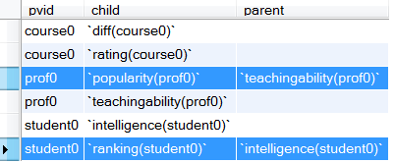
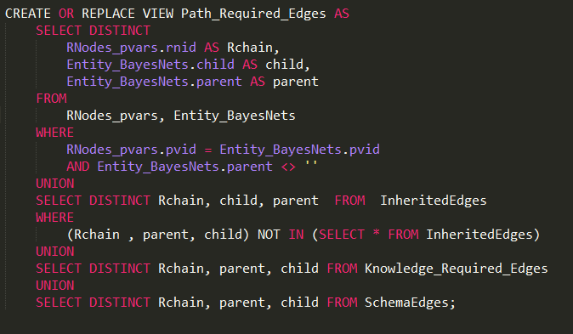
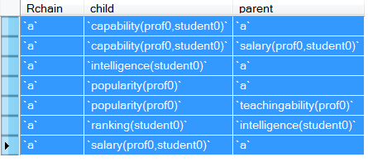
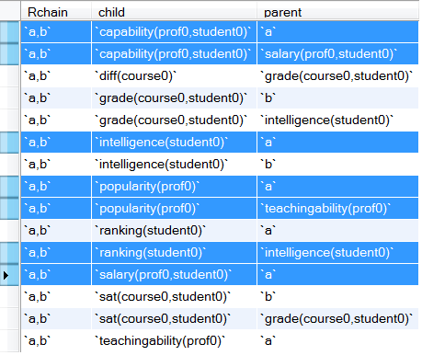

Slide 112
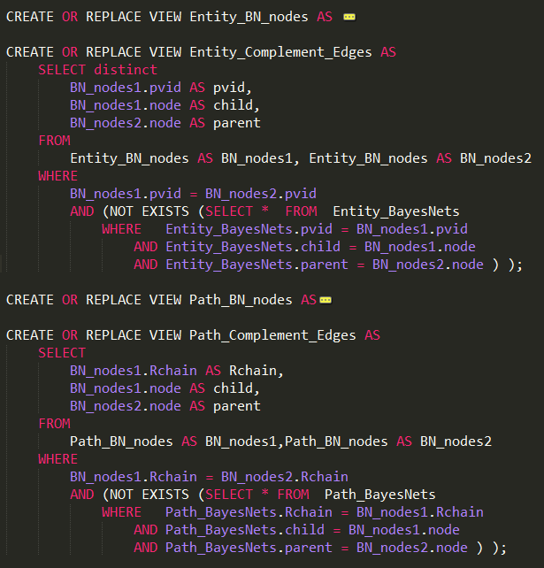
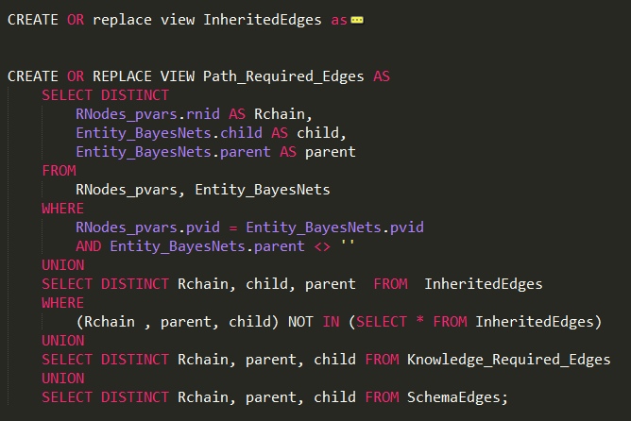
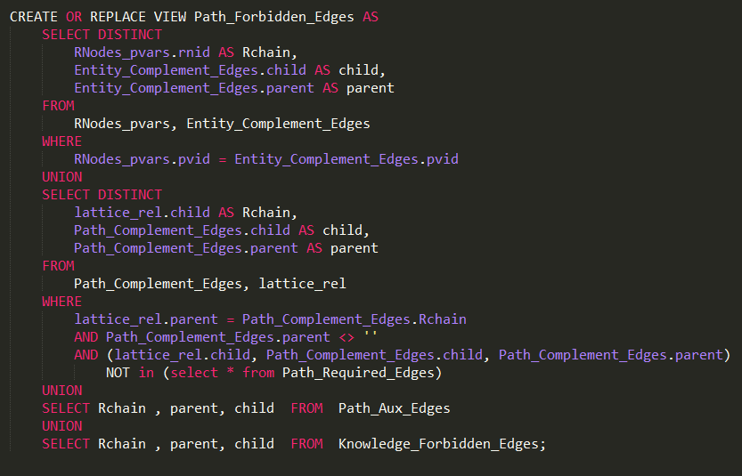
Notes:
ch(5,1)*1 +ch(5,2)*2 +ch(5,3)*3 +ch(5,4)*4 +ch(5,5)*5 = sigma[1,5, ch(5,k)*k] = 80

Slide 113
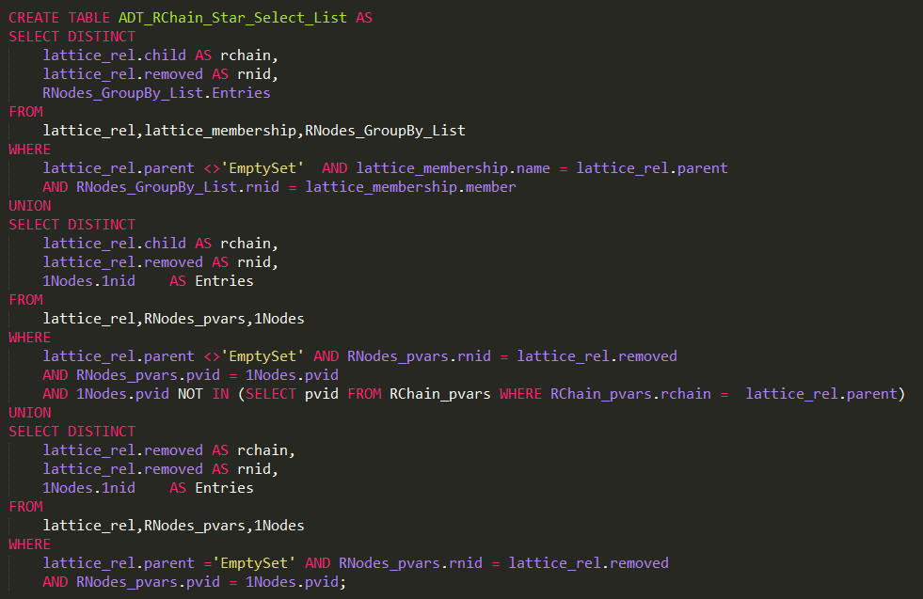
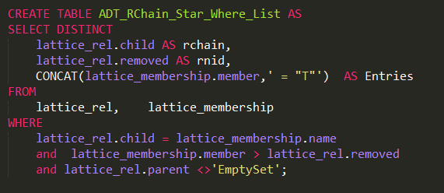
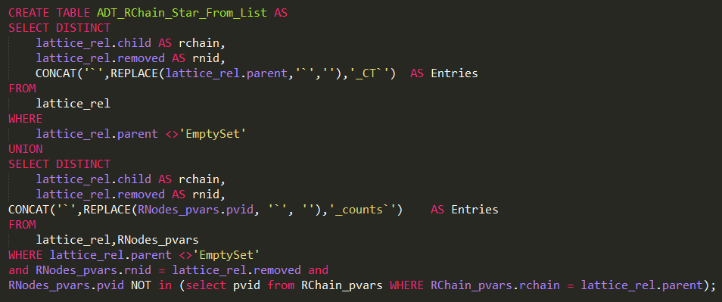
CREATE TABLE CT_{F} AS
SELECT (CT*.COUNT - CT_{T}.COUNT) AS COUNT, Pop, Teach, Intel, Rank
FROM CT* ,CT_{T}
WHERE
CT*.Pop = CT_{T}.Pop AND CT*.Teach = CT_{T}.Teach AND CT*.Intel = CT_{T}.Intel AND CT*.Rank = CT_{T}.Rank
UNION
SELECT (CT*.COUNT) AS COUNT, Pop, Teach, Intel, Rank
FROM CT*
WHERE (Pop, Teach, Intel, Rank) NOT IN (SELECT Pop, Teach, Intel, Rank FROM CT_{T} )
CREATE TABLE CT_{F} AS SELECT (CT*.count - CT_{T} .count) AS count,
Pop, Teach, Intel, Rank FROM CT* , CT_{T} WHERE
CT*.Pop = CT_{T} .Pop AND CT*.Teach = CT_{T} .Teach
AND CT*.Intel = CT_{T} .Intel AND CT*.Rank = CT_{T} .Rank
UNION SELECT (CT*.COUNT) AS COUNT, Pop, Teach, Intel, Rank
FROM CT* WHERE (Pop, Teach, Intel, Rank)
NOT IN (SELECT Pop, Teach, Intel, Rank FROM CT_{T} )
CREATE TABLE CT_{F}⁺ AS SELECT count , Pop, Teach, Intel, Rank, Cap, Sal, (select "F" ) AS RA,(select "n/a") AS cap,(select "n/a") AS Sal FROM CT_{F}
CREATE TABLE CT_{T}⁺ AS SELECT count , Pop, Teach, Intel, Rank, Cap, Sal, (select "T" ) AS RA FROM CT_{T}
Notes:
create table `a_CT` as select `MULT` , `popularity(prof0)` , `teachingability(prof0)` , `intelligence(student0)` , `ranking(student0)` , `capability(prof0,student0)` , `salary(prof0,student0)` , `a` from `a_counts` union select `MULT` , `popularity(prof0)` , `teachingability(prof0)` , `intelligence(student0)` , `ranking(student0)` , `capability(prof0,student0)` , `salary(prof0,student0)` , `a` from `a_false`, `a_join`;

Slide 114
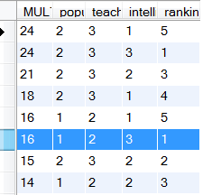
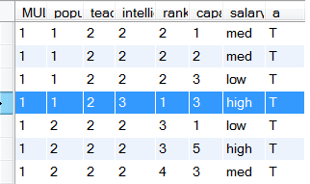
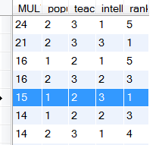
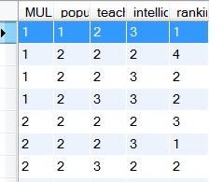

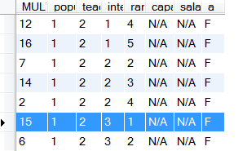
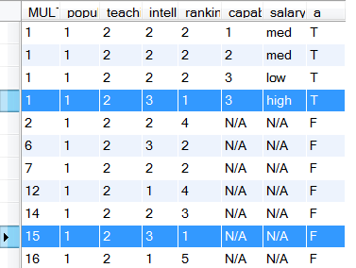







$$a_star$$
$a_$true
-
$$π_{\overline{2Nodes(R})}$$
$a_$flat
Add column a=T
$a_$flase
$a_$CT
$$union$$
Notes:
Snapshot of generating a_ct based on unielwin_CT, Jan 2nd

Slide 115








CT(Nodes | $\vec{R}$ = T , $R_{pivot}$ = * )
CT(Nodes, 2Nodes($R_{pivot}$) | $\vec{R}$ = T , $R_{pivot}$ = T )
$$−$$
$$π_{\text{Nodes}}$$
CT(Nodes | $\vec{R}$ = T , $R_{pivot}$ = F)
Add columns
$R_{pivot}$=F, 2Nodes($R_{pivot}$) = N/A
Add column
$R_{pivot}$=T
∪
CT(Nodes, $R_{pivot}$, 2Nodes($R_{pivot}$) | $\vec{R}$ = T)
Oliver’s version
Precondition: The set Nodes does not contain any of the 2Nodes($R_{pivot}$) and $R_{pivot}$
Notes:
Thursday, Dec. 19
PivotCT(Nodes, $R_{pivot}$, $\vec{R}$ )
Input:
CT(Nodes |$\vec{R}$ = T , $R_{pivot}$ = * )
CT(Nodes, 2Nodes($R_{pivot}$) | $\vec{R}$ = T , $R_{pivot}$ = T )
Output:
CT(Nodes, $R_{pivot}$, 2Nodes($R_{pivot}$) | $\vec{R}$ = T)
Note:
ordered relationship list : $\vec{R}=\left\{R_{1},R_{2}, …,R_{m}\right\}= \left\{\vec{R} ∪R_{pivot} \right\}$ , m ≥ 1 , $R_{pivot}$is the ith relationship
When m = 1, then $R_{pivot}$= $R_{1}$ and $\vec{R_{pivot}}$ = NULL
Nodes : all nodes but not 2Nodes($R_{pivot}$) nor $R_{pivot}$

Slide 116


Pivot(Nodes, R_{pivot} , $\vec{R}$ )
CT(1Nodes(X)) x CT(1Nodes(Y))
X,Y are the population variables involved in R
CT(1Nodes(R)|R = *)
CT(1nodes(R), 2nodes(R)|R=T)
Join of existing tables via meta-query
Pivot(1Nodes(R),R)
$\vec{R}$ is empty, R_{pivot} = R
CT(1nodes(R), 2nodes(R), R )
For single Relationship $\vec{R}$ is empty, R_{pivot} = R
Notes:
Thursday, Dec. 19
For one relationship , R = R_{pivot}

Slide 117


CT(1Nodes(X)) x CT(1Nodes(Y))
X,Y are the population variables involved in a and not involved in b.
CT(1Nodes(b),2Nodes(b)|b=T)
Computed at stage 1
CT(1Nodes(a,b),2Nodes(b))|a = *, b=T)
$\vec{R_{}}$ = b, Rpivot = a
CT(1nodes(a,b), 2nodes(a,b)|a=T,b=T) Join of existing tables via meta- query
Pivot(1Nodes(a,b),2Nodes(b), a, b)
CT(1Nodes(X)) x CT(1Nodes(Y))
X,Y are the population variables involved in b and not involved in a.
CT(1Nodes(a),2Nodes(a),a)
CT(1nodes(a,b), 2nodes(a), a| b=* )
CT(1nodes(a,b), 2nodes(a,b), a| b=T )
Pivot(1Nodes(a,b),2Nodes(a), a, b)
$\vec{R_{}}$ is empty, Rpivot = b
CT(1nodes(a,b), 2nodes(a,b), a,b)
For multiple relationships: a,b
Notes:
Thursday, Dec. 19
Pivot(Nodes, R_{pivot} , $\vec{R}$ )
For multiple relationships: a,b
1.R_{pivot} = a, R_{arrow} = b
1.R_{pivot} = b, R_{arrow} = empty

Slide 118
Explain Moebius transform
Define operators.
Discuss implementations.
sort-merge? compressing columns?
Go to previous slides for workshop.

Slide 119
Evaluation

Slide 120
Constructing Contingency Tables
Metric: how long to build the biggest table.
Also how much space?
Methods:
simple join.
join with indices. [Postgress?] [Column limitations?]
Moebius transform method.
Question: is it scalability or runtime even on small datasets.
Depends on system resources.
And join algorithm.

Slide 121
Statistical Evaluation
Databases:
University
MovieLens(1M)
Mutagenesis
Financial
Hepatitis
IMDB
Mondial
UW-CSE
Metrics
Pseudo_BIC
Pseudo_AIC
Norm_log-likelihood
# Para
Methods:
BBH3/Flat/Complete/Disconnected

Slide 122
Backup slides
Notes:
Jan 2nd

Slide 123
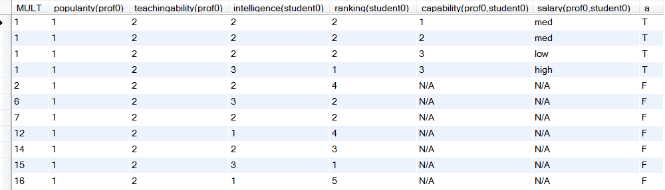
Count | Diff. | Rat. | Pop. | Teach. | Intel. | Rank. | Cap. | Sal. | Grade | Sat. | RA | Reg.
1 | 1 | 1 | 1 | 2 | 3 | 1 | 3 | High | 1 | 1 | T | T
1 | 1 | 2 | 1 | 2 | 2 | 2 | n/a | n/a | 2 | 2 | F | T
3 | 1 | 2 | 1 | 2 | 2 | 2 | 1 | Med | n/a | n/a | T | F
24 | 2 | 1 | 1 | 2 | 1 | 5 | n/a | n/a | n/a | n/a | F | F
… | … | … | … | … | … | … | … | … | … | … | … | …
1 | 2 | 1 | 2 | 2 | 1 | 4 | n/a | n/a | 3 | 2 | F | T
Notes:
uni-ct-table.JPG

Slide 124
Count | Diff. | Rat. | Pop. | Teach. | Intel. | Rank. | Cap. | Sal. | Grade | Sat. | RA | Reg.
1 | 1 | 1 | 1 | 2 | 3 | 1 | 3 | High | 1 | 1 | T | T
1 | 1 | 2 | 1 | 2 | 2 | 2 | n/a | n/a | 2 | 2 | F | T
3 | 1 | 2 | 1 | 2 | 2 | 2 | 1 | Med | n/a | n/a | T | F
24 | 2 | 1 | 1 | 2 | 1 | 5 | n/a | n/a | n/a | n/a | F | F
… | … | … | … | … | … | … | … | … | … | … | … | …
1 | 2 | 1 | 2 | 2 | 1 | 4 | n/a | n/a | 3 | 2 | F | T
Notes:
uni-ct-table.JPG

Slide 125
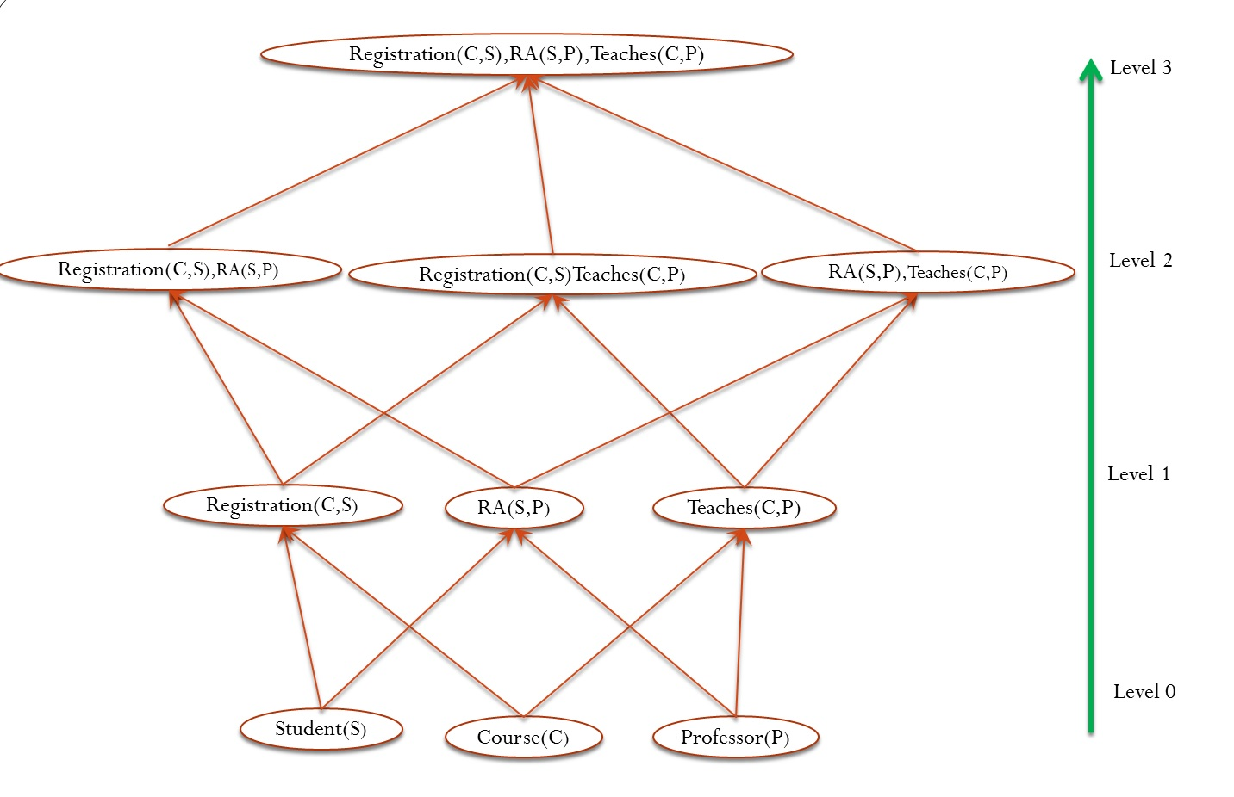
Notes:
uni-big-lattice.jpg

Slide 126
Registration(S,C),RA(P,S),Teaches(P,C)
Level 3
Registration(S,C),RA(P,S)
Registration(S,C),Teaches(P,C)
RA(P,S),Teaches(P,C)
Level 2
Registration(S,C)
RA(P,S)
Teaches(P,C)
Level 1
Student(S)
Course(C)
Professor(P)
Level 0
Notes:
make picture consistent.
Add arrows to indicate propagating edges.

Slide 127
Registration(S,C),RA(P,S),Teaches(P,C)
Level 3
lines 9-23
l = 3
Registration(S,C),RA(P,S)
Registration(S,C),Teaches(P,C)
RA(P,S),Teaches(P,C)
Level 2
lines 9-23
l = 2
Registration(S,C)
RA(P,S)
Teaches(P,C)
Level 1
lines 4-8
Student(S)
Course(C)
Professor(P)
Level 0 lines 1-3
Notes:
make picture consistent.
Add arrows to indicate propagating edges.

Slide 128
Registration(S,C),RA(P,S)
relationship chain
lines | Operation | Resulting ct-table
11 | Reg(S,C) = T, RA(P,S) = T | Current_ct
13, 14 | i = 1, Reg(S,C) = *, RA(P,S) = T | ct*
20 | PIVOT | Current_ct
16, 18 | i = 2, RA(P,S) = * | ct*
20 | PIVOT | Final ct-table for Registration(S,C),RA(P,S)
Notes:
Aug. 20, 2014, rchain-loop.pdf

Slide 129
lines | Operation | Resulting ct-table
11 | Reg(S,C) = T, RA(P,S) = T | Current_ct
13-14 | i = 1, Reg(S,C) = *, RA(P,S) = T | ct*
20 | PIVOT | Current_ct
16-18 | i = 2, RA(P,S) = * | ct*
20 | PIVOT | Final ct-table for Reg(S,C),RA(P,S)
Notes:
Aug. 20, 2014, rchain-loop.jpg

Slide 130
Registration(S,C),RA(S,P),Teaches(P,C)
Level 3
Registration(S,C),RA(S,P)
Registration(C,S),Teaches(C,P)
RA(S,P),Teaches(P,C)
Level 2
Registration(S,C)
RA(S,P)
Teaches(P,C)
Level 1
Student(S)
Course(C)
Professor(P)
Level 0
Notes:
make picture consistent.
Add arrows to indicate propagating edges.

Slide 131
CT*
Count | Pop | Teach | Intel. | Rank
16 | 1 | 2 | 3 | 1
15 | 2 | 3 | 2 | 2
18 | 2 | 3 | 1 | 4
24 | 2 | 3 | 1 | 5
Count | Pop | Teach | Intel. | Rank | Cap | Sal.
1 | 1 | 2 | 3 | 1 | 3 | high
1 | 1 | 2 | 2 | 2 | 3 | Low
1 | 2 | 2 | 2 | 4 | 3 | Med
1 | 1 | 2 | 2 | 2 | 1 | Med
CT_{T}
-
π_{Nodes}
CT_{F}
Count | Pop | Teach | Intel. | Rank
15 | 1 | 2 | 3 | 1
16 | 2 | 3 | 2 | 3
21 | 2 | 3 | 3 | 1
24 | 2 | 3 | 1 | 5
Count | Pop | Teach | Intel. | Rank
1 | 1 | 2 | 3 | 1
1 | 1 | 2 | 2 | 2
1 | 2 | 2 | 2 | 4
1 | 1 | 2 | 2 | 2
RA | Cap | Sal
F | n/a | n/a
RA
T
CT_{F}⁺
CT_{T}⁺
Count | Pop | Teach | Intel. | Rank | Cap | Sal. | RA
15 | 1 | 2 | 3 | 1 | n/a | n/a | F
12 | 1 | 2 | 1 | 4 | n/a | n/a | F
7 | 1 | 2 | 2 | 2 | n/a | n/a | F
6 | 1 | 2 | 3 | 2 | n/a | n/a | F
Count | Pop | Teach | Intel. | Rank | Cap | Sal. | RA
1 | 1 | 2 | 3 | 1 | 3 | high | T
1 | 1 | 2 | 2 | 2 | 3 | Low | T
1 | 2 | 2 | 2 | 4 | 3 | Med | T
1 | 1 | 2 | 2 | 2 | 1 | Med | T
∪
CT
Count | Pop | Teach | Intel. | Rank | Cap | Sal. | RA
15 | 1 | 2 | 3 | 1 | n/a | n/a | F
1 | 1 | 2 | 3 | 1 | 3 | High | T
1 | 1 | 2 | 2 | 2 | 1 | Med | T
7 | 1 | 2 | 2 | 2 | n/a | n/a | F
Notes:
Sample CT based on uniewlin
Label the table without the dots

Slide 132


Count | Pop | Teach | Intel. | Rank
16 | 1 | 2 | 3 | 1
15 | 2 | 3 | 2 | 2
18 | 2 | 3 | 1 | 4
24 | 2 | 3 | 1 | 5
Count | Pop | Teach | Intel. | Rank | Cap | Sal.
1 | 1 | 2 | 3 | 1 | 3 | high
1 | 1 | 2 | 2 | 2 | 3 | Low
1 | 2 | 2 | 2 | 4 | 3 | Med
1 | 1 | 2 | 2 | 2 | 1 | Med
-
$$π_{\overline{2Nodes(Ra})}$$
Count | Pop | Teach | Intel. | Rank
15 | 1 | 2 | 3 | 1
16 | 2 | 3 | 2 | 3
21 | 2 | 3 | 3 | 1
24 | 2 | 3 | 1 | 5
Count | Pop | Teach | Intel. | Rank
1 | 1 | 2 | 3 | 1
1 | 1 | 2 | 2 | 2
1 | 2 | 2 | 2 | 4
1 | 1 | 2 | 2 | 2
RA
T
RA | Cap | Sal
F | n/a | n/a
$$union$$
Count | Pop | Teach | Intel. | Rank | Cap | Sal. | RA
15 | 1 | 2 | 3 | 1 | n/a | n/a | F
12 | 1 | 2 | 1 | 4 | n/a | n/a | F
7 | 1 | 2 | 2 | 2 | n/a | n/a | F
6 | 1 | 2 | 3 | 2 | n/a | n/a | F
Count | Pop | Teach | Intel. | Rank | Cap | Sal. | RA
15 | 1 | 2 | 3 | 1 | n/a | n/a | F
1 | 1 | 2 | 3 | 1 | 3 | High | T
1 | 1 | 2 | 2 | 2 | 1 | Med | T
7 | 1 | 2 | 2 | 2 | n/a | n/a | F
Notes:
Bigger tables, but looks messy

Slide 133
CT*
Count | Pop | Teach | Intel. | Rank
16 | 1 | 2 | 3 | 1
15 | 2 | 3 | 2 | 2
18 | 2 | 3 | 1 | 4
24 | 2 | 3 | 1 | 5
… | … | … | … | …
Count | Pop | Teach | Intel. | Rank | Cap | Sal.
1 | 1 | 2 | 3 | 1 | 3 | high
1 | 1 | 2 | 2 | 2 | 3 | Low
1 | 2 | 2 | 2 | 4 | 3 | Med
1 | 1 | 2 | 2 | 2 | 1 | Med
… | … | … | … | … | … | …
CT_{T}
-
π_{Nodes}
CT_{F}
Count | Pop | Teach | Intel. | Rank
15 | 1 | 2 | 3 | 1
16 | 2 | 3 | 2 | 3
21 | 2 | 3 | 3 | 1
24 | 2 | 3 | 1 | 5
… | … | … | … | …
Count | Pop | Teach | Intel. | Rank
1 | 1 | 2 | 3 | 1
1 | 1 | 2 | 2 | 2
1 | 2 | 2 | 2 | 4
1 | 1 | 2 | 2 | 2
… | … | … | … | …
RA | Cap | Sal
F | n/a | n/a
RA
T
CT_{F}⁺
CT_{T}⁺
Count | Pop | Teach | Intel. | Rank | Cap | Sal. | RA
15 | 1 | 2 | 3 | 1 | n/a | n/a | F
12 | 1 | 2 | 1 | 4 | n/a | n/a | F
7 | 1 | 2 | 2 | 2 | n/a | n/a | F
6 | 1 | 2 | 3 | 2 | n/a | n/a | F
… | … | … | … | … | … | … | …
Count | Pop | Teach | Intel. | Rank | Cap | Sal. | RA
1 | 1 | 2 | 3 | 1 | 3 | high | T
1 | 1 | 2 | 2 | 2 | 3 | Low | T
1 | 2 | 2 | 2 | 4 | 3 | Med | T
1 | 1 | 2 | 2 | 2 | 1 | Med | T
… | … | … | … | … | … | … | …
CT
∪
Count | Pop | Teach | Intel. | Rank | Cap | Sal. | RA
15 | 1 | 2 | 3 | 1 | n/a | n/a | F
1 | 1 | 2 | 3 | 1 | 3 | High | T
1 | 1 | 2 | 2 | 2 | 1 | Med | T
7 | 1 | 2 | 2 | 2 | n/a | n/a | F
... | ... | ... | ... | ... | ... | ... | ...
Notes:
Label the table, added the dots Dec 24,updated on Jan 2nd,
Add some queries?

Slide 134
Count | Pop | Teach | Intel. | Rank
16 | 1 | 2 | 3 | 1
15 | 2 | 3 | 2 | 2
18 | 2 | 3 | 1 | 4
24 | 2 | 3 | 1 | 5
… | … | … | … | …
Count | Pop | Teach | Intel. | Rank | Cap | Sal.
1 | 1 | 2 | 3 | 1 | 3 | high
1 | 1 | 2 | 2 | 2 | 3 | Low
1 | 2 | 2 | 2 | 4 | 3 | Med
1 | 1 | 2 | 2 | 2 | 1 | Med
… | … | … | … | … | … | …
CT*
CT_{T}
CREATE TABLE CT* AS SELECT p_ct.count * s_ct.count as count, Pop ,Teach, Intel, Rank FROM p_ct , s_ct
CREATE TABLE CT_{T} AS SELECT count(*) as count , Pop, Teach, Intel, Rank, Cap, Sal FROM p, s, RA WHERE RA.p_id = p.p_id and RA.s_id = s.s_id
GROUP BY Pop, Teach, Intel, Rank, Cap, Sal
-
π_{Nodes}
CT_{F}
Count | Pop | Teach | Intel. | Rank
15 | 1 | 2 | 3 | 1
16 | 2 | 3 | 2 | 3
21 | 2 | 3 | 3 | 1
24 | 2 | 3 | 1 | 5
… | … | … | … | …
Count | Pop | Teach | Intel. | Rank
1 | 1 | 2 | 3 | 1
1 | 1 | 2 | 2 | 2
1 | 2 | 2 | 2 | 4
1 | 1 | 2 | 2 | 2
… | … | … | … | …
CREATE TABLE temp SELECT count , Pop, Teach, Intel, Rank FROM CT_{T}
CREATE TABLE CT_{F} AS SELECT (CT*.count - temp .count) AS count,
Pop, Teach, Intel, Rank FROM CT* , temp WHERE
CT*.Pop = temp.Pop AND CT*.Teach = temp.Teach
AND CT*.Intel = temp.Intel AND CT*.Rank = temp.Rank
UNION SELECT (CT*.COUNT) AS COUNT, Pop, Teach, Intel, Rank
FROM CT* WHERE (Pop, Teach, Intel, Rank)
NOT IN (SELECT Pop, Teach, Intel, Rank FROM temp )
CREATE TABLE CT_{F}⁺ AS SELECT count , Pop, Teach, Intel, Rank, Cap, Sal,(select "n/a") AS Cap,(select "n/a") AS Sal, (select "F" ) AS RA FROM CT_{F}
CREATE TABLE CT_{T}⁺ AS SELECT count , Pop, Teach, Intel, Rank, Cap, Sal, (select "T" )as RA FROM CT_{T}
RA | Cap | Sal
F | n/a | n/a
RA
T
CT_{F}⁺
CT_{T}⁺
Count | Pop | Teach | Intel. | Rank | Cap | Sal. | RA
15 | 1 | 2 | 3 | 1 | n/a | n/a | F
12 | 1 | 2 | 1 | 4 | n/a | n/a | F
7 | 1 | 2 | 2 | 2 | n/a | n/a | F
6 | 1 | 2 | 3 | 2 | n/a | n/a | F
… | … | … | … | … | … | … | …
Count | Pop | Teach | Intel. | Rank | Cap | Sal. | RA
1 | 1 | 2 | 3 | 1 | 3 | high | T
1 | 1 | 2 | 2 | 2 | 3 | Low | T
1 | 2 | 2 | 2 | 4 | 3 | Med | T
1 | 1 | 2 | 2 | 2 | 1 | Med | T
… | … | … | … | … | … | … | …
CT
∪
CREATE TABLE CT AS
SELECT * FROM CT_{F}⁺ UNION SELECT * FROM CT_{T}⁺
Count | Pop | Teach | Intel. | Rank | Cap | Sal. | RA
15 | 1 | 2 | 3 | 1 | n/a | n/a | F
1 | 1 | 2 | 3 | 1 | 3 | High | T
1 | 1 | 2 | 2 | 2 | 1 | Med | T
7 | 1 | 2 | 2 | 2 | n/a | n/a | F
... | ... | ... | ... | ... | ... | ... | ...
Notes:
Label the table, added the dots Dec 24,updated on Jan 2nd, Add some queries, Jan 3^{rd,} updated on Jan 13rd
create table `a_star` as Select `prof0_counts`.`MULT` * `student0_counts`.`MULT` as `MULT` ,`popularity(prof0)` , `teachingability(prof0)` , `intelligence(student0)` , `ranking(student0)` from `prof0_counts` , `student0_counts`
create table `a_counts` as Select count(*) as "MULT" , prof0.popularity AS `popularity(prof0)` , prof0.teachingability AS `teachingability(prof0)` , student0.intelligence AS `intelligence(student0)` , student0.ranking AS `ranking(student0)` , `a`.capability AS `capability(prof0,student0)` , `a`.salary AS `salary(prof0,student0)` , `a` from unielwin.prof AS prof0 , unielwin.student AS student0 , unielwin.RA AS `a` , (select "T" as `a`) as `temp_a` where `a`.prof_id = prof0.prof_id and `a`.student_id = student0.student_id group by`popularity(prof0)` , `teachingability(prof0)` , `intelligence(student0)` , `ranking(student0)` , `capability(prof0,student0)` , `salary(prof0,student0)` , `a`
create table `a_flat` as Select sum(`a_counts`.`MULT`) as "MULT" , `popularity(prof0)` , `teachingability(prof0)` , `intelligence(student0)` , `ranking(student0)` from `a_counts` group by`popularity(prof0)` , `teachingability(prof0)` , `intelligence(student0)` , `ranking(student0)`
create table `a_CT` as select `MULT` , `popularity(prof0)` , `teachingability(prof0)` , `intelligence(student0)` , `ranking(student0)` , `capability(prof0,student0)` , `salary(prof0,student0)` , `a` from `a_counts` union select `MULT` , `popularity(prof0)` , `teachingability(prof0)` , `intelligence(student0)` , `ranking(student0)` , `capability(prof0,student0)` , `salary(prof0,student0)` , `a` from `a_false`, `a_join`;

Slide 135
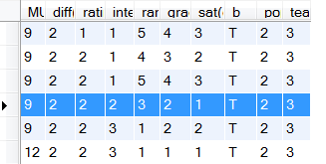
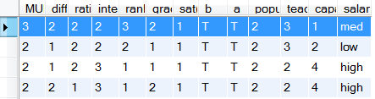
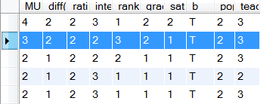
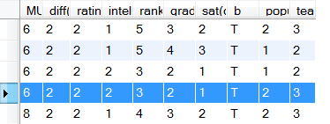





$a,b_$true
$$_star$$
$$π_{\overline{2Nodes(}Rpivot)}$$
$_$flat
-
$_$temp
Notes:
For rchain “a,b” .
Current Pivot : a

Slide 136
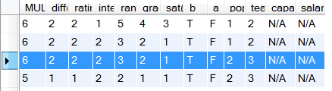
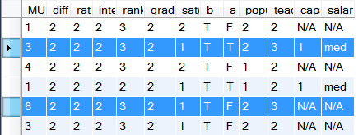





$_$temp
$a,b_$true
$_$flase
Add column a=T
$$union$$
$a,b_a_$CT
Notes:
Current Pivot : a

Slide 137
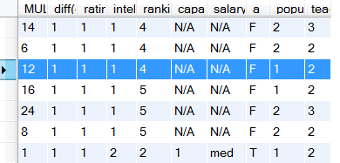
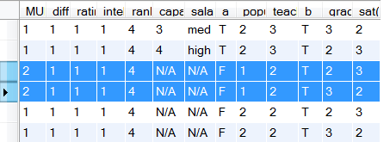
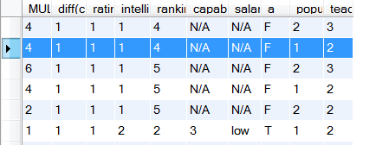
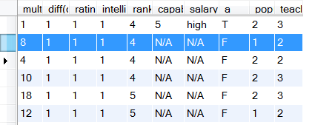





$$_star$$
$a,b_a_$CT
$$π_{\overline{2Nodes(}Rpivot)}$$
-
$_$flat
$_$temp
Notes:
Current Pivot : b
Previous Pivot : a

Slide 138
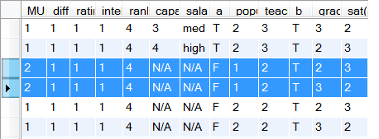

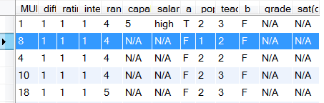
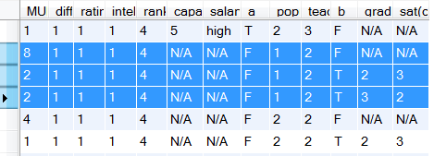





$a,b_a_$CT
$_$temp
Add column b=T
$_$flase
$$union$$
$a,b_$CT

Slide 139




CT(Nodes | $\vec{R_{pivot}}$ = T , $R_{pivot}$ = * )
CT(Nodes, 2Nodes($R_{pivot}$) | $\vec{R_{pivot}}$ = T , $R_{pivot}$ = T )
$$−$$
$$π_{\text{Nodes}}$$
CT(Nodes | $\vec{R_{pivot}}$ = T , $R_{pivot}$ = F)
Add columns
$R_{pivot}$=F, 2Nodes($R_{pivot}$) = N/A
Add column
$R_{pivot}$=T
∪
CT(Nodes, $R_{pivot}$, 2Nodes($R_{pivot}$) | $\vec{R_{pivot}}$ = T)
Zhensong version
Notes:
PivotCT(Nodes, $R_{pivot}$, $\vec{R_{pivot}}$ )
Input:
CT(Nodes | $\vec{R_{pivot}}$ = T , $R_{pivot}$ = * )
CT(Nodes, 2Nodes($R_{pivot}$) | $\vec{R_{pivot}}$ = T , $R_{pivot}$ = T )
Output:
CT(Nodes, $R_{pivot}$, 2Nodes($R_{pivot}$) | $\vec{R_{pivot}}$ = T)
Note:
ordered relationship list : $\vec{R}=\left\{R_{1},R_{2}, …,R_{m}\right\}= \left\{ \vec{R_{pivot}} ∪R_{pivot} \right\}$ , m ≥ 1 , $R_{pivot}$is the ith relationship
When m = 1, then $R_{pivot}$= $R_{1}$ and $\vec{R_{pivot}}$ = NULL
Nodes : all nodes but not 2Nodes($R_{pivot}$)

Slide 140


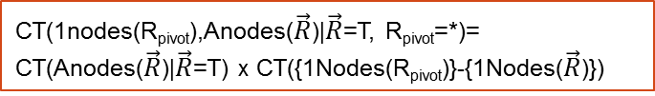


CT(1nodes(R_{pivot}),Anodes($\vec{R}$)|$\vec{R}$=T, R_{pivot}=*)=
CT(Anodes($\vec{R}$)|$\vec{R}$=T) x CT({1Nodes(R_{pivot})}-{1Nodes($\vec{R}$)})
CT(Anodes(R_{pivot},$\vec{R}$)|R_{pivot}=T,$\vec{R}$=T)
Join of existing tables
$$π_{\overline{2Nodes(}Rpivot)}$$
$$−$$
CT(1nodes(R_{pivot}),Anodes($\vec{R}$)|R_{pivot}=F, $\vec{R}$=T)
Add columns R_{pivot}=F,2Nodes(R_{pivot})= N/A
Add column R_{pivot}=T
∪
CT(Anodes(R_{pivot ,} $\vec{R}$), R_{pivot}|$\vec{R}$=T)
Notes:
copy

Slide 141

CT(1nodes(R1),Anodes(R2)|R2=T,R1=*)=
CT(Anodes(R2)|R2=T) x CT(1Nodes(R1)-1Nodes(R2))
CT(Anodes(R1,R2)|R1=T,R2=T)
Join of existing tables
$$π_{\overline{2Nodes(R}1)}$$
$$−$$
CT(Anodes(R1)|R1=F,R2=T)
Add columns R1=F,2Nodes(R1)= N/A
Add column R1=T
∪
CT(Anodes(R1),R1|R2=T)

Slide 142

CT(1nodes(R1),Anodes(R2)|R2=T,R1=*)=
CT(Anodes(R2)|R2=T) x CT(1Nodes(R1)-1Nodes(R2))
CT(Anodes(R1,R2)|R1=T,R2=T)
Join of existing tables
$$π_{\overline{2Nodes(R}1)}$$
$$−$$
CT(Anodes(R1,R2)|R1=F,R2=T)
Add columns R1=F,2Nodes(R1)= N/A
Add column R1=T
CT(Anodes(R1),R1) x
CT(1Nodes(R2)-1Nodes(R1))
∪
CT(Anodes(R1),R1,1Nodes(R2)|R2=*)
CT(Anodes(R1,R2),R1|R2=T)
$$π_{\overline{2Nodes(R}2)}$$
CT(Anodes(R1),R1,1nodes(R2|R2=T)

Slide 143
Metaqueries | Entries for rnid = RA(S,P)
CREATE TABLE Select_List AS SELECT rnid, CONCAT(‘COUNT(*)',' as "count"') AS Entries FROM RV.RNodes UNION DISTINCT SELECT rnid, CONCAT(pvid,'.',COLUMN_NAME,' AS ',1nid) AS Entries FROM RV.RNodes_1Nodes | COUNT(*) as “count"
 | prof0.popularity AS `popularity(prof0)`
 | prof0.teachingability AS `teachingability(prof0)`
 | student0.intelligence AS `intelligence(student0)`
 | student0.ranking AS `ranking(student0)`
CREATE TABLE From_List AS SELECT rnid, CONCAT('@database@.',TABLE_NAME) AS Entries FROM RV.RNodes_pvars UNION DISTINCT SELECT rnid, CONCAT('@database@.',TABLE_NAME) AS Entries FROM RV.RNodes | @database@.prof AS prof0
 | @database@.student AS student0
 | @database@.RA AS `RA`
CREATE TABLE Where_List AS SELECT rnid, CONCAT(rnid,'.',COLUMN_NAME,' = ', pvid,'.', REFERENCED_COLUMN_NAME) AS Entries FROM RV.RNodes_pvars; | `RA`.prof_id = prof0.prof_id
 | `RA`.student_id =student0.student_id

Slide 144
Metaqueries | Entries
CREATE TABLE Select_List AS SELECT rnid, CONCAT(‘COUNT(*)',' as "count"') AS Entries FROM RNodes UNION DISTINCT SELECT rnid, CONCAT(pvid,'.',COLUMN_NAME,' AS ',1nid) AS Entries FROM RNodes_1Nodes | COUNT(*) as “count"
 | prof0.popularity AS `popularity(prof0)`
 | prof0.teachingability AS `teachingability(prof0)`
 | student0.intelligence AS `intelligence(student0)`
 | student0.ranking AS `ranking(student0)`
CREATE TABLE From_List AS SELECT rnid, CONCAT('@database@.',TABLE_NAME, ' AS ', pvid) AS Entries FROM RNodes_pvars UNION DISTINCT SELECT rnid, CONCAT('@database@.',TABLE_NAME, ' AS ', rnid) AS Entries FROM RNodes | @database@.prof AS prof0
 | @database@.student AS student0
 | @database@.RA AS `RA`
CREATE TABLE Where_List AS SELECT rnid, CONCAT(rnid,'.',COLUMN_NAME,' = ',pvid,'.', REFERENCED_COLUMN_NAME) AS Entries FROM RNodes_pvars; | `RA`.prof_id = prof0.prof_id
 | `RA`.student_id =student0.student_id

Slide 145
CT*
Count | Pop | Teach | Intel | Rank
16 | 1 | 2 | 3 | 1
15 | 2 | 3 | 2 | 2
18 | 2 | 3 | 1 | 4
… | … | … | … | …
Count | Pop | Teach | Intel | Rank | Cap | Sal
1 | 1 | 2 | 3 | 1 | 3 | high
1 | 1 | 2 | 2 | 2 | 3 | low
1 | 2 | 2 | 2 | 4 | 3 | med
… | … | … | … | … | … | …
CT_{T}
CREATE TABLE CT* AS SELECT p_ct.count * s_ct.count as count, CL(p),CL(s) FROM p_ct , s_ct
CREATE TABLE CT_{T} AS SELECT count(*) as count, CL(p), CL(s), CL(RA) FROM p, s, RA WHERE RA.p_id = p.p_id and RA.s_id = s.s_id
GROUP BY CL(p), CL(s), CL(RA)
-
π_{Nodes}
CT_{F}
Count | Pop | Teach | Intel | Rank
15 | 1 | 2 | 3 | 1
16 | 2 | 3 | 2 | 3
21 | 2 | 3 | 3 | 1
… | … | … | … | …
Count | Pop | Teach | Intel | Rank
1 | 1 | 2 | 3 | 1
1 | 1 | 2 | 2 | 2
1 | 2 | 2 | 2 | 4
… | … | … | … | …
temp
CREATE TABLE CT_{F} AS SELECT (CT*.count - temp.count) AS count, CL(temp)
FROM CT* , temp WHERE CL(CT*) = CL (temp)
UNION SELECT (CT*.COUNT) AS COUNT, CL(CT*) FROM CT* WHERE
CL(CT*) NOT IN (SELECT CL(temp) FROM temp )
CREATE TABLE temp AS SELECT SUM(CT_{T}.count) AS count,
CL(p), CL(s) FROM CT_{T} GROUP BY CL(p), CL(s)
RA
T
RA | Cap | Sal
F | n/a | n/a
CT_{T}⁺
CT_{F}⁺
Count | Pop | Teach | Intel | Rank | Cap | Sal | RA
15 | 1 | 2 | 3 | 1 | n/a | n/a | F
12 | 1 | 2 | 1 | 4 | n/a | n/a | F
7 | 1 | 2 | 2 | 2 | n/a | n/a | F
… | … | … | … | … | … | … | …
Count | Pop | Teach | Intel | Rank | Cap | Sal | RA
1 | 1 | 2 | 3 | 1 | 3 | high | T
1 | 1 | 2 | 2 | 2 | 3 | low | T
1 | 2 | 2 | 2 | 4 | 3 | med | T
… | … | … | … | … | … | … | …
∪
Count | Pop | Teach | Intel | Rank | Cap | Sal | RA
15 | 1 | 2 | 3 | 1 | n/a | n/a | F
1 | 1 | 2 | 3 | 1 | 3 | high | T
1 | 1 | 2 | 2 | 2 | 1 | med | T
... | ... | ... | ... | ... | ... | ... | ...
CREATE TABLE CT AS
SELECT * FROM CT_{F}⁺ UNION SELECT * FROM CT_{T}⁺
CT
Notes:
sub.jpg
Fixed typos for temp table. Jan 13rd
CL(CT*) = CL(temp) = Pop, Teach, Intel, Rank
CL(CT_{T}) = Pop, Teach, Intel, Rank, Cap, Sal
CL(CT_{F}) = Pop, Teach, Intel, Rank
CL(CT) = CL(CT_{F}⁺) = CL(CT_{T}⁺) = Pop, Teach, Intel, Rank, Cap, Sal, RA
CL(p) = Pop, Teach
CL(s) = Intel, Rank
CL(RA)= Cap, Sal

Slide 146
DataBase
original data
SQL Script Utilizing information schema
DataBase_RV
Random variables
Fid | Functor Name | Type
intelligence(Student) | intelligence | 1Node
satisfaction(Course, Student) | satisfaction | 2Node
Registration(Course, Student) | Registration | Rnode
Edge Constraints
Model Manager
Lattice Search
DataBase_CT
Contingency Tables
Virtual Join Algorithm
Count | Pop | Teach | Intel | Rank
1 | 1 | 2 | 3 | 1
1 | 1 | 2 | 2 | 2
1 | 2 | 2 | 2 | 4
… | … | … | … | …
Rchian | Child | Parent
Registration(Course, Student), RA (Student, Prof) | ranking(Student) | intelligence(Student)
DataBase_BN
Bayes Nets
Notes:
general-flow-chart.png

Slide 147
CREATE TABLE ct_{T} AS SELECT count(*) as Count , professor.popularity, professor.teachingability, student.intelligence, student.ranking , RA.capability, RA.salary
FROM professor, student, RA
WHERE RA.prof_id = professor.prof_id and RA.student_id = student.student_id
GROUP BY professor.popularity, professor.teachingability, student.intelligence, student.ranking , RA.capability, RA.salary
Notes:
\begin{quote}
CREATE TABLE $\ct_{T}$ AS SELECT count(*) as Count , professor.popularity, professor.teachingability, student.intelligence, student.ranking , RA.capability, RA.salary \\
FROM \\professor, student, RA \\
WHERE \\RA.p\_id = professor.p\_id and RA.s\_id = student.s\_id \\
GROUP BY \\professor.popularity, professor.teachingability, student.intelligence, student.ranking , RA.capability, RA.salary
\end{quote}

