Slide 1

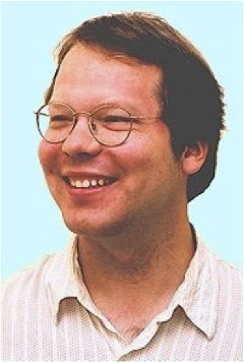
Model Selection Scores for Multi-Relational Bayesian Networks
School of Computing Science
Simon Fraser University
Vancouver, Canada
Sajjad Gholami | Oliver Schulte
Notes:
If you use “insert slide number” under “Footer”, that text box only displays the slide number, not the total number of slides. So I use a new textbox for the slide number in the master.
This is a version of “Equity”.

Slide 2
Outline
Brief Summary of Main Paper: Learning first-order Bayesian Networks for Multi-Relational Data
What is a first-order BN good for?
Answering first-order probabilistic queries.
Probabilistic inference over links and attributes
Extracting Features: Extract, Transform, Load
Classification
Exception Mining and Anomaly Detection

Slide 3
Main Paper Summary

Slide 4



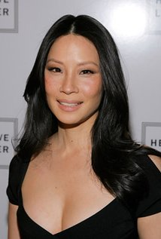


Example: IMDB toy data
gender = Man
country = U.S.
gender = Man
country = U.S.
gender = Woman
country = U.S.
gender = Woman
country = U.S.
False
n/a
False
n/a
True
$500K
False
n/a
False
n/a
True
$5M
False
n/a
True
$2M
ActsIn
salary
runtime = 98 min
drama = true
action = true
runtime = 111 min
drama = false
action = true
Notes:
functors: gender, genre, who acts in what.

Slide 5
Formulas
A (conjunctive) formula is a joint assignment term₁ = value₁,...,term_{n}=value_{n}
e.g., ActsIn(Actor, Movie) = T, gender(Actor) = W
A ground formula contains only constants
e.g., ActsIn(UmaThurman, KillBill) = T, gender(UmaThurman) = W
Notes:
The value_i are constants.
Maybe say something about more complex formulas.

Slide 6
Probabilistic First-Order Queries
Database probability of a first-order formula = number of satisfying instantiations/ number of possible instantiations
Examples:
P_{D}(gender(Actor) = W) = 2/4
P_{D}(gender(Actor) = W, ActsIn(Actor,Movie) = T) = 2/8

Slide 7
Probabilistic First-Order Queries

Slide 8
First-Order Bayesian Networks
A first-order Bayesian network is a Bayesian network whose nodes are first-order terms
(Wang et al. 2008)
AKA parametrized Bayesian network (Poole 2003, Kimmig et al. 2014)
gender(A)
Drama(M)
ActsIn(A,M)
First-Order Bayesian Networks represent a Database Distribution
Notes:
Bayesian networks are close to rules (Kersting and deRaedt)
parametrized BNs not a frequency model
Demo.
First-order Random variables = terms.

Slide 9
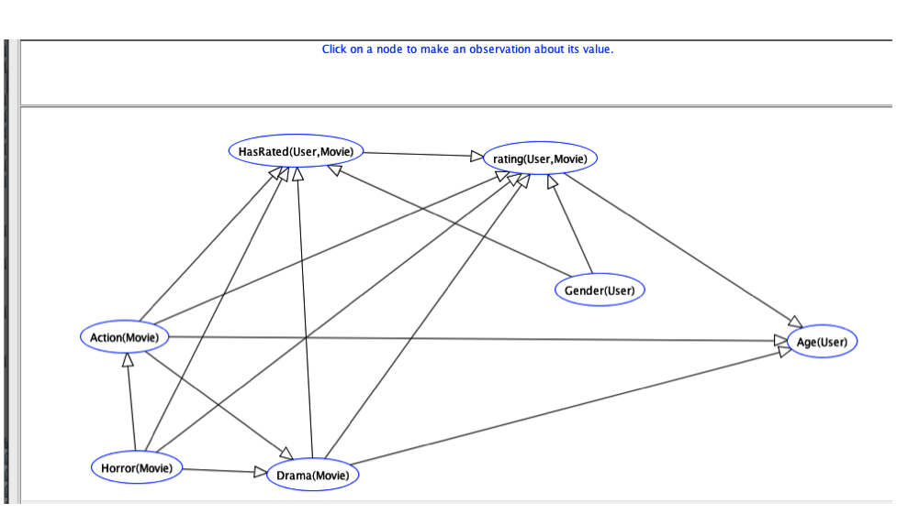
Learned Bayes Net for IMDb
With only 1 relationship HasRated(User,Movie).
Notes:
IMDb_1R.xml
for simplicity, our examples consider only one relationship. In principle, there is no limit to the number of relationships required.

Slide 10
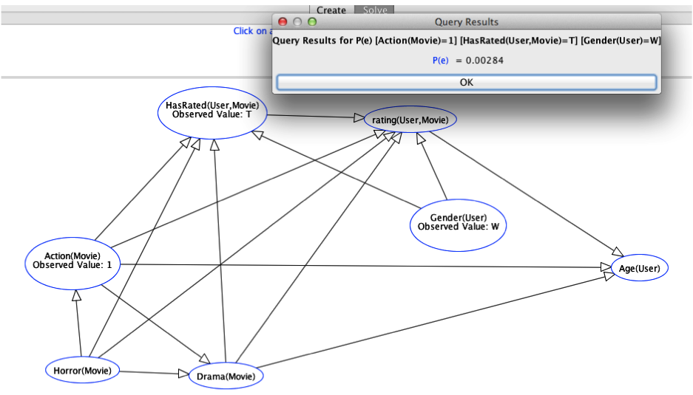
Bayes Net Query

Slide 11
Data Query
Num Movies | 3883
Num Users | 6039
Num Movie-User Pairs | 3883 x 6039 = 23449437
movie-user pairs with action movie, woman user
Action(Movie) = T, HasRated(User,Movie) = T, gender(User) = W | 66642
Frequency | 66642/23449437= 0.0028
More Examples in spreadsheet on website
Notes:
run the actual queries

Slide 12
Statistical Consistency
We provide a general method for generalizing non-relational model selection scores to multi-relational scores [need figure]
A model selection score is consistent if BNs that maximize the score are guaranteed to represent the database distribution if the domain sizes are arbitrarily large.
Theorem main presentation

Slide 13
Intuitions
The main issue: Event counts depend on the data and on the networks considered.
Solution:
Rescale counts to be compatible for current and alternative graphs.
Normalize scores to be compatible across alternative graphs.

Slide 14
Applications of First-Order Bayesian Networks
Tutorial: https://oschulte.github.io/srl-tutorial-slides/
Github: https://github.com/sfu-cl-lab/FactorBase/blob/master/README.md

Slide 15
Example: IMDB toy data
gender = Man
country = U.S.
gender = Man
country = U.S.
gender = Woman
country = U.S.
gender = Woman
country = U.S.
False
n/a
False
n/a
True
$500K
False
n/a
False
n/a
True
$5M
False
n/a
True
$2M
ActsIn
salary
runtime = 98 min
drama = true
action = true
runtime = 111 min
drama = false
action = true
Notes:
functors: gender, genre, who acts in what.

Slide 16
ETL: Feature Vectors
Learned Bayesian network ➔family conjunctions
Feature = proportion of family conjunction in data
Works well for classification and anomaly detection
ActsIn(A,M)
Drama(M)
gender(A)
gender(A) | ActsIn(A,M) | Drama(M)
M | T | T | 0 | 0 | 1/2 | 0
M | T | F | 0 | 0 | 0 | 0
M | F | T | 1/2 | 0 | 0 | 0
M | F | F | 1/2 | 0 | 1/2 | 0
W | T | T | 0 | 0 | 0 | 0
W | T | F | 0 | 1/2 | 0 | 1/2
W | F | T | 0 | 1/2 | 0 | 1/2
W | F | F | 0 | 0 | 0 | 0
Notes:
for each actor, instantiate A = the actor. Then compute instantiation count for value assignment.

Slide 17

Native Relational Applications
Via ETL, a Bayesian network can leverage traditional machine learning classification and anomaly/exception mining.
Purely relational methods work even better (see refs).
For exception mining, compare Kullback-Leibler divergence (KLD) between data distribution for a random average individual and data distribution for a specific individual.
Population Database e.g. IMDB
Individual Database e.g. Brad Pitt’s movies

Slide 18
Case Study: Soccer Strikers and Movies
Brave Heart is the most unusual drama
Its most unusual feature is Actor Quality
93% of Brave Heart’s actors have the highest actor quality
A random average drama has only 42% actors of highest quality
MovieTitle | Genre | KLD Rank | KLD Max Node | KLD Max feature Value | Individual Probability | Class Probability
Brave Heart | Drama | 1 | Actor_Quality | a_quality=4 | 0.93 | 0.42
Austin Powers | Comedy | 2 | Cast_position | cast_num=3 | 0.78 | 0.49
Blue Brothers | Comedy | 3 | Cast_position | cast_num=3 | 0.88 | 0.49

Slide 19
Case Study: Strikers and Movies
Player Name | Position | KLD Rank | KLD Max Node | KLD Max Value | Individual Probability | Class Probability
Edin Dzeko | Striker | 1 | Dribble Efficiency | DE = Low | 0.16 | 0.50
Paul Robinson | Goalie | 2 | SavesMade | SM = Medium | 0.30 | 0.04
Michel Vorm | Goalie | 3 | SavesMade | SM = Medium | 0.37 | 0.04

Slide 20
Conclusions
Relational Bayes net learning has a solid theoretical foundation.
Scales to millions of records.
Supports various applications, e.g.
database frequency estimation
joint inference over attributes and relationships
link-based classification
exception mining

